Slide 1
Foundations of Cryptography
One-Way Functions
Slides by Vinod Vaikuntanathan (Edited): https://mit6875.github.io/

Slide 2
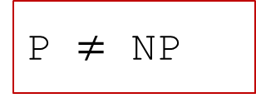
Crypto Picture So Far…
Message Auth
PRF
CPA Enc
PRG
One-Time Enc
P $≠$ NP

Slide 3
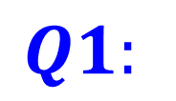
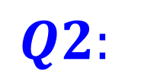
$$Q1:$$
Do PRGs exist?
$$Q2:$$
Are they necessary for all applications?

Slide 4
This Week
Define one-way functions (OWF).
Minimal tool necessary for “all crypto”.
sufficient for “much of crypto”.
2. Define Hardcore bits (HCB).
3. Show that one-way functions* + HCB $⇒$ PRG
4. Goldreich-Levin Theorem: every OWF has a HCB.

Slide 5
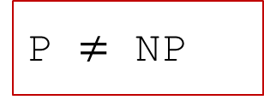
Crypto from OWFs
Message Auth
PRF
CPA Enc
PRG
One-Time Enc
OWF
P $≠$ NP

Slide 6
One-way Functions (Informally)
F
Easy to
compute
Hard to
invert
domain
range

Slide 7
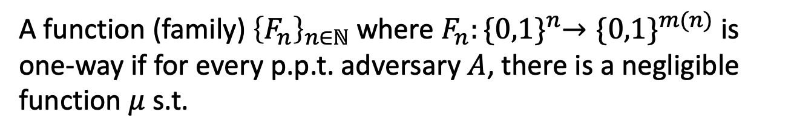
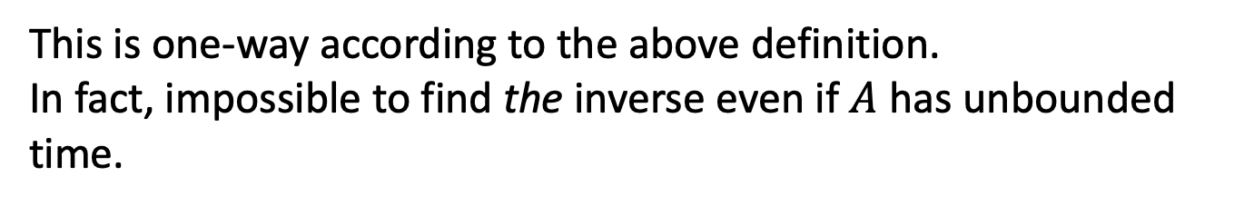
One-way Functions (Take 1)
A function (family${\text{) }\left\{F_{n}\right\}}_{n∈ℕ}$ where $F_{n}:{\{0,1\}}^{n}→{\{0,1\}}^{m(n)}$ is one-way if for every p.p.t. adversary $A$, there is a negligible function $μ$ s.t.
$$\operatorname{Pr}\left[x←{\left\{0,1\right\}}^{n};y=F_{n}\left(x\right):A\left(1^{n},y\right)=x\right]≤μ(n)$$
Consider $F_{n}\left(x\right)=0$ for all x.
This is one-way according to the above definition.
In fact, impossible to find the inverse even if $A$ has unbounded time.
Conclusion: not a useful/meaningful definition.

Slide 8
One-way Functions (Take 1)
A function (family${\text{) }\left\{F_{n}\right\}}_{n∈ℕ}$ where $F_{n}:{\{0,1\}}^{n}→{\{0,1\}}^{m(n)}$ is one-way if for every p.p.t. adversary $A$, there is a negligible function $μ$ s.t.
$$\operatorname{Pr}\left[x←{\left\{0,1\right\}}^{n};y=F_{n}\left(x\right):A\left(1^{n},y\right)=x\right]≤μ(n)$$
The Right Definition: Impossible to find an inverse in p.p.t.

Slide 9
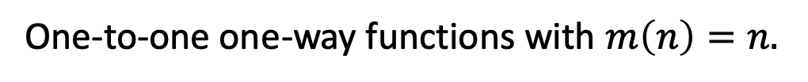
One-way Functions: The Definition
A function (family${\text{) }\left\{F_{n}\right\}}_{n∈ℕ}$ where $F_{n}:{\{0,1\}}^{n}→{\{0,1\}}^{m(n)}$ is one-way if for every p.p.t. adversary $A$, there is a negligible function $μ$ s.t.
$$\operatorname{Pr}\left[x←{\left\{0,1\right\}}^{n};y=F_{n}\left(x\right);A\left(1^{n},y\right)=x^{′}:y=F_{n}\left(x^{′}\right)\right]≤μ(n)$$
Can always find an inverse with unbounded time
… but should be hard with probabilistic polynomial time
One-way Permutations:
One-to-one one-way functions with $m\left(n\right)=n.$

Slide 10
Whiteboard
Alternate view of One-Way Functions
Connection to P vs NP.
Impagliazzo’s worlds

Slide 11
Today
1. Define one-way functions (OWF).
2. Define Hardcore bits (HCB).
3. Show that one-way permutations (OWP) $⇒$ PRG
4. Goldreich-Levin Theorem: every OWF has a HCB.

Slide 12
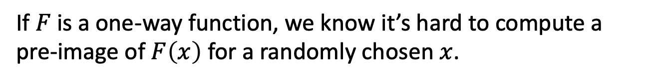
Hardcore Bits
If $F$ is a one-way function, we know it’s hard to compute a pre-image of $F\left(x\right)$ for a randomly chosen $x$.
How about computing partial information about an inverse?
Exercise: There are one-way functions for which it is easy to compute the first half of the bits of an inverse.
Notes:
Poll: F(xy) = F(x) || y is it one-way?

Slide 13
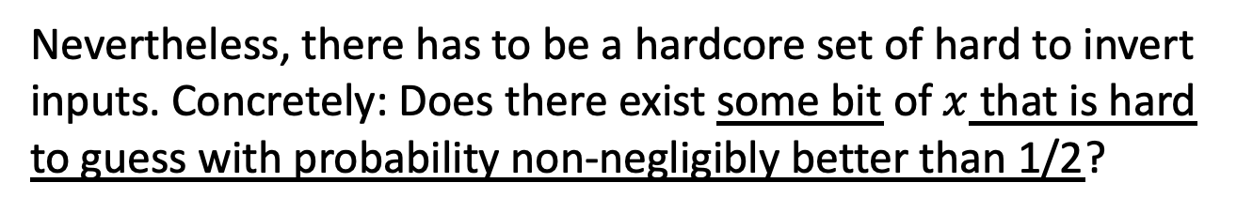
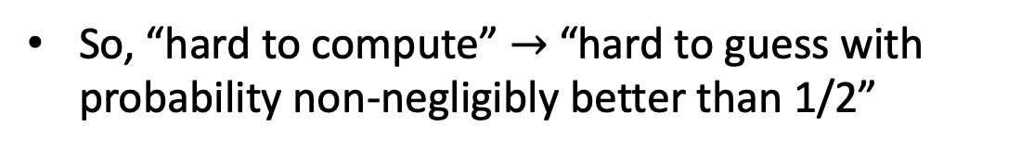
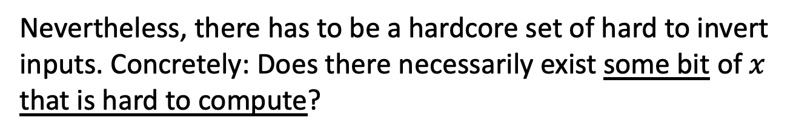
Hardcore Bits
If $F$ is a one-way function, we know it’s hard to compute a pre-image of $F\left(x\right)$ for a randomly chosen $x$.
HARDCORE BIT (Take 1)
Nevertheless, there has to be a hardcore set of hard to invert inputs. Concretely: Does there exist some bit of $x$ that is hard to guess with probability non-negligibly better than 1/2?
Nevertheless, there has to be a hardcore set of hard to invert inputs. Concretely: Does there necessarily exist some bit of $x$ that is hard to compute?
Any bit can be guessed correctly w.p. 1/2
So, “hard to compute” $→$ “hard to guess with probability non-negligibly better than 1/2”

Slide 14
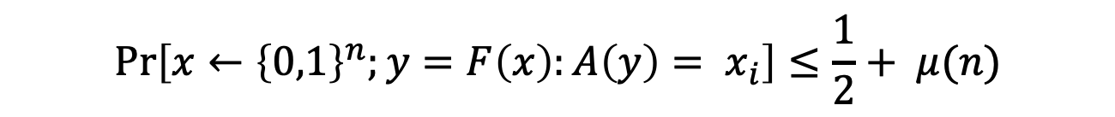
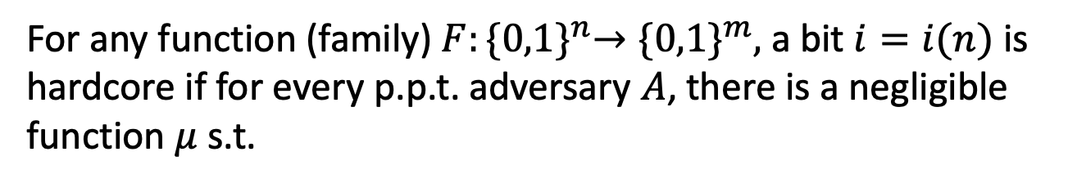
Hardcore Bits
If $F$ is a one-way function, we know it’s hard to compute a pre-image of $F\left(x\right)$ for a randomly chosen $x$.
HARDCORE BIT (Take 1)
For any function (family) $F:{\{0,1\}}^{n}→{\{0,1\}}^{m},$ a bit $i=i(n)$ is hardcore if for every p.p.t. adversary $A$, there is a negligible function $μ$ s.t.
$$\operatorname{Pr}\left[x←{\left\{0,1\right\}}^{n};y=F\left(x\right):A\left(y\right)= x_{i}\right]≤\frac{1}{2}+ μ(n)$$

Slide 15
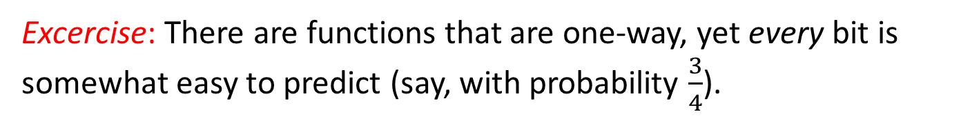
Does every one-way function
have a hardcore bit?
Excercise: There are functions that are one-way, yet every bit is somewhat easy to predict (say, with probability $\frac{3}{4}$).
So, we will generalize the notion of a hardcore “bit”.

Slide 16
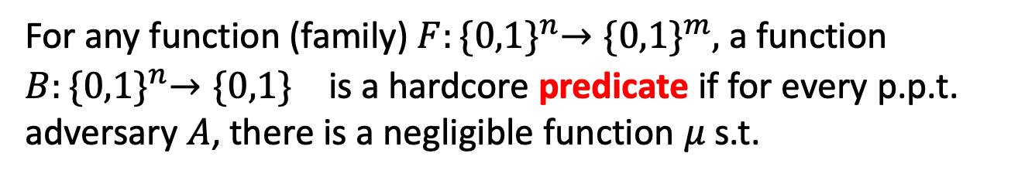
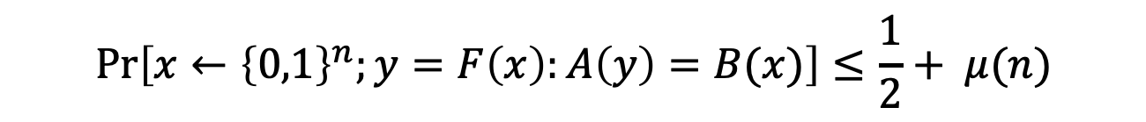
Hardcore Bits
HARDCORE PREDICATE (Definition)
For any function (family) $F:{\{0,1\}}^{n}→{\{0,1\}}^{m},$ a function $B:{\{0,1\}}^{n}→{\{0,1\}}^{}$ is a hardcore predicate if for every p.p.t. adversary $A$, there is a negligible function $μ$ s.t.
$$\operatorname{Pr}\left[x←{\left\{0,1\right\}}^{n};y=F\left(x\right):A\left(y\right)=B(x)\right]≤\frac{1}{2}+ μ(n)$$
For us, henceforth, a hardcore bit will mean a hardcore predicate.

Slide 17
Hardcore Predicate (in pictures)
Easy to
compute
F(x)
Hard to
predict
x
B(x)
Easy to
compute

Slide 18
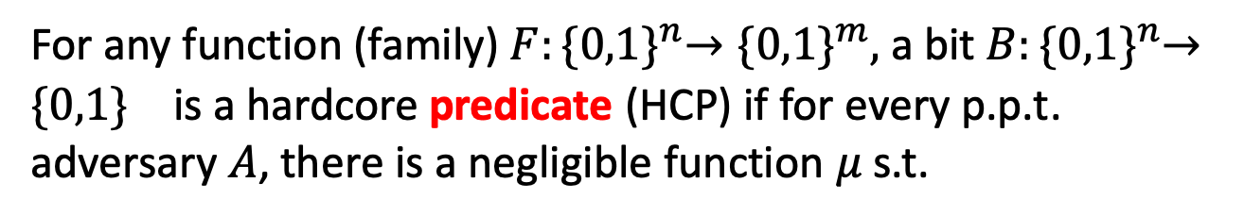
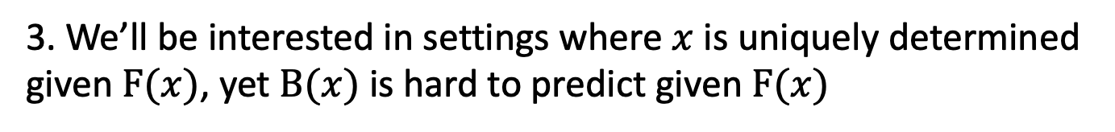
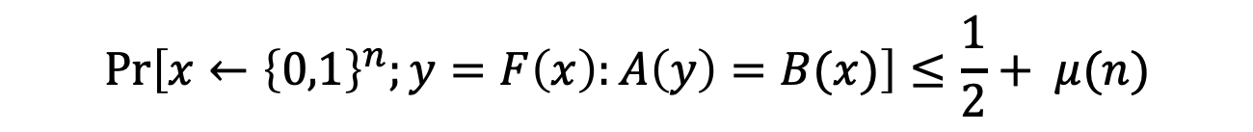
Discussion on the Definition
HARDCORE PREDICATE (Definition)
For any function (family) $F:{\{0,1\}}^{n}→{\{0,1\}}^{m},$ a bit $B:{\{0,1\}}^{n}→{\{0,1\}}^{}$ is a hardcore predicate (HCP) if for every p.p.t. adversary $A$, there is a negligible function $μ$ s.t.
$$\operatorname{Pr}\left[x←{\left\{0,1\right\}}^{n};y=F\left(x\right):A\left(y\right)=B(x)\right]≤\frac{1}{2}+ μ(n)$$
1. Definition of HCP makes sense for any function family, not just one-way functions.
2. Some functions can have information-theoretically hard to guess predicates (e.g., compressing functions)
3. We’ll be interested in settings where $x$ is uniquely determined given $F(x)$, yet $B(x)$ is hard to predict given $F(x)$

Slide 19

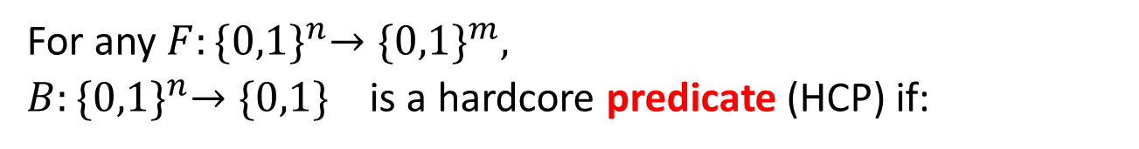
Alternate Definition
For any $F:{\{0,1\}}^{n}→{\{0,1\}}^{m},$
$B:{\{0,1\}}^{n}→{\{0,1\}}^{}$ is a hardcore predicate (HCP) if:
Unpredictability Def
For every p.p.t. predictor $P$, there is a negligible $μ$ s.t.
$$\operatorname{Pr}\left[x←{\left\{0,1\right\}}^{n};y=F\left(x\right):P\left(y\right)=B(x)\right]≤\frac{1}{2}+ μ(n)$$
Indistinguishability Def
$$\left(F\left(x\right), B\left(x\right)\right) ≈(F\left(x\right), u)$$
where $x←{\left\{0,1\right\}}^{n}, u←\{0,1\}$

Slide 20
Alternate Definition
For any $F:{\{0,1\}}^{n}→{\{0,1\}}^{m},$
$B:{\{0,1\}}^{n}→{\{0,1\}}^{}$ is a hardcore predicate (HCP) if:
Unpredictability Def
For every p.p.t. predictor $P$, there is a negligible $μ$ s.t.
$$\operatorname{Pr}\left[x←{\left\{0,1\right\}}^{n};y=F\left(x\right):P\left(y\right)=B(x)\right]≤\frac{1}{2}+ μ(n)$$
Indistinguishability Def
For every p.p.t. distinguisher $D$, there is a negligible $μ$ s.t.
$$|\underset{x}{Pr}\left[D\left(F\left(x\right), B\left(x\right)\right)=1\right]−\underset{x,u}{Pr}⁡[D\left(F\left(x\right),u\right)=1]| ≤ μ(n)$$

Slide 21

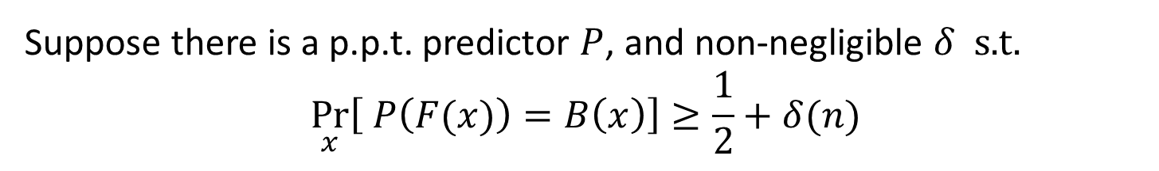
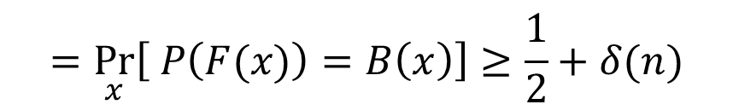



Indistinguishability = Unpredictability
$$⇒$$
Proof: Contrapositive
Suppose there is a p.p.t. predictor $P$, and non-negligible $δ$ s.t.
$$\underset{x}{Pr}\left[ P\left(F(x)\right)=B\left(x\right)\right]≥\frac{1}{2}+δ(n)$$
Consider $D\left(y,b\right):$
If $P\left(y\right)=b$ output 1 else 0
$$=\underset{x}{Pr}\left[ P\left(F(x)\right)=B\left(x\right)\right]≥\frac{1}{2}+δ(n)$$
$$\underset{x}{Pr}\left[D\left(F\left(x\right),B\left(x\right)\right)=1\right]$$
$$=\frac{1}{2}$$
$$\underset{x,u}{Pr}\left[D\left(F\left(x\right),u\right)=1\right]$$
So: $|\underset{x}{Pr}\left[D\left(F\left(x\right), B\left(x\right)\right)=1\right]−\underset{x,u}{Pr}⁡[D\left(F\left(x\right),u\right)=1]|≥δ(n)$

Slide 22
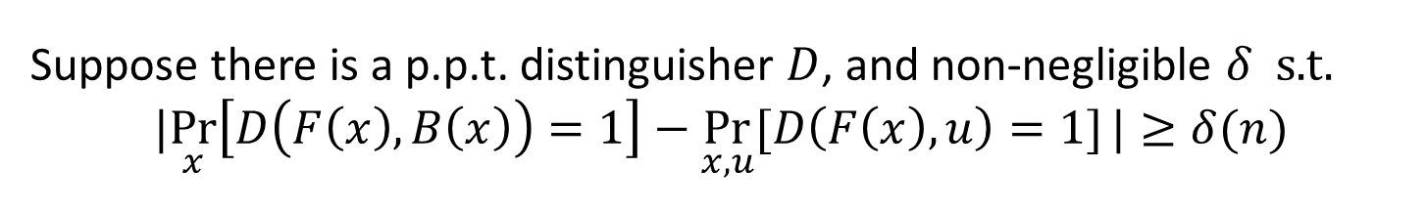

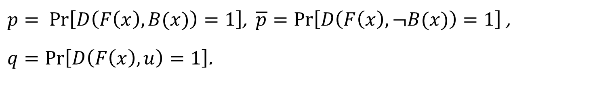
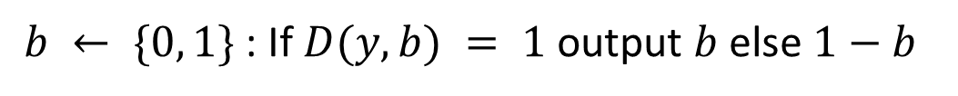
Indistinguishability = Unpredictability
$$⇐$$
Proof: Contrapositive
Suppose there is a p.p.t. distinguisher $D$, and non-negligible $δ$ s.t.
$$|\underset{x}{Pr}\left[D\left(F\left(x\right), B\left(x\right)\right)=1\right]−\underset{x,u}{Pr}⁡[D\left(F\left(x\right),u\right)=1]|≥δ(n)$$
Consider $P(y):$
$b ← \{0, 1\}$: If $D(y, b) = 1$ output $b$ else $1−b$
$p= \operatorname{Pr}\left[D\left(F\left(x\right),B(x)\right)=1\right]$, $\overline{p}=\operatorname{Pr}\left[D\left(F\left(x\right),¬B(x)\right)=1\right]$,
$q=Pr\left[D\left(F\left(x\right),u\right)=1\right]$.
Claim: $q=\frac{1}{2}(p+\overline{p}$)
Corollary: $p−\overline{p}=2\left(p−q\right)≥2δ(n)$

Slide 23

Analysis of the Predictor P
$$\operatorname{Pr}\left[P\left(F(x)\right)=B(x)\right]$$
$$=\operatorname{Pr}\left[D\left(F\left(x\right),b\right)=1| b=B(x)\right]\operatorname{Pr}\left[b=B(x)\right]+$$
$$\operatorname{Pr}\left[D\left(F\left(x\right),b\right)=0| b≠B(x)\right]\operatorname{Pr}\left[b≠B(x)\right]+$$
$=\frac{1}{2}(\operatorname{Pr}\left[D\left(F\left(x\right),b\right)=1| b=B(x)\right]$ $+\operatorname{Pr}\left[D\left(F\left(x\right),b\right)=0| b≠B(x)\right])$
$=\frac{1}{2}(\operatorname{Pr}\left[ D\left(F\left(x\right),B\left(x\right)\right)=1 \right]$ $+\operatorname{Pr}\left[ D\left(F\left(x\right),¬B(x)\right)=0 \right])$
$=\frac{1}{2}(\operatorname{Pr}\left[ D\left(F\left(x\right),B\left(x\right)\right)=1 \right]$ $+ 1 −\operatorname{Pr}\left[ D\left(F\left(x\right),¬B(x)\right)=1 \right])$
$$=\frac{1}{2}\left(1+p −\overline{p}\right)≥\frac{1}{2} +δ(n)$$
Notes:
By def of how D works
Since b is random
Syntactic
Since pr[D(..)=0] = 1 – pr[D(..) = 1]

Slide 24
Today
1. Define one-way functions (OWF).
2. Define Hardcore bits (HCB).
3. Show that one-way permutations (OWP) $⇒$ PRG
4. Goldreich-Levin Theorem: every OWF has a HCB.

Slide 25

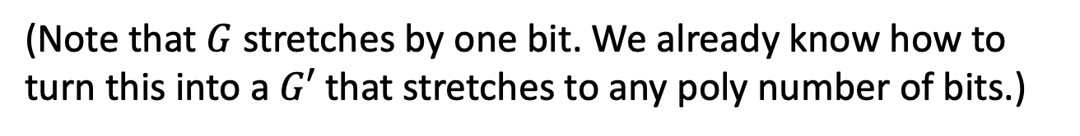
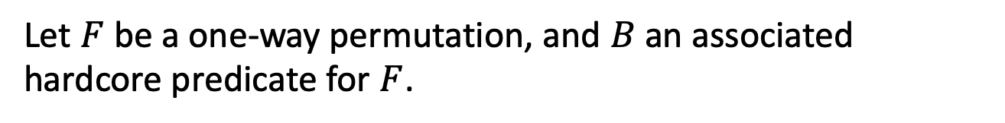
OWP $⇒$ PRG
CONSTRUCTION
Let $F$ be a one-way permutation, and $B$ an associated hardcore predicate for $F$.
Then, define $G\left(x\right)=F\left(x\right) | B(x)$ .
Theorem: $G$ is a PRG assuming $F$ is a one-way permutation.
(Note that $G$ stretches by one bit. We already know how to turn this into a $G′$ that stretches to any poly number of bits.)

Slide 26



OWP $⇒$ PRG
CONSTRUCTION
Let $F$ be a one-way permutation, and $B$ an associated hardcore predicate for $F$.
Then, define $G\left(x\right)=F\left(x\right) || B(x)$ .
Theorem: $G$ is a PRG assuming $F$ is a one-way permutation.
Proof: Use indistinguishability definition of hardcore bits
$\left(F\left(x\right) , B\left(x\right)\right)≈\left(F\left(x\right), u\right)$
$$G\left(x\right)$$
uniform over ${\left\{0,1\right\}}^{n+1}$

Slide 27
Today
1. Define one-way functions (OWF).
2. Define Hardcore bits (HCB).
3. Show that one-way permutations (OWP) $⇒$ PRG
4. Goldreich-Levin Theorem: every OWF has a HCB.

Slide 28
A Hardcore Predicate for all OWF
Let’s shoot for a universal hardcore predicate.
i.e., a single predicate $B$ where it is hard to guess $B(x)$ given $F(x)$
Is this possible?
Turns out the answer is “no”.
So, what is one to do?

Slide 29
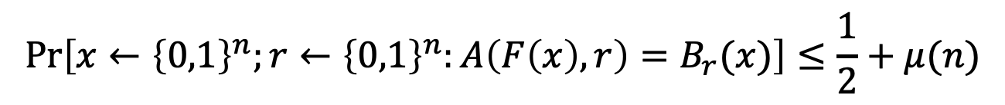
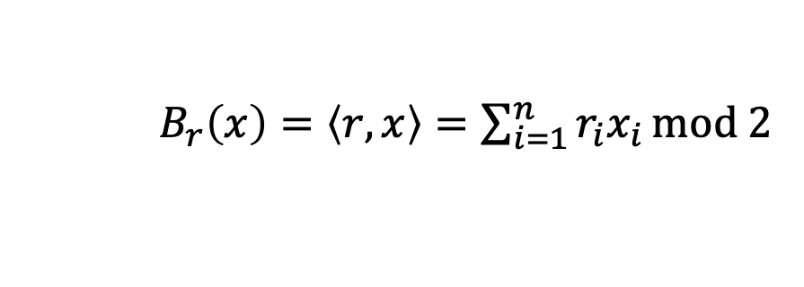
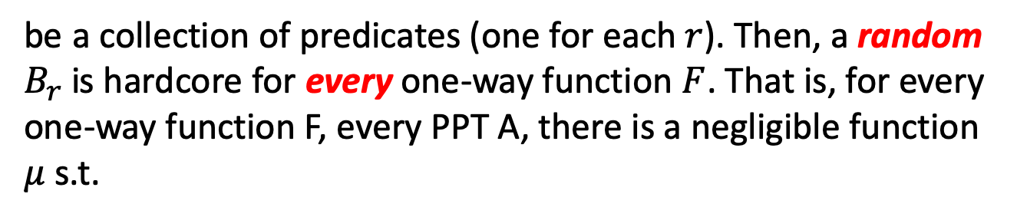
Goldreich-Levin (GL) Theorem
Let ${\{B}_{r}:{\{0,1\}}^{n}→\{0,1\}\}$ where
$B_{r}\left(x\right)=\left\langle r,x\right\rangle =\sum_{i=1}^{n}{r_{i}x_{i}}mod 2$
be a collection of predicates (one for each $r$). Then, a random $B_{r}$is hardcore for every one-way function $F$. That is, for every one-way function F, every PPT A, there is a negligible function $μ$ s.t.
$$\operatorname{Pr}\left[x←{\left\{0,1\right\}}^{n};r←{\left\{0,1\right\}}^{n}:A\left(F\left(x\right),r\right)=B_{r}(x)\right]≤\frac{1}{2}+μ(n)$$

Slide 30

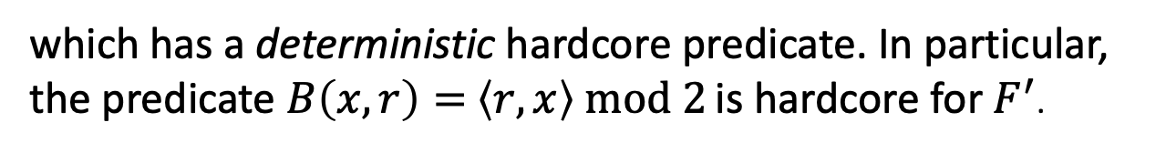

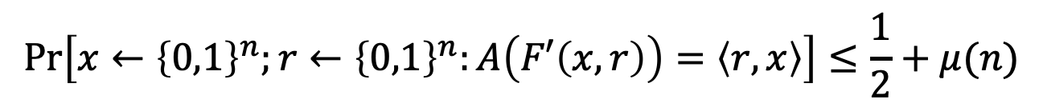
GL Theorem: Alternative Interpretation
For every one-way function/permutation $F$, there is a related one-way function/permutation
$F^{′}\left(x,r\right)=(F\left(x\right),r)$
which has a deterministic hardcore predicate. In particular, the predicate $B\left(x,r\right)=$ $\left\langle r,x\right\rangle mod 2$ is hardcore for $F^{′}$.
$$\operatorname{Pr}\left[x←{\left\{0,1\right\}}^{n};r←{\left\{0,1\right\}}^{n}:A\left(F′\left(x,r\right)\right)=\left\langle r,x\right\rangle \right]≤\frac{1}{2}+μ(n)$$
Key Point:
This statement is sufficient to construct PRGs from any OWP.

Slide 31
Proof of GL Theorem
Let’s make our lives easier: assume a perfect predictor $P$
Assume for contradiction there is a predictor $P$
$$\operatorname{Pr}\left[x←{\left\{0,1\right\}}^{n};r←{\left\{0,1\right\}}^{n}:P\left(F\left(x\right),r\right)=\left\langle r,x\right\rangle \right]≥\frac{1}{2}+1/p(n)$$
$$\operatorname{Pr}\left[x←{\left\{0,1\right\}}^{n};r←{\left\{0,1\right\}}^{n}:P\left(F\left(x\right),r\right)=\left\langle r,x\right\rangle \right]=1$$
We will need to show an inverter $A$ for $F$
$$\operatorname{Pr}\left[x←{\left\{0,1\right\}}^{n} :A\left(F\left(x\right)\right)=x^{′}:F\left(x^{′}\right)=F(x)\right]≥1/p′(n)$$

Slide 32
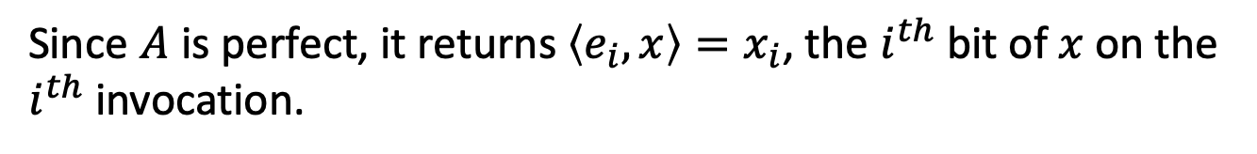
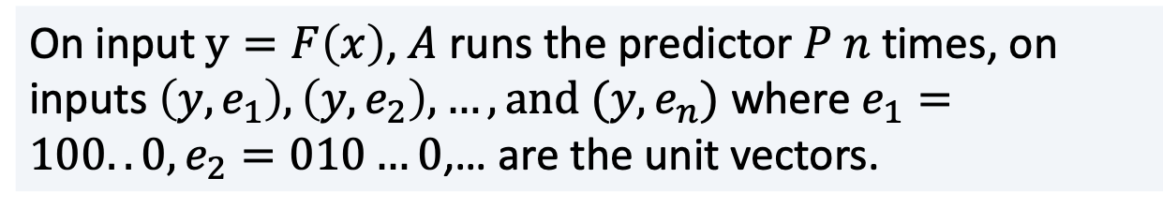
Proof of GL Theorem
Let’s make our lives easier: assume a perfect predictor $P$
Assume for contradiction there is a predictor $P$
$$\operatorname{Pr}\left[x←{\left\{0,1\right\}}^{n};r←{\left\{0,1\right\}}^{n}:P\left(F\left(x\right),r\right)=\left\langle r,x\right\rangle \right]=1$$
The inverter $A$ works as follows:
On input $y=F\left(x\right)$, $A$ runs the predictor $P$ $n$ times, on inputs $\left(y,e_{1}\right), \left(y,e_{2}\right),…, and (y,e_{n})$ where $e_{1}=100..0, e_{2}=010…0$,… are the unit vectors.
Since $A$ is perfect, it returns $\left\langle e_{i},x\right\rangle =x_{i}$, the $i^{th}$ bit of $x$ on the $i^{th}$ invocation.

Slide 33
Proof of GL Theorem
OK, now let’s assume less: assume a pretty good predictor $P$
Assume for contradiction there is a predictor $P$
$$\operatorname{Pr}\left[x←{\left\{0,1\right\}}^{n};r←{\left\{0,1\right\}}^{n}:P\left(F\left(x\right),r\right)=\left\langle r,x\right\rangle \right]≥\frac{3}{4}+1/p(n)$$
First, we need an averaging argument.
Claim: For at least a $1/2p(n)$ fraction of the $x$,
$$\operatorname{Pr}\left[r←{\left\{0,1\right\}}^{n}:P\left(F\left(x\right),r\right)=\left\langle r,x\right\rangle \right]≥\frac{3}{4}+1/2p(n)$$
Proof: Exercise in counting.
Call these the good $x.$

Slide 34
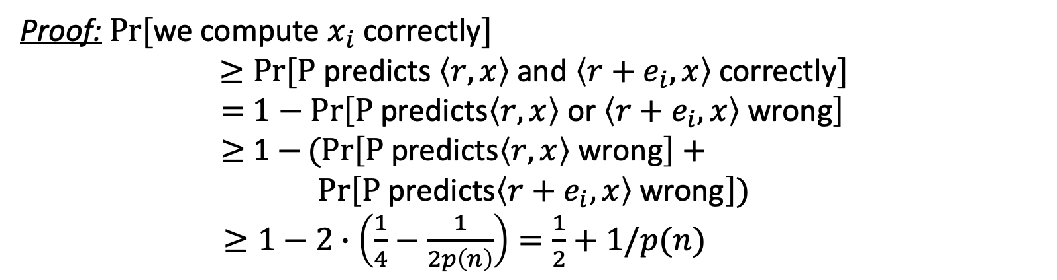
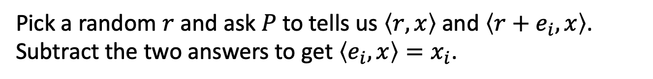
Proof of GL Theorem
For at least a $1/2p(n)$ fraction of the $x$,
$$\operatorname{Pr}\left[r←{\left\{0,1\right\}}^{n}:P\left(F\left(x\right),r\right)=\left\langle r,x\right\rangle \right]≥\frac{3}{4}+1/2p(n)$$
Key Idea: Linearity
Pick a random $r$ and ask $P$ to tells us $\left\langle r,x\right\rangle$ and $\left\langle r+e_{i},x\right\rangle$. Subtract the two answers to get $\left\langle e_{i},x\right\rangle =x_{i}$.
Proof: $Pr⁡[$we compute $x_{i}$ correctly$]$
$$≥Pr⁡[\text{P} \text{predicts} \left\langle r,x\right\rangle \text{and} \left\langle r+e_{i},x\right\rangle \text{correctly}]$$
$=$ $1−\operatorname{Pr}\left[\text{P} \text{predicts}\left\langle r,x\right\rangle \text{or} \left\langle r+e_{i},x\right\rangle \text{wrong}\right]$
$≥$ 1 $−(Pr\left[\text{P} \text{predicts}\left\langle r,x\right\rangle \text{wrong}\right]+$
$$\operatorname{Pr}\left[\text{P} \text{predicts}\left\langle r+e_{i},x\right\rangle \text{wrong}\right])$$
$≥1−2∙\left(\frac{1}{4}−\frac{1}{2p\left(n\right)}\right)=\frac{1}{2}+1/p(n)$
(by union bound)

Slide 35
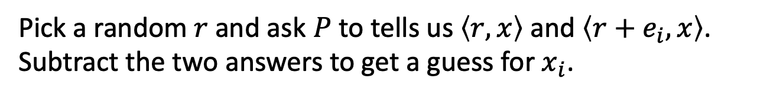
Proof of GL Theorem
For at least a $1/2p(n)$ fraction of the $x$,
$$\operatorname{Pr}\left[r←{\left\{0,1\right\}}^{n}:P\left(F\left(x\right),r\right)=\left\langle r,x\right\rangle \right]≥\frac{3}{4}+1/2p(n)$$
Inverter A:
Repeat for each $i∈\left\{1,2,…,n\right\}$:
Repeat $\log{n}∗p(n)$ times:
Pick a random $r$ and ask $P$ to tells us $\left\langle r,x\right\rangle$ and $\left\langle r+e_{i},x\right\rangle$. Subtract the two answers to get a guess for $x_{i}$.
Compute the majority of all such guesses and set the bit as $x_{i}$
Output the concatenation of all $x_{i}$ as $x.$
Analysis: Chernoff + Union Bound

Slide 36
Now the real Proof…
Assume (after averaging) that for $≥1/2p(n)$ fraction of the $x$,
$$\operatorname{Pr}\left[r←{\left\{0,1\right\}}^{n}:P\left(F\left(x\right),r\right)=\left\langle r,x\right\rangle \right]≥\frac{1}{2}+1/2p(n)$$

Slide 37
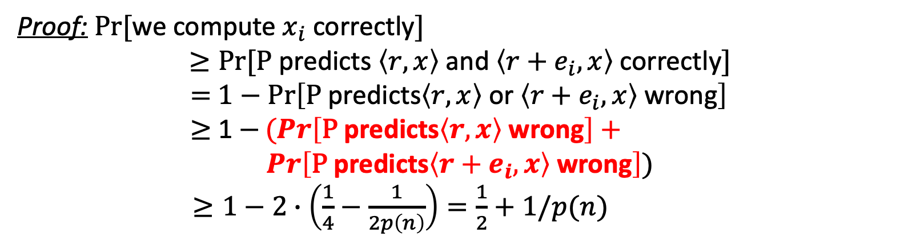
Who’s the culprit here?
For at least a $1/2p(n)$ fraction of the $x$,
$$\operatorname{Pr}\left[r←{\left\{0,1\right\}}^{n}:P\left(F\left(x\right),r\right)=\left\langle r,x\right\rangle \right]≥\frac{3}{4}+1/2p(n)$$
Pick a random $r$ and ask $P$ to tells us $\left\langle r,x\right\rangle$ and $\left\langle r+e_{i},x\right\rangle$. Subtract the two answers to get $\left\langle e_{i},x\right\rangle =x_{i}$.
Proof: $Pr⁡[$we compute $x_{i}$ correctly$]$
$$≥Pr⁡[\text{P} \text{predicts} \left\langle r,x\right\rangle \text{and} \left\langle r+e_{i},x\right\rangle \text{correctly}]$$
$=$ $1−\operatorname{Pr}\left[\text{P} \text{predicts}\left\langle r,x\right\rangle \text{or} \left\langle r+e_{i},x\right\rangle \text{wrong}\right]$
$≥$ 1 $−(Pr\left[\text{P} \text{predicts}\left\langle r,x\right\rangle \text{wrong}\right]+$
$$\operatorname{Pr}\left[\text{P} \text{predicts}\left\langle r+e_{i},x\right\rangle \text{wrong}\right])$$
$≥1−2∙\left(\frac{1}{4}−\frac{1}{2p\left(n\right)}\right)=\frac{1}{2}+1/p(n)$
(by union bound)

Slide 38
Now on to the Real Proof
Assume (after averaging) that for $≥1/2p(n)$ fraction of the $x$,
$$\operatorname{Pr}\left[r←{\left\{0,1\right\}}^{n}:P\left(F\left(x\right),r\right)=\left\langle r,x\right\rangle \right]≥\frac{1}{2}+1/2p(n)$$
Key Idea: Pairwise independence

Slide 39


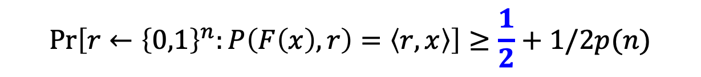
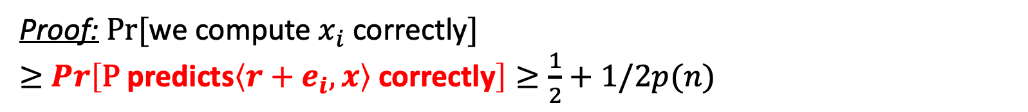
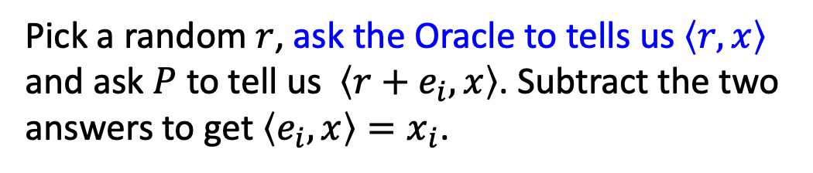
A Proof of the GL Theorem
(attributed to Charlie Rackoff)
Assume (after averaging) that for $≥1/2p(n)$ fraction of the $x$,
$$\operatorname{Pr}\left[r←{\left\{0,1\right\}}^{n}:P\left(F\left(x\right),r\right)=\left\langle r,x\right\rangle \right]≥\frac{1}{2}+1/2p(n)$$
For a minute, assume we have a bit of help/advice.
Pick a random $r$, ask the Oracle to tells us $\left\langle r,x\right\rangle$ and ask $P$ to tell us $\left\langle r+e_{i},x\right\rangle$. Subtract the two answers to get $\left\langle e_{i},x\right\rangle =x_{i}$.
Proof: $Pr⁡[$we compute $x_{i}$ correctly$]$
$≥$ $\operatorname{Pr}\left[\text{P} \text{predicts}\left\langle r+e_{i},x\right\rangle \text{correctly}\right]≥\frac{1}{2}+1/2p(n)$

Slide 40

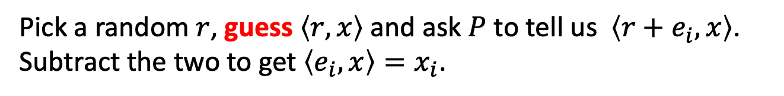
A Proof of the GL Theorem
(attributed to Charlie Rackoff)
Assume (after averaging) that for $≥1/2p(n)$ fraction of the $x$,
$$\operatorname{Pr}\left[r←{\left\{0,1\right\}}^{n}:P\left(F\left(x\right),r\right)=\left\langle r,x\right\rangle \right]≥\frac{1}{2}+1/2p(n)$$
Pick a random $r$, guess $\left\langle r,x\right\rangle$ and ask $P$ to tell us $\left\langle r+e_{i},x\right\rangle$. Subtract the two to get $\left\langle e_{i},x\right\rangle =x_{i}$.
If our guesses are all correct, then the analysis works out just as before.
But what’s the chance…?

Slide 41
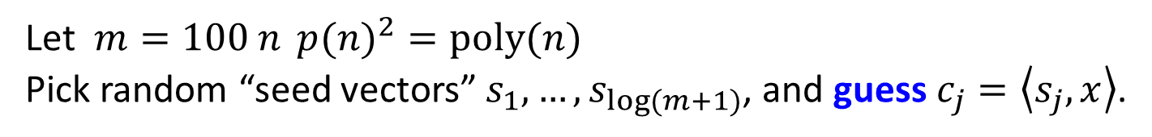
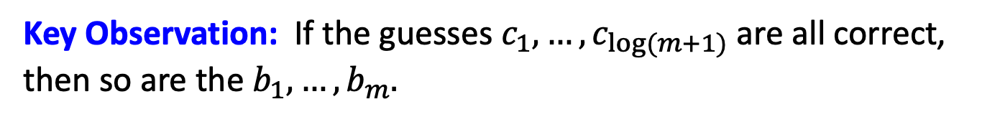
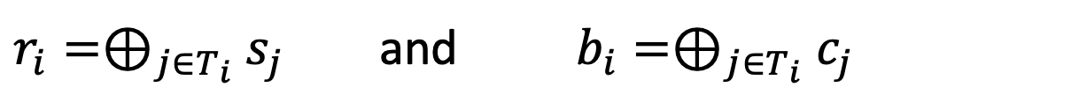
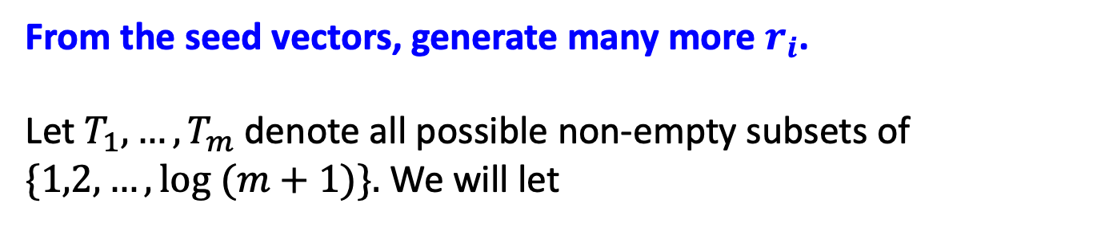
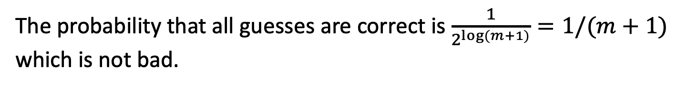
Parsimony in Guessing
Let $m=100 n{{p(n)}^{2}}=poly(n)$
Pick random “seed vectors” $s_{1},…,s_{\log{(m+1)}}$, and guess $c_{j}=\left\langle s_{j},x\right\rangle$.
The probability that all guesses are correct is $\frac{1}{2^{\log{(m+1)}}}=1/(m+1)$ which is not bad.
From the seed vectors, generate many more $r_{i}$.
Let $T_{1},…,T_{m}$ denote all possible non-empty subsets of $\{1,2,…,\log{(m+1)\}.}$ We will let
$r_{i}=⊕_{j∈T_{i}}$ $s_{j}$ and $b_{i}=⊕_{j∈T_{i}}$ $c_{j}$
Key Observation: If the guesses $c_{1},…,c_{\log{(m+1)}}$ are all correct, then so are the $b_{1},…,b_{m}.$

Slide 42

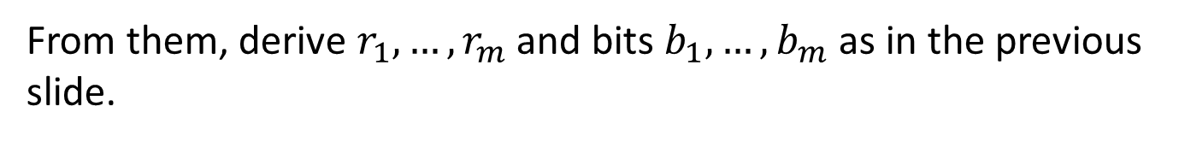
The OWF Inverter
Generate random $s_{1},…,s_{log⁡(m+1)}$ and bits $c_{1},…,c_{log⁡(m+1)}$.
From them, derive $r_{1},…,r_{m}$ and bits $b_{1},…,b_{m}$ as in the previous slide.
Repeat for each $i∈\left\{1,2,…,n\right\}$:
For each $j∈\left\{1,2,…,m\right\}$
Ask $P$ to tells us $\left\langle r_{j}+e_{i},x\right\rangle$. XOR P’s reply with $b_{i}$to get a guess for $x_{i}$.
Compute the majority of all such guesses and set the bit as $x_{i}$
Output the concatenation of all $x_{i}$ as $x.$

Slide 43
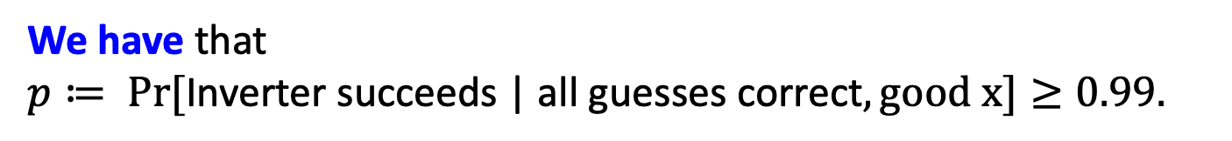
Analysis of the Inverter
Let’s condition on the guesses $c_{1},…,c_{log⁡(m+1)}$ being all correct.
The main issue: The $r_{i}$ are not independent (can’t do Chernoff)
Key Observation: The $r_{i}$ are pairwise independent.
Therefore, can apply Chebyshev!
We have that
$p≔ Pr⁡[\text{Inverter} \text{succeeds}\text{ | }\text{all} \text{guesses} \text{correct}, good x]≥0.99.$

Slide 44
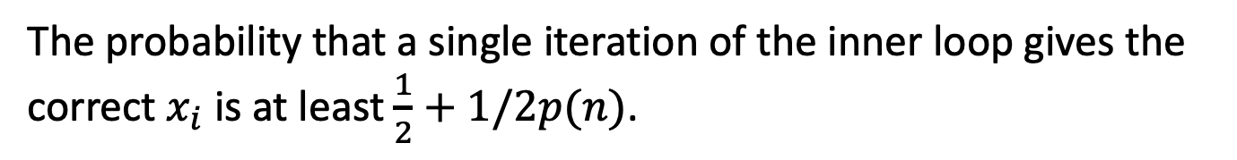



Analysis of the Inverter
The probability that a single iteration of the inner loop gives the correct $x_{i}$ is at least $\frac{1}{2}+1/2p(n)$.
Let this be the good event $E_{i}$ (for the $i^{th}$ iteration of the inner loop).
The majority decision is correct if the number of events $E_{i}$ that occur is at least $\frac{m}{2}=50 n{(p(n))}^{2}.$
The expected number of events that occur is
$(\frac{1}{2}+\frac{1}{2p\left(n\right)})$. $100 n{(p(n))}^{2}=50 n{(p(n))}^{2}+50np\left(n\right).$
The variance is
$≈\frac{1}{4}∙100 n{\left(p\left(n\right)\right)}^{2}=25n{\left(p\left(n\right)\right)}^{2}$

Slide 45



Analysis of the Inverter
The expected number of events that occur is
$(\frac{1}{2}+\frac{1}{2p\left(n\right)})$. $100 n{(p(n))}^{2}=50 n{(p(n))}^{2}+50np\left(n\right).$
The variance is $≈\frac{1}{4}∙100 n{\left(p\left(n\right)\right)}^{2}=25n{\left(p\left(n\right)\right)}^{2}$
By an application of Chebyshev, we have
$\operatorname{Pr}\left[majority decision w.r.t x_{i} incorrect\right]≤\frac{25n{\left(p\left(n\right)\right)}^{2}}{{\left(50np\left(n\right)\right)}^{2}}=\frac{1}{100n}$
By an application of union bound, we have
$\operatorname{Pr}\left[one of the x_{i} is incorrect\right]≤n∙\frac{1}{100n}=1/100$
$∴$ The inverter outputs the correct inverse w.p. $p≥0.99.$

Slide 46


Putting it all together
$Pr⁡[$Inverter succeeds$]$
$≥$ $Pr⁡[$Inverter succeeds | all guesses correct, good x$] ∙$
$Pr[all guesses correct]∙$ Pr[good x]
= $p∙\frac{1}{m+1}∙\frac{1}{2p(n)}$= $p∙ \frac{1}{{2n}^{2}{p\left(n\right)}^{3}}$
So, it suffices to show that $p$is large.
By our calculation (last two slides), $p≥0.99$, so we are done.
Can also make the success probability $≈1/p(n)$ by enumerating over all the “guesses”. Each guess results in a supposed inverse, but we can check which of them is the actual inverse!

Slide 47




The Coding-Theoretic View of GL
$x→{(\left\langle x,r\right\rangle )}_{r∈{\{0,1\}}^{n}}$ can be viewed as a highly redundant, exponentially long encoding of $x$ = the Hadamard code.
$P(F\left(x\right),r)$ can be thought of as providing access to a noisy codeword.
What we proved = unique decoding algorithm for Hadamard code with error rate $\frac{1}{4}−1/p(n)$.
The real proof = list-decoding algorithm for Hadamard code with error rate $\frac{1}{2}−1/p(n)$.

Slide 48


Hardcore Predicates from any
List-Decodable Code
(due to Impagliazzo and Sudan)
$x→C(x)$ is the encoding.
Given a $C(x)$ that is incorrect at $\frac{1}{2}−ε$ fraction of the locations, a list-decoder outputs a list $\{x_{1},…,x_{m}\}$ of possibilities for $x$.
The hardcore predicate is
$$B_{i}\left(x\right)= {C(x)}_{i}.$$
A hardcore-bit predictor gives us access to a corrupted codeword. Running the list-decoder on it gives us the list of possible inverses. The fact that the OWF is easy to compute means that we can filter out the bogus (non-)inverses.

Slide 49

Recap
1. Defined one-way functions (OWF).
2. Defined Hardcore bits (HCB).
3. Goldreich-Levin Theorem: every OWF has a HCB.
(showed proof for an important special case)
4. Show that one-way permutations (OWP) $⇒$ PRG
(in fact, one-way functions $⇒$ PRG, but that’s a much harder theorem)

