Slide 1
Foundations of Cryptography
Digital Signatures
Slides by Vinod Vaikuntanathan (Edited): https://mit6875.github.io/

Slide 2




Recall: Message Authentication Codes
m
$$m, t=MAC(sk,m)$$
sk
sk
$$Verify(sk,m,t)$$
Authenticity: Bob wants to ensure that the message came from Alice.
Needs Bob and Alice to share a secret key beforehand.

Slide 3


Digital Signatures:
Public-key Analog of MACs
Alice
vk
m
$$m, σ←Sign(sk,m)$$
sk
$$Verify(vk,m,σ)$$
(Public) verification keys are stored in a “directory”.
Only Alice can produce signatures; but Bob (or indeed, anyone else) can verify them.

Slide 4
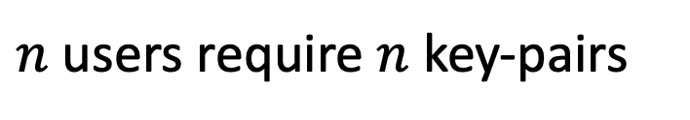
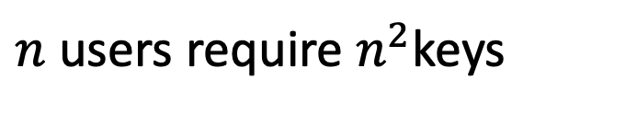
Digital Signatures vs. MACs
Signatures
MACs
$n$ users require $n$ key-pairs
$n$ users require $n^{2}$keys
Publicly Verifiable
Privately Verifiable
Transferable
Not Transferable
Provides Non-Repudiation
Does not provide Non-Rep.
(is this a good thing or a bad thing?)

Slide 5
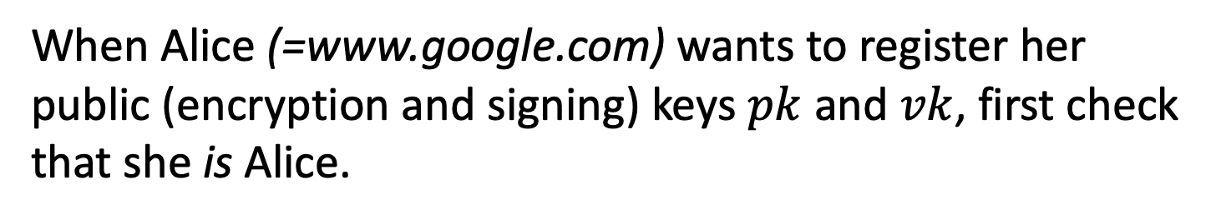

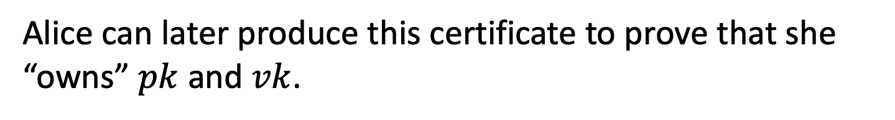
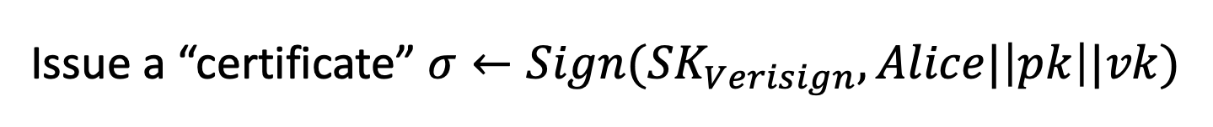
Alice
pk,vk
Other Applications
1. Certificates, or a public-key directory in practice:
Trusted Certificate Authority, e.g. Verisign, Let’s Encrypt.
When Alice (=www.google.com) wants to register her public (encryption and signing) keys $pk$ and $vk$, first check that she is Alice.
Issue a “certificate” $σ←Sign({SK}_{Verisign},Alice|\left|pk\right||vk)$
Alice can later produce this certificate to prove that she “owns” $pk$ and $vk$.
Browsers store ${VK}_{Verisign}$ and check the certificate.

Slide 6
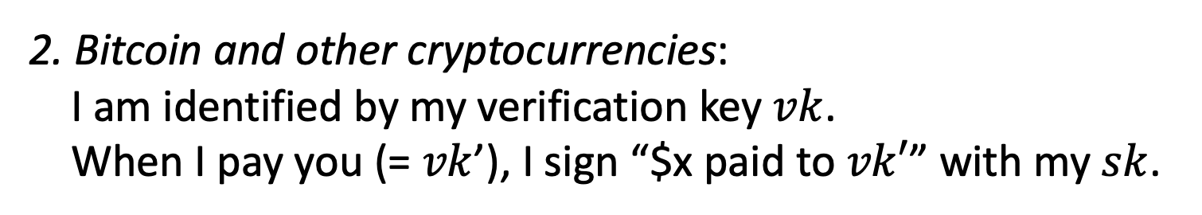
Other Applications
2. Bitcoin and other cryptocurrencies:
I am identified by my verification key $vk$.
When I pay you (= $vk$’), I sign “$x paid to $vk′$” with my $sk$.

Slide 7

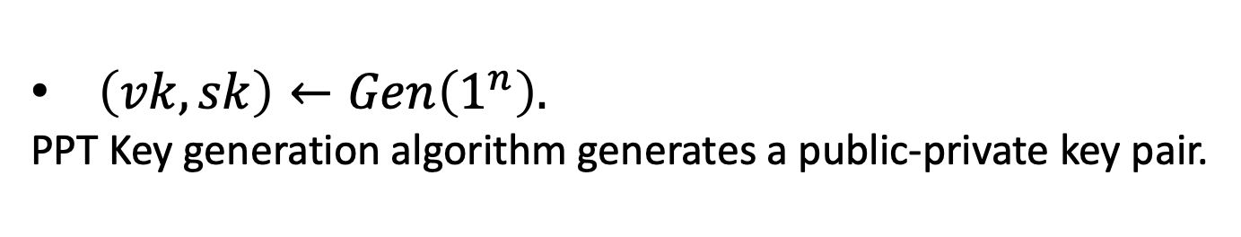
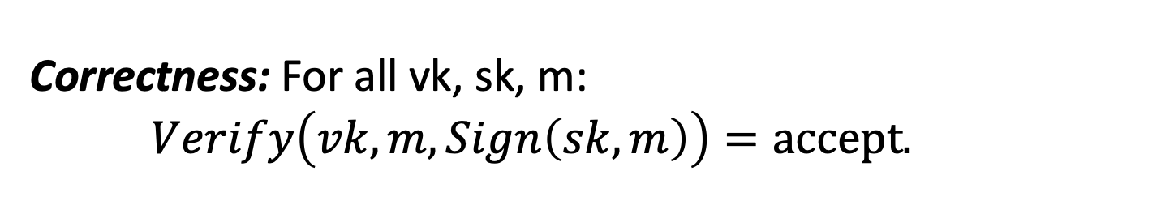
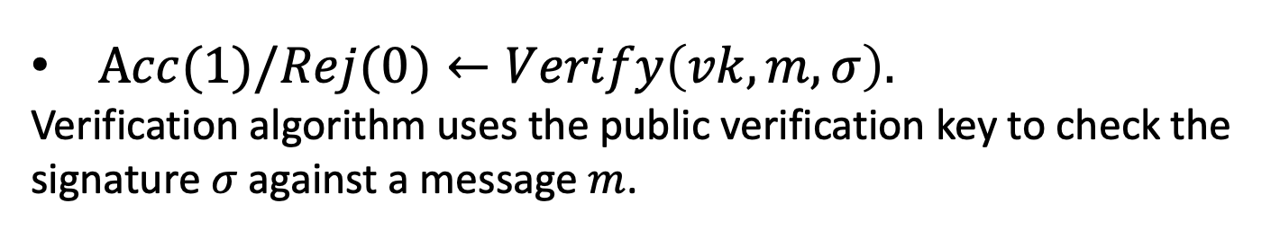
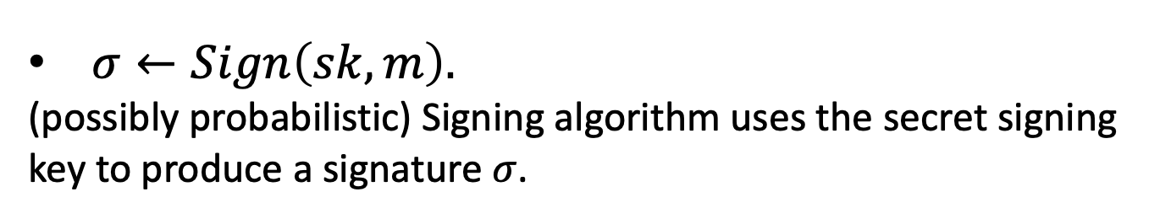
Digital Signatures: Definition
A triple of PPT algorithms $(Gen,Sign,Verify)$ s.t.
$\left(vk,sk\right)←Gen\left(1^{n}\right).$
PPT Key generation algorithm generates a public-private key pair.
$σ←Sign\left(sk,m\right).$
(possibly probabilistic) Signing algorithm uses the secret signing key to produce a signature $σ$.
$Acc(1)/Rej(0)←Verify\left(vk,m,σ\right).$
Verification algorithm uses the public verification key to check the signature $σ$against a message $m$.
Correctness: For all vk, sk, m: $Verify\left(vk,m,Sign\left(sk,m\right)\right)=accept.$

Slide 8
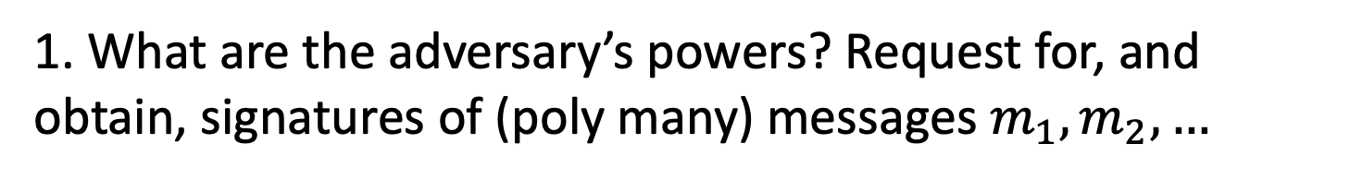
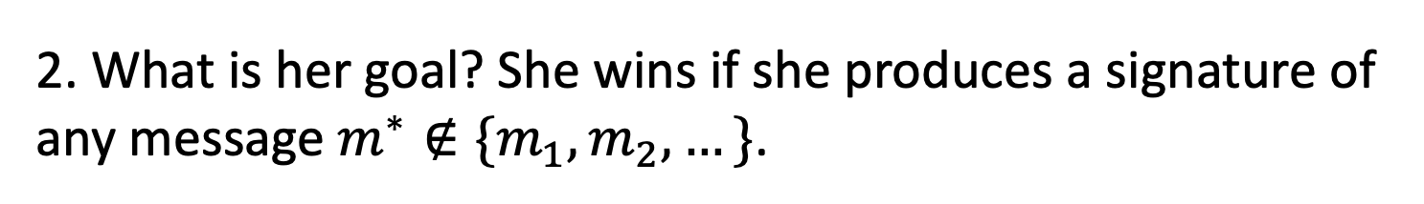
Digital Signatures: Security
“The adversary after seeing signatures of many msgs, should not be able to produce a signature of any new msg.”
1. What are the adversary’s powers? Request for, and obtain, signatures of (poly many) messages $m_{1},m_{2},…$
Chosen-message attack
2. What is her goal? She wins if she produces a signature of any message $m^{∗}∉\{m_{1},m_{2},…\}$.
Existential Forgery

Slide 9





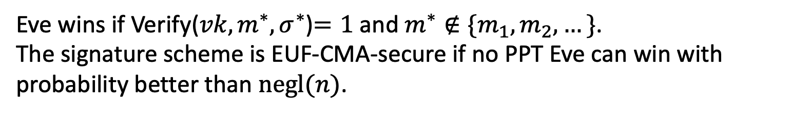



EUF-CMA Security
(Existentially Unforgeable against a Chosen Message Attack)
Challenger
Eve
$$\left(vk,sk\right)←Gen\left(1^{n}\right)$$
$$vk$$
$$m_{i}$$
poly many times
$$σ_{i}$$
$$σ_{i}←Sign(sk,m_{i})$$
$$m^{∗},σ^{∗}$$
Eve wins if Verify(${vk,m}^{∗},σ^{∗}$)$=1$ and $m^{∗}∉\{m_{1},m_{2},…\}$.
The signature scheme is EUF-CMA-secure if no PPT Eve can win with probability better than $negl(n)$.
Notes:
Encryption has to be probabilistic.

Slide 10
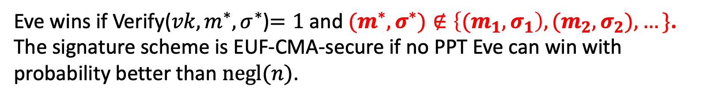
Strong EUF-CMA Security
(Existentially Unforgeable against a Chosen Message Attack)
Challenger
Eve
$$\left(vk,sk\right)←Gen\left(1^{n}\right)$$
$$vk$$
$$m_{i}$$
poly many times
$$σ_{i}$$
$$σ_{i}←Sign(sk,m_{i})$$
$$m^{∗},σ^{∗}$$
Eve wins if Verify(${vk,m}^{∗},σ^{∗}$)$=1$ and ${(m}^{∗},σ^{∗})∉\left\{{(m}_{1},σ_{1}\right),{(m}_{2},σ_{2}),…\}$.
The signature scheme is EUF-CMA-secure if no PPT Eve can win with probability better than $negl(n)$.
Notes:
Encryption has to be probabilistic.

Slide 11
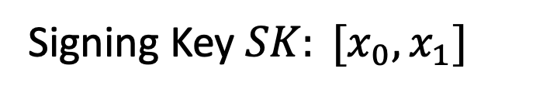
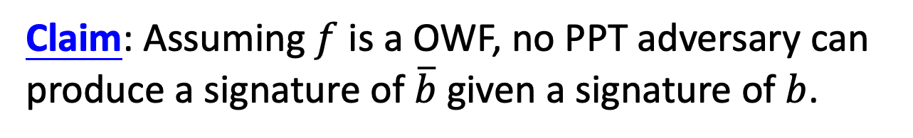

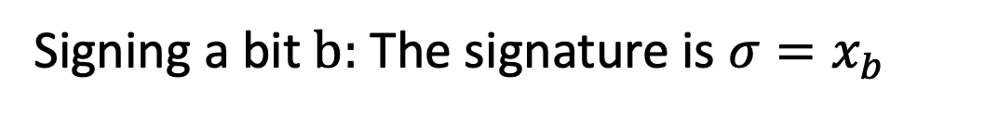
Lamport (One-time) Signatures
How to sign a bit
Signing Key $SK: [x_{0},x_{1}]$
Verification Key $VK: [y_{0}=f(x_{0}),{y_{1}=f(x}_{1})]$
Signing a bit $b:$ The signature is ${σ=x}_{b}$
?
Verifying $(b,σ):$ Check if $f\left(σ\right)=y_{b}$
Claim: Assuming $f$ is a OWF, no PPT adversary can produce a signature of $\overline{b}$ given a signature of $b$.
Notes:
No proof here because we will prove the stronger statement in a few slides

Slide 12



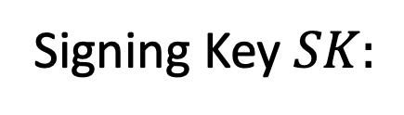




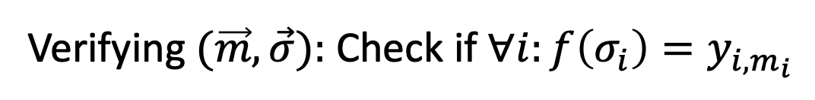


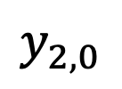


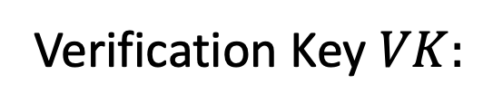

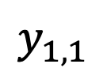
Lamport (One-time) Signatures
How to sign n bits
$$x_{1,0}$$
$$x_{2,0}$$
$$x_{n,0}$$
Signing Key $SK:$
$$x_{1,1}$$
$$x_{2,1}$$
$$x_{n,1}$$
$$y_{1,0}$$
$$y_{2,0}$$
$$y_{n,0}$$
Verification Key $VK:$
$$y_{1,1}$$
$$y_{2,1}$$
$$y_{n,1}$$
where ${y_{i,c}=f(x}_{i,c})$.
Signing an n-bit message $(m_{1},…,m_{n}):$
The signature is $\left(x_{1,m_{1}},…,x_{n,m_{n}}\right).$
?
Verifying $(\vec{m},\vec{σ}):$ Check if $∀i:f\left(σ_{i}\right)=y_{i,m_{i}}$

Slide 13

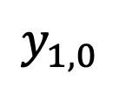
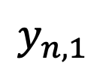
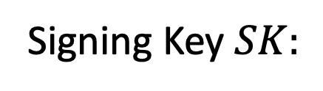




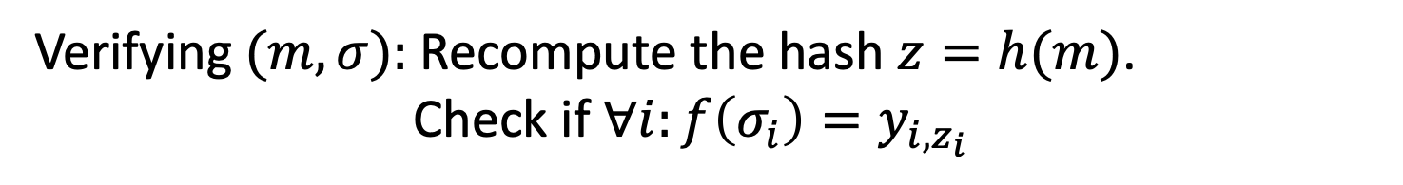

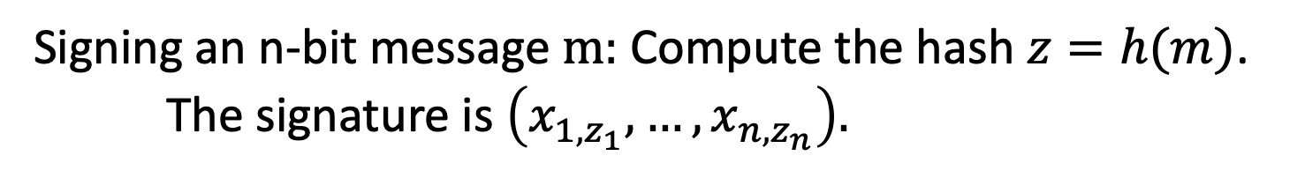



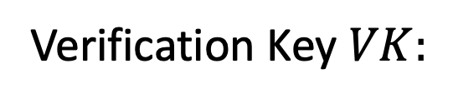


How to Sign Polynomially Many Bits
(with a fixed verification key)
Idea: Hash the message into n bits and sign the hash.
$$x_{1,0}$$
$$x_{2,0}$$
$$x_{n,0}$$
Signing Key $SK:$
$$x_{1,1}$$
$$x_{2,1}$$
$$x_{n,1}$$
$$y_{1,0}$$
$$y_{2,0}$$
$$y_{n,0}$$
Verification Key $VK:$
and $h←𝓗$.
$$y_{1,1}$$
$$y_{2,1}$$
$$y_{n,1}$$
Signing an n-bit message $m:$ Compute the hash $z=h(m)$.
The signature is $\left(x_{1,z_{1}},…,x_{n,z_{n}}\right).$
Verifying $(m,σ):$ Recompute the hash $z=h(m)$.
Check if $∀i:f\left(σ_{i}\right)=y_{i,z_{i}}$

Slide 14
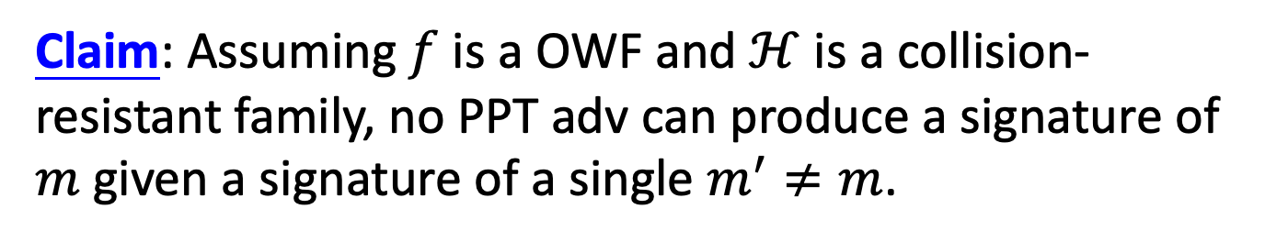
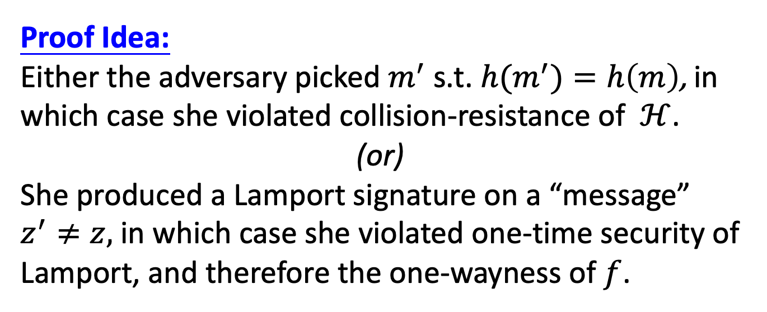
How to Sign Polynomially Many Bits
(with a fixed verification key)
Claim: Assuming $f$ is a OWF and $ℋ$ is a collision-resistant family, no PPT adv can produce a signature of $m$ given a signature of a single $m^{′}≠m$.
Proof Idea:
Either the adversary picked $m^{′}$ s.t. ${h(m}^{′})=h\left(m\right)$, in which case she violated collision-resistance of $ℋ$.
(or)
She produced a Lamport signature on a “message” $z^{′}≠z,$ in which case she violated one-time security of Lamport, and therefore the one-wayness of $f$.

Slide 15
So far, only one-time security…

Slide 16
Constructing a Signature Scheme
Theorem [Naor-Yung’89, Rompel’90]
(EUF-CMA-secure) Signature schemes exist assuming that one-way functions exist.
TODAY:
(EUF-CMA-secure) Signature schemes exist assuming that collision-resistant hash functions exist.

Slide 17
(Many-time) Signature Scheme
In four+ steps
Step 1. Stateful, Growing Signatures. Idea: Signature Chains
Step 2. How to Shrink the signatures. Idea: Signature Trees
Step 3. How to Shrink Alice’s storage.
Idea: Pseudorandom Trees
Step 4. How to make Alice stateless.
Idea: Randomization
Step 5 (optional). How to make Alice stateless and deterministic. Idea: PRFs.

Slide 18
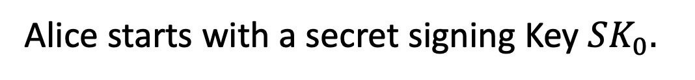

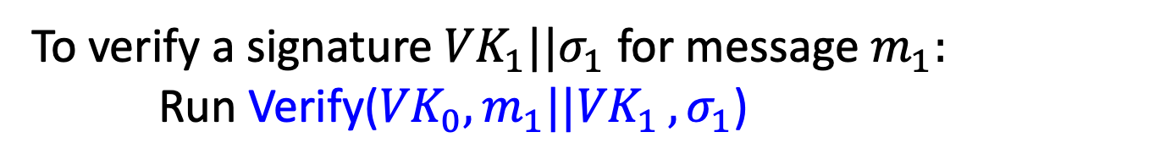
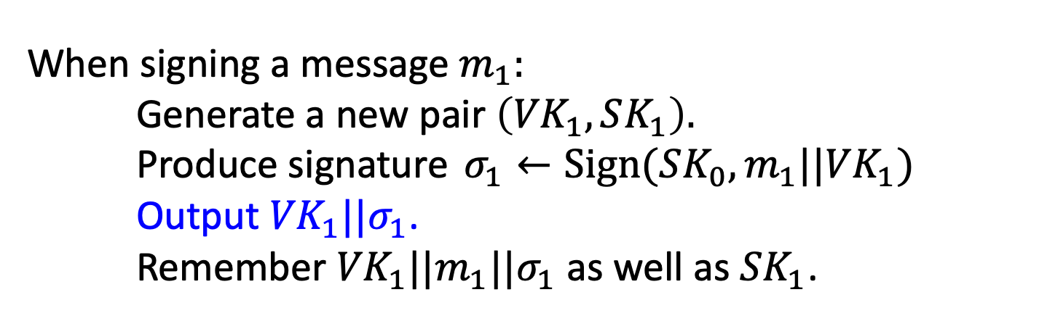
Step 1: Stateful Many-time Signatures
Idea: Signature Chains.
Alice
$$VK_{0}$$
Alice starts with a secret signing Key $SK_{0}.$
When signing a message $m_{1}:$
Generate a new pair $\left({VK}_{1},SK_{1}\right).$
Produce signature $σ_{1}←Sign({SK_{0},m_{1}||VK}_{1})$
Output ${VK}_{1}||σ_{1}$.
Remember ${VK}_{1}||{m_{1}||σ}_{1}$ as well as ${SK}_{1}$.
To verify a signature ${VK}_{1}||σ_{1}$ for message $m_{1}:$
Run Verify(${VK}_{0}{,m_{1}||VK}_{1},σ_{1}$)

Slide 19




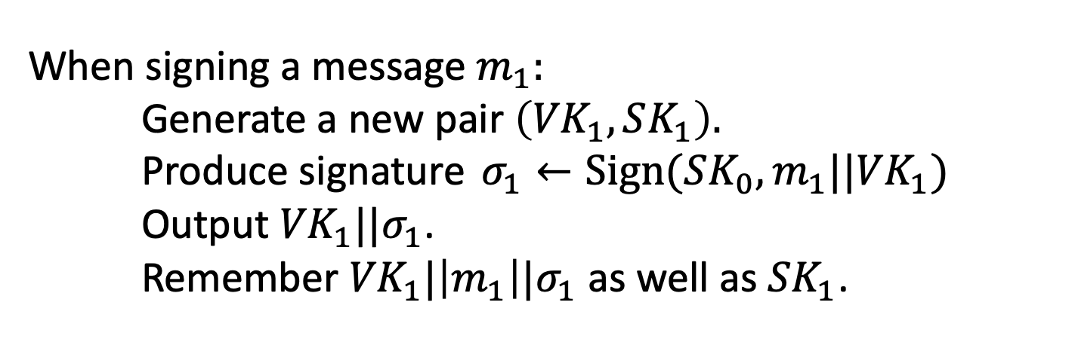
Step 1: Stateful Many-time Signatures
Idea: Signature Chains.
Alice
$$VK_{0}$$
Alice starts with a secret signing Key $SK_{0}.$
When signing a message $m_{1}:$
Generate a new pair $\left({VK}_{1},SK_{1}\right).$
Produce signature $σ_{1}←Sign({SK_{0},m_{1}||VK}_{1})$
Output ${VK}_{1}||σ_{1}$.
Remember ${VK}_{1}|\left|m_{1}\right||σ_{1}$ as well as ${SK}_{1}$.
$$m_{1}$$
$$σ_{1}$$
$${VK}_{0}$$
$${VK}_{1}$$

Slide 20
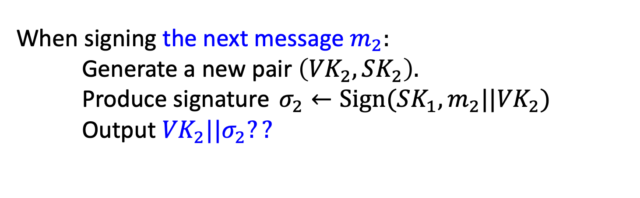
Step 1: Stateful Many-time Signatures
Idea: Signature Chains.
Alice
$$VK_{0}$$
Alice starts with a secret signing Key $SK_{0}.$
When signing the next message $m_{2}:$
Generate a new pair $\left({VK}_{2},SK_{2}\right).$
Produce signature $σ_{2}←Sign({SK_{1},m_{2}||VK}_{2})$
Output ${VK}_{2}||σ_{2}??$
$$m_{1}$$
$$σ_{1}$$
$${VK}_{0}$$
$${VK}_{1}$$

Slide 21
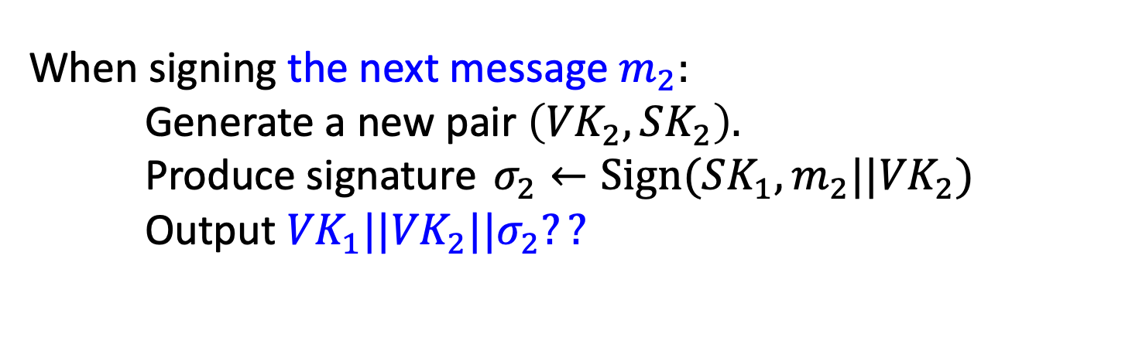
Step 1: Stateful Many-time Signatures
Idea: Signature Chains.
Alice
$$VK_{0}$$
Alice starts with a secret signing Key $SK_{0}.$
When signing the next message $m_{2}:$
Generate a new pair $\left({VK}_{2},SK_{2}\right).$
Produce signature $σ_{2}←Sign({SK_{1},m_{2}||VK}_{2})$
Output ${{VK}_{1}||VK}_{2}||σ_{2}??$
$$m_{1}$$
$$σ_{1}$$
$${VK}_{0}$$
$${VK}_{1}$$

Slide 22








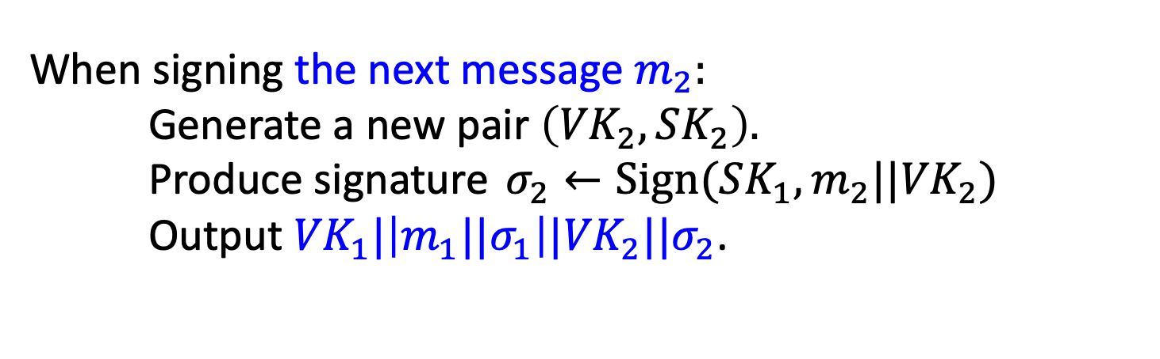


Step 1: Stateful Many-time Signatures
Idea: Signature Chains.
Alice
$$VK_{0}$$
Alice starts with a secret signing Key $SK_{0}.$
When signing the next message $m_{2}:$
Generate a new pair $\left({VK}_{2},SK_{2}\right).$
Produce signature $σ_{2}←Sign({SK_{1},m_{2}||VK}_{2})$
Output ${{VK}_{1}|\left|{m_{1}||σ}_{1}\right||VK}_{2}||σ_{2}$.
$$m_{1}$$
$$m_{2}$$
$$m_{3}$$
$$m_{4}$$
$$σ_{1}$$
$$σ_{2}$$
$$σ_{3}$$
$$σ_{4}$$
$$…$$
$${VK}_{0}$$
$${VK}_{1}$$
$${VK}_{2}$$
$${VK}_{3}$$
$${VK}_{4}$$

Slide 23
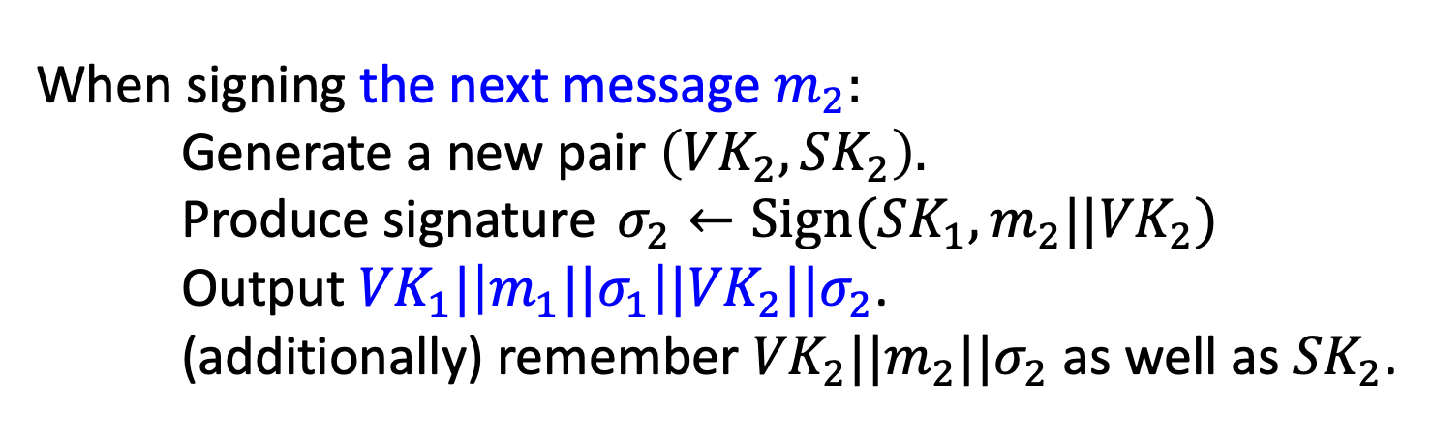
Step 1: Stateful Many-time Signatures
Idea: Signature Chains.
Alice
$$VK_{0}$$
Alice starts with a secret signing Key $SK_{0}.$
When signing the next message $m_{2}:$
Generate a new pair $\left({VK}_{2},SK_{2}\right).$
Produce signature $σ_{2}←Sign({SK_{1},m_{2}||VK}_{2})$
Output ${{VK}_{1}|\left|{m_{1}||σ}_{1}\right||VK}_{2}||σ_{2}$.
(additionally) remember ${VK}_{2}||{m_{2}||σ}_{2}$ as well as ${SK}_{2}$.
$$m_{1}$$
$$m_{2}$$
$$m_{3}$$
$$m_{4}$$
$$σ_{1}$$
$$σ_{2}$$
$$σ_{3}$$
$$σ_{4}$$
$$…$$
$${VK}_{0}$$
$${VK}_{1}$$
$${VK}_{2}$$
$${VK}_{3}$$
$${VK}_{4}$$

Slide 24


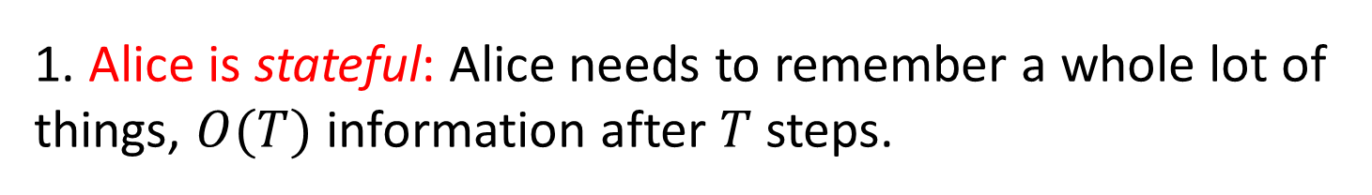



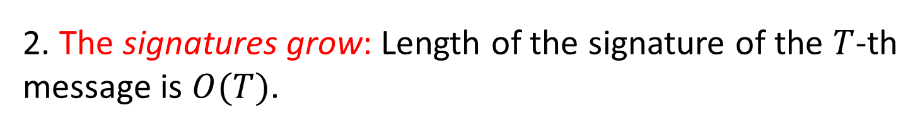
Step 1: Stateful Many-time Signatures
Idea: Signature Chains.
Two major problems:
1. Alice is stateful: Alice needs to remember a whole lot of things, $O(T)$ information after $T$ steps.
2. The signatures grow: Length of the signature of the $T$-th message is $O(T)$.
$$m_{1}$$
$$m_{2}$$
$$m_{3}$$
$$m_{4}$$
$$σ_{1}$$
$$σ_{2}$$
$$σ_{3}$$
$$σ_{4}$$
$$…$$
$${VK}_{0}$$
$${VK}_{1}$$
$${VK}_{2}$$
$${VK}_{3}$$
$${VK}_{4}$$

Slide 25
(Many-time) Signature Scheme
In four+ steps
Step 1. Stateful, Growing Signatures. Idea: Signature Chains
Step 2. How to Shrink the signatures. Idea: Signature Trees

Slide 26


Alice
$$VK_{ε}$$
Step 2.
How to Shrink the signatures.
$${VK}_{ε}$$

Slide 27


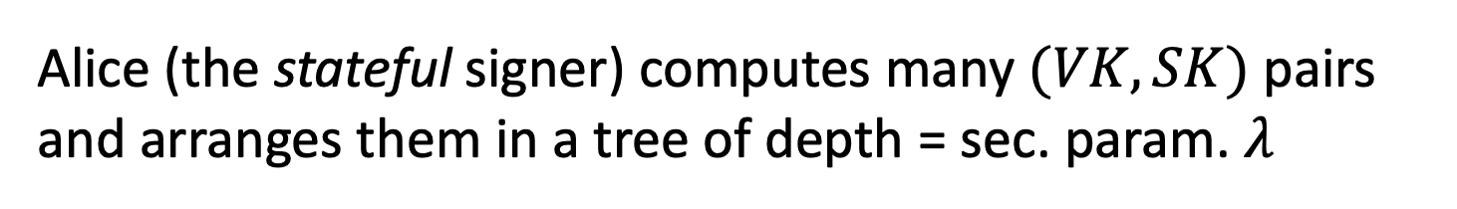











Alice
$$VK_{ε}$$
Step 2.
How to Shrink the signatures.
$${VK}_{ε}$$
$${VK}_{0}$$
$${VK}_{1}$$
$${VK}_{00}$$
$${VK}_{01}$$
$${VK}_{10}$$
$${VK}_{11}$$
$${VK}_{000}$$
$${VK}_{001}$$
$${VK}_{010}$$
$${VK}_{011}$$
$${VK}_{100}$$
$${VK}_{101}$$
$${VK}_{110}$$
$${VK}_{111}$$
Alice (the stateful signer) computes many $(VK,SK)$ pairs and arranges them in a tree of depth = sec. param. $λ$

Slide 28






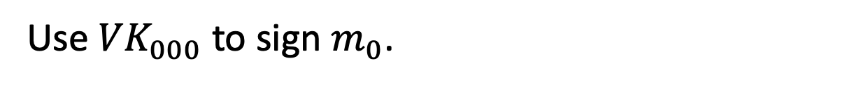
Step 2.
How to Shrink the signatures.
$${VK}_{ε}$$
$${VK}_{0}$$
$$σ_{ε}$$
$${VK}_{1}$$
$$σ_{0}$$
$${VK}_{00}$$
$${VK}_{01}$$
$${VK}_{10}$$
$${VK}_{11}$$
$$σ_{00}$$
$${VK}_{000}$$
$${VK}_{001}$$
$${VK}_{010}$$
$${VK}_{011}$$
$${VK}_{100}$$
$${VK}_{101}$$
$${VK}_{110}$$
$${VK}_{111}$$
$$τ_{0}$$
$$m_{0}$$
Signature of the first message $m_{0}:$
Use ${VK}_{000}$ to sign $m_{0}$.
“Authenticate” ${VK}_{000}$ using the “signature path”.

Slide 29

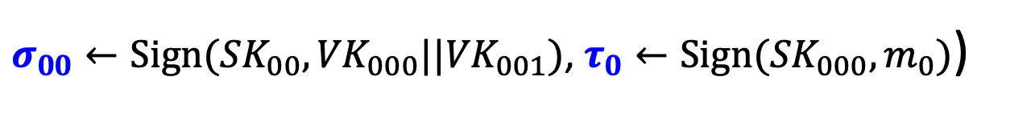
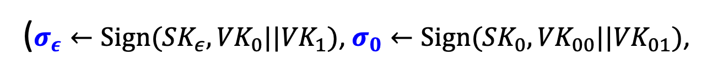
Step 2.
How to Shrink the signatures.
$${VK}_{ε}$$
$${VK}_{0}$$
$$σ_{ε}$$
$${VK}_{1}$$
$$σ_{0}$$
$${VK}_{00}$$
$${VK}_{01}$$
$${VK}_{10}$$
$${VK}_{11}$$
$$σ_{00}$$
$${VK}_{000}$$
$${VK}_{001}$$
$${VK}_{010}$$
$${VK}_{011}$$
$${VK}_{100}$$
$${VK}_{101}$$
$${VK}_{110}$$
$${VK}_{111}$$
$$τ_{0}$$
$$m_{0}$$
Signature of the first message $m_{0}:$
($σ_{ε}←Sign({SK}_{ε},{VK}_{0}||{VK}_{1})$, $σ_{0}←Sign({SK}_{0},{VK}_{00}||{VK}_{01})$,
$σ_{00}←Sign({SK}_{00},{VK}_{000}||{VK}_{001})$, $τ_{0}←Sign({SK}_{000},m_{0})$)

Slide 30

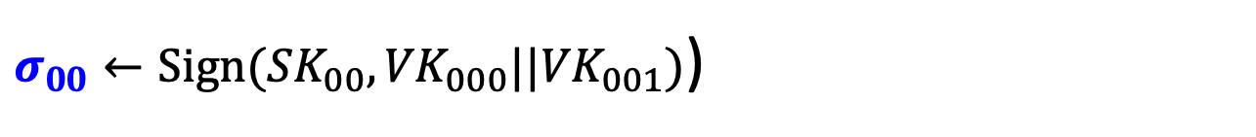
Step 2.
How to Shrink the signatures.
$${VK}_{ε}$$
$${VK}_{0}$$
$$σ_{ε}$$
$${VK}_{1}$$
$$σ_{0}$$
$${VK}_{00}$$
$${VK}_{01}$$
$${VK}_{10}$$
$${VK}_{11}$$
$$σ_{00}$$
$${VK}_{000}$$
$${VK}_{001}$$
$${VK}_{010}$$
$${VK}_{011}$$
$${VK}_{100}$$
$${VK}_{101}$$
$${VK}_{110}$$
$${VK}_{111}$$
$$τ_{0}$$
$$m_{0}$$
Authentication Path for ${VK}_{000}$:
($σ_{ε}←Sign({SK}_{ε},{VK}_{0}||{VK}_{1})$, $σ_{0}←Sign({SK}_{0},{VK}_{00}||{VK}_{01})$,
$σ_{00}←Sign({SK}_{00},{VK}_{000}||{VK}_{001})$)

Slide 31
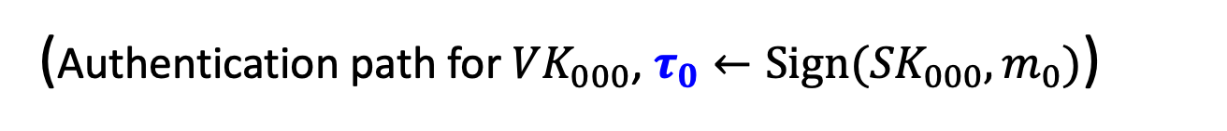
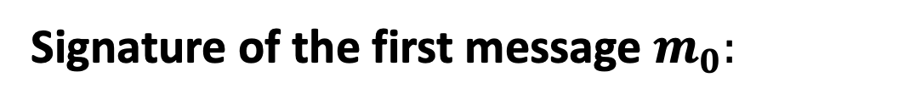
Step 2.
How to Shrink the signatures.
$${VK}_{ε}$$
$${VK}_{0}$$
$$σ_{ε}$$
$${VK}_{1}$$
$$σ_{0}$$
$${VK}_{00}$$
$${VK}_{01}$$
$${VK}_{10}$$
$${VK}_{11}$$
$$σ_{00}$$
$${VK}_{000}$$
$${VK}_{001}$$
$${VK}_{010}$$
$${VK}_{011}$$
$${VK}_{100}$$
$${VK}_{101}$$
$${VK}_{110}$$
$${VK}_{111}$$
$$τ_{0}$$
$$m_{0}$$
Signature of the first message $m_{0}:$
(Authentication path for ${VK}_{000}$, $τ_{0}←Sign({SK}_{000},m_{0})$)

Slide 32


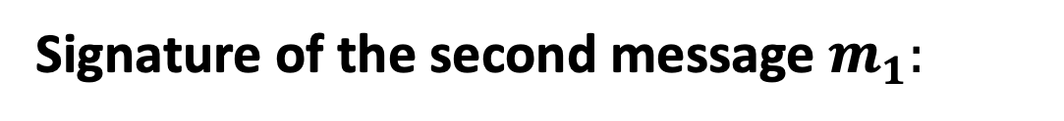

Step 2.
How to Shrink the signatures.
$${VK}_{ε}$$
$${VK}_{0}$$
$$σ_{ε}$$
$${VK}_{1}$$
$$σ_{0}$$
$${VK}_{00}$$
$${VK}_{01}$$
$${VK}_{10}$$
$${VK}_{11}$$
$$σ_{00}$$
$${VK}_{000}$$
$${VK}_{001}$$
$${VK}_{010}$$
$${VK}_{011}$$
$${VK}_{100}$$
$${VK}_{101}$$
$${VK}_{110}$$
$${VK}_{111}$$
$$τ_{1}$$
$$m_{1}$$
Signature of the second message $m_{1}:$
(Authentication path for ${VK}_{001}$, $τ_{0}←Sign({SK}_{001},m_{1})$)

Slide 33



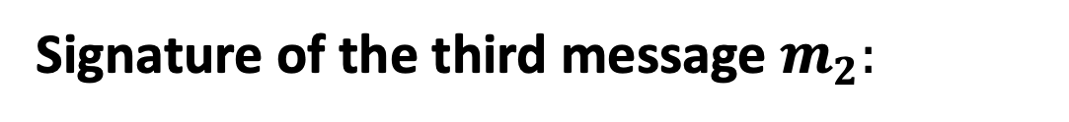

Step 2.
How to Shrink the signatures.
$${VK}_{ε}$$
$${VK}_{0}$$
$$σ_{ε}$$
$${VK}_{1}$$
$$σ_{0}$$
$${VK}_{00}$$
$${VK}_{01}$$
$${VK}_{10}$$
$${VK}_{11}$$
$$σ_{01}$$
$${VK}_{000}$$
$${VK}_{001}$$
$${VK}_{010}$$
$${VK}_{011}$$
$${VK}_{100}$$
$${VK}_{101}$$
$${VK}_{110}$$
$${VK}_{111}$$
$$τ_{2}$$
$$m_{2}$$
Signature of the third message $m_{2}:$
(Authentication path for ${VK}_{010}$, $τ_{2}←Sign({SK}_{010},m_{2})$)

Slide 34

Step 2.
How to Shrink the signatures.
$${VK}_{ε}$$
$${VK}_{0}$$
$$σ_{ε}$$
$${VK}_{1}$$
$$σ_{0}$$
$${VK}_{00}$$
$${VK}_{01}$$
$${VK}_{10}$$
$${VK}_{11}$$
$$σ_{01}$$
$${VK}_{000}$$
$${VK}_{001}$$
$${VK}_{010}$$
$${VK}_{011}$$
$${VK}_{100}$$
$${VK}_{101}$$
$${VK}_{110}$$
$${VK}_{111}$$
$$τ_{2}$$
$$m_{2}$$
GOOD NEWS:
Each verification key (incl. at the leaves) is used only once, so one-time security suffices!

Slide 35
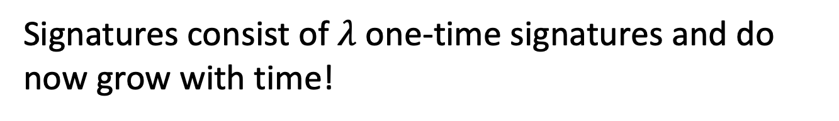
Step 2.
How to Shrink the signatures.
$${VK}_{ε}$$
$${VK}_{0}$$
$$σ_{ε}$$
$${VK}_{1}$$
$$σ_{0}$$
$${VK}_{00}$$
$${VK}_{01}$$
$${VK}_{10}$$
$${VK}_{11}$$
$$σ_{01}$$
$${VK}_{000}$$
$${VK}_{001}$$
$${VK}_{010}$$
$${VK}_{011}$$
$${VK}_{100}$$
$${VK}_{101}$$
$${VK}_{110}$$
$${VK}_{111}$$
$$τ_{2}$$
$$m_{2}$$
GOOD NEWS:
Signatures consist of $λ$ one-time signatures and do now grow with time!

Slide 36


Step 2.
How to Shrink the signatures.
$${VK}_{ε}$$
$${VK}_{0}$$
$$σ_{ε}$$
$${VK}_{1}$$
$$σ_{0}$$
$${VK}_{00}$$
$${VK}_{01}$$
$${VK}_{10}$$
$${VK}_{11}$$
$$σ_{01}$$
$${VK}_{000}$$
$${VK}_{001}$$
$${VK}_{010}$$
$${VK}_{011}$$
$${VK}_{100}$$
$${VK}_{101}$$
$${VK}_{110}$$
$${VK}_{111}$$
$$τ_{2}$$
$$m_{2}$$
BAD NEWS:
Signer generates and keeps the entire ($≈ 2^{λ}$-size) signature tree in memory!

Slide 37
(Many-time) Signature Scheme
In four+ steps
Step 1. Stateful, Growing Signatures. Idea: Signature Chains
Step 2. How to Shrink the signatures. Idea: Signature Trees
Step 3. How to Shrink Alice’s storage.
Idea: Pseudorandom Trees

Slide 38























Step 3.
Pseudorandom Signature Trees.
$$r_{ε}$$
$({VK}_{ε}$,${SK}_{ε})$
$$r_{0}$$
$$r_{1}$$
$({VK}_{1}$,${SK}_{1})$
$({VK}_{0}$,${SK}_{0})$
$$r_{00}$$
$$…$$
$$r_{01}$$
$$…$$
$$r_{10}$$
$$…$$
$$r_{11}$$
$$…$$
$$r_{000}$$
$$r_{001}$$
$$r_{010}$$
$$r_{011}$$
$$r_{100}$$
$$r_{101}$$
$$r_{110}$$
$$r_{111}$$
Tree of pseudorandom values:
The signing key is a PRF key $K$.
Populate the nodes with $r_{x}=PRF(K,x)$.
Use $r_{x}$ to derive the keys $({VK}_{x},{SK}_{x})←Gen(1^{λ};r_{x})$.

Slide 39















Step 3.
Pseudorandom Signature Trees.
$$r_{ε}$$
$${VK}_{ε}$$
$$r_{0}$$
$$r_{1}$$
$${VK}_{1}$$
$${VK}_{0}$$
$$r_{00}$$
$$r_{01}$$
$$r_{10}$$
$$r_{11}$$
$${VK}_{00}$$
$${VK}_{01}$$
$${VK}_{10}$$
$${VK}_{11}$$
$$r_{000}$$
$$r_{001}$$
$$r_{010}$$
$$r_{011}$$
$$r_{100}$$
$$r_{101}$$
$$r_{110}$$
$$r_{111}$$
$${VK}_{000}$$
$${VK}_{001}$$
$${VK}_{010}$$
$${VK}_{011}$$
$${VK}_{100}$$
$${VK}_{101}$$
$${VK}_{110}$$
$${VK}_{111}$$
Tree of pseudorandom values:
The signing key is a PRF key $K$.
Populate the nodes with $r_{x}=PRF(K,x)$.
Use $r_{x}$ to derive the keys $({VK}_{x},{SK}_{x})←Gen(1^{λ};r_{x})$.

Slide 40
Step 3.
Pseudorandom Signature Trees.
$${VK}_{ε}$$
$${VK}_{0}$$
$${VK}_{1}$$
$${VK}_{00}$$
$${VK}_{01}$$
$${VK}_{10}$$
$${VK}_{11}$$
$${VK}_{000}$$
$${VK}_{001}$$
$${VK}_{010}$$
$${VK}_{011}$$
$${VK}_{100}$$
$${VK}_{101}$$
$${VK}_{110}$$
$${VK}_{111}$$
GOOD NEWS:
Short signatures and small storage for the signer

Slide 41
Step 3.
Pseudorandom Signature Trees.
$${VK}_{ε}$$
$${VK}_{0}$$
$${VK}_{1}$$
$${VK}_{00}$$
$${VK}_{01}$$
$${VK}_{10}$$
$${VK}_{11}$$
$${VK}_{000}$$
$${VK}_{001}$$
$${VK}_{010}$$
$${VK}_{011}$$
$${VK}_{100}$$
$${VK}_{101}$$
$${VK}_{110}$$
$${VK}_{111}$$
$$τ_{2}$$
$$m_{2}$$
BAD NEWS:
Signer needs to keep a counter indicating which leaf (which tells her which secret key) to use next.

Slide 42
(Many-time) Signature Scheme
In four+ steps
Step 1. Stateful, Growing Signatures. Idea: Signature Chains
Step 2. How to Shrink the signatures. Idea: Signature Trees
Step 3. How to Shrink Alice’s storage.
Idea: Pseudorandom Trees
Step 4. How to make Alice stateless.
Idea: Randomization

Slide 43










Step 4.
Statelessness via Randomization
$${VK}_{ε}$$
$$σ_{ε}$$
$${VK}_{0}$$
$$σ_{ε}$$
$${VK}_{1}$$
$$σ_{0}$$
$$σ_{1}$$
$${VK}_{00}$$
$${VK}_{01}$$
$${VK}_{10}$$
$${VK}_{11}$$
$$σ_{01}$$
$$σ_{10}$$
$${VK}_{000}$$
$${VK}_{001}$$
$${VK}_{010}$$
$${VK}_{011}$$
$${VK}_{010}$$
$${VK}_{100}$$
$${VK}_{101}$$
$${VK}_{101}$$
$${VK}_{110}$$
$${VK}_{111}$$
Signature of a message $m:$
Pick a random leaf $r$. Use ${VK}_{r}$ to sign $m$.
$$σ_{r}←Sign({SK}_{r},m)$$
Output $(r, σ_{r},$ authentication path for ${VK}_{r})$

Slide 44
Step 4.
Statelessness via Randomization
$${VK}_{ε}$$
$${VK}_{0}$$
$$σ_{ε}$$
$${VK}_{1}$$
$$σ_{0}$$
$${VK}_{00}$$
$${VK}_{01}$$
$${VK}_{10}$$
$${VK}_{11}$$
$$σ_{01}$$
$${VK}_{000}$$
$${VK}_{001}$$
$${VK}_{010}$$
$${VK}_{011}$$
$${VK}_{010}$$
$${VK}_{100}$$
$${VK}_{101}$$
$${VK}_{110}$$
$${VK}_{111}$$
GOOD NEWS:
No need to keep state.

Slide 45

Step 4.
Statelessness via Randomization
$${VK}_{ε}$$
$${VK}_{0}$$
$$σ_{ε}$$
$${VK}_{1}$$
$$σ_{0}$$
$${VK}_{00}$$
$${VK}_{01}$$
$${VK}_{10}$$
$${VK}_{11}$$
$$σ_{01}$$
$${VK}_{000}$$
$${VK}_{001}$$
$${VK}_{010}$$
$${VK}_{011}$$
$${VK}_{010}$$
$${VK}_{100}$$
$${VK}_{101}$$
$${VK}_{110}$$
$${VK}_{111}$$
Key Idea:
If the signer produces $q$ signatures, the probability she picks the same leaf twice is ${≤q}^{2}/2^{λ}$.

Slide 46
(Many-time) Signature Scheme
In four+ steps
Step 1. Stateful, Growing Signatures. Idea: Signature Chains
Step 2. How to Shrink the signatures. Idea: Signature Trees
Step 3. How to Shrink Alice’s storage.
Idea: Pseudorandom Trees
Step 4. How to make Alice stateless.
Idea: Randomization
Step 5 (optional). How to make Alice stateless and deterministic. Idea: PRFs.

Slide 47
Step 5.
Making the Signer Deterministic.
$${VK}_{ε}$$
$${VK}_{0}$$
$$σ_{ε}$$
$${VK}_{1}$$
$$σ_{0}$$
$${VK}_{00}$$
$${VK}_{01}$$
$${VK}_{10}$$
$${VK}_{11}$$
$$σ_{01}$$
$${VK}_{000}$$
$${VK}_{001}$$
$${VK}_{010}$$
$${VK}_{011}$$
$${VK}_{010}$$
$${VK}_{100}$$
$${VK}_{101}$$
$${VK}_{110}$$
$${VK}_{111}$$
Key Idea:
Generate $r$ pseudo-randomly.
Have another PRF key $K′$ and let $r=PRF(K^{′},m)$

Slide 48
That’s it for the construction.

Slide 49
Direct Constructions
“Hash-and-Sign”: Secure in the “random oracle model”.

Slide 50


“Vanilla” RSA Signatures
Start with any trapdoor permutation, e.g. RSA.
Gen($1^{λ}$): Pick primes $\left(P,Q\right)$ and let $N=PQ.$ Pick $e$ relatively prime to $φ\left(N\right)$ and let $d=e^{−1} (mod$ $φ\left(N\right)).$
SK = $\left(N,d\right)$ and VK = $\left(N,e\right)$
Sign($SK,m$): Output signature $σ=m^{d} \left(mod N\right).$
Verify($VK,m,σ$): Check if $σ^{e}=m \left(mod N\right).$
Problem: Existentially forgeable!

Slide 51


“Vanilla” RSA Signatures
Sign($SK,m$): Output signature $σ=m^{d} \left(mod N\right).$
Verify($VK,m,σ$): Check if $σ^{e}=m \left(mod N\right).$
Problem: Existentially forgeable!
Attack: Pick a random $σ$ and output (${m=σ}^{e}$, $σ$) as the forgery.
Problem: Malleable!
Attack: Given a signature of $m$, you can produce a signature of $2^{e}∗m,3^{e}∗m,…,m^{2},m^{3},…$

Slide 52
“Vanilla” RSA Signatures
Sign($SK,m$): Output signature $σ=m^{d} \left(mod N\right).$
Verify($VK,m,σ$): Check if $σ^{e}=m \left(mod N\right).$
Fundamental Issues:
1. Can ”reverse-engineer” the message starting from the signature (Attack 1)
2. Algebraic structure allows malleability (Attack 2)

Slide 53

How to Fix Vanilla RSA
Start with any trapdoor permutation, e.g. RSA.
Gen($1^{λ}$): Pick primes $\left(P,Q\right)$ and let $N=PQ.$ Pick $e$ relatively prime to $φ\left(N\right)$ and let $d=e^{−1} (mod$ $φ\left(N\right)).$
SK = $\left(N,d\right)$ and VK = $\left(N,e,H\right)$
Sign($SK,m$): Output signature $σ={H(m)}^{d} \left(mod N\right).$
Verify($VK,m,σ$): Check if $σ^{e}=H(m) \left(mod N\right).$
So, what is H? Some very complicated “hash” function.

Slide 54
How to Fix Vanilla RSA
Start with any trapdoor permutation, e.g. RSA.
Gen($1^{λ}$): Pick primes $\left(P,Q\right)$ and let $N=PQ.$ Pick $e$ relatively prime to $φ\left(N\right)$ and let $d=e^{−1} (mod$ $φ\left(N\right)).$
SK = $\left(N,d\right)$ and VK = $\left(N,e,H\right)$
Sign($SK,m$): Output signature $σ={H(m)}^{d} \left(mod N\right).$
Verify($VK,m,σ$): Check if $σ^{e}=H(m) \left(mod N\right).$
H should be at least one-way to prevent Attack #1.

Slide 55
How to Fix Vanilla RSA
Start with any trapdoor permutation, e.g. RSA.
Gen($1^{λ}$): Pick primes $\left(P,Q\right)$ and let $N=PQ.$ Pick $e$ relatively prime to $φ\left(N\right)$ and let $d=e^{−1} (mod$ $φ\left(N\right)).$
SK = $\left(N,d\right)$ and VK = $\left(N,e,H\right)$
Sign($SK,m$): Output signature $σ={H(m)}^{d} \left(mod N\right).$
Verify($VK,m,σ$): Check if $σ^{e}=H(m) \left(mod N\right).$
Hard to “algebraically manipulate” H(m) into H(related m’).
(to prevent Attack #2.)

Slide 56
How to Fix Vanilla RSA
Start with any trapdoor permutation, e.g. RSA.
Gen($1^{λ}$): Pick primes $\left(P,Q\right)$ and let $N=PQ.$ Pick $e$ relatively prime to $φ\left(N\right)$ and let $d=e^{−1} (mod$ $φ\left(N\right)).$
SK = $\left(N,d\right)$ and VK = $\left(N,e,H\right)$
Sign($SK,m$): Output signature $σ={H(m)}^{d} \left(mod N\right).$
Verify($VK,m,σ$): Check if $σ^{e}=H(m) \left(mod N\right).$
Collision-resistance does not seem to be enough. (Given a CRHF h(m), you may be able to produce h(m’) for related m’.)

Slide 57




The Random Oracle Heuristic
Want: A public H that is “non-malleable”.
Given H(m), it is hard to produce H(m’) for any non-trivially related m’.
For every PPT adv $A$and “every non-trivial relation” $R$,
$\operatorname{Pr}\left[A\left(H\left(m\right)\right)=H\left(m^{′}\right):R\left(m,m^{′}\right)=1\right]=negl(λ)$
How about the relation $R$ where $R\left(x,y\right)=1$ if and only if $y=H\left(x\right)$?

Slide 58






The Random Oracle Heuristic
Proxy: A public H that “behaves like a random function”
(A PRF also behaves like a random function, but ${PRF}_{K}$ is not publicly computable.)
Reality:
Random Oracle Heuristic:
$𝒜$(
)
$$𝒜$$
($1^{λ}$)
H
H
H is virtually a black box.
The only way to compute H is by calling the oracle.

Slide 59





Proof
Assume there is a PPT adversary $𝒜$that breaks the EUF-CMA security of hashed RSA in the random oracle model.
$$VK$$
$$𝒜$$
“Give me H(m)”
“Give me a signature of m”
Then, there is an algorithm $ℬ$ that solves the RSA problem.
$$(m^{∗},σ^{∗})$$

Slide 60











Proof
Assume there is a ($Q$-query) PPT adversary $𝒜$that breaks the EUF-CMA security of hashed RSA in the random oracle model.
$$ℬ$$
$$VK=(N,e)$$
$$(N,e,y)$$
$$𝒜$$
Hash Query: m
Pick random $\tilde{m}$
“trap”
$H\left(\tilde{m}\right)=y$
“normal”
o.w., $H\left(m\right)=x^{e}$
Sign Query: m
$m=\tilde{m}?$ !abort!
o.w., $σ=x$
Forgery: $m^{∗},σ^{∗}$

Slide 61




Proof
Claim: To produce a successful forgery, $𝒜$ must have queried the hash oracle on $m^{∗}$. W.p. $1/Q$, $m^{∗}$ is the trap.
$$ℬ$$
$$VK=(N,e)$$
$$(N,e,y)$$
$$𝒜$$
Hash Query: m
$H\left(\tilde{m}\right)=y$
o.w., $H\left(m\right)=x^{e}$
Sign Query: m
$m=\tilde{m}?$ !abort!
o.w., $σ=x$
$$y^{1/e}$$
“trap”
If $m^{∗}=\tilde{m}$, yay!
Forgery: $m^{∗},σ^{∗}$

Slide 62


Bottomline: Hashed RSA
(PKCS Standard, used everywhere)
In practice, we let $H$ be the SHA-3 hash function.
… and believe that SHA-3 ”acts like a random function”. That’s the heuristic. On the one hand, it doesn’t make any sense, but on the other, it has served us well so far. No attacks against RSA + SHA-3, for example.

