Slide 1
Searching
Dr. Jose Annunziato

Slide 2
Linear Search
Linear search iterates over an array sequentially searching for a matching element
int linearSearch(int haystack[], int size, int needle) {
for ( int k = 0; k < size; k++ ) O(n)
if ( haystack [ k ] == needle )
return k;
return -1;
}
n = 10 t ~ n
0 | 1 | 2 | 3 | 4 | 5 | 6 | 7 | 8 | 9
12 | 34 | 45 | 56 | 67 | 78 | 89 | 90 | 123 | 234

Slide 3
Binary Search
Binary search assumes array is sorted and progressively reduces search size in half
Consider searching for 123 in the following array
Let's look at iterative and recursive implementation
12 | 34 | 45 | 56 | 67 | 78 | 89 | 90 | 123 | 234
78 | 89 | 90 | 123 | 234
90 | 123 | 234
123

Slide 4
int binarySearch ( int a[], int low, int high, int target ) {
while (low <= high) {
int middle = low + (high - low)/2;
if (target < a[middle])
high = middle - 1;
else if (target > a[middle])
low = middle + 1;
else
return middle;
}
return -1;
}

Slide 5
Using Binary Search
int main() {
int array[] = {12,23,34,45,56,67,78,89,90,123};
int result = binarySearch(array, 0, 9, 89);
cout << "Found at: " << result << endl;
getch();
}

Slide 6
Recursive Binary Search
int binarySearchRec ( int a[], int low, int high, int target ) {
if (high < low)
return -1;
int middle = (low + high)/2;
if (target < a[middle])
return binarySearchRec(a, low, middle-1, target);
else if (target > a[middle])
return binarySearchRec(a, middle+1, high, target);
else if (target == a[middle])
return middle;
}

Slide 7
Using Recursive Binary Search
int main() {
int array[] = {12,23,34,45,56,67,78,89,90,123};
int result = binarySearchRec(array, 0, 9, 89);
cout << "Found at: " << result << endl;
getch();
}

Slide 8
Performance of Binary Search
binarySearchRec(array, 0, 7, 45);
Height has something to do with # of comparisons
n = 8
0 | 1 | 2 | 3 | 4 | 5 | 6 | 7
12 | 34 | 45 | 56 | 67 | 78 | 89 | 90
0 | 1 | 2 | 3
12 | 34 | 45 | 56
2 | 3
45 | 56
h = 3
2
45

Slide 9
Performance of Binary Search
n = 16
0 | 1 | 2 | 3 | 4 | 5 | 6 | 7 | 8 | 9 | 10 | 11 | 12 | 13 | 14 | 15
1 | 3 | 7 | 9 | 11 | 17 | 23 | 32 | 34 | 43 | 45 | 54 | 56 | 65 | 67 | 76
0 | 1 | 2 | 3 | 4 | 5 | 6 | 7
1 | 3 | 7 | 9 | 11 | 17 | 23 | 32
4 | 5 | 6 | 7
11 | 17 | 23 | 32
h = 4
6 | 7
23 | 32
4 = log₂( 16 )
h = log₂n
O(lg n)
6
23

Slide 10
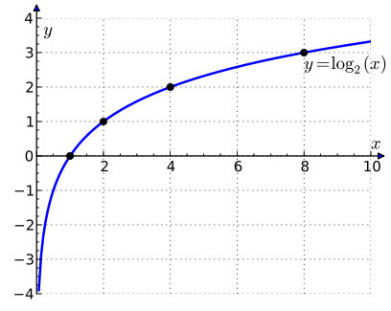
Linear Search Vs. Binary Search
t
t ~ n
O ( n )
t ~ log₂ (n)
O ( ln n )
n

