Slide 1
Fibonacci Heaps

Slide 2
Fibonacci Heaps

Slide 3
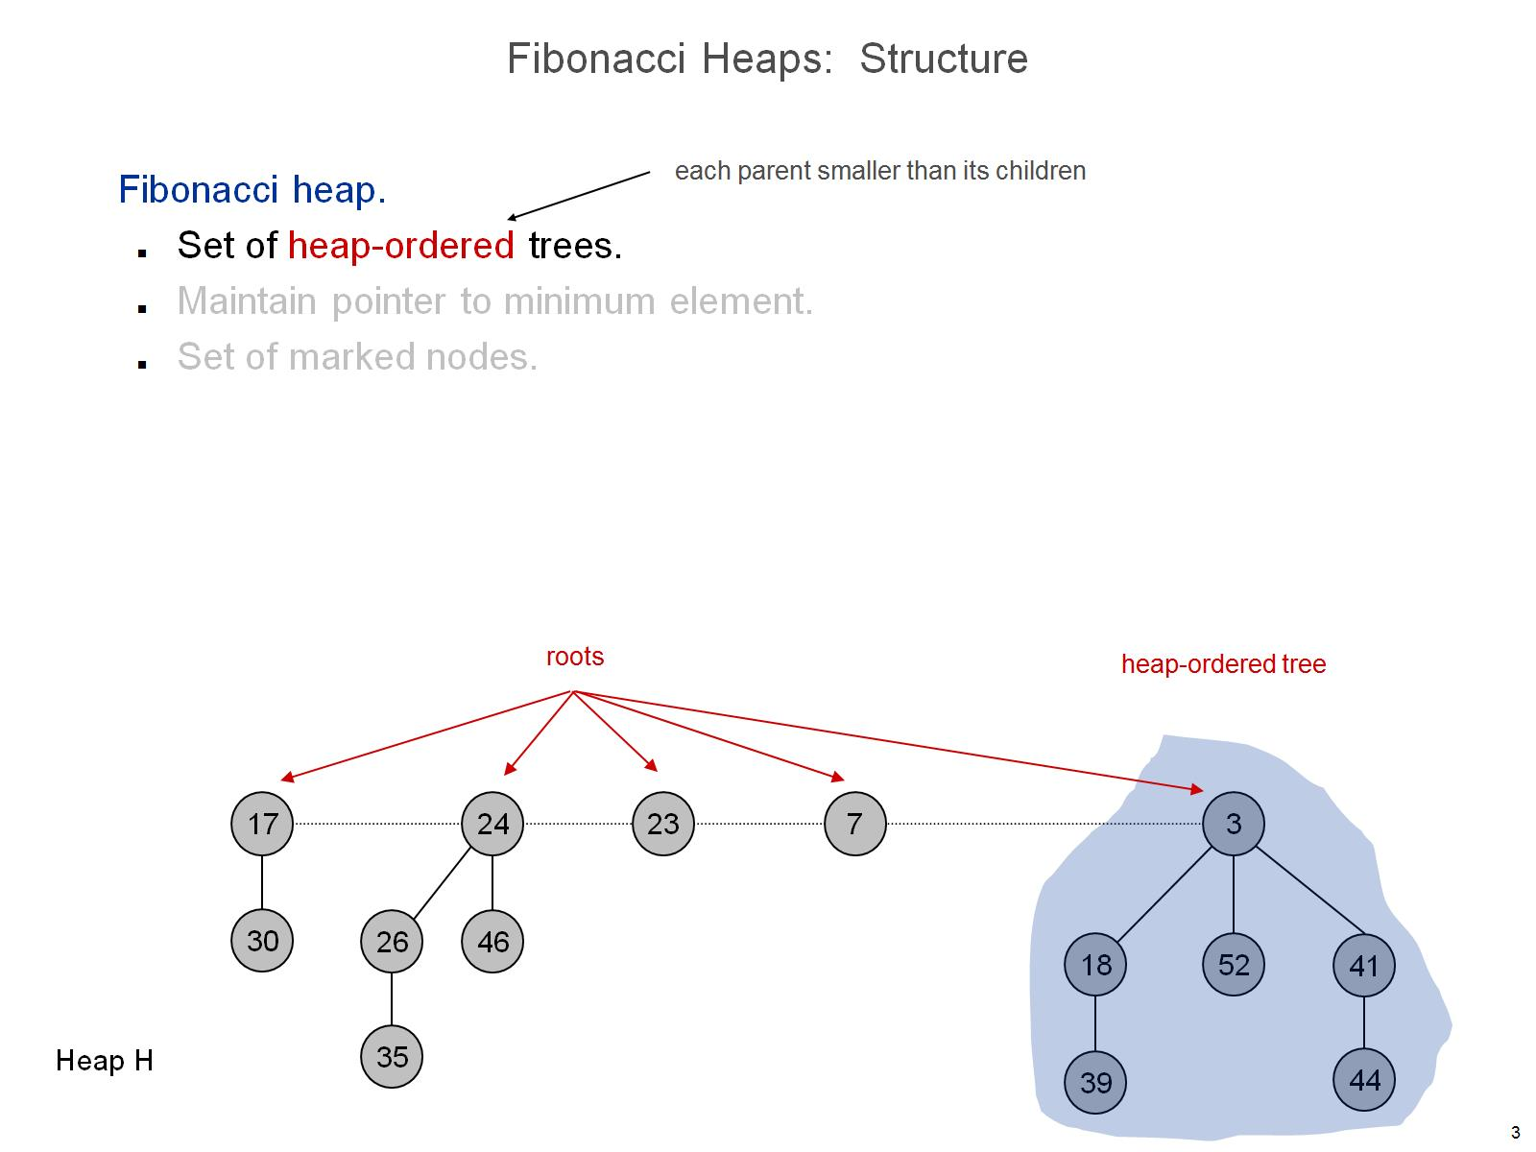
Fibonacci Heaps: Structure

Slide 4
Fibonacci Heaps: Structure

Slide 5
Fibonacci Heaps: Structure

Slide 6
Fibonacci Heaps: Notation

Slide 7
Fibonacci Heaps: Potential Function

Slide 9
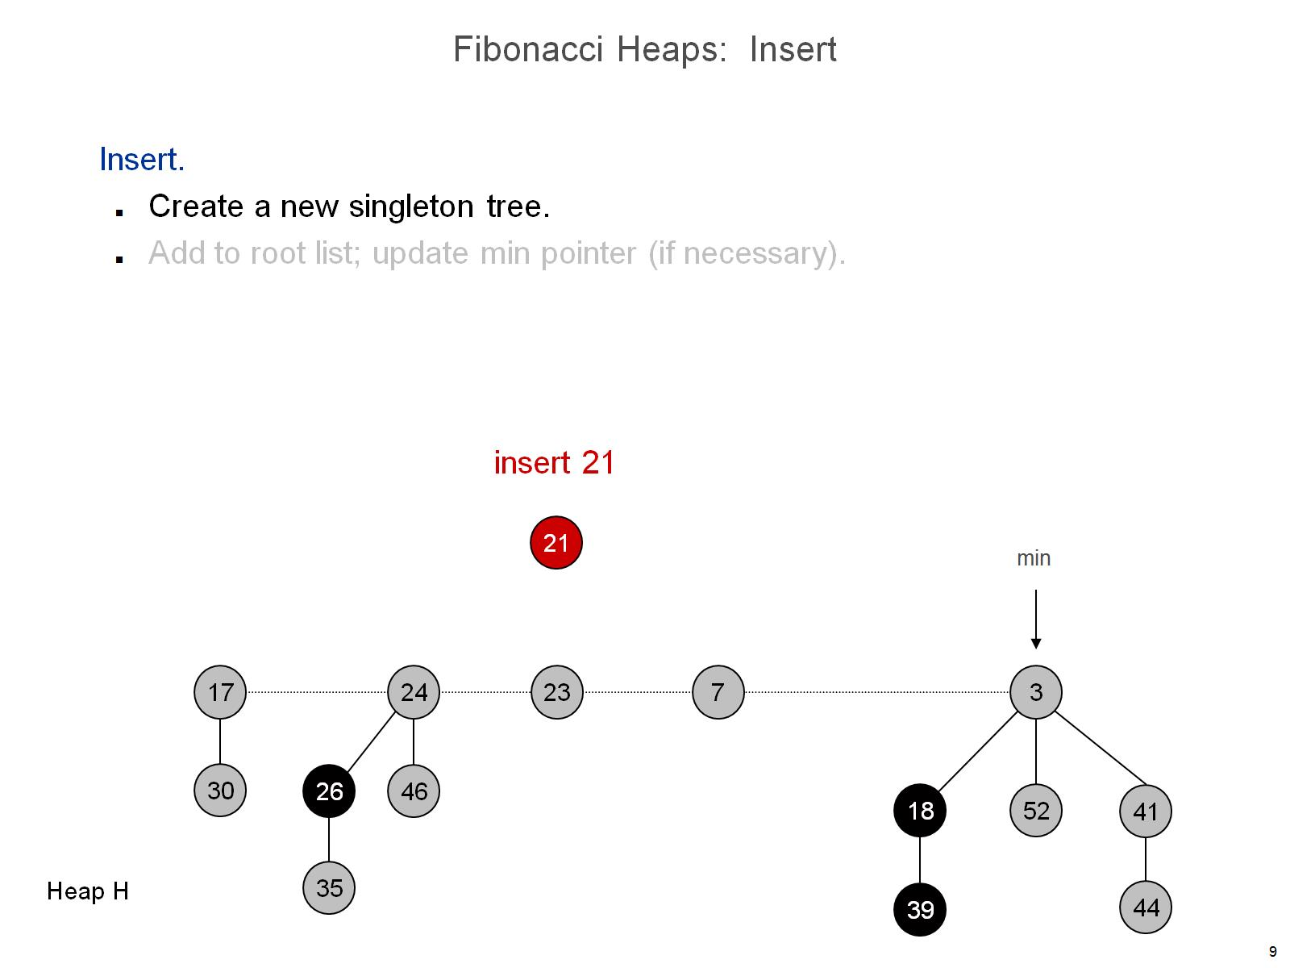
Fibonacci Heaps: Insert

Slide 10
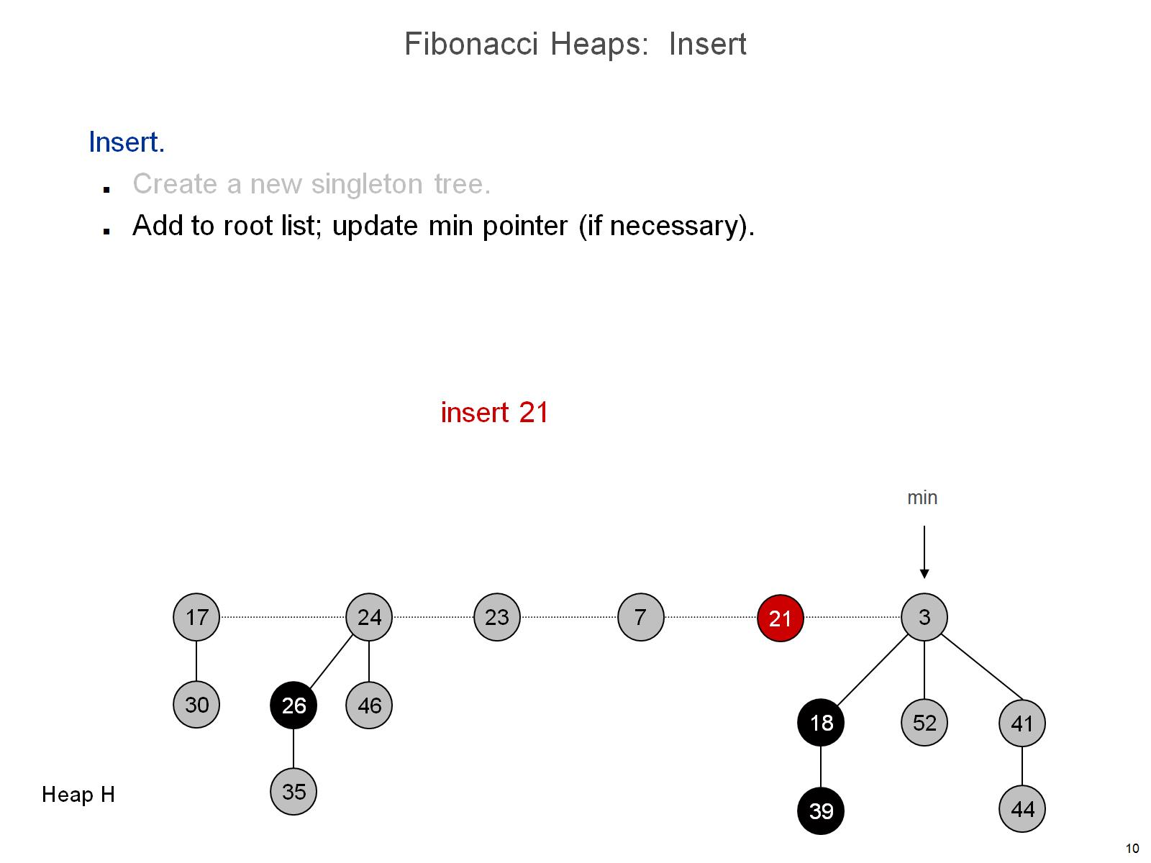
Fibonacci Heaps: Insert

Slide 11
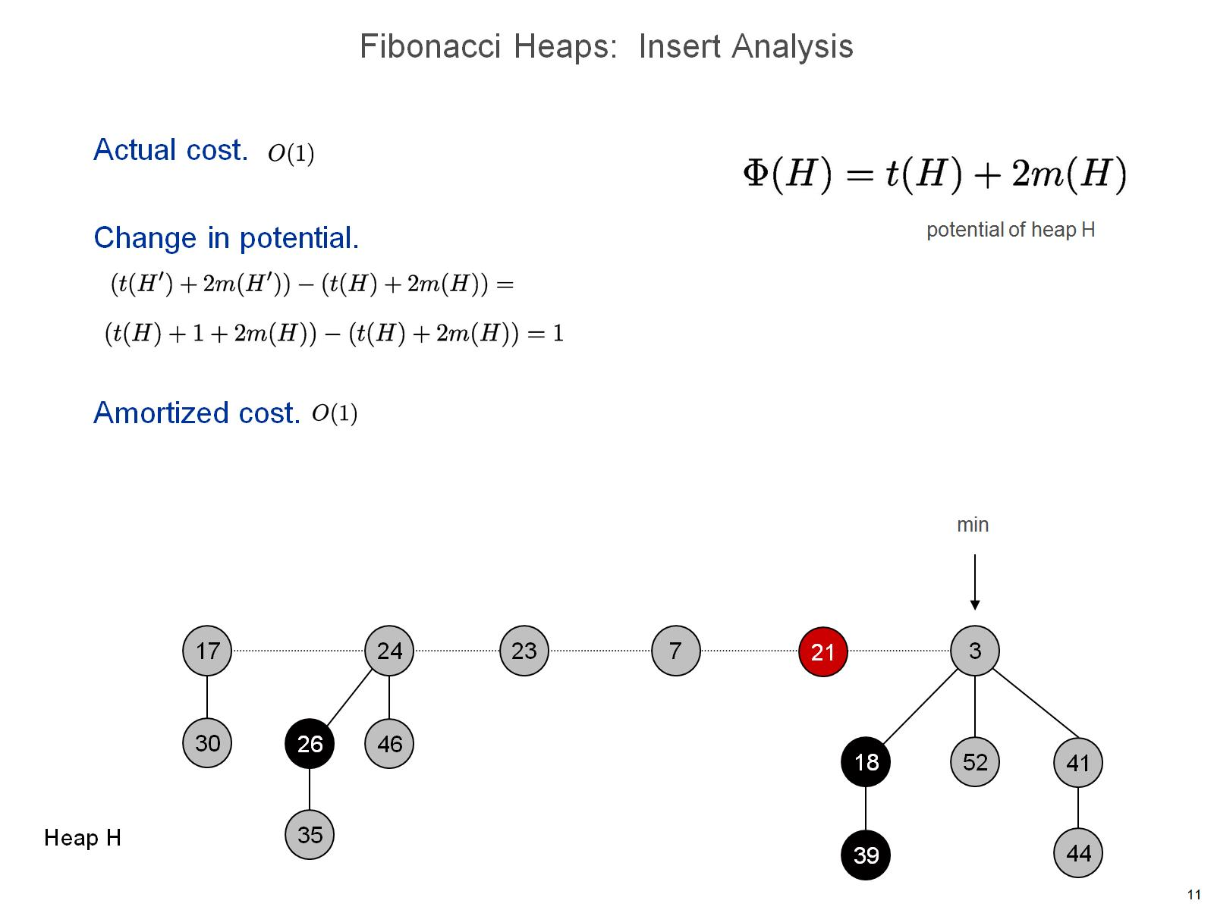
Fibonacci Heaps: Insert Analysis

Slide 13
Linking Operation

Slide 14
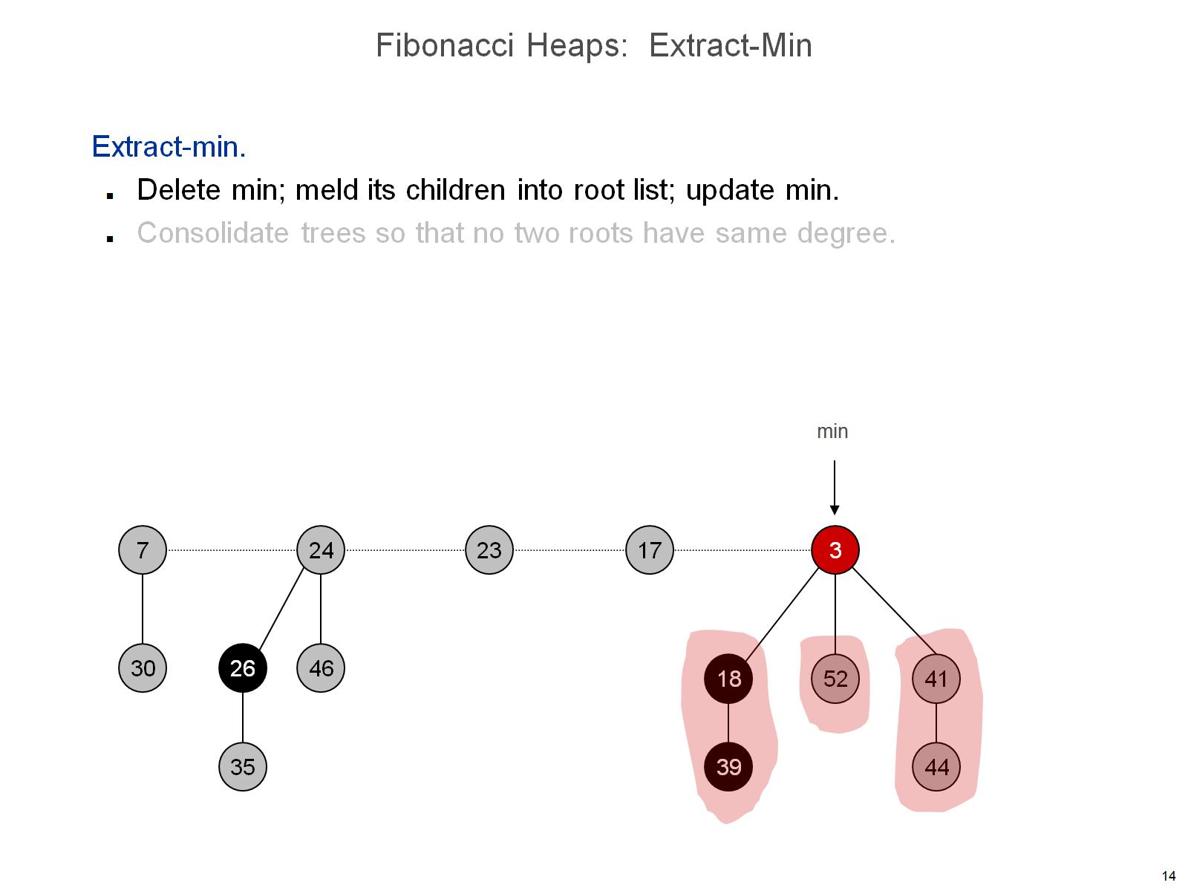
Fibonacci Heaps: Extract-Min

Slide 15
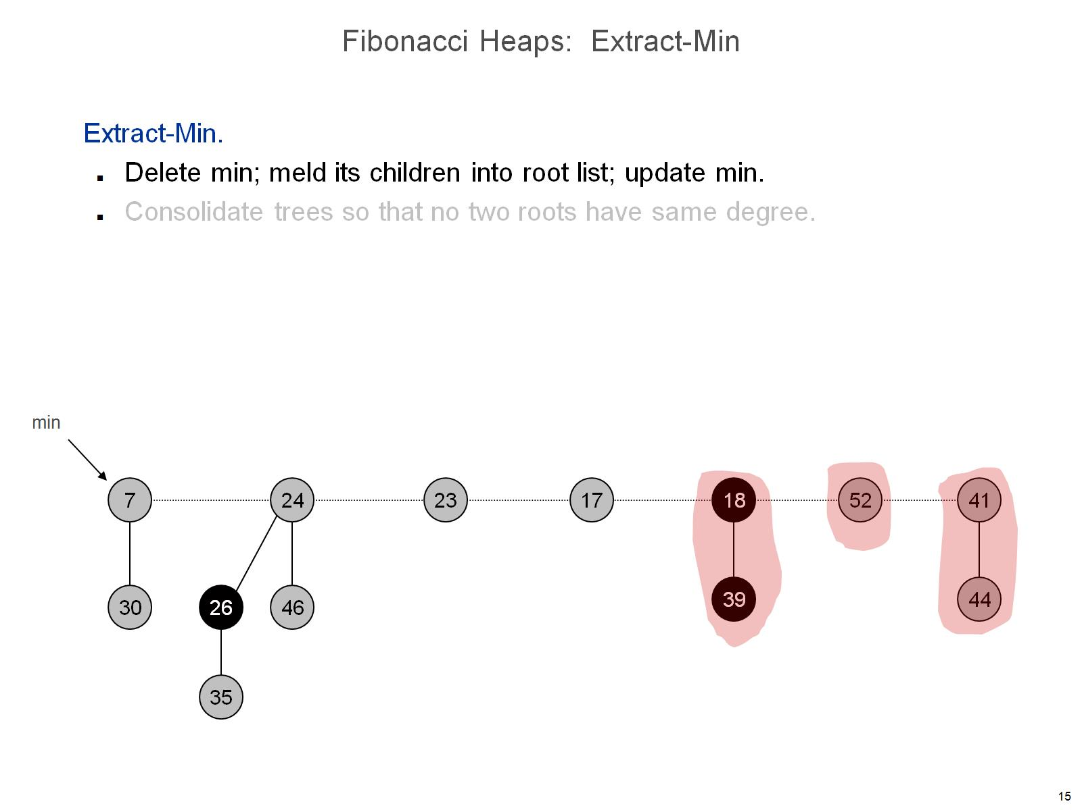
Fibonacci Heaps: Extract-Min

Slide 16
Fibonacci Heaps: Extract-Min

Slide 17
Fibonacci Heaps: Extract-Min

Slide 18
Fibonacci Heaps: Extract-Min

Slide 19
Fibonacci Heaps: Extract-Min

Slide 20
Fibonacci Heaps: Extract-Min

Slide 21
Fibonacci Heaps: Extract-Min

Slide 22
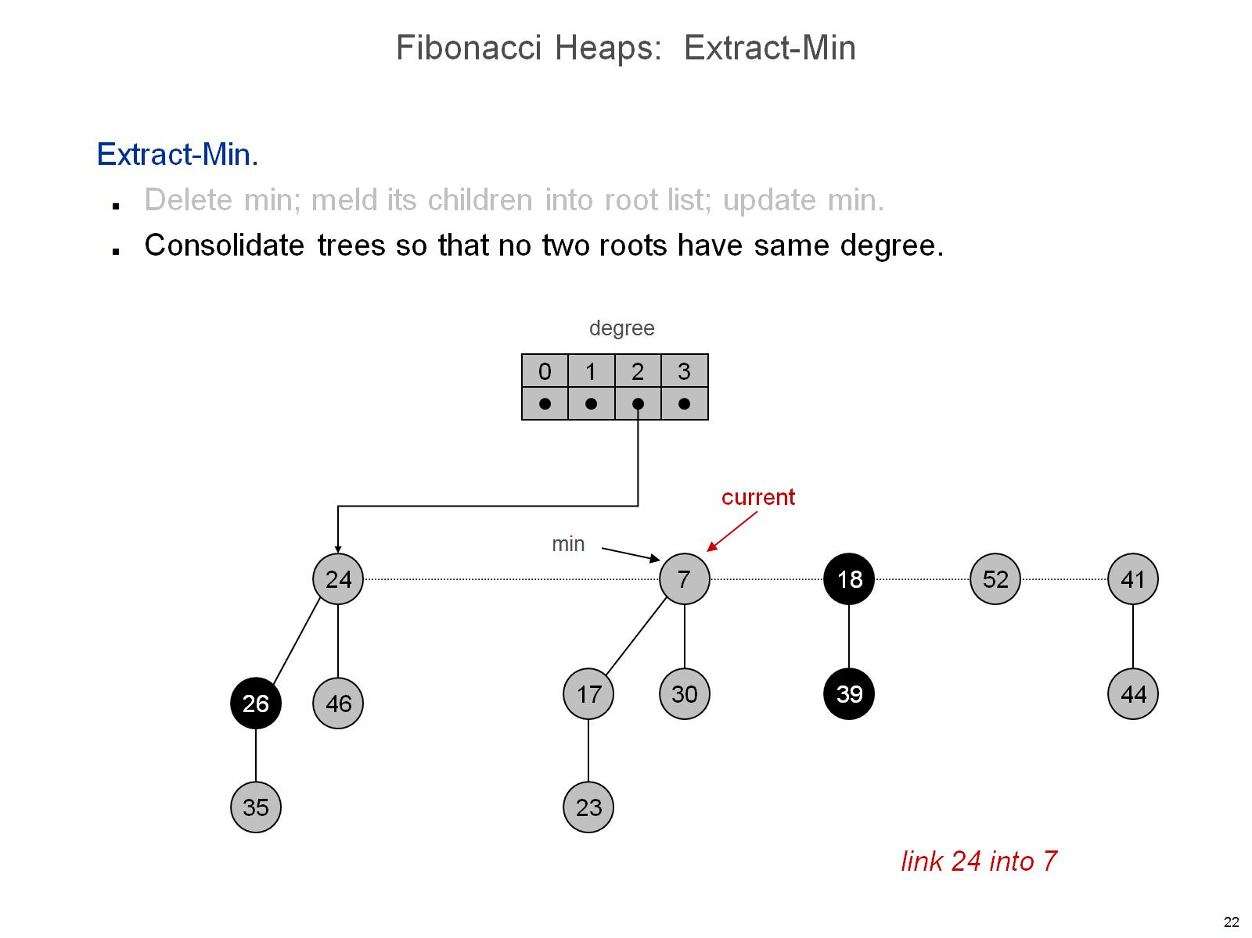
Fibonacci Heaps: Extract-Min

Slide 23
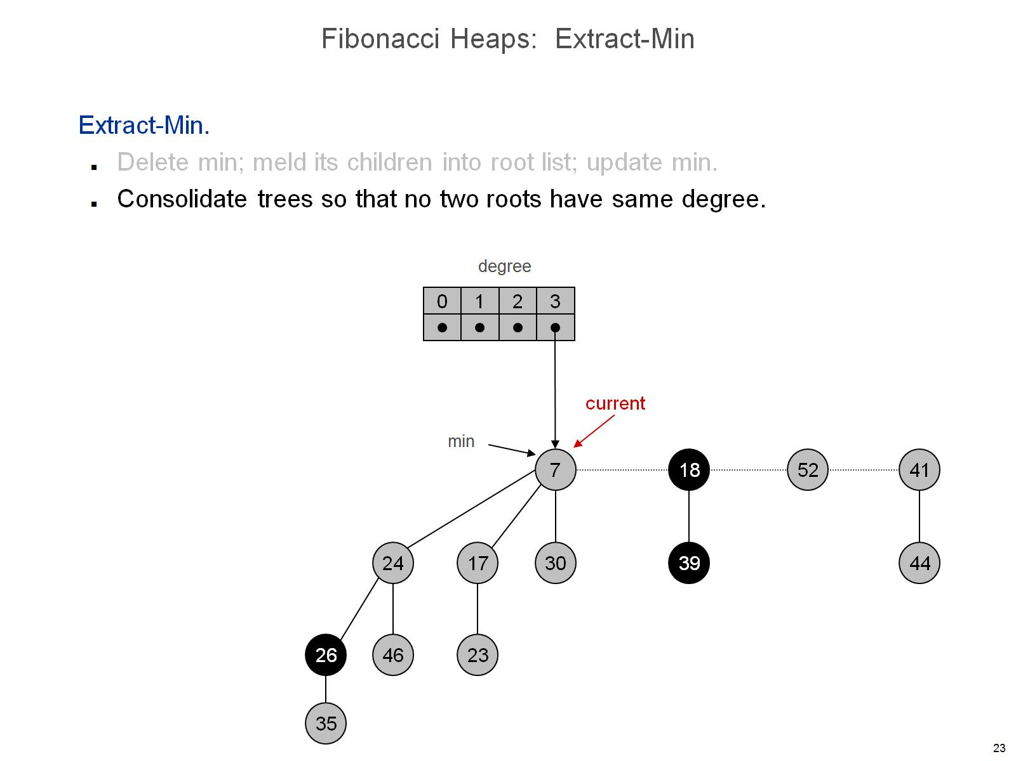
Fibonacci Heaps: Extract-Min

Slide 24
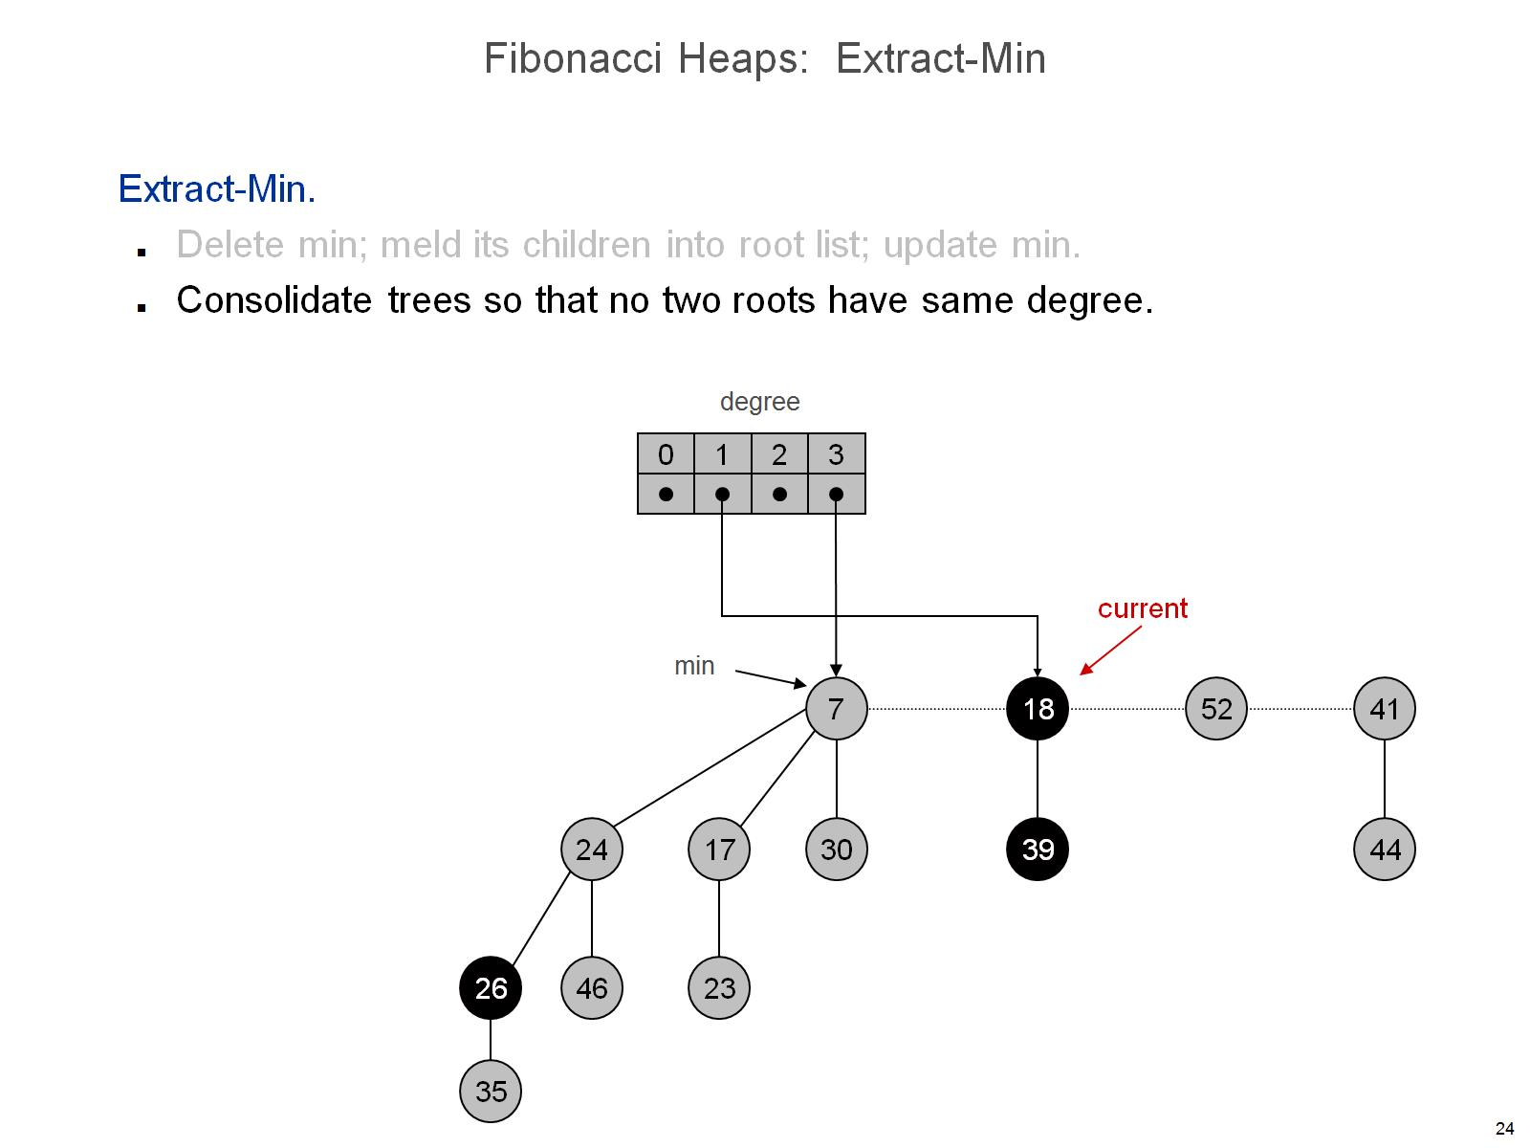
Fibonacci Heaps: Extract-Min

Slide 25
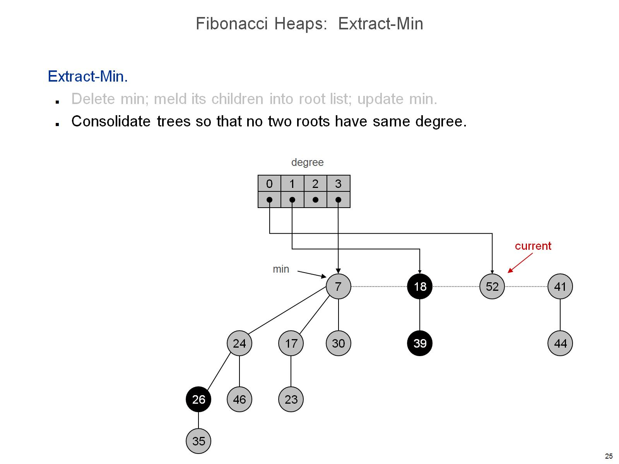
Fibonacci Heaps: Extract-Min

Slide 26
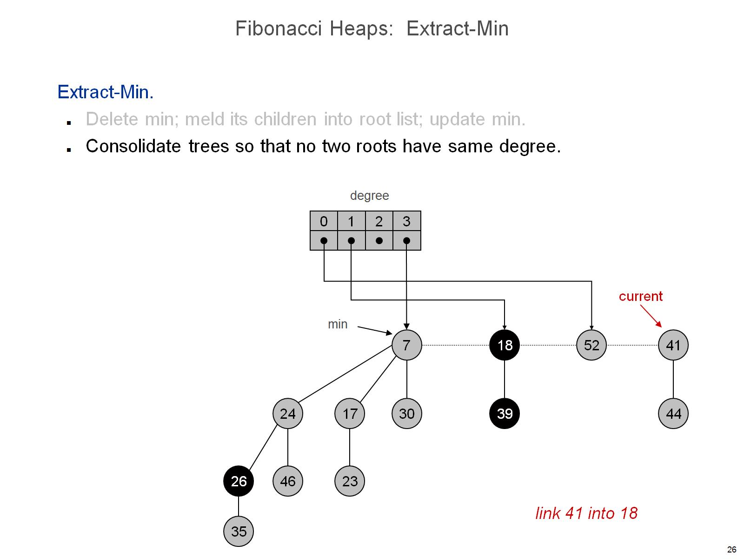
Fibonacci Heaps: Extract-Min

Slide 27
Fibonacci Heaps: Extract-Min

Slide 28
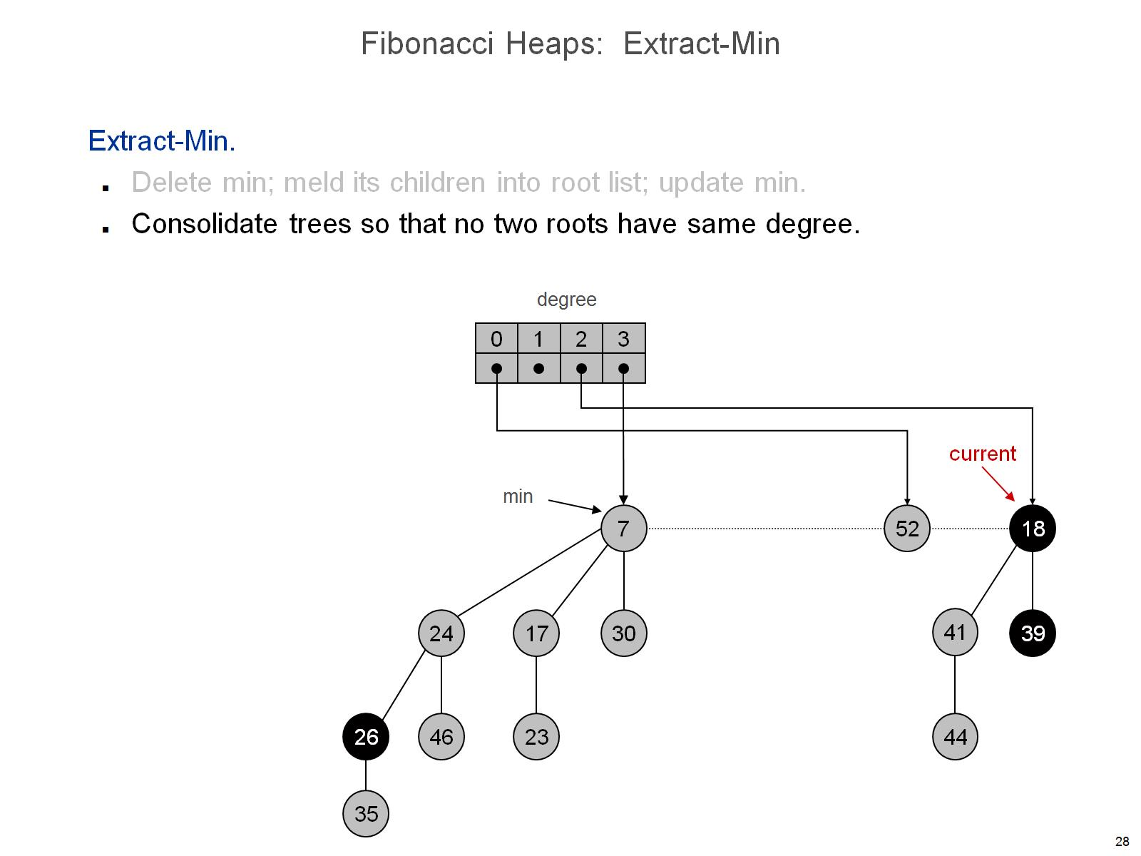
Fibonacci Heaps: Extract-Min

Slide 29
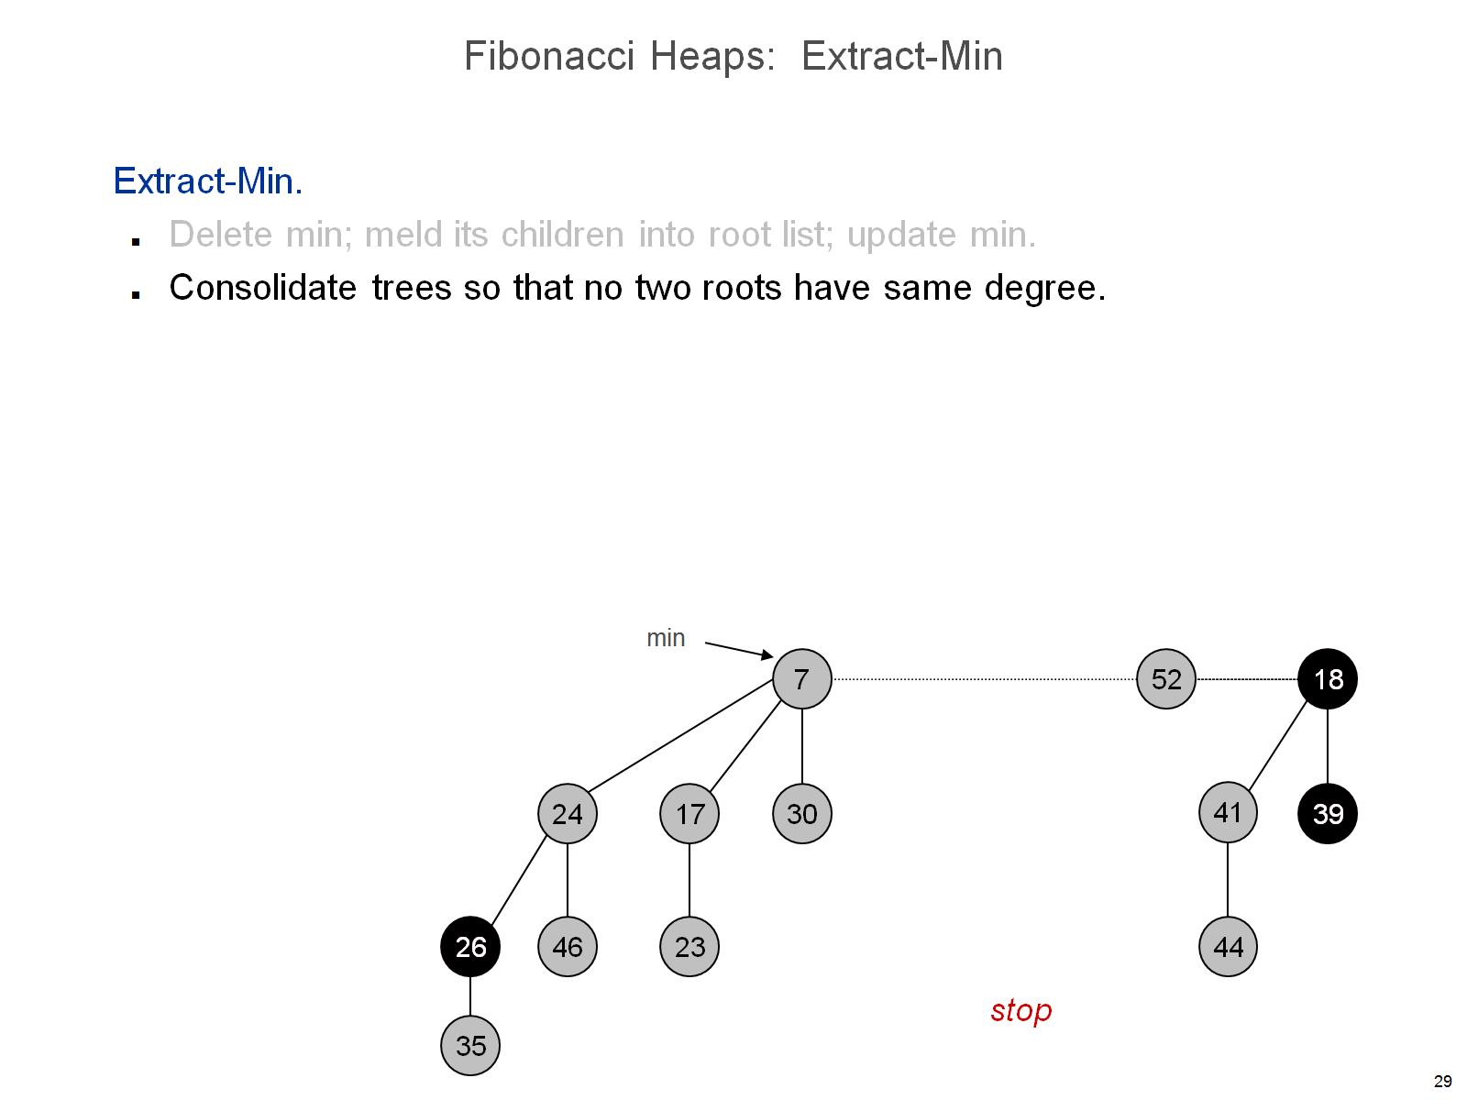
Fibonacci Heaps: Extract-Min

Slide 30
Fibonacci Heaps: Extract-Min Analysis

Slide 32
Fibonacci Heaps: Decrease Key

Slide 33
Fibonacci Heaps: Decrease Key

Slide 34
Fibonacci Heaps: Decrease Key

Slide 35
Fibonacci Heaps: Decrease Key

Slide 36
Fibonacci Heaps: Decrease Key

Slide 37
Fibonacci Heaps: Decrease Key

Slide 38
Fibonacci Heaps: Decrease Key

Slide 39
Fibonacci Heaps: Decrease Key

Slide 40
Fibonacci Heaps: Decrease Key

Slide 41
Fibonacci Heaps: Decrease Key

Slide 42
Fibonacci Heaps: Decrease Key

Slide 43
Fibonacci Heaps: Decrease Key

Slide 44
Fibonacci Heaps: Decrease Key

Slide 45
Fibonacci Heaps: Decrease Key

Slide 46
Fibonacci Heaps: Decrease Key Analysis

Slide 47
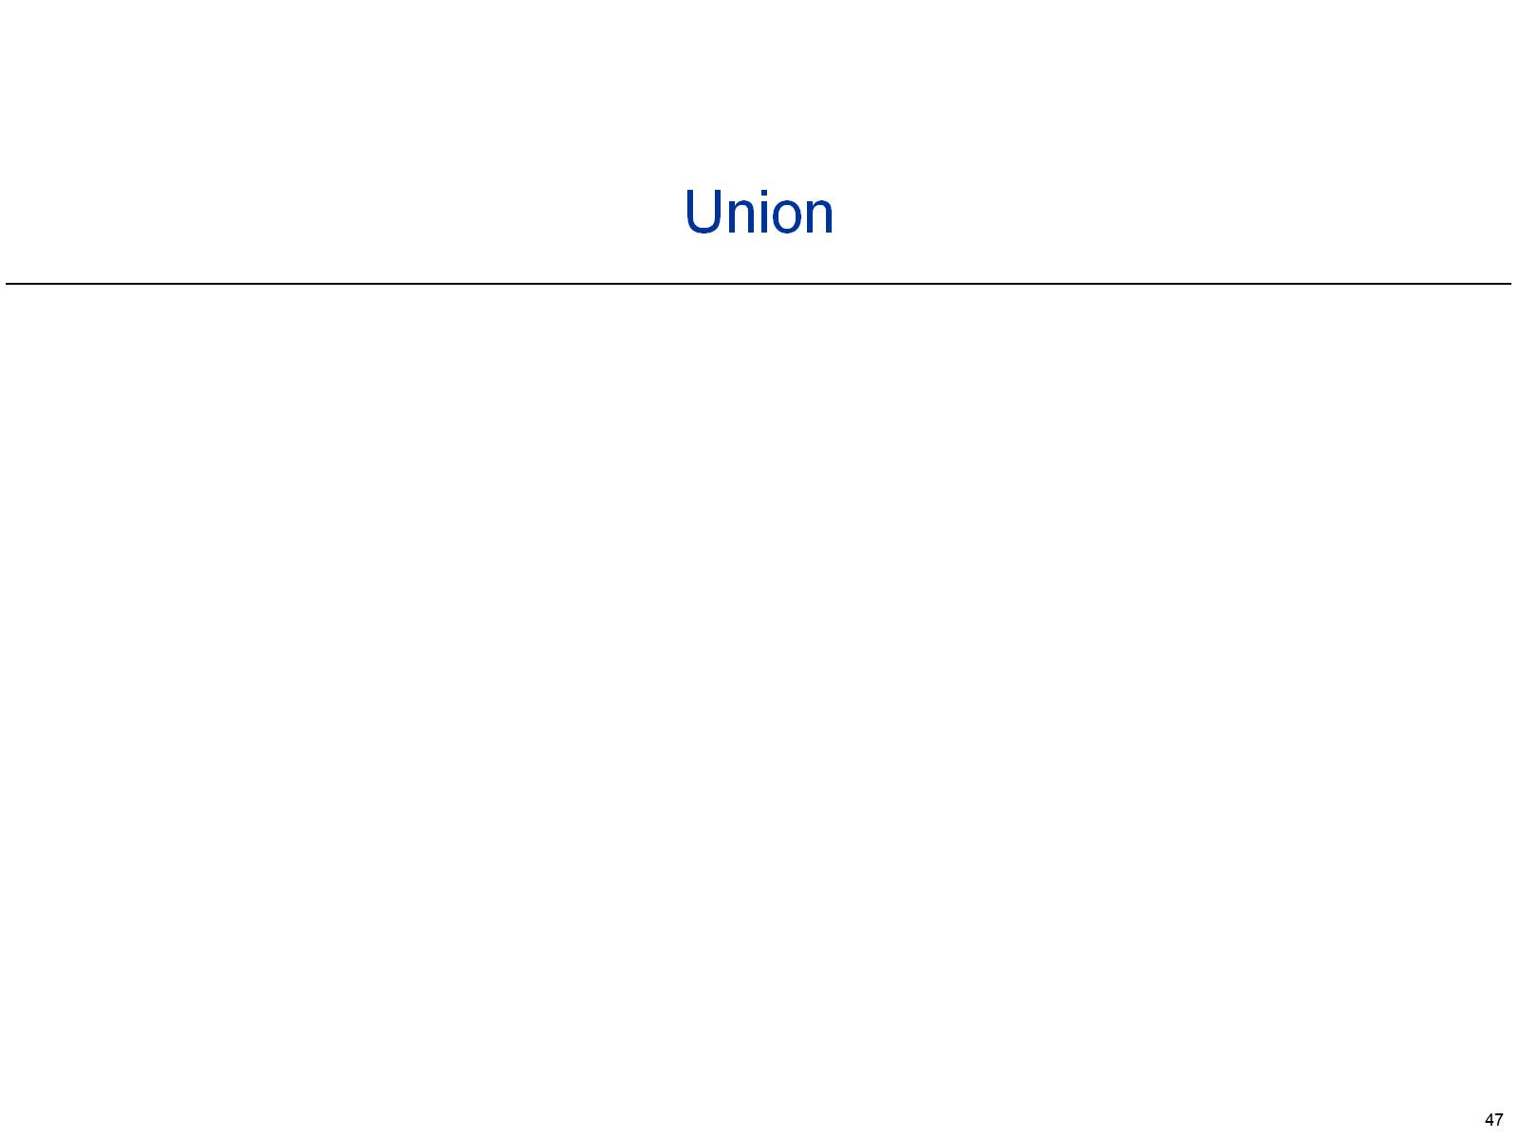

Slide 48
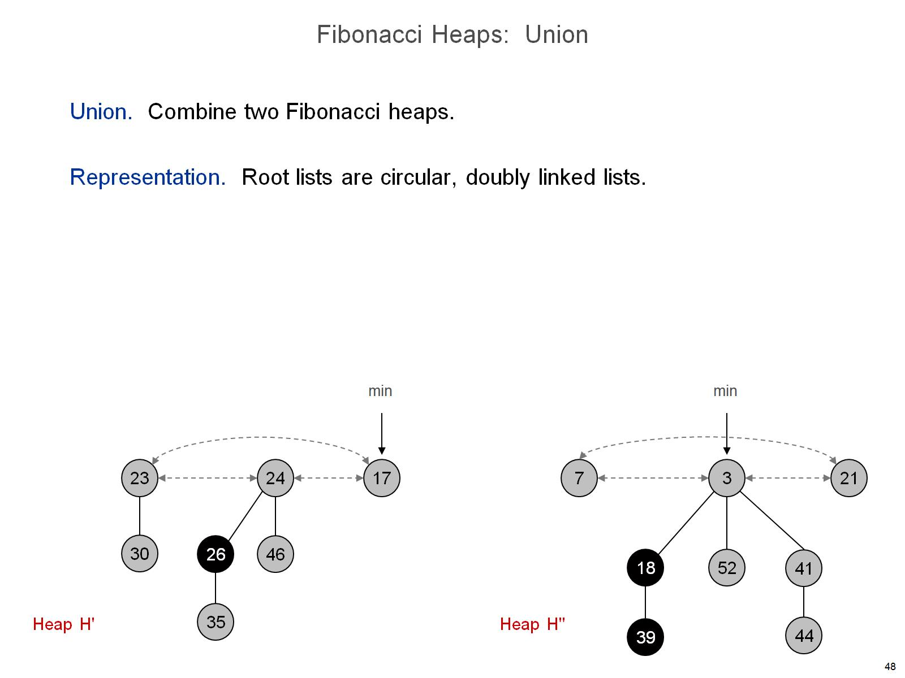
Fibonacci Heaps: Union

Slide 49
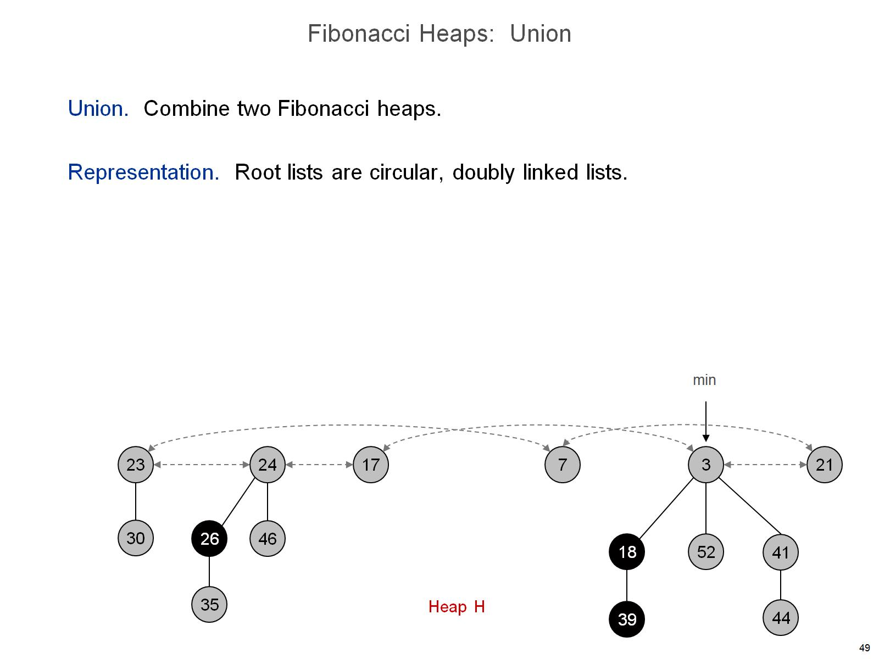
Fibonacci Heaps: Union

Slide 50
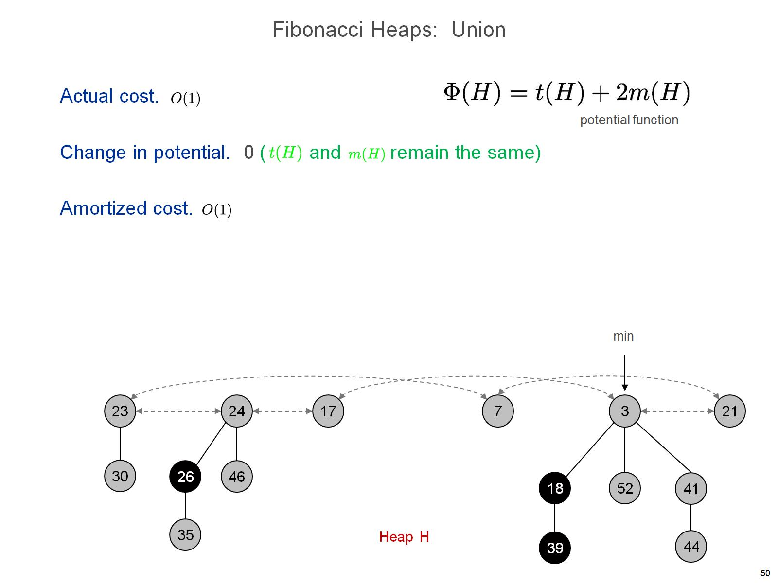
Fibonacci Heaps: Union

Slide 52
Fibonacci Heaps: Delete

Slide 53
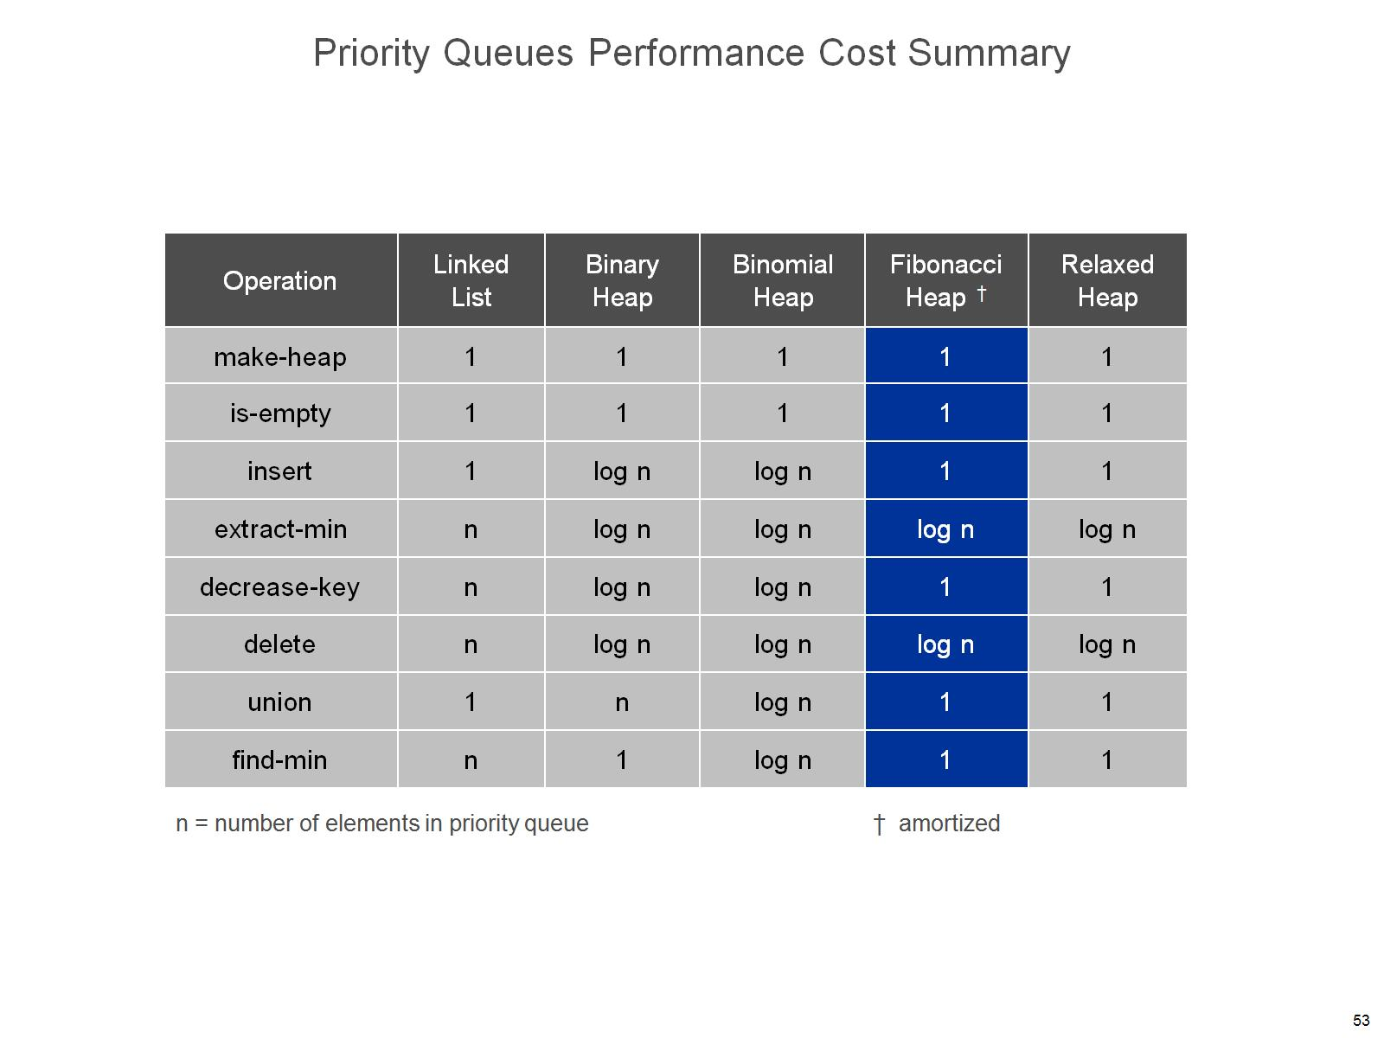
Priority Queues Performance Cost Summary

