Slide 1
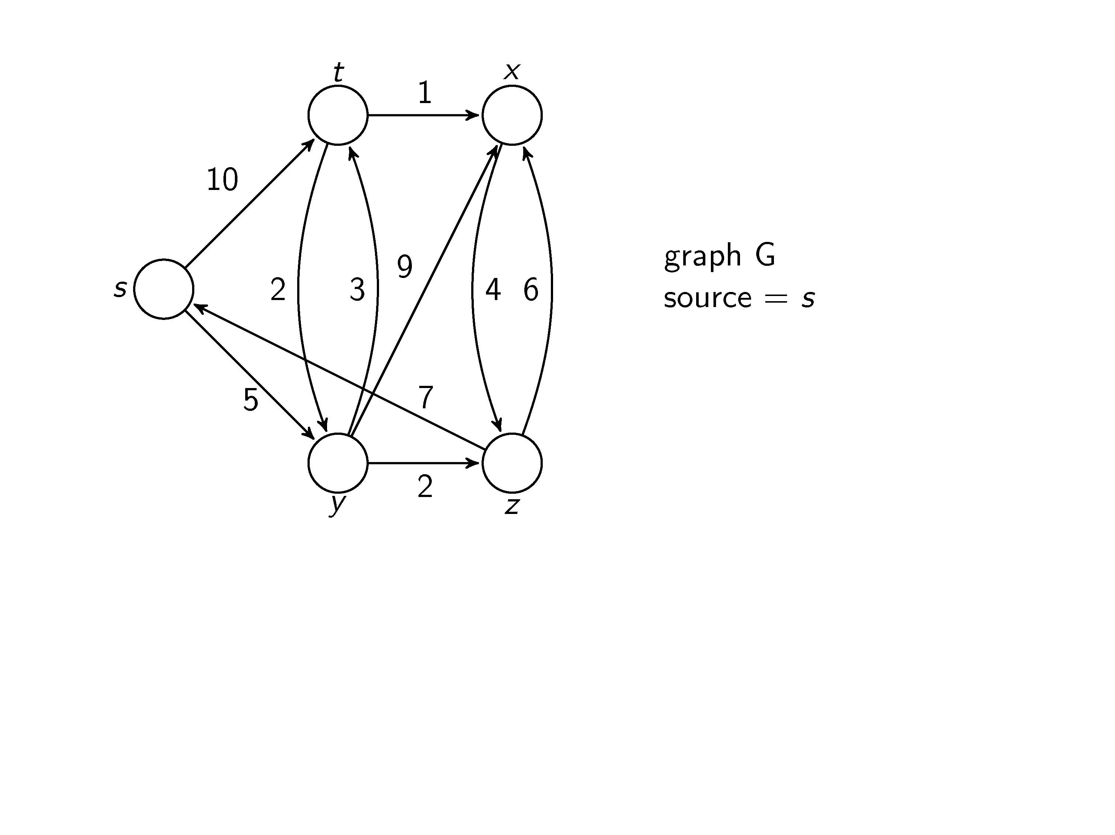
We want to find the shortest path from s to every node

Slide 2
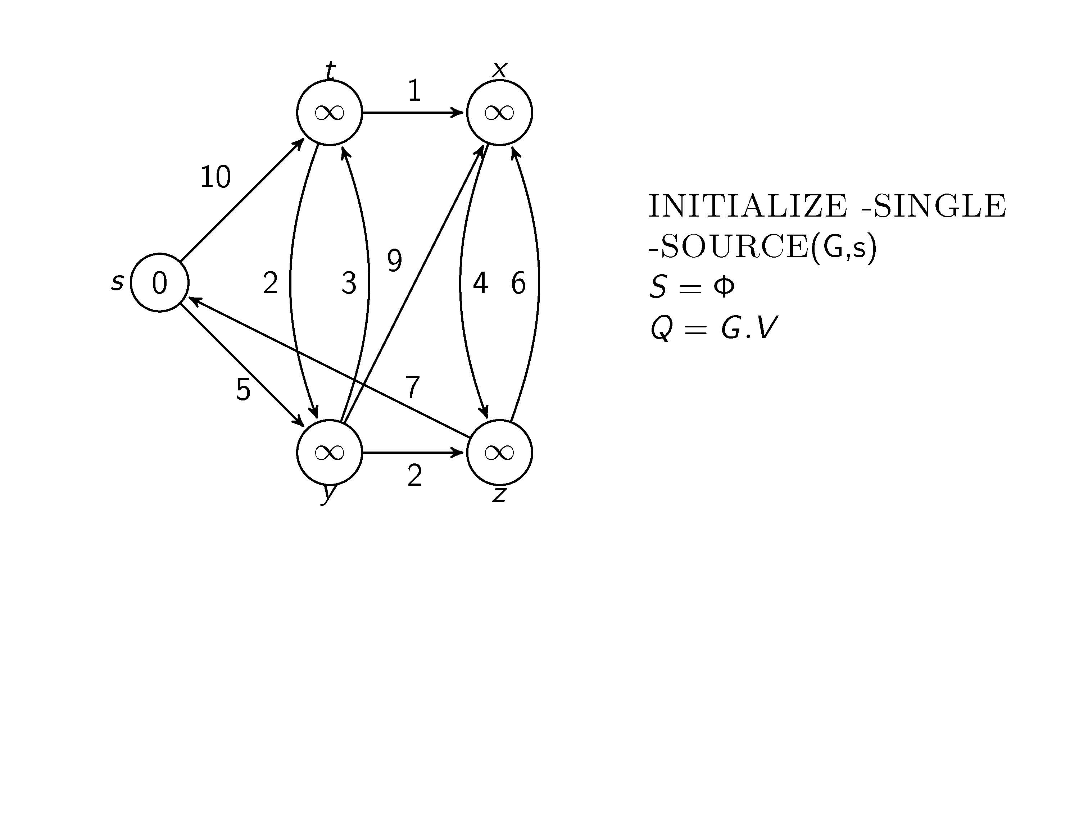
After initialization, we have for all , , and for

Slide 3
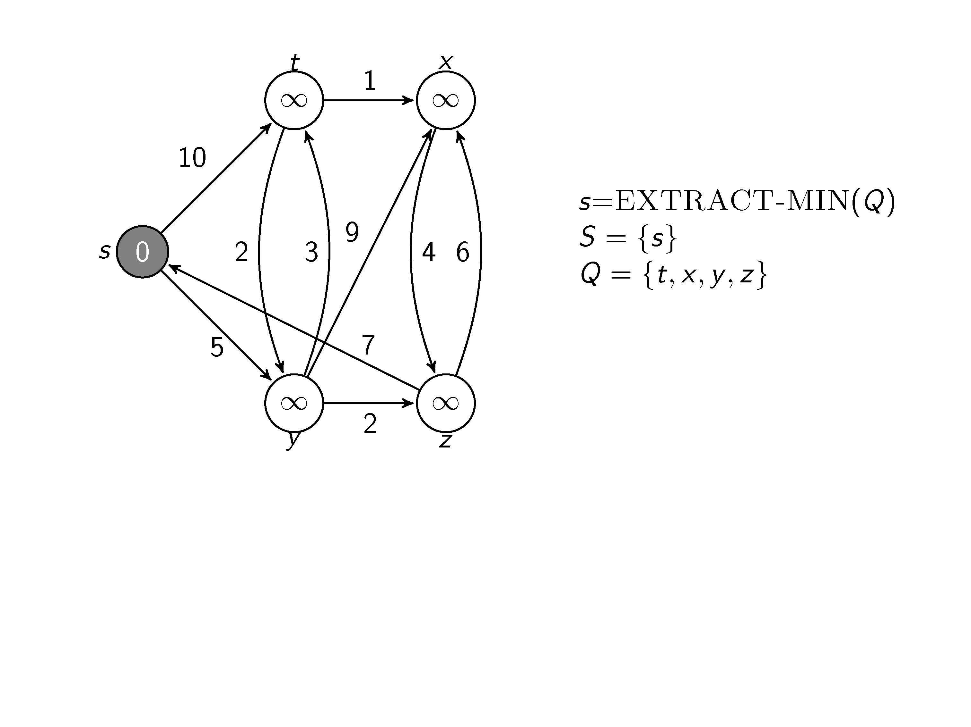
We are at node s

Slide 4
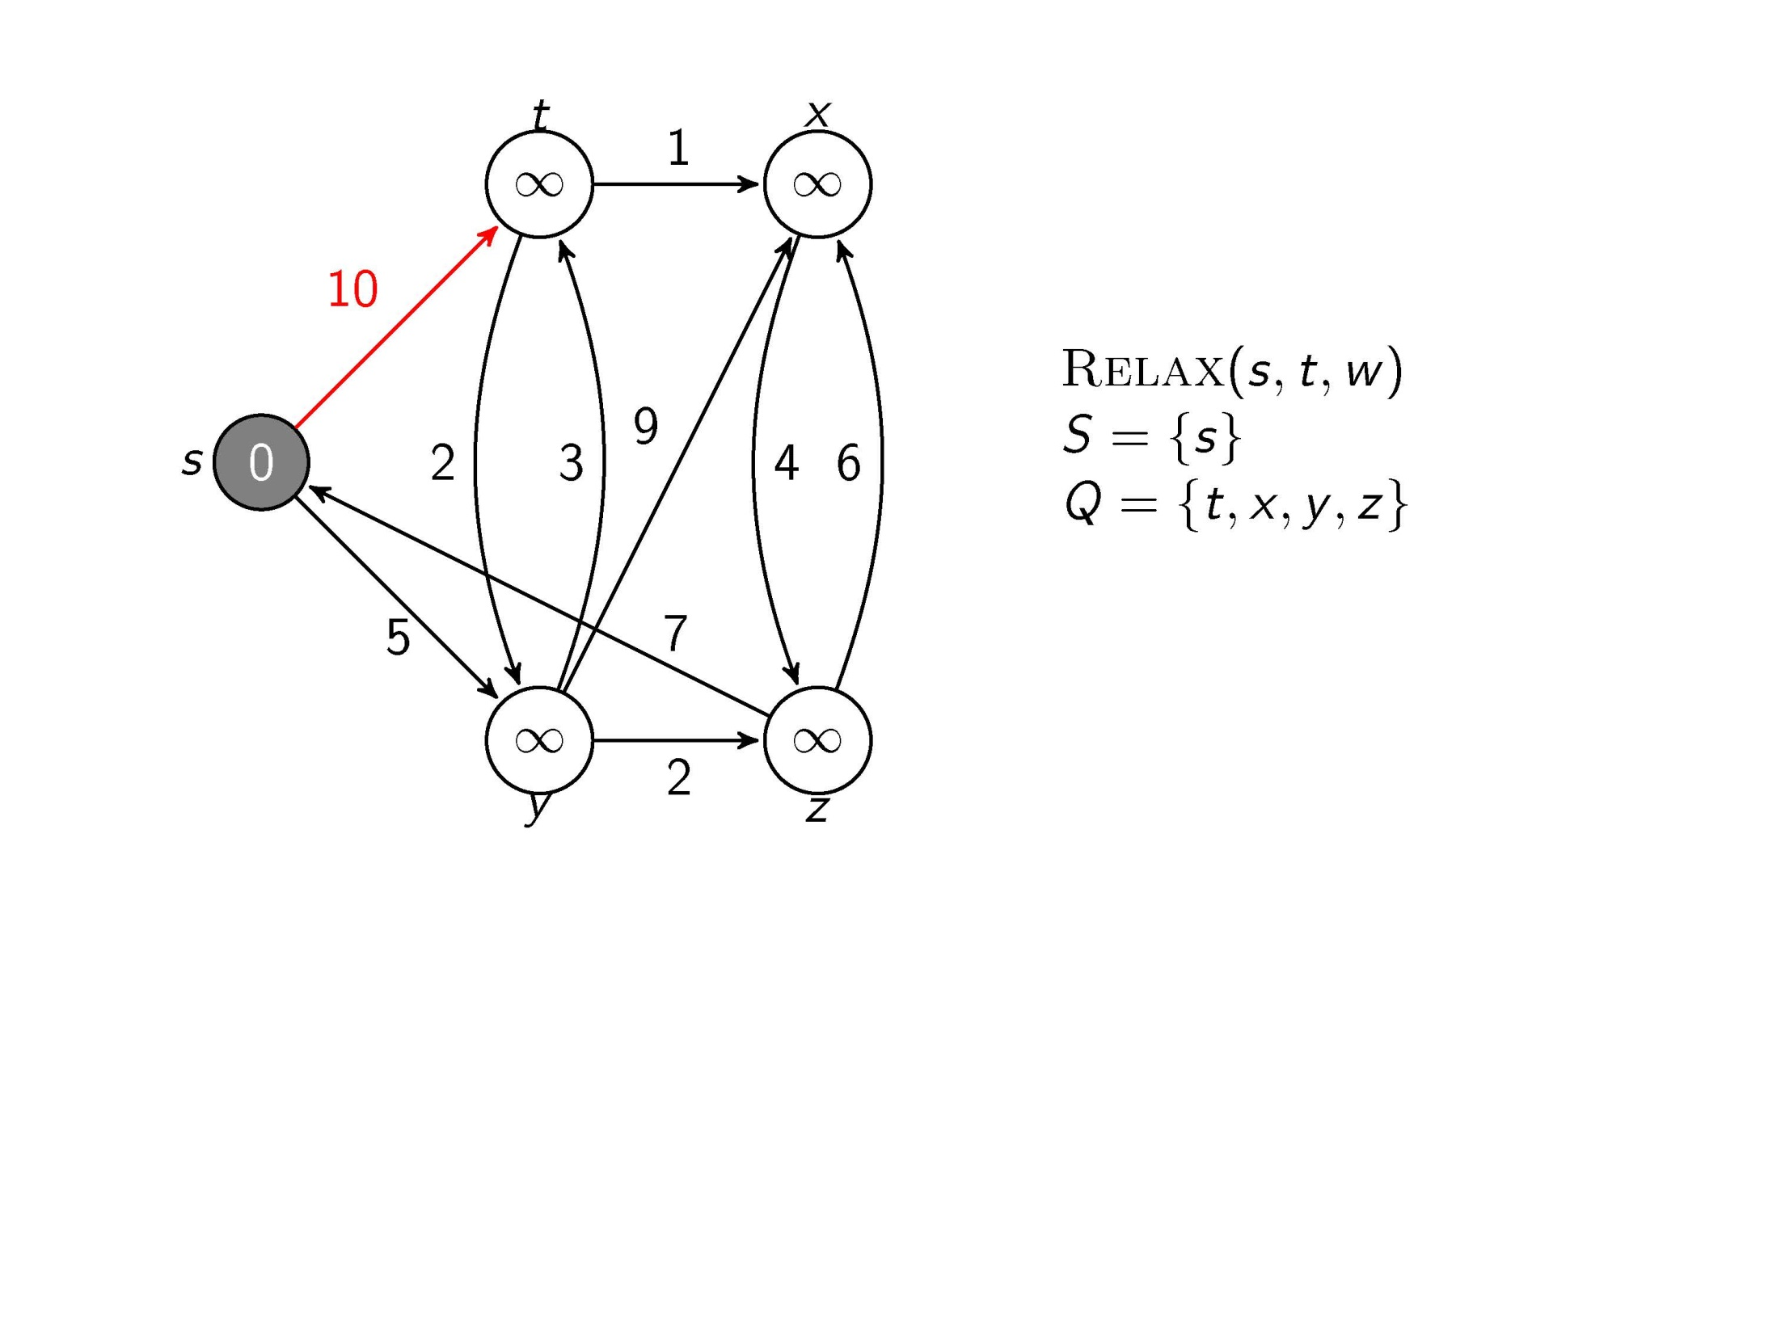
Test whether we can improve the shortest path to t found so far by going through s

Slide 5
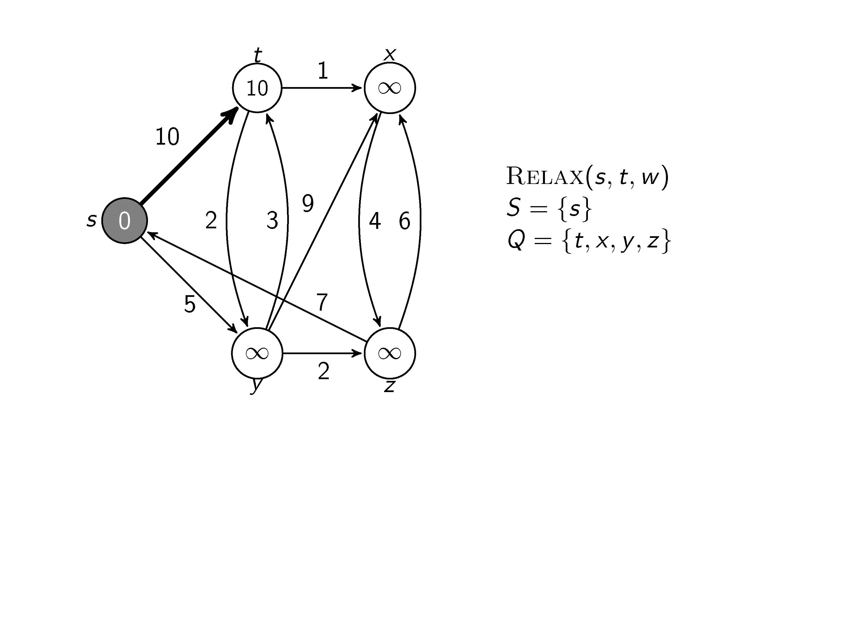
Update and

Slide 6
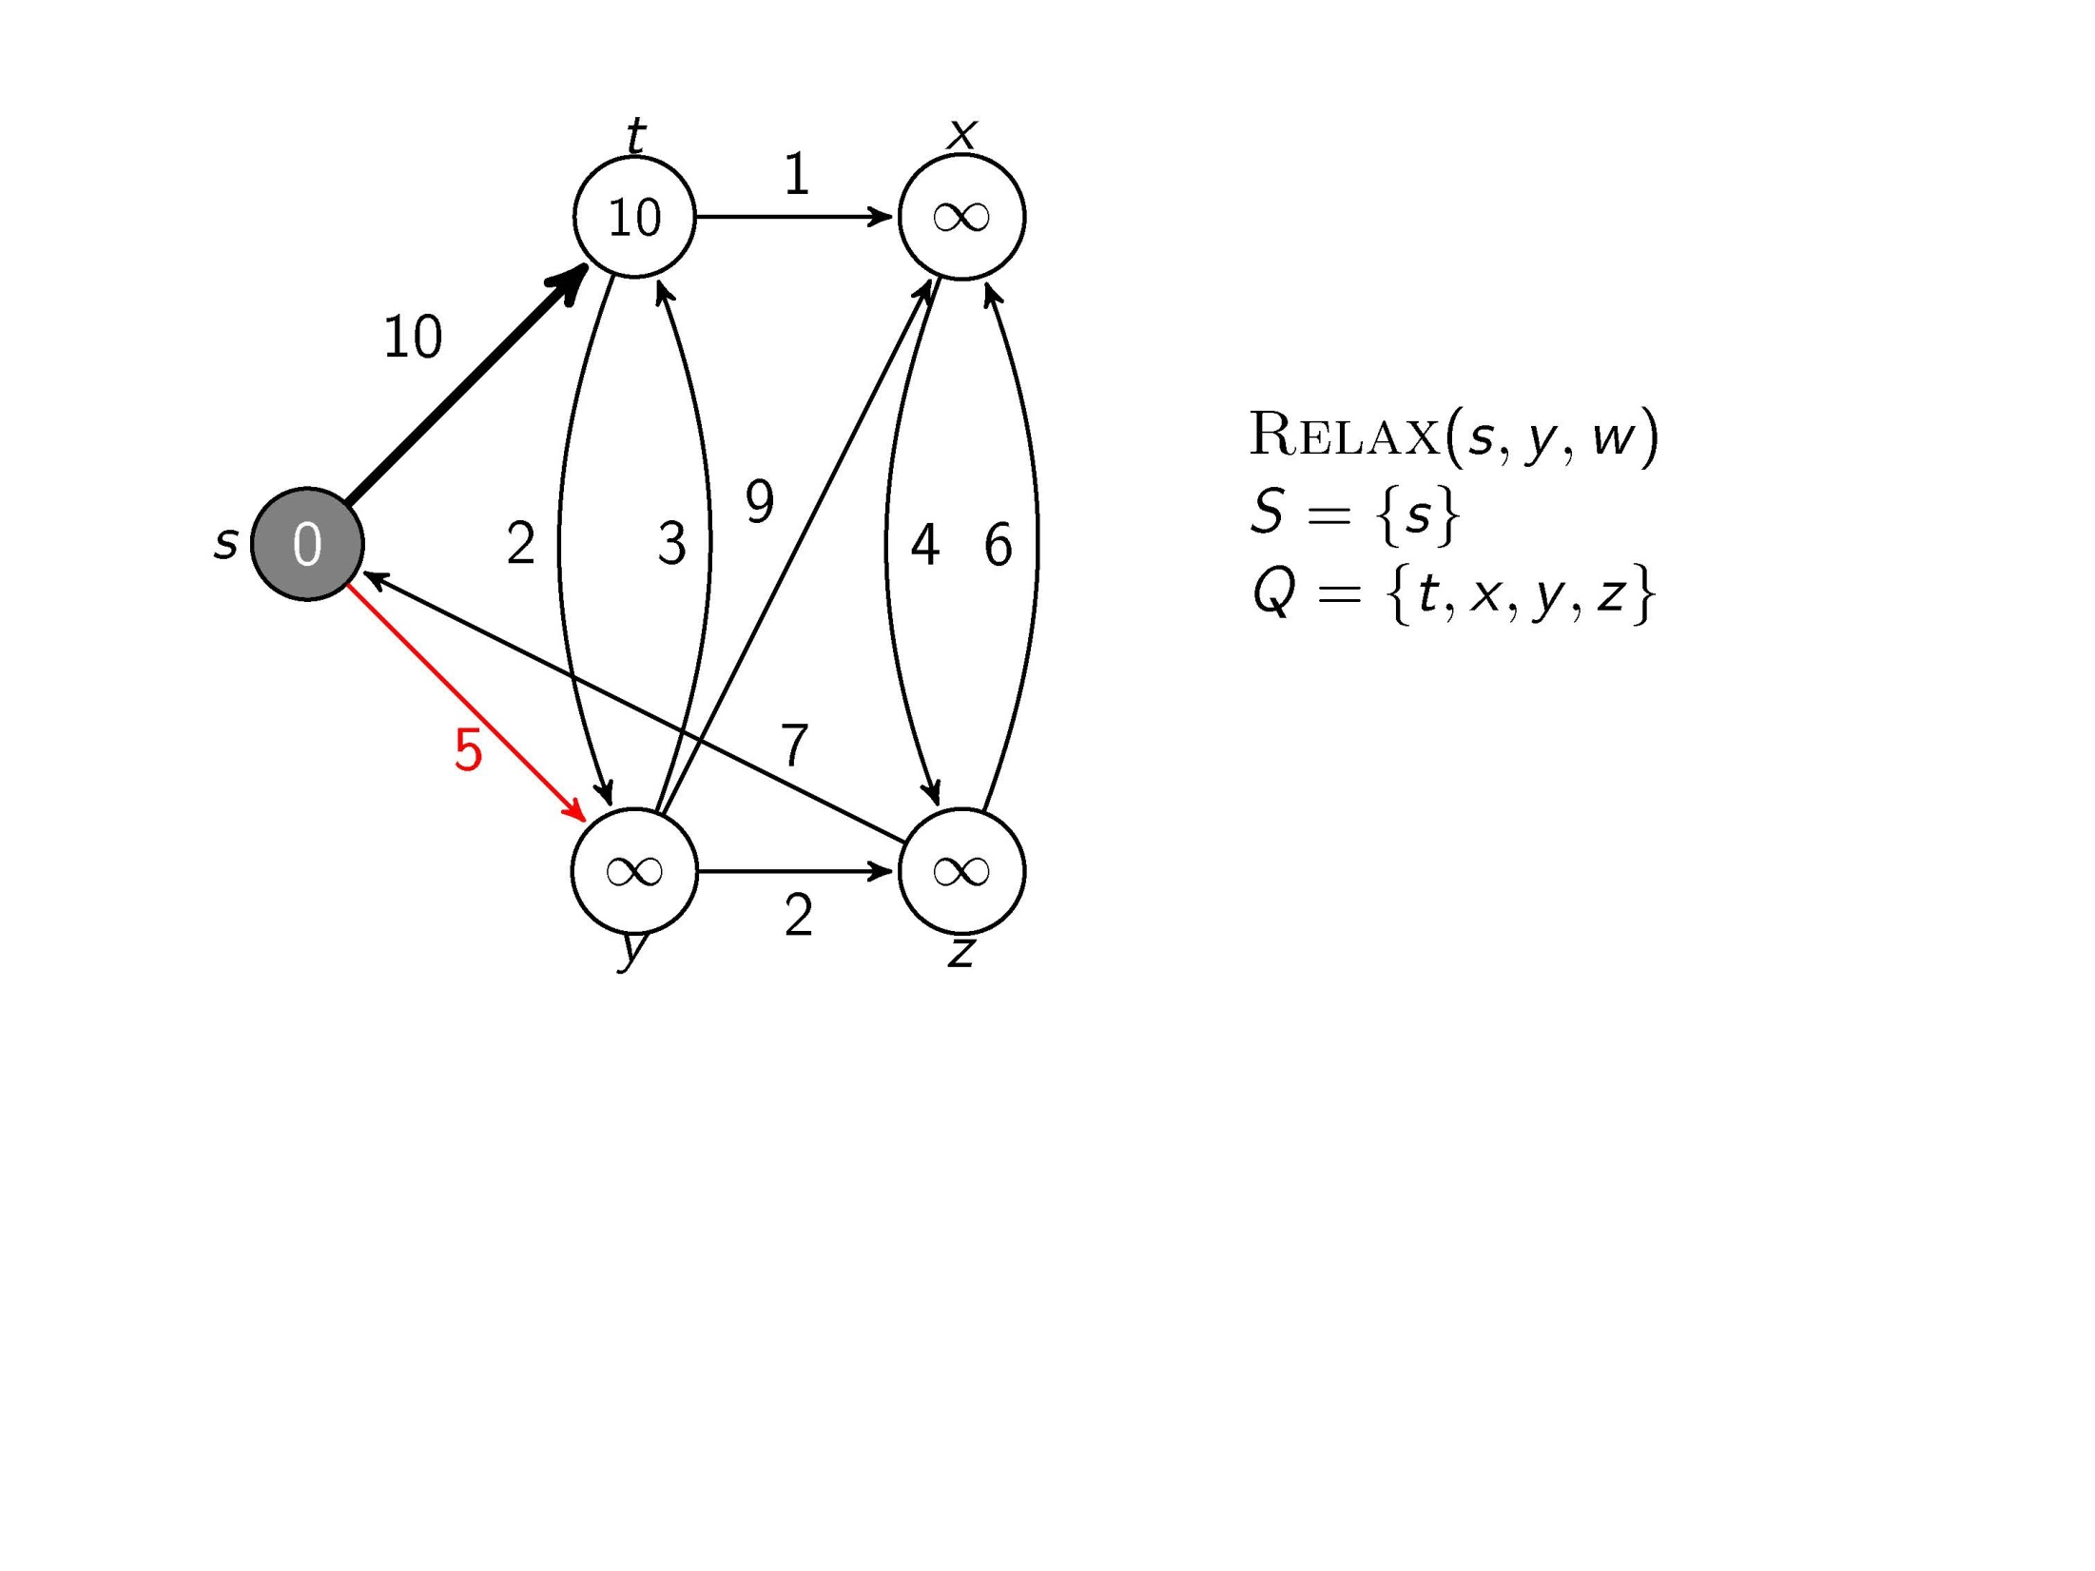
Test whether we can improve the shortest path to y found so far by going through s

Slide 7
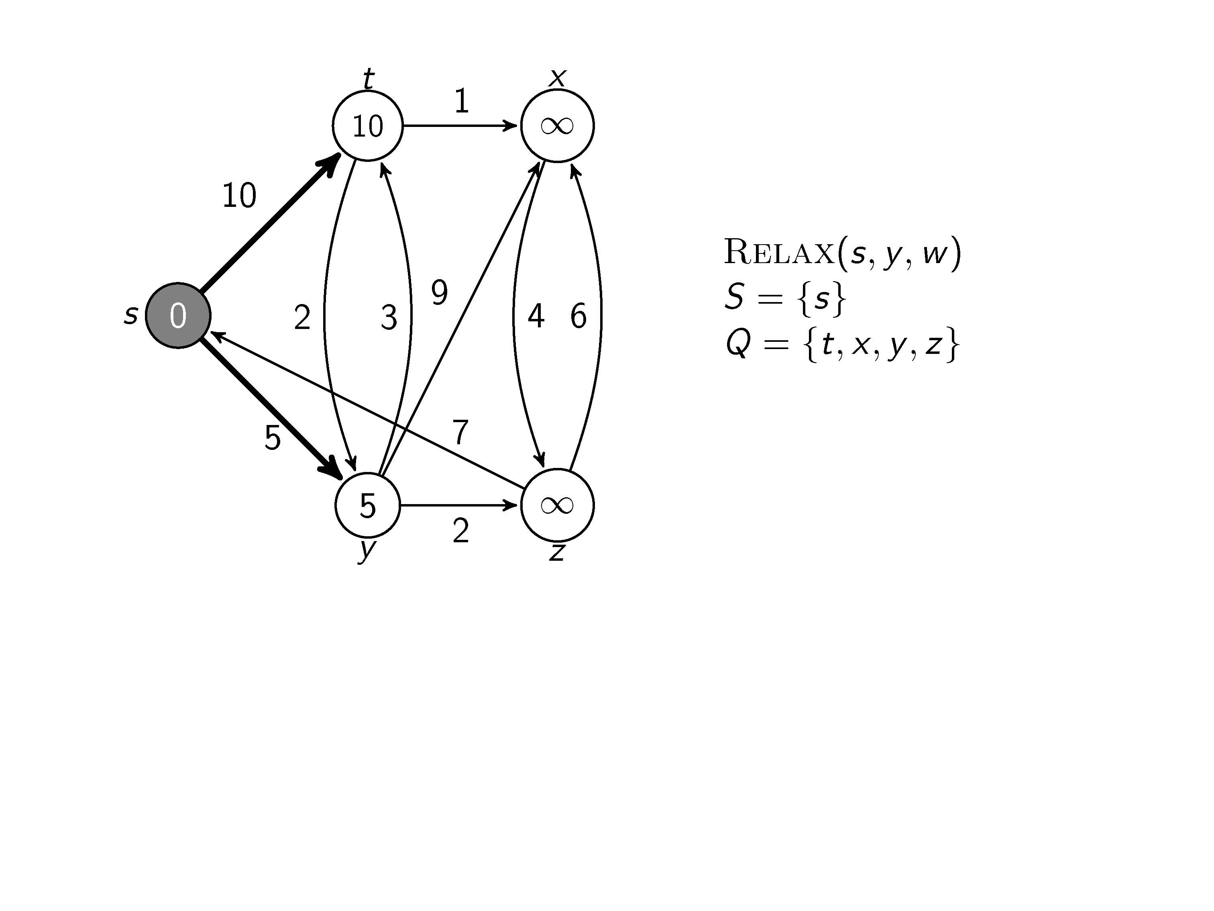
Update and

Slide 8
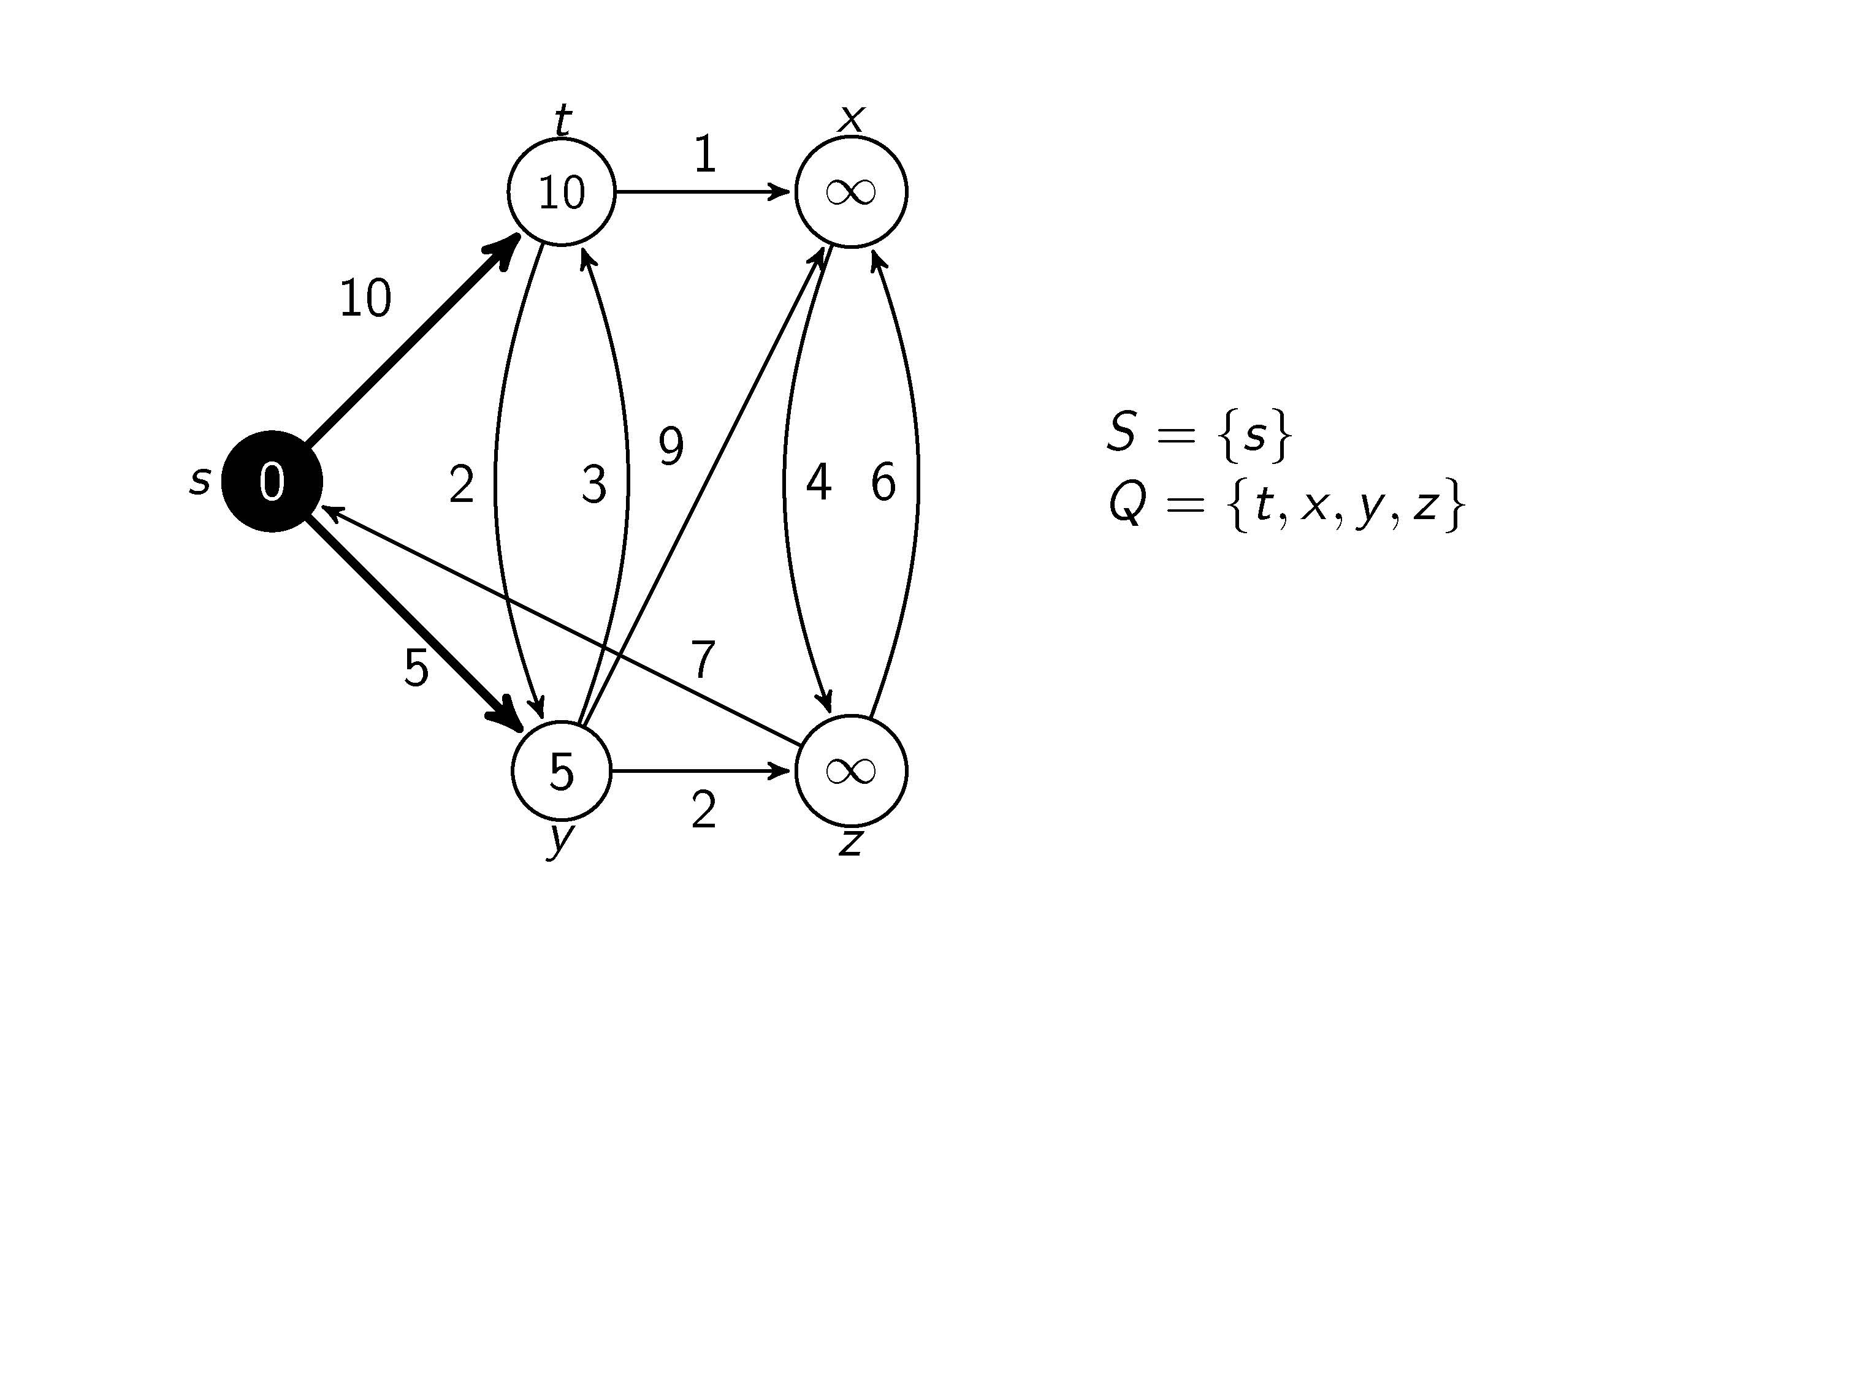
All edges leaving s have been tested

Slide 9
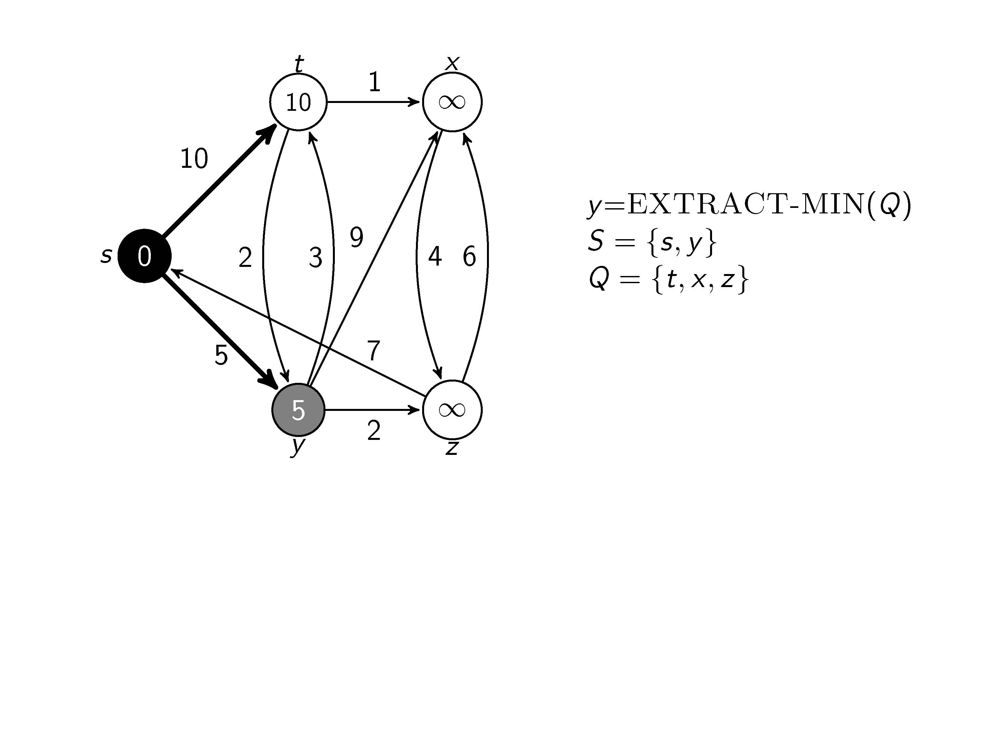
We are at node y

Slide 10
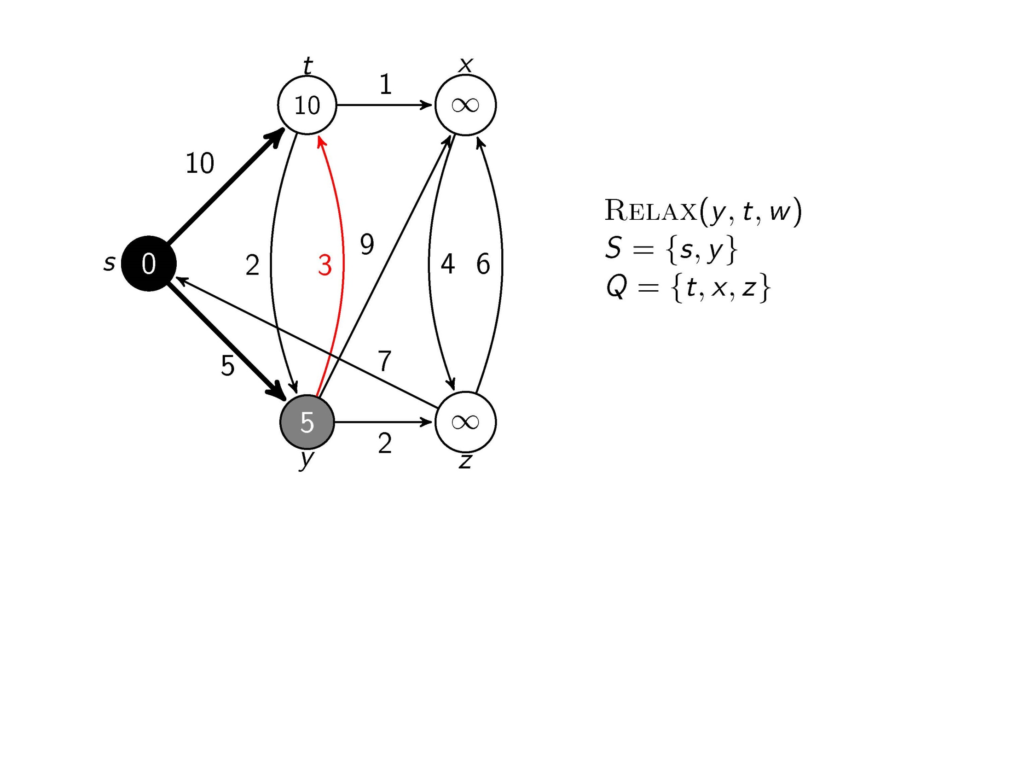
Test whether we can improve the shortest path to t found so far by going through y

Slide 11
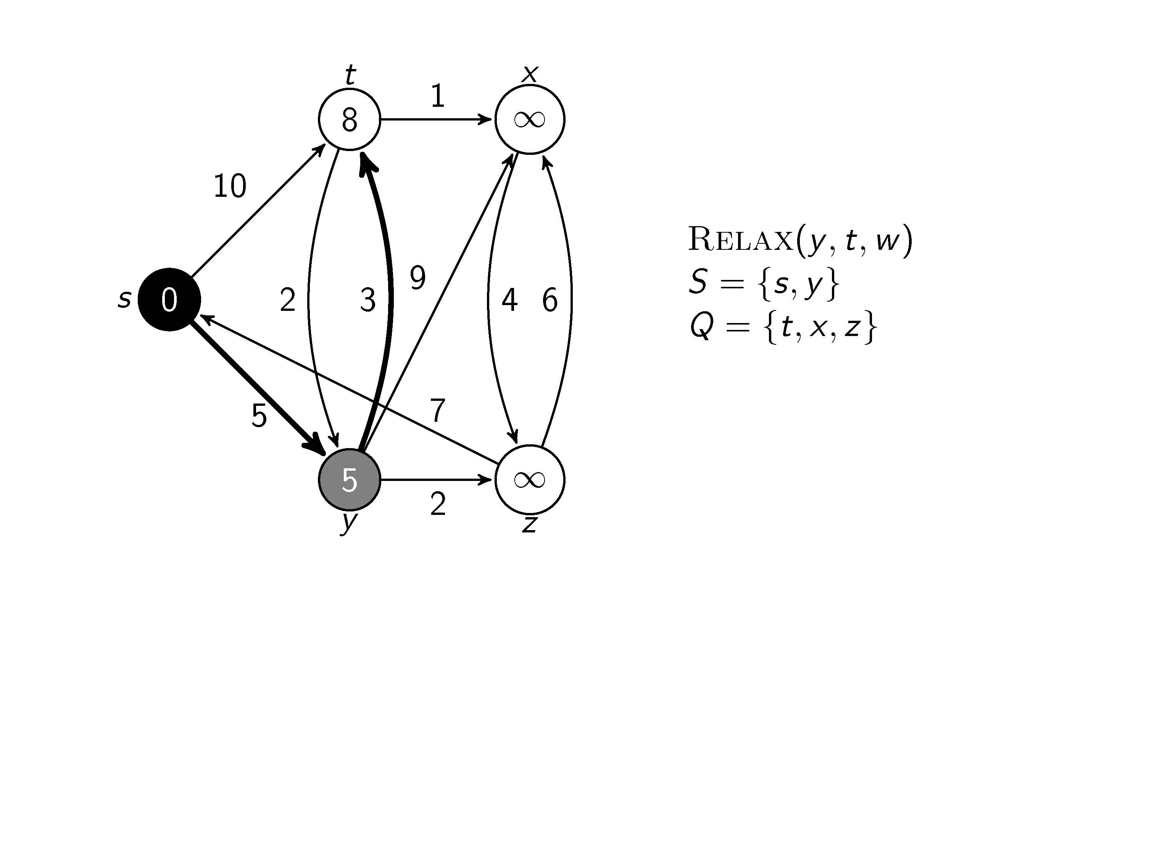
Update and

Slide 12
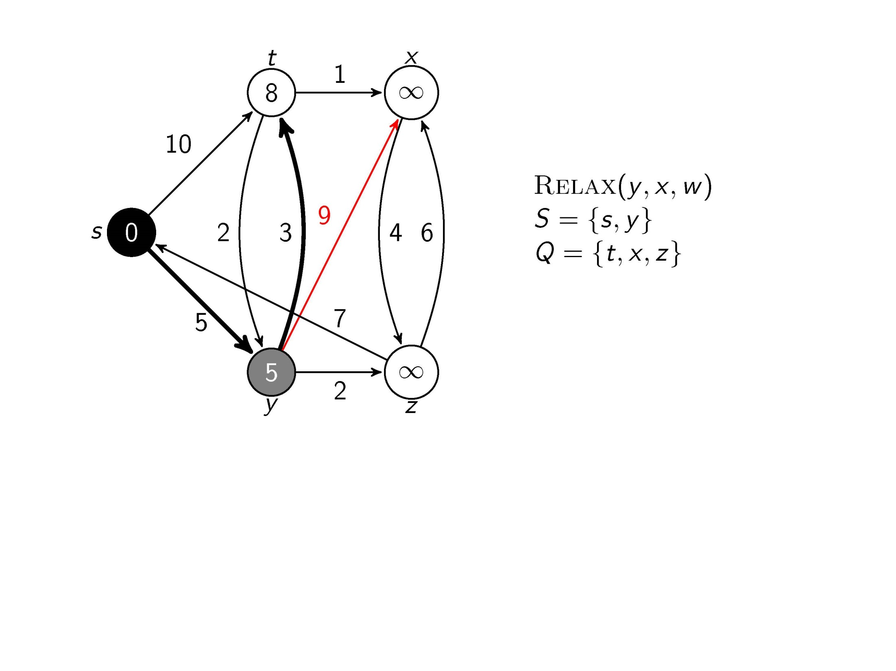
Test whether we can improve the shortest path to x found so far by going through y

Slide 13
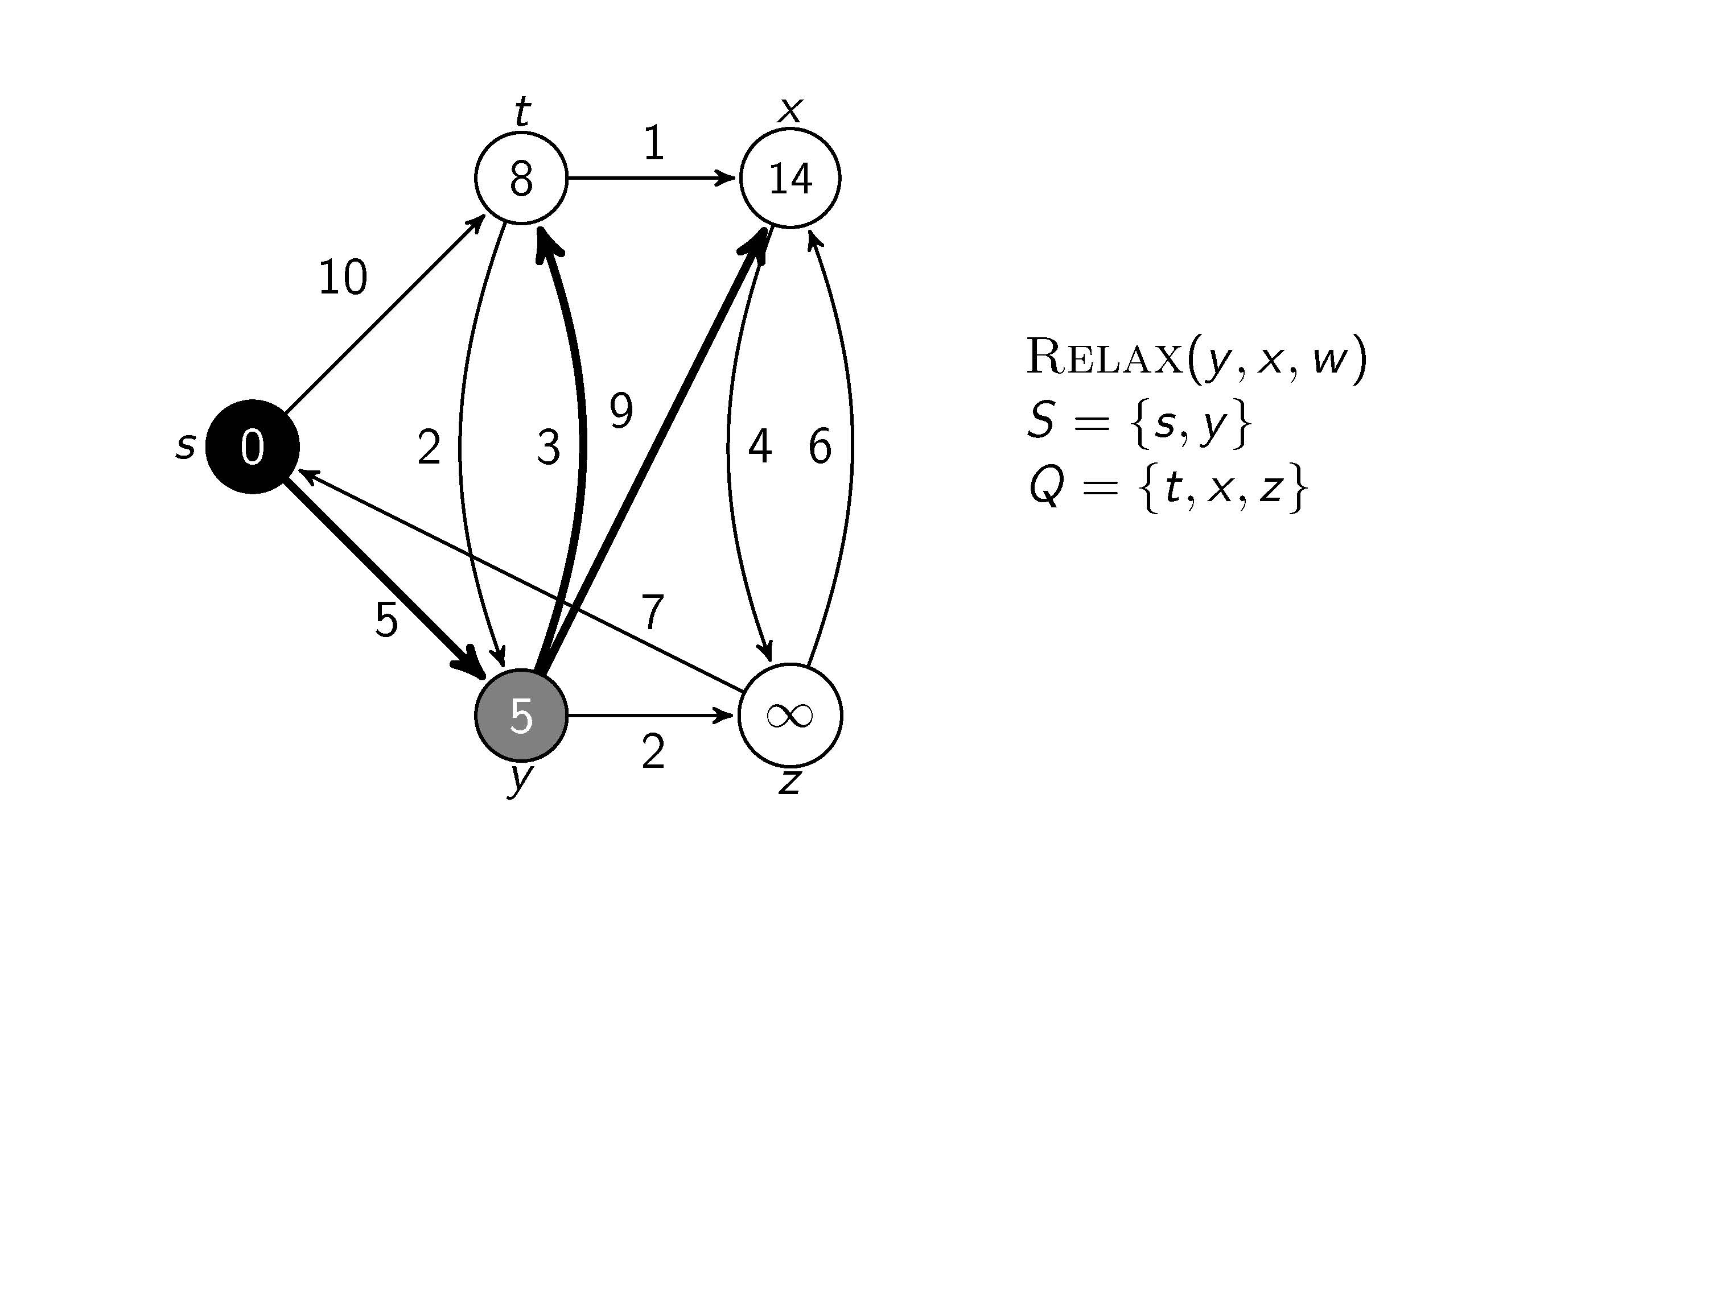
Update and

Slide 14
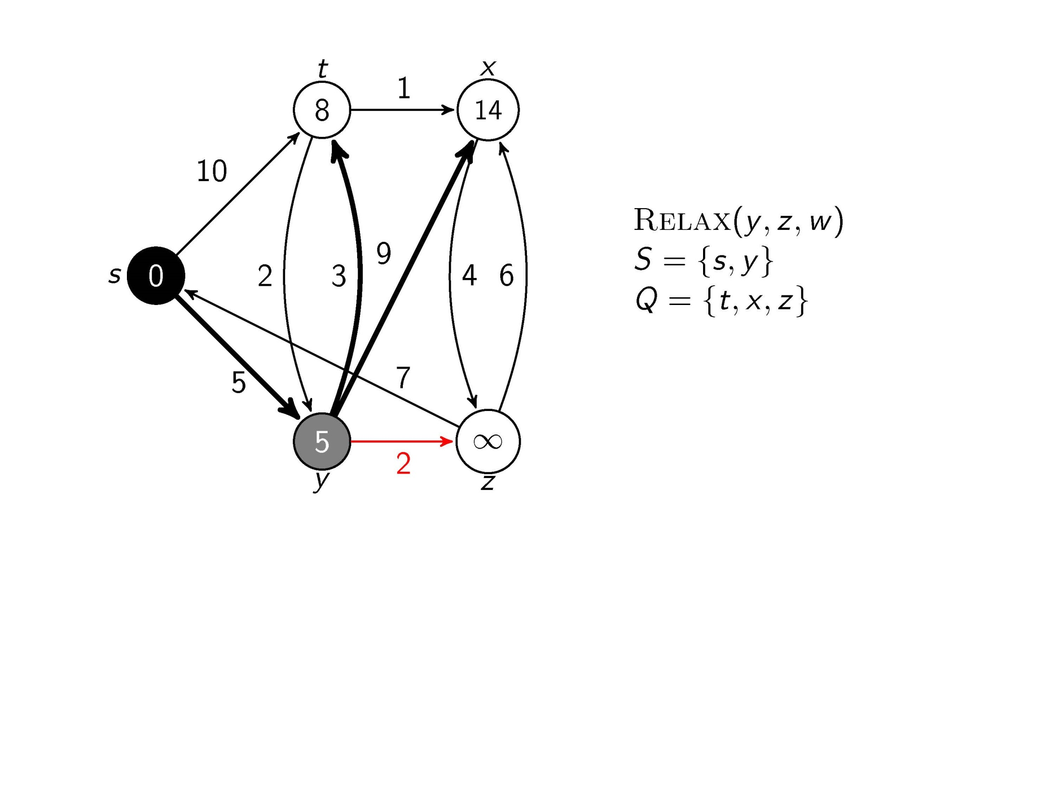
Test whether we can improve the shortest path to z found so far by going through y

Slide 15
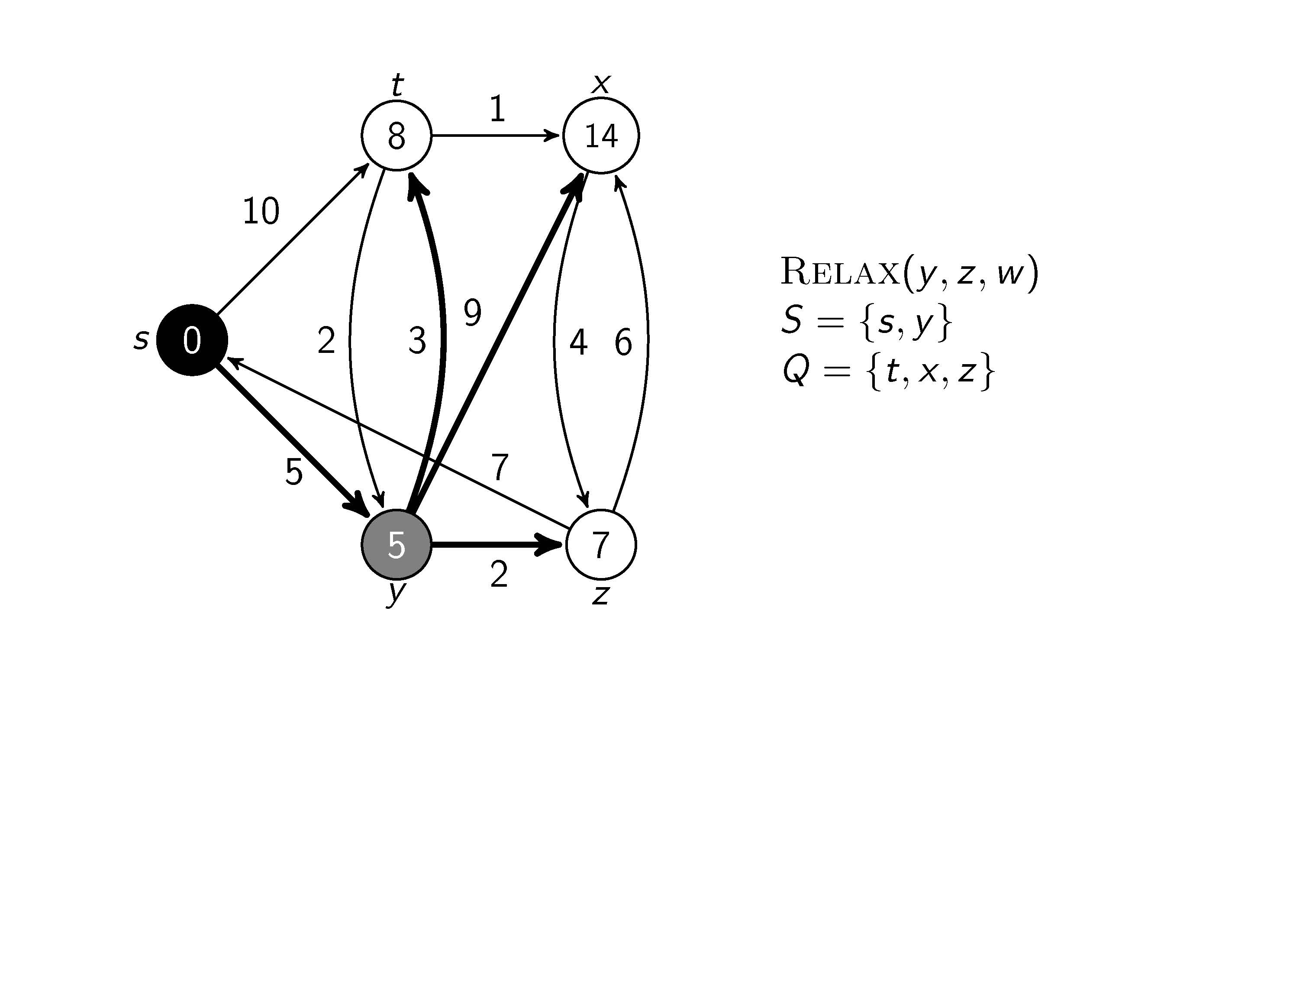
Update and

Slide 16
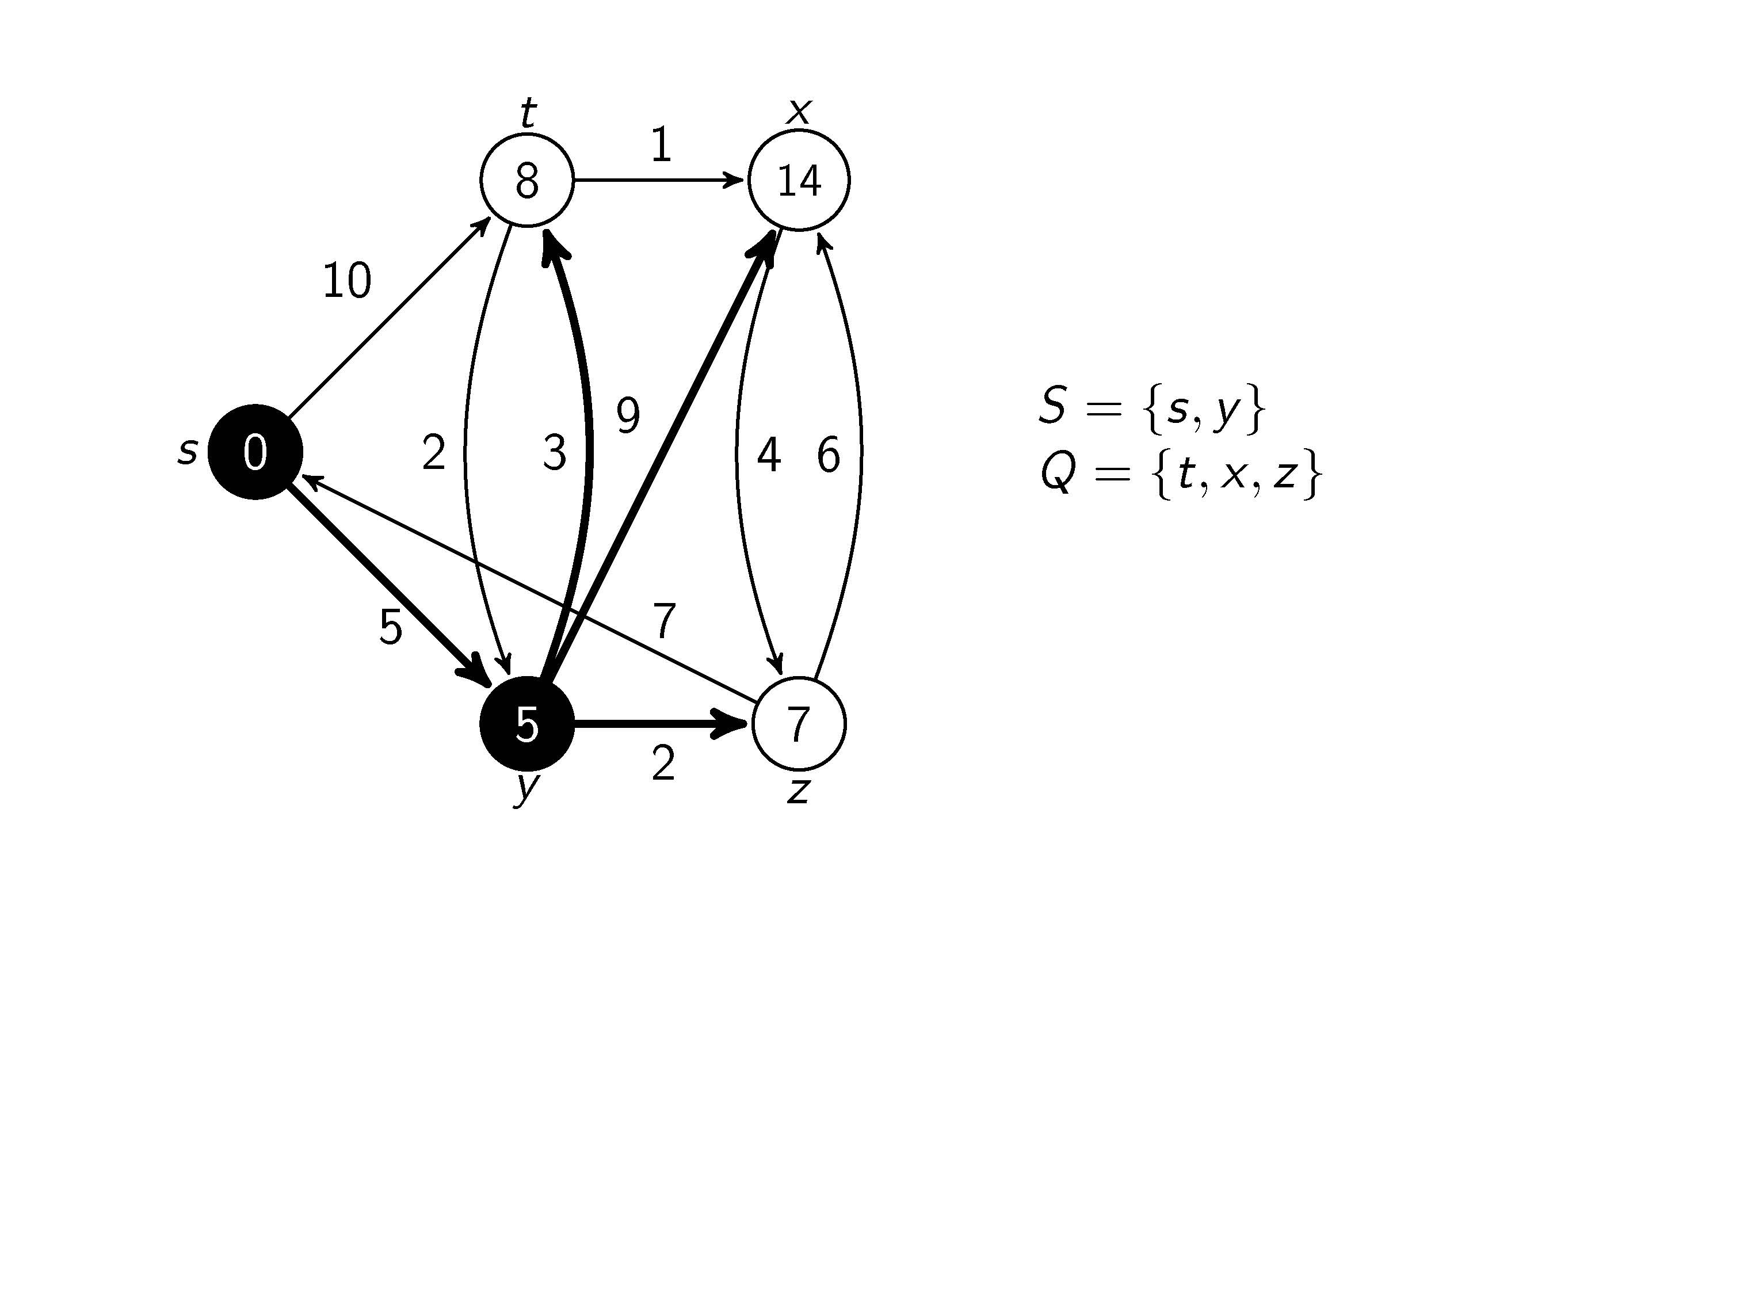
All edges leaving y have been tested

Slide 17
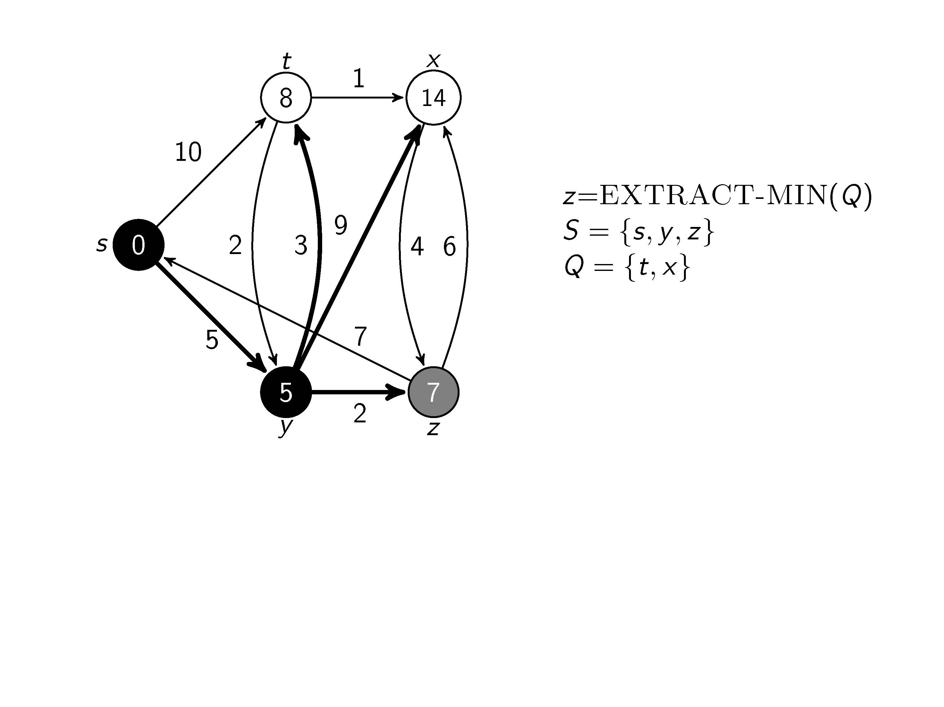
We are at node z

Slide 18
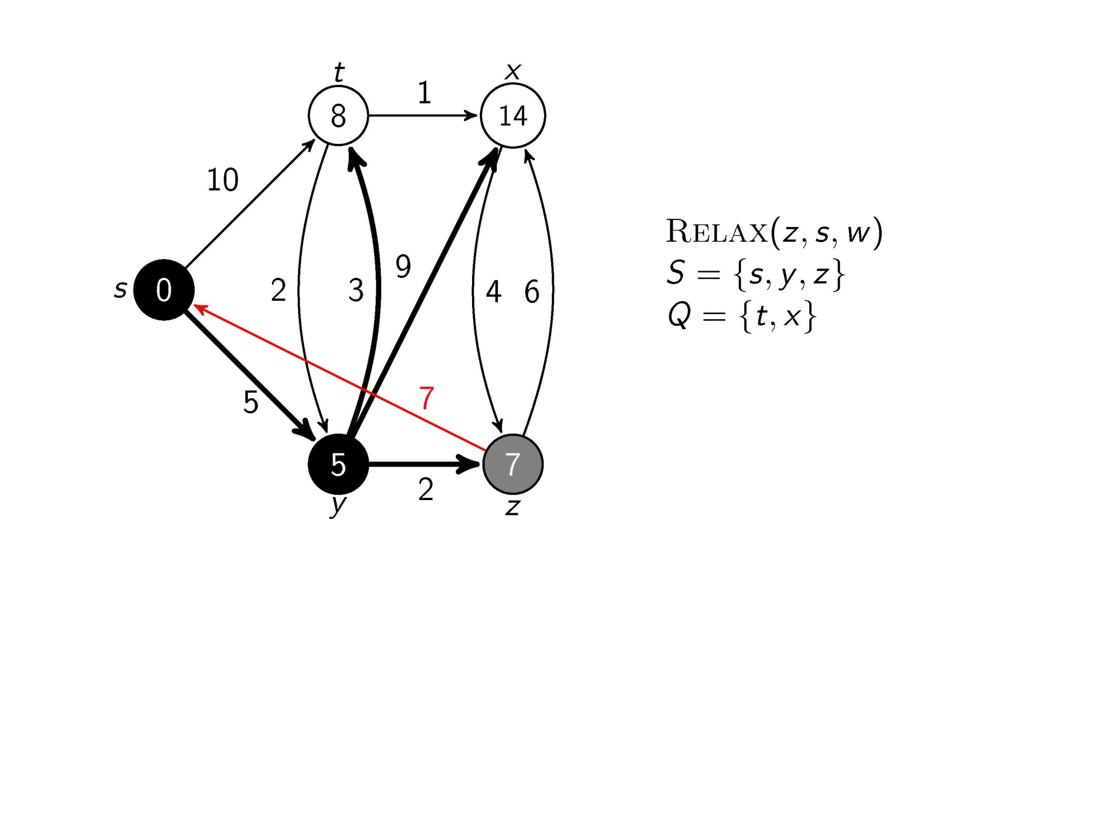
Test whether we can improve the shortest path to s found so far by going through z

Slide 19
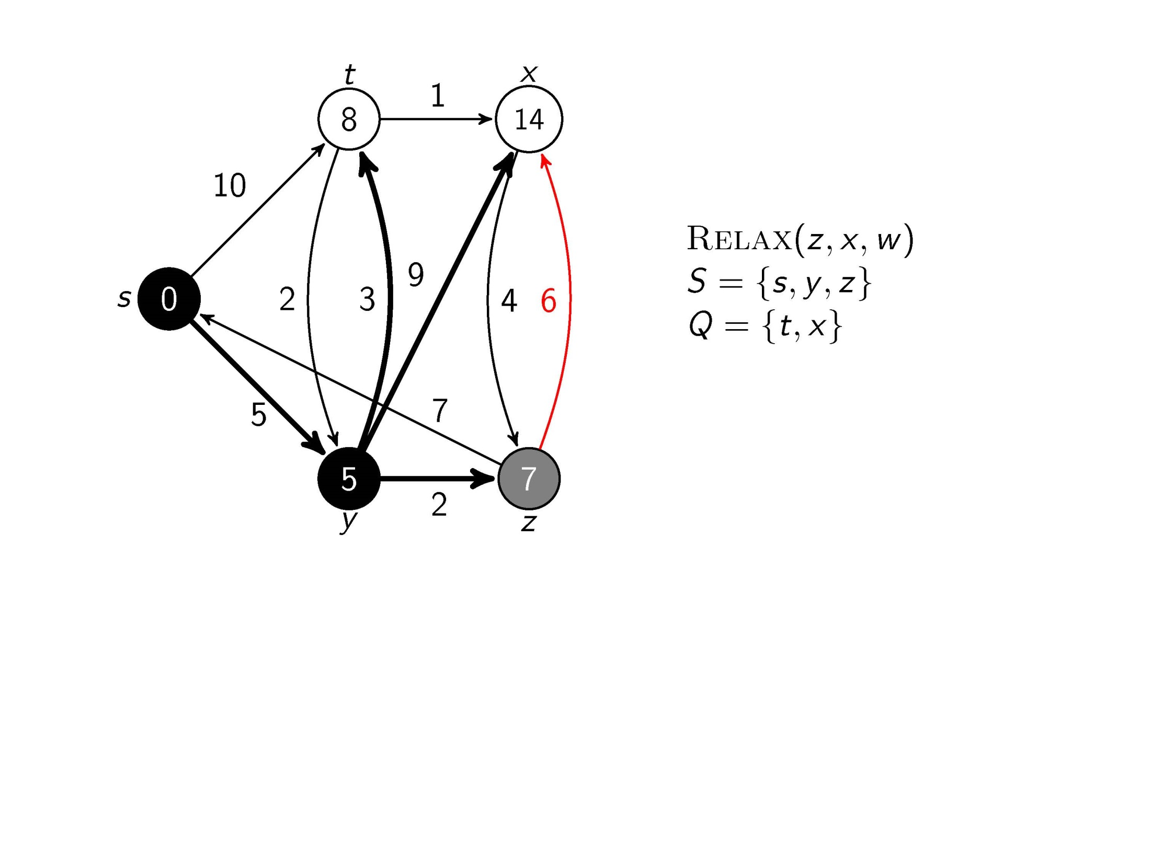
Test whether we can improve the shortest path to x found so far by going through z

Slide 20
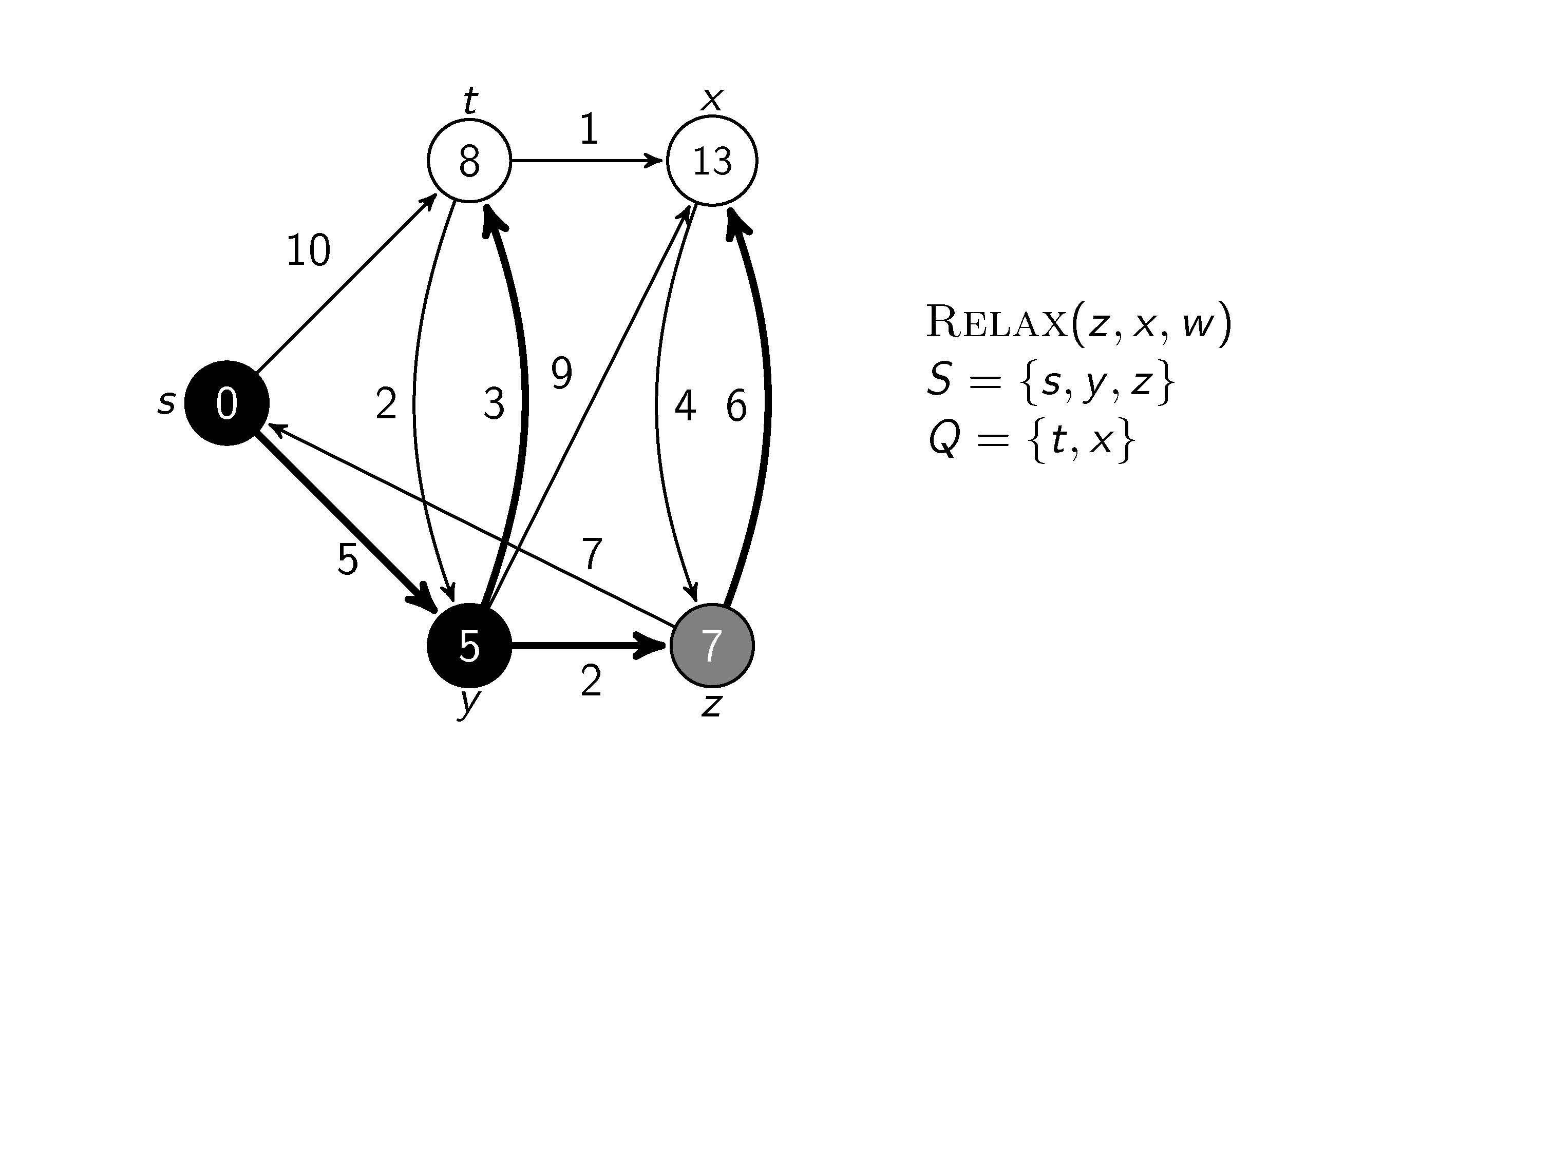
Update and

Slide 21
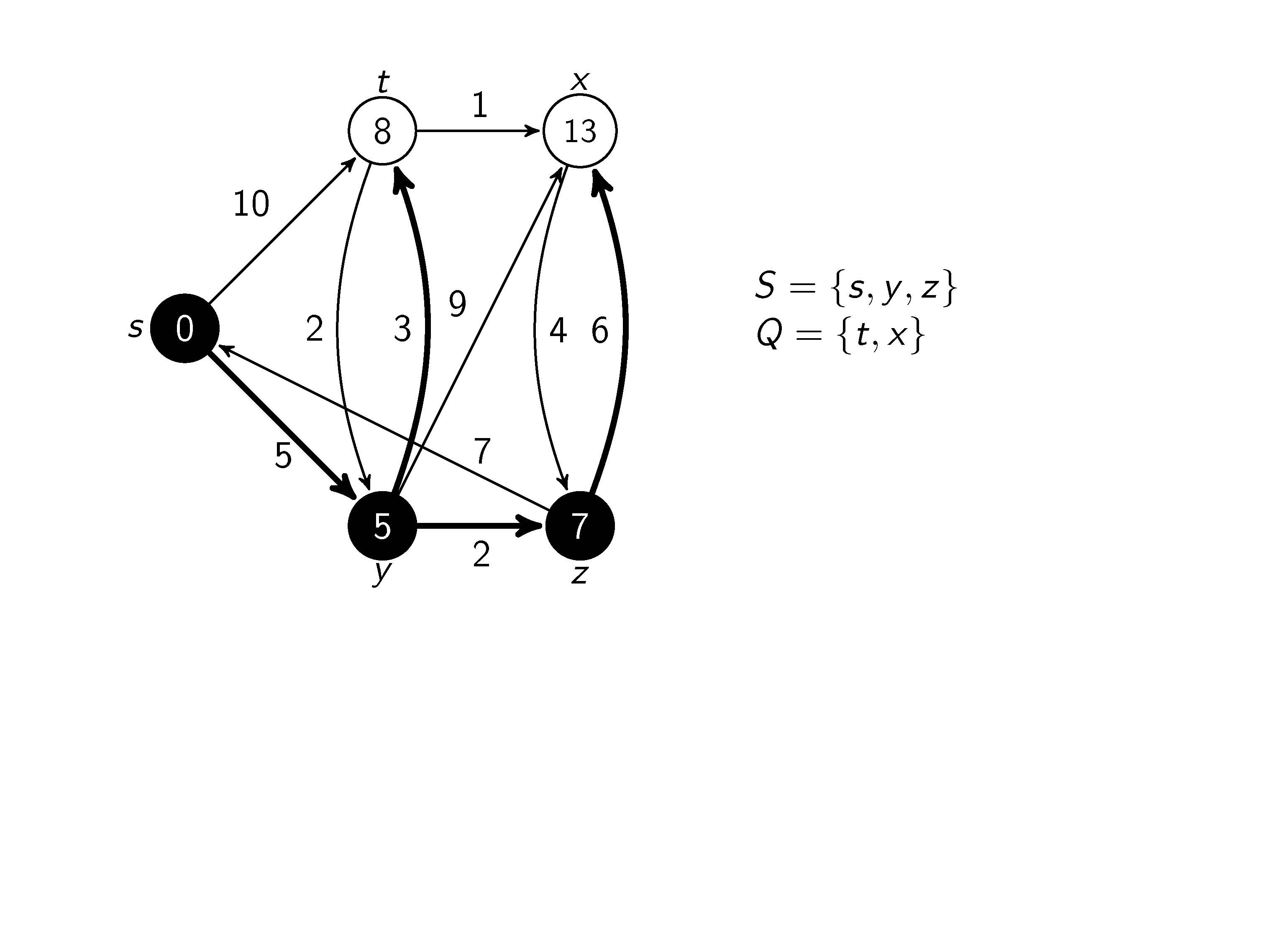
All edges leaving z have been tested

Slide 22
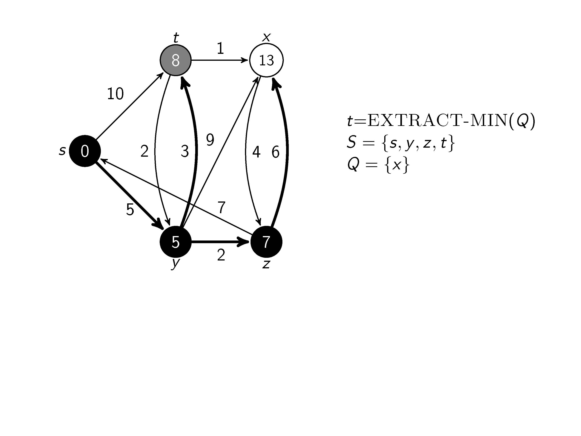
We are at node t

Slide 23
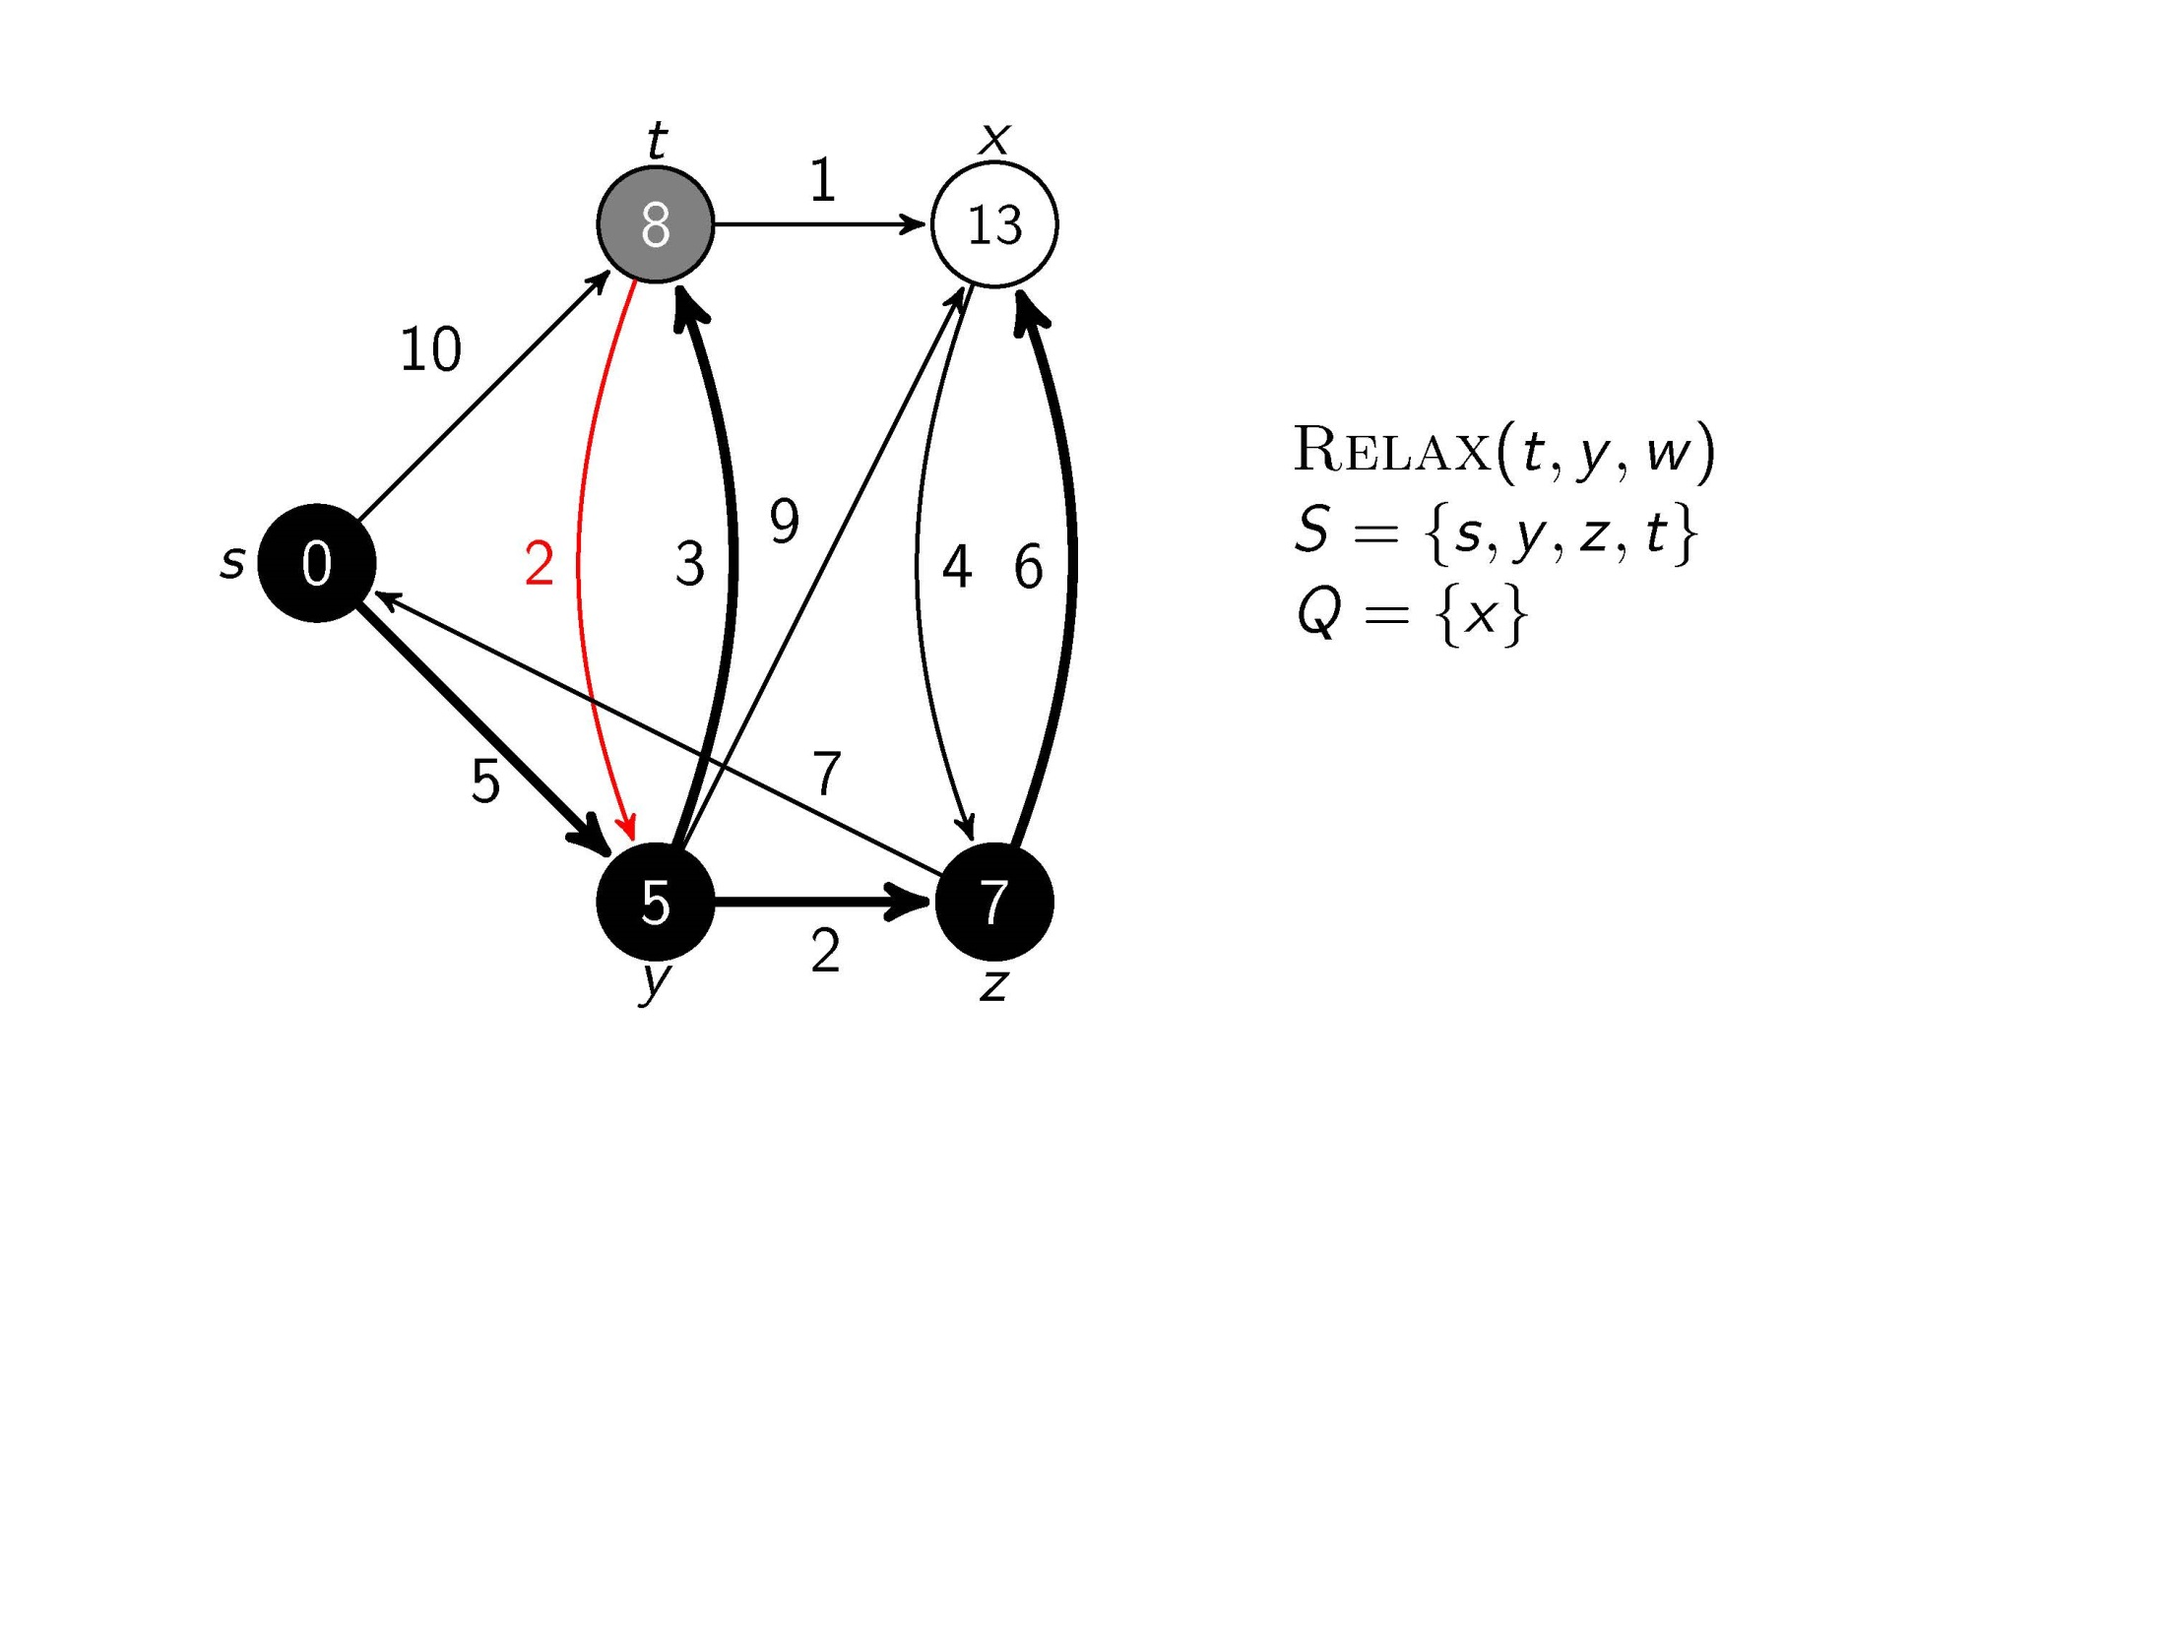
Test whether we can improve the shortest path to y found so far by going through t

Slide 24
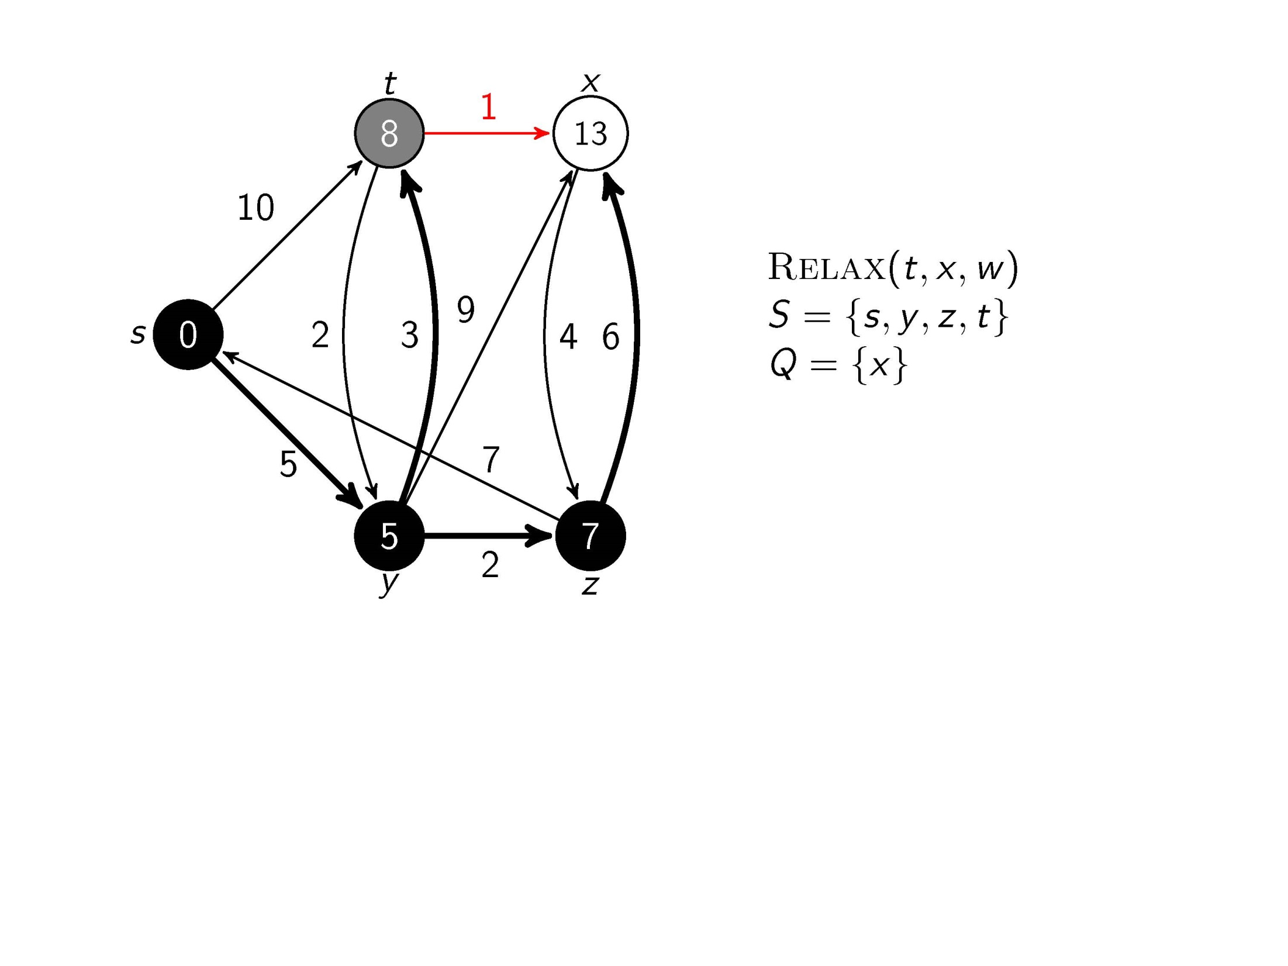
Test whether we can improve the shortest path to x found so far by going through t

Slide 25
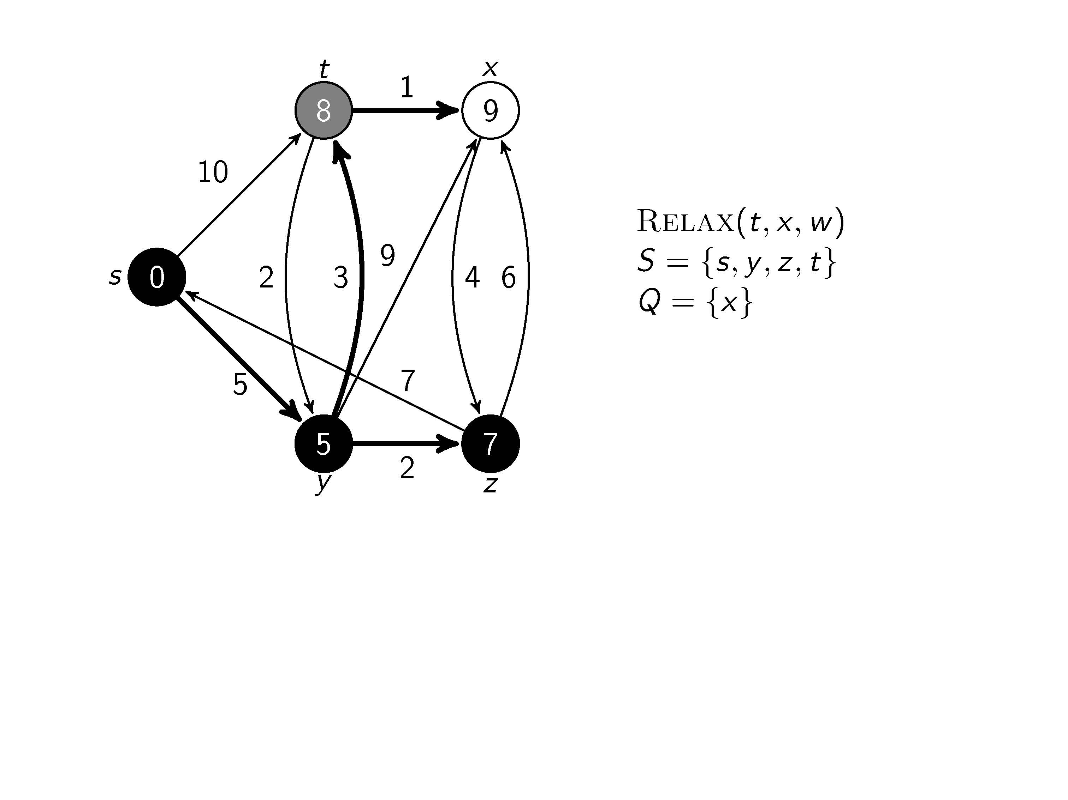
Update and

Slide 26
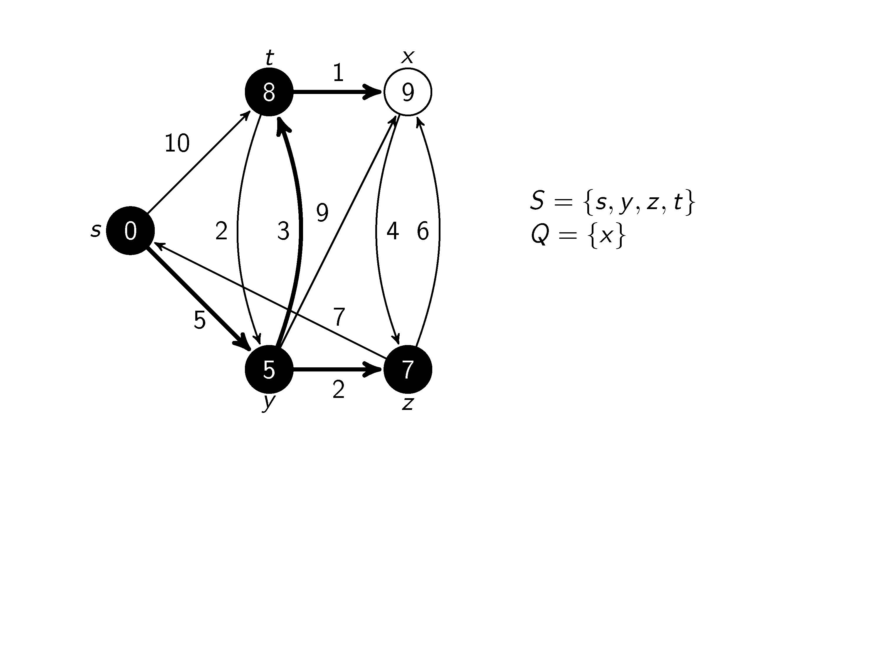
All edges leaving t have been tested

Slide 27
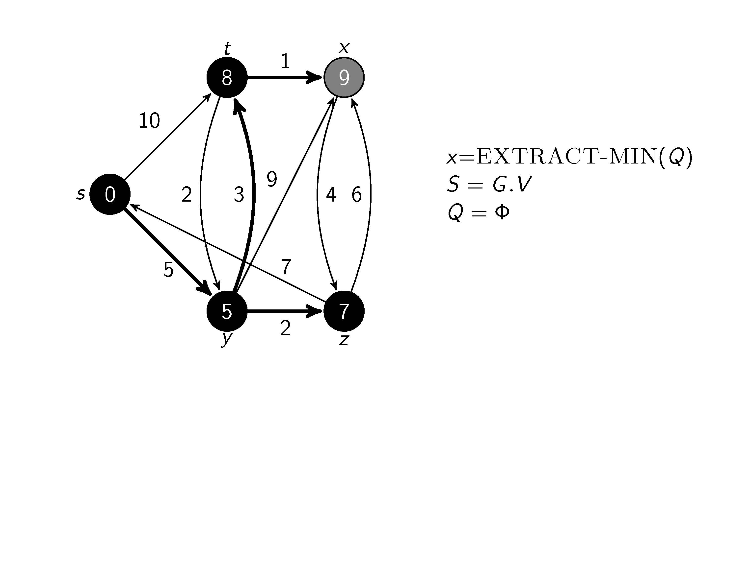
We are at node x

Slide 28
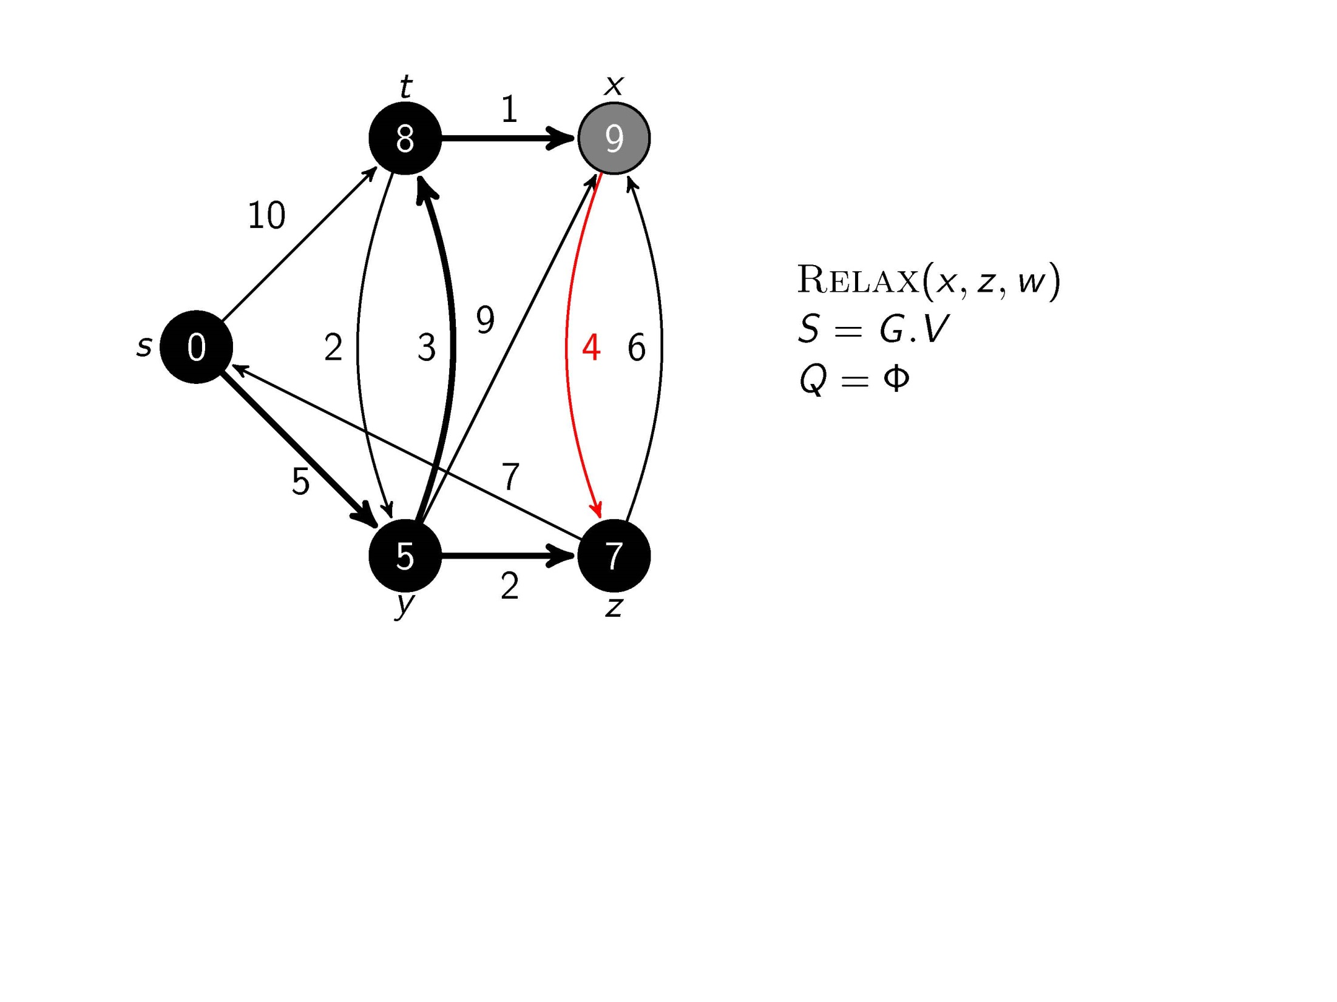
Test whether we can improve the shortest path to z found so far by going through x

Slide 29
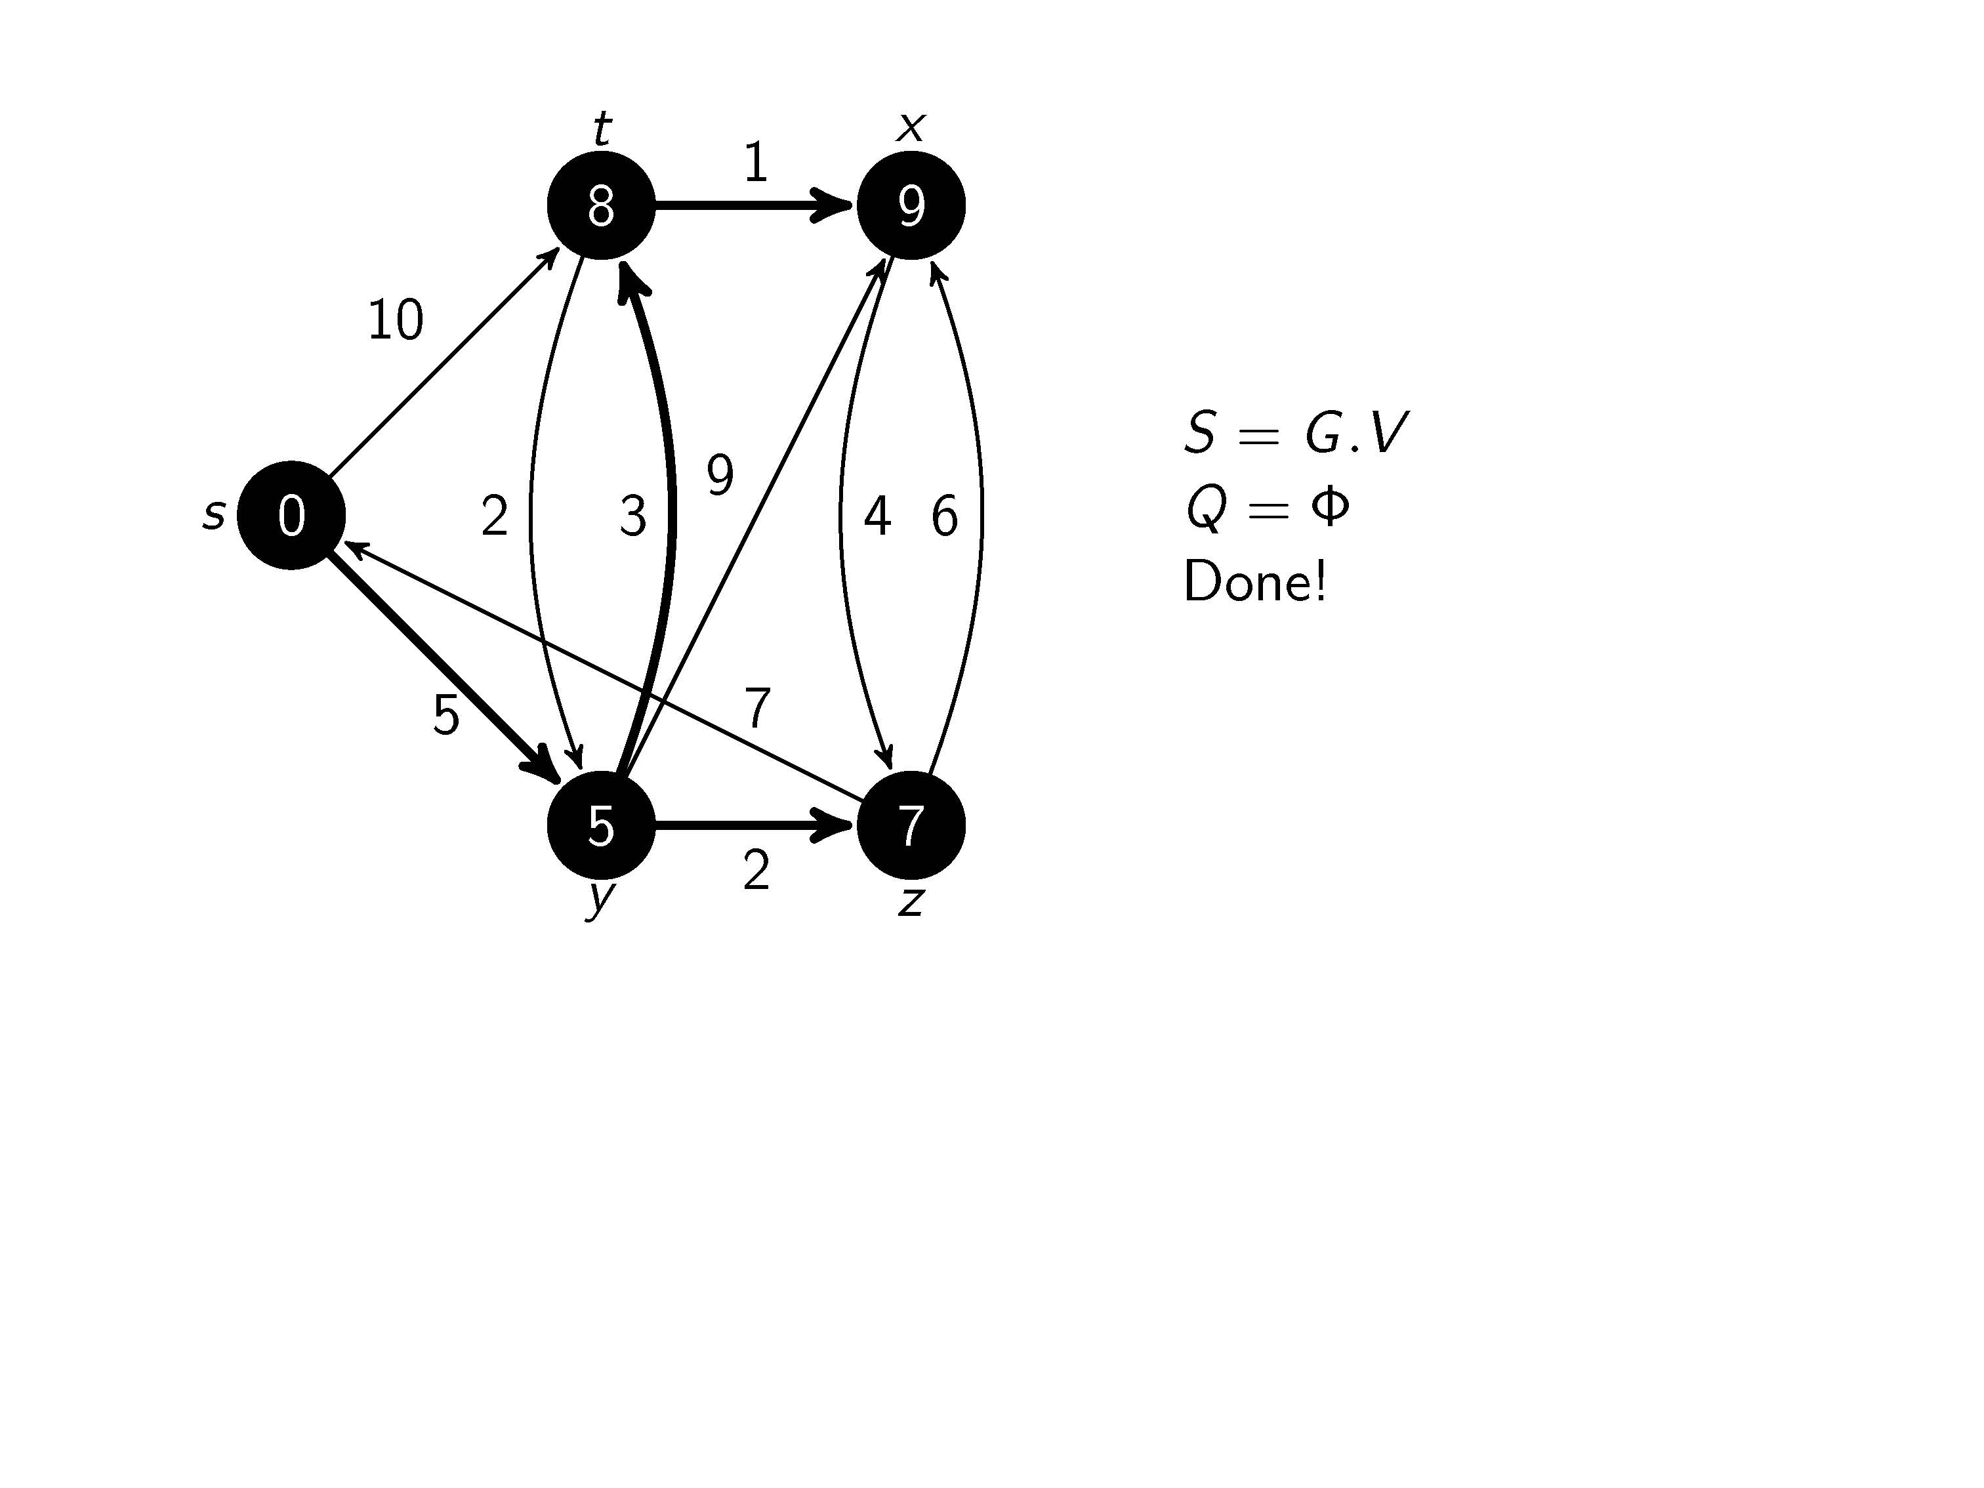
All edges leaving x have been tested.
Every vertex’s shortest path from s has been determined. We are done.

