Slide 1
RL Review: Model-Based RL, Function Approximation, DQN, Policy Gradient
Chris Amato
Northeastern University with some slides from Rob Platt, Lawson Wong and U Alberta
Notes:
1

Slide 2
Announcements
Class website: https://www.khoury.northeastern.edu/home/camato/7170scheduleF25.html
  I’ll put slides there
Teams
  If you aren’t on it, let me know!

Slide 3
Background reading
Recommended Sutton and Barto:
  MDPs 3.1--3.8
  Dynamic Programming 4.1--4.8
  Monte Carlo Methods 5.1--5.7 (you can skip Example 5.5)
  Temporal Difference Learning 6.1--6.8
  Planning and Learning 8.1--8.6;8.9--8.12
  Linear Function Approximation 9.1--9.5, 9.8, 10.1
  Policy gradient and actor critic 13.1--13.7
Other topics:
  Deep learning
  DQN and extensions
  Deep policy gradient/actor critic algorithms

Slide 4
This week
Will be talking about partially observable and multi-agent RL
Start reading my book draft
  An Initial Introduction to Cooperative Multi-Agent Reinforcement Learning
  https://arxiv.org/abs/2405.06161
  Comments are more than welcome over email, Teams, or in person!
  Read at least the first 2 chapters (they are short and easy) for Thursday

Slide 5
External lectures (with video)
DeepMind x UCL
  https://deepmind.com/learning-resources/reinforcement-learning-series-2021
David Silver
  https://www.davidsilver.uk/teaching/
Berkeley (Deep RL)
  https://rail.eecs.berkeley.edu/deeprlcourse/
Coursera, Udacity, etc. also have lectures

Slide 6
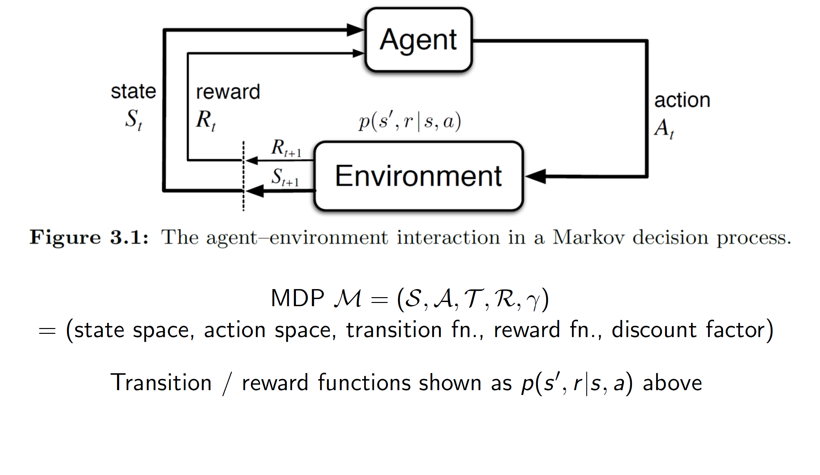
Our MDP journey
0. Markov decision process p(s', r | s, a)

Slide 7
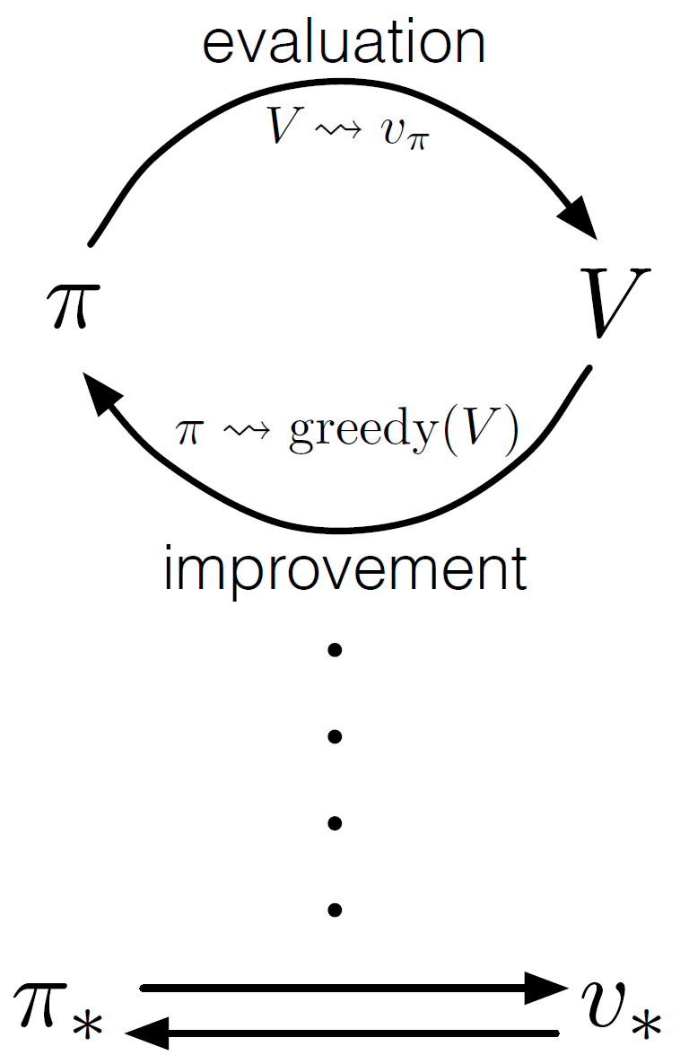
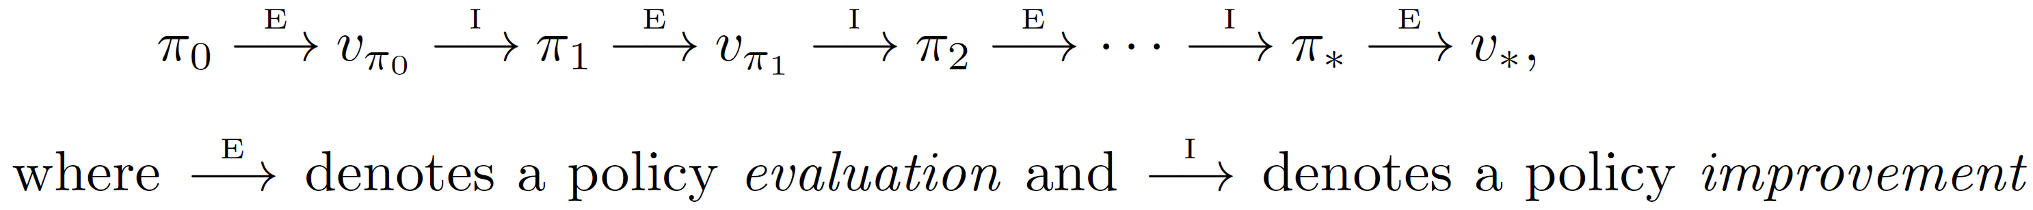
Our MDP journey
0. Markov decision process p(s', r | s, a)
1. Dynamic programming
- Value iteration
- Policy evaluation
- Policy iteration

Slide 8
Our MDP journey
0. Markov decision process p(s', r | s, a)
1. Dynamic programming
Value iteration, policy evaluation, policy iteration

Slide 9
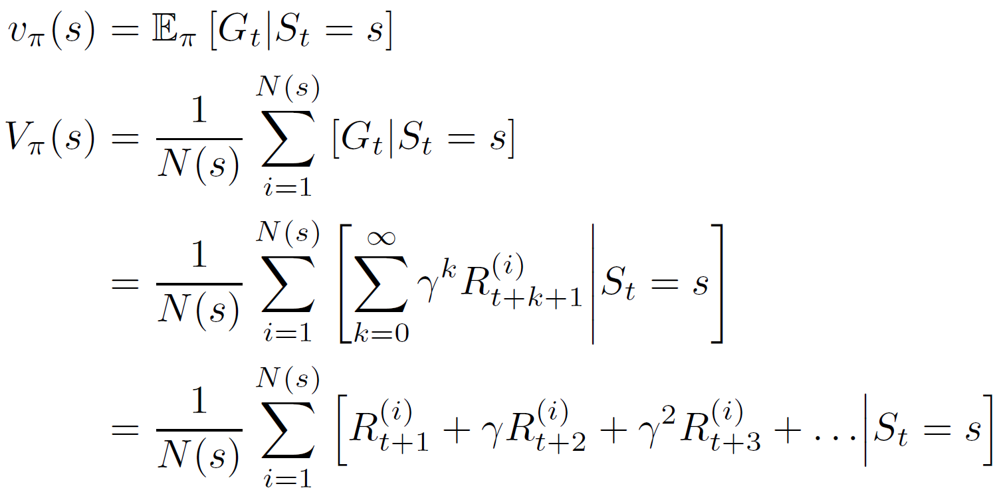
Our MDP journey
0. Markov decision process p(s', r | s, a)
1. Dynamic programming
Value iteration, policy evaluation, policy iteration
2. Monte-Carlo methods (cf. Multi-armed bandits)
Sample average of
episodic returns

Slide 10

Our MDP journey
0. Markov decision process p(s', r | s, a)
1. Dynamic programming
Value iteration, policy evaluation, policy iteration
2. Monte-Carlo methods (cf. Multi-armed bandits)
Sample average of episodic returns
3. Temporal-difference learning

Slide 11
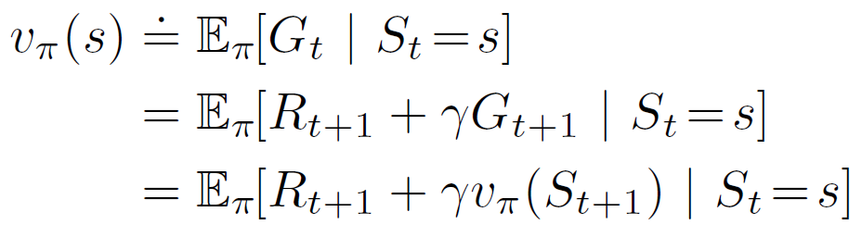
Learning targets
Monte-Carlo:
TD(0):
SARSA:
Q-learning (off-policy):

Slide 12
Are there more learning targets?
Monte-Carlo:
TD(0):
SARSA:
Q-learning (off-policy):

Slide 13

Learning targets
Monte-Carlo:
TD(0):
n-step returns:

Slide 14
Planning and Learning Summary
Emphasized close relationship between planning and learning
Important distinction between distribution models and sample models
Looked at some ways to integrate planning and learning
  synergy among planning, acting, model learning
  Using model to generate data for RL (e.g., Dyna-Q)
Distribution of backups: focus of the computation
  prioritized sweeping
  sample backups
  trajectory sampling: backup along trajectories
  heuristic search/MCTS
Size of backups: full/sample; deep/shallow

Slide 15
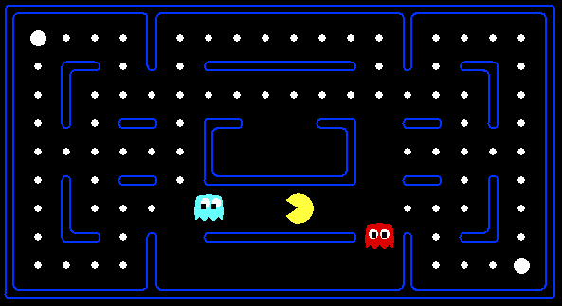



What happens in large or continuous state spaces?
Example of a large state space: Atari Learning Environment
– state: video game screen
– actions: joystick actions
– reward: game score
Agent takes actions
a
Agent
s,r
Agent perceives states and rewards
Why are large state spaces a problem for tabular methods?
Notes:
15

Slide 16
Generalization
So far, discussed Q-Learning that keeps a table of all Q-values (for each state and action)
In realistic situations, we cannot possibly learn about every single state!
  Too many states to visit them all in training
  Too many states to hold the Q-tables in memory
Instead, we want to generalize:
  Learn about some small number of training states from experience
  Generalize that experience to new, similar situations
  (Basically the idea of machine learning – so combine with RL with ML)

Slide 17
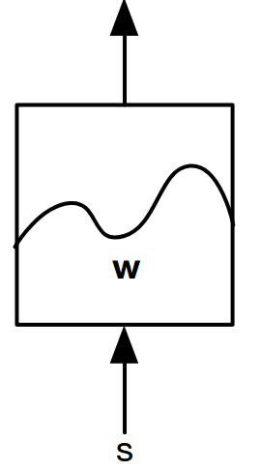
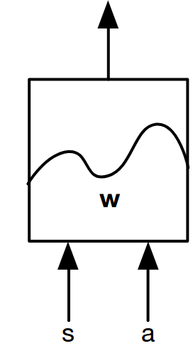
Function approximation
Approximating the value function using function approximator:
Output
Some kind of function
approximator parameterized
by w
Input
Notes:
17

Slide 18
Linear function approximation
Want: Generalization
- Learn about small number of training states
- Use features to generalize that experience
to new but similar situations
Instead of storing a table of values (of V(s) or Q(s,a)),
devise features f and store weights w,
and use them to implicitly define V(s) or Q(s,a):
+ Advantage: our experience is summed up in a few powerful numbers
- Disadvantage: states may share features but actually be very different in value!

Slide 19
What exactly to optimize
In the tabular case, we directly maximize the value function
With function approximation, we will not be able to get the optimal value function exactly
Use some form of error/loss, e.g., Mean Squared Value Error (VE):
  Given a distribution over states 𝜇(s) (we’ll come back to this)
We will minimize such errors in function approx. methods
Linear methods can often converge to a global optimum, but nonlinear (e.g., deep) methods only converge to a local optimum or not at all!

Slide 20
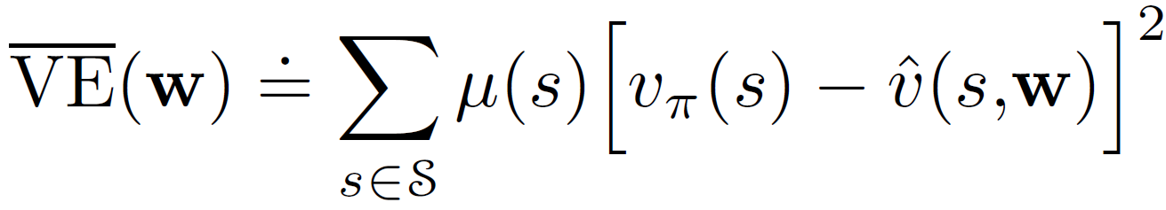
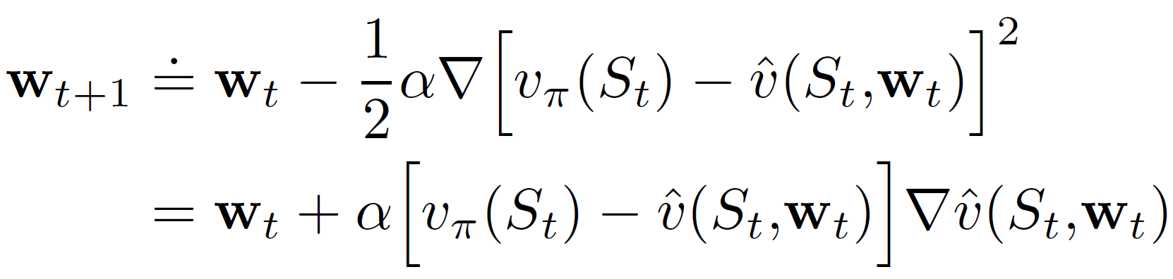
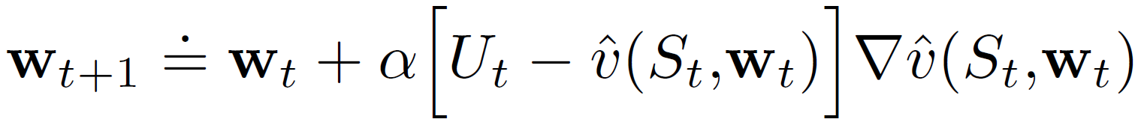
Learning targets
Minimize mean-squared value error:
Compute the gradient and iteratively descend:
Change the true value to an estimate (ideally unbiased):

Slide 21
Gradient Monte Carlo policy evaluation
Goal: calculate
Notice that in MC, the return is an unbiased, noisy sample of the
true value,
Can therefore apply supervised learning to “training data”:
The weight update “sampled” from the training data is:
Gradient updates every step gives us stochastic gradient descent
Notes:
21

Slide 22
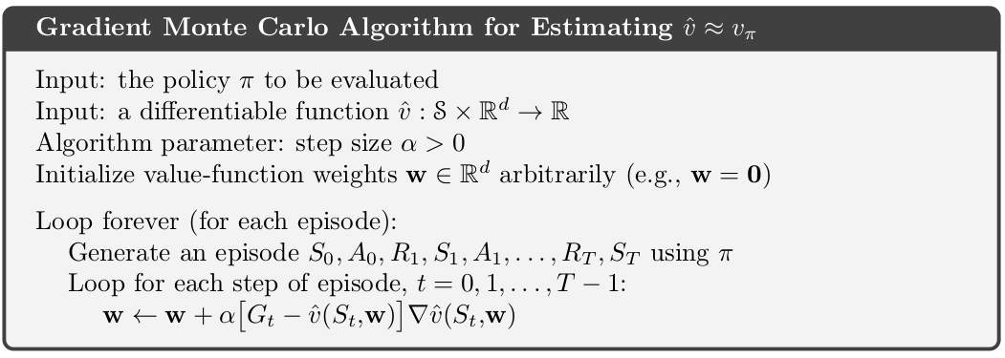
Gradient Monte Carlo policy evaluation
For linear function approximation, gradient MC converges to the
weights that minimize MSE wrt the true value function
Even for non-linear function approximation, gradient MC converges
to a local optimum
However, since this is MC, the estimates are high-variance
Notes:
22

Slide 23
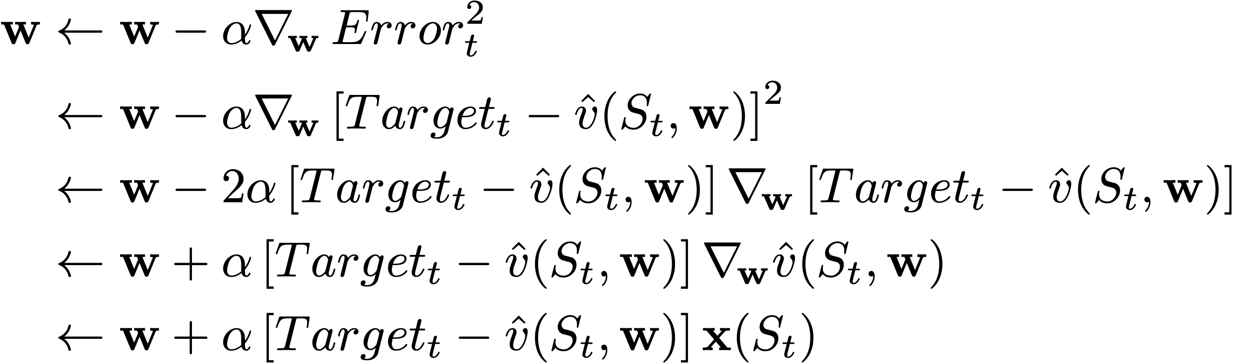
SGD for TD case
Update the weights after each new sample to reduce the error (rather than in
batch model like regular gradient descent)
General SGD:
For VFA:
Chain rule:
(Semi-)gradient:
Linear case:
Feature vector
The estimate is unbiased in the MC case, but biased in the TD case
Target is no longer independent of w
(would need to take the gradient w.r.t. it too!)
We call the TD case semi-gradient
Semi-gradient methods will have weaker convergence guarantees (but still useful)

Slide 24
TD Learning with value function approximation
The TD target, is an estimate of the
true value,
But, let’s ignore that and use the TD target anyway…
Training data:
This gives us TD(0) policy evaluation with:
Next state
Notes:
24

Slide 25
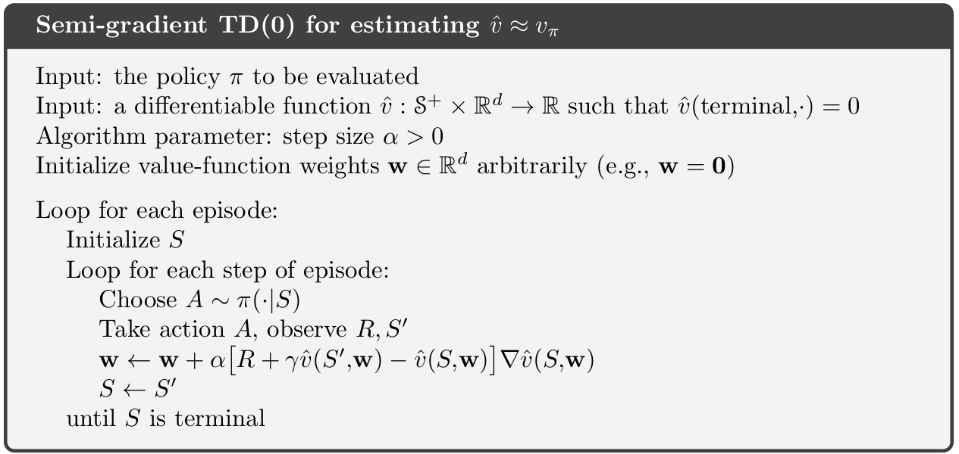
TD prediction with value function approximation
Notes:
25

Slide 26
Think-pair-share
Write the semi-gradient weight update equation for the special
case of linear function approximation
How would you update this algorithm for Q-learning?
Notes:
26

Slide 27
More learning targets
- n-step returns (RL2e 10.2)
- λ-returns (RL2e 12.2, 12.3, 12.7)
- Importance-sampled returns (for off-policy)
(RL2e Ch. 11)
…
Basically, you can modify any previously covered
tabular RL algorithm to obtain
(semi-)gradient RL algorithm
with function approximation

Slide 28
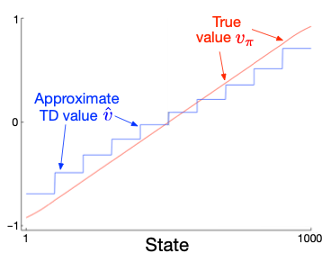
Example: Gradient TD on 1000-state random walk
10 groups of 100 states
after 100,000 episodes
α = 2 x 10⁻⁵
Relative values are
still pretty accurate

Slide 29
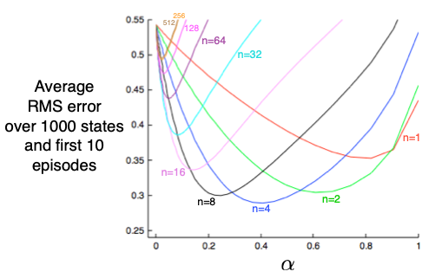
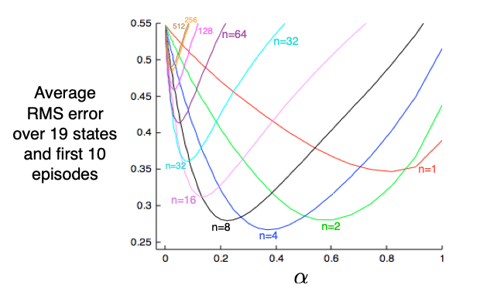
Bootstrapping still speeds learning
1000 states aggregated
into 20 groups of 50
19 states tabular
(from Chapter 7)
n-step returns used

Slide 30
Convergence results summary
1. Gradient-MC converges for both linear and non-linear fn approx
2. Gradient-MC converges to an optimal value estimate, i.e. an
estimate that min MSE
– but MC is high variance!
3. Semi-gradient-TD(0) converges for linear fn approx
4. Semi-gradient-TD(0) converges to a biased estimate
– but lower variance!
– converges to a point, , that does does not minimize MSE
– but we have:
Fixed point for semi-gradient TD
Point that min MSE
Notes:
30

Slide 31
Outline
✓ Linear function approximation (FA)
✓ General learning algorithm for prediction with linear FA
✓ Specific learning targets and learning algorithms
- Specific features
- Prediction → Control
- On-policy → Off-policy

Slide 32
Constructing features
All fast learning is linear learning
  The original perception
  Support Vector Machines (SVMs)
Even in deep learning (artificial neural networks),
learning is linear in the critical last layer
But very important to pick the right features!
Often requires domain knowledge
Note: we can include combinations of features

Slide 33

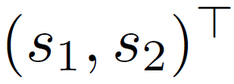
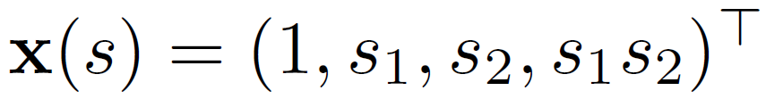
Features: Polynomials

Slide 34
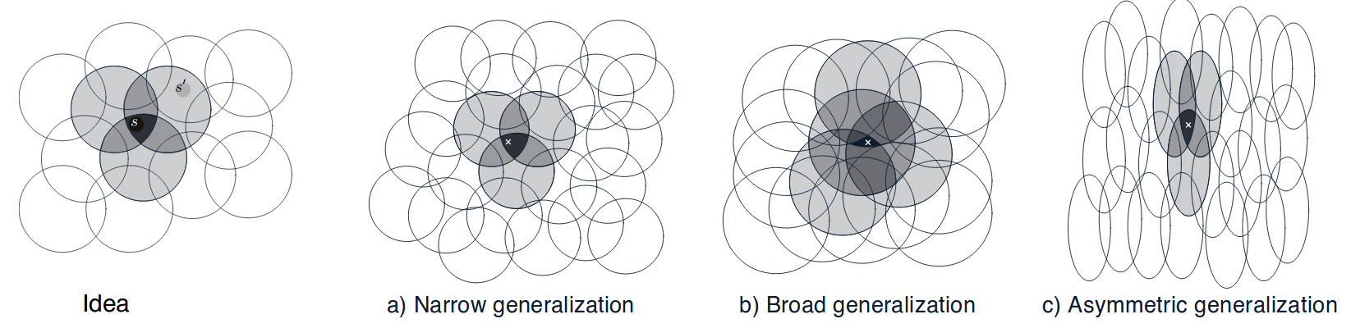
Linear value function approximation: Coarse coding
For example, the elements in x(s) could correspond to regions of a
continuous state space:
Binary features
– one feature for each circle (above)
The value function is encoded
by the combination of all tiles
that a state intersects
When features overlap, it is coarse coding
Notes:
34

Slide 35
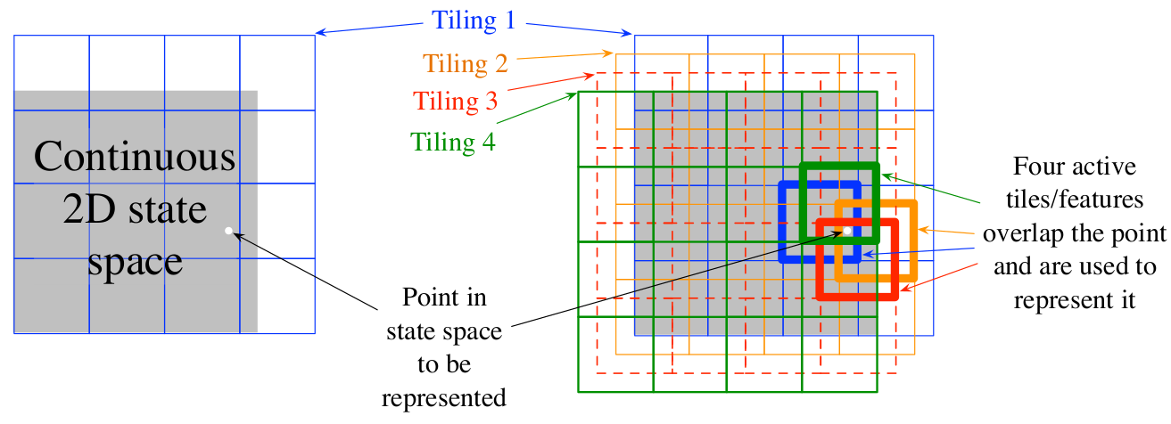
Linear value function approx: Tile coding
For example, x(s) could be constructed using tile coding:
– Each tiling is a partition of the state space.
– Assigns each state to a unique tile.
Binary features
n = num tiles x num tilings
In this example: n = 16 x 4
Notes:
35

Slide 36
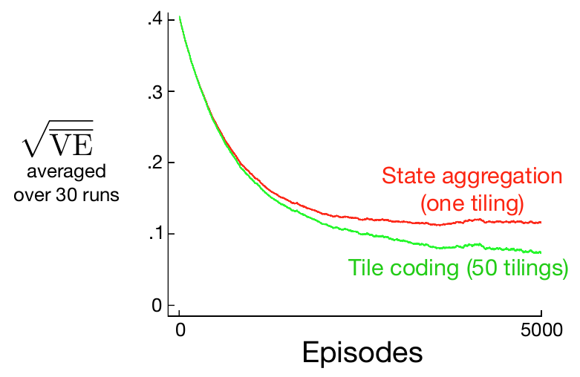
Example: Tile coding on random walk
groups/tiles of 200 states
α set so that initial learning rate
is the same for both methods
Notes:
36

Slide 37


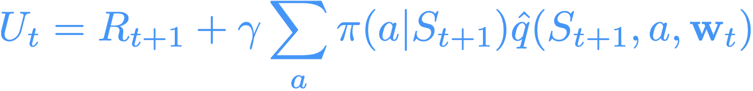
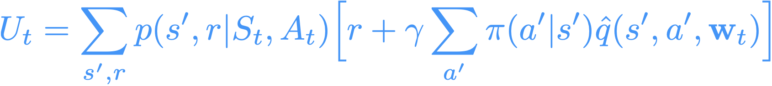
Control
(Semi-)gradient methods carry over to control in the usual on-policy GPI way
Always learn the action-value function of the current policy
Always act near-greedily wrt the current action-value estimates
The learning rule is the same as in Chapter 9:
update target, e.g.,
(MC)
(Sarsa)
(Expected Sarsa)
(DP)

Slide 38
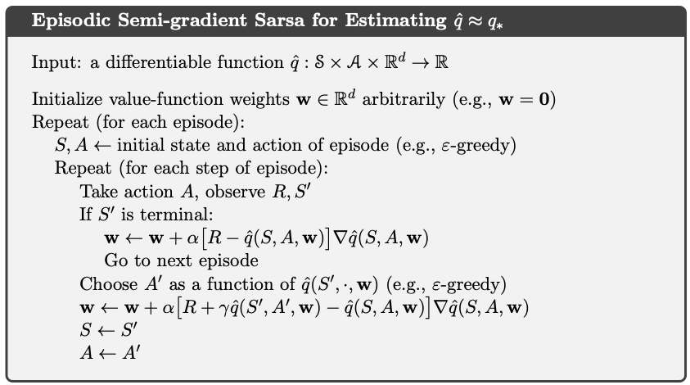
Semi-gradient control with SARSA

Slide 39
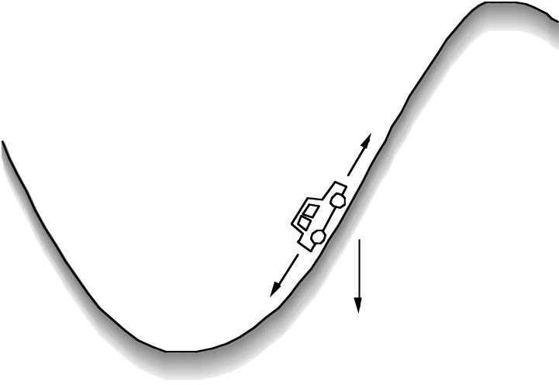
Example: Mountain-Car
Goal
STATES:
car's position and velocity
ACTIONS:
three thrusts: forward, reverse, none
REWARDS:
always –1 until car reaches the goal
Episodic, No Discounting, 𝜸=1
Gravity wins
Minimum-Time-to-Goal Problem

Slide 40
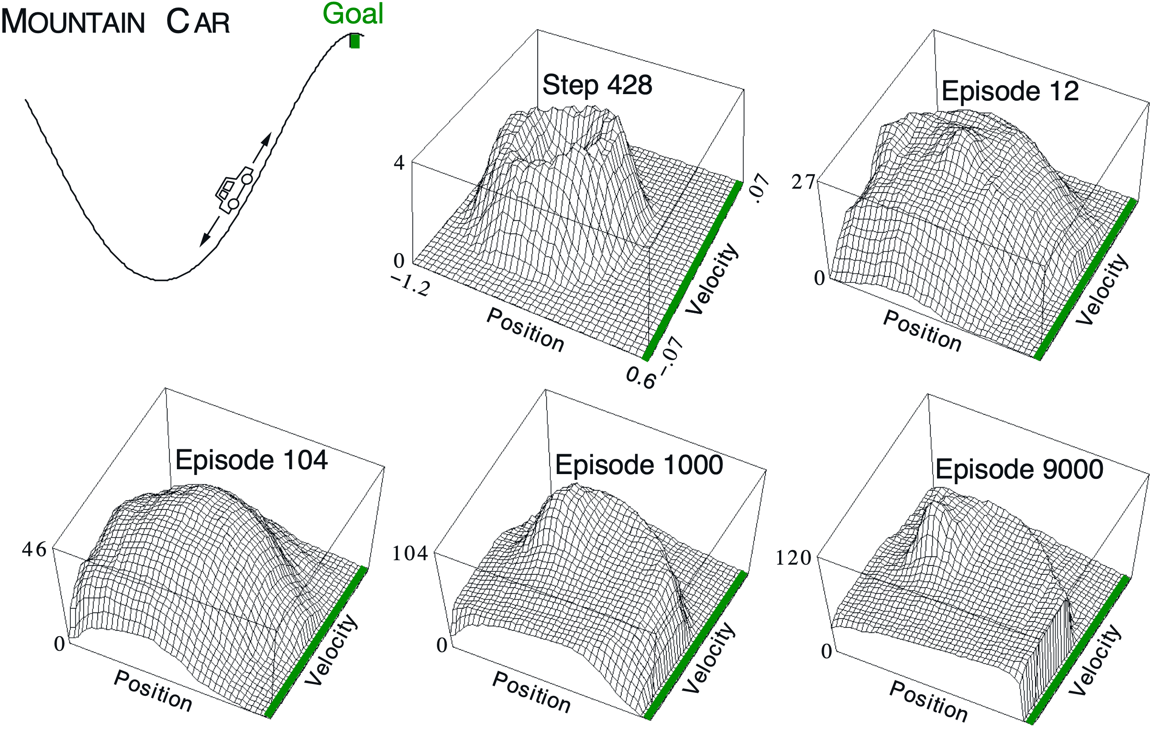
Linear Sarsa with Coarse Coding in Mountain Car
Notes:
40

Slide 41
Outline
✓ Linear function approximation (FA)
✓ General learning algorithm for prediction with linear FA
✓ Specific learning targets and learning algorithms
✓ Specific features
✓ Prediction → Control
- On-policy → Off-policy

Slide 42
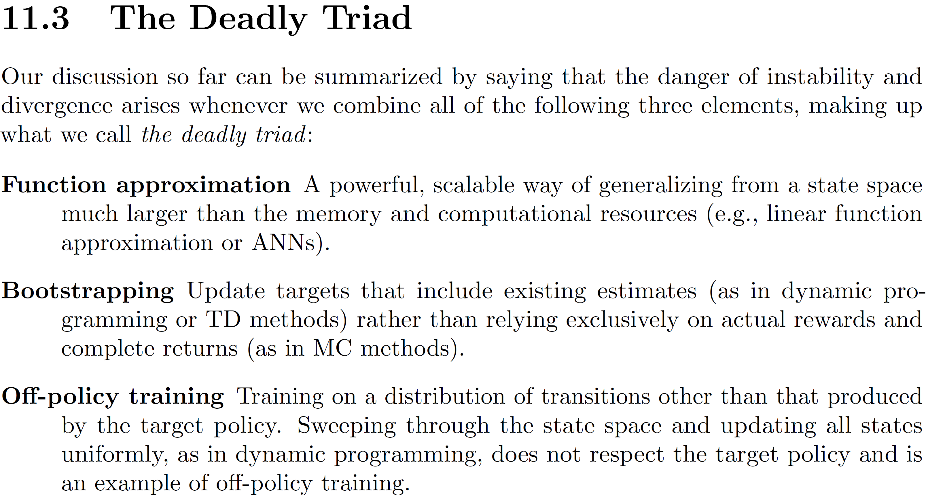
Off-policy

Slide 43
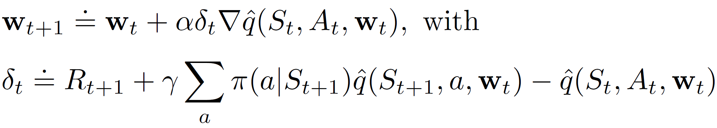

Off-policy
All bets are off. But, we can still try...!
(the hubris of deep learning)
Semi-gradient expected SARSA:
Semi-gradient Q-learning:
Target policy = greedy with respect to

Slide 44
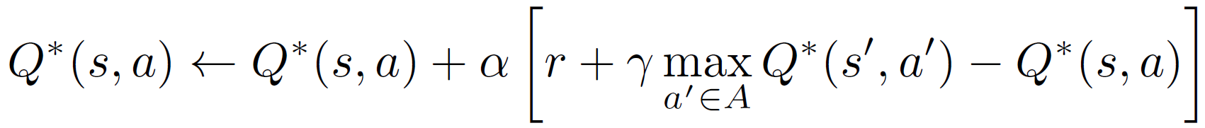
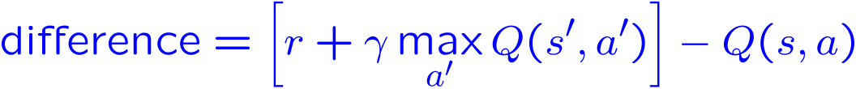
Semi-gradient Q-learning with linear FA
In the tabular case: Given sample (s, a, s', r),
In the case with linear function approximation
(i.e., Q(s,a) = Weighted sum of features)):
Given sample (s, a, s', r),
1. Compute TD-error:
2. For each weight w_{i} corresponding to feature f_{i}:

Slide 45

Example: Approximate Q-learning
User-defined features evaluated at s, a

Slide 46
Example: Approximate Q-learning
Approximate Q-function before update
Current weights:
w_{DOT} = 4.0
w_{GST} = -1.0

Slide 47

Example: Approximate Q-learning
Current weights:
w_{DOT} = 4.0
w_{GST} = -1.0
Approximate
Q-function computed from features and current weights

Slide 48
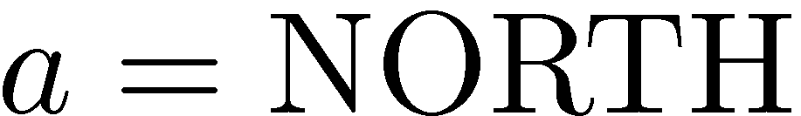
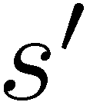
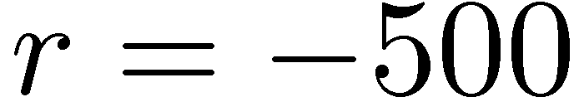

Example: Approximate Q-learning
Take an
actual action,
reach s',
receive r

Slide 49
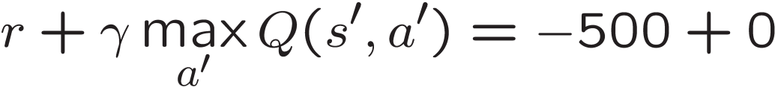
Example: Approximate Q-learning
Compute prediction of Q(s,a) based on next state's (s') Q-value

Slide 50
Example: Approximate Q-learning
Compute
TD-error:
-500 - (+1)

Slide 51
Example: Approximate Q-learning
Use
TD-error
to update
feature weights

Slide 52
Example: Approximate Q-learning
Approximate Q-function after update
New weights:
w_{DOT} = 3.0
w_{GST} = -3.0

Slide 53
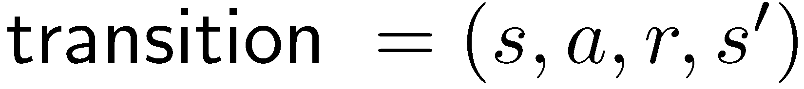

Approximate Q-Learning
Q-learning with linear Q-functions:
Intuitive interpretation:
  Adjust weights of active features
  E.g., if something unexpectedly bad happens, blame the features that were on: disprefer all states with that state’s features
Formal justification: online least squares
Exact Q’s
Approximate Q’s

Slide 54
Approximate Q-Learning
Q-learning with linear Q-functions:
Intuitive interpretation:
  If TD-error is positive, then Q(s,a) needs to become more positive.
  The contribution of feature i to Q(s,a) is given by w_{i} * f_{i}
  To make w_{i} * f_{i} more positive, w_{i} must become more positive if f_{i} is positive,
  and w_{i} must become more negative if f_{i} is negative
Formal justification: online least squares
Exact Q’s
Approximate Q’s

Slide 55
Approximate Q-Learning
Q-learning with linear Q-functions:
Intuitive interpretation:
  f_{i}(s,a) in the update rule also maintains the relative importance of each weight
  Update rule adjusts weights in the correct direction, at the correct scale
Formal justification: online least squares
Exact Q’s
Approximate Q’s

Slide 56
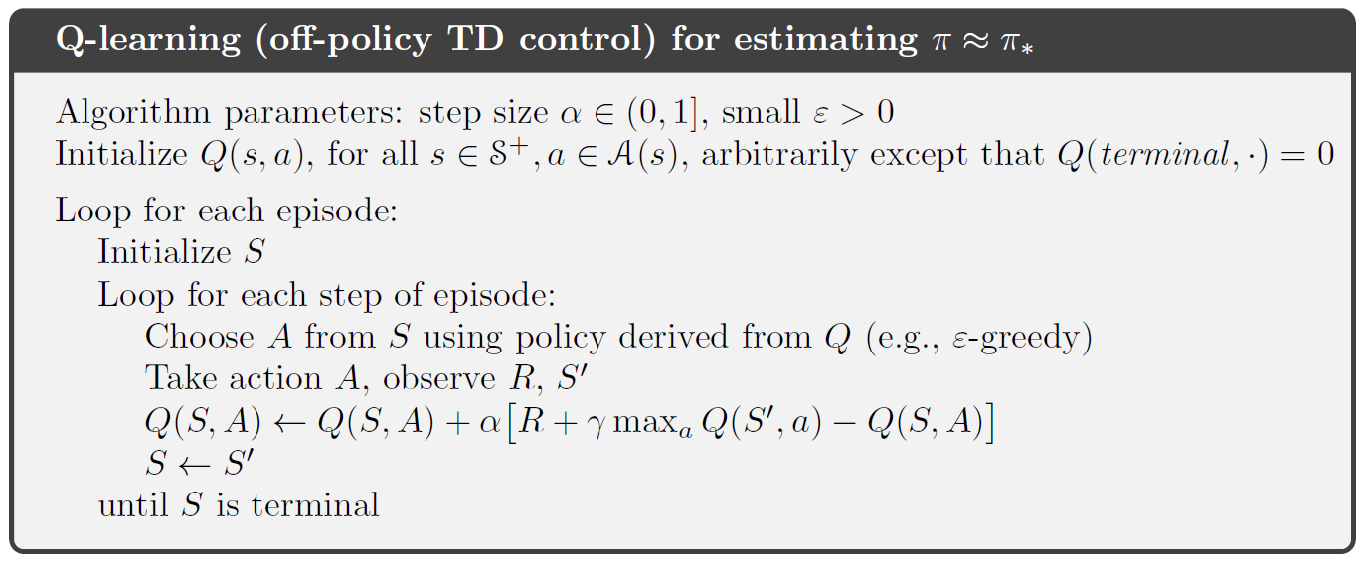
Semi-gradient Q-learning with linear FA
Replace line in box with steps on previous slide:
1. Compute TD-error:
2. For each weight w_{i} corresponding to feature f_{i}:

Slide 57
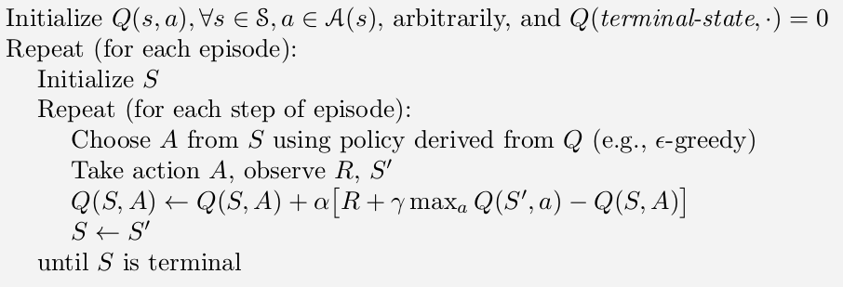
(Tabular) Q-learning
Q-function
World
Q
action
argmax
state
action
state
Update rule

Slide 58
Q-learning with linear function approx
Q-function
World
Q(s,a₁)
state
argmax
action
Q(s,a_{n})
Hand-selected feature representation
for state or state-action pairs

Slide 59
Deep Q-learning*
Q-function
World
Q(s,a₁)
state
argmax
action
Q(s,a_{n})
Values of different possible
discrete actions
*Deep Q-Networks (DQN)

Slide 60
State may be big/complex
Agent takes actions
a
Agent
s,r
How do we get state?
Typically can’t use “raw” sensor data as state w/ a tabular Q-function
– it’s too big (e.g. Pac-man has something like 2^(num pellets) + … states)
– linear function approximation requires choosing features
Hence, nonlinear function approximation (NNs)!
Agent perceives states and rewards

Slide 61
State may be big/complex
Agent takes actions
a
Agent
Is it possible to do RL WITHOUT
hand-coding features?
s,r
How do we get state?
Typically can’t use “raw” sensor data as state w/ a tabular Q-function
– it’s too big (e.g. Pac-man has something like 2^(num pellets) + … states)
– linear function approximation requires choosing features
Hence, nonlinear function approximation (NNs)!
Agent perceives states and rewards

Slide 62
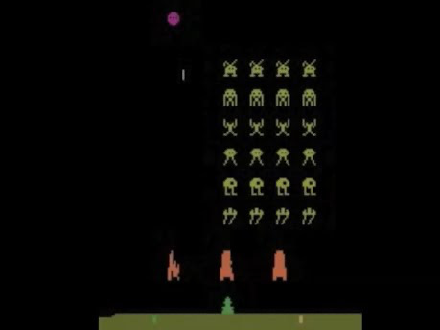
DQN on Space Invaders

Slide 63
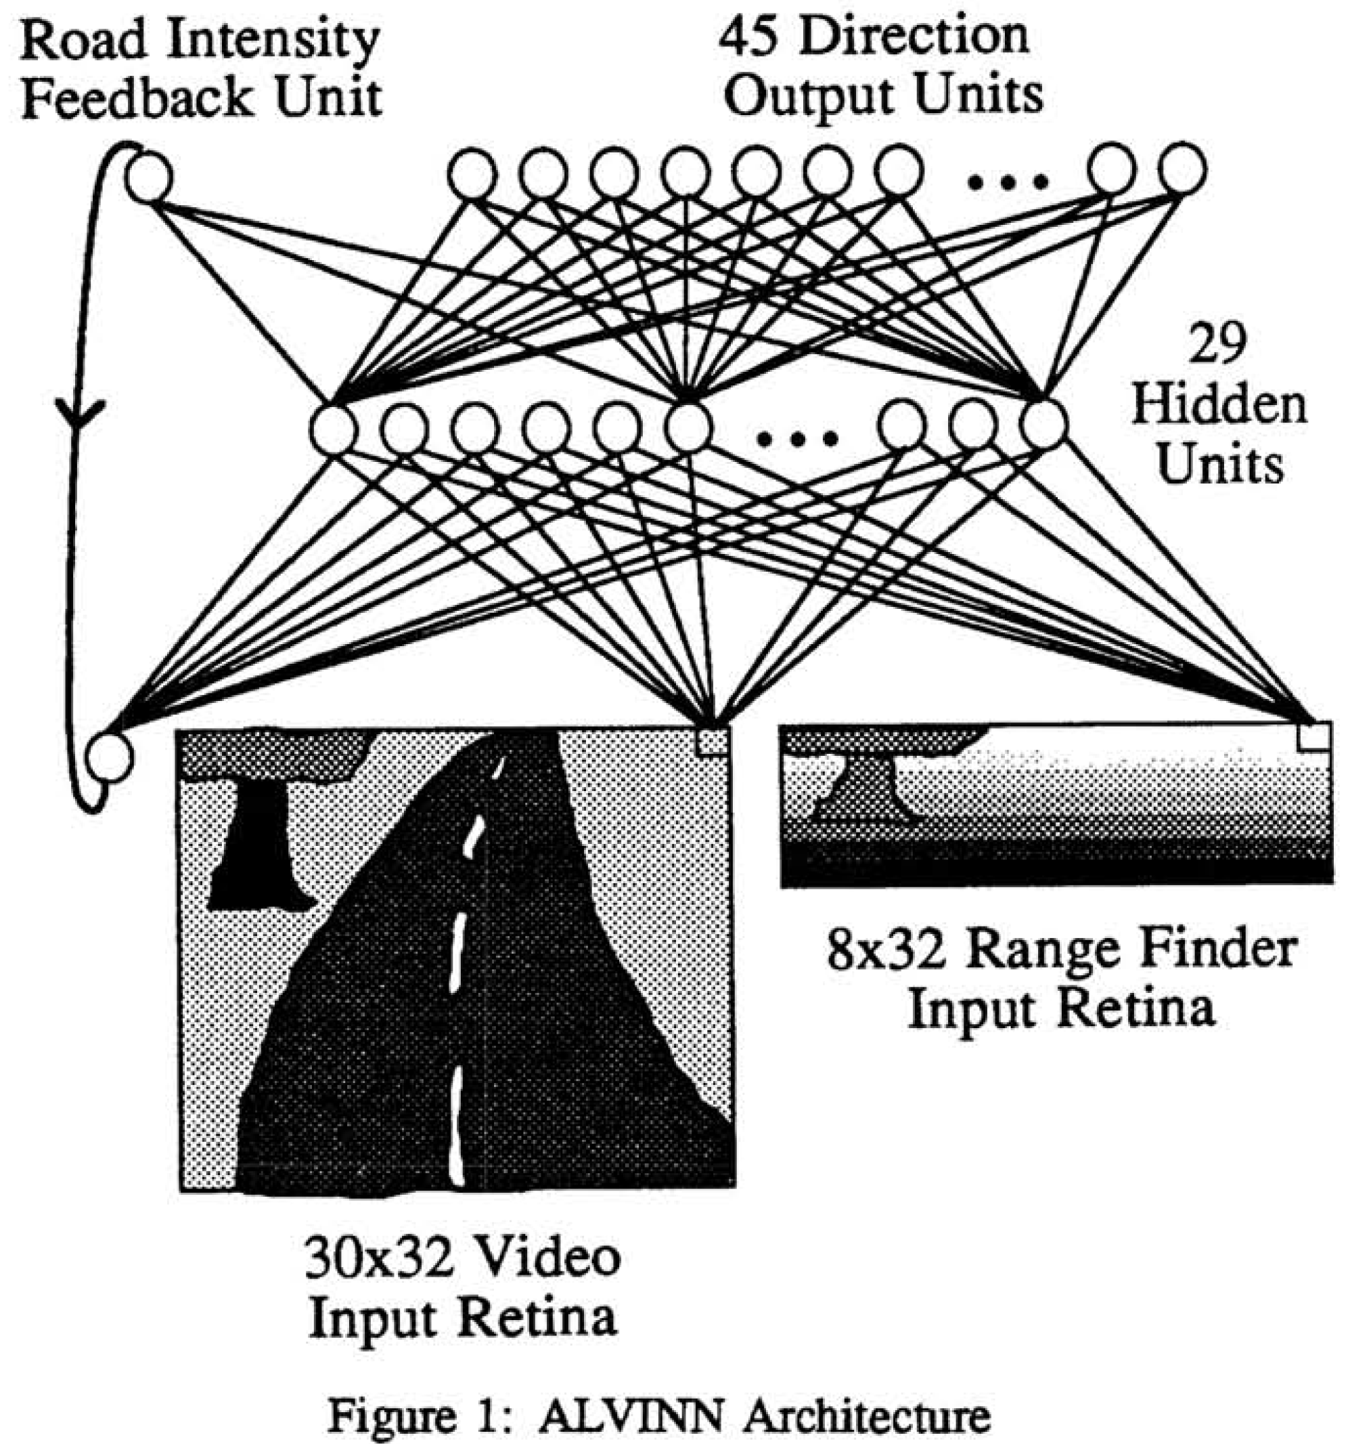
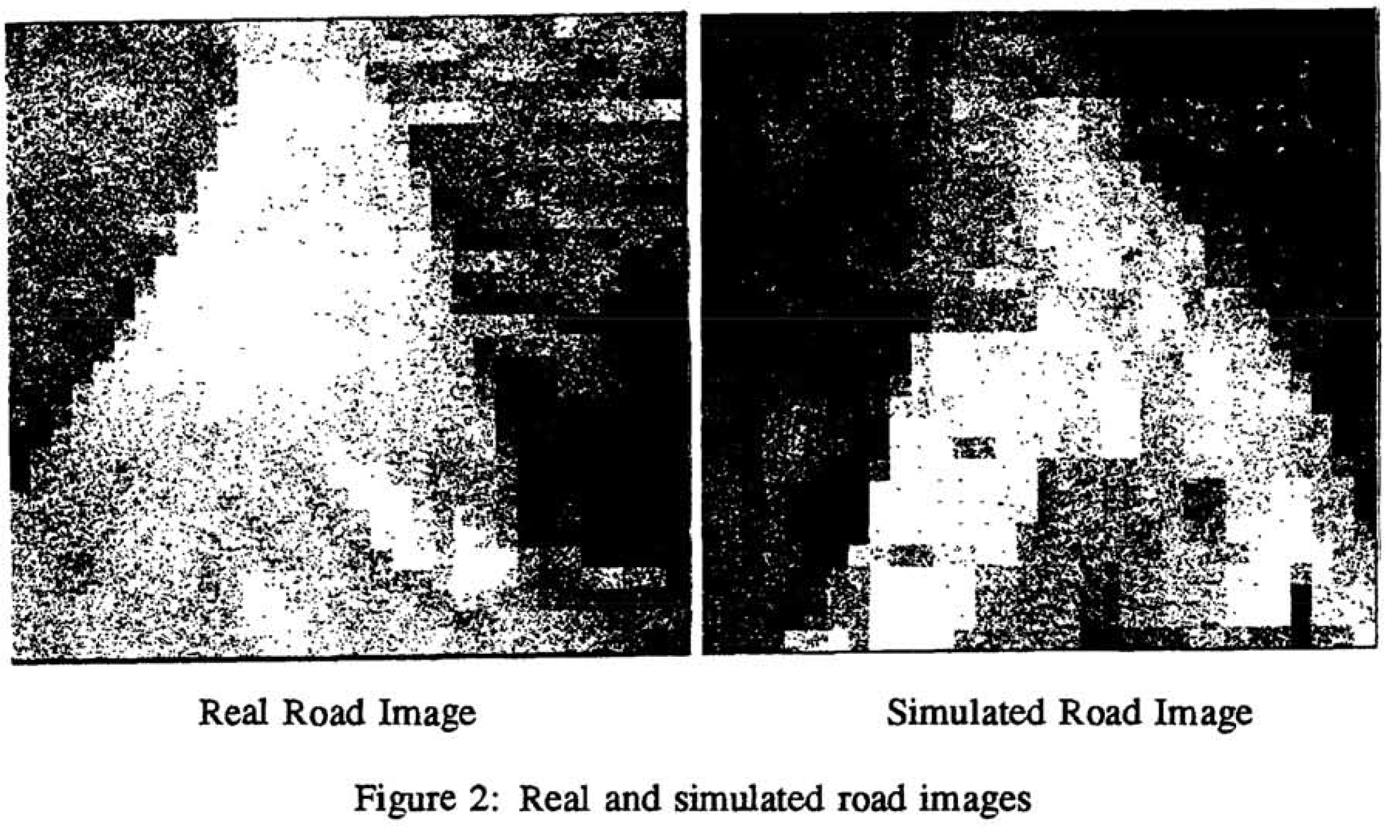
Digression: RL history
When were the following first developed?
Self-driving cars
Advances in
Neural Information
Processing Systems 1
(1989)

Slide 64
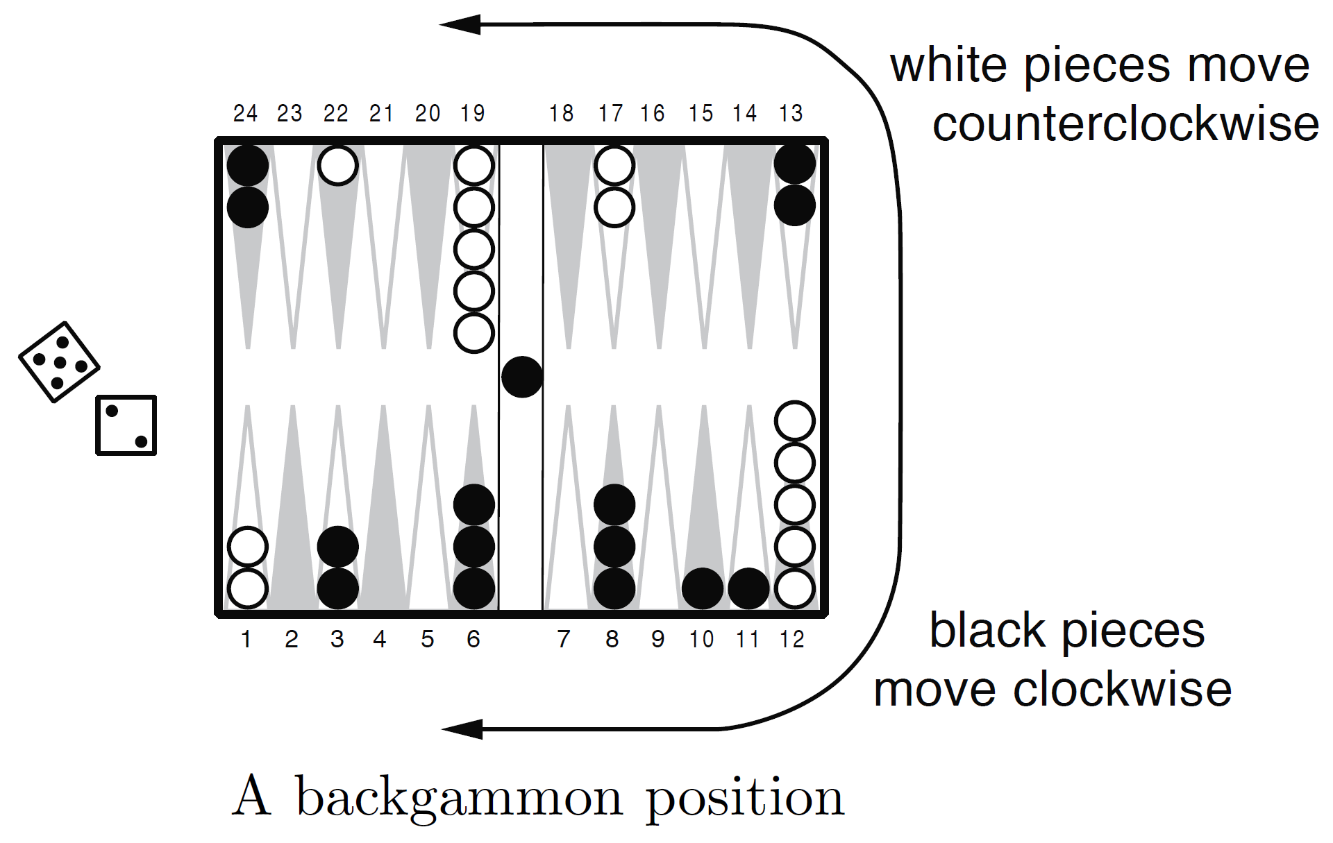
Digression: TD-Gammon (RL2e 16.1)
Communications of the ACM (1995):
https://bkgm.com/articles/tesauro/tdl.html

Slide 65
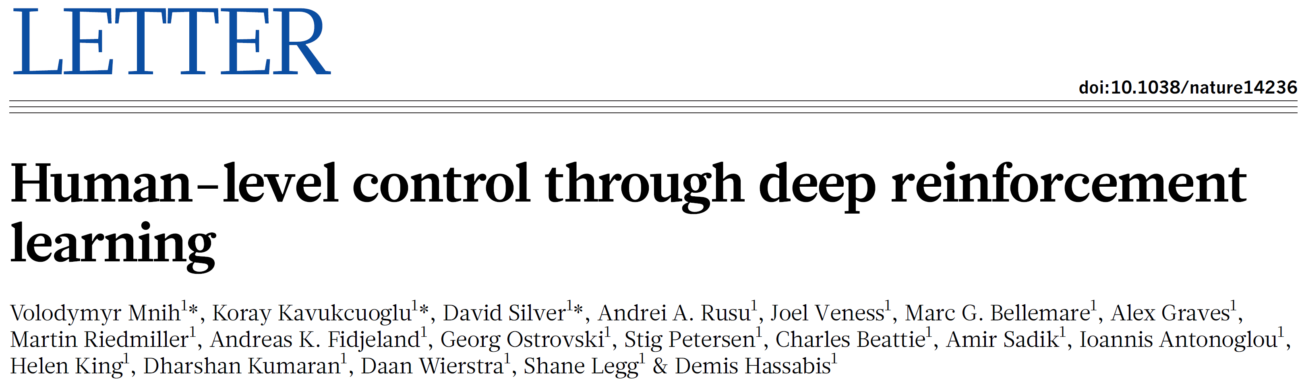
Deep RL
DQN 2015
So, what happened between 1995 and 2015?
TD-Gammon still needed a lot of feature engineering and compute
Hard to find a general and scalable solution (so most people stopped trying to use NNs)

Slide 66
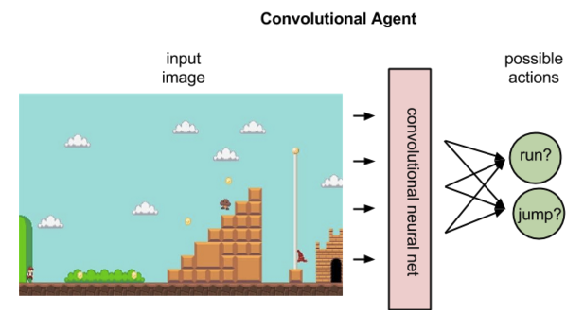
DQN

Slide 67
DQN
Instead of state, we have an image (for example, but it could be other sensor data)
– in practice, it could be a history of the k most recent images
stacked as a single k-channel image (a common hack)
Hopefully, this new image representation is Markov…
– in some domains, it might not be!
– we’ll talk about that soon

Slide 68
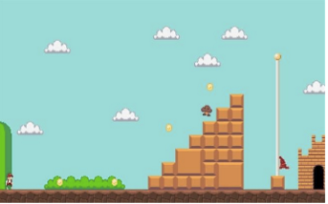
DQN
Stack of images
Q-function
Conv 1
Conv 2
FC 1
Output

Slide 69
DQN
Stack of images
Q-function
Conv 1
Conv 2
FC 1
Output

Slide 70
DQN
Num output nodes equals
the number of actions
Stack of images
Q-function
Conv 1
Conv 2
FC 1
Output

Slide 71
DQN
That way we don’t have to
do multiple passes for max
Stack of images
Q-function
Conv 1
Conv 2
FC 1
Output

Slide 72
Q-function updates in DQN
Here’s the standard Q-learning update equation:
Rewriting:

Slide 73
Q-function updates in DQN
Here’s the standard Q-learning update equation:
Rewriting:
remember this is the “target”
This equation adjusts Q(s,a) in the direction of the target
We’re just going to do function approximation
using neural networks...

Slide 74
Q-function updates in DQN
Use this loss function:

Slide 75
Q-function updates in DQN
Use this loss function:
Notice that Q is now
parameterized by the weights, w

Slide 76
Q-function updates in DQN
Use this loss function:
target
I’m including the bias in the weights

Slide 77
Q-function updates in DQN
Use this loss function:
target

Slide 78
Q-function updates in DQN
Use this loss function:
target
Minimize TD error

Slide 79
Q-function updates in DQN
Use this loss function:
target
We’re going to optimize this loss function using the following gradient:

Slide 80
Question
Use this loss function:
target
We’re going to optimize this loss function using the following gradient:
Does this look familiar?

Slide 81
Q-function updates in DQN
Use this loss function:
target
We’re going to optimize this loss function using the following gradient:
Does this look familiar?
This is exactly the same equation for TD with (linear) function approximation
Recall this is semi-gradient rather than the gradient
– semi-gradient descent may not converge in the off-policy case
– this is often more convenient (i.e., people do it anyway)

Slide 82
Q-function updates in DQN
Use this loss function:
target
We’re going to optimize this loss function using the following gradient:
Does this look familiar?
This is exactly the same equation for TD with (linear) function approximation
Recall this is semi-gradient rather than the gradient
We’ll just have to do forward prop to get Q, backprop to get ∇
and then update weights w

Slide 83
“Barebones” DQN
Initialize Q(s,a;w) with random weights
Repeat (for each episode):
Initialize s
Repeat (for each step of the episode):
Choose a from s using policy derived from Q (e.g. e-greedy)
Take action a, observe r, s’
Until s is terminal
This is all that changed
relative to standard
Q-learning
Where:

Slide 84
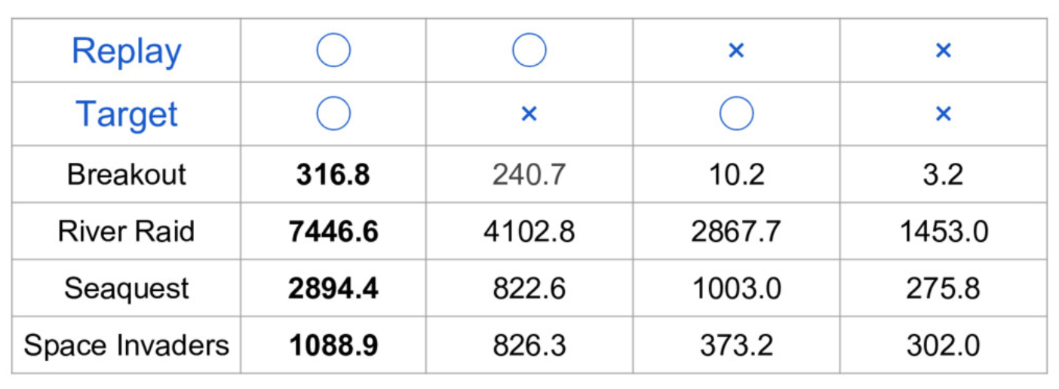
“Barebones” DQN
Unfortunately “Barebones” DQN doesn’t work well
  Poor performance
  May diverge
Two solutions
  Replay buffer
  Target network

Slide 85
Experience replay
Deep learning (and most supervised learning methods)
typically assumes independent, identically distributed (IID)
training data
But is this true in the deep RL scenario?

Slide 86
Experience replay
Deep learning typically assumes independent,
identically distributed (IID) training data
But is this true in the deep RL scenario?
Initialize Q(s,a;w) with random weights
Repeat (for each episode):
Initialize s
Repeat (for each step of the episode):
Choose a from s using policy derived from Q (e.g., e-greedy)
Take action a, observe r, s’
Until s is terminal

Slide 87
Experience replay
Deep learning typically assumes independent,
identically distributed (IID) training data
But is this true in the deep RL scenario?
Initialize Q(s,a;w) with random weights
Repeat (for each episode):
Initialize s
Repeat (for each step of the episode):
Choose a from s using policy derived from Q (e.g. e-greedy)
Take action a, observe r, s’
Until s is terminal
Our solution: buffer experiences and then
“replay” randomly them during training

Slide 88
Experience replay
Initialize with random weights
Repeat (for each episode):
Initialize s
Repeat (for each step of the episode):
Choose a from s using policy derived from Q (e.g., e-greedy)
Take action a, observe r, s’
If mod(step,trainfreq) == 0:
sample batch B from D
Replay buffer
Add this exp to buffer
Train every
trainfreq steps
One step grad
descent wrt buffer

Slide 89
Experience replay
Initialize with random weights
Repeat (for each episode):
Initialize s
Repeat (for each step of the episode):
Choose a from s using policy derived from Q (e.g. e-greedy)
Take action a, observe r, s’
If mod(step,trainfreq) == 0:
sample batch B from D
Replay buffer
Add this exp to buffer
Train every
trainfreq steps
One step grad
descent wrt buffer
Where:

Slide 90
Experience replay
Initialize with random weights
Repeat (for each episode):
Initialize s
Repeat (for each step of the episode):
Choose a from s using policy derived from Q (e.g. e-greedy)
Take action a, observe r, s’
If mod(step,trainfreq) == 0:
sample batch B from D
Replay buffer
Buffers like this are pretty common in deep learning
Add this exp to buffer
Train every
trainfreq steps
One step grad
descent wrt buffer
Where:

Slide 91
Question
Initialize with random weights
Repeat (for each episode):
Initialize s
Repeat (for each step of the episode):
Choose a from s using policy derived from Q (e.g. e-greedy)
Take action a, observe r, s’
If mod(step,trainfreq) == 0:
sample batch B from D
What do you think are the tradeoffs between:
– large replay buffer vs small replay buffer?
‘old’ data vs. forgetting
– large batch size vs small batch size?
computation vs. stability

Slide 92
Target network
Initialize with random weights
Repeat (for each episode):
Initialize s
Repeat (for each step of the episode):
Choose a from s using policy derived from Q (e.g. e-greedy)
Take action a, observe r, s’
If mod(step,trainfreq) == 0:
sample batch B from D
if mod(step,copyfreq) == 0:
Also use a target network:
an older copy of your Q network
Where:

Slide 93
Target network
Initialize with random weights
Repeat (for each episode):
Initialize s
Repeat (for each step of the episode):
Choose a from s using policy derived from Q (e.g. e-greedy)
Take action a, observe r, s’
If mod(step,trainfreq) == 0:
sample batch B from D
if mod(step,copyfreq) == 0:
Target networks helps stabilize DL
– why?
Where:

Slide 94
DQN architecture

Slide 95
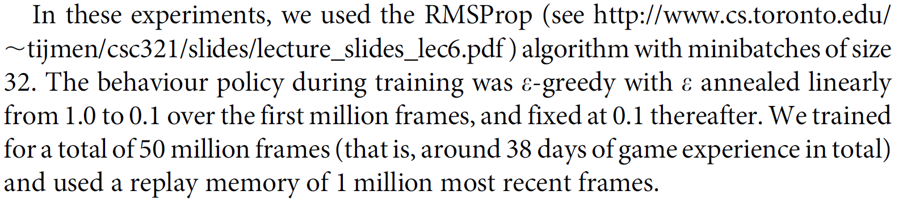
DQN training

Slide 96
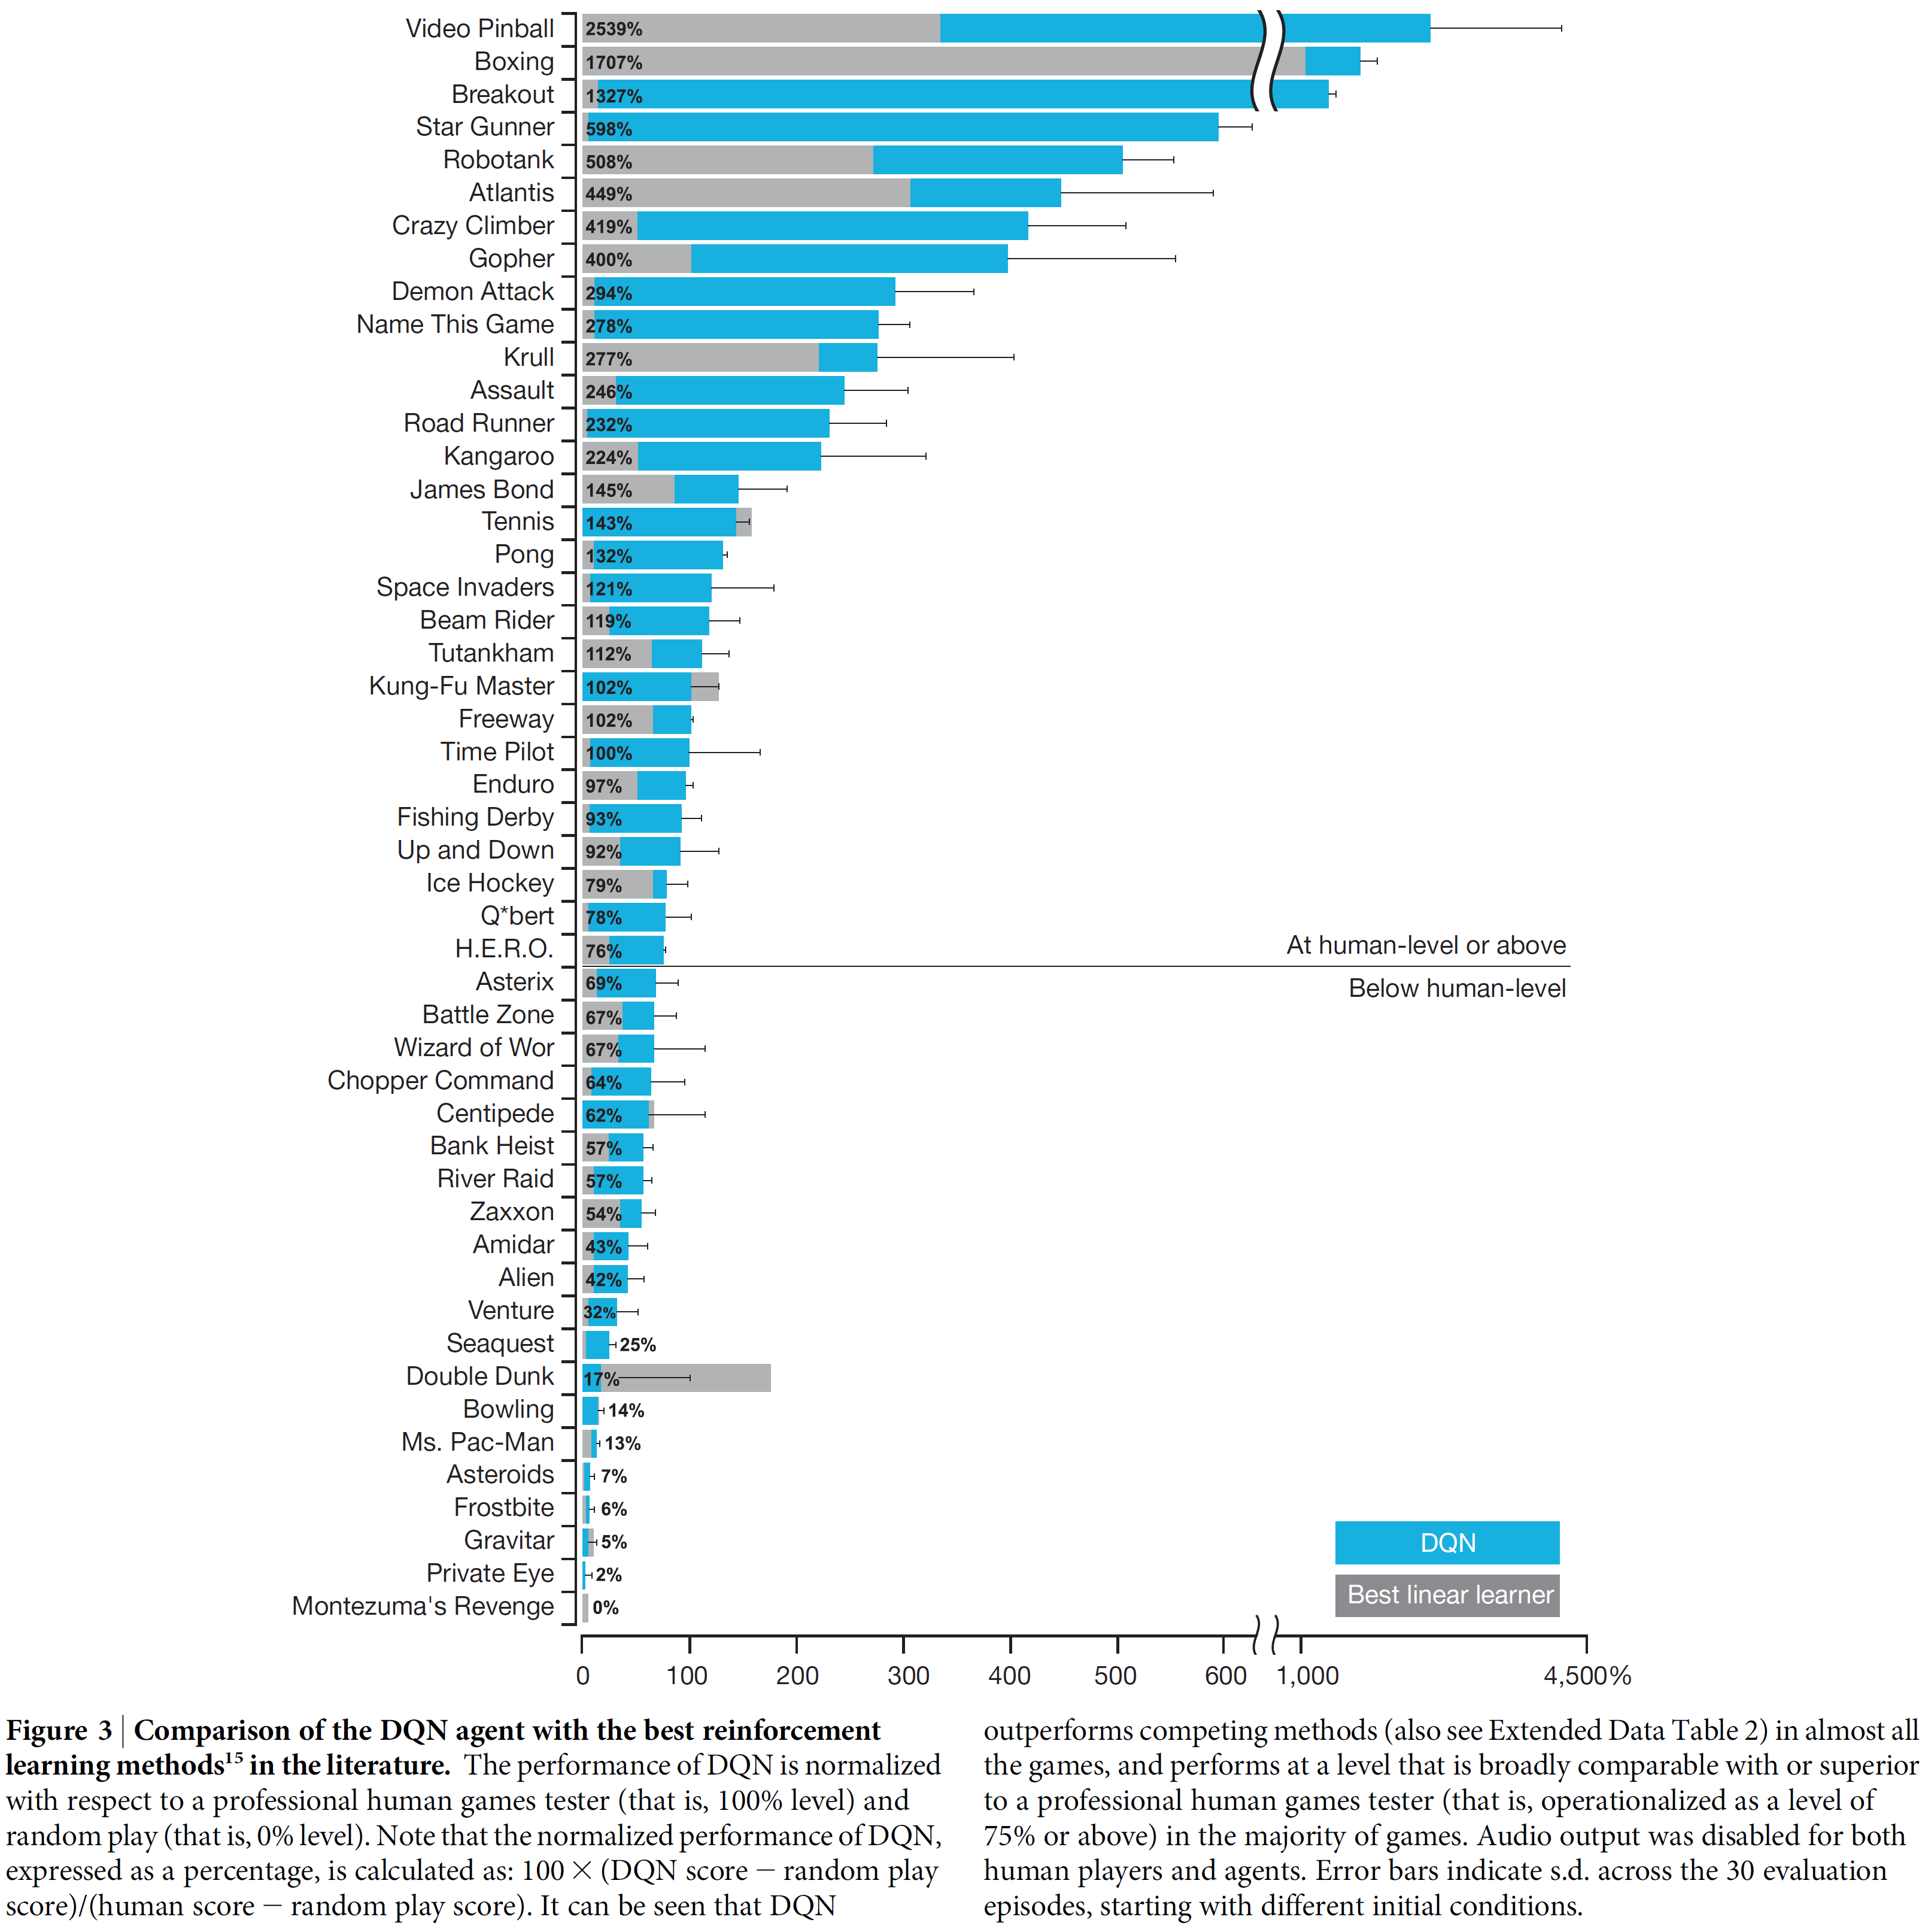
DQN results
Deep Q-Networks: Results

Slide 97
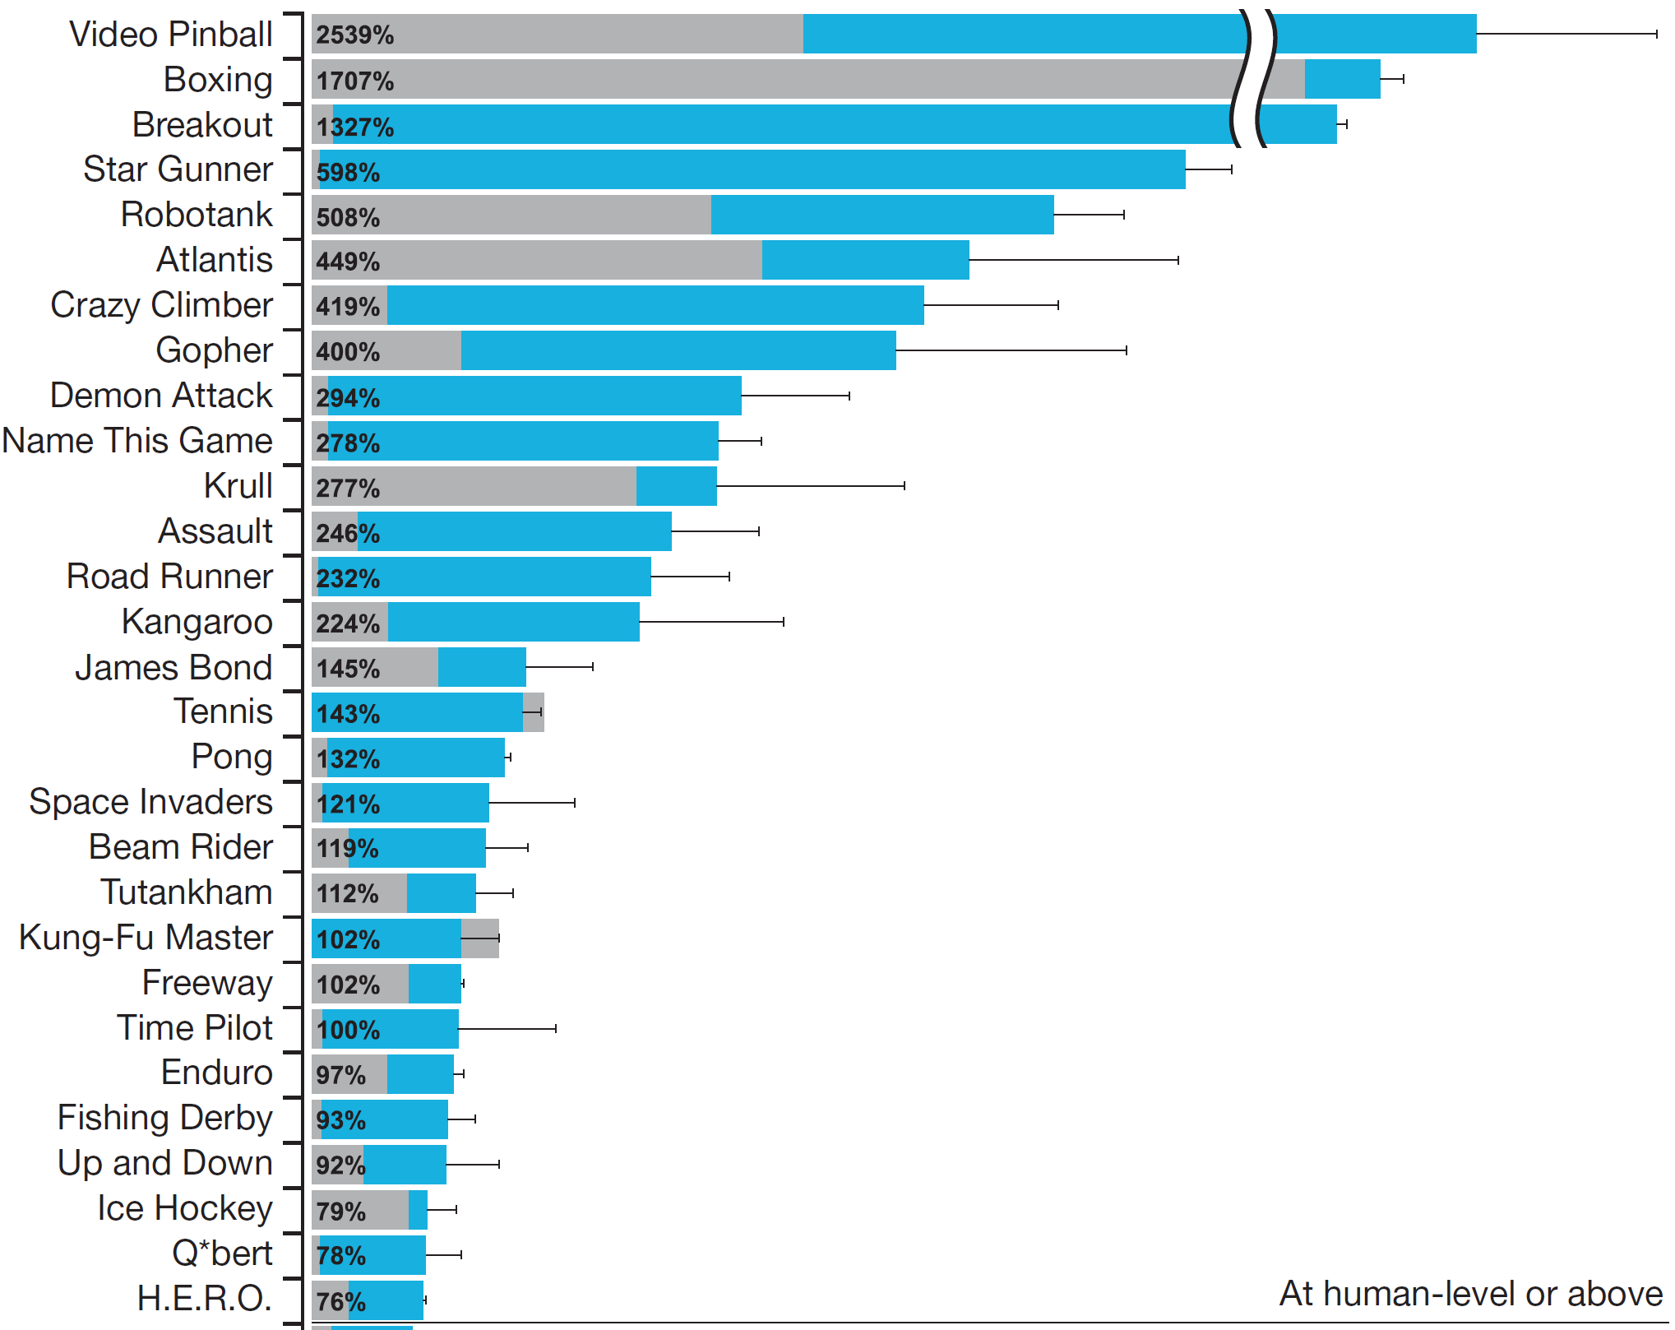
Deep Q-Networks: Results

Slide 98
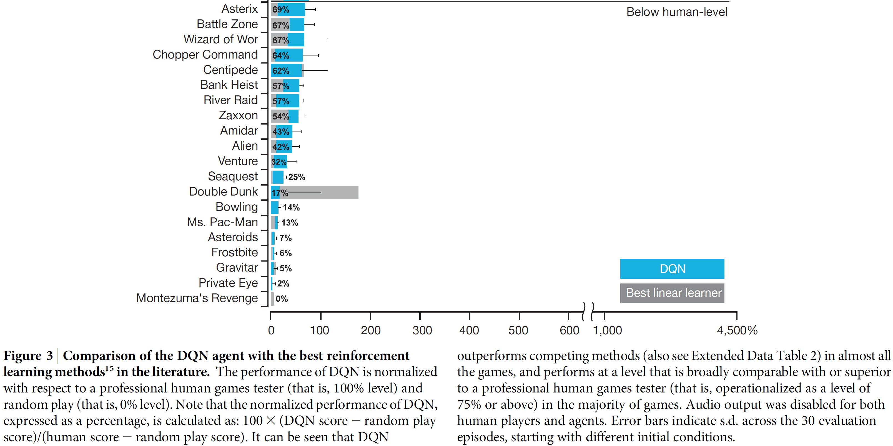
DQN results

Slide 99

DQN results

Slide 100
DQN ablations: Some Atari games
Experience replay and target networks really help!

Slide 101

DQN details

Slide 102

DQN details

Slide 103

DQN details

Slide 104

DQN details

Slide 105

DQN details

Slide 106

Double DQN
Recall the problem of maximization bias:

Slide 107

Double DQN
Recall the problem of maximization bias
Our solution from the TD lecture:
We already have a second Q-function!

Slide 108
Double DQN
Initialize with random weights
Repeat (for each episode):
Initialize s
Repeat (for each step of the episode):
Choose a from s using policy derived from Q (e.g., e-greedy)
Take action a, observe r, s’
If mod(step,trainfreq) == 0:
sample batch B from D
if mod(step,copyfreq) == 0:
Where:

Slide 109
DQN vs Double DQN
Update for both
DQN
Double DQN
Where:
Where:

Slide 110

Double DQN

Slide 111
Prioritized replay buffer
Initialize with random weights
Repeat (for each episode):
Initialize s
Repeat (for each step of the episode):
Choose a from s using policy derived from Q (e.g. e-greedy)
Take action a, observe r, s’
If mod(step,trainfreq) == 0:
sample batch B from D
Previously this sample was uniformly random
Can we do better by sampling the batch intelligently?

Slide 112
Prioritized replay buffer
Idea: sample elements of minibatch
by drawing samples with probability:
where denotes the priority of a sample
– simplest case:
( this is “proportional” sampling)
Problem: since we’re changing the distribution of updates performed,
we are (potentially) getting the wrong distribution of returns
– need to weight sample updates:
Ideas that is similar to things we did in the tabular case
(prioritized sweeping, importance sampling)!

Slide 113

Prioritized replay buffer
– averaged results over 57 atari games

Slide 114
Dueling networks for Q-learning
Advantage function
Decompose Q as:

Slide 115
Think-pair-share
Advantage function
Decompose Q as:
1. Why might this decomposition be better?
2. Is A always positive, negative, or either? Why?

Slide 116


Intuition
Atari Enduro. Source: https://gfycat.com/clumsypaleimpala

Slide 117
Intuition
Baseline
Action-based offset

Slide 118
Dueling networks for Q-learning
Notice that the V/Q decomposition is not unique, given Q targets only
Therefore:
When a=a*, Q(s,a)=V(s)

Slide 119
Dueling networks for Q-learning
Notice that the V/Q decomposition is not unique, given Q targets only
Actually do:
This is more stable, but less intuitive (i.e., it works better)

Slide 120

Dueling networks for Q-learning
Action set: left, right, up, down, no-op (arbitrary number of no-op actions).
SE: squared error relative to true value function
Compare dueling w/ single stream networks (all networks are three-layer MLPs)
Increasing number of actions in above corresponds to increases in no-op actions
Conclusion: Dueling networks can help a lot for large numbers of actions
(especially when actions have similar value)

Slide 121

Dueling networks: With DDQN
Change in avg rewards for 57 ALE domains versus (D)DQN w/ single network

Slide 122
Dueling networks: With PER
Change in avg rewards for 57 ALE domains versus (rank-based) Prioritized DDQN

Slide 123


Distributional Q-learning

Slide 124


Combine all these ideas (Rainbow)!

Slide 125
Summary
Deep reinforcement learning methods give us powerful function approximation, but with added complications
DQN: Deep Q-Networks
  Extending Q-learning to use (deep) neural nets as function approximation
Many extensions of DQN to improve performance
These extensions are typically based on ideas from the tabular case

Slide 126
External lectures (with video)
DeepMind x UCL
  https://deepmind.com/learning-resources/reinforcement-learning-series-2021
David Silver
  https://www.davidsilver.uk/teaching/
Berkeley (Deep RL)
  https://rail.eecs.berkeley.edu/deeprlcourse/
Coursera, Udacity, etc. also have lectures

Slide 127

From the end of lecture 9 (Volodymyr Mnih)

Slide 128

Getting Deep RL working
https://spinningup.openai.com/en/latest/index.html

Slide 129

Deep policy gradient (A3C)

Slide 130

A selection of ‘modern’ RL algorithms
From: https://spinningup.openai.com/en/latest/spinningup/rl_intro2.html

Slide 131
A selection of ‘modern’ RL algorithms

Slide 132
A selection of ‘modern’ RL algorithms

Slide 133
A selection of ‘modern’ RL algorithms

Slide 134
A selection of ‘modern’ RL algorithms

Slide 135

Paradigm so far: Generalized policy iteration
"Almost all reinforcement learning
methods are well described as
GPI [Generalized Policy Iteration].”

Slide 136
Paradigm so far: Generalized policy iteration
"Almost all reinforcement learning
methods are well described as
GPI [Generalized Policy Iteration].”
Do we really need to
learn a value function?

Slide 137

Do we really need to learn a value function?
Sometimes, the policy
might be quite simple
Breakout: Do not die
(ensure paddle is always
underneath ball)

Slide 138
Do we really need to learn a value function?
Sometimes, the policy
might be quite simple
Breakout: Do not die
(ensure paddle is always
underneath ball)
In contrast, value function
might be quite complicated
(depends on remaining bricks, etc.)
“Yak shaving”: Do not make the solution
more complicated than the original problem

Slide 139
Approaches to control
Previous approach: Action-value methods:
  learn the value of each action
  pick the max (usually)
New approach: Policy-gradient methods:
  learn the parameters of a stochastic policy (or a continuous-action policy)
  update by gradient ascent in performance
  includes actor-critic methods, which learn both value and policy parameters

Slide 140
Why approximate policies rather than values?
In many problems, the policy is simpler to approximate than the value function
In some problems, the optimal policy is stochastic
  e.g., multi-agent, function approximation
To enable smoother change in policies
To avoid a search on every step (the max)
Easier to inject policy-related prior knowledge (e.g., as the initial policy)

Slide 141
Policy Approximation
Policy = a function from state to action
  How does the agent select actions?
  In such a way that it can be affected by learning?
  In such a way as to assure exploration?
Approximation: there are too many states and/or actions to represent all policies
  To handle large/continuous action spaces
Any parameterization is ok as long as it is differentiable (we are going to use gradient methods)

Slide 142
Some notes/disadvantages
- Most methods are on-policy
- Frequently applied to continuous control tasks
- Higher variance
- Less sample efficient
- Less well-understood overall
(still very much in active development)

Slide 143

Policy search
Optimize the policy directly with respect to some objective
Consider a parameterized family of policies:
Define a scalar performance measure J(θ) :
Typically:
Goal: Find θ that maximizes J(θ)

Slide 144
Policy search
Goal: Find θ that maximizes J(θ)
Many approaches to solve this optimization problem!
Derivative-free methods:
- Exhaustive search
- Genetic algorithms
- Cross-entropy method
- Evolution strategies (e.g., covariance-matrix adaptation)
(e.g., see Ch. 10 of Algorithms for Decision Making,
Kochenderfer, Wheeler, and Wray;
https://algorithmsbook.com/)

Slide 145



Policy gradient
Goal: Find θ that maximizes J(θ)
Many approaches to solve this optimization problem!
Gradient-based (first-order) methods:
- (Stochastic) Gradient ascent
This assumes that exists, which in turn assumes that exists
i.e., the policy's action probabilities are smoothly varying
with respect to the parameters θ

Slide 146

Parameterized policies
Discrete actions:
Boltzmann distribution
(softmax) with

Slide 147


Parameterized policies
Discrete actions:
Boltzmann distribution
(softmax) with
Action preferences h can be arbitrary, e.g.:
- A learnable scalar for each action / state-action pair
- Linear in features:
If linear, gradients are (Ex. 13.3):

Slide 148
Parameterized policies
Discrete actions:
Boltzmann distribution
(softmax) with
Action preferences h can be arbitrary, e.g.:
- A learnable scalar for each action / state-action pair
- Linear in features:
- Neural network with weights θ

Slide 149


Parameterized policies
Continuous actions:
Gaussian policy with learnable mean and stdevs
Mean and log-stdev can be linear in features:
Gradients
(Ex. 13.4):

Slide 150
Parameterized policies
Continuous actions:
Gaussian policy with learnable mean and stdevs
Mean and log-stdev can be linear in features:
Could be outputs of neural networks with weights θ_{μ} , θ_{σ}

Slide 151
Outline
✓ Motivation for policy search / optimization
✓ Policy search & policy-gradient optimization
- Warm up: Gradient bandits
- Policy-gradient theorem
- REINFORCE
- Actor-critic methods
- Extensions and further methods

Slide 152



Policy gradient setup
Stochastic policy that is
parameterized by 𝜃
Given a policy parameterization:
And objective:
(or average reward)
Approximate stochastic gradient ascent:
Typically, based on the Policy-Gradient Theorem:
on-policy distribution

Slide 153
Policy gradient setup
Given a policy parameterization:
Assume an initial state for now
And objective:
(or average reward)
Approximate stochastic gradient ascent:
Typically, based on the Policy-Gradient Theorem:
on-policy distribution

Slide 154
Policy gradient setup
Given a policy parameterization:
And objective:
(or average reward)
Directly maximize objective
with gradient ascent
Approximate stochastic gradient ascent:
Typically, based on the Policy-Gradient Theorem:
on-policy distribution

Slide 155
Policy gradient setup
Given a policy parameterization:
And objective:
(or average reward)
Like before, we are
approximating the gradient
with samples
Approximate stochastic gradient ascent:
Typically, based on the Policy-Gradient Theorem:
on-policy distribution

Slide 156
Policy gradient setup
Given a policy parameterization:
And objective:
(or average reward)
Approximate stochastic gradient ascent:
We’ll talk about this next
Typically, based on the Policy-Gradient Theorem:
on-policy distribution

Slide 157
The policy gradient theorem
Just like we approximated the value function and updated its parameters with gradient decent, we can do the same thing with the policy parameterization
Policy now changes smoothly (unlike in action-value methods)
Can’t guarantee the policy improves values at at all states, but (remember) we really care about states in proportion to their visits
But this depends on the policy that is changing

Slide 158

The policy gradient theorem
The policy gradient theorem gives a way to calculate the gradient of the performance objective without the derivative of the state distribution:
Intuition: Change in
= [ Change in J wrt. π ] * [ Change in π wrt. θ ]

Slide 160
Policy gradient theorem (cont.)

Slide 161
Outline
✓ Motivation for policy search / optimization
✓ Policy search & policy-gradient optimization
✓ Warm up: Gradient bandits
✓ Policy gradient theorem
- REINFORCE
- Actor-critic methods
- Extensions and further methods

Slide 162
REINFORCE
How do we actually use the policy gradient theorem?
Need to estimate the on-policy distribution and the q-values
Like usual, we’ll do this by (Monte Carlo) sampling

Slide 163

Deriving REINFORCE from the PGT
Using expectation notation:
we will visit states with the
on-policy distribution when
we follow the policy

Slide 164
Deriving REINFORCE from the PGT
Multiplying through

Slide 165
Deriving REINFORCE from the PGT
Estimating q with MC returns

Slide 166

Deriving REINFORCE from the PGT
SGD version
Thus

Slide 167
Deriving REINFORCE from the PGT
The REINFORCE update
Thus

Slide 168
Deriving REINFORCE from the PGT
Parameters increase
with return
Thus

Slide 169
Deriving REINFORCE from the PGT
Thus
Towards repeating A_{t} in S_{t}
adjusting magnitude based
on probability (balancing
actions that are taken frequently)

Slide 170
REINFORCE
MC, so generating full
episode before updating

Slide 171


REINFORCE
Score function trick or REINFORCE trick
=

Slide 172


REINFORCE finds the right probability

Slide 173
REINFORCE with baseline
REINFORCE will converge to a local optimum (with appropriate 𝛼)
But, as we know, Monte Carlo estimates have high variance
What did we do in the gradient bandit case?

Slide 174

REINFORCE with baseline
Policy-gradient theorem with baseline:
any function of state, not action

Slide 175
REINFORCE with baseline
Policy-gradient theorem with baseline:
Why?
any function of state, not action

Slide 176
REINFORCE with baseline
Policy-gradient theorem with baseline:
any function of state, not action
Because

Slide 177


REINFORCE with baseline
Policy-gradient theorem with baseline:
any function of state, not action
Because
Thus

Slide 178
REINFORCE with baseline
Policy-gradient theorem with baseline:
any function of state, not action
Because
Baseline varies per state since
magnitude of action-values could
be very different in different states
Thus

Slide 179


Subtracting off baseline
Again

Slide 180
Learning a baseline from MC
returns using function approx
Again

Slide 181


REINFORCE with baseline is faster

Slide 182

REINFORCE
Also famous for one of the inventors
of backprop and other early NN work

Slide 183
Outline
✓ Motivation for policy search / optimization
✓ Policy search & policy-gradient optimization
✓ Warm up: Gradient bandits
✓ Policy gradient theorem
✓ REINFORCE
- Actor-critic methods
- Extensions and further methods

Slide 184
Actor-critic methods
How is the state-value estimate used in REINFORCE? Does it use bootstrapping? No.
Actor-critic methods use bootstrapping
  As a result, they are biased, but often learn faster than MC methods
  Replace the MC return with a bootstrapped return (and call still use a state-value baseline)

Slide 185


Actor-Critic methods
REINFORCE with baseline:
Actor-Critic method (semi-gradient TD(0) version):
One-step TD error

Slide 186
Learning targets
Alternative learning targets?
- Above: Monte-Carlo return
- One-step return
- n-step return
- λ-return
…

Slide 187
Actor-Critic (TD(0) version)
What is I doing?

Slide 188
Actor-Critic (TD(0) version)
This is Q(S,A)-V(S)
The advantage!

Slide 189
Actor-Critic (TD(0) version)
Advantage actor-critic:
A2C

Slide 190
Actor-Critic (TD(0) version)
Q actor-critic just uses the
Q estimate here (no baseline)

Slide 191

Actor-critic architecture

Slide 192
A selection of ‘modern’ RL algorithms

Slide 193
Asynchronous Advantage Actor Critic (A3C) --- ICML 2016
Uses multiple environments instead of experience replay
  Still decorrelated since different agents will be in different states
  Parallel implementation (can be done on CPU)
A general idea but extend A2C (so on-policy and stochastic policy)

Slide 194

A3C
t_{max}=1 for 1-step

Slide 195

A3C results
Typically, episodes or steps

Slide 196
Continuous actions
Policy gradient methods can also learn parameterizations of continuous action policies
  Either as parameters for a continuous probability distribution (rather than a discrete one)
    We’ll talk about this first
  Or directly considering parameters of the continuous action space
    We’ll talk about this after…

Slide 197
Actions chosen by a Gaussian
Actions as real numbers
Gaussian given by mean and standard deviation
The policy can be defined with a Gaussian
Need to learn

Slide 198
Actions chosen by a Gaussian
The policy can be defined with a Gaussian
Need to learn
Maybe we want a linear representation for 𝜇 and an exponential for 𝜎
We can use the same algorithms to learn these parameters

Slide 199
Gaussian eligibility functions
Now, we just need the gradients to make updates:
Gradients (score/eligibility functions):

Slide 200
Continuous states and actions
Continuous MDP objective:
  Rho is the (discounted) state distribution
  Just replacing sums with integrals
Continuous MDP PGT:

Slide 201
Off-policy case
Off-policy objective:
  Using behavior policy 𝛽 and target policy 𝜋_{𝜃}
Off-policy PG approximation (not exact)

Slide 202
Deterministic policy gradient (DPG)---ICML 2014
Deterministic policy objective:
Deterministic policy gradient theorem

Slide 203
Deterministic policy gradient (DPG)
Deterministic policy objective:
Deterministic policy gradient theorem
Not exactly the same as stochastic case but can
show that the stochastic policy gradient converges
to deterministic one as stochasticity goes to 0

Slide 204
On-policy DPG
Could be used on-policy if we don’t need exploration from stochastic policy
Replace the corresponding lines in our above algorithms with:

Slide 205
Off-policy DPG
Many possible algorithms using DPG
Paper presents an actor-critic approach
Critic updates omega, actor updates theta
If use Q-learning (1-step TD) you don’t need importance sampling
Target policy

Slide 206
Deep deterministic policy gradient (DDPG) ---ICLR 2016
Basically, DPG combined with DQN
  Still off-policy actor-critic framework
  Replay buffer, target networks for both actor and critic (but they are ‘soft’ with θ ← τθ + (1 − τ )θ )
  Updates from DPG
  Added noise to actor for exploration

Slide 207
DDPG
DQN
Target policy with
target critic
DQN
DPG update
Soft update

Slide 208


DDPG results

Slide 209
Twin Delayed DDPG (TD3)---ICML 2018
An extension to DDPG
Like Double Q-learning, uses two (twin) Q-functions to help with overestimation
Updates the actor less frequently (delayed updates)
Adds noise to actions to improve robustness

Slide 210

TD3

Slide 211

TD3 results

Slide 212
Soft actor-critic (SAC)---ICML 2018
Uses maximum entropy reinforcement learning objective:
  Encourages stochastic policies
  Helps with exploration and capture multiple possible optimal (or good) policies
  It is common to add an extropy loss to PG methods just for exploration
Off-policy, stochastic (not deterministic) policy
Typically used for continuous control but also works for discrete actions

Slide 213

SAC
2 Q networks like TD3
Entropy
Using done
Min over 2 Qs

Slide 214


SAC results

Slide 215
A selection of ‘modern’ RL algorithms

Slide 216
Trust region policy optimization (TRPO)---ICML 2015
On-policy PG methods are not very sample efficient
Would like to take large step sizes, but this can make methods unstable
TRPO tries to improve the improve the policy as much as possible, while bounding how much it can change (measured by KL):
Computationally intractable, so use second order (quadratic) approximation and average KL

Slide 217

TRPO

Slide 218
Proximal policy optimization (PPO)---arXiv 2017
TRPO is computationally demanding and complex to implement
PPO further approximates the KL constraint with clipping:
Still on-policy
Same as TRPO
Bound the loss instead of using KL

Slide 219

PPO
Can be parallelized

Slide 220


TRPO and PPO results

Slide 221
Summary
Policy gradient methods allow learning of policies (as well as value functions)
More naturally scale to large and continuous action spaces than action-value methods
Like other gradient methods (typically) only have locally optimal convergence guarantees

Slide 222
Partially observable RL
Sometimes the environment includes state variables that are not visible to the agent
  the agent sees only observations, not state
  e.g., the object in the box, or in other rooms, velocities, even real positions as distinct from sensor readings
This makes the environment Non-Markov
Note red title slides from Andrea Baisero

Slide 223






Examples of Full and Partial Observability
Informal definition: Some state information is hidden.
(a) Acrobot.
(b) Lunar Lander.
(c) Sokoban.
(d) Flappybird. (e) Breakout.
(f) ViZDoom.

Slide 224

DQN with a recurrent layer (DRQN)

Slide 225
Implications of Partial Observability
What is partial observability?
Environment state is in some way hidden from agent
e.g., behind the agent, behind the corner, contents of a box, etc.
Agent sees indirect observations, not full state
  Sometimes filtered state
  Sometimes separate observation space altogether
Non-Markovian Pr(ot | ot−1, . . . , o1) ̸= Pr(ot | ot−1)
Is that such a big deal?
No, just use the same methods with available observation
Reactive policies π : O → ∆A

Slide 226
Implications of Partial Observability
What is partial observability?
Environment state is in some way hidden from agent
e.g., behind the agent, behind the corner, contents of a box, etc.
Agent sees indirect observations, not full state
  Sometimes filtered state
  Sometimes separate observation space altogether
Non-Markovian Pr(ot | ot−1, . . . , o1) ̸= Pr(ot | ot−1)
Is that such a big deal?
No, just use the same methods with available observation
YES! Significant theoretical & practical consequences!
Reactive policies π : O → ∆A are far from ideal!

Slide 227

A Positive Example: Sutton’s Gridworld
Observation: 3x3 region around agent
Figure: Reactive solution to Sutton’s gridworld (Littman, 1994).
Keypoints: State aliasing
Suboptimality, reactive control as constrained control Still, we can guarantee goal

Slide 228

A Negative Example: McCallum’s Maze
Observation: 3x3 region around agent
Figure: McCallum’s Maze (Littman, 1994).
Question: Can we guarantee goal?

Slide 229

A Negative Example: McCallum’s Maze
Observation: 3x3 region around agent
Figure: McCallum’s Maze (Littman, 1994).
Question: Can we guarantee goal?
Keypoints: Deterministic π fails from one direction (constrained policy) Stochastic π succeeds from both directions (still suboptimal) Optimal deterministic policy not guaranteed?

Slide 230

A Negative Example: McCallum’s Maze
Observation: 3x3 region around agent
Figure: McCallum’s Maze (Littman, 1994).
Question: Can we guarantee goal?
Keypoints: Deterministic π fails from one direction (constrained policy) Stochastic π succeeds from both directions (still suboptimal) Optimal deterministic policy not guaranteed?
Resolution: Deterministic π w/ memory, guarantee goal from both directions!

Slide 231
Information Gathering & Memorization
Goal: Reach good exit, avoid bad exit
Observability:
Full observability of position
Partial observability of exits
FO Optimality: Just exit
PO Optimality: Backtrack, memorize, exit
Easy to execute Deviously hard to discover
Information Gathering:
Exit
Exit
Agent
Priest
Figure: Heaven/Hell Problem.
Broader than state estimation, about reaching desireable belief-states
Problem-dependent, e.g., info gathering actions/states/experiences, etc.
Commonly harmful upfront cost, hard to overcome
Memorization: History contains all the info, memorize what?
Memory as information extraction
Needle in haystack problem, key to extract and integrate right info
Remember too little, remember too much, remember wrong things

Slide 232


Information Gathering & Memorization
(b) Observation.
(a) State.
Figure: Memory-Four-Rooms-9x9, a procedurally generated navigation task which requires information-gathering and memorization. The agent must avoid the bad exit and reach the good exit, which is identifiable by the color of the beacon.

Slide 233
Full vs Partial Observability
Fully Observable Control
Access to full system state
π : S → ∆A
Solid theory, comparatively easy!
Strong assumption, not always possible!
Partially Observable Control
Access to partial/indirect observations derived from state
π : ? → ∆A
Better match to reality, common in real world problems
Extremely wide range of difficulties (technical vs significant PO)
  At best, about as difficult as full observability
  At worst, orders of magnitude more difficult, virtually impossible

Slide 234

Markov decision processes (MDPs)
Defined with tuple M = <S, A, P, R>
  S, discrete or continuous (Markovian) states
  A, discrete or continuous actions
  P, the state transition model:
  R, the reward model:
Generate policy 𝜋: S → A to maximize cumulative reward over finite or infinite time steps
a
Environment
s,r

Slide 235
POMDPs
Defined with tuple: M = <S, A, P, R, Ω, O>
  S,A,P,R, the same as the MDP
  Ω, discrete or continuous observations
  O, the observation model:
A policy is a mapping 𝜋: H → A or 𝜋: B → A
  Map obs histories (H) to distributions over states (belief states, B)
a
Environment
o,r

Slide 236
POMDPs
A policy is a mapping 𝜋: H → A or 𝜋: B → A
  Map obs histories (H) to distributions over states (belief states, B)
Solve (discrete) POMDP as continuous state “belief” MDP
Or directly evaluate histories: V^{𝜋}(h)
a
Environment
o,r

Slide 237
POMDPs
A policy is a mapping 𝜋: H → A or 𝜋: B → A
  Map obs histories (H) to distributions over states (belief states, B)
Solve (discrete) POMDP as continuous state “belief” MDP
Or directly evaluate histories: V^{𝜋}(h)
  Beliefs can be concise but hard to estimate, histories grow with horizon but maybe we can learn an abstraction
a
Environment
o,r

Slide 238
Computing belief states
Begin with some initial belief state b prior to any observations
Compute new belief state b′ based on current belief state b, action a, and observation o
b′(s′) = P(s′|o,a,b)
b′(s′) ∝ P(o|s′,a,b)P(s′|a,b)
b′(s′) ∝ O(o|s′,a)P(s′|a,b)
b′(s′) ∝ O(o|s′,a) ∑sP(s′|a,b,s)P(s|a,b)
b′(s′) ∝ O(o|s′,a) ∑sT(s′|s,a)b(s)

Slide 239
Computing belief states
Begin with some initial belief state b prior to any observations
Compute new belief state b′ based on current belief state b, action a, and observation o
b′(s′) = P(s′|o,a,b)
b′(s′) ∝ P(o|s′,a,b)P(s′|a,b)
b′(s′) ∝ O(o|s′,a)P(s′|a,b)
b′(s′) ∝ O(o|s′,a) ∑sP(s′|a,b,s)P(s|a,b)
b′(s′) ∝ O(o|s′,a) ∑sT(s′|s,a)b(s)
Kalman filter: exact update of the belief state for linear dynamical systems
Particle filter: approximate update for general systems

Slide 240


POMDP belief example
Prob
0
1

Slide 241
POMDP belief example
Prob
0
1

Slide 242
POMDP belief example
Prob
0
1

Slide 243
POMDP belief example
Prob
0
1

Slide 244
POMDP belief example
Prob
0
1

Slide 245
POMDP belief example
Prob
0
1

Slide 246

Crying Baby problem
Need to decide whether to feed baby given whether baby is crying
Crying is a noisy indication that the baby is hungry
Costs 5 to feed and 10 for hungry
Infinite horizon with discount γ

Slide 247

Crying baby Problem
P(c¹ | h⁰) = 0.1 (cry when not hungry)
P(c¹ | h¹) = 0.8 (cry when hungry)

Slide 248
Crying baby example
b=(h⁰,h¹)=(0.5, 0.5)
No feed, cry
b=(0.0928, 0.9072)
Feed, no cry
b=(1,0)
No feed, no cry
b=(0.9759, 0.0241)
No feed, no cry
b=(0.9701, 0.0299)
No feed, cry
b=(0.4624, 0.5376)
Observation model:
P(c¹ | h⁰) = 0.1 (cry when not hungry)
P(c¹ | h¹) = 0.8 (cry when hungry)

Slide 249


Histories
Notation:
.
∗
History Space H = O × (A × O)
e.g., h = (o0, a0, o1, . . . al−1, ol−1) history with length |h| = l
Concatenation notation hao = (*h, a, o)
History-based Control:
History policy π : H → ∆A
History values via Bellman equations
(3)
(4)
where
(5)
(6)

Slide 250
POMDP as belief MDP
POMDP is really an MDP where the states are belief states
B, the set of belief states, comprise the state space
  If there are n discrete states, then B ⊂ ℝ^{n}
A, the set of actions, remains the same
τ(b′|b,a) is the state transition function
  See DMU equation 6.5:
ρ(b,a),the immediate reward, is equal to ∑_{s} b(s)R(s,a)
Now in a continuous MDP (with some added structure)
There are extensions of dynamic programming to POMDPs, but we won’t discuss them

Slide 251
POMDP as belief MDP
POMDP is really an MDP where the states are belief states
B, the set of belief states, comprise the state space
  If there are n discrete states, then B ⊂ ℝ^{n}
A, the set of actions, remains the same
τ(b′|b,a) is the state transition function
  See DMU equation 6.5:
ρ(b,a),the immediate reward, is equal to ∑_{s} b(s)R(s,a)
Now in a continuous MDP (with some added structure)
There are extensions of dynamic programming to POMDPs, but we won’t discuss them
Practical Difficulties:
Continuous MDP even for discrete POMDPs
Requires model of environment
Estimating beliefs and belief updates is hard

Slide 252


POMDP as history MDP
Definition: History-MDP tuple
    State space
    Action space
    Transition function
    Reward function R(h,a) = E_{s|h}[R(s,a)]

Slide 253
POMDP as history MDP
Definition: History-MDP tuple
    State space
    Action space
    Transition function
    Reward function R(h,a) = E_{s|h}[R(s,a)]
Rejoice! MDP theory fully applies to POMDPs via history-MDPs!
No need to rederive all of MDP theory for history-MDPs
POMDPs just as easy as MDPs!
POMDPs just as “easy” as VERY HARD MDPs!
Practical Difficulties:
Exponential space size
Never encounter same history twice
Hard to generalize well
Do similar histories imply similar optimal actions?
Needle in a haystack problem

Slide 254
Online solution methods for POMDPs
The belief MDP is big
Online methods determine the optimal policy by planning from the current belief state
Many online methods use a depth-first tree-based search up to some horizon
The belief states reachable from the current state is typically small compared to the full belief space
Time complexity is exponential in the search depth
Heuristics and brand-and-bound techniques allow search space to be pruned

Slide 255
Forward Search

Slide 256
Monte Carlo evaluation
Use rollouts similar to the MDP case

Slide 257
Monte Carlo Tree search
Nodes represent
histories
Root sample
Get s’, r and o
Partially observable Monte Carlo planning (POMCP)

Slide 258
POMCP [Silver&Veness 2010 NIPS]
Still a state-of-the-art online planner for POMDPs
Monte Carlo Tree Search algorithm (a form of UCT)
  Lookahead search on tree of histories
  Nodes function as 'particle filters'
h₀ (now)
a₀
a_{k}
a₁
a₂
o₀
o₁
o₀
h₁ = h₀a₀o₀
h₁' = h₀a₀o₁
h₁'' = h₀a₂o₀

Slide 259

POMCP [Silver&Veness 2010 NIPS]
Same tree!
(but now in
more detail)
Still a state-of-the-art online planner for POMDPs
Monte Carlo Tree Search algorithm (a form of UCT)
  Lookahead search on tree of histories
  Nodes function as 'particle filters'
h₀ (now)
a₀
a_{k}
a₁
a₂
o₀
o₁
o₀
h₁ = h₀a₀o₀
h₁' = h₀a₀o₁
h₁'' = h₀a₂o₀

Slide 260
POMCP – example
{s_{a},s_{b},s_{c},s_{d}}
s_{d}
a₀
a₁
o₀
o₁
o₀
{s_{e}}
{s_{b}}
{s_{a}}

Slide 261
POMCP – example
{s_{a},s_{b},s_{c},s_{d},s_{d}}
s_{d}~b₀
a₀
a₁
o₀
o₁
o₀
{s_{e}}
{s_{b}}
{s_{a}}

Slide 262
POMCP – example
{s_{a},s_{b},s_{c},s_{d},s_{d}}
a₀
a₁
o₀
o₁
o₀
{s_{e}}
{s_{b}}
{s_{a},s_{f}}
s_{f}
a₀
o₁
{s_{b}}
s_{b}~T(.|s_{f},a₀)

Slide 263
POMCP – example
{s_{a},s_{b},s_{c},s_{d},s_{d}}
a₀
a₁
o₀
o₁
o₀
{s_{e}}
{s_{b}}
{s_{a},s_{f}}
a₀
o₁
{s_{b}}

Slide 264
POMCP – example
{s_{a},s_{b},s_{c},s_{d},s_{d}}
a₀
a₁
o₀
o₁
o₀
{s_{e}}
{s_{b}}
{s_{a},s_{f}}
a₀
How are the actions chosen in the tree?
  use stored statistics of the returns
  optimistically: chose action that has chance of being best one
o₁
{s_{b}}
upper
confidence
bound
mean return
exploration bonus

Slide 265

POMCP Summary
Successful:
  larger problems as before
  including Pac-man and Atari
but... requires simulator!

Slide 266


Example domain: target object search in clutter (ICRA-19)
Uncertainties (due to noisy perception and intricate occlusions):
► Locating each object
► Recognizing each object
► Manipulation outcome
Goal: the robot has to reason about the potential locations of the target object (stapler); move around and manipulate objects in an efficient manner to fetch the target under the uncertainties mentioned above.
Notes:
Searching for a specific object in a cluttered scene is a common task in our daily lives.

Slide 267

POMDP formulation
A POMDP can be defined as a tuple $<𝓢, 𝓐, Ω, 𝓣, 𝓞, 𝓡>$.
► State Space, $𝓢$.
・robot’s 3D position (x,y,z) and orientation $φ$;
・each object’s 3D position (x,y,z) and orientation $θ;$
・each object’s type (1/0 indicates whether it is target or not).
► Action Space, $𝓐$.
・MOVE_BASE(x,y,z,$φ$), navigates the robot to the specific location and orientation;
・MOVE_OBJ(i), picks up obj_{i} and places it into a predefined area;
・FETCH_OBJ(i), grasps obj_{i} and declares it is the target;
・NO_TARGET, affirms the target object is not in the environment.
► Observation Space, $Ω$.
・robot’s state (fully observable);
・each object’s position $p_{i}∈\{\left(x,y,z, θ\right),Moved, N\text{one}\text{\}}$; type $t_{i}∈\{0, 1, N\text{one}\text{\}}$;
occlusion ratio ${occl}_{i}∈\{0.0, 0.3, 1.0\}$.
► Transition $𝓣$ and observation $𝓞$ dynamics are encoded in a simulator.
► Rewards, $𝓡$.
・MOVE_BASE, -200; Successfully MOVE_OBJ(i), -100, otherwise -1000;
・Correctly FETCH_OBJ(i) as the target, 100, otherwise -1000;
・Correctly declare NO_TARGET, 100, otherwise -1000.
Notes:
In oder to solve this task and deal with the uncertainties mentioned in the previous slide, we model this problem as pomdp.

Slide 268

Target object search

Slide 269
Partially observable RL (PORL)
What about extending RL to the POMDP case?
Markov property rarely holds…
→ So PORL seems pretty important!
But… also difficult… let’s give it a try...

Slide 270
PORL example
your action: A1, A2, or A3?

Slide 271
PORL example
your action: A1, A2, or A3? → A3

Slide 272
PORL example
your action: A1, A2, or A3? → A3
returned: -100, O1

Slide 273
PORL example
your action: A1, A2, or A3? → A3
returned: -100, O1
your action: A1, A2, or A3?

Slide 274
PORL example
your action: A1, A2, or A3? → A3
returned: -100, O1
your action: A1, A2, or A3? → A1

Slide 275
PORL example
your action: A1, A2, or A3? → A3
returned: -100, O1
your action: A1, A2, or A3? → A1
returned: -1, O2

Slide 276
PORL example
your action: A1, A2, or A3? → A3
returned: -100, O1
your action: A1, A2, or A3? → A1
returned: -1, O2
your action: A1, A2, or A3?

Slide 277
PORL example
your action: A1, A2, or A3? → A3
returned: -100, O1
your action: A1, A2, or A3? → A1
returned: -1, O2
your action: A1, A2, or A3? → A1

Slide 278
PORL example
your action: A1, A2, or A3? → A3
returned: -100, O1
your action: A1, A2, or A3? → A1
returned: -1, O2
your action: A1, A2, or A3? → A1
returned: -1, O2

Slide 279
PORL example
your action: A1, A2, or A3? → A3
returned: -100, O1
your action: A1, A2, or A3? → A1
returned: -1, O2
your action: A1, A2, or A3? → A1
returned: -1, O2
your action: A1, A2, or A3?

Slide 280
PORL example
your action: A1, A2, or A3? → A3
returned: -100, O1
your action: A1, A2, or A3? → A1
returned: -1, O2
your action: A1, A2, or A3? → A1
returned: -1, O2
your action: A1, A2, or A3? → A2

Slide 281
PORL example
your action: A1, A2, or A3? → A3
returned: -100, O1
your action: A1, A2, or A3? → A1
returned: -1, O2
your action: A1, A2, or A3? → A1
returned: -1, O2
your action: A1, A2, or A3? → A2
returned: +10, O1

Slide 282
PORL example
your action: A1, A2, or A3? → A3
returned: -100, O1
your action: A1, A2, or A3? → A1
returned: -1, O2
your action: A1, A2, or A3? → A1
returned: -1, O2
your action: A1, A2, or A3? → A2
returned: +10, O1
your action: A1, A2, or A3?

Slide 283
PORL example
your action: A1, A2, or A3? → A3
returned: -100, O1
your action: A1, A2, or A3? → A1
returned: -1, O2
your action: A1, A2, or A3? → A1
returned: -1, O2
your action: A1, A2, or A3? → A2
returned: +10, O1
your action: A1, A2, or A3? → A2

Slide 284
PORL example
your action: A1, A2, or A3? → A3
returned: -100, O1
your action: A1, A2, or A3? → A1
returned: -1, O2
your action: A1, A2, or A3? → A1
returned: -1, O2
your action: A1, A2, or A3? → A2
returned: +10, O1
your action: A1, A2, or A3? → A2
returned: -100, O1

Slide 285
PORL example
your action: A1, A2, or A3? → A3
returned: -100, O1
your action: A1, A2, or A3? → A1
returned: -1, O2
your action: A1, A2, or A3? → A1
returned: -1, O2
your action: A1, A2, or A3? → A2
returned: +10, O1
your action: A1, A2, or A3? → A2
returned: -100, O1
Fun, eh?

Slide 286
PORL example
=OpenRight
=HearLeft
=Listen
=HearRight
=Listen
=HearRight
=OpenLeft
=HearLeft
=OpenLeft
=...
your action: A1, A2, or A3? → A3
returned: -100, O1
your action: A1, A2, or A3? → A1
returned: -1, O2
your action: A1, A2, or A3? → A1
returned: -1, O2
your action: A1, A2, or A3? → A2
returned: +10, O1
your action: A1, A2, or A3? → A2
returned: -100, O1

Slide 287



Histories - Why Actions?
Question: Agent chooses actions, they are not observations of state Do we actually need them?
Answer: Yes, actions may influence unobserved part of state
(a) Starting state. (b) Left turn. (c) Right turn.
Figure: Spiral problem where action-memory is necessary.
In Practice:
Highly dependent on problem and action semantics
  Generic case: Strictly necessary
  Special case: Plausibly unnecesaary and ignorable

Slide 288


Agent POV Example
Figure: Tiger problem¹.
Table: Tiger Problem POV.
Keypoints:
Unlikely seeing same histories enough times to learn (despite tiny size)
• Hard to interpret long sequences despite semantics
¹ (Possibly recursive) image credit to Chris Amato’s PORL slides.

Slide 289
Beliefs
Belief: Distribution over states given observed history
Belief Space B = ∆S
Concatenation notation bao = (∗b, a, o)
POMDP initial belief p ∈ B, prior to any observation
.
Notation overload: b : H → ∆S, likelihood of s given observed history h
.
b(h, s) = Pr(s | h)
Belief-based Control:
Belief policy π : B → ∆A
Belief values via Bellman equations
V ^{π} (b) = E_{a∼π(b)} [R(b, a) + γ E_{o|b,a} [V ^{π} (bao)]]
(7)
(8)
Q^{π} (b, a) = R(b, a) + γ E_{o|b,a} [E_{a}′_{∼π(bao)} [Q^{π} (bao, a′)]]
R(b, a) = Es∼b [R(s, a)]
where
.
(9)
(10)
L
′ ′
Pr(o | b, a) = b(s)T (s, a, s )O(s , a, o)
s,s′

Slide 290
Belief Update
Rules: Just Bayes’ rule
po(s) ∝ p(s)O(s, o)
(11)
( !
L
′ ′ ′
bao(s ) ∝ b(s)T (s, a, s ) O(a, s , o)
(12)
s
In practice:
Discrete state space S ≡ {si}^{n}
i=1
=⇒ Tensor operations, exact recursive update
Continuous state space, linear dynamic system, e.g.
st+1 = Ftst + Btat + wt ot = Htst + vt
(13)
(14)
=⇒ Kalman filter, exact recursive update on µ = E [s | h] , Σ = C [s | h]
General system
=⇒ Particle filter {sk}^{K} , approximate sample-based update
k=1
Particles {sk}^{K} + rejection sampling → {s′ }^{K}
k=1 k k=1
Particles {sk, wk}^{K} + importance sampling → {s′ , w′ }^{K}
k=1 k k k=1

Slide 291
DRQN: A simple model-free approach
Deep Recurrent Q-Networks
Deep Q-Networks (DQN) (Mnih et al., Nature 15) uses a neural net for function approximation
DRQN (Hausknecht and Stone, arXiv 15) adds a recurrent layer for memory
Idea: don’t stack states (who knows how many you’ll need), but train a recurrent network to some abstraction of history

Slide 292
Deep Recurrent Q-Networks (DRQN) (Hausknecht and Stone, 2015)
Control Problem: Flickering Atari, frame obscured with p = 50%
Approach: Ditch frame stacking, employ RNNs!
Theoretical “infinite” memory!
Vanishing gradients problem
  LSTMs (Hochreiter and Schmidhuber, 1997)
  GRUs (Cho et al., 2014)
Keypoints:
Use RNN to combine all observation information over time, ϕ(h)
Combine RNN with any deep RL method, PO “solved”!
Limitations:
Training RNNs is slow and requires A LOT of data
Vanishing gradient still a problem for LSTMs and GRUs
RNNs may not easily learn good history representations just via RL

Slide 293
DRQN
Basic idea: Add a recurrent layer in your network
This is one example for Atari ->
Everything else (i.e., replay buffer, target network) is the same, but now train on sequences rather than single (o,a,o’,r) tuples

Slide 294

DRQN results
Stacking works fine in most Atari games, but not all
When there is more partial observability DRQN helps even more

Slide 295
DRQN
Can add recurrent layers to any deep RL method (e.g., RA3C, RPPO)
A simple idea that can often help deal with partial observability
But…
Training recurrent networks is slow
LSTMs/GRUs etc. may not be able to learn good history representations in this way

Slide 296
Deep RL for POMDPs
Helps scale to large state/observation spaces, but doesn’t solve other problems
  Sample efficiency/online learning
  Dealing with partial observability

Slide 297
Stateful PORL
Groundbreaking new idea: Let’s use state in PORL!
... ... Wait, what?
State available at training time:
Agent learning algorithm uses state to improve agent policy
Agent policy does not use state to select actions

Slide 298
Stateful PORL - Offline RL
Training with static dataset:
FO dataset D = {(si, ai, ri, s′ )}^{N}
i
i
PO dataset D = {(hi, ai, ri, oi, ri)}^{N}
i
PO+state dataset D = {(hi, si, ai, ri, s′, oi, ri)}^{N}
i
i
Training with dynamic simulator:
Exploit simulated state representation
Other practical advantages: Physical safety, training efficiency
Other practical concerns (sim-to-real):
  State completeness (e.g., missing variables)
  Observation realism (e.g., out-of-distribution issues)
  Dynamics accuracy (e.g., impossible transitions, collisions, clipping)
Multi-agent: Centralized Training for Decentralized Execution (CTDE)
Single-agent: Offline Training for Online Execution (OTOE)
Question: How to use state (correctly) to improve history-policy?

Slide 299
Stateful PORL - Asymmetric Actor-Critic
“Asymmetric Actor Critic for Image-Based Robot Learning” (Pinto et al., 2018)
Goal: Robot control from images
Topics:
Robotic manipulation: Pick-n-place, push, move, etc.
Vision based control: Third POV of workspace
Goal based control (with explicit goal representation)
Sim-to-real: Transfer from simulated training to real environment
Asymmetric training: Exploit (compact) simulator state for training
Asymmetric Training:
History policy constrained by problem definition
π : H → ∆A, where H ≡ history of images
State critic as training construct, not used during execution
V^{ˆ} : S → R, where S ≡ simulator internal state

Slide 300


Stateful PORL - Asymmetric Actor-Critic
“Asymmetric Actor Critic for Image-Based Robot Learning” (Pinto et al., 2018)
(a) Asymmetric training framework⁵ .
(b) Randomized simulated environments⁵ .
⁵ (Pinto et al., 2018)

Slide 301


Stateful PORL - Asymmetric Actor-Critic
“Asymmetric Actor Critic for Image-Based Robot Learning” (Pinto et al., 2018)
(Symmetric) Actor-Critic:
Asymmetric Actor-Critic:
Question: Does the asymmetric ∇J =? equality hold?
Answer: Not in general!
Can work in practice (e.g., for reactive control, as in paper!)
But concerning theoretical issues re: partial observability

Slide 302




Bias Example – Noisy Beverage (from Xueguang Lyu)
🍵
🍵❗️
😑
🍵/☕❓
💁‍♂️
😌
😑
🍵
🍵
💵
💁‍♂️
💁‍♂️
🍵❗️
😑
☕
25%
😑
🍵/☕❓
☕❗️
💁‍♂️
😑
75%
Notes:
Now we make the beverage domain more realistic.
[click] Our barista can now ask the customer what he wants, [click] and the customer can say either tea or coffee, [click] you then can serve the drink with that information.
Interestingly, the customer is erratic, [click] only disclosing his true preference say 75% percent of the time, so it may be the case that the agent has to ask multiple times until say hearing a consistent answer two or third time in a row just to make sure.
of course let’s say there is a small time penalty otherwise we might be asking for his preference forever.

Slide 303



History values
Q(
,
) =
💵
Q(
,
) =
💵
Q(
,
) =
💵
Q(
,
) =
💵
Notes:
Let’s say we have a relatively good policy, which serves after hearing three consistent consecutive answers
if we look at Q values for the “asking” action, we would get those history values and state values.
[go though each one]

Slide 304


State values
Q(
,
) =
…
Q(
,
) =
💵
= Q(
,
)
State value cannot represent the value of a particular history
Notes:
[click] Remember, the state values are weighted sum of state history values. For example, let’s look at the state of customer wanting tea, and let’s say the underlying state of those values on the right have this underlying state. [click] The state value is just then the weighted average of those values, weighted by the probability of each individual history, of course.
[click] Now, because we are not at advantage whether the customer wants tea or coffee, assuming our policy does not bias against either type of customer, the value of customer wanting coffee have the same overall value.
Now if you think about it, the strategy of making-sure means you are trying to decrease your uncertainty on the underlying state, effectively increasing your chance of getting that dollar. So if we get consist answers from our client, we ought to increase our value estimate and vise versa. Now if you think about learning this policy, it requires our our confident to be reflected in history values, so that the action of asking becomes appealing when we need to gather information. It is clear that the optimal policy cannot be learned from those constant state values.
So remember for policy updates, you go with the estimated value.
The history values tells you, oh if you are confident of the true customer preference, you are to expect a higher return.
The state value tells you that no matter what you hear from the customer, at any point in time, how sure or unsure you are, the value does not change. Imagine how hard it is to learn from that.
In other words, we see key distinction here is that the state values does not factor in the uncertainty, but, as you can see, being able to deal with uncertainty is kinda crucial in partially observable domains like serving tea or coffee.

Slide 305
State values
Q(
,
) =
…
Q(
,
) =
💵
= Q(
,
)
Proofs in the paper
Notes:
[click] Remember, the state values are weighted sum of state history values. For example, let’s look at the state of customer wanting tea, and let’s say the underlying state of those values on the right have this underlying state. [click] The state value is just then the weighted average of those values, weighted by the probability of each individual history, of course.
[click] Now, because we are not at advantage whether the customer wants tea or coffee, assuming our policy does not bias against either type of customer, the value of customer wanting coffee have the same overall value.
Now if you think about it, the strategy of making-sure means you are trying to decrease your uncertainty on the underlying state, effectively increasing your chance of getting that dollar. So if we get consist answers from our client, we ought to increase our value estimate and vise versa. Now if you think about learning this policy, it requires our our confident to be reflected in history values, so that the action of asking becomes appealing when we need to gather information. It is clear that the optimal policy cannot be learned from those constant state values.
So remember for policy updates, you go with the estimated value.
The history values tells you, oh if you are confident of the true customer preference, you are to expect a higher return.
The state value tells you that no matter what you hear from the customer, at any point in time, how sure or unsure you are, the value does not change. Imagine how hard it is to learn from that.
In other words, we see key distinction here is that the state values does not factor in the uncertainty, but, as you can see, being able to deal with uncertainty is kinda crucial in partially observable domains like serving tea or coffee.

Slide 306
Stateful PORL - Theory of Stateful Values
Table: Theoretical properties of value functions.
“Unbiased Asymmetric Reinforcement Learning under Partial Observability” (Baisero and Amato, 2022)
Observations | Policy | Value | Well Defined | Unbiased
Generic o ∼ O(a, s) | History π(h) | V ^{π} (h) | ✓ | ✓
 |  | V ^{π} (s)
 |  | V ^{π} (s, o)
 |  | V ^{π} (h, s) | ✓ | ✓
 |  | V ^{π} (h, z) | ✓ | ✓
Generic o ∼ O(a, s) | Reactive π(o) | V ^{π} (h) | ✓ | ✓
 |  | V ^{π} (s)
 |  | V ^{π} (s, o) | ✓ | ✓
 |  | V ^{π} (h, s) | ✓ | ✓
 |  | V ^{π} (h, z) | ✓ | ✓
Reactive o ∼ O(s) | Reactive π(o) | V ^{π} (h) | ✓ | ✓
 |  | V ^{π} (s) | ✓
 |  | V ^{π} (s, o) | ✓ | ✓
 |  | V ^{π} (h, s) | ✓ | ✓
 |  | V ^{π} (h, z) | ✓ | ✓
Reactive o ∼ O(s), w/o aliasing | Reactive π(o) | V ^{π} (h) | ✓ | ✓
 |  | V ^{π} (s) | ✓ | ✓
 |  | V ^{π} (s, o) | ✓ | ✓
 |  | V ^{π} (h, s) | ✓ | ✓
 |  | V ^{π} (h, z) | ✓ | ✓

Slide 307



Stateful PORL - Unbiased Asymmetric Actor-Critic
“Unbiased Asymmetric Reinforcement Learning under Partial Observability” (Baisero and Amato, 2022)
(Symmetric) Actor-Critic: (Unbiased) Asymmetric Actor-Critic:
Question: Does the asymmetric ∇J =? equality hold?
Theorem (Stateful Policy Gradient)
(25)
Keypoints:
Applicable to generic non-reactive problems and policies
Small implementation change, huge empirical advantages

Slide 308








Stateful PORL - Unbiased Asymmetric Actor-Critic
“Unbiased Asymmetric Reinforcement Learning under Partial Observability” (Baisero and Amato, 2022)
A2C-asym-hs A2C-asym-s A2C A2C-react-2 A2C-react-4
1.0
0.8
0.6
0.8
0 0
0.6
−50
−50
0.4
0.4
−100
0.2
0.0
0.2
−100
0.0
−150
0 2 M 4 M 6 M 8 M 10 M 0 2 M 4 M 6 M 8 M 10 M
Timestep Timestep
(a) Heaven-Hell-3 (b) Heaven-Hell-4
−150
0
500 k 1 M 1.5 M 2 M
Timestep
0 500 k 1 M 1.5 M 2 M
Timestep
(c) Shopping-5
(d) Shopping-6
2
0
0.4
60
0
−2
0.2
40
−2
−4
−4
0.0
20
0 1 M 2 M 3 M 4 M 0 1 M 2 M 3 M 4 M
Timestep Timestep
(e) Car-Flag (f) Cleaner
0
2 M
Timestep
4 M
6 M 0
2 M
Timestep
4 M
6 M
(g) Memory-Four- Rooms-7x7
(h) Memory-Four- Rooms-9x9
Figure: Learning performance curves of episodic returns averaged over the last 100 episodes, with statistics computed over 20 independent runs. Shaded areas are centered around the empirical mean and show one standard error of the mean.

Slide 309
Next time
Multi-Agent RL!

