Slide 1
CS 4300
Computer Graphics
Prof. Harriet Fell
Fall 2012
Lecture 33 – November 26, 2012

Slide 2
Today’s Topics
Animation

Slide 3
Static to Animated
we have mostly created static scenes
except when we applied affine transformations to set the pose (position and orientation) objects
  defined in a local coordinate frame with respect to an enclosing global frame
  we change the transformation and re-draw the scene
  if the change between each redraw is small enough, the object appears to move continuously
  we make changes in response to mouse motion events, typically reported frequently enough that the relative motion from the last event is only a few pixels

Slide 4
Moving Pictures
in fact, this is how virtually all “moving pictures” work, whether they were recorded from live motion, generated by a computer, or drawn by hand: by quickly presenting a series of static images, each with an object in a slightly different pose, the human eye and brain “sees” an object which appears to actually be moving

Slide 5
Aliasing
  the faster an object is moving, the more change there will be in subsequent frames
  so for a fixed framerate, as an object moves faster, its motion will be represented with fewer samples, and this eventually starts to look bad
  this is yet another instance of taking discrete samples of a continuous physical process
  but faster framerates are harder to implement, because more data needs to be captured, transmitted, and redisplayed

Slide 6
Live TV and Film vs. Animation
for normal “live action” TV and film, frames are recorded by a camera which takes a series of pictures of the real world at the same rate at which they will be played back
typically, we reserve the word animation to refer to motion sequences that were not captured as images of the real world, but instead were either drawn by hand or by computer

Slide 7
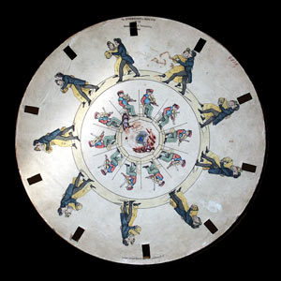
One of Stampfer's Stroboscopic Discs. c1830s

Slide 8
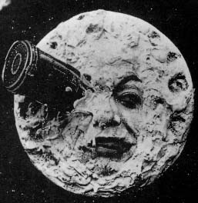
A scene from "A trip to the moon" (1902) by Georges Méliès.

Slide 9
TV and Film
both work this way
  present a new image at a rate of about 30 times per second (30 frames per second or FPS)
  each individual frame is a static image
  ~30 FPS has been empirically found to be a good trade-off between visual quality and complexity of the system
  actual systems use slightly different rates in practice for various implementation reasons

Slide 10
by Computer or by Hand
in either case, it is possible for a human to specify each individual frame exactly
but this is a lot of work!
2H feature film:
  (2H)(60m/H)(60s/m)(30f/s)=216000 frames
at roughly 1 to 10 man-hours to draw a frame
about 2000 hours in a typical work year
so from about 100 to 1000 man-years of work to draw all frames for a single feature length film!

Slide 11
Animation
Keyframing
  Set data at key points and interpolate.
Procedural
  Let mathematics make it happen.
Physics-based
  Solve differential equations
Motion Capture
  Turn real-world motion into animation.

Slide 12
Key Principles of Animation
John Lasseter 1987
Squash and stretch
Timing
Anticipation
Follow through and overlapping action
Slow-in and slow-out
Staging
Arcs
Secondary action
Straight ahead and pose-to-pose action
Exaggeration
Solid drawing skill
Appeal
        Siggraph web reference

Slide 13
PowerPoint Animation

Slide 14
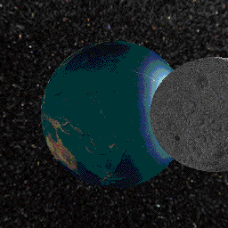
Animated gif
Johan Ovlinger’s Trip to Earth and Back

Slide 15
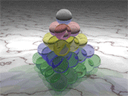
Pyramid of 35 Spheres
Rendered by Blotwell using POV-Ray and converted with Adobe ImageReady.

Slide 16
Deformation

Slide 17
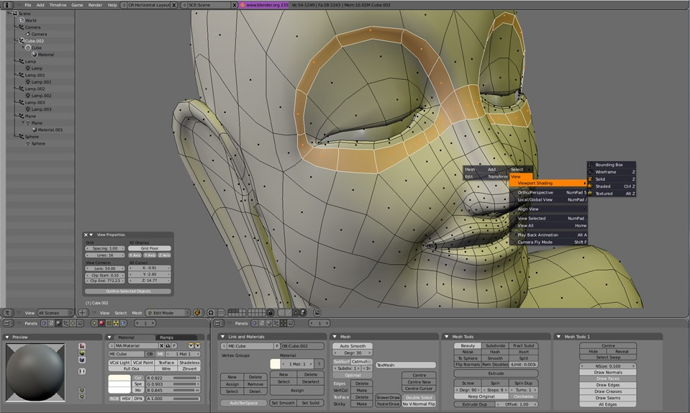
Blender free software, under the terms of the
GNU General Public License

Slide 18
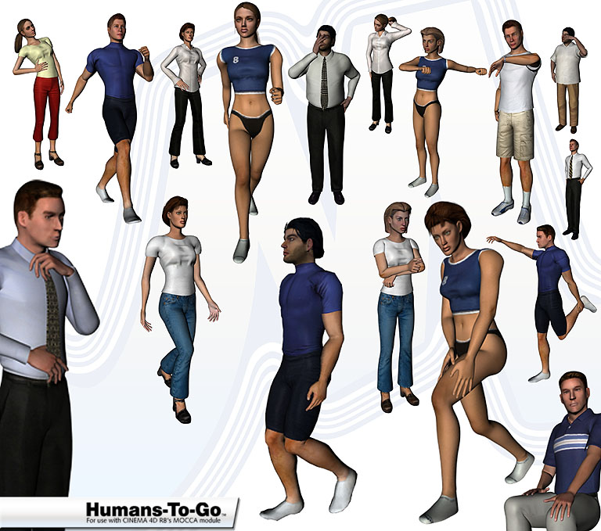
Character Animation

Slide 19
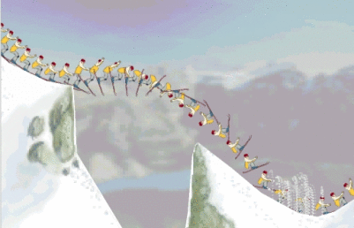
Physics-Based Animation
http://www.cs.ubc.ca/labs/imager/imager-web/Research/images/michiel.gif

Slide 20
Flash Animation
POWER OF THE GEEK

Slide 21
Keyframing
A frame is one of the many still images that make up a moving picture.
A key frame is a frame that was drawn or otherwise constructed directly by the user.
In hand-drawn animation, the senior artist would draw these frames; an apprentice would draw the "in between" frames.
In computer animation, the animator creates only the first and last frames of a simple sequence; the computer fills in the gap.
This is called in-betweening or tweening.

Slide 22
Flash Basics
Media objects
  graphic, text, sound, video objects
The Timeline
  when specific media objects should appear on the Stage
ActionScript code
  programming code to make for user interactions and to finely control object behavior

Slide 23
Lord of the Rings
Inside Effects
making of Gollum
Helm's Deep
http://www.lordoftherings.net/legend/video/
http://www.youtube.com/watch?v=4ul3zwO8W50&noredirect=1

