Slide 1
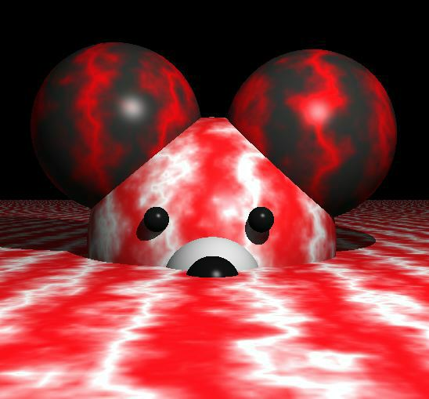
Perlin Noise
CS4300

Slide 2

The Oscar™
To Ken Perlin for the development of Perlin Noise, a technique used to produce natural appearing textures on computer generated surfaces for motion picture visual effects.

Slide 3
The Movies
James Cameron Movies (Abyss,Titanic,...)
Animated Movies (Lion King, Moses,...)
Arnold Movies (T2, True Lies, ...)
Star Wars Episode I
Star Trek Movies
Batman Movies
and lots of others
In fact, after around 1990 or so, every Hollywood effects film has used it.

Slide 4
What is Noise?
Noise is a mapping from R^{n} to R - you input an n-dimensional point with real coordinates, and it returns a real value.
n=1 for animation
n=2 cheap texture hacks
n=3 less-cheap texture hacks
n=4 time-varying solid textures

Slide 5
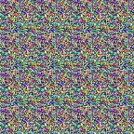
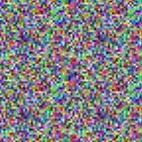
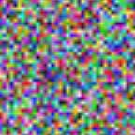
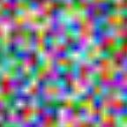
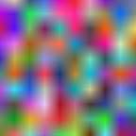



Noise is Smooth Randomness

Slide 6
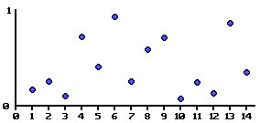
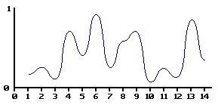
Making Noise
Generate random values at grid points.
Interpolate smoothly between these values.

Slide 7
Linear Noise

Slide 8
lerp
The basic operation of linear interpolation between two values is so commonly used in computer graphics that it is sometimes called a lerp in the jargon of computer graphics.
Lerp operations are built into the hardware of all modern computer graphics processors.

Slide 9
lerping
lerp(v1, v2, t) = (1 – t)v1 + tv2
t of the distance from P to Q
Q
(1-t)P + tQ
P

Slide 10
2D Linear Noise
101 15 182
253 45 3
50 5 241
199 57 20
139 80 230
154 74 178
145 68 37
228 154 219
207 133 174

Slide 11
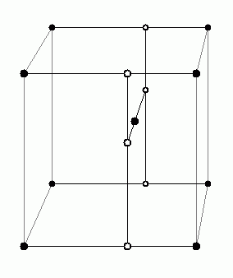
3D Linear Noise

Slide 12
Noise is Smooth Randomness

Slide 13
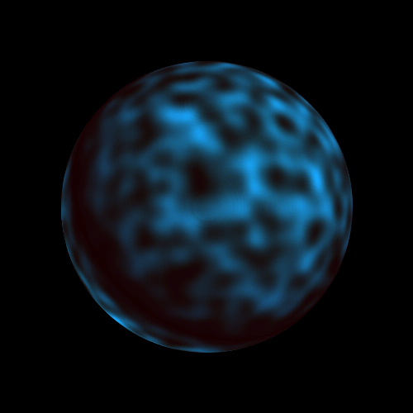
Perlin Noise Sphere

Slide 14
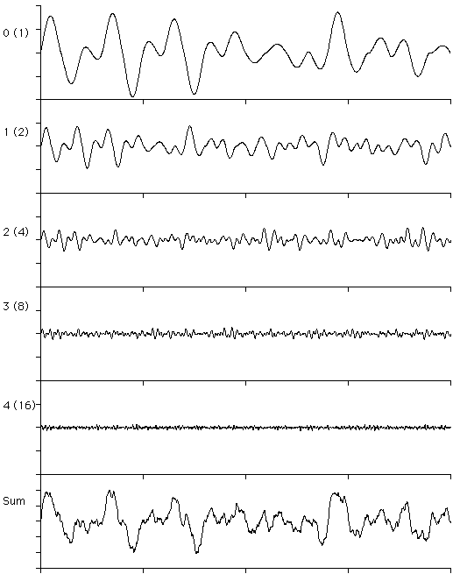
Turbulence or Sum 1/f(noise)
noise(p) + ½ noise(2p) + ¼ noise(4p) ...

Slide 15
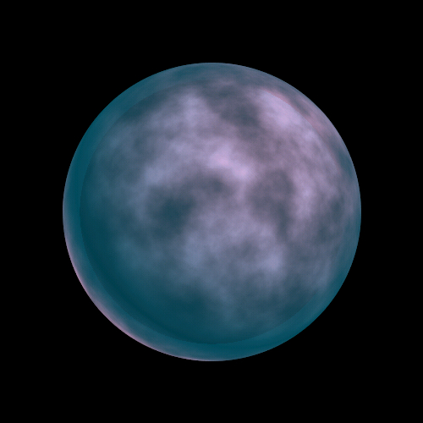
Perlin Sum 1/f(noise) Sphere

Slide 16
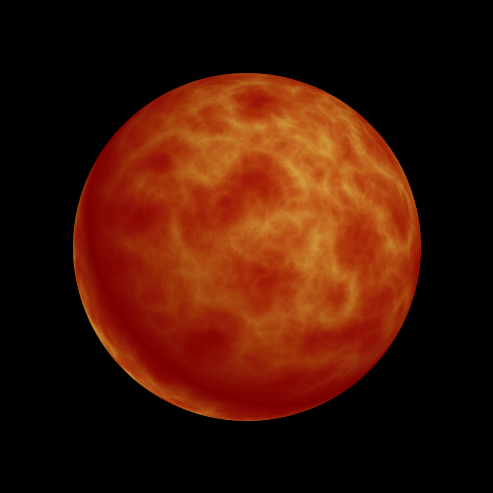
Perlin Sum 1/f(|noise|) Sphere

Slide 17
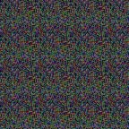
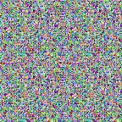
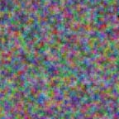
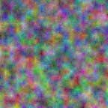
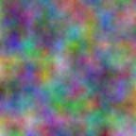

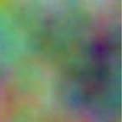
2D Nornalized Turbulence
Just Noise

Slide 18

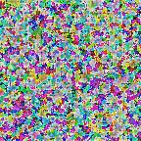
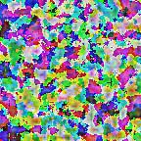
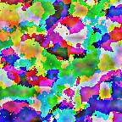
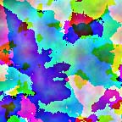
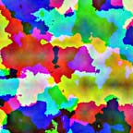
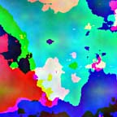
2D Turbulence - Clipped

Slide 19
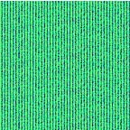
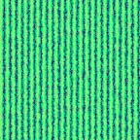
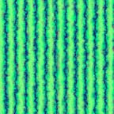
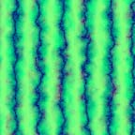
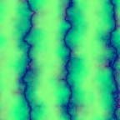
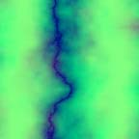
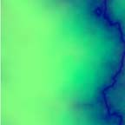
Marble
factorG = sqrt(abs(sin(x + twist*turbulence(x, y, noise))))
color = (0, trunc(factorG*255), 255);

Slide 20
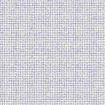
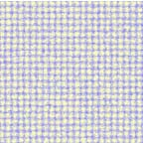
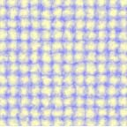
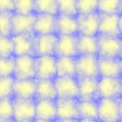
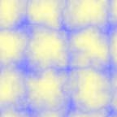
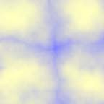


Clouds
r = sqrt((x-200/d)*(x-200/d) + (y-200/d)*(y-200/d));
factorB = abs(cos(r + fluff*turbulence(x, y, noise));
color=(127 + 128*(1 - factorB), 127 + 128*(1 - factorB), 255);

Slide 21
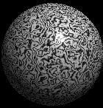
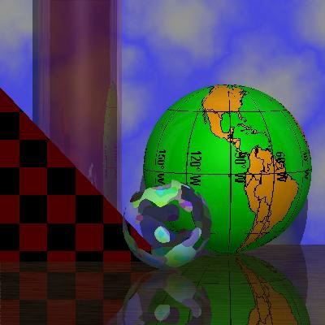
Student Images

Slide 22
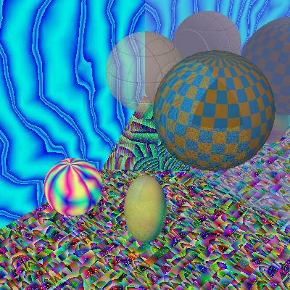
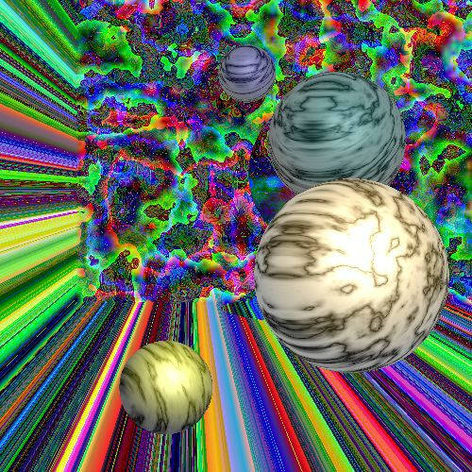
Student Images

Slide 23
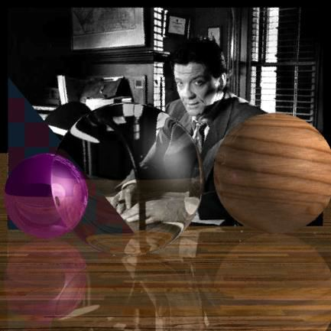
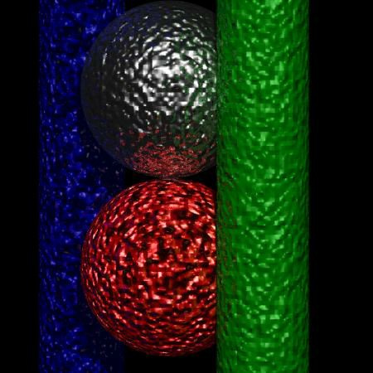
Student Images

Slide 24

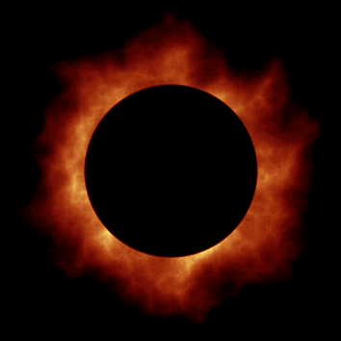
Perlin’s Clouds and Corona

