Slide 1
CS 4300
Computer Graphics
Prof. Harriet Fell
Fall 2012
Lecture 29 – November 14, 2012

Slide 2
CS 4300
Computer Graphics
Prof. Harriet Fell
Fall 2012
Lecture 28 – November 8, 2012

Slide 3
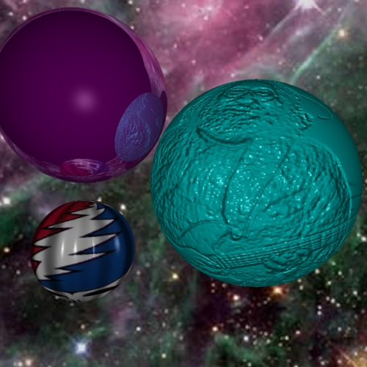
Bump Map from an Image
Victor Ortenberg

Slide 4
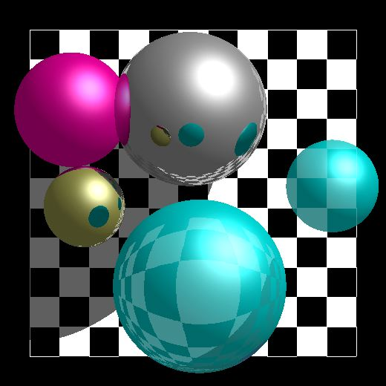
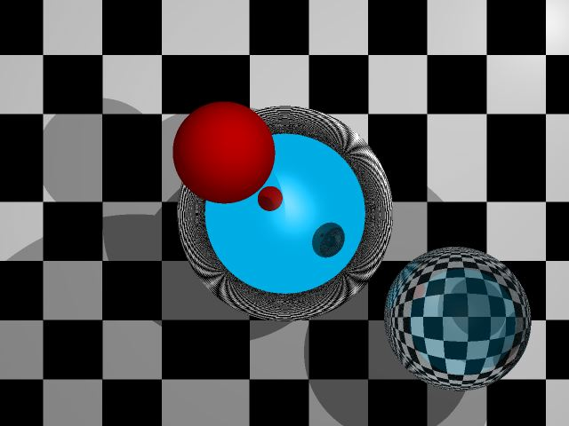
Simple Textures on Planes Parallel to Coordinate Planes

Slide 5
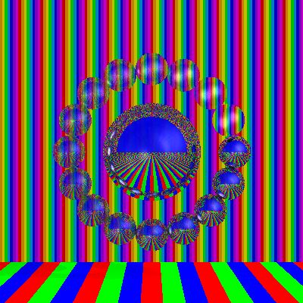
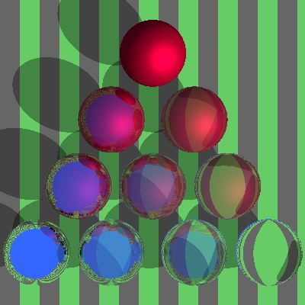
Stripes

Slide 6
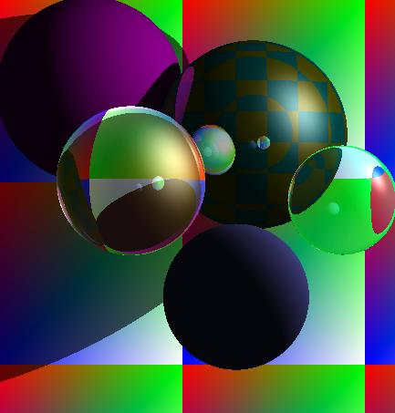
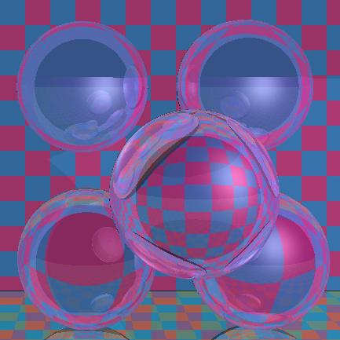
Checks

Slide 7
Stripes and Checks
Red and Blue Stripes
if ((x % 50) < 25) color = red
else color = blue
0
24
49
Cyan and Magenta Checks
if (((x % 50) < 25 && (y % 50) < 25)) ||
(((x % 50) >= 25 && (y % 50) >= 25)))
color = cyan
else color = magenta
What happens when you cross x = 0 or y = 0?

Slide 8
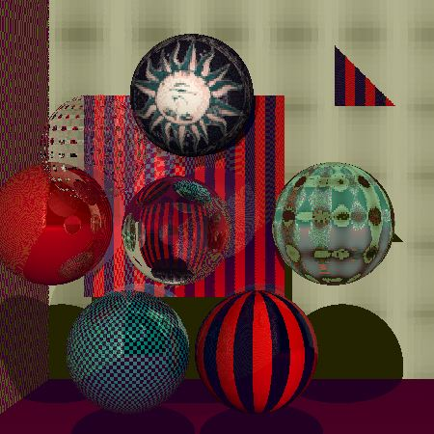
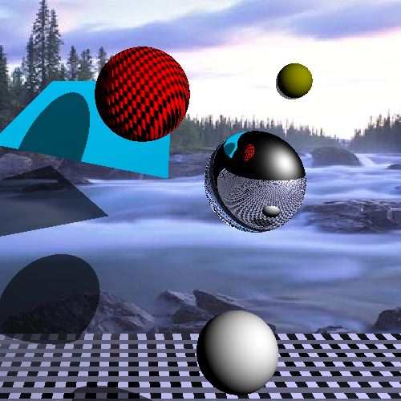
Stripes, Checks, Image

Slide 9
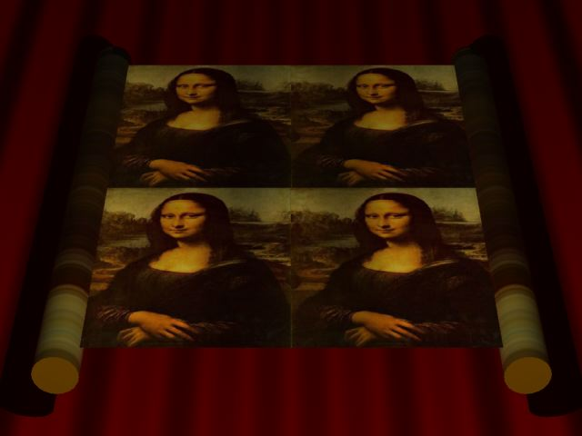
Mona Scroll

Slide 10
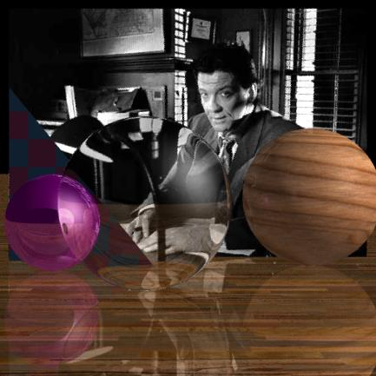
Textures on 2 Planes

Slide 11
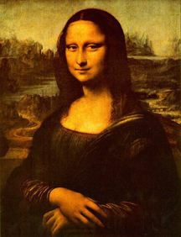
Mapping a Picture to a Plane
Use an image in a ppm file.
Read the image into an array of RGB values.
  Color myImage[width][height]
For a point on the plane (x, y, d)
  theColor(x, y, d) = myImage(x % width, y % height)
How do you stretch a small image onto a large planar area?

Slide 12
Other planes and Triangles
N
Given a normal and 2 points on the plane:
Make u from the two points.
v = N x u
Express P on the plane as
P = P₀ + au + bv.
P₁
N x u = v
u
P₀

Slide 13
Image to Triangle - 1
B
A
C

Slide 14
Image to Triangle - 2
B
A
C

Slide 15
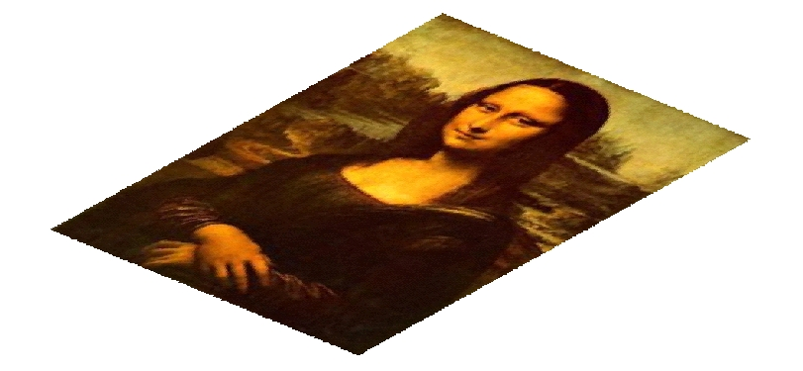
Image to Triangle - 3
B
A
C

Slide 16
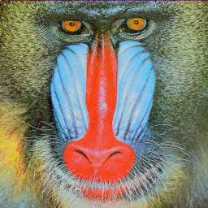
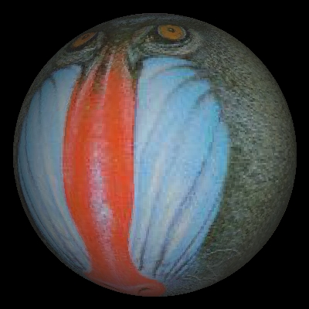
Mandrill Sphere

Slide 17
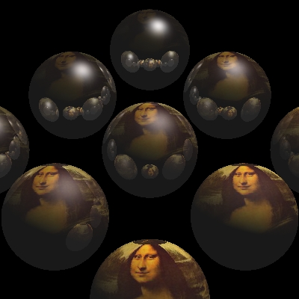
Mona Spheres

Slide 18

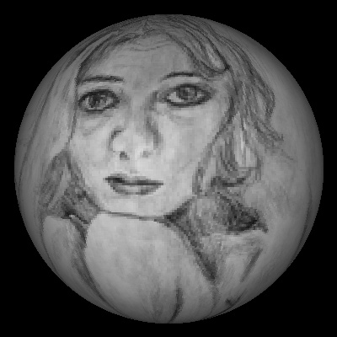
Tova Sphere

Slide 19
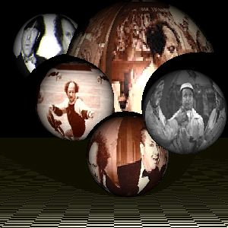
More Textured Spheres

Slide 20
Spherical Geometry
y
P = (x, y, z)
y
φ
φ = arccos(y/R)
R
θ = arctan(x/z)
x
z
θ
x
z

Slide 21
// for texture map – in lieu of using sphere color
double phi, theta; // for spherical coordinates
double x, y, z; // sphere vector coordinates
int h, v; // ppm buffer coordinates
Vector3D V;
V = SP - theSpheres[hitObject].center;
V.Get(x, y, z);
phi = acos(y/theSpheres[hitObject].radius);
if (z != 0) theta = atan(x/z); else phi = 0; // ???
v = (phi)*ppmH/pi;
h = (theta + pi/2)*ppmW/pi;
if (v < 0) v = 0; else if (v >= ppmH) v = ppmH - 1;
v = ppmH -v -1; //v = (v + 85*ppmH/100)%ppmH;//9
if (h < 0) h = 0; else if (h >= ppmW) h = ppmW - 1;
h = ppmW -h -1; //h = (h + 1*ppmW/10)%ppmW;
rd = fullFactor*((double)(byte)myImage[h][v][0]/255); clip(rd);
gd = fullFactor*((double)(byte)myImage[h][v][1]/255); clip(gd);
bd = fullFactor*((double)(byte) myImage[h][v][2]/255); clip(bd);

