Slide 1
CS 4300
Computer Graphics
Prof. Harriet Fell
Fall 2012
Lecture 28 – November 8, 2012

Slide 2
Today’s Topics
Fractals
  Mandelbrot Set
    Julia Sets
  L-Systems

Slide 3
Fractals
The term fractal was coined in 1975 by Benoît Mandelbrot, from the Latin fractus, meaning "broken" or "fractured".
(colloquial) a shape that is recursively constructed or self-similar, that is, a shape that appears similar at all scales of magnification.
(mathematics) a geometric object that has a Hausdorff dimension greater than its topological dimension.

Slide 4
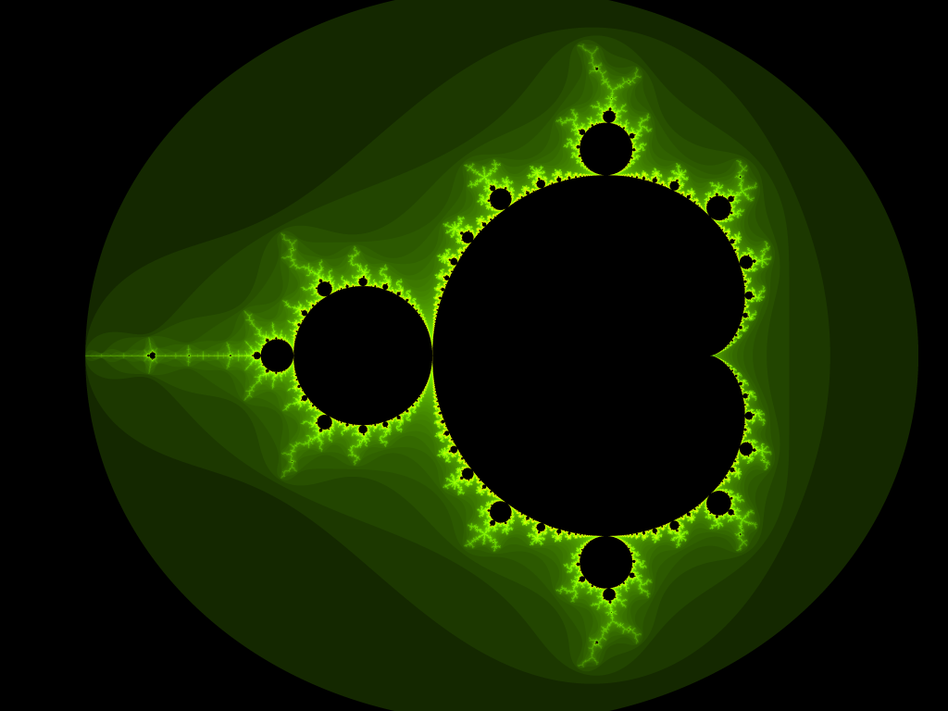
Mandelbrot Set
Mandelbrotset, rendered with Evercat's program.

Slide 5
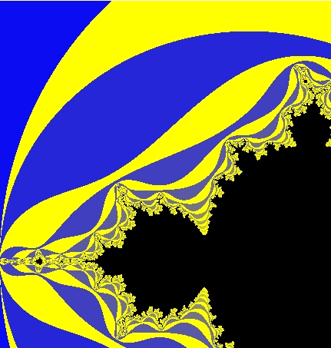

Mandelbrot Set

Slide 6
What is the Mandelbrot Set?
We start with a quadratic function on the complex numbers.
The Mandelbrot Set is the set of complex c such that

Slide 7
Example

Slide 8
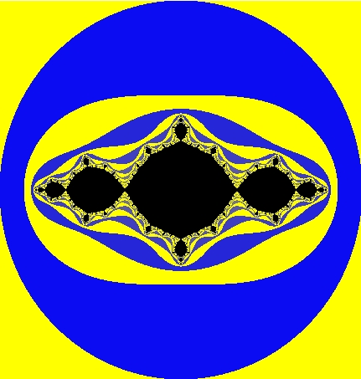
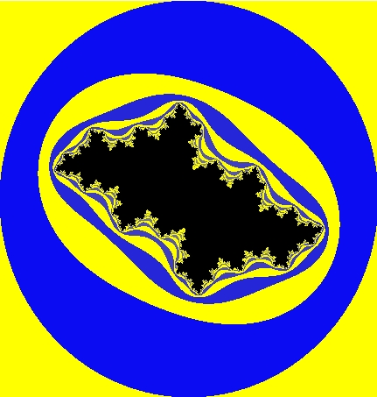
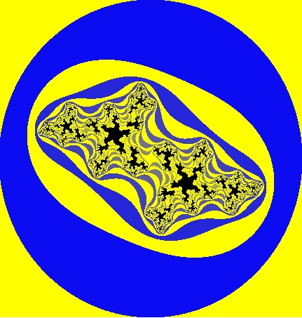
(Filled-in) Julia Sets
c = –1
c = –.5 +.5i
c = – 5 +.5i
The Julia Set of f_{c} is the set of points with 'chaotic' behavior under iteration.
The filled-in Julia set (or Prisoner Set), is the set of all z whos orbits do not tend towards infinity. The "normal" Julia set is the boundary of the filled-in Julia set.

Slide 9
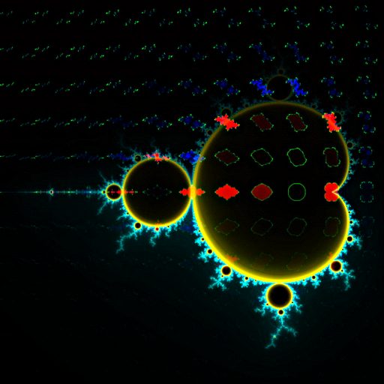
Julia Sets and the Mandelbrot Set
Some Julia sets are connected others are not.
The Mandelbrot set is the set of Complex numbers c for which the Julia set of f_{c}(z) = z² + c is connected.
Map of 121 Julia sets in position over the Mandelbrot set (wikipedia)

Slide 10
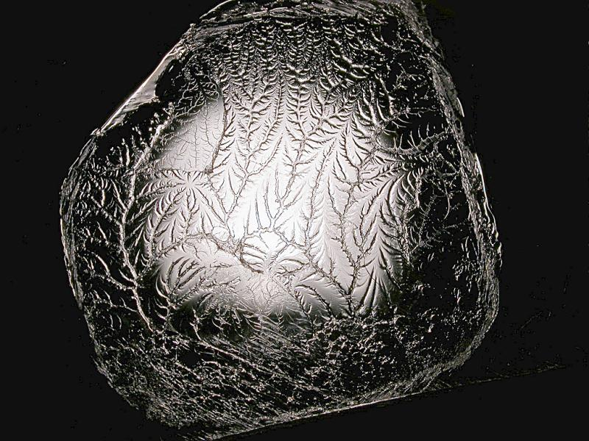
A fractal is formed when pulling apart two glue-covered acrylic sheets.

Slide 11
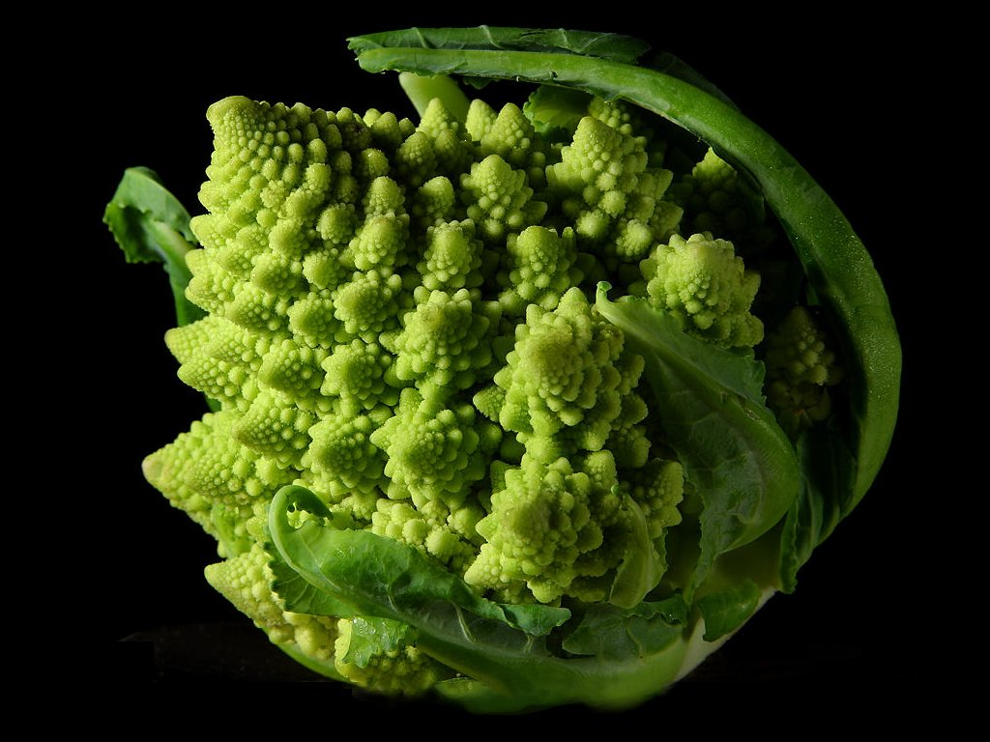
Fractal Form of a Romanesco Broccoli photo by Jon Sullivan

Slide 12
L-Systems
An L-system or Lindenmayer system, after Aristid Lindenmayer (1925–1989), is a formal grammar (a set of rules and symbols) most famously used to model the growth processes of plant development, though able to model the morphology of a variety of organisms.
L-systems can also be used to generate self-similar fractals such as iterated function systems.

Slide 13
L-System References
Przemyslaw Prusinkiewicz & Aristid Lindenmayer, “The Algorithmic Beauty of Plants,” Springer, 1996.
http://en.wikipedia.org/wiki/L-System

Slide 14
L-System Grammar
G = {V, S, ω, P}, where
  V (the alphabet) is a set of variables
  S is a set of constant symbols
  ω (start, axiom or initiator) is a string of symbols from V defining the initial state of the system
  P is a set of rules or productions defining the way variables can be replaced with combinations of constants and other variables.
    A production consists of two strings - the predecessor and the successor.

Slide 15
L-System Examples
Koch curve (from wikipedia)
A variant which uses only right-angles.
  variables : F
  constants : + −
  start : F
  rules : (F → F+F−F−F+F)
Here, F means "draw forward", + means "turn left 90°", and - means "turn right 90°" (see turtle graphics).

Slide 16
Turtle Graphics
class Turtle {
double angle; // direction of turtle motion in degrees
double X; // current x position
double Y; // current y position
double step; // step size of turtle motion
boolean pen; // true if the pen is down
public void forward(Graphics g)
// moves turtle forward distance step in direction angle
public void turn(double ang)
// sets angle = angle + ang;
public void penDown(), public void penUp()
// set pen to true or false
}

Slide 17
My L-System Data Files
Koch Triangle Form // title
4 // number of levels to iterate
90 // angle to turn
F // starting shape
F:F+F-F-F+F // a rule
Go to Eclipse
F
F+F-F-F+F
F+F-F-F+F+F+F-F-F+F-F+F-F-F+F-F+F-F-F+F+F+F-F-F+F

Slide 18
More Variables
Dragon When drawing, treat L and R just like F.
10
90
L
L:L+R+
R:-L-R
L
L+R+
L+R+ + -L-R +
L+R+ + -L-R + + - L+R+ - -L-R +

Slide 19
A Different Angle
Sierpinski Gasket
6
60
R
L:R+L+R
R:L-R-L
R
L-R-L
R+L+R- L-R-L -R+L+R

Slide 20
Moving with Pen Up
Islands and Lakes
2
90
F+F+F+F
F:F+f-FF+F+FF+Ff+FF-f+FF-F-FF-Ff-FFF
f:ffffff // f means move forward with the pen up
next slide
F+f-FF+F+FF+Ff+FF-f+FF-F-FF-Ff-FFF
F+F+F+F

Slide 21
Islands and Lakes
One Side of the Box
F+f-FF+F+FF+Ff+FF-f+FF-F-FF-Ff-FFF

Slide 22
Using a Stack to Make Trees
Tree1 [ push the turtle state onto the stack
4 ] pop the turtle state from the stack
22.5
F
F:FF-[-F+F+F]+[+F-F-F]
and I add leaves here
FF-[-F+F+F]+[+F-F-F]

Slide 23
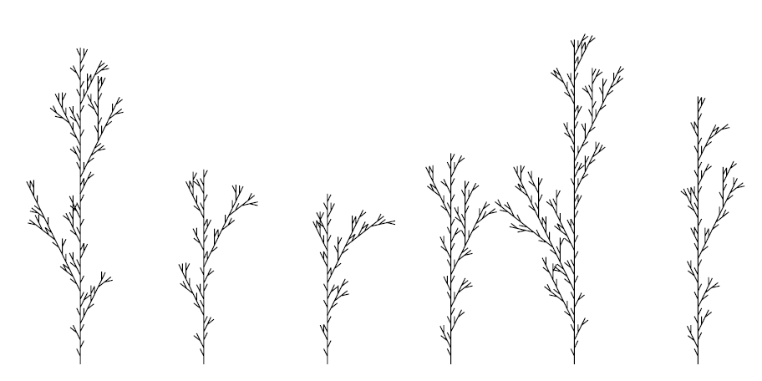
Stochastic L-Systems http://algorithmicbotany.org/lstudio/CPFGman.pdf
seed: 2454 // different seeds for different trees
derivation length: 3
axiom: F
F--> F[+F]F[-F]F : 1/3
F--> F[+F]F : 1/3
F--> F[-F]F : 1/3

Slide 24
3D Turtle Rotations
Heading, Left, or, Up vector tell turtle direction.
+(θ) Turn left by angle θ◦ around the U axis.
−(θ) Turn right by angle θ◦ around the U axis.
&(θ) Pitch down by angle θ◦ around the L axis.
∧(θ) Pitch up by angle θ◦ around the L axis.
\(θ) Rollleftbyangleθ◦ around the H axis.
/(θ) Roll right by angle θ◦ around the H axis.
| Turn around 180◦ around the U axis.
@v Roll the turtle around the H axis so that H and U lie in a common vertical plane with U closest to up.

Slide 25
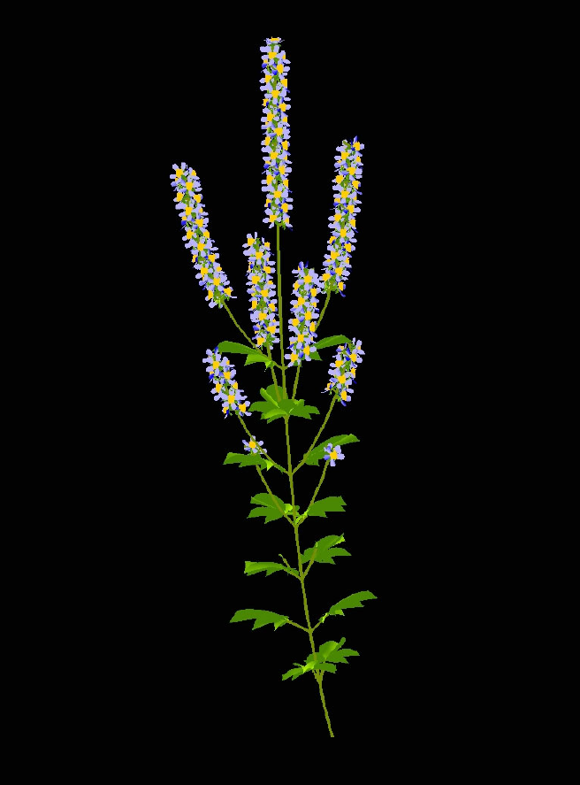
A Mint http://algorithmicbotany.org/papers/
A model of a member of the mint family that exhibits a basipetal
flowering sequence.

Slide 26
Flow
“Flow means we need a certain amount of time to load our knowledge and skills into our brain RAM. And the more big or small interruptions we have, the less likely we are to ever get there.”
-- Kathy Sierra

Slide 27
Slow Down, Brave Multitasker, and Don’t Read This in Traffic
Check e-mail messages once an hour, at most.
In a recent study, a group of Microsoft workers took, on average, 15 minutes to return to serious mental tasks, like writing reports or computer code, after responding to incoming e-mail or instant messages.

