Slide 1
CS 4300
Computer Graphics
Prof. Harriet Fell
Fall 2011
Lecture 10 – September 28, 2011

Slide 2
3D Vectors
What we said about 2D vectors holds for 3D vectors too.
a =( x_{a}, y_{a}, z_{a} ) b =( x_{b}, y_{b}, z_{b} )
a•b = x_{a} x_{b} + y_{a} y_{b} + z_{a} z_{b}
a•b = ||a||•||b||cos(φ)

Slide 3
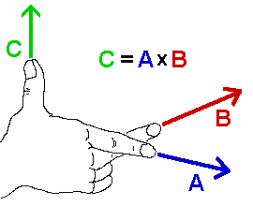
Vector Cross Product
axb
axb is perpendicular to a and b.
Use the right hand rule to determine the direction of axb.
b
φ
a
Image from www.physics.udel.edu

Slide 4
Cross Product and Area
axb
b
b
φ
φ
||a||
a
a
||a x b|| = area of the parallelogram.

Slide 5
Computing the Cross Product

Slide 6
Linear Interpolation
LERP: /lerp/, vi.,n.
  Quasi-acronym for Linear Interpolation, used as a verb or noun for the operation. “Bresenham's algorithm lerps incrementally between the two endpoints of the line.”
p = (1 – t) a + t b = a + t(b – a)
(1-t)L
b
tL
L
a

Slide 7
Lerping
p = (1 – t) a + t b = a + t(b – a)
t = 1
b
t = .75
t = .5
t = .25
t = 0
L
a

Slide 8
Triangles
a
If (x, y) is on the edge ab,
(x, y) = (1 – t) a + t b = a + t(b – a).
Similar formulas hold for points on the other edges.
If (x, y) is in the triangle:
(x, y) = α a + β b + γ c
α + β + γ = 1
(α , β , γ ) are the
Barycentric coordinates of (x, y).
(x,y)
c
b

Slide 9
Triangles
p = a + β(b-a) + γ(c-a)
β = 2
β = 0
β = 1
β = -1
γ = 2
p = (1- β - γ)a + βb + γc
α = 1- β - γ
p = p(α, β, γ) =
αa + βb + γc
γ = 1
c
c-a
γ = 0
a
b-a
b
Barycentric coordinates
γ = -1
α = 1
α = 0

Slide 10
Computing
Barycentric Coordinates
a
(x,y)
(x,y)
b
c

Slide 11
Barycentric Coordinates as Areas
a
(x,y)
where A is the area of the
triangle.
α + β + γ = 1
c
b

Slide 12
3D Triangles
a
This all still works in 3D.
(x,y,z)
where A is the area of the
triangle.
α + β + γ = 1
c
b

Slide 13
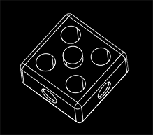
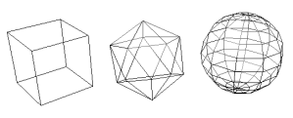
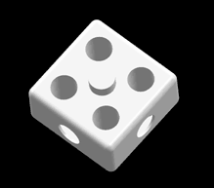
Wireframe Rendering
Hidden-Line Removal
Hidden-Face Removal
Copyright (C) 2000,2001,2002 Free Software Foundation, Inc. 51 Franklin St, Fifth Floor, Boston, MA 02110-1301 USA Everyone is permitted to copy and distribute verbatim copies of this license document, but changing it is not allowed.

Slide 14
Convex Polyhedra
We can see a face if and only if its normal has a component toward us.
N·V > 0
V points from the face toward the viewer.
N point toward the outside of the polyhedra.

Slide 15
Hidden Surface Removal
Backface culling
  Never show the back of a polygon.
Viewing frustum culling
  Discard objects outside the camera’s view.
Occlusion culling
  Determining when portions of objects are hidden.
    Painter’s Algorithm
    Z-Buffer
Contribution culling
  Discard objects that are too far away to be seen.
    http://en.wikipedia.org/wiki/Hidden_face_removal

Slide 16
Painter’s Algorithm

Slide 17
Painter’s Algorithm
Sort objects back to front relative to the viewpoint.
for each object (in the above order) do
draw it on the screen
-- more on this later

Slide 18
Visible Surface Determination
If surfaces are invisible, don’t render them.
  Ray Tracing
    We only render the nearest object.
  Binary Space Partitioning (BSP)
    Recursively cut up space into convex sets with hyperplanes.
    The scene is represented by a BSP-tree.

Slide 19
Rendering a Polymesh
Scene is composed of triangles or other polygons.
We want to view the scene from different view-points.
  Hidden Surface Removal
    Cull out surfaces or parts of surfaces that are not visible.
  Visible Surface Determination
    Head right for the surfaces that are visible.
    Ray-Tracing is one way to do this.

Slide 20
Polygon Table
Polygon Table
A, B, C, D of the plane equation
shading or color info (e.g. color and N)
in (out) boolean
initialized to false (= out) at start of scanline
z – at lowest y, x

Slide 21
Coherence
Non-penetrating polygons maintain their relative z values.
  If the polygons penetrate, add a false edge.
If there is no change in edges from one scanline to the next, and no change in order wrt x, then no new computations of z are needed.

Slide 22
Active Edge Table
Keep in order of increasing x.
At (1) AET ➔ AB ➔ AC ➔ DF ➔ EF

Slide 23
Running the Algorithm 1
If more than one in is true, compute the z values at that point to see which polygon is furthest forward.
If only one in is true, use that polygon’s color and shading.

Slide 24
Running the Algorithm 2
On crossing an edge
set in of polygons with that edge to not in.
At (2) AET ➔ AB ➔ DF ➔ AC EF
If there is a third polygon, GHIJ behind the other two, after edge AC is passed at level (2) there is no need to evaluate z again - if the polygons do not pierce each other.

Slide 25
Painter’s Algorithm
Sort objects back to front relative to the viewpoint.
for each object (in the above order) do
draw it on the screen

Slide 26
Painter’s Problem

Slide 27
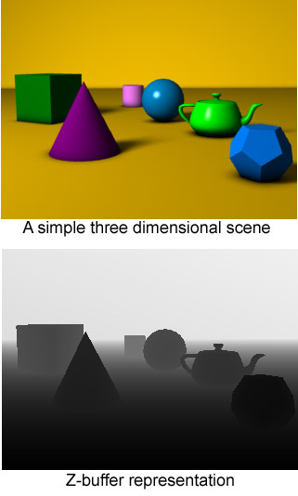
Z-Buffer
The Z-Buffer is usually part of graphics card hardware. It can also be implemented in software.
The Z-Buffer is a 2D array that holds one value for each pixel.
The depth of each pixel is stored in the z-buffer.
An object is rendered at a pixel only if its z-value is higher(lower) than the buffer value. The buffer is then updated.
This image is licensed under the
Creative Commons Attribution License v. 2.0.

Slide 28
Visible Surface Determination
If surfaces are invisible, don’t render them.
  Ray Tracing
    We only render the nearest object.
  Binary Space Partitioning (BSP)
    Recursively cut up space into convex sets with hyperplanes.
    The scene is represented by a BSP-tree.

Slide 29
Sorting the Polygons
The first step of the Painter’s algorithm is:
Sort objects back to front relative to the viewpoint.
The relative order may not be well defined.
We have to reorder the objects when we change the viewpoint.
The BSP algorithm and BSP trees solve these problems.

Slide 30
Binary Space Partition
Our scene is made of triangles.
  Other polygons can work too.
Assume no triangle crosses the plane of any other triangle.
  We relax this condition later.
        following Shirley et al.

Slide 31
BSP – Basics
Let a plane in 3-space (or line in 2-space) be defined implicitly, i.e.
  f(P) = f(x, y, z) = 0 in 3-space
  f(P) = f(x, y) = 0 in 2-space
All the points P such that f(P) > 0 lie on one side of the plane (line).
All the points P such that f(P) < 0 lie on the other side of the plane (line).
Since we have assumed that all vertices of a triangle lie on the same side of the plane (line), we can tell which side of a plane a triangle lies on.

Slide 32
BSP on a Simple Scene
Suppose scene has 2 triangles
T1 on the plane f(P) = 0
  T2 on the f(P) < 0 side
  e is the eye.
  if f(e) < 0 then
  draw T1; draw T2
  else
  draw T2; draw T1

Slide 33
The BSP Tree
Suppose scene has many triangles, T1, T2, … .
We still assume no triangle crosses the plane of any other triangle.
Let f_{i}(P) = 0 be the equation of the plane containing Ti.
The BSPTREE has a node for each triangle with T1 at the root.
At the node for Ti,
the minus subtree contains all the triangles whose vertices have f_{i}(P) < 0
the plus subtree contains all the triangles whose vertices have f_{i}(P) > 0.

Slide 34
BSP on a non-Simple Scene
function draw(bsptree tree, point e)
if (tree.empty) then
return
if (f_{tree.root}(e) < 0) then
  draw(tree.plus, e)
  render tree.triangle
  draw(tree.minus, e)
else
  draw(tree.minus, e)
  render tree.triangle
  draw(tree.plus, e)

Slide 35
2D BSP Trees Demo
http://www.symbolcraft.com/graphics/bsp/index.php
This is a demo in 2 dimensions.
The objects are line segments.
The dividing hyperplanes are lines.

Slide 36
Building the BSP Tree
We still assume no triangle crosses the plane of another triangle.
tree = node(T1)
for I in {2, …, N} do tree.add(Ti)
function add (triangle T)
if (f(a) < 0 and f(b) < 0 and f(c) < 0) then
if (tree.minus.empty) then
tree.minus = node(T)
else
tree.minus.add(T)
else if (f(a) > 0 and f(b) > 0 and f(c) > 0) then
if (tree.plus.empty) then
tree.plus = node(T)
else
tree.plus.add(T)

Slide 37
Triangle Crossing a Plane
a
Two vertices, a and b, will be on one side and one, c, on the other side.
A
c
Find intercepts , A and B, of the plane with the 2 edges that cross it.
B
b

Slide 38
Cutting the Triangle
a
Cut the triangle into three triangles, none of which cross the cutting plane.
A
c
Be careful when one or more of a, b, and c is close to or on the cutting plane.
B
b

