Slide 1
CS6220: Data Mining Techniques
Chapter 8&9: Classification: Part 3
Instructor: Yizhou Sun
yzsun@ccs.neu.edu
March 11, 2013

Slide 2
Midterm Report
Grade Distribution
90 - 100 | 10
80 - 89 | 16
70 - 79 | 8
60 - 69 | 4
<60 | 1
Statistics
Count | 39
Minimum Value | 55.00
Maximum Value | 98.00
Average | 82.54
Median | 84.00
Standard Deviation | 9.18

Slide 3
Announcement
Midterm Solution
  https://blackboard.neu.edu/bbcswebdav/pid-12532-dt-wiki-rid-8320466_1/courses/CS6220.32435.201330/mid_term.pdf
Course Project:
  Midterm report due next week
    A draft for final report
      Don’t forget your project title
    Main purpose
      Check the progress and make sure you can finish it by the deadline

Slide 4
Chapter 8&9. Classification: Part 3
Bayesian Learning
  Naïve Bayes
  Bayesian Belief Network
Instance-Based Learning
Summary

Slide 5
Bayesian Classification: Why?
A statistical classifier: performs probabilistic prediction, i.e., predicts class membership probabilities
Foundation: Based on Bayes’ Theorem.
Performance: A simple Bayesian classifier, naïve Bayesian classifier, has comparable performance with decision tree and selected neural network classifiers
Incremental: Each training example can incrementally increase/decrease the probability that a hypothesis is correct — prior knowledge can be combined with observed data
Standard: Even when Bayesian methods are computationally intractable, they can provide a standard of optimal decision making against which other methods can be measured

Slide 6
Basic Probability Review
Have two dices h₁ and h₂
The probability of rolling an i given die h₁ is denoted P(i|h₁). This is a conditional probability
Pick a die at random with probability P(h_{j}), j=1 or 2. The probability for picking die h_{j} and rolling an i with it is called joint probability and is P(i, h_{j})=P(h_{j})P(i| h_{j}).
For any events X and Y, P(X,Y)=P(X|Y)P(Y)
If we know P(X,Y), then the so-called marginal probability P(X) can be computed as

Slide 7
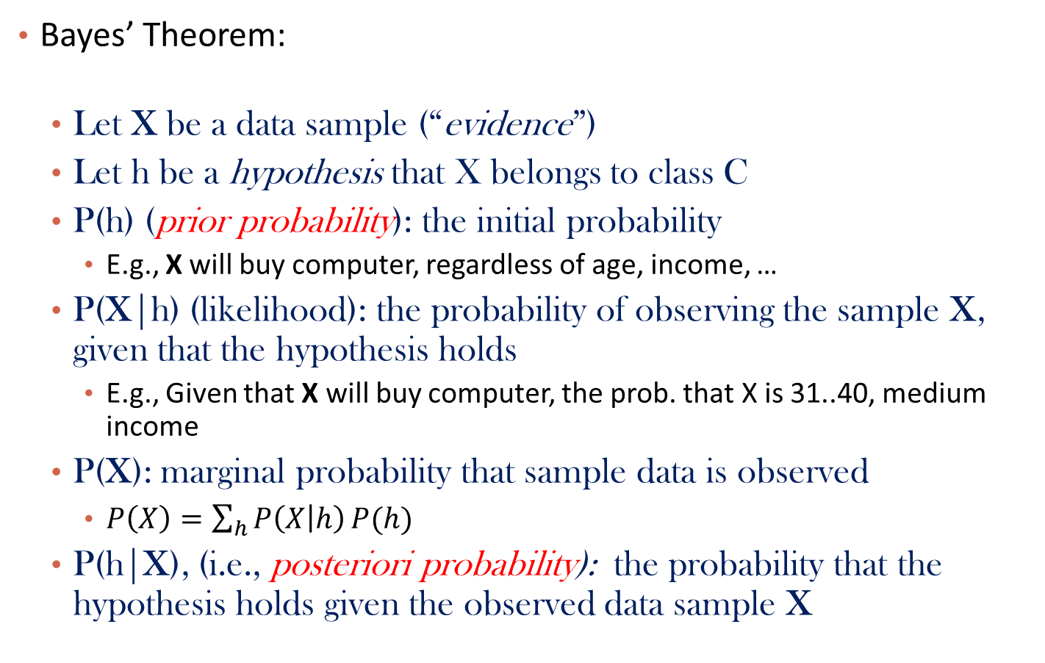
Bayes’ Theorem: Basics
Bayes’ Theorem:
  Let X be a data sample (“evidence”)
  Let h be a hypothesis that X belongs to class C
  P(h) (prior probability): the initial probability
    E.g., X will buy computer, regardless of age, income, …
  P(X|h) (likelihood): the probability of observing the sample X, given that the hypothesis holds
    E.g., Given that X will buy computer, the prob. that X is 31..40, medium income
  P(X): marginal probability that sample data is observed
    $P\left(X\right)=\sum_{h}{P\left(X | h\right)}P(h)$
  P(h|X), (i.e., posteriori probability): the probability that the hypothesis holds given the observed data sample X

Slide 8
Classification: Choosing Hypotheses
Maximum Likelihood (maximize the likelihood):
Maximum a posteriori (maximize the posterior):
  Useful observation: it does not depend on the denominator P(D)
D: the whole training data set

Slide 9
Classification by Maximum A Posteriori
Let D be a training set of tuples and their associated class labels, and each tuple is represented by an n-D attribute vector X = (x₁, x₂, …, x_{n})
Suppose there are m classes C₁, C₂, …, C_{m}.
Classification is to derive the maximum posteriori, i.e., the maximal P(C_{i}|X)
This can be derived from Bayes’ theorem
Since P(X) is constant for all classes, only needs to be maximized

Slide 10
Example: Cancer Diagnosis
A patient takes a lab test with two possible results (+ve, -ve), and the result comes back positive. It is known that the test returns
  a correct positive result in only 98% of the cases (true positive); and
  a correct negative result in only 97% of the cases (true negative).
  Furthermore, only 0.008 of the entire population has this disease.
  1. What is the probability that this patient has cancer?
  2. What is the probability that he does not have cancer?
  3. What is the diagnosis?

Slide 11
Solution
P(cancer) = .008 P(¬ cancer) = .992
P(+ve|cancer) = .98 P(-ve|cancer) = .02
P(+ve| ¬ cancer) = .03 P(-ve| ¬ cancer) = .97
Using Bayes Formula:
P(cancer|+ve) = P(+ve|cancer)xP(cancer) / P(+ve)
= 0.98 x 0.008/ P(+ve) = .00784 / P(+ve)
P(¬ cancer|+ve) = P(+ve| ¬ cancer)xP(¬ cancer) / P(+ve)
= 0.03 x 0.992/P(+ve) = .0298 / P(+ve)
So, the patient most likely does not have cancer.

Slide 12
Chapter 8&9. Classification: Part 3
Bayesian Learning
  Naïve Bayes
  Bayesian Belief Network
Instance-Based Learning
Summary

Slide 13
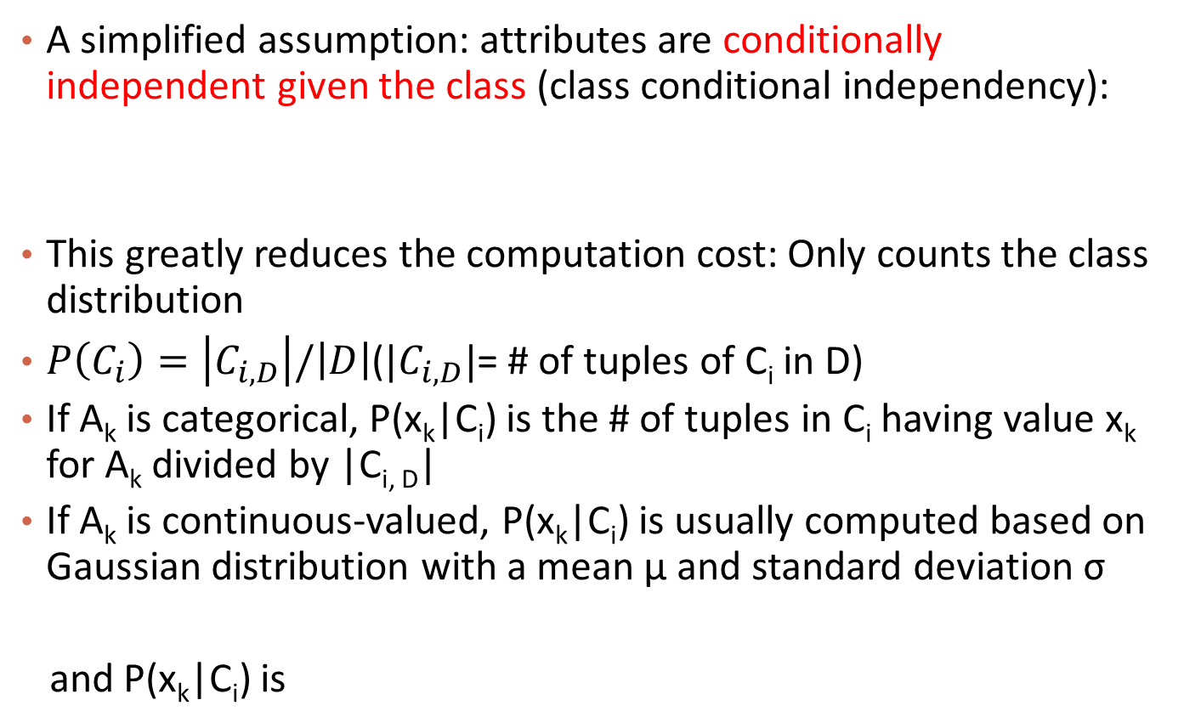
Naïve Bayes Classifier
A simplified assumption: attributes are conditionally independent given the class (class conditional independency):
This greatly reduces the computation cost: Only counts the class distribution
$P\left(C_{i}\right)=\left|C_{i,D}\right|/\left|D\right|$(${|C}_{i,D}|$= # of tuples of C_{i} in D)
If A_{k} is categorical, P(x_{k}|C_{i}) is the # of tuples in C_{i} having value x_{k} for A_{k} divided by |C_{i, D}|
If A_{k} is continuous-valued, P(x_{k}|C_{i}) is usually computed based on Gaussian distribution with a mean μ and standard deviation σ
and P(x_{k}|C_{i}) is

Slide 14
Naïve Bayes Classifier: Training Dataset
Class:
C1:buys_computer = ‘yes’
C2:buys_computer = ‘no’
Data to be classified:
X = (age <=30,
Income = medium,
Student = yes
Credit_rating = Fair)

Slide 15
Naïve Bayes Classifier: An Example
P(C_{i}): P(buys_computer = “yes”) = 9/14 = 0.643
P(buys_computer = “no”) = 5/14= 0.357
Compute P(X|C_{i}) for each class
  P(age = “<=30” | buys_computer = “yes”) = 2/9 = 0.222
  P(age = “<= 30” | buys_computer = “no”) = 3/5 = 0.6
  P(income = “medium” | buys_computer = “yes”) = 4/9 = 0.444
  P(income = “medium” | buys_computer = “no”) = 2/5 = 0.4
  P(student = “yes” | buys_computer = “yes) = 6/9 = 0.667
  P(student = “yes” | buys_computer = “no”) = 1/5 = 0.2
  P(credit_rating = “fair” | buys_computer = “yes”) = 6/9 = 0.667
  P(credit_rating = “fair” | buys_computer = “no”) = 2/5 = 0.4
X = (age <= 30 , income = medium, student = yes, credit_rating = fair)
P(X|C_{i}) : P(X|buys_computer = “yes”) = 0.222 x 0.444 x 0.667 x 0.667 = 0.044
P(X|buys_computer = “no”) = 0.6 x 0.4 x 0.2 x 0.4 = 0.019
P(X|C_{i})*P(C_{i}) : P(X|buys_computer = “yes”) * P(buys_computer = “yes”) = 0.028
P(X|buys_computer = “no”) * P(buys_computer = “no”) = 0.007
Therefore, X belongs to class (“buys_computer = yes”)

Slide 16
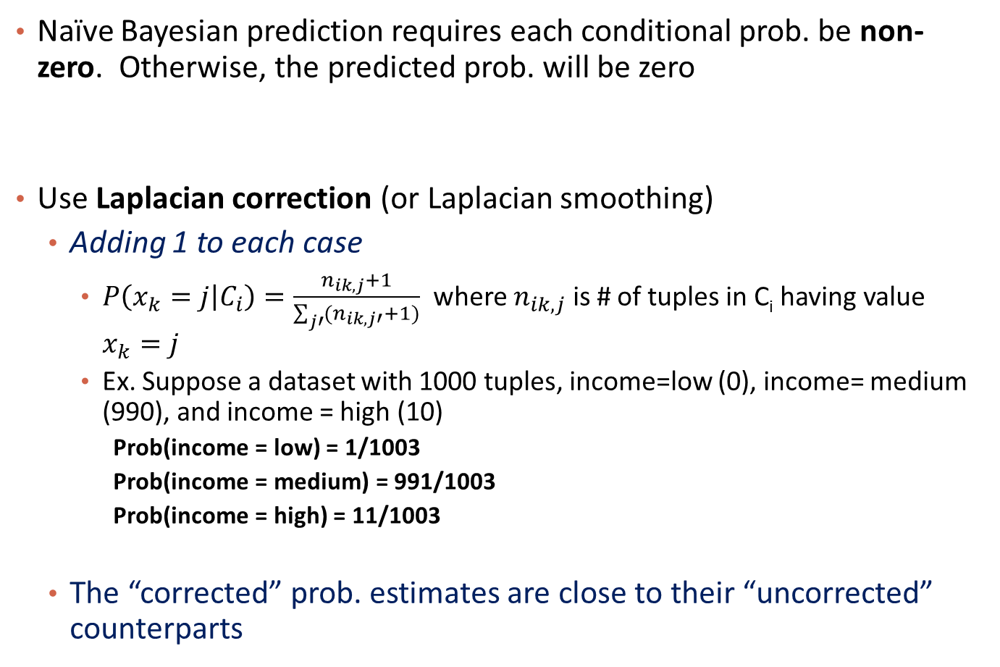
Avoiding the Zero-Probability Problem
Naïve Bayesian prediction requires each conditional prob. be non-zero. Otherwise, the predicted prob. will be zero
Use Laplacian correction (or Laplacian smoothing)
  Adding 1 to each case
    $P\left(x_{k}=j | C_{i}\right)=\frac{n_{ik,j}+1}{\sum_{j′}{(n_{ik,j′}+1)}}$ where $n_{ik,j}$ is # of tuples in C_{i} having value $x_{k}=j$
    Ex. Suppose a dataset with 1000 tuples, income=low (0), income= medium (990), and income = high (10)
      Prob(income = low) = 1/1003
      Prob(income = medium) = 991/1003
      Prob(income = high) = 11/1003
  The “corrected” prob. estimates are close to their “uncorrected” counterparts

Slide 17

*Notes on Parameter Learning
Why the probability of $P\left(X_{k} | C_{i}\right)$ is estimated in this way?
  http://www.cs.columbia.edu/~mcollins/em.pdf
  http://www.cs.ubc.ca/~murphyk/Teaching/CS340-Fall06/reading/NB.pdf

Slide 18
Naïve Bayes Classifier: Comments
Advantages
  Easy to implement
  Good results obtained in most of the cases
Disadvantages
  Assumption: class conditional independence, therefore loss of accuracy
  Practically, dependencies exist among variables
    E.g., hospitals: patients: Profile: age, family history, etc.
      Symptoms: fever, cough etc., Disease: lung cancer, diabetes, etc.
    Dependencies among these cannot be modeled by Naïve Bayes Classifier
How to deal with these dependencies? Bayesian Belief Networks

Slide 19
Chapter 8&9. Classification: Part 3
Bayesian Learning
  Naïve Bayes
  Bayesian Belief Network
Instance-Based Learning
Summary

Slide 20
Bayesian Belief Networks (BNs)
Bayesian belief network (also known as Bayesian network, probabilistic network): allows class conditional independencies between subsets of variables
Two components: (1) A directed acyclic graph (called a structure) and (2) a set of conditional probability tables (CPTs)
A (directed acyclic) graphical model of causal influence relationships
  Represents dependency among the variables
  Gives a specification of joint probability distribution
Nodes: random variables
Links: dependency
X and Y are the parents of Z, and Y is the parent of P
No dependency between Z and P conditional on Y
Has no cycles
X
Y
Z
P
20
Notes:
20

Slide 21
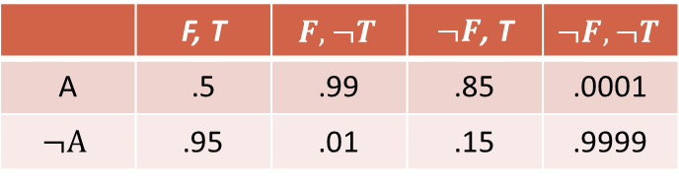
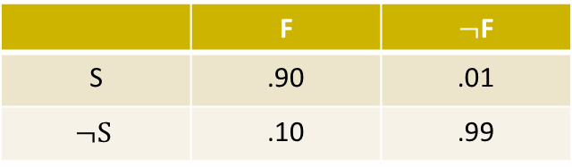
A Bayesian Network and Some of Its CPTs
Fire (F)
Tampering (T)
CPT: Conditional Probability Tables
 | F | $¬$F
S | .90 | .01
$$¬S$$ | .10 | .99
Smoke (S)
Alarm (A)
 | F, T | $$F, ¬T$$ | $¬F$, T | $$¬F, ¬T$$
A | .5 | .99 | .85 | .0001
$$¬A$$ | .95 | .01 | .15 | .9999
Leaving (L)
Report (R)
CPT shows the conditional probability for each possible combination of its parents
Derivation of the probability of a particular combination of values of X, from CPT (joint probability):

Slide 22
Inference in Bayesian Networks
Infer the probability of values of some variable given the observations of other variables
  E.g., P(Fire = True|Report = True, Smoke = True)?
Computation
  Exact computation by enumeration
  In general, the problem is NP hard
    Approximation algorithms are needed

Slide 23
Inference by enumeration
To compute posterior marginal P(X_{i} | E=e)
  Add all of the terms (atomic event probabilities) from the full joint distribution
  If E are the evidence (observed) variables and Y are the other (unobserved) variables, then:
    P(X|e) = α P(X, E) = α ∑ P(X, E, Y)
  Each P(X, E, Y) term can be computed using the chain rule
Computationally expensive!

Slide 24
Example: Enumeration
a
b c
d e
P (d|e) = α Σ_{ABC}P(a, b, c, d, e)
= α Σ_{ABC}P(a) P(b|a) P(c|a) P(d|b,c) P(e|c)
With simple iteration to compute this expression, there’s going to be a lot of repetition (e.g., P(e|c) has to be recomputed every time we iterate over C=true)
  A solution: variable elimination

Slide 25
How Are Bayesian Networks Constructed?
Subjective construction: Identification of (direct) causal structure
  People are quite good at identifying direct causes from a given set of variables & whether the set contains all relevant direct causes
  Markovian assumption: Each variable becomes independent of its non-effects once its direct causes are known
  E.g., S ‹— F —› A ‹— T, path S—›A is blocked once we know F—›A
Synthesis from other specifications
  E.g., from a formal system design: block diagrams & info flow
Learning from data
  E.g., from medical records or student admission record
  Learn parameters give its structure or learn both structure and parms
  Maximum likelihood principle: favors Bayesian networks that maximize the probability of observing the given data set

Slide 26
Learning Bayesian Networks: Several Scenarios
Scenario 1: Given both the network structure and all variables observable: compute only the CPT entries (Easiest case!)
Scenario 2: Network structure known, some variables hidden: gradient descent (greedy hill-climbing) method, i.e., search for a solution along the steepest descent of a criterion function
  Weights are initialized to random probability values
  At each iteration, it moves towards what appears to be the best solution at the moment, w.o. backtracking
  Weights are updated at each iteration & converge to local optimum
Scenario 3: Network structure unknown, all variables observable: search through the model space to reconstruct network topology
Scenario 4: Unknown structure, all hidden variables: No good algorithms known for this purpose
D. Heckerman. A Tutorial on Learning with Bayesian Networks. In Learning in Graphical Models, M. Jordan, ed. MIT Press, 1999.

Slide 27
Chapter 8&9. Classification: Part 3
Bayesian Learning
  Naïve Bayes
  Bayesian Belief Network
Instance-Based Learning
Summary

Slide 28
Lazy vs. Eager Learning
Lazy vs. eager learning
  Lazy learning (e.g., instance-based learning): Simply stores training data (or only minor processing) and waits until it is given a test tuple
  Eager learning (the above discussed methods): Given a set of training tuples, constructs a classification model before receiving new (e.g., test) data to classify
Lazy: less time in training but more time in predicting
Accuracy
  Lazy method effectively uses a richer hypothesis space since it uses many local linear functions to form an implicit global approximation to the target function
  Eager: must commit to a single hypothesis that covers the entire instance space

Slide 29
Lazy Learner: Instance-Based Methods
Instance-based learning:
  Store training examples and delay the processing (“lazy evaluation”) until a new instance must be classified
Typical approaches
  k-nearest neighbor approach
    Instances represented as points in a Euclidean space.
  Locally weighted regression
    Constructs local approximation

Slide 30
The k-Nearest Neighbor Algorithm
All instances correspond to points in the n-D space
The nearest neighbor are defined in terms of Euclidean distance, dist(X₁, X₂)
Target function could be discrete- or real- valued
For discrete-valued, k-NN returns the most common value among the k training examples nearest to x_{q}
Vonoroi diagram: the decision surface induced by 1-NN for a typical set of training examples
_
.
.
_
_
+
_
.
.
+
.
_
x_{q}
+
_
.
+

Slide 31
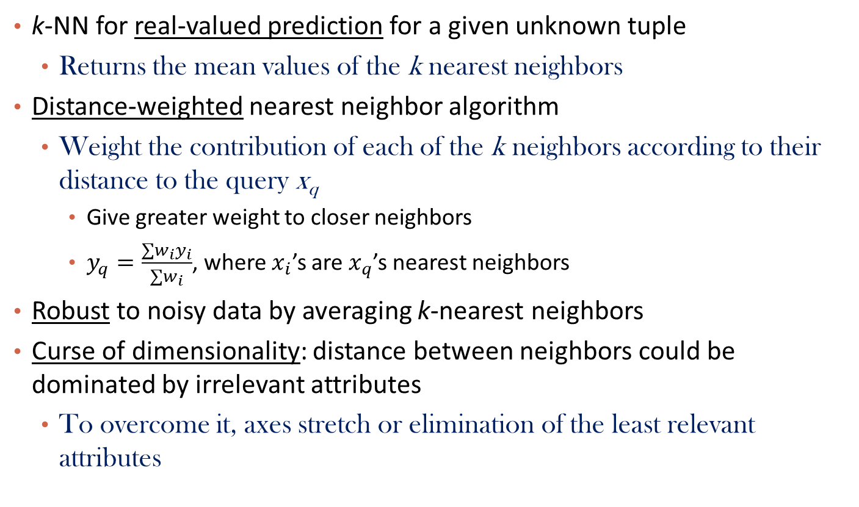
Discussion on the k-NN Algorithm
k-NN for real-valued prediction for a given unknown tuple
  Returns the mean values of the k nearest neighbors
Distance-weighted nearest neighbor algorithm
  Weight the contribution of each of the k neighbors according to their distance to the query x_{q}
    Give greater weight to closer neighbors
    $y_{q}=\frac{∑w_{i}y_{i}}{∑w_{i}}$, where $x_{i}$’s are $x_{q}$’s nearest neighbors
Robust to noisy data by averaging k-nearest neighbors
Curse of dimensionality: distance between neighbors could be dominated by irrelevant attributes
  To overcome it, axes stretch or elimination of the least relevant attributes

Slide 32
Chapter 8&9. Classification: Part 3
Bayesian Learning
  Naïve Bayes
  Bayesian Belief Network
Instance-Based Learning
Summary

Slide 33
Summary
Bayesian Learning
  Bayes theorem
  Naïve Bayes, class conditional independence
  Bayesian Belief Network, DAG, conditional probability table
Instance-Based Learning
  Lazy learning vs. eager learning
  K-nearest neighbor algorithm

