Slide 1
CS6220: Data Mining Techniques
Chapter 8&9: Classification: Part 2
Instructor: Yizhou Sun
yzsun@ccs.neu.edu
February 11, 2013

Slide 2
Announcement
Homework 1
  Apriori algorithm: some length-l candidate can be pruned by checking whether all its sub-patterns with length-(l-1) are in frequent
  FP-growth: Need to scan DB twice
Proposal due tomorrow
  Report
  Sign up meeting time with me on Wednesday afternoon or Thursday morning
Homework 2 will be out tomorrow
No class next week
  The make-up class is canceled
  With homework 2 due on next Friday
Midterm exam (Feb. 25, the same location, same time as classes, 6-8pm)
  You can take a A4 “cheating sheet”
  Covers to the content taught by today

Slide 3
Chapter 8&9. Classification: Part 2
Neural Networks
Support Vector Machine
Summary

Slide 4
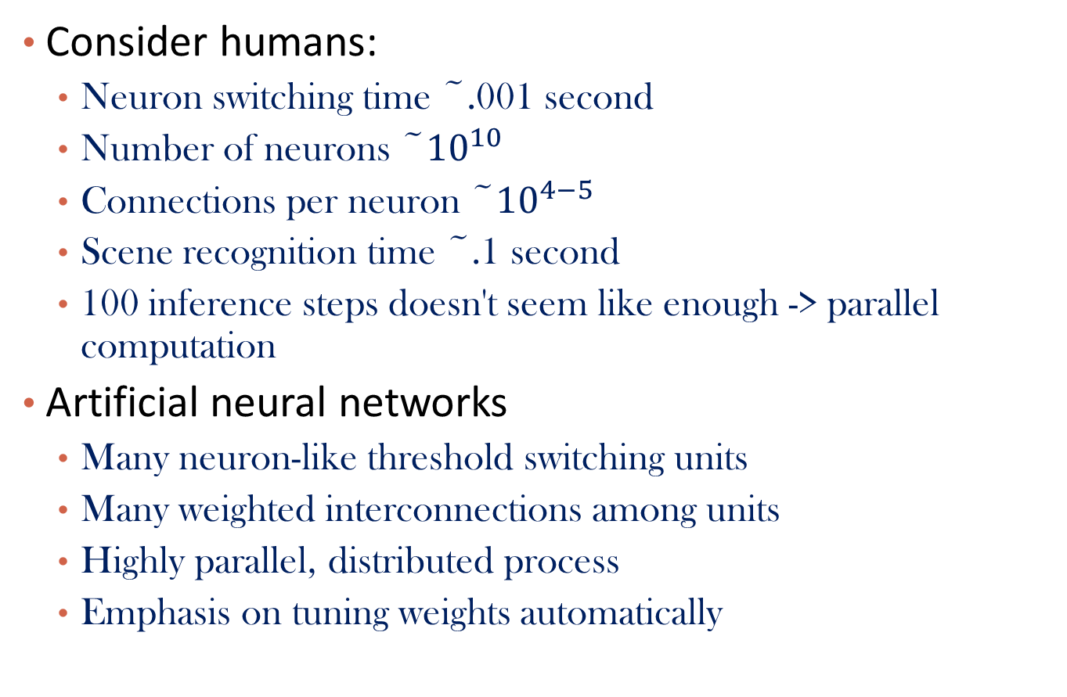
Artificial Neural Networks
Consider humans:
  Neuron switching time ~.001 second
  Number of neurons ~${10}^{10}$
  Connections per neuron ~${10}^{4−5}$
  Scene recognition time ~.1 second
  100 inference steps doesn't seem like enough -> parallel computation
Artificial neural networks
  Many neuron-like threshold switching units
  Many weighted interconnections among units
  Highly parallel, distributed process
  Emphasis on tuning weights automatically

Slide 5

Single Unit: Perceptron
Bias: $θ$
x₀
w₀
x₁
w₁
∑
f
output y
x_{n}
w_{n}
Input
vector x
weight
vector w
weighted
sum
Activation
function
An n-dimensional input vector x is mapped into variable y by means of the scalar product and a nonlinear function mapping
5
Notes:
5
MK Oct 2009: I removed “neuron = perceptron” from title since we do not use that term in the book.

Slide 6
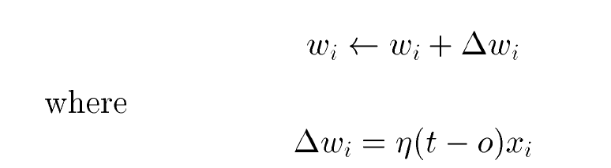
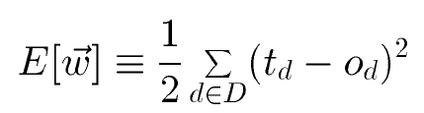
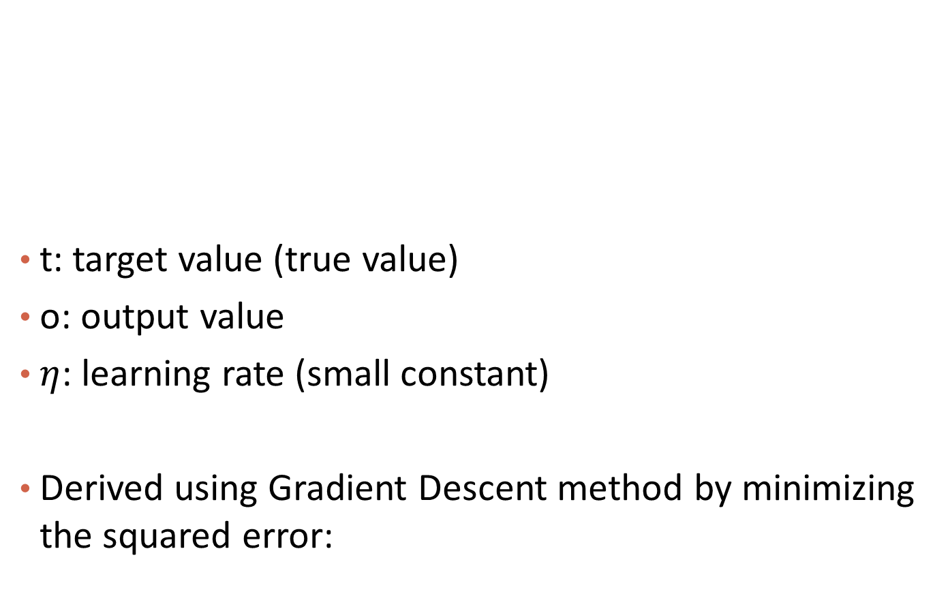
Perceptron Training Rule
t: target value (true value)
o: output value
$η$: learning rate (small constant)
Derived using Gradient Descent method by minimizing the squared error:

Slide 7
A Multi-Layer Feed-Forward Neural Network
Output vector
Output layer
A two-layer network
Hidden layer
w_{ij}
Input layer
Input vector: X
Notes:
MK: Note – different notation than used in book. Will have to standardize notation.

Slide 8
How A Multi-Layer Neural Network Works
The inputs to the network correspond to the attributes measured for each training tuple
Inputs are fed simultaneously into the units making up the input layer
They are then weighted and fed simultaneously to a hidden layer
The number of hidden layers is arbitrary, although usually only one
The weighted outputs of the last hidden layer are input to units making up the output layer, which emits the network's prediction
The network is feed-forward: None of the weights cycles back to an input unit or to an output unit of a previous layer
From a math point of view, networks perform nonlinear regression: Given enough hidden units and enough training samples, they can closely approximate any function

Slide 9
Defining a Network Topology
Decide the network topology: Specify # of units in the input layer, # of hidden layers (if > 1), # of units in each hidden layer, and # of units in the output layer
Normalize the input values for each attribute measured in the training tuples to [0.0—1.0]
One input unit per domain value, each initialized to 0
Output, if for classification and more than two classes, one output unit per class is used
Once a network has been trained and its accuracy is unacceptable, repeat the training process with a different network topology or a different set of initial weights

Slide 10
Classification by Backpropagation
Backpropagation: A neural network learning algorithm
Started by psychologists and neurobiologists to develop and test computational analogues of neurons
During the learning phase, the network learns by adjusting the weights so as to be able to predict the correct class label of the input tuples
Also referred to as connectionist learning due to the connections between units

Slide 11
Backpropagation
Iteratively process a set of training tuples & compare the network's prediction with the actual known target value
For each training tuple, the weights are modified to minimize the mean squared error between the network's prediction and the actual target value
Modifications are made in the “backwards” direction: from the output layer, through each hidden layer down to the first hidden layer, hence “backpropagation”

Slide 12
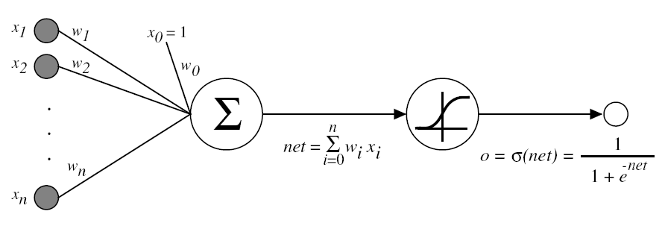


Sigmoid Unit
$σ\left(x\right)=\frac{1}{1+e^{−x}}$ is a sigmoid function
  Property:
  Will be used in backpropagation

Slide 13
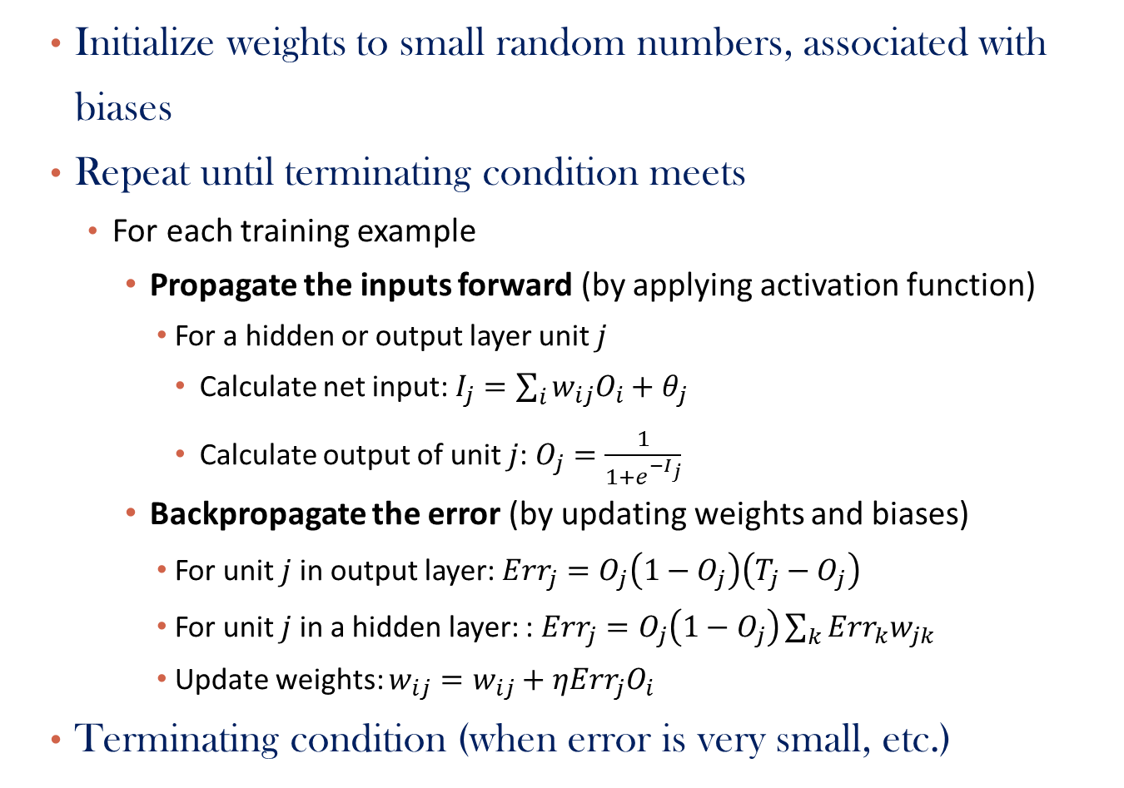
Backpropagation Steps
  Initialize weights to small random numbers, associated with biases
  Repeat until terminating condition meets
    For each training example
      Propagate the inputs forward (by applying activation function)
        For a hidden or output layer unit $j$
          Calculate net input: $I_{j}=\sum_{i}{w_{ij}O_{i}}+θ_{j}$
          Calculate output of unit $j$: $O_{j}=\frac{1}{1+e^{−I_{j}}}$
      Backpropagate the error (by updating weights and biases)
        For unit $j$ in output layer: $Err_{j}=O_{j}\left(1−O_{j}\right)\left(T_{j}−O_{j}\right)$
        For unit $j$ in a hidden layer: : $Err_{j}=O_{j}\left(1−O_{j}\right)\sum_{k}{Err_{k}w_{jk}}$
        Update weights: $w_{ij}=w_{ij}+ηErr_{j}O_{i}$
  Terminating condition (when error is very small, etc.)

Slide 14
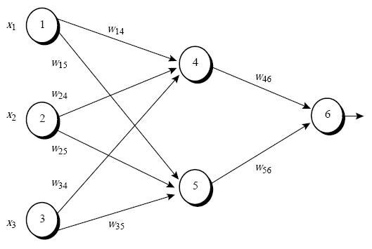
Example
A multilayer feed-forward neural network
Initial Input, weight, and bias values

Slide 15
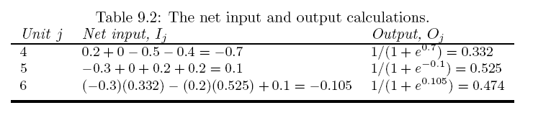
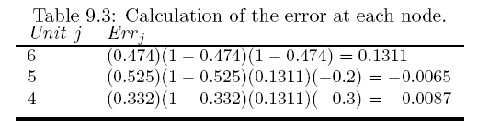
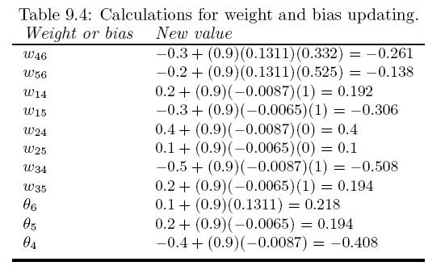
Input forward:
Error backpropagation and weight update:

Slide 16
Efficiency and Interpretability
Efficiency of backpropagation: Each epoch (one iteration through the training set) takes O(|D| * w), with |D| tuples and w weights, but # of epochs can be exponential to n, the number of inputs, in worst case
For easier comprehension: Rule extraction by network pruning
  Simplify the network structure by removing weighted links that have the least effect on the trained network
  Then perform link, unit, or activation value clustering
  The set of input and activation values are studied to derive rules describing the relationship between the input and hidden unit layers
Sensitivity analysis: assess the impact that a given input variable has on a network output. The knowledge gained from this analysis can be represented in rules
  E.g., If x decreases 5% then y increases 8%

Slide 17
Neural Network as a Classifier
Weakness
  Long training time
  Require a number of parameters typically best determined empirically, e.g., the network topology or “structure.”
  Poor interpretability: Difficult to interpret the symbolic meaning behind the learned weights and of “hidden units” in the network
Strength
  High tolerance to noisy data
  Well-suited for continuous-valued inputs and outputs
  Successful on an array of real-world data, e.g., hand-written letters
  Algorithms are inherently parallel
  Techniques have recently been developed for the extraction of rules from trained neural networks

Slide 18
Chapter 8&9. Classification: Part 2
Neural Networks
Support Vector Machine
Summary

Slide 19
Classification: A Mathematical Mapping
Classification: predicts categorical class labels
  E.g., Personal homepage classification
    x_{i} = (x₁, x₂, x₃, …), y_{i} = +1 or –1
    x₁ : # of word “homepage”
    x₂ : # of word “welcome”
Mathematically, x ∈ X = ℜ^{n}, y ∈ Y = {+1, –1},
  We want to derive a function f: X → Y
x
x
x
x
x
x
x
x
x
o
o
x
o
o
o
o
o
o
o
o
o
o
o
19
Notes:
19

Slide 20
SVM—Support Vector Machines
A relatively new classification method for both linear and nonlinear data
It uses a nonlinear mapping to transform the original training data into a higher dimension
With the new dimension, it searches for the linear optimal separating hyperplane (i.e., “decision boundary”)
With an appropriate nonlinear mapping to a sufficiently high dimension, data from two classes can always be separated by a hyperplane
SVM finds this hyperplane using support vectors (“essential” training tuples) and margins (defined by the support vectors)

Slide 21
SVM—History and Applications
Vapnik and colleagues (1992)—groundwork from Vapnik & Chervonenkis’ statistical learning theory in 1960s
Features: training can be slow but accuracy is high owing to their ability to model complex nonlinear decision boundaries (margin maximization)
Used for: classification and numeric prediction
Applications:
  handwritten digit recognition, object recognition, speaker identification, benchmarking time-series prediction tests

Slide 22
SVM—General Philosophy
Small Margin
Large Margin
Support Vectors

Slide 23
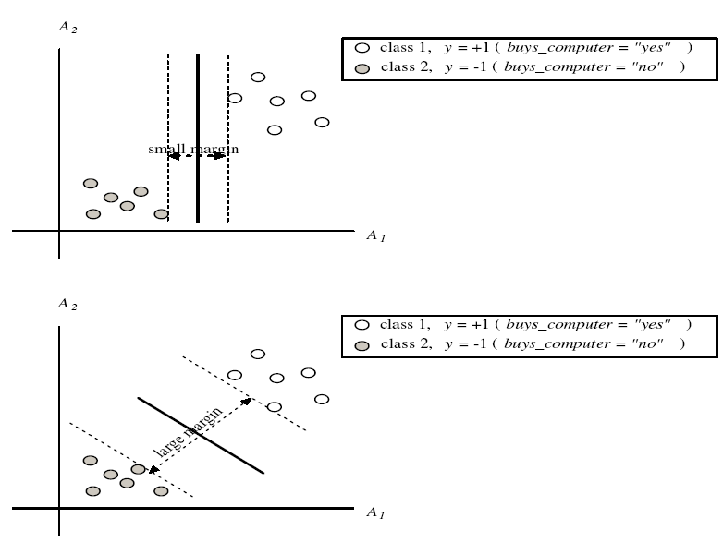
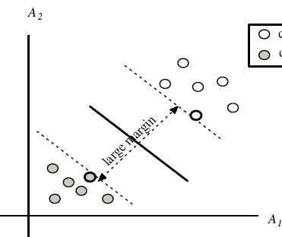
SVM—Margins and Support Vectors

Slide 24
SVM—When Data Is Linearly Separable
m
Let data D be (X₁, y₁), …, (X_{|D|}, y_{|D|}), where X_{i} is the set of training tuples associated with the class labels y_{i}
There are infinite lines (hyperplanes) separating the two classes but we want to find the best one (the one that minimizes classification error on unseen data)
SVM searches for the hyperplane with the largest margin, i.e., maximum marginal hyperplane (MMH)

Slide 25
SVM—Linearly Separable
A separating hyperplane can be written as
    W ● X + b = 0
  where W={w₁, w₂, …, w_{n}} is a weight vector and b a scalar (bias)
For 2-D it can be written as
    w₀ + w₁ x₁ + w₂ x₂ = 0
The hyperplane defining the sides of the margin:
    H₁: w₀ + w₁ x₁ + w₂ x₂ ≥ 1 for y_{i} = +1, and
    H₂: w₀ + w₁ x₁ + w₂ x₂ ≤ – 1 for y_{i} = –1
Any training tuples that fall on hyperplanes H₁ or H₂ (i.e., the
sides defining the margin) are support vectors
This becomes a constrained (convex) quadratic optimization problem: Quadratic objective function and linear constraints → Quadratic Programming (QP) → Lagrangian multipliers

Slide 26

Maximum Margin Calculation
w: decision hyperplane normal vector
x_{i}: data point i
y_{i}: class of data point i (+1 or -1)
ρ
w^{T}x_{a} + b = 1
w^{T}x_{b} + b = -1
$$ρ=\frac{2}{||w||}$$
w^{T} x + b = 0

Slide 27

SVM as a Quadratic Programming
QP
A better form
Objective: Find w and b such that $ρ=\frac{2}{||w||}$ is maximized;
Constraints: For all {(x_{i} , y_{i})}
  w^{T}x_{i} + b ≥ 1 if y_{i}=1;
  w^{T}x_{i} + b ≤ -1 if y_{i} = -1
Objective: Find w and b such that Φ(w) =½ w^{T}w is minimized;
Constraints: for all {(x_{i} ,y_{i})}: y_{i} (w^{T}x_{i} + b) ≥ 1

Slide 28
Solve QP
This is now optimizing a quadratic function subject to linear constraints
Quadratic optimization problems are a well-known class of mathematical programming problem, and many (intricate) algorithms exist for solving them (with many special ones built for SVMs)
The solution involves constructing a dual problem where a Lagrange multiplier α_{i} is associated with every constraint in the primary problem:

Slide 29
Primal Form and Dual Form
More derivations: http://cs229.stanford.edu/notes/cs229-notes3.pdf
Objective: Find w and b such that Φ(w) =½ w^{T}w is minimized;
Constraints: for all {(x_{i} ,y_{i})}: y_{i} (w^{T}x_{i} + b) ≥ 1
Primal
Equivalent under some conditions: KKT conditions
Objective: Find α₁…α_{n} such that
Q(α) =Σα_{i} - ½ΣΣα_{i}α_{j}y_{i}y_{j}x_{i}^{T}x_{j} is maximized and
Constraints
(1) Σα_{i}y_{i} = 0
(2) α_{i} ≥ 0 for all α_{i}
Dual

Slide 30
The Optimization Problem Solution
The solution has the form:
Each non-zero α_{i} indicates that corresponding x_{i} is a support vector.
Then the classifying function will have the form:
Notice that it relies on an inner product between the test point x and the support vectors x_{i}
  We will return to this later.
Also keep in mind that solving the optimization problem involved computing the inner products x_{i}^{T}x_{j} between all pairs of training points.
w =Σα_{i}y_{i}x_{i} b= y_{k}- w^{T}x_{k} for any x_{k} such that α_{k}≠ 0
f(x) = Σα_{i}y_{i}x_{i}^{T}x + b

Slide 31
Why Is SVM Effective on High Dimensional Data?
The complexity of trained classifier is characterized by the # of support vectors rather than the dimensionality of the data
The support vectors are the essential or critical training examples —they lie closest to the decision boundary (MMH)
If all other training examples are removed and the training is repeated, the same separating hyperplane would be found
The number of support vectors found can be used to compute an (upper) bound on the expected error rate of the SVM classifier, which is independent of the data dimensionality
Thus, an SVM with a small number of support vectors can have good generalization, even when the dimensionality of the data is high

Slide 32
Soft Margin Classification
Sec. 15.2.1
If the training data is not linearly separable, slack variables ξ_{i} can be added to allow misclassification of difficult or noisy examples.
Allow some errors
  Let some points be moved to where they belong, at a cost
Still, try to minimize training set errors, and to place hyperplane “far” from each class (large margin)
ξ_{i}
ξ_{j}

Slide 33
Soft Margin Classification Mathematically
Sec. 15.2.1
The old formulation:
The new formulation incorporating slack variables:
Parameter C can be viewed as a way to control overfitting
  A regularization term (L1 regularization)
Find w and b such that
Φ(w) =½ w^{T}w is minimized and for all {(x_{i} ,y_{i})}
y_{i} (w^{T}x_{i} + b) ≥ 1
Find w and b such that
Φ(w) =½ w^{T}w + CΣξ_{i} is minimized and for all {(x_{i} ,y_{i})}
y_{i} (w^{T}x_{i} + b) ≥ 1- ξ_{i} and ξ_{i} ≥ 0 for all i

Slide 34
Soft Margin Classification – Solution
Sec. 15.2.1
The dual problem for soft margin classification:
Neither slack variables ξ_{i} nor their Lagrange multipliers appear in the dual problem!
Again, x_{i} with non-zero α_{i} will be support vectors.
Solution to the dual problem is:
Find α₁…α_{N} such that
Q(α) =Σα_{i} - ½ΣΣα_{i}α_{j}y_{i}y_{j}x_{i}^{T}x_{j} is maximized and
(1) Σα_{i}y_{i} = 0
(2) 0 ≤ α_{i} ≤ C for all α_{i}
w is not needed explicitly for classification!
w = Σα_{i}y_{i}x_{i}
b = y_{k}(1- ξ_{k}) - w^{T}x_{k} where k = argmax α_{k’}
k’
f(x) = Σα_{i}y_{i}x_{i}^{T}x + b

Slide 35
Classification with SVMs
Sec. 15.1
Given a new point x, we can score its projection onto the hyperplane normal:
  I.e., compute score: w^{T}x + b = Σα_{i}y_{i}x_{i}^{T}x + b
    Decide class based on whether < or > 0
  Can set confidence threshold t.
Score > t: yes
Score < -t: no
Else: don’t know
1
0
-1

Slide 36
Linear SVMs: Summary
Sec. 15.2.1
The classifier is a separating hyperplane.
The most “important” training points are the support vectors; they define the hyperplane.
Quadratic optimization algorithms can identify which training points x_{i} are support vectors with non-zero Lagrangian multipliers α_{i}.
Both in the dual formulation of the problem and in the solution, training points appear only inside inner products:
Find α₁…α_{N} such that
Q(α) =Σα_{i} - ½ΣΣα_{i}α_{j}y_{i}y_{j}x_{i}^{T}x_{j} is maximized and
(1) Σα_{i}y_{i} = 0
(2) 0 ≤ α_{i} ≤ C for all α_{i}
f(x) = Σα_{i}y_{i}x_{i}^{T}x + b

Slide 37
Non-linear SVMs
Sec. 15.2.3
Datasets that are linearly separable (with some noise) work out great:
But what are we going to do if the dataset is just too hard?
How about … mapping data to a higher-dimensional space:
0
x
0
x
x²
0
x

Slide 38
Non-linear SVMs: Feature spaces
Sec. 15.2.3
General idea: the original feature space can always be mapped to some higher-dimensional feature space where the training set is separable:
Φ: x → φ(x)

Slide 39
The “Kernel Trick”
Sec. 15.2.3
The linear classifier relies on an inner product between vectors K(x_{i},x_{j})=x_{i}^{T}x_{j}
If every data point is mapped into high-dimensional space via some transformation Φ: x → φ(x), the inner product becomes:
K(x_{i},x_{j})= φ(x_{i}) ^{T}φ(x_{j})
A kernel function is some function that corresponds to an inner product in some expanded feature space.
Example:
2-dimensional vectors x=[x₁ x₂]; let K(x_{i},x_{j})=(1 + x_{i}^{T}x_{j})²,
Need to show that K(x_{i},x_{j})= φ(x_{i}) ^{T}φ(x_{j}):
K(x_{i},x_{j})=(1 + x_{i}^{T}x_{j})²,= 1+ x_{i1}²x_{j1}² + 2 x_{i1}x_{j1} x_{i2}x_{j2}+ x_{i2}²x_{j2}² + 2x_{i1}x_{j1} + 2x_{i2}x_{j2}=
= [1 x_{i1}² √2 x_{i1}x_{i2} x_{i2}² √2x_{i1} √2x_{i2}]^{T} [1 x_{j1}² √2 x_{j1}x_{j2} x_{j2}² √2x_{j1} √2x_{j2}]
= φ(x_{i}) ^{T}φ(x_{j}) where φ(x) = [1 x₁² √2 x₁x₂ x₂² √2x₁ √2x₂]

Slide 40
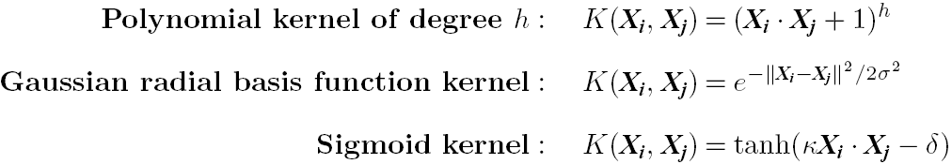
SVM: Different Kernel functions
Instead of computing the dot product on the transformed data, it is math. equivalent to applying a kernel function K(X_{i}, X_{j}) to the original data, i.e., K(X_{i}, X_{j}) = Φ(X_{i}) Φ(X_{j})
Typical Kernel Functions
SVM can also be used for classifying multiple (> 2) classes and for regression analysis (with additional parameters)

Slide 41
Scaling SVM by Hierarchical Micro-Clustering
SVM is not scalable to the number of data objects in terms of training time and memory usage
H. Yu, J. Yang, and J. Han, “Classifying Large Data Sets Using SVM with Hierarchical Clusters”, KDD'03)
CB-SVM (Clustering-Based SVM)
  Given limited amount of system resources (e.g., memory), maximize the SVM performance in terms of accuracy and the training speed
  Use micro-clustering to effectively reduce the number of points to be considered
  At deriving support vectors, de-cluster micro-clusters near “candidate vector” to ensure high classification accuracy

Slide 42
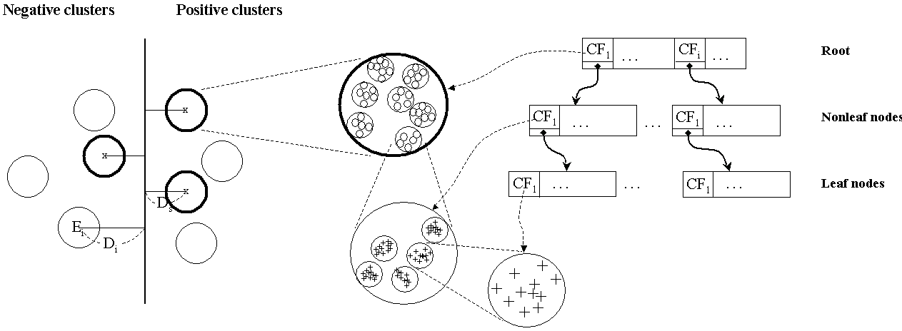
CF-Tree: Hierarchical Micro-cluster
Read the data set once, construct a statistical summary of the data (i.e., hierarchical clusters) given a limited amount of memory
Micro-clustering: Hierarchical indexing structure
  provide finer samples closer to the boundary and coarser samples farther from the boundary

Slide 43
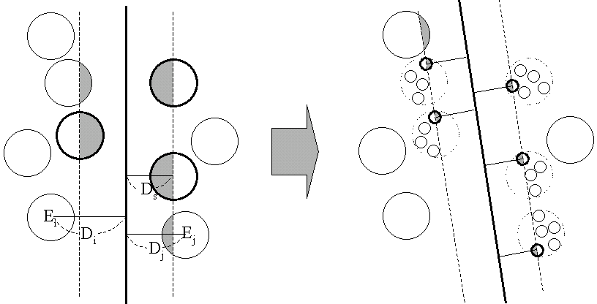
Selective Declustering: Ensure High Accuracy
CF tree is a suitable base structure for selective declustering
De-cluster only the cluster E_{i} such that
  D_{i} – R_{i} < D_{s}, where D_{i} is the distance from the boundary to the center point of E_{i} and R_{i} is the radius of E_{i}
  Decluster only the cluster whose subclusters have possibilities to be the support cluster of the boundary
    “Support cluster”: The cluster whose centroid is a support vector

Slide 44
CB-SVM Algorithm: Outline
Construct two CF-trees from positive and negative data sets independently
  Need one scan of the data set
Train an SVM from the centroids of the root entries
De-cluster the entries near the boundary into the next level
  The children entries de-clustered from the parent entries are accumulated into the training set with the non-declustered parent entries
Train an SVM again from the centroids of the entries in the training set
Repeat until nothing is accumulated

Slide 45
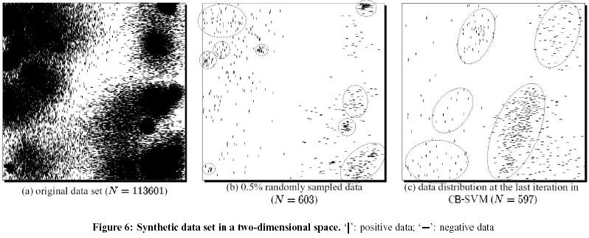
Accuracy and Scalability on Synthetic Dataset
Experiments on large synthetic data sets shows better accuracy than random sampling approaches and far more scalable than the original SVM algorithm

Slide 46
SVM vs. Neural Network
SVM
  Deterministic algorithm
  Nice generalization properties
  Hard to learn – learned in batch mode using quadratic programming techniques
  Using kernels can learn very complex functions
Neural Network
  Nondeterministic algorithm
  Generalizes well but doesn’t have strong mathematical foundation
  Can easily be learned in incremental fashion
  To learn complex functions—use multilayer perceptron (nontrivial)

Slide 47
SVM Related Links
SVM Website: http://www.kernel-machines.org/
Representative implementations
  LIBSVM: an efficient implementation of SVM, multi-class classifications, nu-SVM, one-class SVM, including also various interfaces with java, python, etc.
  SVM-light: simpler but performance is not better than LIBSVM, support only binary classification and only in C
  SVM-torch: another recent implementation also written in C

Slide 48
Chapter 8&9. Classification: Part 2
Neural Networks
Support Vector Machine
Summary

Slide 49
Artificial Neural Networks
  Single unit
  Multilayer neural networks
  Backpropagation algorithm
Support Vector Machine
  Support vectors
  Maximum marginal hyperplane
  Linear separable
  Linear inseparable
  Kernel tricks

Slide 50
Announcement
Homework 1
  Apriori algorithm: some length-l candidate can be pruned by checking whether all its sub-patterns with length-(l-1) are in frequent
  FP-growth: Need to scan DB twice
Proposal due tomorrow
  Report
  Sign up meeting time with me on Wednesday afternoon or Thursday morning
Homework 2 will be out tomorrow
No class next week
  The make-up class is canceled
  With homework 2 due on next Friday
Midterm exam (Feb. 25, the same location, same time as classes, 6-8pm)
  You can take a A4 “cheating sheet”
  Covers to the content taught by today

Slide 51
References (1)
C. M. Bishop, Neural Networks for Pattern Recognition. Oxford University Press, 1995
C. J. C. Burges. A Tutorial on Support Vector Machines for Pattern Recognition. Data Mining and Knowledge Discovery, 2(2): 121-168, 1998
H. Cheng, X. Yan, J. Han, and C.-W. Hsu, Discriminative Frequent pattern Analysis for Effective Classification, ICDE'07
H. Cheng, X. Yan, J. Han, and P. S. Yu, Direct Discriminative Pattern Mining for Effective Classification, ICDE'08
N. Cristianini and J. Shawe-Taylor, Introduction to Support Vector Machines and Other Kernel-Based Learning Methods, Cambridge University Press, 2000
A. J. Dobson. An Introduction to Generalized Linear Models. Chapman & Hall, 1990
G. Dong and J. Li. Efficient mining of emerging patterns: Discovering trends and differences. KDD'99

Slide 52
References (2)
R. O. Duda, P. E. Hart, and D. G. Stork. Pattern Classification, 2ed. John Wiley, 2001
T. Hastie, R. Tibshirani, and J. Friedman. The Elements of Statistical Learning: Data Mining, Inference, and Prediction. Springer-Verlag, 2001
S. Haykin, Neural Networks and Learning Machines, Prentice Hall, 2008
D. Heckerman, D. Geiger, and D. M. Chickering. Learning Bayesian networks: The combination of knowledge and statistical data. Machine Learning, 1995.
V. Kecman, Learning and Soft Computing: Support Vector Machines, Neural Networks, and Fuzzy Logic, MIT Press, 2001
W. Li, J. Han, and J. Pei, CMAR: Accurate and Efficient Classification Based on Multiple Class-Association Rules, ICDM'01
T.-S. Lim, W.-Y. Loh, and Y.-S. Shih. A comparison of prediction accuracy, complexity, and training time of thirty-three old and new classification algorithms. Machine Learning, 2000

Slide 53
References (3)
B. Liu, W. Hsu, and Y. Ma. Integrating classification and association rule mining, p. 80-86, KDD’98.
T. M. Mitchell. Machine Learning. McGraw Hill, 1997.
D.E. Rumelhart, and J.L. McClelland, editors, Parallel Distributed Processing, MIT Press, 1986.
P. Tan, M. Steinbach, and V. Kumar. Introduction to Data Mining. Addison Wesley, 2005.
S. M. Weiss and N. Indurkhya. Predictive Data Mining. Morgan Kaufmann, 1997.
I. H. Witten and E. Frank. Data Mining: Practical Machine Learning Tools and Techniques, 2ed. Morgan Kaufmann, 2005.
X. Yin and J. Han. CPAR: Classification based on predictive association rules. SDM'03
H. Yu, J. Yang, and J. Han. Classifying large data sets using SVM with hierarchical clusters. KDD'03.

