Slide 1
CS6220: Data Mining Techniques
Chapter 8&9: Classification: Part 1
Instructor: Yizhou Sun
yzsun@ccs.neu.edu
February 4, 2013

Slide 2
Chapter 8&9. Classification: Part 1
Classification: Basic Concepts
Decision Tree Induction
Rule-Based Classification
Model Evaluation and Selection
Summary

Slide 3
Supervised vs. Unsupervised Learning
Supervised learning (classification)
  Supervision: The training data (observations, measurements, etc.) are accompanied by labels indicating the class of the observations
  New data is classified based on the training set
Unsupervised learning (clustering)
  The class labels of training data is unknown
  Given a set of measurements, observations, etc. with the aim of establishing the existence of classes or clusters in the data

Slide 4
Prediction Problems: Classification vs. Numeric Prediction
Classification
  predicts categorical class labels (discrete or nominal)
  classifies data (constructs a model) based on the training set and the values (class labels) in a classifying attribute and uses it in classifying new data
Numeric Prediction
  models continuous-valued functions, i.e., predicts unknown or missing values
Typical applications
  Credit/loan approval:
  Medical diagnosis: if a tumor is cancerous or benign
  Fraud detection: if a transaction is fraudulent
  Web page categorization: which category it is

Slide 5
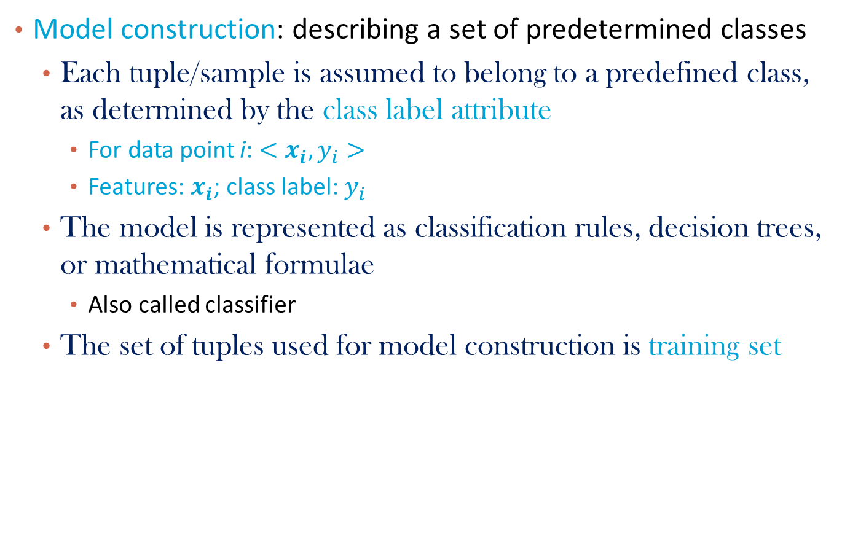
Classification—A Two-Step Process (1)
Model construction: describing a set of predetermined classes
  Each tuple/sample is assumed to belong to a predefined class, as determined by the class label attribute
    For data point i: $<x_{i},y_{i}>$
    Features: $x_{i}$; class label: $y_{i}$
  The model is represented as classification rules, decision trees, or mathematical formulae
    Also called classifier
  The set of tuples used for model construction is training set

Slide 6
Classification—A Two-Step Process (2)
Model usage: for classifying future or unknown objects
  Estimate accuracy of the model
    The known label of test sample is compared with the classified result from the model
    Test set is independent of training set (otherwise overfitting)
    Accuracy rate is the percentage of test set samples that are correctly classified by the model
      Most used for binary classes
  If the accuracy is acceptable, use the model to classify new data
Note: If the test set is used to select models, it is called validation (test) set

Slide 7
Process (1): Model Construction
Classification
Algorithms
Training
Data
Classifier
(Model)
IF rank = ‘professor’
OR years > 6
THEN tenured = ‘yes’

Slide 8
Process (2): Using the Model in Prediction
Classifier
Testing
Data
Unseen Data
(Jeff, Professor, 4)
Tenured?

Slide 9
Classification Methods Overview
Part 1
  Decision tree
  Rule-based classification
Part 2
  ANN
  SVM
Part 3
  Bayesian Learning: Naïve Bayes, Bayesian belief network
  Instance-based learning: KNN
Part 4
  Pattern-based classification
  Ensemble
  Other topics

Slide 10
Chapter 8&9. Classification: Part 1
Classification: Basic Concepts
Decision Tree Induction
Rule-Based Classification
Model Evaluation and Selection
Summary

Slide 11
Decision Tree Induction: An Example
Training data set: Buys_computer
The data set follows an example of Quinlan’s ID3 (Playing Tennis)
Resulting tree:
age?
<=30
overcast
>40
31..40
student?
yes
credit rating?
no
yes
excellent
fair
no
yes
no
yes

Slide 12
Algorithm for Decision Tree Induction
Basic algorithm (a greedy algorithm)
  Tree is constructed in a top-down recursive divide-and-conquer manner
  At start, all the training examples are at the root
  Attributes are categorical (if continuous-valued, they are discretized in advance)
  Examples are partitioned recursively based on selected attributes
  Test attributes are selected on the basis of a heuristic or statistical measure (e.g., information gain)
Conditions for stopping partitioning
  All samples for a given node belong to the same class
  There are no remaining attributes for further partitioning – majority voting is employed for classifying the leaf
  There are no samples left
12

Slide 13
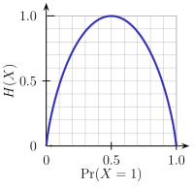
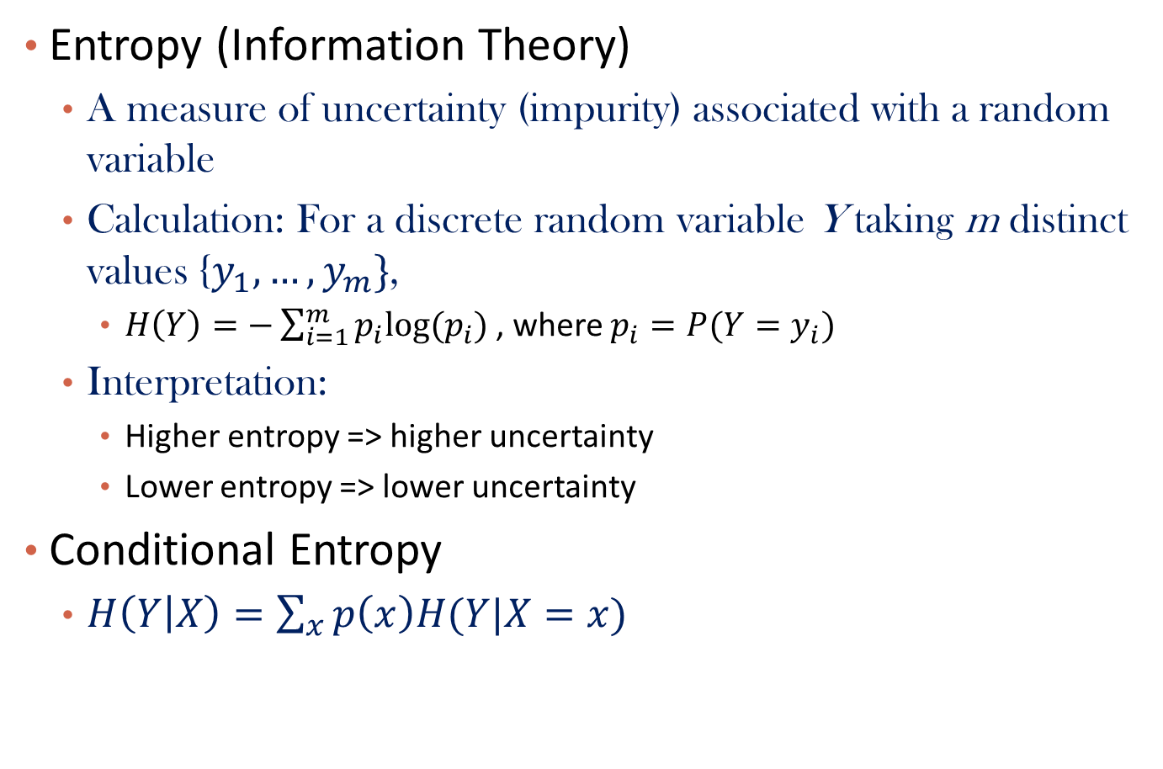
Brief Review of Entropy
Entropy (Information Theory)
  A measure of uncertainty (impurity) associated with a random variable
  Calculation: For a discrete random variable Y taking m distinct values {$y_{1},…,y_{m}\}$,
    $H\left(Y\right)=−\sum_{i=1}^{m}{p_{i}log⁡(p_{i}) }$, where $p_{i}=P(Y=y_{i})$
  Interpretation:
    Higher entropy => higher uncertainty
    Lower entropy => lower uncertainty
Conditional Entropy
  $H\left(Y | X\right)=\sum_{x}{p\left(x\right)H(Y|X=x)}$
m = 2
13

Slide 14
Attribute Selection Measure: Information Gain (ID3/C4.5)
Select the attribute with the highest information gain
Let p_{i} be the probability that an arbitrary tuple in D belongs to class C_{i}, estimated by |C_{i, D}|/|D|
Expected information (entropy) needed to classify a tuple in D:
Information needed (after using A to split D into v partitions) to classify D:
Information gained by branching on attribute A
Notes:
I : the expected information needed to classify a given sample
E (entropy) : expected information based on the partitioning into subsets by A

Slide 15
Attribute Selection: Information Gain
Class P: buys_computer = “yes”
Class N: buys_computer = “no”
means “age <=30” has 5 out of 14 samples, with 2 yes’es and 3 no’s. Hence
Similarly,
15

Slide 16
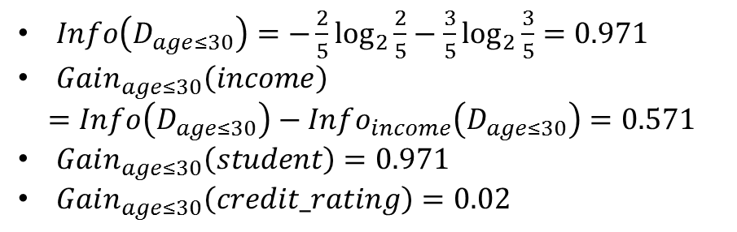

Attribute Selection for a Branch
age?
$Info\left(D_{age≤30}\right)=−\frac{2}{5}\log_{2}{\frac{2}{5}}−\frac{3}{5}\log_{2}{\frac{3}{5}}=0.971$
$Gain_{age≤30}\left(income\right)$
$$=Info\left(D_{age≤30}\right)−Info_{income}\left(D_{age≤30}\right)=0.571$$
$Gain_{age≤30}\left(student\right)=0.971$
$Gain_{age≤30}\left(credit_rating\right)=0.02$
<=30
overcast
>40
31..40
?
yes
?
age?
Which attribute next?
<=30
overcast
>40
31..40
student?
yes
?
$$D_{age≤30}$$
no
yes
no
yes

Slide 17
Computing Information-Gain for Continuous-Valued Attributes
Let attribute A be a continuous-valued attribute
Must determine the best split point for A
  Sort the value A in increasing order
  Typically, the midpoint between each pair of adjacent values is considered as a possible split point
    (a_{i}+a_{i+1})/2 is the midpoint between the values of a_{i} and a_{i+1}
  The point with the minimum expected information requirement for A is selected as the split-point for A
Split:
  D1 is the set of tuples in D satisfying A ≤ split-point, and D2 is the set of tuples in D satisfying A > split-point
17

Slide 18
Gain Ratio for Attribute Selection (C4.5)
Information gain measure is biased towards attributes with a large number of values
C4.5 (a successor of ID3) uses gain ratio to overcome the problem (normalization to information gain)
  GainRatio(A) = Gain(A)/SplitInfo(A)
Ex.
  gain_ratio(income) = 0.029/1.557 = 0.019
The attribute with the maximum gain ratio is selected as the splitting attribute
18

Slide 19
Gini Index (CART, IBM IntelligentMiner)
If a data set D contains examples from n classes, gini index, gini(D) is defined as
where p_{j} is the relative frequency of class j in D
If a data set D is split on A into two subsets D₁ and D₂, the gini index gini(D) is defined as
Reduction in Impurity:
The attribute provides the smallest gini_{split}(D) (or the largest reduction in impurity) is chosen to split the node (need to enumerate all the possible splitting points for each attribute)
19

Slide 20
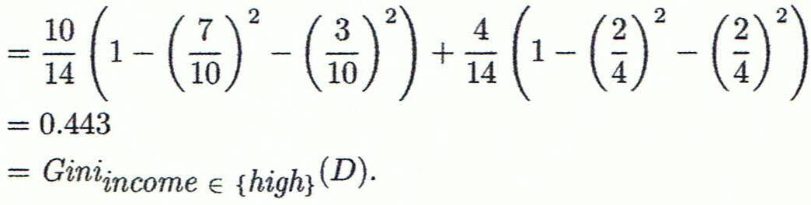
Computation of Gini Index
Ex. D has 9 tuples in buys_computer = “yes” and 5 in “no”
Suppose the attribute income partitions D into 10 in D₁: {low, medium} and 4 in D₂
  Gini_{{low,high}} is 0.458; Gini_{{medium,high}} is 0.450. Thus, split on the {low,medium} (and {high}) since it has the lowest Gini index
20

Slide 21
Comparing Attribute Selection Measures
The three measures, in general, return good results but
  Information gain:
    biased towards multivalued attributes
  Gain ratio:
    tends to prefer unbalanced splits in which one partition is much smaller than the others (why?)
  Gini index:
    biased to multivalued attributes
    has difficulty when # of classes is large
21

Slide 22
Other Attribute Selection Measures
CHAID: a popular decision tree algorithm, measure based on χ² test for independence
C-SEP: performs better than info. gain and gini index in certain cases
G-statistic: has a close approximation to χ² distribution
MDL (Minimal Description Length) principle (i.e., the simplest solution is preferred):
  The best tree as the one that requires the fewest # of bits to both (1) encode the tree, and (2) encode the exceptions to the tree
Multivariate splits (partition based on multiple variable combinations)
  CART: finds multivariate splits based on a linear comb. of attrs.
Which attribute selection measure is the best?
  Most give good results, none is significantly superior than others
22

Slide 23
Overfitting and Tree Pruning
Overfitting: An induced tree may overfit the training data
  Too many branches, some may reflect anomalies due to noise or outliers
  Poor accuracy for unseen samples
Two approaches to avoid overfitting
  Prepruning: Halt tree construction early ̵ do not split a node if this would result in the goodness measure falling below a threshold
    Difficult to choose an appropriate threshold
  Postpruning: Remove branches from a “fully grown” tree—get a sequence of progressively pruned trees
    Use a set of data different from the training data to decide which is the “best pruned tree”
23

Slide 24
Enhancements to Basic Decision Tree Induction
Allow for continuous-valued attributes
  Dynamically define new discrete-valued attributes that partition the continuous attribute value into a discrete set of intervals
Handle missing attribute values
  Assign the most common value of the attribute
  Assign probability to each of the possible values
Attribute construction
  Create new attributes based on existing ones that are sparsely represented
  This reduces fragmentation, repetition, and replication
24

Slide 25
Classification in Large Databases
Classification—a classical problem extensively studied by statisticians and machine learning researchers
Scalability: Classifying data sets with millions of examples and hundreds of attributes with reasonable speed
Why is decision tree induction popular?
  relatively faster learning speed (than other classification methods)
  convertible to simple and easy to understand classification rules
  can use SQL queries for accessing databases
  comparable classification accuracy with other methods
RainForest (VLDB’98 — Gehrke, Ramakrishnan & Ganti)
  Builds an AVC-list (attribute, value, class label)
25

Slide 26
Scalability Framework for RainForest
Separates the scalability aspects from the criteria that determine the quality of the tree
Builds an AVC-list: AVC (Attribute, Value, Class_label)
AVC-set (of an attribute X )
  Projection of training dataset onto the attribute X and class label where counts of individual class label are aggregated
AVC-group (of a node n )
  Set of AVC-sets of all predictor attributes at the node n
26

Slide 27
Rainforest: Training Set and Its AVC Sets
Training Examples
AVC-set on Age
AVC-set on income
Age | Buy_Computer
 | yes | no
<=30 | 2 | 3
31..40 | 4 | 0
>40 | 3 | 2
income | Buy_Computer
 | yes | no
high | 2 | 2
medium | 4 | 2
low | 3 | 1
AVC-set on
credit_rating
AVC-set on Student
student | Buy_Computer
 | yes | no
yes | 6 | 1
no | 3 | 4
Credit rating | Buy_Computer
 | yes | no
fair | 6 | 2
excellent | 3 | 3
27

Slide 28
BOAT (Bootstrapped Optimistic Algorithm for Tree Construction)
Use a statistical technique called bootstrapping to create several smaller samples (subsets), each fits in memory
Each subset is used to create a tree, resulting in several trees
These trees are examined and used to construct a new tree T’
  It turns out that T’ is very close to the tree that would be generated using the whole data set together
Adv: requires only two scans of DB, an incremental alg.
Notes:
28

Slide 29
Chapter 8&9. Classification: Part 1
Classification: Basic Concepts
Decision Tree Induction
Rule-Based Classification
Model Evaluation and Selection
Summary

Slide 30
Using IF-THEN Rules for Classification
Represent the knowledge in the form of IF-THEN rules
  R: IF age = youth AND student = yes THEN buys_computer = yes
  Rule antecedent/precondition vs. rule consequent
Assessment of a rule: coverage and accuracy
  n_{covers} = # of tuples covered by R
  n_{correct} = # of tuples correctly classified by R
  coverage(R) = n_{covers} /|D| /* D: training data set */
  accuracy(R) = n_{correct} / n_{covers}
30

Slide 31
If more than one rule are triggered, need conflict resolution
  Size ordering: assign the highest priority to the triggering rules that has the “toughest” requirement (i.e., with the most attribute tests)
  Class-based ordering: decreasing order of prevalence or misclassification cost per class
  Rule-based ordering (decision list): rules are organized into one long priority list, according to some measure of rule quality or by experts

Slide 32
Rule Extraction from a Decision Tree
Rules are easier to understand than large trees
One rule is created for each path from the root to a leaf
Each attribute-value pair along a path forms a conjunction: the leaf holds the class prediction
Rules are mutually exclusive and exhaustive
age?
young
mid-age
old
student?
yes
credit rating?
no
yes
excellent
fair
no
yes
no
yes
Example: Rule extraction from our buys_computer decision-tree
  IF age = young AND student = no THEN buys_computer = no
  IF age = young AND student = yes THEN buys_computer = yes
  IF age = mid-age THEN buys_computer = yes
  IF age = old AND credit_rating = excellent THEN buys_computer = no
  IF age = old AND credit_rating = fair THEN buys_computer = yes
32

Slide 33
Rule Induction: Sequential Covering Method
Sequential covering algorithm: Extracts rules directly from training data
Typical sequential covering algorithms: FOIL, AQ, CN2, RIPPER
Rules are learned sequentially, each for a given class C_{i} will cover many tuples of C_{i} but none (or few) of the tuples of other classes
Steps:
  Rules are learned one at a time
  Each time a rule is learned, the tuples covered by the rules are removed
  Repeat the process on the remaining tuples until termination condition, e.g., when no more training examples or when the quality of a rule returned is below a user-specified threshold
Comp. w. decision-tree induction: learning a set of rules simultaneously
33

Slide 34
Sequential Covering Algorithm
while (enough target tuples left)
  generate a rule
  remove positive target tuples satisfying this rule
Examples covered
by Rule 2
Examples covered
by Rule 1
Examples covered
by Rule 3
Positive examples
34

Slide 35
Rule Generation
To generate a rule
  while(true)
  find the “best” predicate p
  if foil-gain(p) > threshold then add p to current rule
  else break
A3=1
A3=1&&A1=2
A3=1&&A1=2
&&A8=5
Positive examples
Negative examples
35

Slide 36
How to Learn-One-Rule?
Start with the most general rule possible: condition = empty
Adding new attributes by adopting a greedy depth-first strategy
  Picks the one that most improves the rule quality
Rule-Quality measures: consider both coverage and accuracy
  Foil-gain (in FOIL & RIPPER): assesses info_gain by extending condition
    favors rules that have high accuracy and cover many positive tuples
Rule pruning based on an independent set of test tuples
    Pos/neg are # of positive/negative tuples covered by R.
    If FOIL_Prune is higher for the pruned version of R, prune R
36

Slide 37
Chapter 8&9. Classification: Part 1
Classification: Basic Concepts
Decision Tree Induction
Rule-Based Classification
Model Evaluation and Selection
Summary

Slide 38
Model Evaluation and Selection
Evaluation metrics: How can we measure accuracy? Other metrics to consider?
Use validation test set of class-labeled tuples instead of training set when assessing accuracy
Methods for estimating a classifier’s accuracy:
  Holdout method, random subsampling
  Cross-validation
Comparing classifiers:
  Confidence intervals
  Cost-benefit analysis and ROC Curves

Slide 39
Classifier Evaluation Metrics: Confusion Matrix
Confusion Matrix:
Actual class\Predicted class | C₁ | ¬ C₁
C₁ | True Positives (TP) | False Negatives (FN)
¬ C₁ | False Positives (FP) | True Negatives (TN)
Example of Confusion Matrix:
Actual class\Predicted class | buy_computer = yes | buy_computer = no | Total
buy_computer = yes | 6954 | 46 | 7000
buy_computer = no | 412 | 2588 | 3000
Total | 7366 | 2634 | 10000
Given m classes, an entry, CM_{i,j} in a confusion matrix indicates # of tuples in class i that were labeled by the classifier as class j
May have extra rows/columns to provide totals
39

Slide 40
Classifier Evaluation Metrics: Accuracy, Error Rate, Sensitivity and Specificity
A\P | C | ¬C
C | TP | FN | P
¬C | FP | TN | N
 | P’ | N’ | All
Class Imbalance Problem:
  One class may be rare, e.g. fraud, or HIV-positive
  Significant majority of the negative class and minority of the positive class
  Sensitivity: True Positive recognition rate
    Sensitivity = TP/P
  Specificity: True Negative recognition rate
    Specificity = TN/N
Classifier Accuracy, or recognition rate: percentage of test set tuples that are correctly classified
  Accuracy = (TP + TN)/All
Error rate: 1 – accuracy, or
  Error rate = (FP + FN)/All

Slide 41
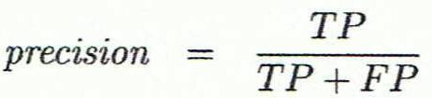
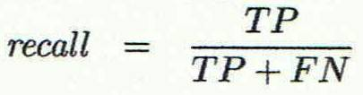
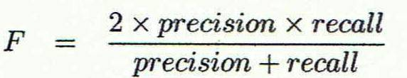
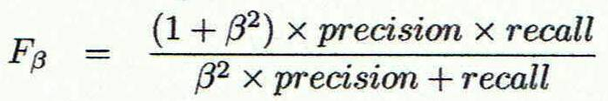
Classifier Evaluation Metrics:
Precision and Recall, and F-measures
Precision: exactness – what % of tuples that the classifier labeled as positive are actually positive
Recall: completeness – what % of positive tuples did the classifier label as positive?
Perfect score is 1.0
Inverse relationship between precision & recall
F measure (F₁ or F-score): harmonic mean of precision and recall,
F_{ß}: weighted measure of precision and recall
  assigns ß times as much weight to recall as to precision

Slide 42
Classifier Evaluation Metrics: Example
Actual Class\Predicted class | cancer = yes | cancer = no | Total | Recognition(%)
cancer = yes | 90 | 210 | 300 | 30.00 (sensitivity
cancer = no | 140 | 9560 | 9700 | 98.56 (specificity)
Total | 230 | 9770 | 10000 | 96.40 (accuracy)
  Precision = 90/230 = 39.13% Recall = 90/300 = 30.00%
42

Slide 43
Evaluating Classifier Accuracy:
Holdout & Cross-Validation Methods
Holdout method
  Given data is randomly partitioned into two independent sets
    Training set (e.g., 2/3) for model construction
    Test set (e.g., 1/3) for accuracy estimation
  Random sampling: a variation of holdout
    Repeat holdout k times, accuracy = avg. of the accuracies obtained
Cross-validation (k-fold, where k = 10 is most popular)
  Randomly partition the data into k mutually exclusive subsets, each approximately equal size
  At i-th iteration, use D_{i} as test set and others as training set
  Leave-one-out: k folds where k = # of tuples, for small sized data
  *Stratified cross-validation*: folds are stratified so that class dist. in each fold is approx. the same as that in the initial data

Slide 44


Estimating Confidence Intervals:
Classifier Models M₁ vs. M₂
Suppose we have 2 classifiers, M₁ and M₂, which one is better?
Use 10-fold cross-validation to obtain and
These mean error rates are just point estimates of error on the true population of future data cases
What if the difference between the 2 error rates is just attributed to chance?
  Use a test of statistical significance
  Obtain confidence limits for our error estimates

Slide 45
Estimating Confidence Intervals:
Null Hypothesis
Perform 10-fold cross-validation of two models: M₁ & M₂
Assume samples follow normal distribution
Use two sample t-test (or Student’s t-test)
Null Hypothesis: M₁ & M₂ are the same (means are equal)
If we can reject null hypothesis, then
  we conclude that the difference between M₁ & M₂ is statistically significant
  Chose model with lower error rate

Slide 46
Model Selection: ROC Curves
ROC (Receiver Operating Characteristics) curves: for visual comparison of classification models
Originated from signal detection theory
Shows the trade-off between the true positive rate and the false positive rate
The area under the ROC curve is a measure of the accuracy of the model
Rank the test tuples in decreasing order: the one that is most likely to belong to the positive class appears at the top of the list
Area under the curve: the closer to the diagonal line (i.e., the closer the area is to 0.5), the less accurate is the model
Vertical axis represents the true positive rate
Horizontal axis rep. the false positive rate
The plot also shows a diagonal line
A model with perfect accuracy will have an area of 1.0

Slide 47
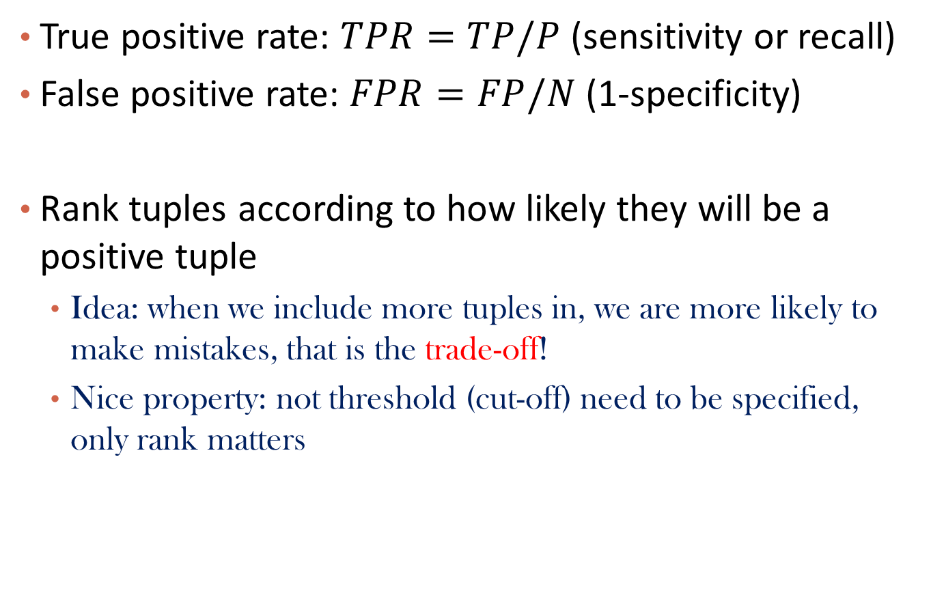
Plotting an ROC Curve
True positive rate: $TPR=TP/P$ (sensitivity or recall)
False positive rate: $FPR=FP/N$ (1-specificity)
Rank tuples according to how likely they will be a positive tuple
  Idea: when we include more tuples in, we are more likely to make mistakes, that is the trade-off!
  Nice property: not threshold (cut-off) need to be specified, only rank matters

Slide 48
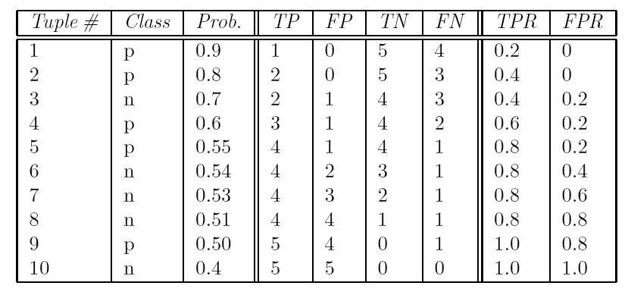
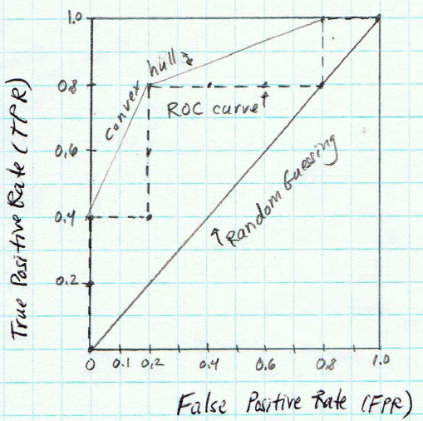
Example

Slide 49
Issues Affecting Model Selection
Accuracy
  classifier accuracy: predicting class label
Speed
  time to construct the model (training time)
  time to use the model (classification/prediction time)
Robustness: handling noise and missing values
Scalability: efficiency in disk-resident databases
Interpretability
  understanding and insight provided by the model
Other measures, e.g., goodness of rules, such as decision tree size or compactness of classification rules

Slide 50
Chapter 8&9. Classification: Part 1
Classification: Basic Concepts
Decision Tree Induction
Rule-Based Classification
Model Evaluation and Selection
Summary

Slide 51
Summary
Classification is a form of data analysis that extracts models describing important data classes.
Effective and scalable methods have been developed for decision tree induction, rule-based classification, and many other classification methods.
Evaluation
  Evaluation metrics include: accuracy, sensitivity, specificity, precision, recall, F measure, and F_{ß} measure.
  Stratified k-fold cross-validation is recommended for accuracy estimation.
  Significance tests and ROC curves are useful for model selection.

Slide 52
Homework 1 is due today
Course project proposal will be due next Monday

Slide 53
References (1)
C. Apte and S. Weiss. Data mining with decision trees and decision rules. Future Generation Computer Systems, 13, 1997
C. M. Bishop, Neural Networks for Pattern Recognition. Oxford University Press, 1995
L. Breiman, J. Friedman, R. Olshen, and C. Stone. Classification and Regression Trees. Wadsworth International Group, 1984
C. J. C. Burges. A Tutorial on Support Vector Machines for Pattern Recognition. Data Mining and Knowledge Discovery, 2(2): 121-168, 1998
P. K. Chan and S. J. Stolfo. Learning arbiter and combiner trees from partitioned data for scaling machine learning. KDD'95
H. Cheng, X. Yan, J. Han, and C.-W. Hsu, Discriminative Frequent Pattern Analysis for Effective Classification, ICDE'07
H. Cheng, X. Yan, J. Han, and P. S. Yu, Direct Discriminative Pattern Mining for Effective Classification, ICDE'08
W. Cohen. Fast effective rule induction. ICML'95
G. Cong, K.-L. Tan, A. K. H. Tung, and X. Xu. Mining top-k covering rule groups for gene expression data. SIGMOD'05

Slide 54
References (2)
A. J. Dobson. An Introduction to Generalized Linear Models. Chapman & Hall, 1990.
G. Dong and J. Li. Efficient mining of emerging patterns: Discovering trends and differences. KDD'99.
R. O. Duda, P. E. Hart, and D. G. Stork. Pattern Classification, 2ed. John Wiley, 2001
U. M. Fayyad. Branching on attribute values in decision tree generation. AAAI’94.
Y. Freund and R. E. Schapire. A decision-theoretic generalization of on-line learning and an application to boosting. J. Computer and System Sciences, 1997.
J. Gehrke, R. Ramakrishnan, and V. Ganti. Rainforest: A framework for fast decision tree construction of large datasets. VLDB’98.
J. Gehrke, V. Gant, R. Ramakrishnan, and W.-Y. Loh, BOAT -- Optimistic Decision Tree Construction. SIGMOD'99.
T. Hastie, R. Tibshirani, and J. Friedman. The Elements of Statistical Learning: Data Mining, Inference, and Prediction. Springer-Verlag, 2001.
D. Heckerman, D. Geiger, and D. M. Chickering. Learning Bayesian networks: The combination of knowledge and statistical data. Machine Learning, 1995.
W. Li, J. Han, and J. Pei, CMAR: Accurate and Efficient Classification Based on Multiple Class-Association Rules, ICDM'01.

Slide 55
References (3)
T.-S. Lim, W.-Y. Loh, and Y.-S. Shih. A comparison of prediction accuracy, complexity, and training time of thirty-three old and new classification algorithms. Machine Learning, 2000.
J. Magidson. The Chaid approach to segmentation modeling: Chi-squared automatic interaction detection. In R. P. Bagozzi, editor, Advanced Methods of Marketing Research, Blackwell Business, 1994.
M. Mehta, R. Agrawal, and J. Rissanen. SLIQ : A fast scalable classifier for data mining. EDBT'96.
T. M. Mitchell. Machine Learning. McGraw Hill, 1997.
S. K. Murthy, Automatic Construction of Decision Trees from Data: A Multi-Disciplinary Survey, Data Mining and Knowledge Discovery 2(4): 345-389, 1998
J. R. Quinlan. Induction of decision trees. Machine Learning, 1:81-106, 1986.
J. R. Quinlan and R. M. Cameron-Jones. FOIL: A midterm report. ECML’93.
J. R. Quinlan. C4.5: Programs for Machine Learning. Morgan Kaufmann, 1993.
J. R. Quinlan. Bagging, boosting, and c4.5. AAAI'96.

Slide 56
References (4)
R. Rastogi and K. Shim. Public: A decision tree classifier that integrates building and pruning. VLDB’98.
J. Shafer, R. Agrawal, and M. Mehta. SPRINT : A scalable parallel classifier for data mining. VLDB’96.
J. W. Shavlik and T. G. Dietterich. Readings in Machine Learning. Morgan Kaufmann, 1990.
P. Tan, M. Steinbach, and V. Kumar. Introduction to Data Mining. Addison Wesley, 2005.
S. M. Weiss and C. A. Kulikowski. Computer Systems that Learn: Classification and Prediction Methods from Statistics, Neural Nets, Machine Learning, and Expert Systems. Morgan Kaufman, 1991.
S. M. Weiss and N. Indurkhya. Predictive Data Mining. Morgan Kaufmann, 1997.
I. H. Witten and E. Frank. Data Mining: Practical Machine Learning Tools and Techniques, 2ed. Morgan Kaufmann, 2005.
X. Yin and J. Han. CPAR: Classification based on predictive association rules. SDM'03
H. Yu, J. Yang, and J. Han. Classifying large data sets using SVM with hierarchical clusters. KDD'03.

