Slide 1
CS6220: Data Mining Techniques
Chapter 11: Advanced Clustering Analysis
Instructor: Yizhou Sun
yzsun@ccs.neu.edu
April 10, 2013

Slide 2
Chapter 10. Cluster Analysis: Basic Concepts and Methods
Beyond K-Means
  K-means
  EM-algorithm
  Kernel K-means
Clustering Graphs and Network Data
Summary

Slide 3
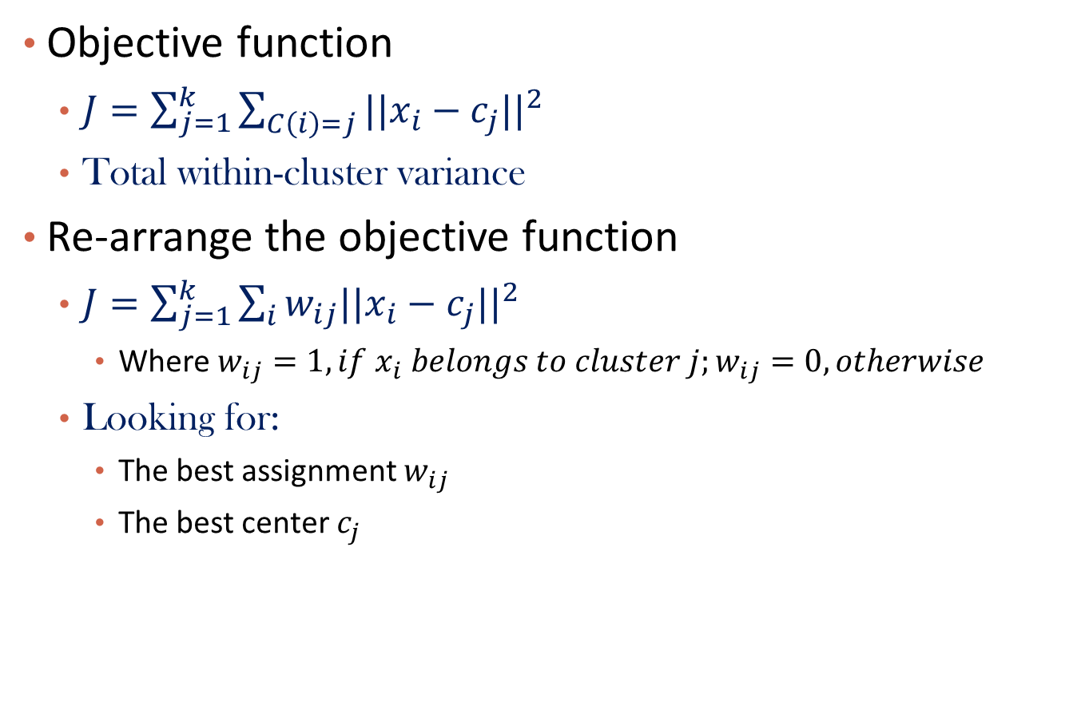
Recall K-Means
Objective function
  $J=\sum_{j=1}^{k}{\sum_{C\left(i\right)=j}{{||x_{i}−c_{j}||}^{2}}}$
  Total within-cluster variance
Re-arrange the objective function
  $J=\sum_{j=1}^{k}{\sum_{i}{{w_{ij}||x_{i}−c_{j}||}^{2}}}$
    Where $w_{ij}=1, if x_{i} belongs to cluster j;w_{ij}=0, otherwise$
  Looking for:
    The best assignment $w_{ij}$
    The best center $c_{j}$

Slide 4
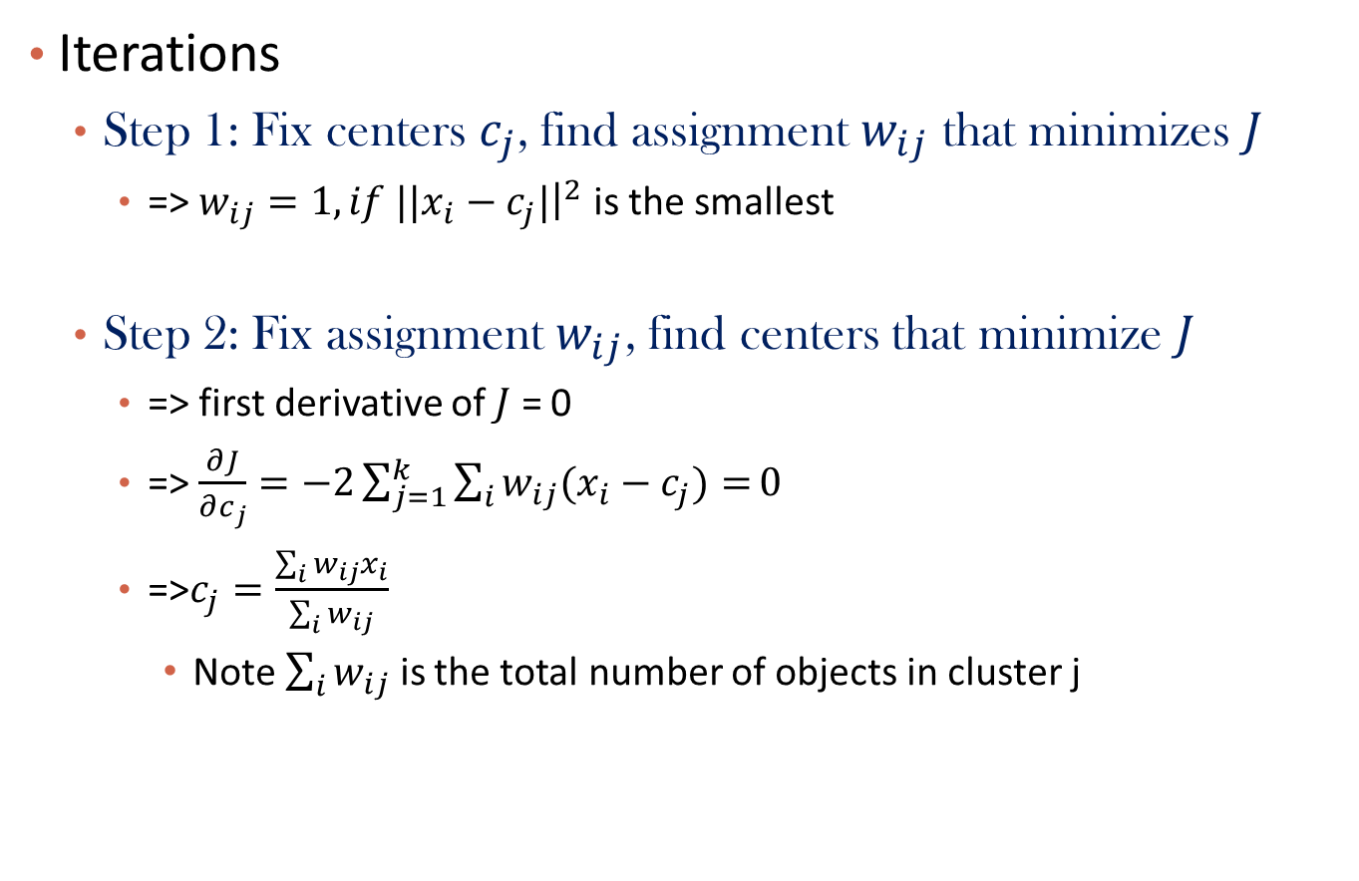
Solution of K-Means
Iterations
  Step 1: Fix centers $c_{j}$, find assignment $w_{ij}$ that minimizes $J$
    => $w_{ij}=1, if {||x}_{i}−c_{j}|{\left.​\right|}^{2}$ is the smallest
  Step 2: Fix assignment $w_{ij}$, find centers that minimize $J$
    => first derivative of $J$ = 0
    => $\frac{∂J}{∂c_{j}}=−2\sum_{j=1}^{k}{\sum_{i}{w_{ij}(x_{i}−c_{j})=}}0$
    =>$c_{j}=\frac{\sum_{i}{w_{ij}x_{i}}}{\sum_{i}{w_{ij}}}$
      Note $\sum_{i}{w_{ij}}$ is the total number of objects in cluster j

Slide 5
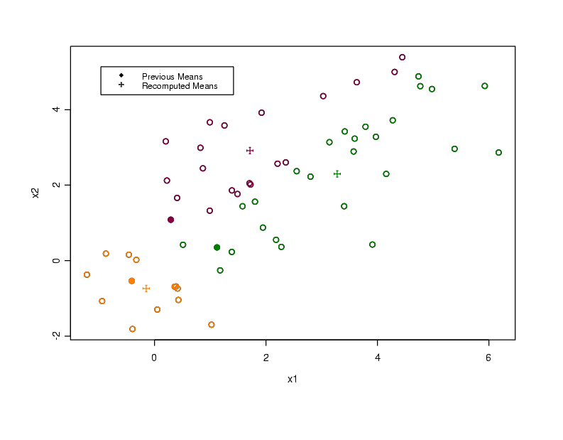

Slide 6
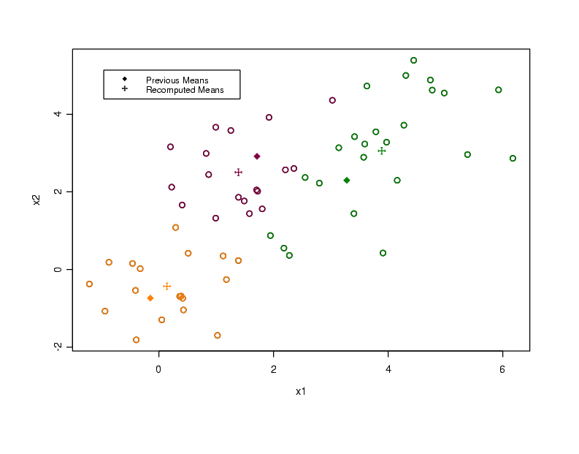

Slide 7
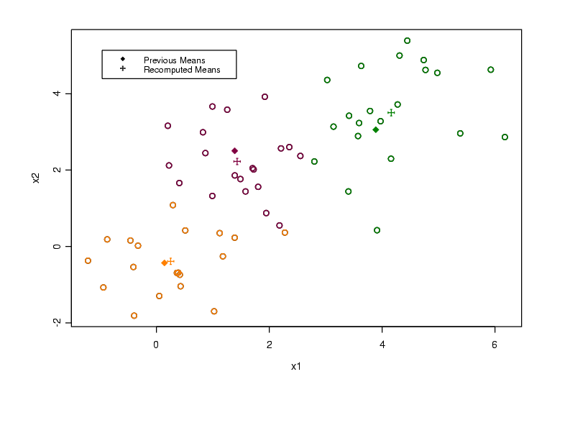

Slide 8


Slide 9
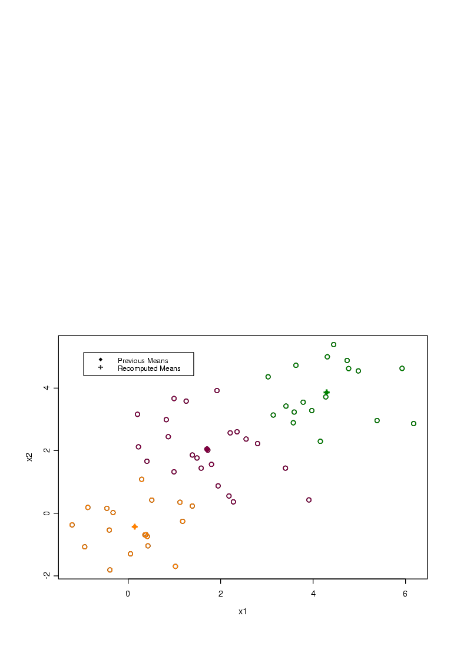

Slide 11
Limitations of K-Means
K-means has problems when clusters are of differing
  Sizes
  Densities
  Non-Spherical Shapes

Slide 12
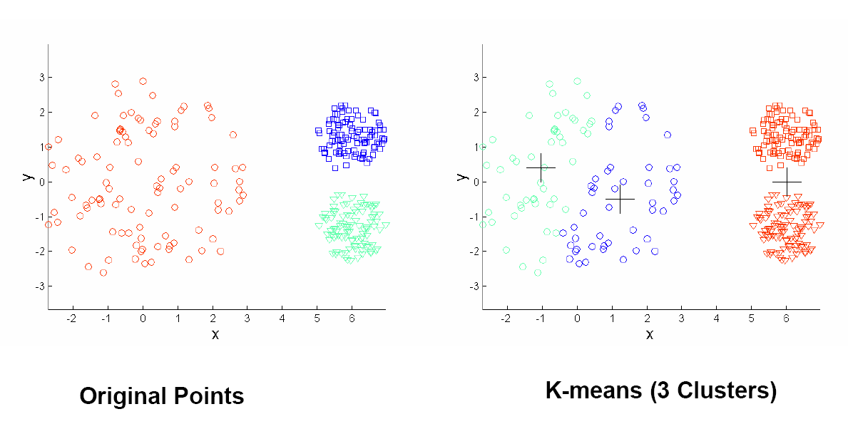
Limitations of K-Means: Different Density and Size

Slide 13
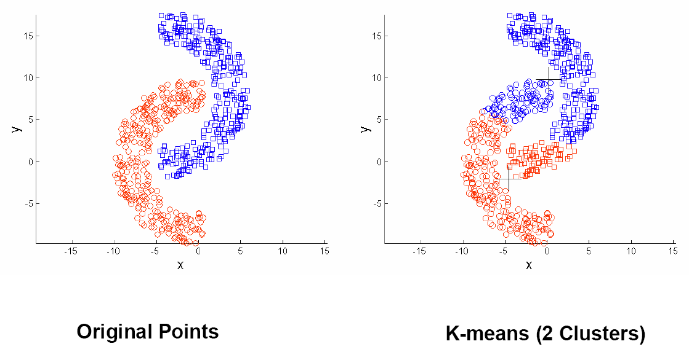
Limitations of K-Means: Non-Spherical Shapes

Slide 14
Fuzzy Set and Fuzzy Cluster
Clustering methods discussed so far
  Every data object is assigned to exactly one cluster
Some applications may need for fuzzy or soft cluster assignment
  Ex. An e-game could belong to both entertainment and software
Methods: fuzzy clusters and probabilistic model-based clusters
Fuzzy cluster: A fuzzy set S: F_{S} : X → [0, 1] (value between 0 and 1)

Slide 15
Probabilistic Model-Based Clustering
Cluster analysis is to find hidden categories.
A hidden category (i.e., probabilistic cluster) is a distribution over the data space, which can be mathematically represented using a probability density function (or distribution function).
Ex. categories for digital cameras sold
  consumer line vs. professional line
  density functions f₁, f₂ for C₁, C₂
  obtained by probabilistic clustering
A mixture model assumes that a set of observed objects is a mixture of instances from multiple probabilistic clusters, and conceptually each observed object is generated independently
Our task: infer a set of k probabilistic clusters that is mostly likely to generate D using the above data generation process
15

Slide 16
Mixture Model-Based Clustering
A set C of k probabilistic clusters C₁, …,C_{k} with probability density functions f₁, …, f_{k}, respectively, and their probabilities ω₁, …, ω_{k}.
Probability of an object o generated by cluster C_{j} is
Probability of o generated by the set of cluster C is
Since objects are assumed to be generated independently, for a data set D = {o₁, …, o_{n}}, we have,
Task: Find a set C of k probabilistic clusters s.t. P(D|C) is maximized
16
Notes:
16

Slide 17
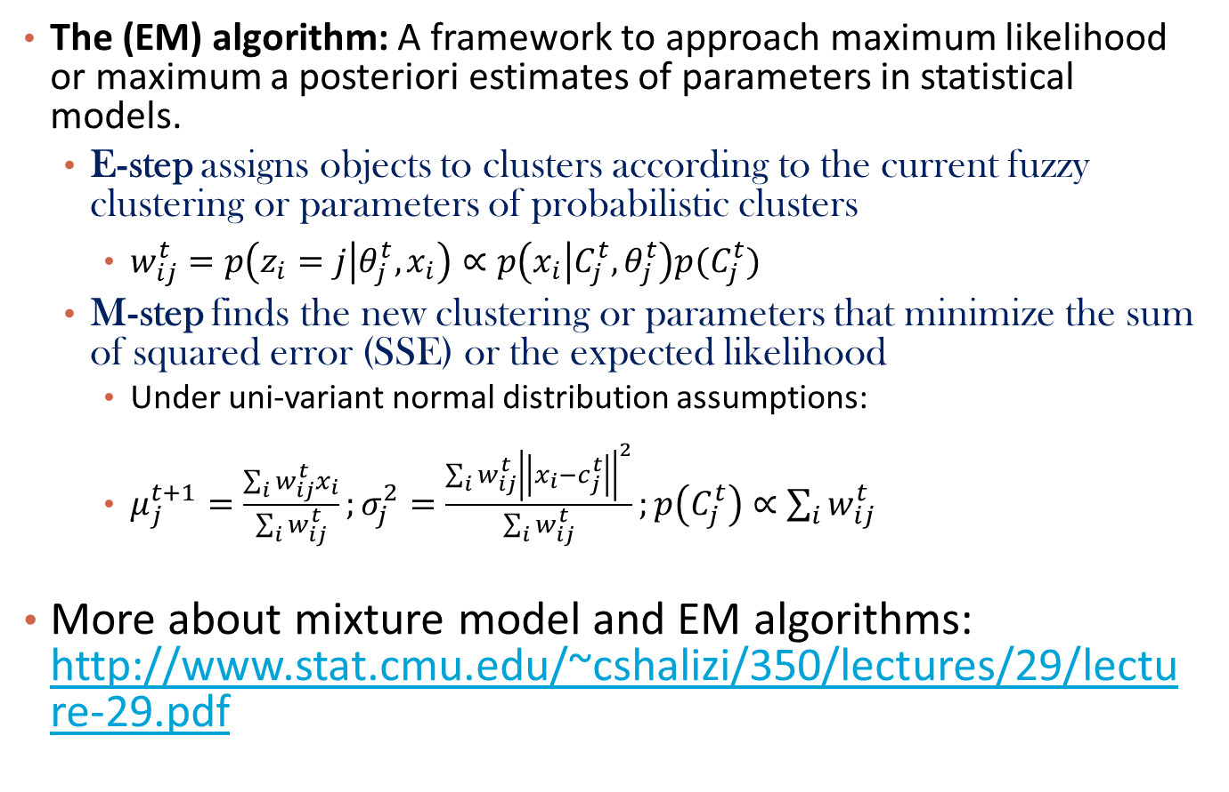
The EM (Expectation Maximization) Algorithm
The (EM) algorithm: A framework to approach maximum likelihood or maximum a posteriori estimates of parameters in statistical models.
  E-step assigns objects to clusters according to the current fuzzy clustering or parameters of probabilistic clusters
    $w_{ij}^{t}=p\left(z_{i}=j | θ_{j}^{t},x_{i}\right)∝p\left(x_{i} | C_{j}^{t},θ_{j}^{t}\right)p(C_{j}^{t})$
  M-step finds the new clustering or parameters that minimize the sum of squared error (SSE) or the expected likelihood
    Under uni-variant normal distribution assumptions:
    $μ_{j}^{t+1}=\frac{\sum_{i}{w_{ij}^{t}x_{i}}}{\sum_{i}{w_{ij}^{t}}};σ_{j}^{2}=\frac{\sum_{i}{w_{ij}^{t}{\left|\left|x_{i}−c_{j}^{t}\right|\right|}^{2}}}{\sum_{i}{w_{ij}^{t}}};p\left(C_{j}^{t}\right)∝\sum_{i}{w_{ij}^{t}}$
More about mixture model and EM algorithms: http://www.stat.cmu.edu/~cshalizi/350/lectures/29/lecture-29.pdf

Slide 18

K-Means: Special Case of Gaussian Mixture Model
When each Gaussian component with covariance matrix $σ^{2}I$
  Soft K-means
When $σ^{2}→0$
  Soft assignment becomes hard assignment

Slide 19
Advantages and Disadvantages of Mixture Models
Strength
  Mixture models are more general than partitioning
  Clusters can be characterized by a small number of parameters
  The results may satisfy the statistical assumptions of the generative models
Weakness
  Converge to local optimal (overcome: run multi-times w. random initialization)
  Computationally expensive if the number of distributions is large, or the data set contains very few observed data points
  Need large data sets
  Hard to estimate the number of clusters

Slide 20
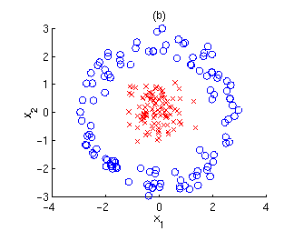
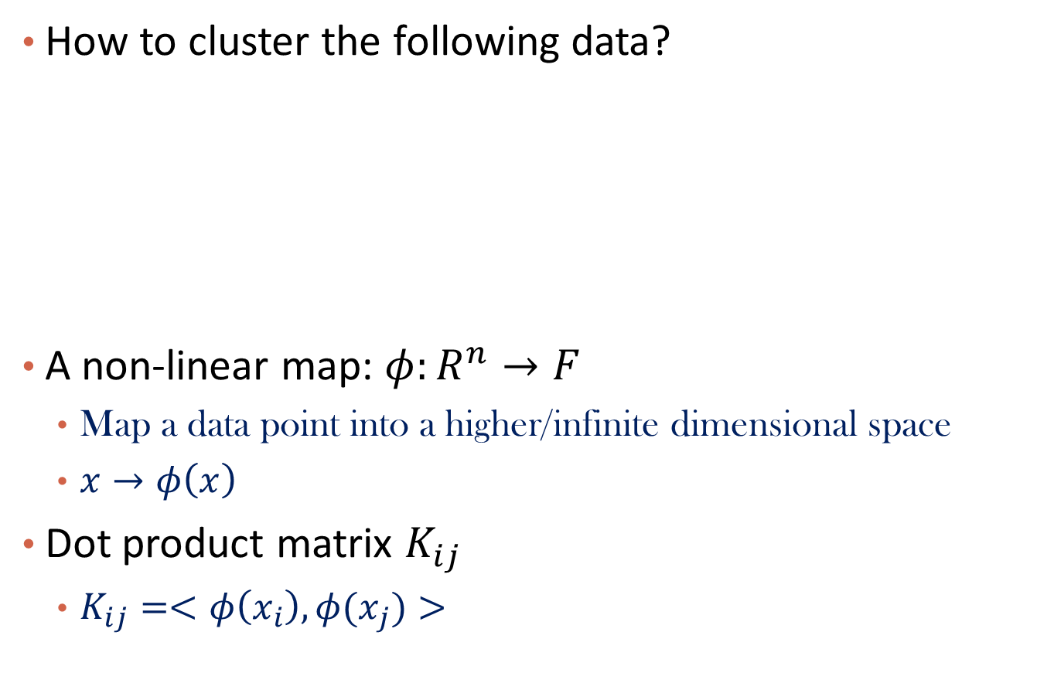
Kernel K-Means
How to cluster the following data?
A non-linear map: $φ:R^{n}→F$
  Map a data point into a higher/infinite dimensional space
  $x→φ\left(x\right)$
Dot product matrix $K_{ij}$
  $K_{ij}=<φ\left(x_{i}\right),φ(x_{j})>$

Slide 21

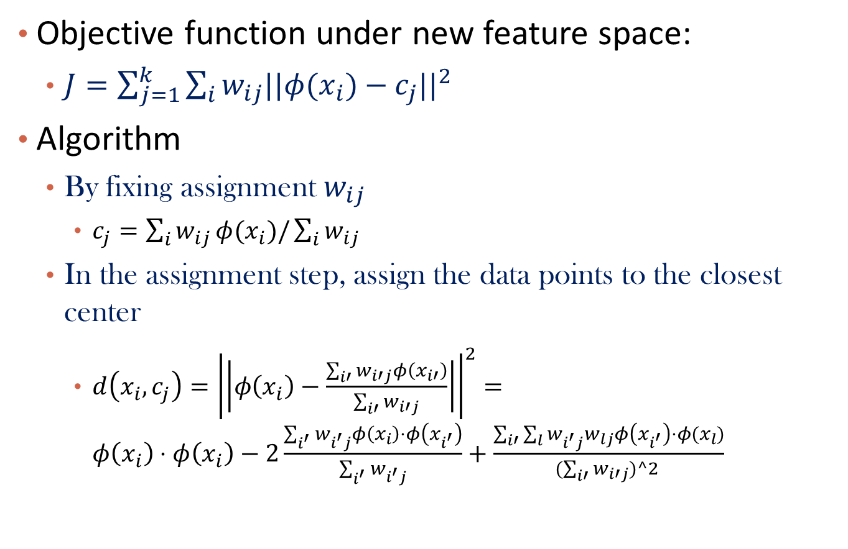
Solution of Kernel K-Means
Objective function under new feature space:
  $J=\sum_{j=1}^{k}{\sum_{i}{{w_{ij}||{φ(x}_{i})−c_{j}||}^{2}}}$
Algorithm
  By fixing assignment $w_{ij}$
    $c_{j}=\sum_{i}{w_{ij}}φ(x_{i})/\sum_{i}{w_{ij}}$
  In the assignment step, assign the data points to the closest center
    $d\left(x_{i},c_{j}\right)={\left|\left|φ\left(x_{i}\right)−\frac{\sum_{i′}{w_{i′j}}φ\left(x_{i′}\right)}{\sum_{i′}{w_{i′j}}}\right|\right|}^{2}=φ\left(x_{i}\right)⋅φ\left(x_{i}\right)−2\frac{\sum_{i^{′}}{w_{i^{′}j}}φ\left(x_{i}\right)⋅φ\left(x_{i^{′}}\right)}{\sum_{i^{′}}{w_{i^{′}j}}}+\frac{\sum_{i′}{\sum_{l}{w_{i^{′}j}w_{lj}φ\left(x_{i^{′}}\right)⋅φ(x_{l})}}}{(\sum_{i′}{w_{i′j})^2 }}$
Do not really need to know $φ\left(x\right), but only K_{ij}$

Slide 22
Advatanges and Disadvantages of Kernel K-Means
Advantages
  Algorithm is able to identify the non-linear structures.
Disadvantages
  Number of cluster centers need to be predefined.
  Algorithm is complex in nature and time complexity is large.
References
  Kernel k-means and Spectral Clustering by Max Welling.
  Kernel k-means, Spectral Clustering and Normalized Cut by Inderjit S. Dhillon, Yuqiang Guan and Brian Kulis.
  An Introduction to kernel methods by Colin Campbell.

Slide 23
Chapter 10. Cluster Analysis: Basic Concepts and Methods
Beyond K-Means
  K-means
  EM-algorithm for Mixture Models
  Kernel K-means
Clustering Graphs and Network Data
Summary

Slide 24
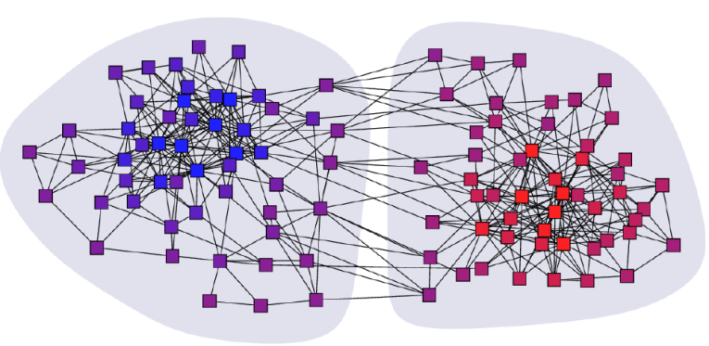
Clustering Graphs and Network Data
Applications
  Bi-partite graphs, e.g., customers and products, authors and conferences
  Web search engines, e.g., click through graphs and Web graphs
  Social networks, friendship/coauthor graphs
Clustering books about politics [Newman, 2006]
24

Slide 25
Algorithms
Graph clustering methods
  Density-based clustering: SCAN (Xu et al., KDD’2007)
  Spectral clustering
  Modularity-based approach
  Probabilistic approach
  Nonnegative matrix factorization
  …

Slide 26
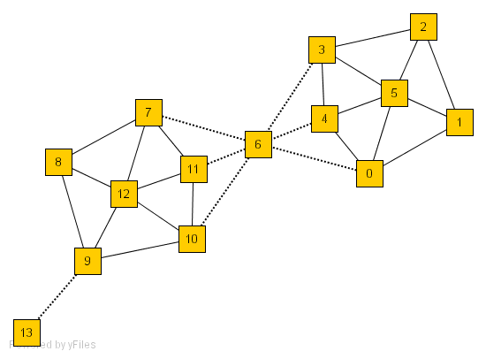
SCAN: Density-Based Clustering of Networks
How many clusters?
What size should they be?
What is the best partitioning?
Should some points be segregated?
An Example Network
Application: Given simply information of who associates with whom, could one identify clusters of individuals with common interests or special relationships (families, cliques, terrorist cells)?
26
Notes:
26

Slide 27
A Social Network Model
Cliques, hubs and outliers
  Individuals in a tight social group, or clique, know many of the same people, regardless of the size of the group
  Individuals who are hubs know many people in different groups but belong to no single group. Politicians, for example bridge multiple groups
  Individuals who are outliers reside at the margins of society. Hermits, for example, know few people and belong to no group
The Neighborhood of a Vertex
  Define Γ(ν) as the immediate neighborhood of a vertex (i.e. the set of people that an individual knows )
27

Slide 28
Structure Similarity
The desired features tend to be captured by a measure we call Structural Similarity
Structural similarity is large for members of a clique and small for hubs and outliers
28

Slide 29
Structural Connectivity [1]
[1] M. Ester, H. P. Kriegel, J. Sander, & X. Xu (KDD'96) “A Density-Based Algorithm for Discovering Clusters in Large Spatial Databases
29
ε-Neighborhood:
Core:
Direct structure reachable:
Structure reachable: transitive closure of direct structure reachability
Structure connected:

Slide 30
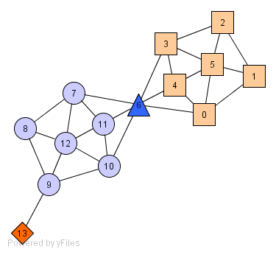
Structure-Connected Clusters
hub
outlier
30
Structure-connected cluster C
  Connectivity:
  Maximality:
Hubs:
  Not belong to any cluster
  Bridge to many clusters
Outliers:
  Not belong to any cluster
  Connect to less clusters

Slide 31
Algorithm
2
3
μ = 2
ε = 0.7
5
1
4
7
6
0
8
11
12
10
9
13
31

Slide 32
Algorithm
2
3
μ = 2
ε = 0.7
5
1
4
7
6
0
8
11
12
10
9
0.63
13
32

Slide 33
Algorithm
2
3
μ = 2
ε = 0.7
5
1
4
7
6
0.67
0
8
11
0.82
12
0.75
10
9
13
33

Slide 34
Algorithm
2
3
μ = 2
ε = 0.7
5
1
4
7
6
0
8
11
12
10
9
13
34

Slide 35
Algorithm
2
3
μ = 2
ε = 0.7
5
1
4
7
6
0
8
11
12
10
9
0.67
13
35

Slide 36
Algorithm
2
3
μ = 2
ε = 0.7
5
1
4
7
6
0
8
0.73
11
12
0.73
0.73
10
9
13
36

Slide 37
Algorithm
2
3
μ = 2
ε = 0.7
5
1
4
7
6
0
8
11
12
10
9
13
37

Slide 38
Algorithm
2
3
μ = 2
ε = 0.7
5
1
4
7
0.51
6
0
8
11
12
10
9
13
38

Slide 39
Algorithm
2
3
μ = 2
ε = 0.7
5
1
4
7
6
0
11
0.68
8
12
10
9
13
39

Slide 40
Algorithm
2
3
μ = 2
ε = 0.7
5
1
4
7
6
0
8
11
12
0.51
10
9
13
40

Slide 41
Algorithm
2
3
μ = 2
ε = 0.7
5
1
4
7
6
0
8
11
12
10
9
13
41

Slide 42
Algorithm
2
3
μ = 2
ε = 0.7
5
0.51
1
4
7
0.68
6
0
11
0.51
8
12
10
9
13
42

Slide 43
Algorithm
2
3
μ = 2
ε = 0.7
5
1
4
7
6
0
8
11
12
10
9
13
43

Slide 44
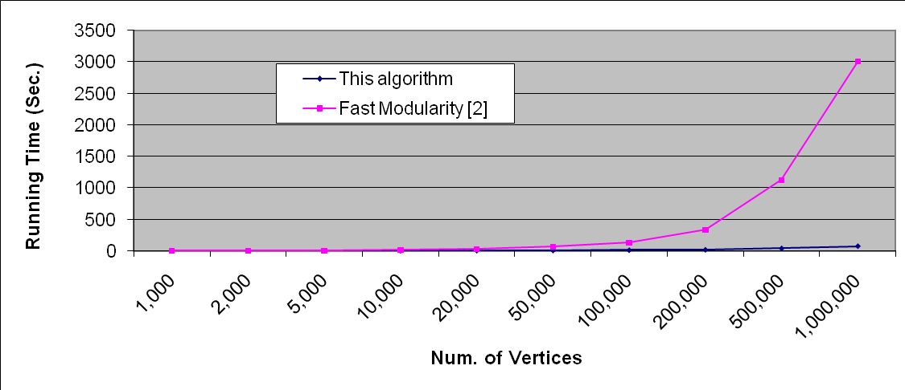
Running Time
Running time = O(|E|)
For sparse networks = O(|V|)
[2] A. Clauset, M. E. J. Newman, & C. Moore, Phys. Rev. E 70, 066111 (2004).
44

Slide 45
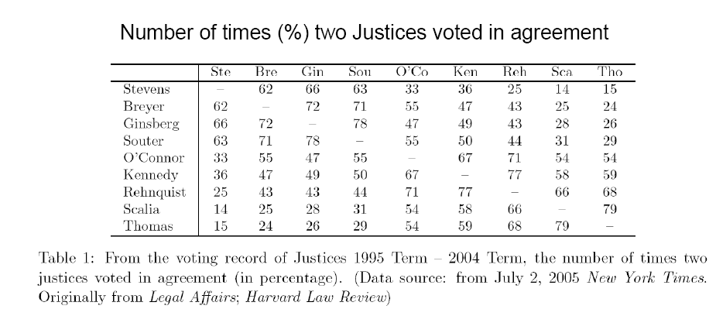
Spectral Clustering
Reference: ICDM’09 Tutorial by Chris Ding
Example:
  Clustering supreme court justices according to their voting behavior

Slide 46
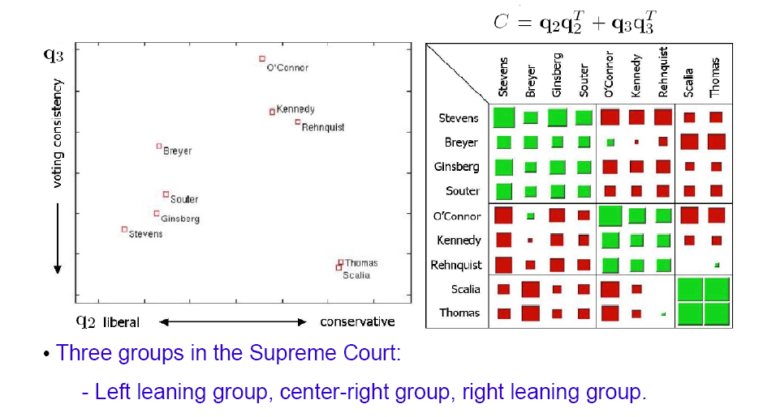
Example: Continue

Slide 47
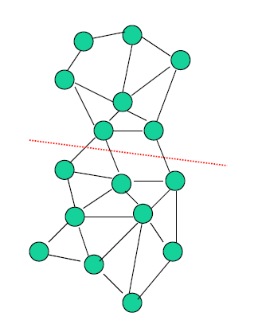
Spectral Graph Partition
Min-Cut
  Minimize the # of cut of edges

Slide 48
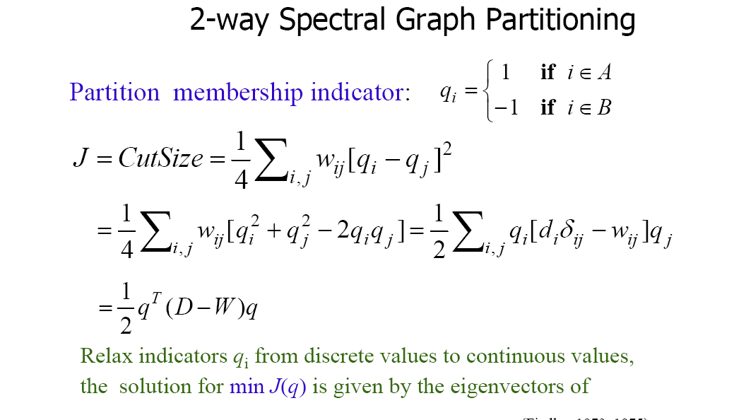

Objective Function

Slide 49
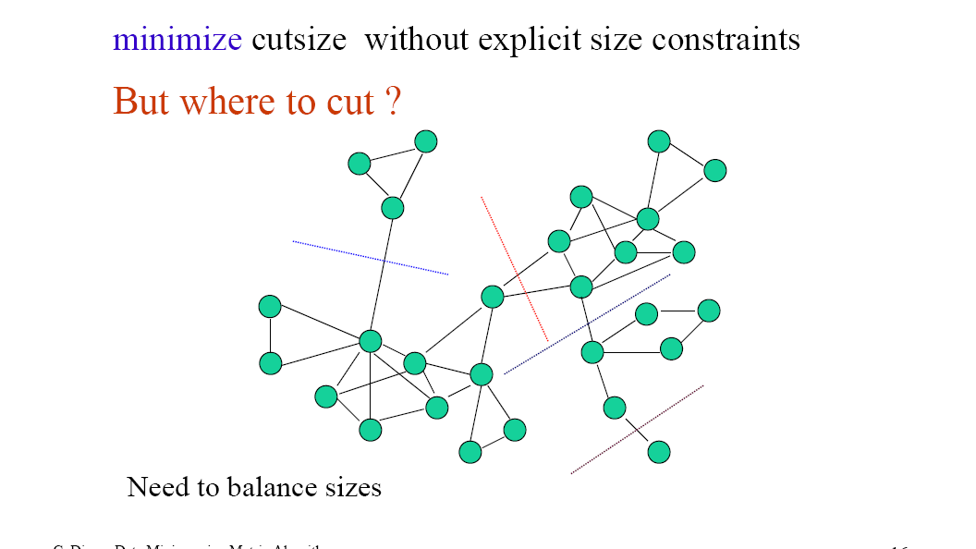
Minimum Cut with Constraints

Slide 50
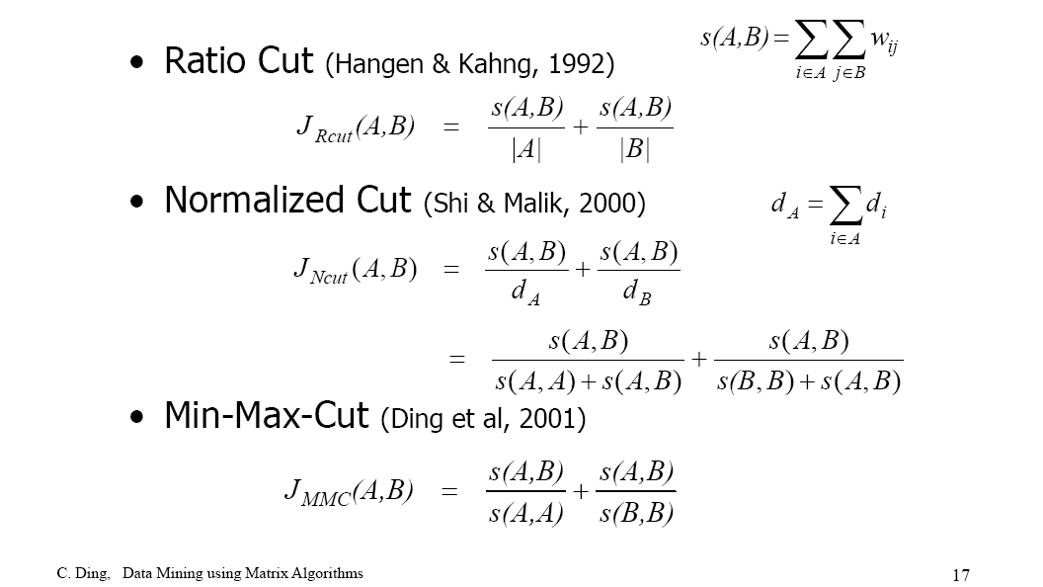
New Objective Functions

Slide 51
Other References
A Tutorial on Spectral Clustering by U. Luxburg http://www.kyb.mpg.de/fileadmin/user_upload/files/publications/attachments/Luxburg07_tutorial_4488%5B0%5D.pdf

Slide 52
Chapter 10. Cluster Analysis: Basic Concepts and Methods
Beyond K-Means
  K-means
  EM-algorithm
  Kernel K-means
Clustering Graphs and Network Data
Summary

Slide 53
Summary
Generalizing K-Means
  Mixture Model; EM-Algorithm; Kernel K-Means
Clustering Graph and Networked Data
  SCAN: density-based algorithm
  Spectral clustering

Slide 54
Announcement
HW #3 due tomorrow
Course project due next week
  Submit final report, data, code (with readme), evaluation forms
  Make appointment with me to explain your project
    I will ask questions according to your report
Final Exam
  4/22, 3 hours in class, cover the whole semester with different weights
  You can bring two A4 cheating sheets, one for content before midterm, and the other for content after midterm
Interested in research?
  My research area: Information/social network mining

