Slide 1
CS6220: Data Mining Techniques
Chapter 6: Mining Frequent Patterns, Associations, and Correlations:
Basic Concepts and Methods
Instructor: Yizhou Sun
yzsun@ccs.neu.edu
February 4, 2013

Slide 2
Homework #1
Textbook
  P80, 2.3, 2.4
  P122, 3.8
  P274, 6.6, 6.14

Slide 3
Chapter 6: Mining Frequent Patterns, Association and Correlations
Basic Concepts
Frequent Itemset Mining Methods
Pattern Evaluation Methods
Summary

Slide 4
What Is Frequent Pattern Analysis?
Frequent pattern: a pattern (a set of items, subsequences, substructures, etc.) that occurs frequently in a data set
First proposed by Agrawal, Imielinski, and Swami [AIS93] in the context of frequent itemsets and association rule mining
Motivation: Finding inherent regularities in data
  What products were often purchased together?— Beer and diapers?!
  What are the subsequent purchases after buying a PC?
  What kinds of DNA are sensitive to this new drug?
Applications
  Basket data analysis, cross-marketing, catalog design, sale campaign analysis, Web log (click stream) analysis, and DNA sequence analysis.

Slide 5
Why Is Freq. Pattern Mining Important?
Freq. pattern: An intrinsic and important property of datasets
Foundation for many essential data mining tasks
  Association, correlation, and causality analysis
  Sequential, structural (e.g., sub-graph) patterns
  Pattern analysis in spatiotemporal, multimedia, time-series, and stream data
  Classification: discriminative, frequent pattern analysis
  Cluster analysis: frequent pattern-based clustering
  Broad applications

Slide 6
Basic Concepts: Frequent Patterns
Tid | Items bought
10 | Beer, Nuts, Diaper
20 | Beer, Coffee, Diaper
30 | Beer, Diaper, Eggs
40 | Nuts, Eggs, Milk
50 | Nuts, Coffee, Diaper, Eggs, Milk
itemset: A set of one or more items
k-itemset X = {x₁, …, x_{k}}
(absolute) support, or, support count of X: Frequency or occurrence of an itemset X
(relative) support, s, is the fraction of transactions that contains X (i.e., the probability that a transaction contains X)
An itemset X is frequent if X’s support is no less than a minsup threshold
Customer
buys both
Customer
buys diaper
Customer
buys beer

Slide 7
Basic Concepts: Association Rules
Find all the rules X → Y with minimum support and confidence
  support, s, probability that a transaction contains X ∪ Y
  confidence, c, conditional probability that a transaction having X also contains Y
Let minsup = 50%, minconf = 50%
Freq. Pat.: Beer:3, Nuts:3, Diaper:4, Eggs:3, {Beer, Diaper}:3
Tid
Items bought
10
Beer, Nuts, Diaper
20
Beer, Coffee, Diaper
30
Beer, Diaper, Eggs
40
Nuts, Eggs, Milk
50
Nuts, Coffee, Diaper, Eggs, Milk
Customer
buys both
Customer
buys diaper
Customer
buys beer
Strong Association rules
  Beer → Diaper (60%, 100%)
  Diaper → Beer (60%, 75%)

Slide 8
Closed Patterns and Max-Patterns
A long pattern contains a combinatorial number of sub-patterns, e.g., {a₁, …, a₁₀₀} contains 2¹⁰⁰ – 1 = 1.27*10³⁰ sub-patterns!
Solution: Mine closed patterns and max-patterns instead
An itemset X is closed if X is frequent and there exists no super-pattern Y כ X, with the same support as X (proposed by Pasquier, et al. @ ICDT’99)
An itemset X is a max-pattern if X is frequent and there exists no frequent super-pattern Y כ X (proposed by Bayardo @ SIGMOD’98)
Closed pattern is a lossless compression of freq. patterns
  Reducing the # of patterns and rules

Slide 9
Closed Patterns and Max-Patterns
Exercise. DB = {<a₁, …, a₁₀₀>, < a₁, …, a₅₀>}
  Min_sup = 1.
What is the set of closed itemset?
  <a₁, …, a₁₀₀>: 1
  < a₁, …, a₅₀>: 2
What is the set of max-pattern?
  <a₁, …, a₁₀₀>: 1
What is the set of all patterns?
  !!

Slide 10
Computational Complexity of Frequent Itemset Mining
How many itemsets are potentially to be generated in the worst case?
  The number of frequent itemsets to be generated is sensitive to the minsup threshold
  When minsup is low, there exist potentially an exponential number of frequent itemsets
  The worst case: M^{N} where M: # distinct items, and N: max length of transactions

Slide 11
The worst case complexity vs. the expected probability
  Ex. Suppose Walmart has 10⁴ kinds of products
    The chance to pick up one product 10⁻⁴
    The chance to pick up a particular set of 10 products: ~10⁻⁴⁰
    What is the chance this particular set of 10 products to be frequent 10³ times in 10⁹ transactions?

Slide 12
Chapter 6: Mining Frequent Patterns, Association and Correlations
Basic Concepts
Frequent Itemset Mining Methods
Pattern Evaluation Methods
Summary

Slide 13
Scalable Frequent Itemset Mining Methods
Apriori: A Candidate Generation-and-Test Approach
  Improving the Efficiency of Apriori
FPGrowth: A Frequent Pattern-Growth Approach
ECLAT: Frequent Pattern Mining with Vertical Data Format
Generating Association Rules

Slide 14
The Apriori Property and Scalable Mining Methods
The Apriori property of frequent patterns
  Any nonempty subsets of a frequent itemset must be frequent
  If {beer, diaper, nuts} is frequent, so is {beer, diaper}
  i.e., every transaction having {beer, diaper, nuts} also contains {beer, diaper}
Scalable mining methods: Three major approaches
  Apriori (Agrawal & Srikant@VLDB’94)
  Freq. pattern growth (FPgrowth—Han, Pei & Yin @SIGMOD’00)
  Vertical data format approach (Eclat)

Slide 15
Apriori: A Candidate Generation & Test Approach
Apriori pruning principle: If there is any itemset which is infrequent, its superset should not be generated/tested! (Agrawal & Srikant @VLDB’94, Mannila, et al. @ KDD’ 94)
Method:
  Initially, scan DB once to get frequent 1-itemset
  Generate length (k+1) candidate itemsets from length k frequent itemsets
  Test the candidates against DB
  Terminate when no frequent or candidate set can be generated

Slide 16
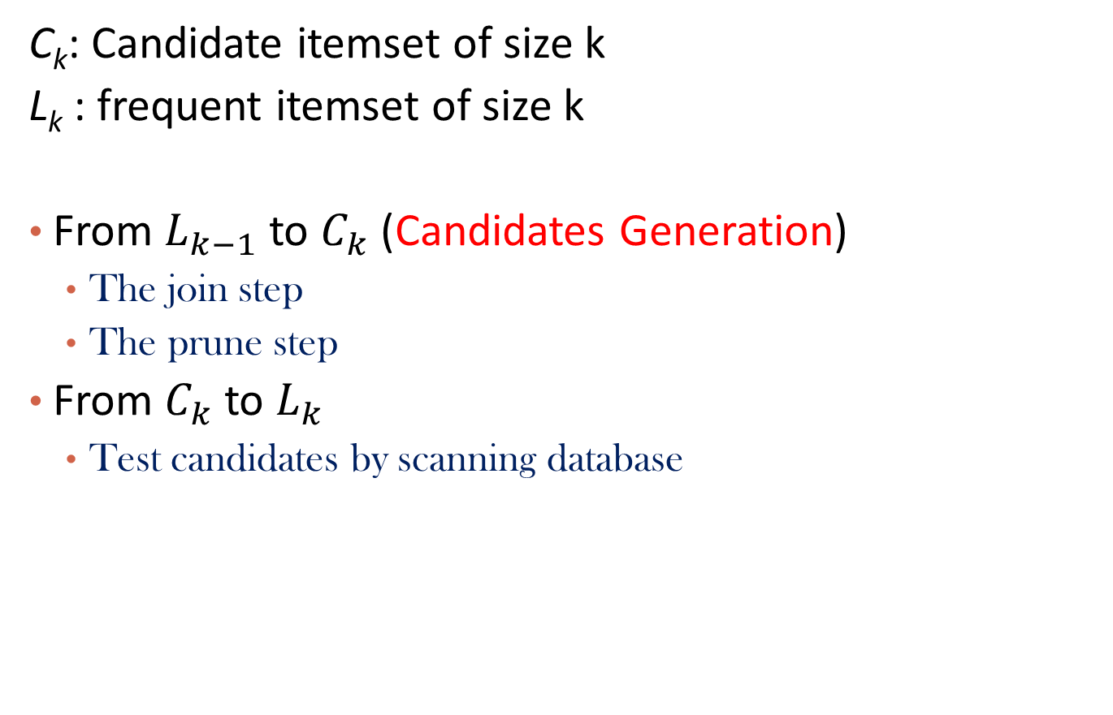
From Frequent k-1 Itemset
To Frequent k-Itemset
C_{k}: Candidate itemset of size k
L_{k} : frequent itemset of size k
From $L_{k−1}$ to $C_{k}$ (Candidates Generation)
  The join step
  The prune step
From $C_{k}$ to $L_{k}$
  Test candidates by scanning database

Slide 17
The Apriori Algorithm—An Example
Sup_{min} = 2
Itemset | sup
{A} | 2
{B} | 3
{C} | 3
{D} | 1
{E} | 3
Database TDB
Itemset | sup
{A} | 2
{B} | 3
{C} | 3
{E} | 3
L₁
Tid | Items
10 | A, C, D
20 | B, C, E
30 | A, B, C, E
40 | B, E
C₁
1st scan
C₂
Itemset | sup
{A, B} | 1
{A, C} | 2
{A, E} | 1
{B, C} | 2
{B, E} | 3
{C, E} | 2
C₂
Itemset
{A, B}
{A, C}
{A, E}
{B, C}
{B, E}
{C, E}
L₂
Itemset | sup
{A, C} | 2
{B, C} | 2
{B, E} | 3
{C, E} | 2
2nd scan
C₃
Itemset
{B, C, E}
3rd scan
L₃
Itemset | sup
{B, C, E} | 2

Slide 18
The Apriori Algorithm (Pseudo-Code)
C_{k}: Candidate itemset of size k
L_{k} : frequent itemset of size k
L₁ = {frequent items};
for (k = 2; L_{k-1} !=∅; k++) do begin
C_{k} = candidates generated from L_{k-1};
for each transaction t in database do
  increment the count of all candidates in C_{k+1} that are contained in t
L_{k+1} = candidates in C_{k+1} with min_support
end
return ∪_{k} L_{k};

Slide 19
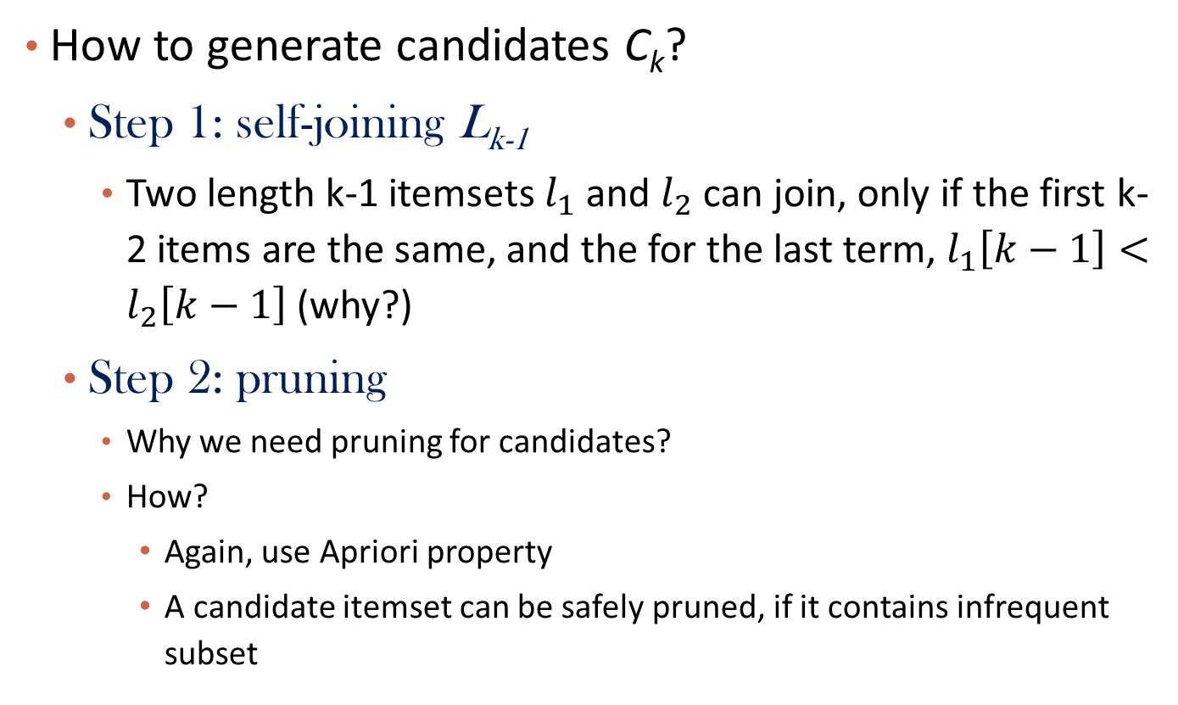
Candidates Generation
How to generate candidates C_{k}?
  Step 1: self-joining L_{k-1}
    Two length k-1 itemsets $l_{1}$ and $l_{2}$ can join, only if the first k-2 items are the same, and the for the last term, $l_{1}\left[k−1\right]<l_{2}\left[k−1\right]$ (why?)
  Step 2: pruning
    Why we need pruning for candidates?
    How?
      Again, use Apriori property
      A candidate itemset can be safely pruned, if it contains infrequent subset

Slide 20
Example of Candidate-generation from L₃ to C₄
  L₃={abc, abd, acd, ace, bcd}
  Self-joining: L₃*L₃
    abcd from abc and abd
    acde from acd and ace
  Pruning:
    acde is removed because ade is not in L₃
  C₄ = {abcd}

Slide 21
The Apriori Algorithm—Example Review
Sup_{min} = 2
Itemset | sup
{A} | 2
{B} | 3
{C} | 3
{D} | 1
{E} | 3
Database TDB
Itemset | sup
{A} | 2
{B} | 3
{C} | 3
{E} | 3
L₁
Tid | Items
10 | A, C, D
20 | B, C, E
30 | A, B, C, E
40 | B, E
C₁
1st scan
C₂
Itemset | sup
{A, B} | 1
{A, C} | 2
{A, E} | 1
{B, C} | 2
{B, E} | 3
{C, E} | 2
C₂
Itemset
{A, B}
{A, C}
{A, E}
{B, C}
{B, E}
{C, E}
L₂
Itemset | sup
{A, C} | 2
{B, C} | 2
{B, E} | 3
{C, E} | 2
2nd scan
C₃
Itemset
{B, C, E}
3rd scan
L₃
Itemset | sup
{B, C, E} | 2

Slide 22
Questions
How many scans on DB are needed for Apriori algorithm?
When (k = ?) does Apriori algorithm generate most candidate itemsets?
  Is support counting for candidates expensive?

Slide 23
Scalable Frequent Itemset Mining Methods
Apriori: A Candidate Generation-and-Test Approach
  Improving the Efficiency of Apriori
FPGrowth: A Frequent Pattern-Growth Approach
ECLAT: Frequent Pattern Mining with Vertical Data Format
Generating Association Rules

Slide 24
Further Improvement of the Apriori Method
Major computational challenges
  Multiple scans of transaction database
  Huge number of candidates
  Tedious workload of support counting for candidates
Improving Apriori: general ideas
  Reduce passes of transaction database scans
  Shrink number of candidates
  Facilitate support counting of candidates

Slide 25
Partition: Scan Database Only Twice
Any itemset that is potentially frequent in DB must be frequent in at least one of the partitions of DB
  Scan 1: partition database and find local frequent patterns
  Scan 2: consolidate global frequent patterns
A. Savasere, E. Omiecinski and S. Navathe, VLDB’95
DB₁
+
DB₂
+
+
DB_{k}
= DB
sup₁(i) < σDB₁
sup₂(i) < σDB₂
sup_{k}(i) < σDB_{k}
sup(i) < σDB

Slide 26
Hash-based Technique: Reduce the Number of Candidates
A k-itemset whose corresponding hashing bucket count is below the threshold cannot be frequent
  Candidates: a, b, c, d, e
  Hash entries
    {ab, ad, ae}
    {bd, be, de}
    …
  Frequent 1-itemset: a, b, d, e
  ab is not a candidate 2-itemset if the sum of count of {ab, ad, ae} is below support threshold
J. Park, M. Chen, and P. Yu. An effective hash-based algorithm for mining association rules. SIGMOD’95
count
itemsets
35
{ab, ad, ae}
88
{bd, be, de}
...
...
102
{yz, qs, wt}
Hash Table

Slide 27
Sampling for Frequent Patterns
Select a sample of original database, mine frequent patterns within sample using Apriori
Scan database once to verify frequent itemsets found in sample, only borders of closure of frequent patterns are checked
  Example: check abcd instead of ab, ac, …, etc.
Scan database again to find missed frequent patterns
H. Toivonen. Sampling large databases for association rules. In VLDB’96

Slide 28
Scalable Frequent Itemset Mining Methods
Apriori: A Candidate Generation-and-Test Approach
  Improving the Efficiency of Apriori
FPGrowth: A Frequent Pattern-Growth Approach
ECLAT: Frequent Pattern Mining with Vertical Data Format
Generating Association Rules

Slide 29
Pattern-Growth Approach: Mining Frequent Patterns Without Candidate Generation
Bottlenecks of the Apriori approach
  Breadth-first (i.e., level-wise) search
    Scan DB multiple times
  Candidate generation and test
    Often generates a huge number of candidates
The FPGrowth Approach (J. Han, J. Pei, and Y. Yin, SIGMOD’ 00)
  Depth-first search
  Avoid explicit candidate generation
Major philosophy: Grow long patterns from short ones using local frequent items only
  “abc” is a frequent pattern
  Get all transactions having “abc”, i.e., project DB on abc: DB|abc
  “d” is a local frequent item in DB|abc → abcd is a frequent pattern

Slide 30
FP-Growth Algorithm Sketch
Construct FP-tree (frequent pattern-tree)
  Compress the DB into a tree
Recursively mine FP-tree by FP-Growth
  Construct conditional pattern base from FP-tree
  Construct conditional FP-tree from conditional pattern base
  Until the tree has a single path or empty

Slide 31
Construct FP-tree from a Transaction Database
TID Items bought (ordered) frequent items
100 {f, a, c, d, g, i, m, p} {f, c, a, m, p}
200 {a, b, c, f, l, m, o} {f, c, a, b, m}
300 {b, f, h, j, o, w} {f, b}
400 {b, c, k, s, p} {c, b, p}
500 {a, f, c, e, l, p, m, n} {f, c, a, m, p}
min_support = 3
{}
Header Table
Item frequency head
f 4
c 4
a 3
b 3
m 3
p 3
Scan DB once, find frequent 1-itemset (single item pattern)
Sort frequent items in frequency descending order, f-list
Scan DB again, construct FP-tree
f:4
c:1
c:3
b:1
b:1
a:3
p:1
m:2
b:1
F-list = f-c-a-b-m-p
p:2
m:1

Slide 32
Partition Patterns and Databases
Frequent patterns can be partitioned into subsets according to f-list
  F-list = f-c-a-b-m-p
  Patterns containing p
  Patterns having m but no p
  …
  Patterns having c but no a nor b, m, p
  Pattern f
Completeness and non-redundency

Slide 33
Find Patterns Having P From P-conditional Database
Starting at the frequent item header table in the FP-tree
Traverse the FP-tree by following the link of each frequent item p
Accumulate all of transformed prefix paths of item p to form p’s conditional pattern base
{}
Header Table
Item frequency head
f 4
c 4
a 3
b 3
m 3
p 3
f:4
c:1
Conditional pattern bases
item cond. pattern base
c f:3
a fc:3
b fca:1, f:1, c:1
m fca:2, fcab:1
p fcam:2, cb:1
c:3
b:1
b:1
a:3
p:1
m:2
b:1
p:2
m:1

Slide 34
From Conditional Pattern-bases to Conditional FP-trees
For each pattern-base
  Accumulate the count for each item in the base
  Construct the FP-tree for the frequent items of the pattern base
m-conditional pattern base:
  fca:2, fcab:1
{}
Header Table
Item frequency head
f 4
c 4
a 3
b 3
m 3
p 3
f:4
c:1
All frequent patterns relate to m
m,
fm, cm, am,
fcm, fam, cam,
fcam
{}
c:3
b:1
b:1

f:3

a:3
p:1
m:2
b:1
c:3
p:2
m:1
a:3
m-conditional FP-tree

Slide 35
Recursion: Mining Each Conditional FP-tree
{}
{}
Cond. pattern base of “am”: (fc:3)
f:3
c:3
f:3
am-conditional FP-tree
c:3
{}
Cond. pattern base of “cm”: (f:3)
a:3
f:3
m-conditional FP-tree
cm-conditional FP-tree
{}
Cond. pattern base of “cam”: (f:3)
f:3
cam-conditional FP-tree

Slide 36
A Special Case: Single Prefix Path in FP-tree
Suppose a (conditional) FP-tree T has a shared single prefix-path P
Mining can be decomposed into two parts
  Reduction of the single prefix path into one node
  Concatenation of the mining results of the two parts
{}
a₁:n₁
a₂:n₂
a₃:n₃
{}
r₁
b₁:m₁
C₁:k₁
a₁:n₁
+

r₁
=
b₁:m₁
C₁:k₁
a₂:n₂
C₂:k₂
C₃:k₃
a₃:n₃
C₂:k₂
C₃:k₃

Slide 37
Benefits of the FP-tree Structure
Completeness
  Preserve complete information for frequent pattern mining
  Never break a long pattern of any transaction
Compactness
  Reduce irrelevant info—infrequent items are gone
  Items in frequency descending order: the more frequently occurring, the more likely to be shared
  Never be larger than the original database (not count node-links and the count field)

Slide 38
The Frequent Pattern Growth Mining Method
Idea: Frequent pattern growth
  Recursively grow frequent patterns by pattern and database partition
Method
  For each frequent item, construct its conditional pattern-base, and then its conditional FP-tree
  Repeat the process on each newly created conditional FP-tree
  Until the resulting FP-tree is empty, or it contains only one path—single path will generate all the combinations of its sub-paths, each of which is a frequent pattern

Slide 39
Scaling FP-growth by Database Projection
What about if FP-tree cannot fit in memory?
  DB projection
First partition a database into a set of projected DBs
Then construct and mine FP-tree for each projected DB
Parallel projection vs. partition projection techniques
  Parallel projection
    Project the DB in parallel for each frequent item
    Parallel projection is space costly
    All the partitions can be processed in parallel
  Partition projection
    Partition the DB based on the ordered frequent items
    Passing the unprocessed parts to the subsequent partitions

Slide 40
FP-Growth vs. Apriori: Scalability With the Support Threshold
Data set T25I20D10K

Slide 41
Advantages of the Pattern Growth Approach
Divide-and-conquer:
  Decompose both the mining task and DB according to the frequent patterns obtained so far
  Lead to focused search of smaller databases
Other factors
  No candidate generation, no candidate test
  Compressed database: FP-tree structure
  No repeated scan of entire database
  Basic ops: counting local freq items and building sub FP-tree, no pattern search and matching
A good open-source implementation and refinement of FPGrowth
  FPGrowth+ (Grahne and J. Zhu, FIMI'03)

Slide 42
Further Improvements of Mining Methods
AFOPT (Liu, et al. @ KDD’03)
  A “push-right” method for mining condensed frequent pattern (CFP) tree
Carpenter (Pan, et al. @ KDD’03)
  Mine data sets with small rows but numerous columns
  Construct a row-enumeration tree for efficient mining
FPgrowth+ (Grahne and Zhu, FIMI’03)
  Efficiently Using Prefix-Trees in Mining Frequent Itemsets, Proc. ICDM'03 Int. Workshop on Frequent Itemset Mining Implementations (FIMI'03), Melbourne, FL, Nov. 2003
TD-Close (Liu, et al, SDM’06)

Slide 43
Extension of Pattern Growth Mining Methodology
Mining closed frequent itemsets and max-patterns
  CLOSET (DMKD’00), FPclose, and FPMax (Grahne & Zhu, Fimi’03)
Mining sequential patterns
  PrefixSpan (ICDE’01), CloSpan (SDM’03), BIDE (ICDE’04)
Mining graph patterns
  gSpan (ICDM’02), CloseGraph (KDD’03)
Constraint-based mining of frequent patterns
  Convertible constraints (ICDE’01), gPrune (PAKDD’03)
Computing iceberg data cubes with complex measures
  H-tree, H-cubing, and Star-cubing (SIGMOD’01, VLDB’03)
Pattern-growth-based Clustering
  MaPle (Pei, et al., ICDM’03)
Pattern-Growth-Based Classification
  Mining frequent and discriminative patterns (Cheng, et al, ICDE’07)

Slide 44
Scalable Frequent Itemset Mining Methods
Apriori: A Candidate Generation-and-Test Approach
  Improving the Efficiency of Apriori
FPGrowth: A Frequent Pattern-Growth Approach
ECLAT: Frequent Pattern Mining with Vertical Data Format
Generating Association Rules

Slide 45
ECLAT: Mining by Exploring Vertical Data Format
Vertical format: t(AB) = {T₁₁, T₂₅, …}
  tid-list: list of trans.-ids containing an itemset
Deriving frequent patterns based on vertical intersections
  t(X) = t(Y): X and Y always happen together
  t(X) ⊂ t(Y): transaction having X always has Y
Using diffset to accelerate mining
  Only keep track of differences of tids
  t(X) = {T₁, T₂, T₃}, t(XY) = {T₁, T₃}
  Diffset (XY, X) = {T₂}
Eclat (Zaki et al. @KDD’97)

Slide 46
Scalable Frequent Itemset Mining Methods
Apriori: A Candidate Generation-and-Test Approach
  Improving the Efficiency of Apriori
FPGrowth: A Frequent Pattern-Growth Approach
ECLAT: Frequent Pattern Mining with Vertical Data Format
Generating Association Rules

Slide 47
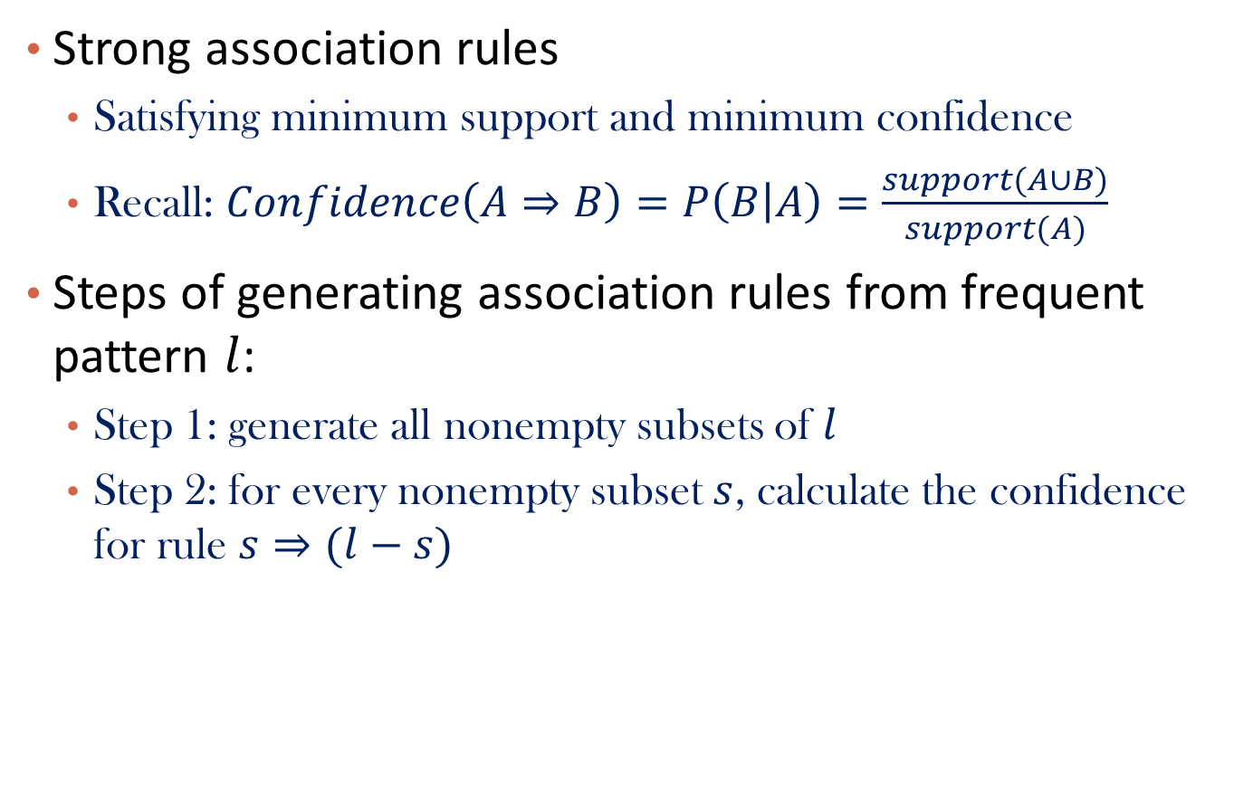
Generating Association Rules
Strong association rules
  Satisfying minimum support and minimum confidence
  Recall: $Confidence\left(A⇒B\right)=P\left(B | A\right)=\frac{support(A∪B)}{support(A)}$
Steps of generating association rules from frequent pattern $l$:
  Step 1: generate all nonempty subsets of $l$
  Step 2: for every nonempty subset $s$, calculate the confidence for rule $s⇒(l−s)$

Slide 48
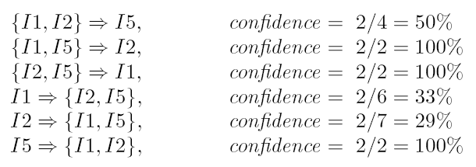

Example
$X=\left\{I1, I2, I5\right\}$
  Nonempty subsets of X are: $\left\{I1,I2\right\}, \left\{I1,I5\right\}, \left\{I2,I5\right\}, \left\{I1\right\}, \left\{I2\right\}, and \left\{I5\right\}$
  Association rules are:

Slide 49
Chapter 6: Mining Frequent Patterns, Association and Correlations
Basic Concepts
Frequent Itemset Mining Methods
Pattern Evaluation Methods
Summary

Slide 50
Misleading Strong Association Rules
Not all strong association rules are interesting
  Shall we target people who play basketball for cereal ads?
  Hint: What is the overall probability of people who eat cereal?
    3750/5000 = 75% > 66.7%!
  Confidence measure of a rule could be misleading
 | Basketball | Not basketball | Sum (row)
Cereal | 2000 | 1750 | 3750
Not cereal | 1000 | 250 | 1250
Sum(col.) | 3000 | 2000 | 5000
play basketball ⇒ eat cereal [40%, 66.7%]

Slide 51

Other Measures
From association to correlation
  Lift
  $χ^{2}$
  All_confidence
  Max_confidence
  Kulczynski
  Cosine

Slide 52
Interestingness Measure: Correlations (Lift)
play basketball ⇒ eat cereal [40%, 66.7%] is misleading
  The overall % of students eating cereal is 75% > 66.7%.
play basketball ⇒ not eat cereal [20%, 33.3%] is more accurate, although with lower support and confidence
Measure of dependent/correlated events: lift
 | Basketball | Not basketball | Sum (row)
Cereal | 2000 | 1750 | 3750
Not cereal | 1000 | 250 | 1250
Sum(col.) | 3000 | 2000 | 5000

Slide 53
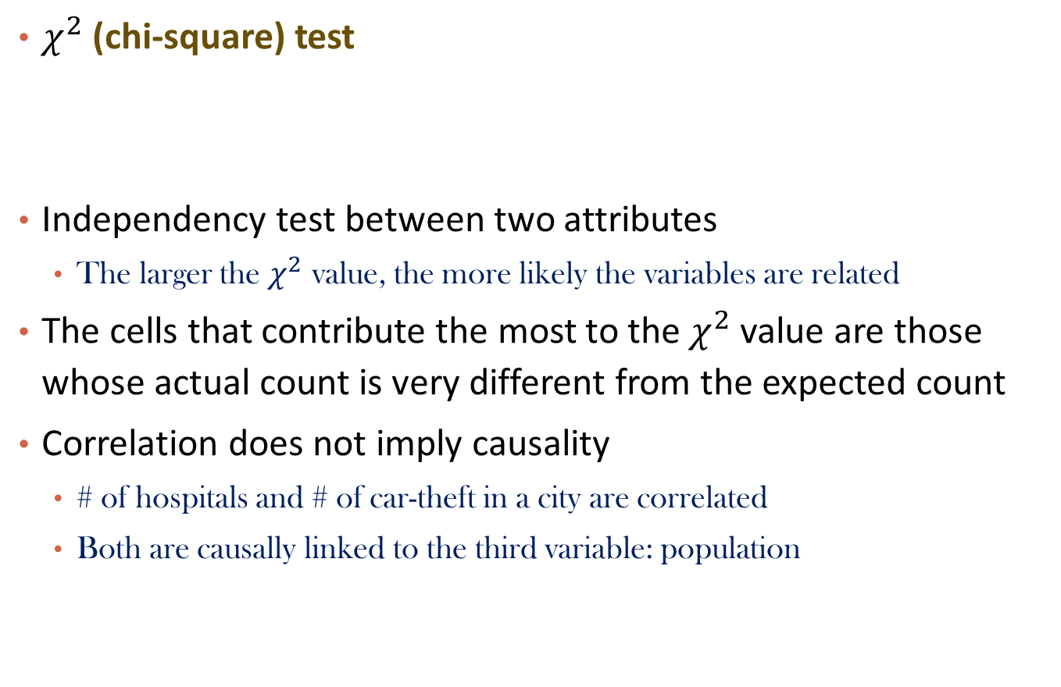
Correlation Analysis (Nominal Data)
$χ^{2}$ (chi-square) test
Independency test between two attributes
  The larger the $χ^{2}$ value, the more likely the variables are related
The cells that contribute the most to the $χ^{2}$value are those whose actual count is very different from the expected count
Correlation does not imply causality
  # of hospitals and # of car-theft in a city are correlated
  Both are causally linked to the third variable: population

Slide 54
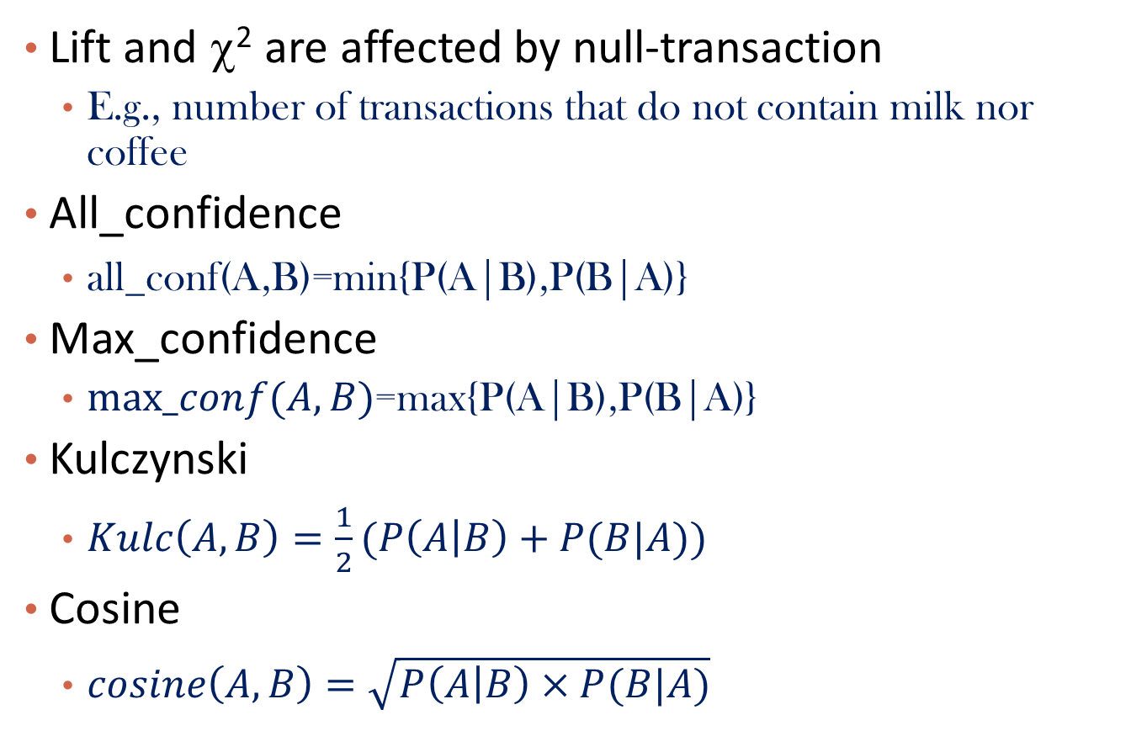
Are lift and χ² Good Measures of Correlation?
Lift and χ² are affected by null-transaction
  E.g., number of transactions that do not contain milk nor coffee
All_confidence
  $\text{all}\text{_}\text{conf}\text{(}\text{A}\text{,}\text{B}\text{)=}\text{min}\text{\{}\text{P}\text{(}\text{A}\text{|}\text{B}\text{),}\text{P}\text{(}\text{B}\text{|}\text{A}\text{)\}}$
Max_confidence
  $max_conf(A,B)$=$\text{m}\text{ax}\text{\{}\text{P}\text{(}\text{A}\text{|}\text{B}\text{),}\text{P}\text{(}\text{B}\text{|}\text{A}\text{)\}}$
Kulczynski
  $Kulc\left(A,B\right)=\frac{1}{2}(P\left(A | B\right)+P(B|A))$
Cosine
  $cosine\left(A,B\right)=\sqrt{P\left(A | B\right)×P(B|A)}$

Slide 55
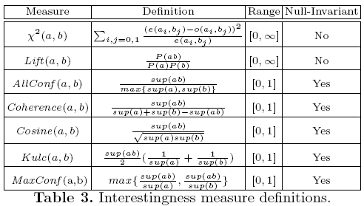
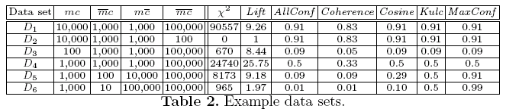
Comparison of Interestingness Measures
Null-(transaction) invariance is crucial for correlation analysis
Lift and χ² are not null-invariant
5 null-invariant measures
 | Milk | No Milk | Sum (row)
Coffee | m, c | ~m, c | c
No Coffee | m, ~c | ~m, ~c | ~c
Sum(col.) | m | ~m | Σ
Null-transactions w.r.t. m and c
Kulczynski measure (1927)
Null-invariant
Subtle: They disagree

Slide 56
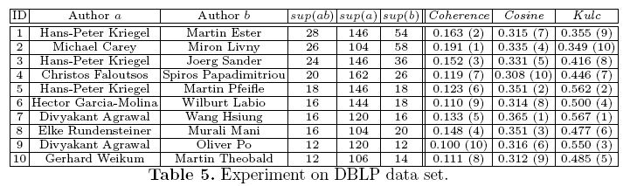
Analysis of DBLP Coauthor Relationships
Recent DB conferences, removing balanced associations, low sup, etc.
Advisor-advisee relation: Kulc: high, coherence: low, cosine: middle
Tianyi Wu, Yuguo Chen and Jiawei Han, “Association Mining in Large Databases: A Re-Examination of Its Measures”, Proc. 2007 Int. Conf. Principles and Practice of Knowledge Discovery in Databases (PKDD'07), Sept. 2007

Slide 57
Which Null-Invariant Measure Is Better?
IR (Imbalance Ratio): measure the imbalance of two itemsets A and B in rule implications
Kulczynski and Imbalance Ratio (IR) together present a clear picture for all the three datasets D₄ through D₆
  D₄ is balanced & neutral
  D₅ is imbalanced & neutral
  D₆ is very imbalanced & neutral

Slide 58
Chapter 6: Mining Frequent Patterns, Association and Correlations
Basic Concepts
Frequent Itemset Mining Methods
Pattern Evaluation Methods
Summary

Slide 59
Summary
Basic concepts
  Frequent pattern, association rules, support-confident framework, closed and max-patterns
Scalable frequent pattern mining methods
  Apriori
  FPgrowth
  Vertical format approach (ECLAT)
Which patterns are interesting?
  Pattern evaluation methods

Slide 60
Ref: Basic Concepts of Frequent Pattern Mining
(Association Rules) R. Agrawal, T. Imielinski, and A. Swami. Mining association rules between sets of items in large databases. SIGMOD'93.
(Max-pattern) R. J. Bayardo. Efficiently mining long patterns from databases. SIGMOD'98.
(Closed-pattern) N. Pasquier, Y. Bastide, R. Taouil, and L. Lakhal. Discovering frequent closed itemsets for association rules. ICDT'99.
(Sequential pattern) R. Agrawal and R. Srikant. Mining sequential patterns. ICDE'95

Slide 61
Ref: Apriori and Its Improvements
R. Agrawal and R. Srikant. Fast algorithms for mining association rules. VLDB'94.
H. Mannila, H. Toivonen, and A. I. Verkamo. Efficient algorithms for discovering association rules. KDD'94.
A. Savasere, E. Omiecinski, and S. Navathe. An efficient algorithm for mining association rules in large databases. VLDB'95.
J. S. Park, M. S. Chen, and P. S. Yu. An effective hash-based algorithm for mining association rules. SIGMOD'95.
H. Toivonen. Sampling large databases for association rules. VLDB'96.
S. Brin, R. Motwani, J. D. Ullman, and S. Tsur. Dynamic itemset counting and implication rules for market basket analysis. SIGMOD'97.
S. Sarawagi, S. Thomas, and R. Agrawal. Integrating association rule mining with relational database systems: Alternatives and implications. SIGMOD'98.

Slide 62
Ref: Depth-First, Projection-Based FP Mining
R. Agarwal, C. Aggarwal, and V. V. V. Prasad. A tree projection algorithm for generation of frequent itemsets. J. Parallel and Distributed Computing:02.
J. Han, J. Pei, and Y. Yin. Mining frequent patterns without candidate generation. SIGMOD’ 00.
J. Liu, Y. Pan, K. Wang, and J. Han. Mining Frequent Item Sets by Opportunistic Projection. KDD'02.
J. Han, J. Wang, Y. Lu, and P. Tzvetkov. Mining Top-K Frequent Closed Patterns without Minimum Support. ICDM'02.
J. Wang, J. Han, and J. Pei. CLOSET+: Searching for the Best Strategies for Mining Frequent Closed Itemsets. KDD'03.
G. Liu, H. Lu, W. Lou, J. X. Yu. On Computing, Storing and Querying Frequent Patterns. KDD'03.
G. Grahne and J. Zhu, Efficiently Using Prefix-Trees in Mining Frequent Itemsets, Proc. ICDM'03 Int. Workshop on Frequent Itemset Mining Implementations (FIMI'03), Melbourne, FL, Nov. 2003

Slide 63
Ref: Vertical Format and Row Enumeration Methods
M. J. Zaki, S. Parthasarathy, M. Ogihara, and W. Li. Parallel algorithm for discovery of association rules. DAMI:97.
Zaki and Hsiao. CHARM: An Efficient Algorithm for Closed Itemset Mining, SDM'02.
C. Bucila, J. Gehrke, D. Kifer, and W. White. DualMiner: A Dual-Pruning Algorithm for Itemsets with Constraints. KDD’02.
F. Pan, G. Cong, A. K. H. Tung, J. Yang, and M. Zaki , CARPENTER: Finding Closed Patterns in Long Biological Datasets. KDD'03.
H. Liu, J. Han, D. Xin, and Z. Shao, Mining Interesting Patterns from Very High Dimensional Data: A Top-Down Row Enumeration Approach, SDM'06.

Slide 64
Ref: Mining Correlations and Interesting Rules
M. Klemettinen, H. Mannila, P. Ronkainen, H. Toivonen, and A. I. Verkamo. Finding interesting rules from large sets of discovered association rules. CIKM'94.
S. Brin, R. Motwani, and C. Silverstein. Beyond market basket: Generalizing association rules to correlations. SIGMOD'97.
C. Silverstein, S. Brin, R. Motwani, and J. Ullman. Scalable techniques for mining causal structures. VLDB'98.
P.-N. Tan, V. Kumar, and J. Srivastava. Selecting the Right Interestingness Measure for Association Patterns. KDD'02.
E. Omiecinski. Alternative Interest Measures for Mining Associations. TKDE’03.
T. Wu, Y. Chen and J. Han, “Association Mining in Large Databases: A Re-Examination of Its Measures”, PKDD'07

Slide 65
Ref: Freq. Pattern Mining Applications
Y. Huhtala, J. Kärkkäinen, P. Porkka, H. Toivonen. Efficient Discovery of Functional and Approximate Dependencies Using Partitions. ICDE’98.
H. V. Jagadish, J. Madar, and R. Ng. Semantic Compression and Pattern Extraction with Fascicles. VLDB'99.
T. Dasu, T. Johnson, S. Muthukrishnan, and V. Shkapenyuk. Mining Database Structure; or How to Build a Data Quality Browser. SIGMOD'02.
K. Wang, S. Zhou, J. Han. Profit Mining: From Patterns to Actions. EDBT’02.

