Slide 1
CS 6220 Homework Submission System
Moonyoung Kang

Slide 2
Homework 0
Due: Sep. 24th (1 week; 0 points)
Create a program that prints out “hello world!\n”
bash, perl, python, etc.
Main executable’s name should be ‘cs6220_start’ and runnable
Copy “/course/cs6220f13/code/homework00” directory if necessary
Submit it using the submission system
Help on your way this time
Reluctant to help you afterwards
If you have laptop with you, DO IT NOW.
Prepare your NEU ID

Slide 3
Submission system
Submission from CCIS machines
Use PC cluster at WVH 1st floor
SSH to CCIS machines
Documentation
Link from Piazza
http://yerihyo.wikidot.com/local--files/courses:7/intro_20130917_1420.pptx
http://yerihyo.wikidot.com/courses:7
Thanks to Prof. Alan Mislove

Slide 4
Register
SSH to CCIS machine
$ /course/cs6220f13/bin/register-student [NEU ID]

Slide 5
Programming
Have an empty folder to program your homework
Put all the code under that folder
Including 3rd-party libraries
The program should be runnable stand-alone only using files under the directory

Slide 6
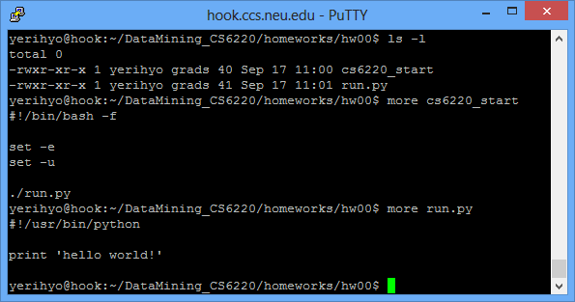
Example (“hello world!”)
Reference directory: “/home/yerihyo/DataMining_CS6220/homeworks/hw00”

Slide 7
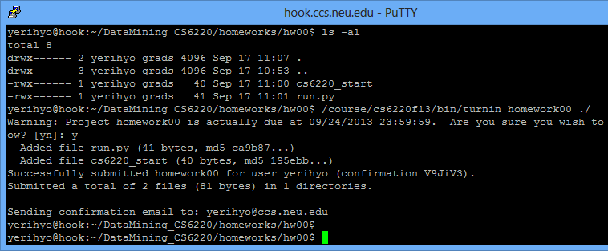
Turnin
$ /course/cs6220f13/bin/turnin [homework code] /path/to/file_or_directory
Homework code info on http://yerihyo.wikidot.com/courses:7
No worries with file permission

Slide 8
Scoring
Run ‘cs6220_start’ from the root directory
All the code & library should be reachable and executable
Check library’s read/execute permission carefully
No “~/” when referencing libraries
If you tested your program on CCIS machine, it should run on our test settings as well

