Slide 1
An Example of Course Project
Face Identification

Slide 2
Agenda
Notes:
achievements
schedule
lessons learned

Slide 3
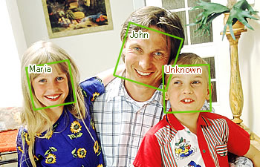
Why Face Identification?
Useful
Interesting
Creating own dataset for extra credits

Slide 4
Data set
The Extended Yale Face Database B
2414 images of 38 human
Own data
100 images of 4 people

Slide 5
Classifiers
SVM (Support Vector Machine)
LIBSVM
Self Implemented SVM Optimizer
ANN (Artificial Neural Network)
Coded in Matlab

Slide 6
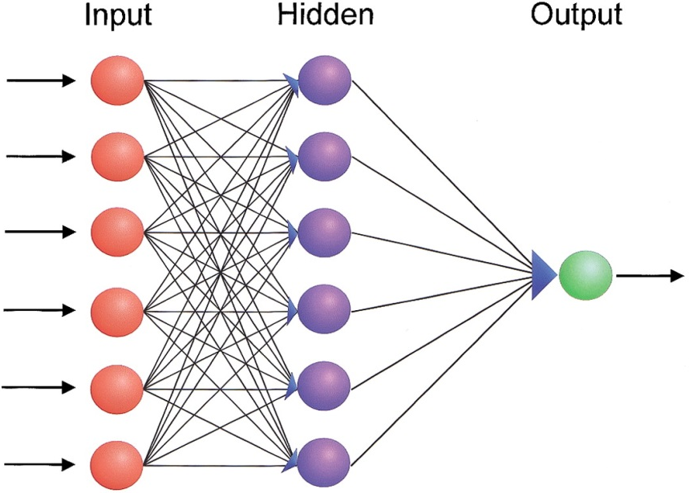
Classifier Parameters
SVM
Kennel functions
ANN
Layers and units

Slide 7
Feature Selection
Raw pixels
Down-sampling pixels
Extracted features
Notes:
Principal Component Analysis

Slide 8
Compare Kernel Functions

Slide 9
Compare Feature Numbers

Slide 10
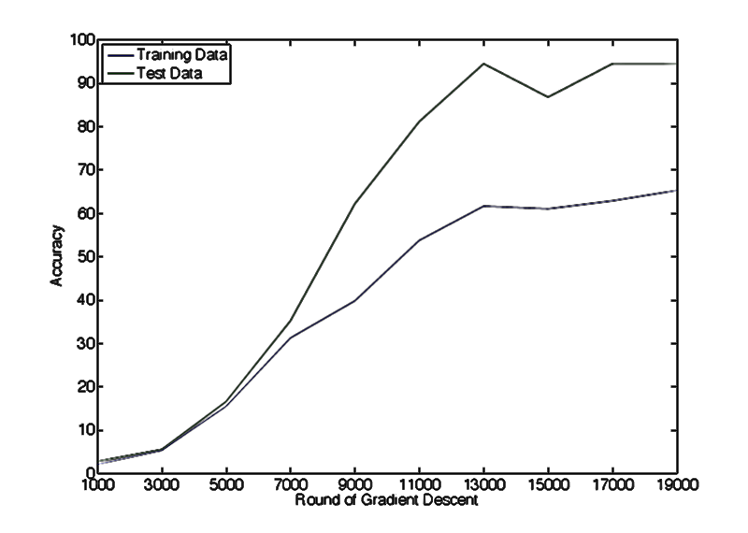
ANN Learn Rate

Slide 11
Report
10 pages

Slide 12
Schedule
12 weeks total
3
2
2
3
2
Proposal
Evaluation
& Report
Prepare
dataset
Algorithms implementation
Data
preprocessing

Slide 13
Lessons Learned
Start early
Review each other’s work

