Slide 1
Dynamic Proofs of Retrievability via
Oblivious RAM
David Cash
Alptekin Kupcu
Daniel Wichs
Rutgers University
Koc University
Northeastern University

Slide 2

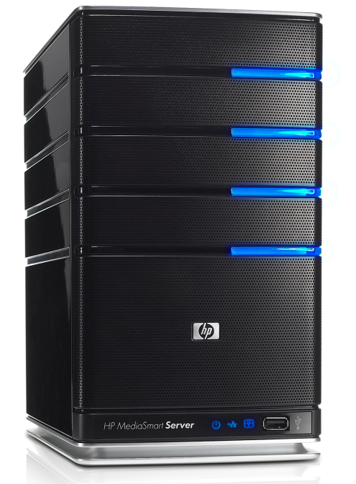


Outsourced Data Storage
Client
Remote Server
Lots of data (music, photos, emails, documents, scientific dataset, ...)
Stores it on remote server
  Accessible from many devices (desktop, laptop, phone, car, ...).
  Greater reliability.
  May be cheaper (economy of scale).

Slide 3
Outsourced Data Storage
Client
Remote Server
Much recent crypto research
  Outsourced computation: FHE, functional encryption, verifiable computing etc.
  Private/verifiable data access: oblivious RAM, memory checking.
This talk: “Is my data still there”?

Slide 4
Defending Against Deletion
Malicious server may lose (some) data
  Due to an accidental failure
  On purpose to save storage/money
But how do you stop someone from deleting something?
You can’t, but you can audit them.

Slide 5
Defending Against Deletion
Proofs of Retrievability (PoR) [Juels-Kaliski ‘07]
  An efficient audit protocol between client & server.
  A server that passes the audit must know all of the client data.
Efficiency: client and server computation is polylog in size of data.
Knowledge: formalized using an extractor (proof-of-knowledge [GMR85]).
Related notions:
  Sub-linear authenticators [Naor-Rothblum ‘05]
  Proofs of data possession [Ateniese et al. ‘07]

Slide 6
Naïve Solutions to PoR
Naïve Solution 1: Download all of the data and verify authenticity.
Does not satisfy efficiency
Naïve Solution 2: Download a few random blocks of data and verify their authenticity.
Efficient, but won’t catch small deletions.

Slide 7
A Simple PoR Scheme [Juels-Kaliski ’07]
Redundantly encode data to recover ½-fraction erasures.
Authenticate each codeword symbol (MAC or Signature).
Encode
verification key vk
Data M
Server file =
[ECC(M) with authentication]

Slide 8
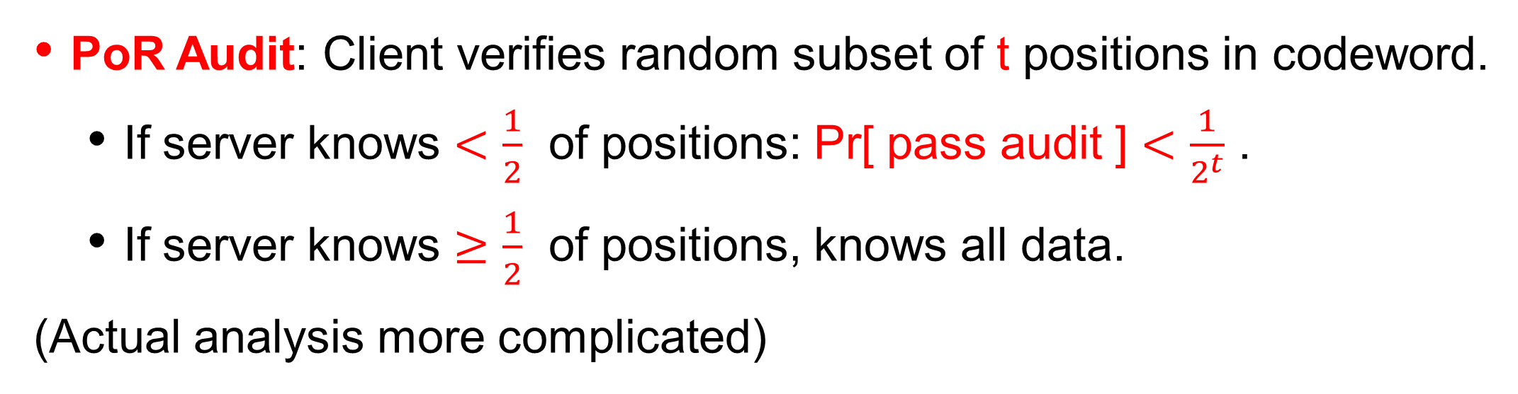
A Simple PoR Scheme [Juels-Kaliski ’07]
PoR Audit: Client verifies random subset of t positions in codeword.
  If server knows $<\frac{1}{2}$ of positions: Pr[ pass audit ] $<\frac{1}{2^{t}}$ .
  If server knows $≥\frac{1}{2}$ of positions, knows all data.
(Actual analysis more complicated)
verification key vk
Server file =
[ECC(M) with authentication]

Slide 9
A Simple PoR Scheme [Juels-Kaliski ’07]
PoR Audit: Client verifies random subset of t positions in codeword.
  If server knows $<\frac{1}{2}$ of positions: Pr[ pass audit ] $<\frac{1}{2^{t}}$ .
  If server knows $≥\frac{1}{2}$ of positions, knows all data.
(Actual analysis more complicated)
Further optimize communication from t authentication tags to 1.
[Shacham-Waters ’08, Dodis-Vadhan-W ’09].
Server file =
[ECC(M) with authentication]

Slide 10
Main Challenge: Dynamic Updates
Known schemes assume data is static once given to the server and never updated afterwards.
Handling updates left as main open problem by Juels and Kaliski.
This work: PoR for dynamic data.
  Efficient protocols to read/write individual locations of client data.
  Audit protocol ensures that server ‘knows’ the latest version of client’s data.

Slide 11
Dynamic PoRs
A dynamic PoR consists of an Encode algorithm, and protocols Read, Write, Audit.
client data: M
Encode
data M
client secret state: k
server storage: S

Slide 12
Dynamic PoRs
Read
client data: M
input: i
...
output: M[i]
state is updated
client secret state: k
server storage: S

Slide 13
Dynamic PoRs
Write
client data: M
set M[i] := v
input: i, v
...
client secret state: k
server storage: S

Slide 14
Dynamic PoRs
Audit
client data: M
...
output: {accept, reject}
client secret state: k
server storage: S

Slide 15
Efficiency of Dynamic PoRs
Server storage |S| = O(|M|).
Small* client state |k|
Small* server/client complexity of read/write/audit
*polylog(|M|)poly(sec)
client secret state: k
server storage: S

Slide 16

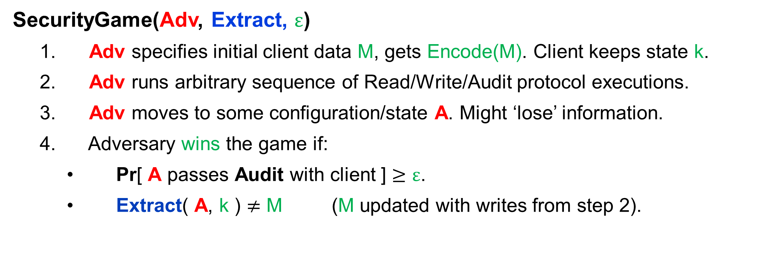
Security Definition for Dynamic PoR
SecurityGame(Adv, Extract, $ε$)
  Adv specifies initial client data M, gets Encode(M). Client keeps state k.
  Adv runs arbitrary sequence of Read/Write/Audit protocol executions.
  Adv moves to some configuration/state A. Might ‘lose’ information.
  Adversary wins the game if:
    Pr[ A passes Audit with client ] $≥ε$.
    Extract( A, k ) $≠$ M (M updated with writes from step 2).
A
“Write v to position i”
“Read j”
“Audit”
…
...
state: k
Client
Adversarial Server Adv

Slide 17
Security Definition for Dynamic PoR
SecurityGame(Adv, Extract, $ε$)
  Adv specifies initial client data M, gets Encode(M). Client keeps state k.
  Adv runs arbitrary sequence of Read/Write/Audit protocol executions.
  Adv moves to some configuration/state A. Might ‘lose’ information.
  Adversary wins the game if:
    Pr[ A passes Audit with client ] $≥ε$.
    Extract( A, k ) $≠$ M (M updated with writes from step 2).
A
“Write v to position i”
“Read j”
“Audit”
…
...
state: k
Client
Adversarial Server Adv

Slide 18
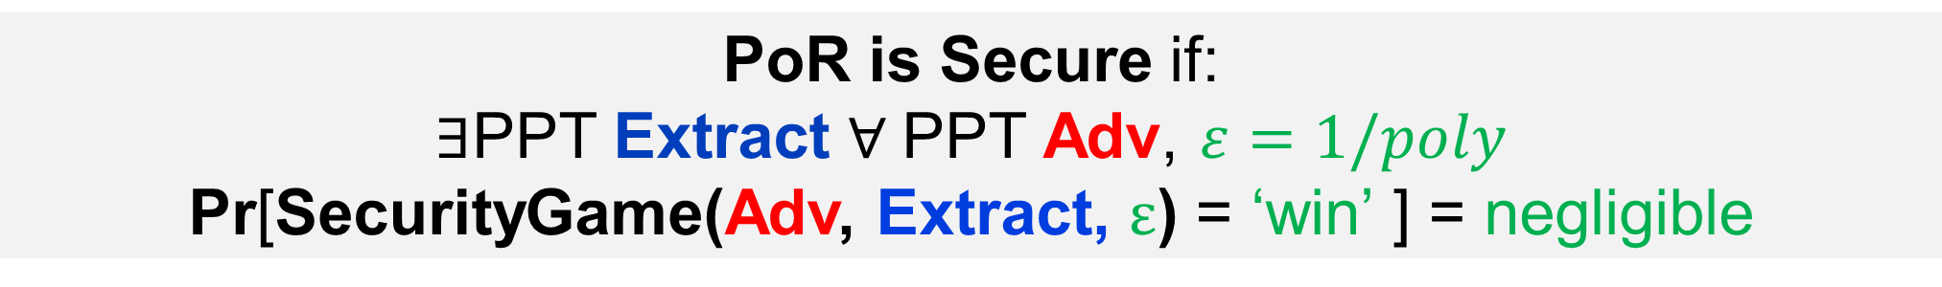
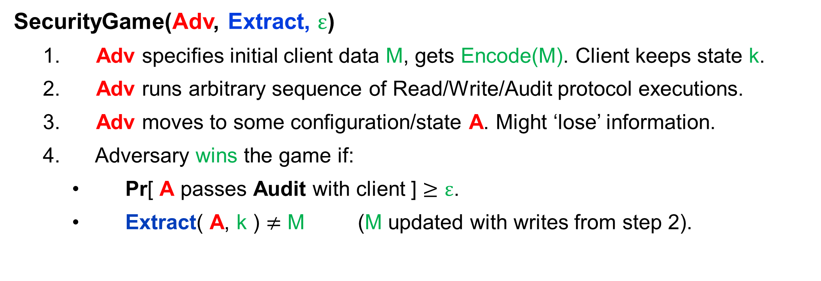
Security Definition for Dynamic PoR
SecurityGame(Adv, Extract, $ε$)
  Adv specifies initial client data M, gets Encode(M). Client keeps state k.
  Adv runs arbitrary sequence of Read/Write/Audit protocol executions.
  Adv moves to some configuration/state A. Might ‘lose’ information.
  Adversary wins the game if:
    Pr[ A passes Audit with client ] $≥ε$.
    Extract( A, k ) $≠$ M (M updated with writes from step 2).
PoR is Secure if:
$∃$PPT Extract $∀$PPT Adv, $ε=1/poly$
Pr[SecurityGame(Adv, Extract, $ε$) = ‘win’ ] = negligible

Slide 19
Outline
Naïve solutions to dynamic PoR. Why they don’t work.
Our Construction using Oblivious RAM.
Analyze security (need new notion of Oblivious RAM).

Slide 20
Difficulty of making PoR Dynamic
Start with [Juels-Kaliski] PoR. Server stores an ECC of data M.
Updating 1 bit of M changes a constant fraction of codeword!
Challenge:
Redundancy is inherent in PoR.
If server deletes few random locations, audit cannot detect.
Redundant encoding with efficient updates?
Encode
Data M
Server stores
S = [ECC(M) with authentication]

Slide 21
Naïve Attempt 1: Local Encoding
Locally encode ‘small’ blocks of data individually.
Encode
Block-wise
Data M = m1, m2, m3
ECC(m1), ECC(m2), ECC(m3)

Slide 22

Naïve Attempt 1: Local Encoding
Locally encode ‘small’ blocks of data individually.
Updating 1 bit of data only affects 1 codeword block.
Write complexity:
|block size|
Data M = m1, m2, m3
ECC(m1), ECC(m2), ECC(m3)

Slide 23
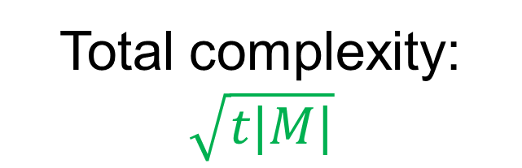
Can we do better?
(polylog)
Naïve Attempt 1: Local Encoding
Locally encode ‘small’ blocks of data individually.
Updating 1 bit of data only affects 1 codeword block.
To lose data, server deletes single codeword block.
  Audit needs to check t symbols/block.
Write complexity:
|block size|
Audit complexity:
t |M|/|block size|
Total complexity:
$$\sqrt{t|M|}$$
Data M = m1, m2, m3
ECC(m1), ECC(m2), ECC(m3)

Slide 24
Tension: PoR Security vs. Locality
Write operation changes few locations on server.
Server can ‘delete’ exactly these locations.
If Audit checks few random locations, unlikely to detect this.
Does not rule out a ‘smarter’ audit. Likelier to check most recently updated data.

Slide 25
Naïve Attempt 2: Local Encode + Permute
Encode
Block-wise
Data M = m1, m2, m3
ECC(m1), ECC(m2), ECC(m3)

Slide 26
Naïve Attempt 2: Local Encode + Permute
Pseudorandomly permute locations of codeword symbols to hide relationship between them.
Server cannot ‘selectively delete’ values in a single codeword block
Encode
Block-wise
Permute (PRP)
Data M = m1, m2, m3
ECC(m1), ECC(m2), ECC(m3)
Server-stored file

Slide 27
Naïve Attempt 2: Local Encode + Permute
Pseudorandomly permute locations of codeword symbols to hide relationship between them.
Server cannot ‘selectively delete’ values in a single codeword block
Read/write reveals locations inside codeword block.
Server-stored file

Slide 28
Main Idea
Store/access codeword symbols on server using oblivious RAM.
  Rough Intuition: Hide which locations are being accessed.
Encode
Block-wise
Oblivious RAM
Data M = m1, m2, m3
ECC(m1), ECC(m2), ECC(m3)

Slide 29
Tool: Oblivious RAM (ORAM) [Goldreich ‘87,Ostrovsky ’90]
Allows a client to store data on a server and read/write to individual locations of the data while hiding the access pattern.
Consists of Encode algorithm, and protocols Read, Write.
  Same syntax as dynamic PoR.
Encode
client secret state: k
data M
server storage: S

Slide 30
Tool: Oblivious RAM (ORAM) [Goldreich ‘87,Ostrovsky ’90]
Allows a client to store data on a server and read/write to individual locations of the data while hiding the access pattern.
Consists of Encode algorithm, and protocols Read, Write.
  Same syntax as dynamic PoR.
input: i
Read
...
client secret state: k
server storage: S
output: M[i]

Slide 31
Tool: Oblivious RAM (ORAM) [Goldreich ‘87,Ostrovsky ’90]
Security of ORAM: For any two values M1, M2 and two equal-size sequences of read/write operations:
server cannot distinguish between ‘ORAM execution’ with (M1, S1) or (M2, S2).
S1
,
S2
read(adr1)
write(adr2, v1)
write(adr3, v2)
read(adr4)
write(adr4,v1)
read(adr2)
read(adr4)
…
write(adr2, v3)
read(adr2, v1)
read(adr2, v1)
read(adr2)
write(adr1,v3)
read(adr2)
read(adr4)
…

Slide 32
History of ORAMs
[Goldreich ‘87] Introduced ORAMs, first non-trivial construction.
[Ostrovsky ‘90] First efficient construction with polylog overhead.
  Client storage is polylog in data size.
  Client/Server amortized complexity per operation is polylog.
Recent flurry of papers: ~10 since 2010
Improving concrete efficiency (log² overhead), worst-case vs. amortized efficiency, 1 round etc.
Can also achieve authenticity against active-adversary server.
  Generically using memory checking, often more efficiently.

Slide 33
Dynamic PoR Construction: Encode
Block-wise
encode
ORAM Encode
Data M = m1, m2, m3
ECC(m1), ECC(m2), ECC(m3)
Server stores memory state

Slide 34
Dynamic PoR Construction: Audit
Check t random distinct codeword symbols.
To read each symbol, execute ORAM read (if ORAM protocol fails, reject)
...
ORAM Read for each symbol
Will access most recently updated server storage

Slide 35
Dynamic PoR Construction: Read
To read location i, find the codeword block that contains it. Use ORAM to read the entire codeword block.
  If ECC is systematic, can read just 1 symbol.
Read symbol i
...
ORAM Read

Slide 36
Dynamic PoR Construction: Write
Use ORAM to read the entire codeword block.
Decode, update position i, re-encode.
Use ORAM to write back new codeword block.
...
ORAM Read each symbol
of Codeword block.
Write to location
i
...
ORAM Write each symbol
of updated codeword block.

Slide 37
Security Intuition
Assume that A passes next audit with probability 1/poly.
Extractor runs many different audits.
  If successful, fill in codeword symbols.
A
...
ORAM Read for each symbol

Slide 38
Security Intuition
Assume that A passes next audit with probability 1/poly.
Extractor runs many different audits.
  If successful, fill in codeword symbols.
A
...
ORAM Read for each symbol

Slide 39
Security Intuition
Assume that A passes next audit with probability 1/poly.
Extractor runs many different audits.
  If successful, fill in codeword symbols.
Total number of “filled in” locations will be large > 3/4 fraction.
A
ORAM => filled in locations are distributed randomly.
Each codeword block > 1/2 symbols filled in.
*
...
ORAM Read for each symbol
*Can verify if Audit succeeds without client secret state.

Slide 40
Security Intuition: Not Quite Right
Assume that A passes next audit with probability 1/poly.
Extractor runs many different audits.
  If successful, fill in codeword symbols.
Total number of “filled in” locations will be large > 3/4 fraction.
ORAM => filled in locations are distributed randomly.
Each codeword block > 1/2 symbols filled in.
Extractor rewinds client and server A after each audit.
Cannot rely on ORAM security:
Same client state used for many ORAM Reads.

Slide 41
Security Intuition: Not Quite Right
There are ORAM schemes with which our PoR construction is insecure.
  A fails on all reads inside some random (unknown) block.
Want: No correlation between next-read access patterns.
Hope: most real ORAM schemes will work.
A
...
fail
ORAM Read for each symbol

Slide 42
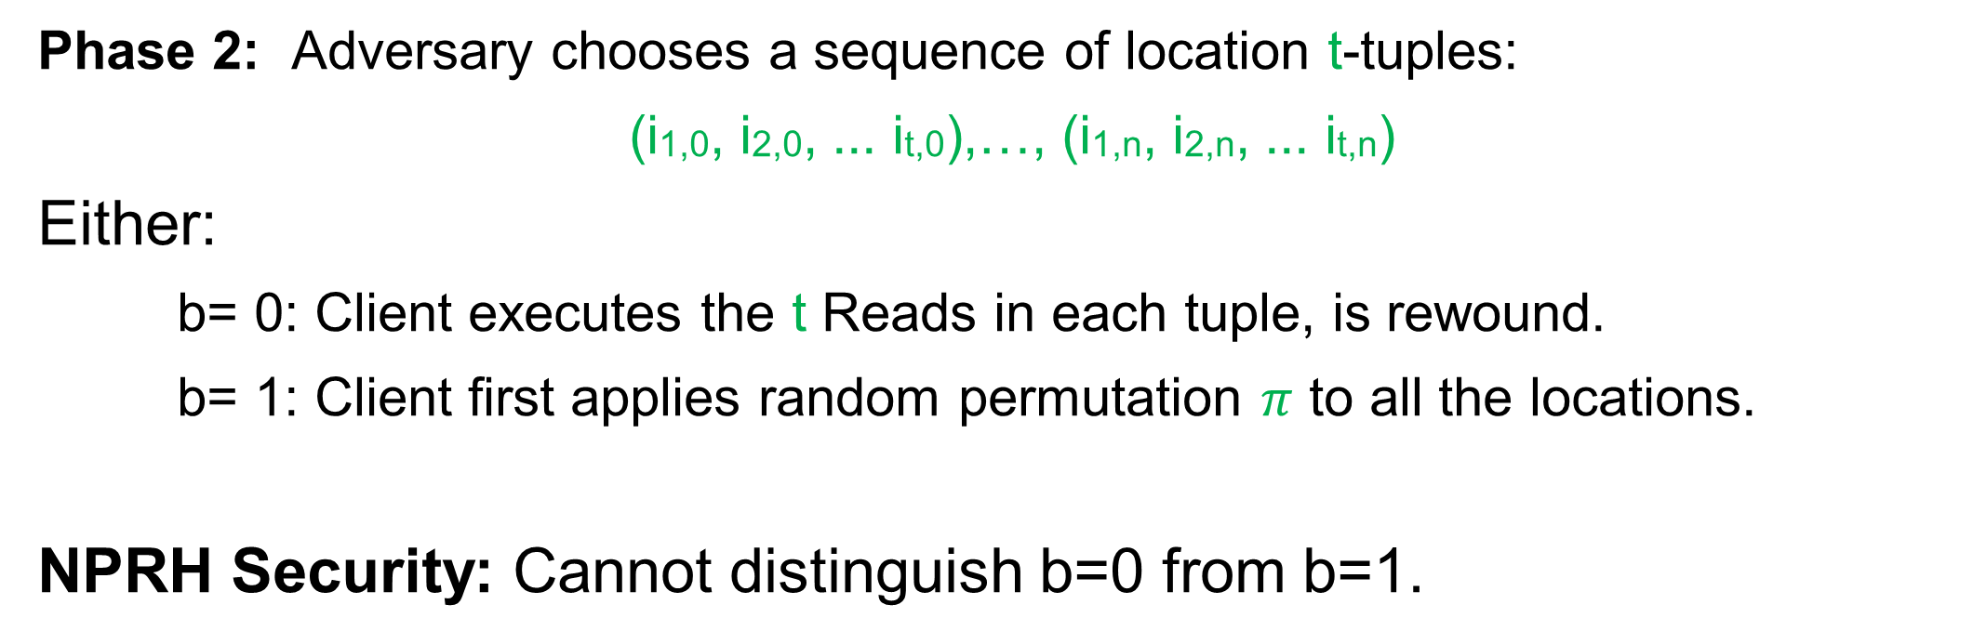
ORAM with Next-Read Pattern Hiding
Security game:
Phase 1: Client encodes data M, executes a sequence of Read/Write protocols chosen by the adversary playing the Server.
Phase 2: Adversary chooses a sequence of location t-tuples:
(i1,0, i2,0, ... it,0),…, (i1,n, i2,n, ... it,n)
Either:
b= 0: Client executes the t Reads in each tuple, is rewound.
b= 1: Client first applies random permutation $π$ to all the locations.
NPRH Security: Cannot distinguish b=0 from b=1.

Slide 43
Security Intuition
Extractor runs many different audits.
  If successful, fill in codeword symbols.
Total number of “filled in” locations will be large > 3/4 fraction.
A
ORAM => filled in locations are distributed randomly.
Each codeword block > 1/2 symbols filled in.
...
ORAM Read for each symbol

Slide 44
Example: Ostrovsky’s ORAM is NRPH
Server Storage
level
log N “levels” for N items
Level i contains 2^{i} buckets
Each buckets contains t slots
Each slot contains a ciphertext encrypting data or dummy.
0
1
2
3
4

Slide 45
Example: Ostrovsky’s ORAM is NRPH
Server Storage
Client Storage
level
PRF keys
0
k1
1
k2
2
3
k3
4
k4

Slide 46
Example: Ostrovsky’s ORAM is NRPH
Server Storage
Client Storage
level
Invariant:
PRF keys
Data item (i, M[i]) is stored at some level j in bucket F_{kj}(i)
0
k1
1
k2
2
= data
3
k3
4
k4

Slide 47
Example: Ostrovsky’s ORAM is NRPH
Server Storage
Client Storage
Read i:
level
PRF keys
For each level j read entire bucket F_{kj}(i) until “find” (i, M[i])
Read random bucket after that.
Put data on top, re-encrypt all.
0
k1
1
it’s here
k2
2
= data
3
k3
4
k4

Slide 48
Example: Ostrovsky’s ORAM is NRPH
Server Storage
Client Storage
level
Write i,v:
PRF keys
Read i.
Encrypt (i,v) when putting data item on top.
0
k1
1
it’s here
k2
2
3
k3
4
k4

Slide 49
Example: Ostrovsky’s ORAM is NRPH
Server Storage
Client Storage
level
Problem: Top bucket fills up.
PRF keys
Shuffles: Every 2^{i} operations move all values in top i levels to level i+1. Fresh keys.
Needs to be oblivious (sorting networks)
0
k1
1
i=1
k2
2
3
k3
4
k4

Slide 50
Example: Ostrovsky’s ORAM is NRPH
Server Storage
Client Storage
level
Problem: Top bucket fills up.
PRF keys
Shuffles: Every 2^{i} operations move all values in top i levels to level i+1. Fresh keys.
Needs to be oblivious (sorting networks)
0
k1
1
i=1
k2
2
3
k3
4
k4

Slide 51
Example: Ostrovsky’s ORAM is NRPH
Server Storage
Client Storage
level
ORAM Security:
PRF keys
At any point in time, reading location i accesses random buckets at each level.
0
k1
1
F_{kj}(i)
never called
k2
2
it’s here
3
k3
4
k4

Slide 52
Example: Ostrovsky’s ORAM is NRPH
Server Storage
Client Storage
level
NRPH Security:
PRF keys
At any point in time, reading distinct locations i1,i2,i3,i4… accesses random/independent buckets at each level.
0
k1
1
k2
2
3
k3
4
k4

Slide 53
Other ORAM Schemes
In the paper, we show NRPH security of a more efficient ORAM of [Goodrich-Mitzenmacher ‘11].

Slide 54
Summary of Results
First construction of “dynamic” proof of retrievability
Resolve technical difficulty via Oblivious RAM
Construction is asymptotically efficient
Client Storage | O(t) i.e. ORAM client state
Server storage | O(N + t)
Read complexity | 1 ORAM read
Write complexity | O(t) ORAM reads and writes
Audit complexity | O(t) ORAM reads
t = security param, N = size of client data

Slide 55
Open Problems
Is ORAM inherent in dynamic PoR?
Is it possible to have dynamic PoR where client does not have any secret state?
Are there other applications of NRPH security?

Slide 56
Thanks!

