Slide 1
Tamper Detection and non-malleable codes
Daniel Wichs (Northeastern U)

Slide 2
Protecting Data Against “Tampering”
Question: How can we protect data against tampering by an adversary?
Variants of this question studied in cryptography, information theory and coding theory.
  What kind of tampering are we considering?
  What protection/guarantees do we want to achieve?
  Can we use secret keys or randomness ?
Tools: Signatures, MACs, Hash Functions, Error-correcting codes, Error-detecting codes.
New variants: tamper-detection codes, non-malleable codes, continuous non-malleable codes.

Slide 3


Motivation: Physical Attacks
Implementing cryptography on a physical device is often difficult.
  Side-Channel Leakage: Adversary observes physical properties of the device.
  Tampering: Adversary modifies internal state and interacts with tampered device.

Slide 4
Motivating Example (Signature)
If a single bit of the signing key is flipped, can use the resulting signature to factor the RSA modulus. [BDL97]
m
Sign_{sk}(m)
sk

Slide 5
Motivating Example
Signature infrastructure using secure tokens (no PKI).
All tokens have the same secret signing key sk.
Each token has a unique userID.
On input message m, token signs (userID, m).
m
Sign_{sk}(userID, m)
(userID, sk)

Slide 6
Motivating Example:
Sign_{sk}(userID, m)
Can we attack scheme with simple tampering attacks?
Attack 1 (RSA sig): Introduce single faulty to signing key. Use resulting sig to factor the RSA modulus. [BDL97]
Attack 2 (any sig): Eve tampers userID = “Eve” to userID = “Eva” by flipping a few bits. Impersonates Eva.

Slide 7
Coding against Tampering
Solution Idea: encode the data on the device to protect it against tampering.
  Each execution first decodes the underlying data.
Example: Use an error-correcting code to protect against attacks that modify a few bits.
What kind of tampering can we protect against?
What kind of codes do we need?

Slide 8
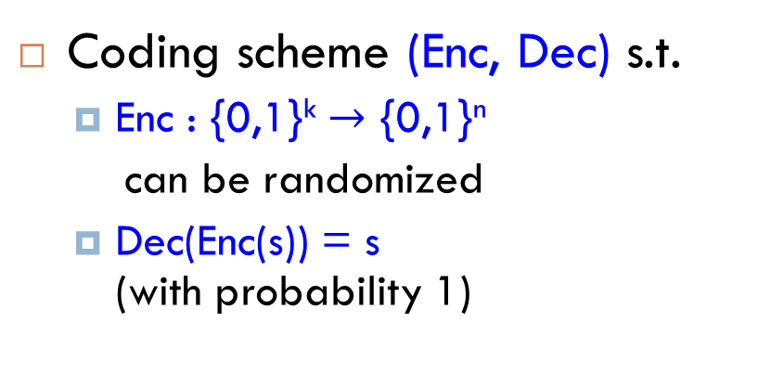
The “Tampering Experiment”
Coding scheme (Enc, Dec) s.t.
  Enc : {0,1}^{k} $→$ {0,1}^{n}
  can be randomized
  Dec(Enc(s)) = s (with probability 1)
message: s
c= Enc(s)
Message: s.
Codeword c Ã Enc(s).
Tampered codeword c* = f(c).
  f 2 F adversarial but independent of randomness of c.
Decoded message: s* = Dec(c*).

Slide 9
The “Tampering Experiment”
c= Enc(s)
c*
s* = Dec(c*)
F={
}
,
f₁
f₂
Message: s.
Codeword c Ã Enc(s).
Tampered codeword c* = f(c).
  f 2 F adversarial but independent of randomness of c.
Decoded message: s* = Dec(c*).

Slide 10
The “Tampering Experiment”
source message
codeword
tampered codeword
decoded message
s
c
c*
s*
Enc
f
Dec
randomized
encoding
tampering function
f 2 family F
decoding
Differences from “standard” coding problems:
  No notion of distance between original and tampered codeword. Focus on the family of functions being applied.
  Tampering is “worst-case”, but choice of function f does not depend on randomness of encoding.

Slide 11
The “Tampering Experiment”
source message
codeword
tampered codeword
decoded message
s
c
c*
s*
Enc
f
Dec
randomized
encoding
tampering function
f 2 family F
decoding
Goal:
For “interesting” families F, design coding scheme (Enc, Dec) which provides “meaningful guarantees” about the outcome of the tampering experiment.

Slide 12
Correction
source message
codeword
tampered codeword
decoded message
s
c
c*
s*
Enc
f
Dec
randomized
encoding
tampering function
f 2 family F
decoding
Error-Correction: require that s* = s
Error-Correcting Codes for Hamming Distance: The family F = {f s.t. 8 x dist(x, f(x)) < d }
Too limited for us! Must preserve some relationship between original and tampered codeword.
  E.g., cannot protect against overwriting with random value.

Slide 13

Tamper Detection
source message
codeword
tampered codeword
decoded message
s
c
c*
s*
Enc
f
Dec
randomized
encoding
tampering function
f 2 family F
decoding
Tamper-Detection: If tampering occurs, then we require that s* = ? (error) with overwhelming probability.
Definition: An (F, $ε$)-Tamper Detection Code guarantees:
$∀$ s , f $∈$ F : Pr[ Dec( f( Enc(s) ) ) $≠ ⊥$ ] $≤ε$

Slide 14
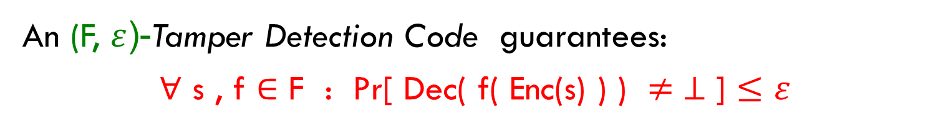
Tamper Detection
An (F, $ε$)-Tamper Detection Code guarantees:
$∀$ s , f $∈$ F : Pr[ Dec( f( Enc(s) ) ) $≠ ⊥$ ] $≤ε$
Error-Correcting Codes provide tamper detection for the family F = {f s.t. 8 x 0 < dist(x, f(x)) < d }
Algebraic Manipulation Detection (AMD)

Slide 15

Tamper Detection: AMD Codes
An (F, $ε$)-Tamper Detection Code guarantees:
$∀$ s , f $∈$ F : Pr[ Dec( f( Enc(s) ) ) $≠ ⊥$ ] $≤ε$
Algebraic Manipulation Detection (AMD) Codes [CDFPW08] :
Tamper detection for F = { f_{e}(x) = x + e : e $≠$ 0 }
Intuition: Can add any error e you want, but must choose it before you see the codeword.
Encoding is necessarily randomized. Choice of f_{e} 2 F must be independent of randomness.

Slide 16
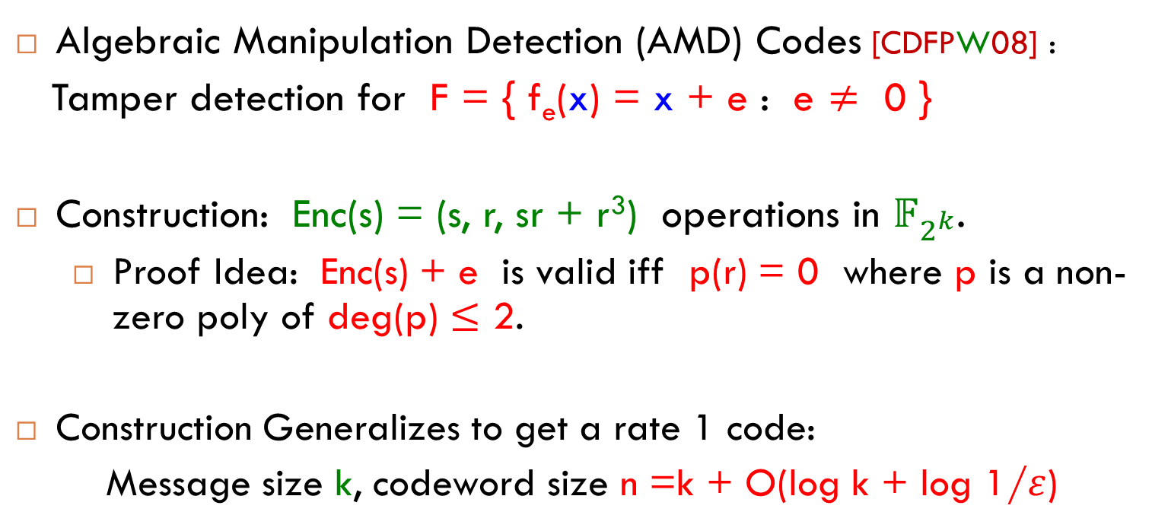
Tamper Detection: AMD Codes
An (F, $ε$)-Tamper Detection Code guarantees:
$∀$ s , f $∈$ F : Pr[ Dec( f( Enc(s) ) ) $≠ ⊥$ ] $≤ε$
Algebraic Manipulation Detection (AMD) Codes [CDFPW08] :
Tamper detection for F = { f_{e}(x) = x + e : e $≠$ 0 }
Construction: Enc(s) = (s, r, sr + r³) operations in $𝔽_{2^{k}}$.
  Proof Idea: Enc(s) + e is valid iff p(r) = 0 where p is a non-zero poly of deg(p) $≤$ 2.
Construction Generalizes to get a rate 1 code:
Message size k, codeword size n =k + O(log k + log 1/$ε$)

Slide 17

Tamper Detection: AMD Codes
An (F, $ε$)-Tamper Detection Code guarantees:
$∀$ s , f $∈$ F : Pr[ Dec( f( Enc(s) ) ) $≠ ⊥$ ] $≤ε$
Algebraic Manipulation Detection (AMD) Codes [CDFPW08] :
Tamper detection for F = { f_{e}(x) = x + e : e $≠$ 0 }
Many applications of AMD codes:
  Secret Sharing and Fuzzy Extractors [CDFPW08]
  Error-Correcting Codes for “Simple” Channels [GS10]
  Multiparty Computation [GIPST14]
  Related-Key Attack Security
  ...

Slide 18
Tamper Detection: Beyond AMD?
An (F, $ε$)-Tamper Detection Code guarantees:
$∀$ s , f $∈$ F : Pr[ Dec( f( Enc(s) ) ) $≠ ⊥$ ] $≤ε$
Question: Can we go beyond AMD codes?
What function families F allow for tamper-detection codes?
Can’t allow functions that are (close to) “identity”.
Can’t allow functions that are (close to) “constant”.
Can’t allow functions that are “too complex”:
  e.g., f(x) = Enc( Dec(x) + 1)

Slide 19
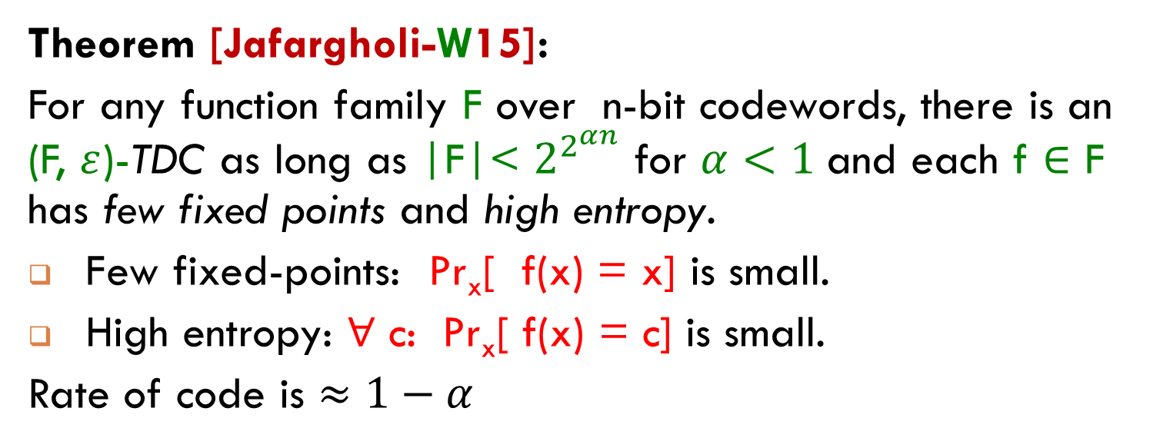
Tamper Detection: General Result
Theorem [Jafargholi-W15]:
For any function family F over n-bit codewords, there is an (F, $ε$)-TDC as long as |F|< $2^{2^{αn}}$ for $α<1$and each f $∈$ F has few fixed points and high entropy.
Few fixed-points: Pr_{x}[ f(x) = x] is small.
High entropy: $∀$ c: Pr_{x}[ f(x) = c] is small.
Rate of code is $≈1−α$

Slide 20
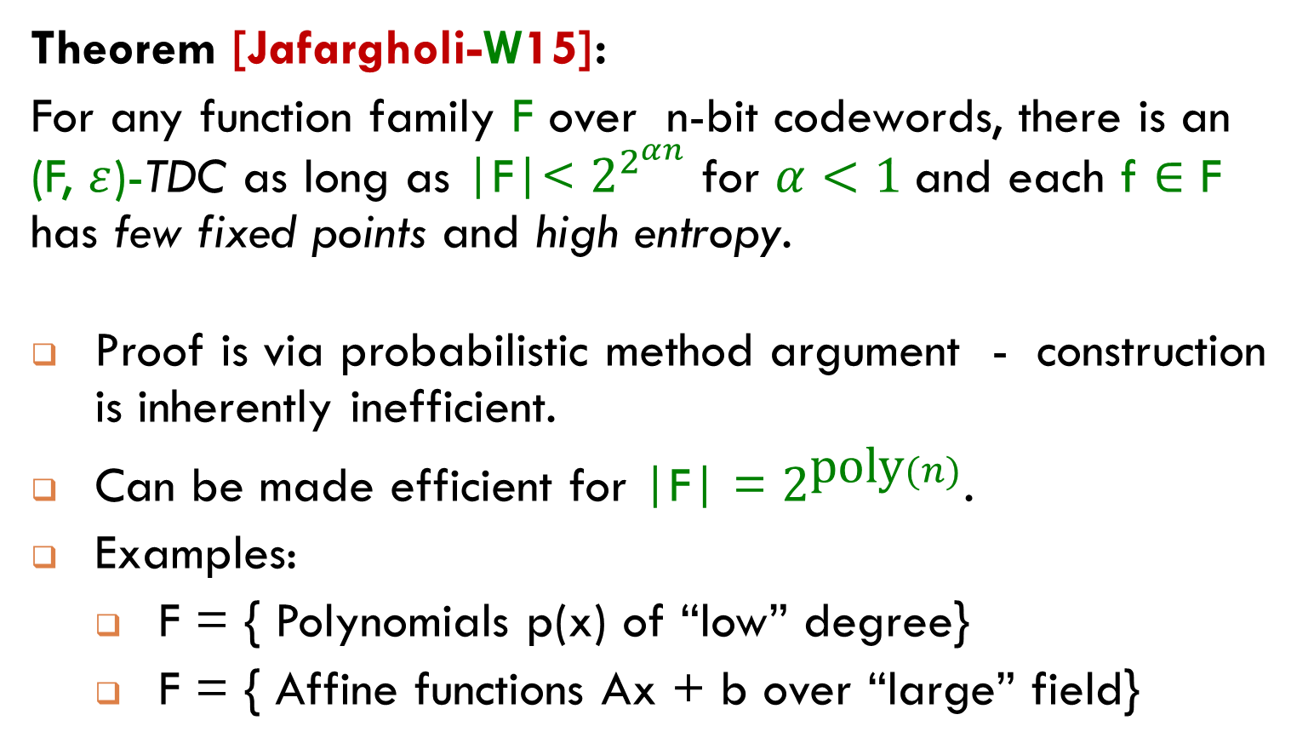
Tamper Detection: General Result
Theorem [Jafargholi-W15]:
For any function family F over n-bit codewords, there is an (F, $ε$)-TDC as long as |F|< $2^{2^{αn}}$ for $α<1$and each f $∈$ F has few fixed points and high entropy.
Proof is via probabilistic method argument - construction is inherently inefficient.
Can be made efficient for |F| = $2^{\text{poly}(n)}$.
Examples:
  F = { Polynomials p(x) of “low” degree}
  F = { Affine functions Ax + b over “large” field}

Slide 21
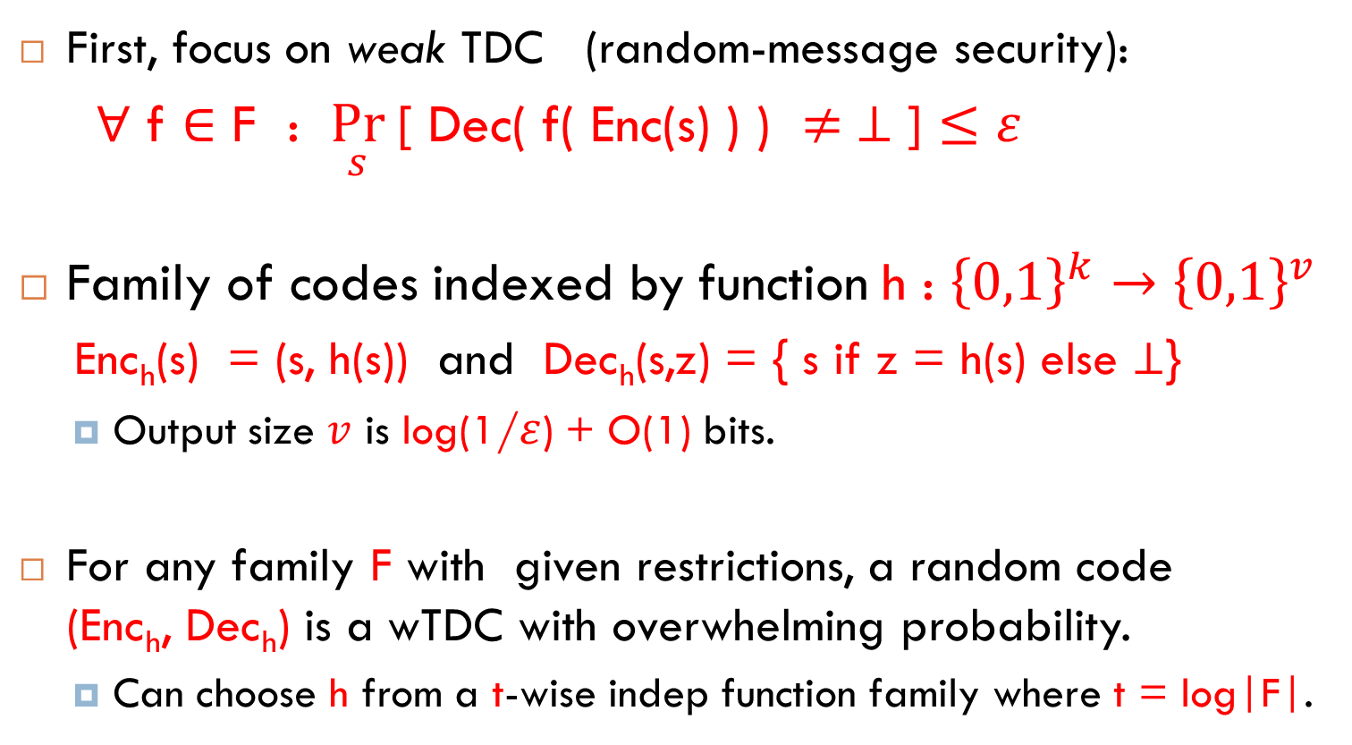
Tamper Detection: Construction
First, focus on weak TDC (random-message security):
$∀$ f $∈$ F : $\underset{s}{Pr}$[ Dec( f( Enc(s) ) ) $≠ ⊥$ ] $≤ε$
Family of codes indexed by function h : ${\left\{0,1\right\}}^{k}→{\left\{0,1\right\}}^{v}$
Enc_{h}(s) = (s, h(s)) and Dec_{h}(s,z) = { s if z = h(s) else $⊥$}
  Output size $v$ is log(1/$ε$) + O(1) bits.
For any family F with given restrictions, a random code (Enc_{h}, Dec_{h}) is a wTDC with overwhelming probability.
  Can choose h from a t-wise indep function family where t = log|F|.

Slide 22
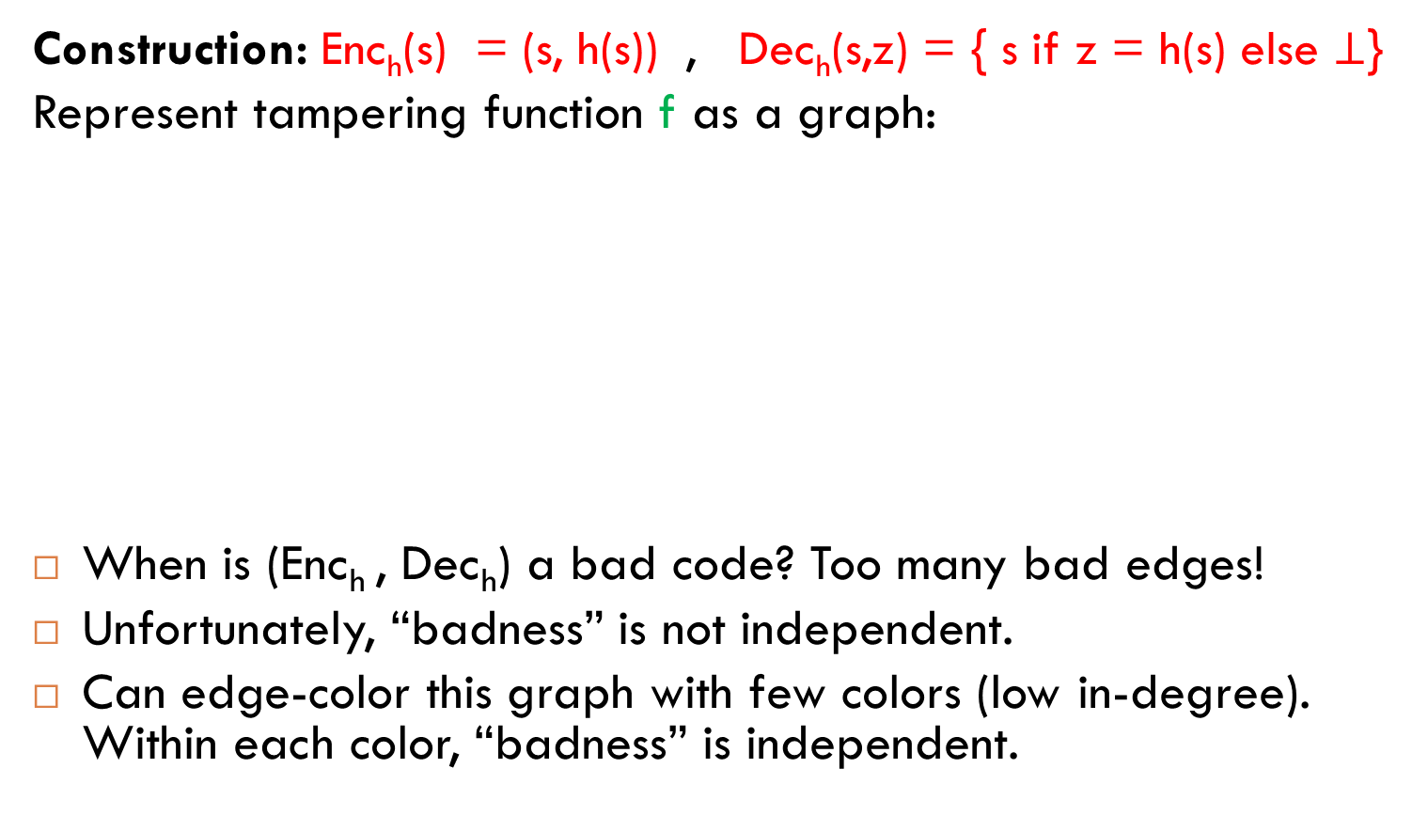
Tamper Detection: Analysis
  Construction: Enc_{h}(s) = (s, h(s)) , Dec_{h}(s,z) = { s if z = h(s) else $⊥$}
Represent tampering function f as a graph:
When is (Enc_{h} , Dec_{h}) a bad code? Too many bad edges!
Unfortunately, “badness” is not independent.
Can edge-color this graph with few colors (low in-degree). Within each color, “badness” is independent.
(s₁,z₁)
(s₃,z₃)
(s₄,z₄)
Bad edge:
z = h(s)
for both
end points
(s₂,z₂)
(s₅,z₅)

Slide 23
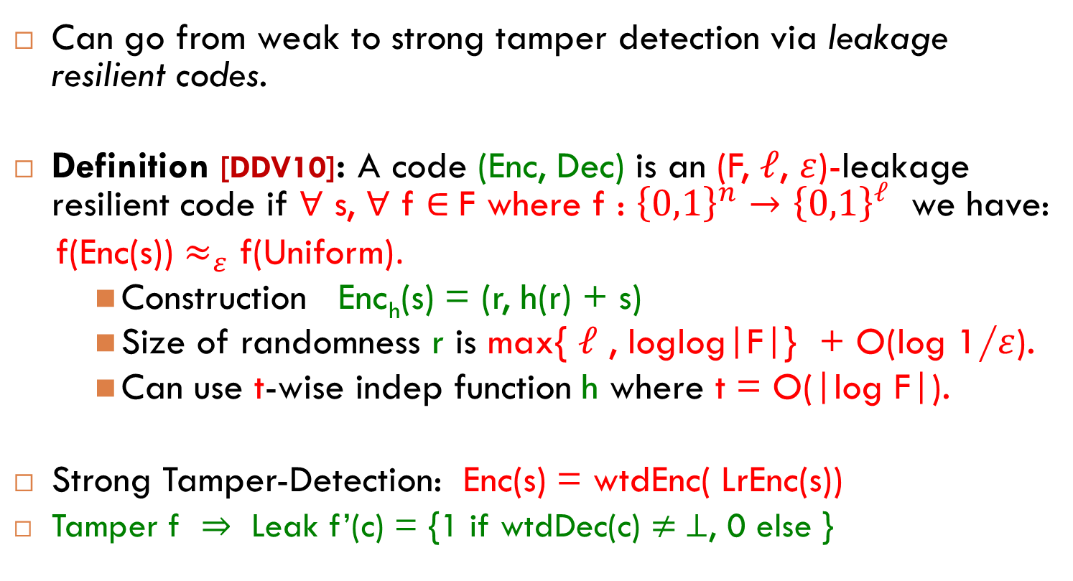
Tamper Detection: Construction
Can go from weak to strong tamper detection via leakage resilient codes.
Definition [DDV10]: A code (Enc, Dec) is an (F, $ℓ$, $ε$)-leakage resilient code if ∀ s, ∀ f $∈$F where f : ${\left\{0,1\right\}}^{n}→{\left\{0,1\right\}}^{ℓ}$ we have:
f(Enc(s)) $≈_{ε}$ f(Uniform).
    Construction Enc_{h}(s) = (r, h(r) + s)
    Size of randomness r is max{ $ℓ$ , loglog|F|} + O(log 1/$ε$).
    Can use t-wise indep function h where t = O(|log F|).
Strong Tamper-Detection: Enc(s) = wtdEnc( LrEnc(s))
Tamper f $⇒$ Leak f’(c) = {1 if wtdDec(c) $≠ ⊥$, 0 else }

Slide 24
Tamper Detection: Limitations
Tamper detection fails for functions with many fixed points, or low entropy.
This is inherent, but perhaps not so bad.
  Fixed-points: nothing changes!
  Low-entropy: not much remains!
Can we relax tamper-detection and still get meaningful security?

Slide 25
Non-Malleability [Dziembowski-Pietrzak-W10]
source message
codeword
tampered codeword
decoded message
s
c
c*
s*
Enc
f
Dec
randomized
encoding
tampering function
f 2 family F
decoding
Non-Malleability: either s*= s or s* is “unrelated” to s.
  Analogous to non-malleability in cryptography [DDN91].
Harder to define formally (stay tuned).
Examples of “malleability”:
  The value s* is same as s, except with 1st bit flipped.
  If s begins with 0, then s* = s. Otherwise s* = ?.

Slide 26

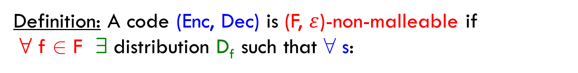
Defining Non-Malleability
High Level: either codeword doesn’t change or the new message is unrelated to the original.
Definition: A code (Enc, Dec) is (F, $ε$)-non-malleable if
8 f 2 F 9 distribution D_{f} such that 8 s:
c Ã Enc(s) , c* Ã f(c)
If c* = c output “same”
else output Dec (c*)
D_{f}
_\_$≈_{ε}$__

Slide 27

General Results for Non-Malleability
For every code (Enc, Dec) there exists a bad function f, for which the scheme is malleable.
  f(c) = Enc(Dec(c) + 1).
  Bad f depends heavily on (Enc, Dec).
Theorem [DPW10, CG13, FMVW14, JW15]:
For any function family F over n-bit codewords, there is an non-malleable code for F as long as |F|< $2^{2^{αn}}$ for $α<1$.
Rate of code is $≈1−α$
If |F| = $2^{\text{poly}(n)}$ then code can be made efficient.

Slide 28
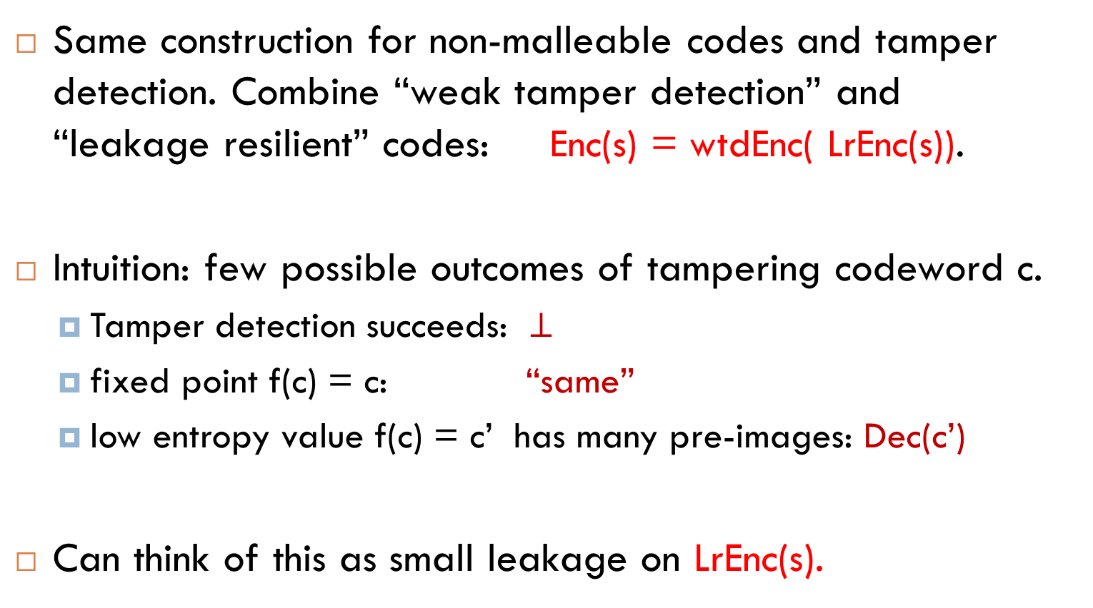
General Results for Non-Malleability
Same construction for non-malleable codes and tamper detection. Combine “weak tamper detection” and “leakage resilient” codes: Enc(s) = wtdEnc( LrEnc(s)).
Intuition: few possible outcomes of tampering codeword c.
  Tamper detection succeeds: $⊥$
  fixed point f(c) = c: “same”
  low entropy value f(c) = c’ has many pre-images: Dec(c’)
Can think of this as small leakage on LrEnc(s).

Slide 29
Special-Purpose Results
Bit-wise tampering [DPW10,CG13]: each bit of codeword is tampered independently but arbitrarily.
Split-state model [DKO13, ADL13, ADKO15] : Codeword split into two parts that are tampered independently but arbitrarily.
Permuting bits of codeword [AGM+14]

Slide 30
Application: Tamper-Resilient Security
Non-malleable codes can protect physical devices against tampering attacks.
Tampering leaves data unchanged, or completely overwrites it with a new unrelated value.

Slide 31

Tamper-Resilient Security
Compiled functionality: G’, state c.
Functionality: G. State s.
Tamper:
f 2 F
input: x
input: x
Black-Box
access
output: y
output: y
adversary
simulator
Assume tampering only changes the state and not the computation.
Tamper-Resilient Compiler: given (G, s) output (G’, c) such that:
  (G’, c) acts the same as (G, s).
  For any adversary with tampering access to (G’, c), there is a simulator with BB access to (G, s) which learns the same information.

Slide 32
Tamper-Resilient Security
Compiled functionality: G’, state c.
Functionality: G. State s.
Tamper:
f 2 F
input: x
input: x
Black-Box
access
output: y
output: y
adversary
simulator
Theorem:
If (Enc, Dec) is non-malleable w.r.t. F, compiler below is tamper-resilient:
c = Enc(s)
G’ : decode s = Dec(c) and run G with state s and input x.
  re-encode c’ = Enc(s’).

Slide 33
Continuous Tampering and Re-Encoding
Tamper-Resilient compiler has to re-encode the codeword each time with fresh randomness. Is this necessary?
Non-malleable codes only allow one tampering attack per codeword.
Can we allow continuous tampering of a single codeword?
Continuous non-malleable codes (4 flavors): [FMV+14, JW15]
  “Self-destruct” if tampering detected?
  “Persistent” tampering?

Slide 34
Continuous Non-Malleable Codes
Few fixed points, High entropy
No Self-Destruct, Non-Persistent
(strongest)
Self-Destruct,
Non-Persistent
No Self-Destruct,
Persistent
High entropy
Few fixed points
Self-Destruct, Persistent
(weakest)
No restrictions on F

Slide 35
Conclusions
Defined tamper-detection codes and (continuous) non-malleable codes.
One general construction. Based on probabilistic method, but can be made efficient for “small” function families.
Open Questions:
  Explicit constructions of tamper detection codes and non-malleable codes. More families. Simpler. Better rate.
  More applications.
    To non-malleable cryptography [AGM+14,CMT+15,CDT+15]
    To other areas?

Slide 36
Thank you!

