Slide 1
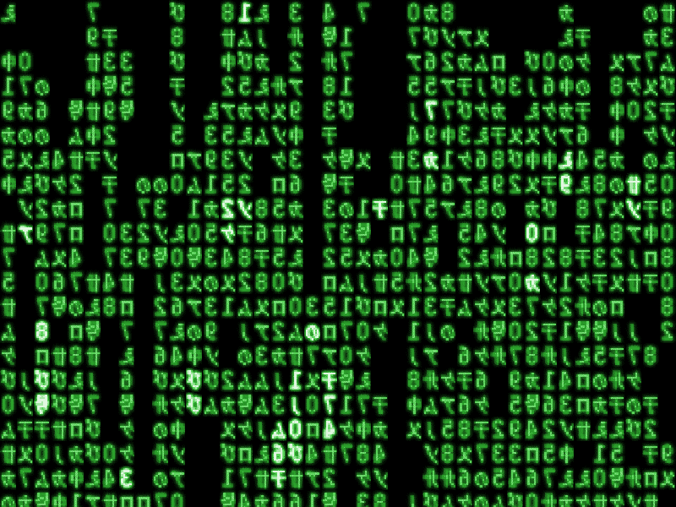
Garbled RAM, Revisited
Daniel Wichs
(Northeastern University)
Joint work with: Craig Gentry, Shai Halevi, Seteve Lu,
Rafail Ostrovsky, Mariana Raykova

Slide 2
Goals of Garbled RAM
An analogue of Yao garbled circuits [Yao82] that directly garbles Random Access Machines (RAM).
Avoid efficiency loss of converting a RAM to a circuit.
  Google search vs. reading the Internet.
First proposed/constructed by [Lu-Ostrovsky 13].
  Proof of security contains subtle flaw (circularity problem).
This works: new constructions with provable security.

Slide 3

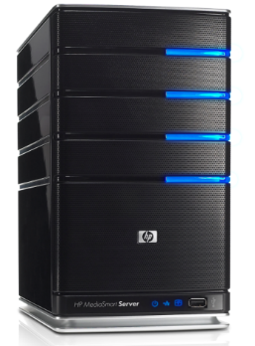
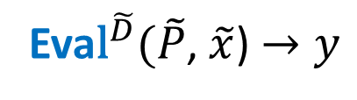
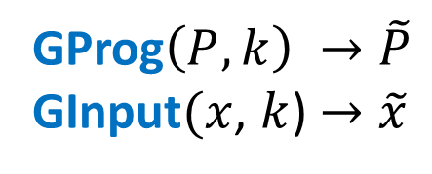
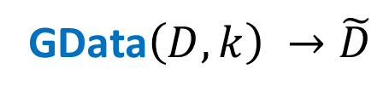
Garbled RAM Definition
GData$\left(D,k\right) →\tilde{D}$
GProg$\left(P,k\right) →\tilde{P}$
GInput$(x$, $k$) $→\tilde{x}$
Client
Server
secret: k
Eva${\text{l}}^{\tilde{D}}(\tilde{P}$, $\tilde{x}$) $→y$

Slide 4


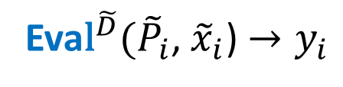
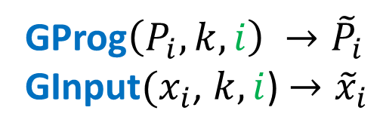
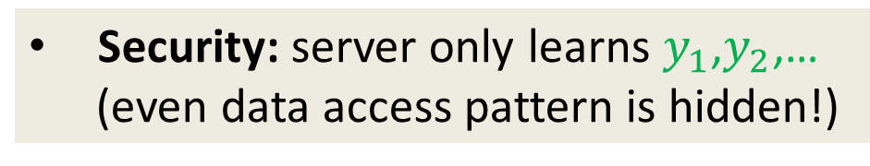
Garbled RAM Definition
GData$\left(D,k\right) →\tilde{D}$
GProg$\left(P_{i},k,i\right) →{\tilde{P}}_{i}$
GInput$(x_{i}$, $k,i$) $→{\tilde{x}}_{i}$
  $≈$ O(run-time)
Client
Server
secret: k
Eva${\text{l}}^{\tilde{D}}({\tilde{P}}_{i}$, ${\tilde{x}}_{i}$) $→y_{i}$
Security: server only learns $y_{1}$,$y_{2}$,…
(even data access pattern is hidden!)
  $≈$ O(run-time)

Slide 5
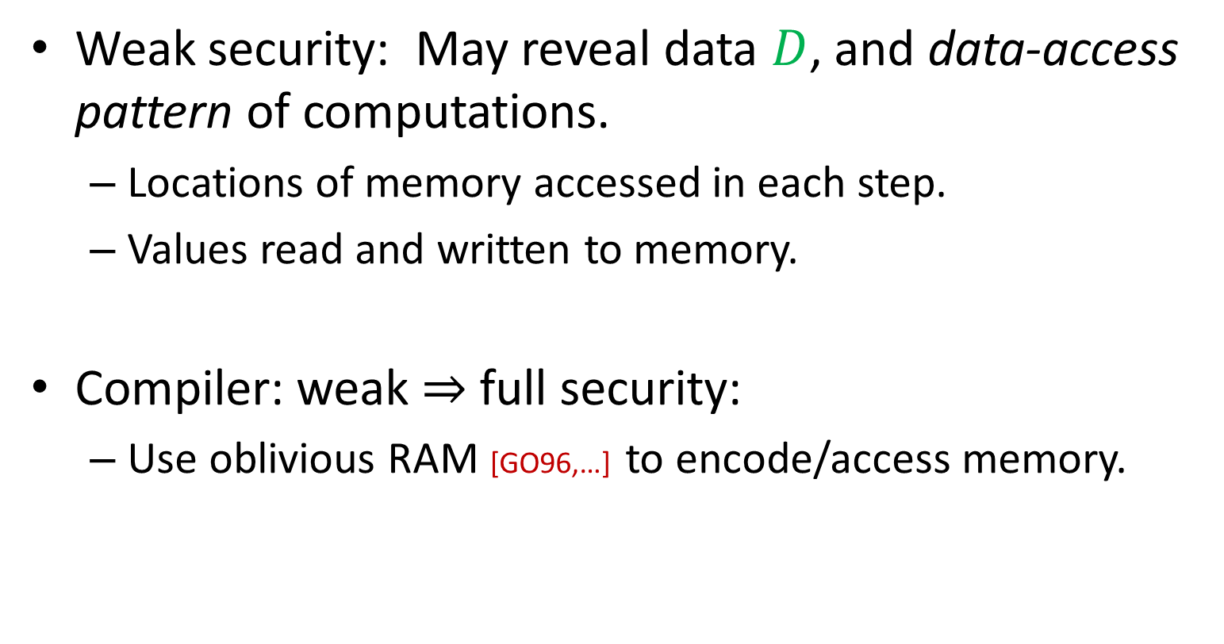
Weak vs. Full Security
Weak security: May reveal data $D$, and data-access pattern of computations.
  Locations of memory accessed in each step.
  Values read and written to memory.
Compiler: weak $⇒$ full security:
  Use oblivious RAM [GO96,…] to encode/access memory.

Slide 6
Overview of [Lu-Ostrovsky 13]
For now,
read-only computation.

Slide 7



Memory
Data D=
…
$$D[1]$$
$$D[2]$$
$$D[3]$$
Read location: i
CPU
Step 1
read bit
CPU
Step 2
state
state
…

Slide 8
Memory
Data D=
…
$$D[1]$$
$$D[2]$$
$$D[3]$$
GProg:
Read location: i
GInp
CPU
Step 1
read bit
CPU
Step 2
state
state
garbled circuit
garbled circuit
…
garbled
garbled

Slide 9

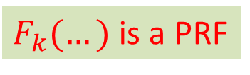


…
GData:
$$F_{k}\left(1,D[1] \right)$$
$$F_{k}\left(2,D[2] \right)$$
$$F_{k}\left(3,D[3] \right)$$
$F_{k}(…)$ is a PRF
GProg:
Read location: i
GInp
CPU
Step 1
read bit
CPU
Step 2
state
state
garbled circuit
garbled circuit
…
garbled
garbled

Slide 10
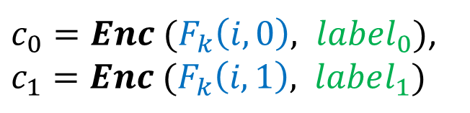
…
GData:
$$F_{k}\left(1,D[1] \right)$$
$$F_{k}\left(2,D[2] \right)$$
$$F_{k}\left(3,D[3] \right)$$
$F_{k}(…)$ is a PRF
Read location: i
GProg:
$c_{0}=Enc (F_{k}\left(i,0\right), label_{0})$, $c_{1}=Enc (F_{k}\left(i,1\right), label_{1})$
GInp
CPU
Step 1
read bit
CPU
Step 2
state
state
garbled circuit
garbled circuit
…
PRF Key: k
PRF Key: k
garbled
garbled

Slide 11
Let’s try to prove security…
Read location: i
$c_{0}=Enc (F_{k}\left(i,0\right), label_{0})$, $c_{1}=Enc (F_{k}\left(i,1\right), label_{1})$
CPU
Step 1
read bit
CPU
Step 2
state
state
garbled circuit
garbled circuit
…
PRF Key: k
PRF Key: k
garbled
garbled

Slide 12
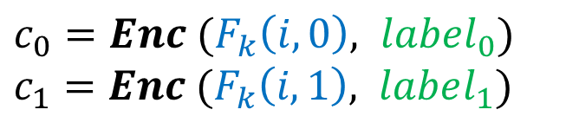
Use security of 1st garbled circuit
only learn output
$c_{0}=Enc (F_{k}\left(i,0\right), label_{0})$ $c_{1}=Enc (F_{k}\left(i,1\right), label_{1})$
read bit
CPU
Step 2
state
labels
garbled state
garbled circuit
…
PRF Key: k

Slide 13


Use security of 1st garbled circuit
only learn output
(assume D[i]=1)
$c_{0}=Enc (F_{k}\left(i,0\right), label_{0})$
$$label_{1}$$
read bit
CPU
Step 2
state
labels
garbled state
garbled circuit
…
PRF Key: k

Slide 14
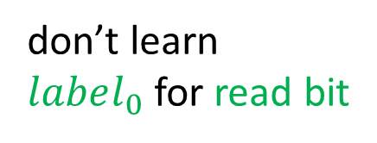
Use security of 2nd garbled circuit
don’t learn
$label_{0}$ for read bit
don’t learn
PRF key k
Use security of Encryption/PRF
$c_{0}=Enc (F_{k}\left(i,0\right), label_{0})$
$$label_{1}$$
read bit
CPU
Step 2
state
labels
garbled state
garbled circuit
…
PRF Key: k

Slide 15
Circularity* Problem!
* May appear rectangular

Slide 16
So is it secure?
Perhaps, but…
  No proof.
  No “simple” circularity assumption on one primitive.

Slide 17
Can we fix it? Yes!
Fix 1 :
  Using identity-based encryption (IBE).
Fix 2 :
  Only use one-way functions.
  Bigger overhead.

Slide 18
The Fix
Public-key instead of symmetric-key encryption.
  Garbled circuits have hard-coded public key.
  Break circularity: security of ciphertexts holds even given public-key hard-coded in all garbled circuits.
Caveat: need identity-based encryption (IBE)
  Original solution used “Sym-key IBE”.

Slide 19
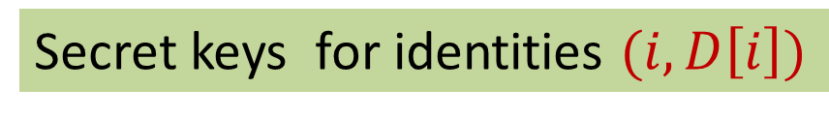
Secret keys for identities $(i, D\left[i\right])$
Garbled
Memory
…
$$F_{k}\left(1,D[1] \right)$$
$$F_{k}\left(2,D[2] \right)$$
$$F_{k}\left(3,D[3] \right)$$
Read location: i
Encrypt to identities
(i,0) and (i,1)
$c_{0}=Enc (F_{k}\left(i,0\right), label_{0})$, $c_{1}=Enc (F_{k}\left(i,1\right), label_{1})$
CPU
Step 1
read bit
CPU
Step 2
state
state
PRF Key: k
PRF Key: k
Master SK

Slide 20




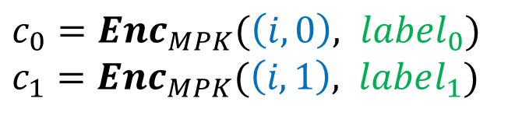
Secret keys for identities $(i, D\left[i\right])$
Garbled
Memory
…
$$sk_{(1,D\left[1\right])}$$
$${sk}_{(2,D\left[2\right])}$$
$${sk}_{(3,D\left[3\right])}$$
Read location: i
Encrypt to identities
(i,0) and (i,1)
$c_{0}=Enc_{MPK}(\left(i,0\right), label_{0})$ $c_{1}=Enc_{MPK}(\left(i,1\right), label_{1})$
CPU
Step 1
read bit
CPU
Step 2
state
state
MPK
MPK
Master PK

Slide 21
How to allow writes?
Predictably-Timed Writes:
Whenever read location i,
“know” its last-write-time u.
Compiler
Any Program
Write location j, bit b
Read location i
CPU
Step 1
read bit
CPU
Step 2
state
state
…

Slide 22
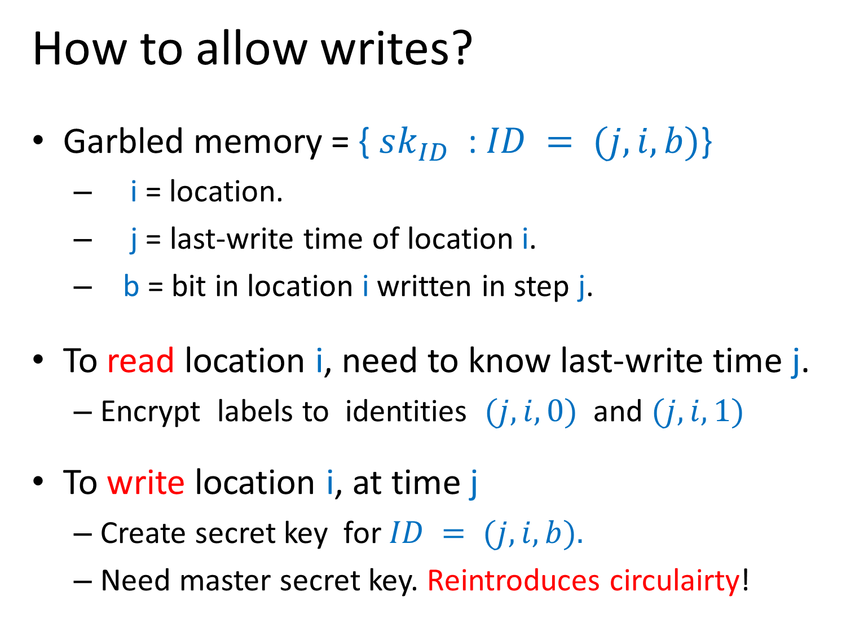
How to allow writes?
Garbled memory = { $sk_{ID}$ : $ID = (j, i, b)$}
  i = location.
  j = last-write time of location i.
  b = bit in location i written in step j.
To read location i, need to know last-write time j.
  Encrypt labels to identities $(j, i,0)$ and $(j, i,1)$
To write location i, at time j
  Create secret key for $ID = (j,i,b).$
  Need master secret key. Reintroduces circulairty!

Slide 23
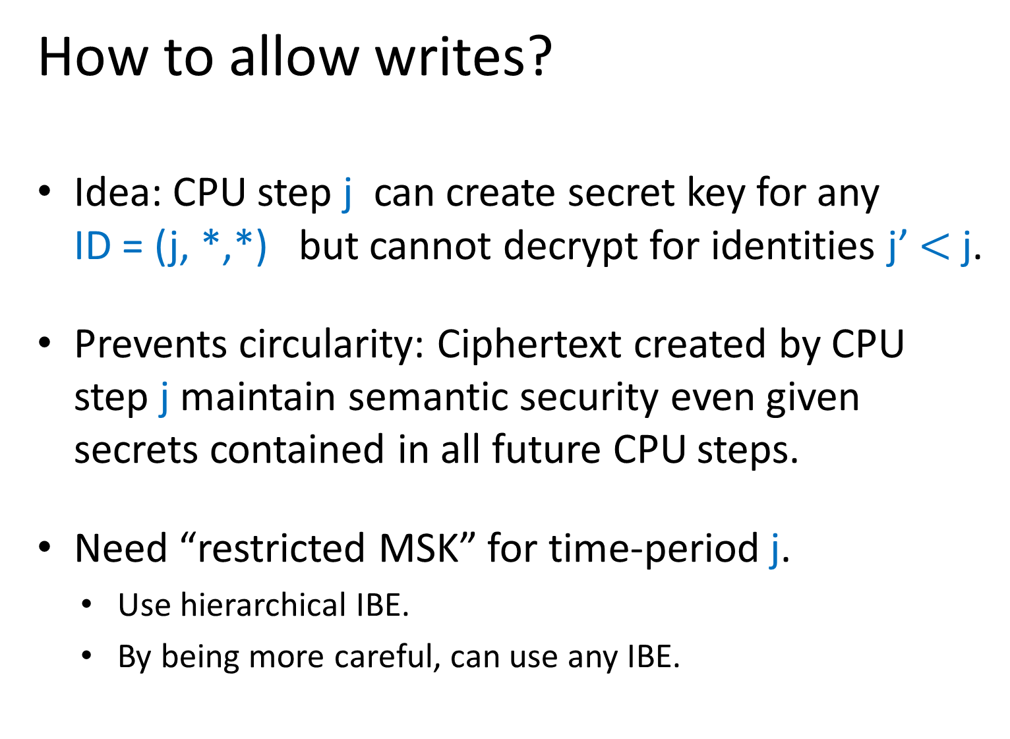
How to allow writes?
Idea: CPU step j can create secret key for any ID = (j, *,*) but cannot decrypt for identities j’ $<$ j.
  Prevents circularity: Ciphertext created by CPU step j maintain semantic security even given secrets contained in all future CPU steps.
  Need “restricted MSK” for time-period j.
    Use hierarchical IBE.
    By being more careful, can use any IBE.

Slide 24
Timed IBE (TIBE): restricted notion of HIBE.

Slide 25






Timed IBE (TIBE): restricted notion of HIBE.
  Time-period key $TSK_{j}$ can be used to create a single identity secret key for any identity ID = (j, *).
  Semantic security holds for all other j.
Can construct TIBE from any IBE. (see paper)
$$MSK$$
$$TSK_{j=1}$$
$$TSK_{j=2}$$
$$TSK_{j=3}$$
…
…
…
$$sk_{(1,????)}$$
$$sk_{(2,????)}$$
$$sk_{(3,????)}$$

Slide 26

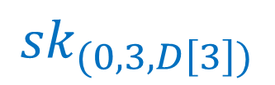
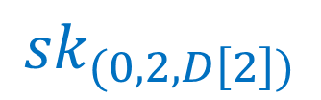
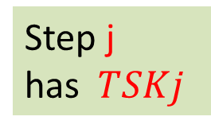
Garbled
Memory
…
$$sk_{(0,1,D\left[1\right])}$$
$${sk}_{(0,2,D\left[2\right])}$$
$${sk}_{(0,3,D\left[3\right])}$$
initially all keys have time j=0
Invariant: always have ${sk}_{(j,i,b)}$ where
j=last-write-time(i), and b is latest bit.
CPU
Step 1
read bit
CPU
Step 2
state
state
Step j
has $TSKj$
$$MPK,TSK_{1}$$
$$MPK,TSK_{2}$$

Slide 27
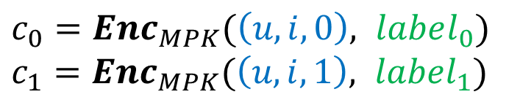
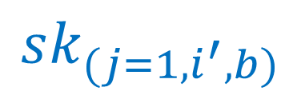
Garbled
Memory
…
$$sk_{(0,1,D\left[1\right])}$$
$${sk}_{(0,2,D\left[2\right])}$$
$${sk}_{(0,3,D\left[3\right])}$$
u < cur step: semantic security for $c_{b}$ holds given future $TSK_{j}$
Read: i, (last-write time: u)
Write: i’, bit b
$c_{0}=Enc_{MPK}(\left(u,i,0\right), label_{0})$ $c_{1}=Enc_{MPK}(\left(u,i,1\right), label_{1})$
$$sk_{(j=1,i^{′},b)}$$
CPU
Step 1
read bit
CPU
Step 2
state
state
$$MPK,TSK_{1}$$
$$MPK,TSK_{2}$$

Slide 28
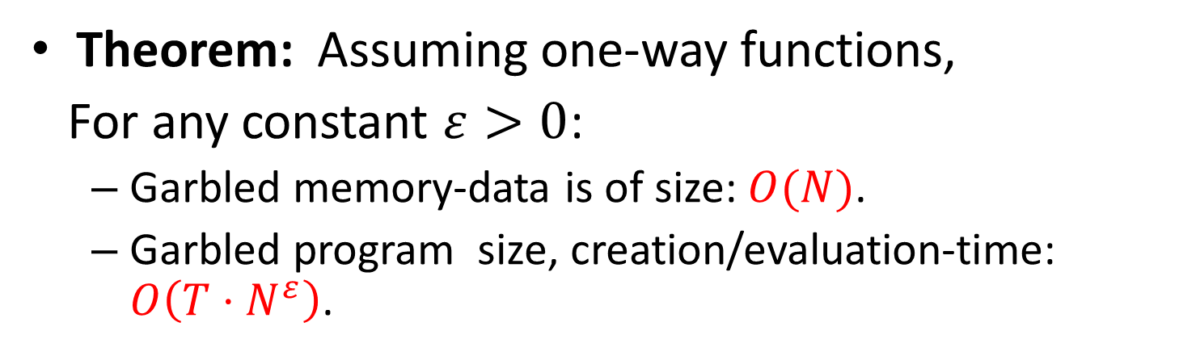
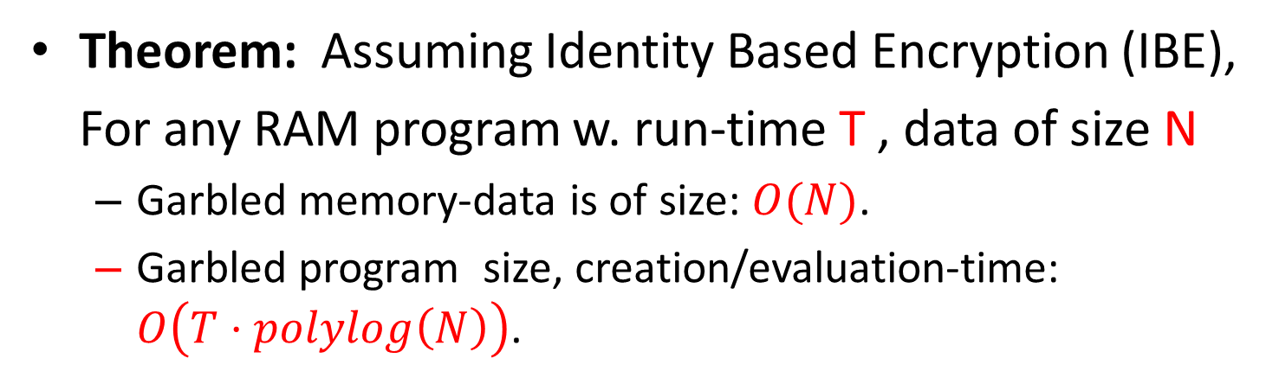
Theorem: Assuming Identity Based Encryption (IBE),
For any RAM program w. run-time T , data of size N
  Garbled memory-data is of size: $O(N)$.
  Garbled program size, creation/evaluation-time: $O\left(T⋅polylog\left(N\right)\right)$.
Theorem: Assuming one-way functions,
For any constant $ε>0$:
  Garbled memory-data is of size: $O(N)$.
  Garbled program size, creation/evaluation-time: $O\left(T⋅N^{ε}\right)$.

Slide 29
Thank You!

