Slide 1
On the Communication Complexity of SFE with Long Output
Daniel Wichs (Northeastern)
joint work with Pavel Hubáček

Slide 2
Secure Function Evaluation (SFE)
Output: y=f(x_{A}, x_{B})
…
Bob (x_{B})
Alice (x_{A})
Alice and Bob have inputs x_{A}, x_{B}.
Goal: Bob learns y= f(x_{A}, x_{B}).
Nothing else is revealed to Alice or Bob (simulation).

Slide 3
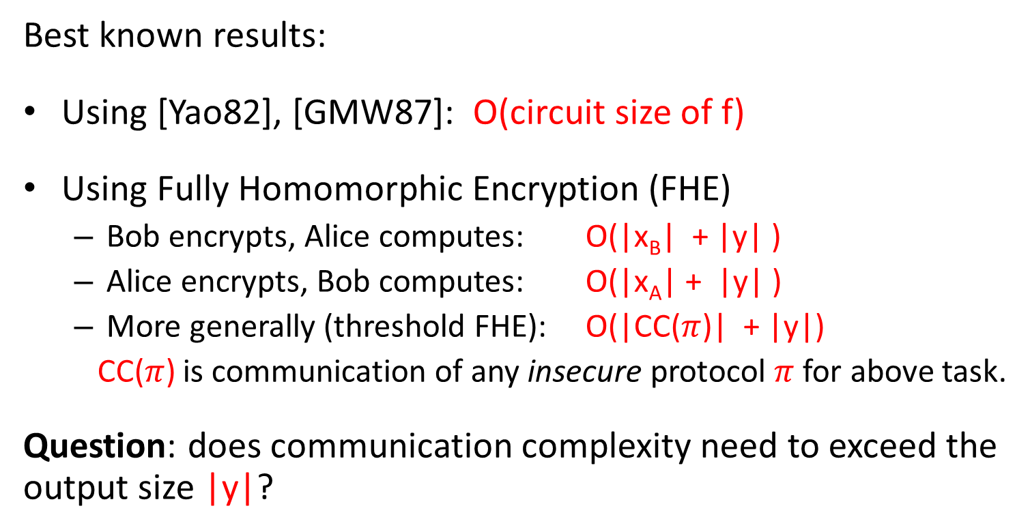
Communication Complexity of SFE
Alice and Bob have inputs x_{A}, x_{B}. Bob learns y=f(x_{A}, x_{B}).
Best known results:
Using [Yao82], [GMW87]: O(circuit size of f)
Using Fully Homomorphic Encryption (FHE)
  Bob encrypts, Alice computes: O(|x_{B}| + |y| )
  Alice encrypts, Bob computes: O(|x_{A}| + |y| )
  More generally (threshold FHE): O(|CC($π$)| + |y|)
  CC($π$) is communication of any insecure protocol $π$for above task.
Question: does communication complexity need to exceed the output size |y|?

Slide 4
Motivating Examples
Alice has short key k for pseudorandom function (PRF) F. Bob has no input, and Bob should learn F_{k}(1),…,F_{k}(n).
Can we get communication complexity < n ?
Alice has secret decryption key k, Bob has a large encrypted database Enc_{k}(DB) and Bob should learn DB.
Can we get communication complexity < |DB| ?

Slide 5
Overview of Our Results
Negative: In any general SFE scheme in the fully malicious setting, the communication complexity must exceed output size.
Extends to “honest-but-deterministic” setting: corrupted party follows protocol but does not use randomness (random tape = 0*).
Positive: Construct a general SFE scheme in the honest-but-curious setting whose communication matches the best insecure protocol (independent of output size).
Relies on heavy hammers: indistinguishability obfuscation and FHE.

Slide 6
Negative Result: Background
Our negative result generalizes an incompressibility argument used in several prior works to get lower bounds for garbled circuit and functional encryption. [AIKW13, AGVW13, DIJ+13, GGJS13, GHRW14]
All these prior results follow as simple corollaries - would imply SFE with small communication.

Slide 7
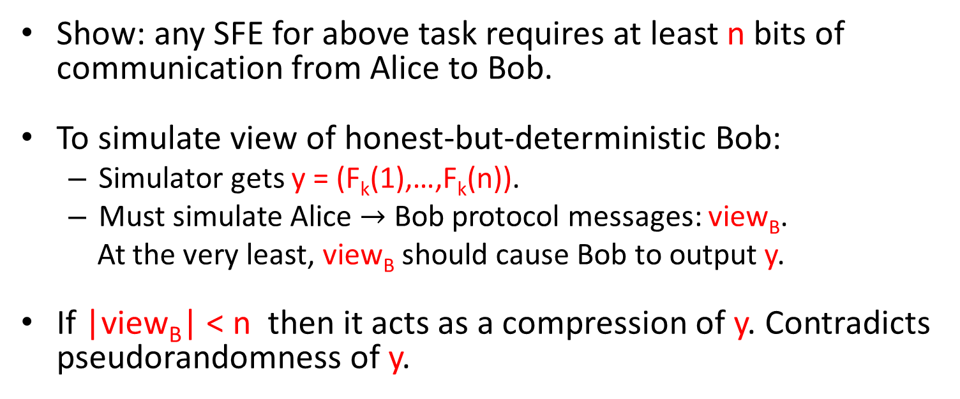
Negative Result
Alice has short key k for PRF F with 1-bit output.
Bob has no input, Bob should learn y= (F_{k}(1),…,F_{k}(n)).
Show: any SFE for above task requires at least n bits of communication from Alice to Bob.
To simulate view of honest-but-deterministic Bob:
  Simulator gets y = (F_{k}(1),…,F_{k}(n)).
  Must simulate Alice $→$ Bob protocol messages: view_{B}.
  At the very least, view_{B} should cause Bob to output y.
If |view_{B}| < n then it acts as a compression of y. Contradicts pseudorandomness of y.

Slide 8
Negative Result: Generalization I
In any SFE, the communication from Alice to Bob must exceed the Yao incompressibility entropy of y =f(x_{A},x_{B})
for the worst-case choice of fixed x_{B} and distribution x_{A}.
Definition: X has > k bits of Yao incompressibility entropy if it cannot be efficiently compressed to k bits.

Slide 9
Negative Result: Generalization II
Can we have an offline/online* protocol with small online communication, independent of output size?
*offline phase executed before parties know their inputs.
Not if the offline phase has to be simulated first, before simulator knows input/output of corrupted party.
e.g., inputs are chosen adaptively after offline phase.
( Yes otherwise: can use Yao garbled circuits. )

Slide 10
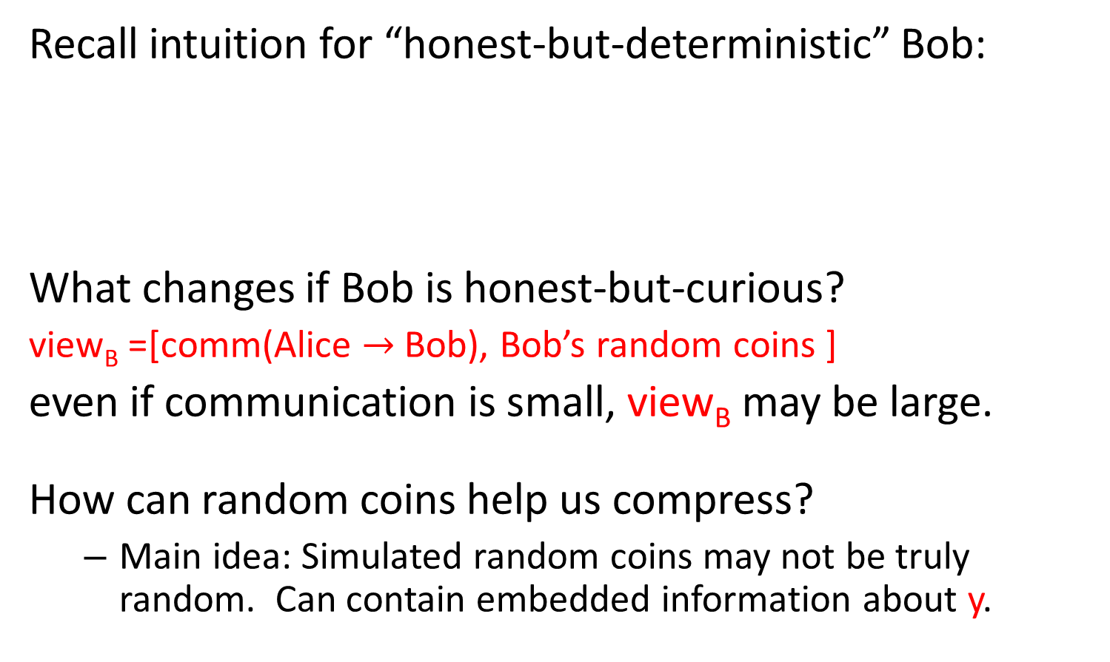
Overcoming the Negative Result
Recall intuition for “honest-but-deterministic” Bob:
What changes if Bob is honest-but-curious?
view_{B} =[comm(Alice $→$ Bob), Bob’s random coins ]
even if communication is small, view_{B} may be large.
How can random coins help us compress?
  Main idea: Simulated random coins may not be truly random. Can contain embedded information about y.
Simulator gets Bob’s output y, must produce view_{B} which is enough to reconstruct y. Cannot be too small, else compression of y.

Slide 11
Positive Result: Simplified Goal
As a start let’s focus on above task, later generalize to any SFE.
Goal:
  Security against honest-but-curious Bob.
  Communication complexity << n.
Alice has short key k for PRF F with 1-bit output.
Bob has no input, Bob should learn y= (F_{k}(1),…,F_{k}(n)).

Slide 12
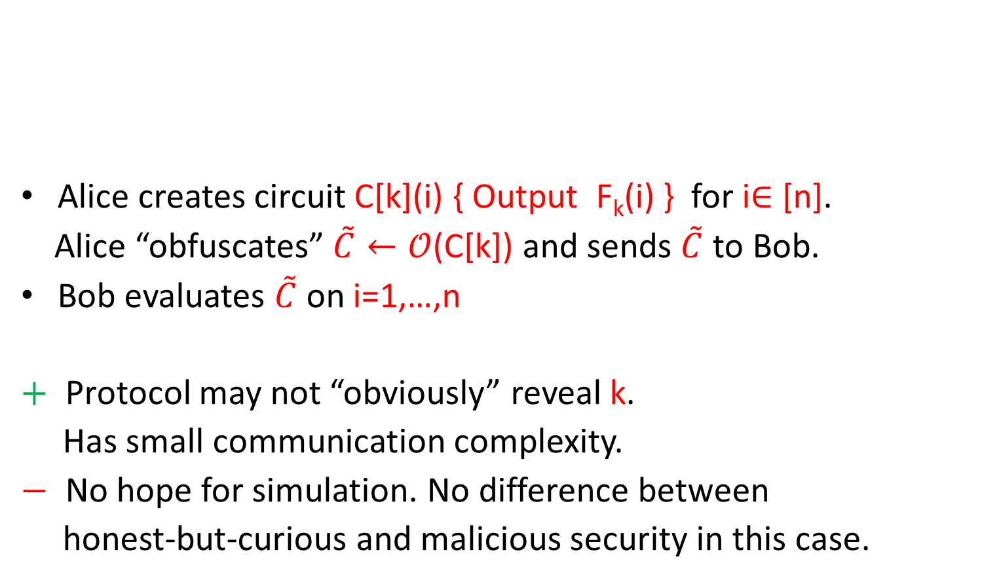
Attempt I
Alice creates circuit C[k](i) { Output F_{k}(i) } for i$∈$ [n].
Alice “obfuscates” $\tilde{C}←𝒪$(C[k]) and sends $\tilde{C}$ to Bob.
Bob evaluates $\tilde{C}$ on i=1,…,n
$+$ Protocol may not “obviously” reveal k.
Has small communication complexity.
$−$ No hope for simulation. No difference between
honest-but-curious and malicious security in this case.
Alice has short key k for PRF F with 1-bit output.
Bob has no input, Bob should learn y= (F_{k}(1),…,F_{k}(n)).

Slide 13
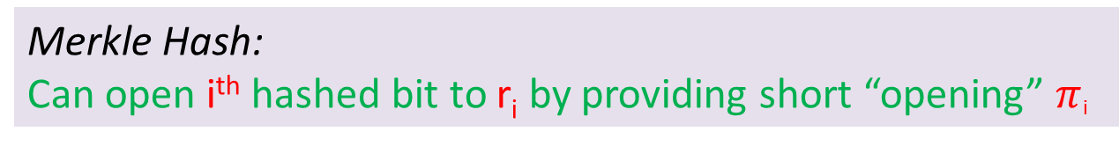
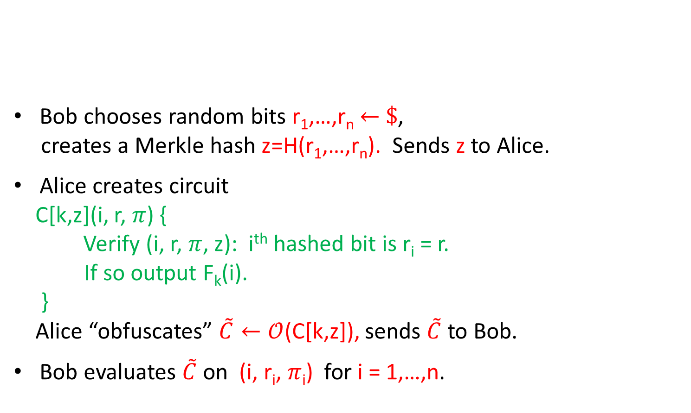
Our Scheme (Almost)
Bob chooses random bits r₁,…,r_{n} $←$ $\$$,
creates a Merkle hash z=H(r₁,…,r_{n}). Sends z to Alice.
Alice creates circuit
C[k,z](i, r, $π$) {
Verify (i, r, $π$, z): i^{th} hashed bit is r_{i} = r.
If so output F_{k}(i).
}
Alice “obfuscates” $\tilde{C}←𝒪$(C[k,z]), sends $\tilde{C}$ to Bob.
Bob evaluates $\tilde{C}$ on (i, r_{i}, $π$_{i}) for i = 1,…,n.
Alice has short key k for PRF F with 1-bit output.
Bob has no input, Bob should learn y= (F_{k}(1),…,F_{k}(n)).
// needs r_{i} to run, ignores it otherwise.
Merkle Hash:
Can open i^{th} hashed bit to r_{i} by providing short “opening” $π$_{i}

Slide 14
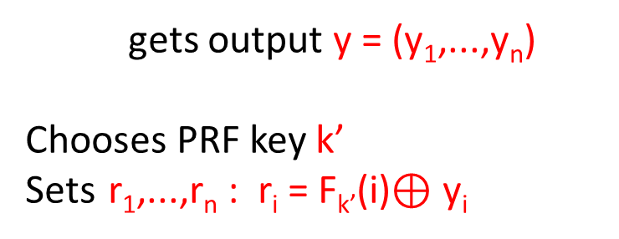
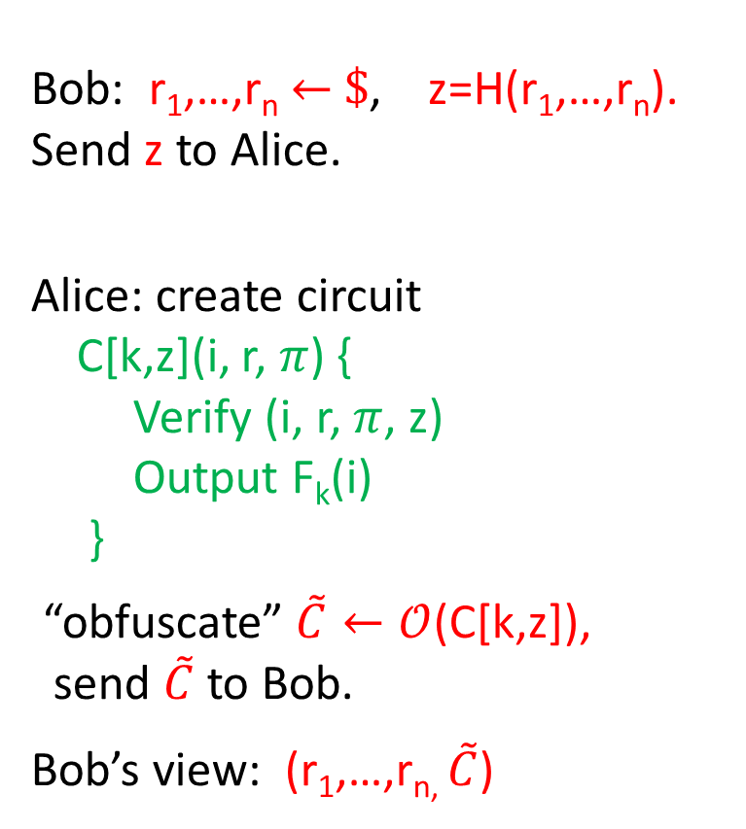
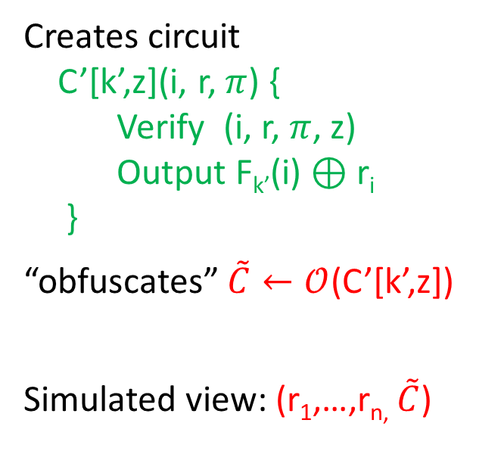
Protocol
Simulation
gets output y = (y₁,...,y_{n})
Chooses PRF key k’
Sets r₁,...,r_{n} : r_{i} = F_{k’}(i)$⊕$ y_{i}
Bob: r₁,…,r_{n} $←$ $\$$, z=H(r₁,…,r_{n}).
Send z to Alice.
Alice: create circuit
C[k,z](i, r, $π$) {
Verify (i, r, $π$, z)
Output F_{k}(i)
}
“obfuscate” $\tilde{C}←𝒪$(C[k,z]),
send $\tilde{C}$ to Bob.
Bob’s view: (r₁,…,r_{n,} $\tilde{C}$)
Creates circuit
C’[k’,z](i, r, $π$) {
Verify (i, r, $π$, z)
Output F_{k’}(i) $⊕$ r_{i}
}
“obfuscates” $\tilde{C}←𝒪$(C’[k’,z])
Simulated view: (r₁,…,r_{n,} $\tilde{C}$)

Slide 15
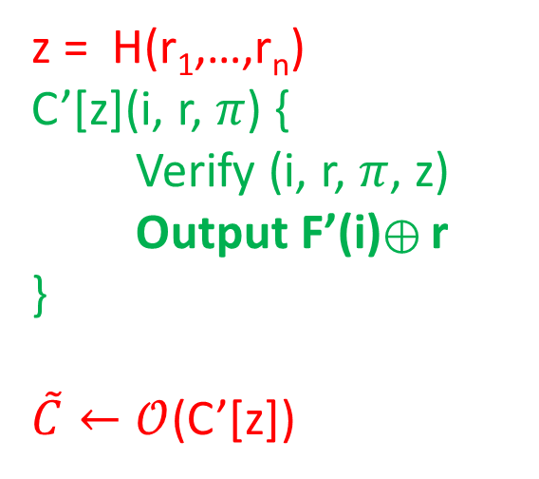
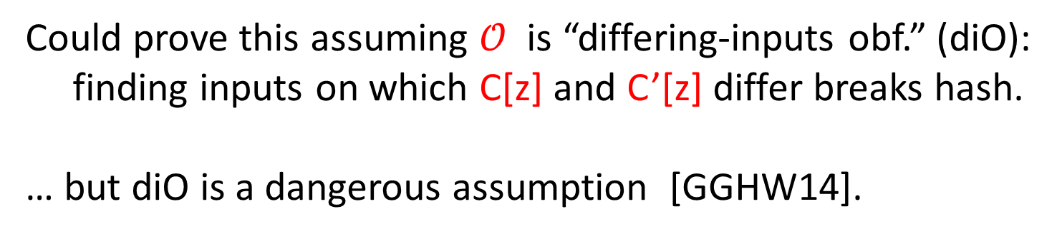
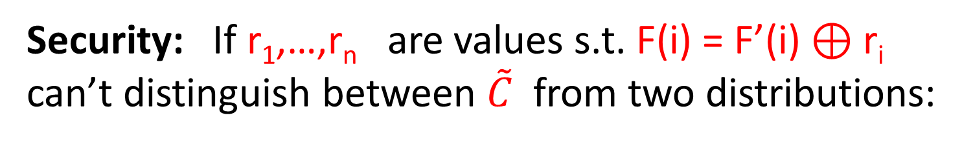
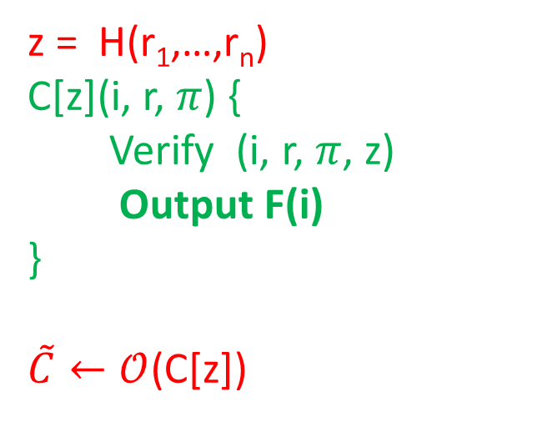
Security: If r₁,…,r_{n} are values s.t. F(i) = F’(i) $⊕$ r_{i}
can’t distinguish between $\tilde{C}$ from two distributions:
z = H(r₁,…,r_{n})
C[z](i, r, $π$) {
Verify (i, r, $π$, z)
Output F(i)
}
$\tilde{C}←𝒪$(C[z])
z = H(r₁,…,r_{n})
C’[z](i, r, $π$) {
Verify (i, r, $π$, z)
Output F’(i)$⊕$r
}
$\tilde{C}←𝒪$(C’[z])
Could prove this assuming $𝒪$ is “differing-inputs obf.” (diO):
finding inputs on which C[z] and C’[z] differ breaks hash.
… but diO is a dangerous assumption [GGHW14].

Slide 16
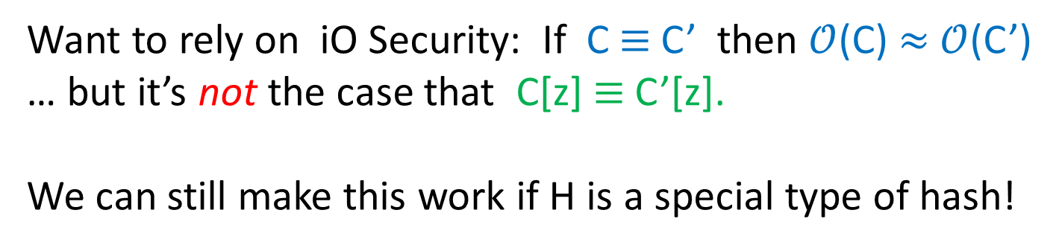
Security: If r₁,…,r_{n} are values s.t. F(i) = F’(i) $⊕$ r_{i}
can’t distinguish between $\tilde{C}$ from two distributions:
z = H(r₁,…,r_{n})
C[z](i, r, $π$) {
Verify (i, r, $π$, z)
Output F(i)
}
$\tilde{C}←𝒪$(C[z])
z = H(r₁,…,r_{n})
C’[z](i, r, $π$) {
Verify (i, r, $π$, z)
Output F’(i)$⊕$r
}
$\tilde{C}←𝒪$(C’[z])
Want to rely on iO Security: If C $≡$ C’ then $𝒪$(C) $≈$ $𝒪$(C’)
… but it’s not the case that C[z] $≡$ C’[z].
We can still make this work if H is a special type of hash!

Slide 17
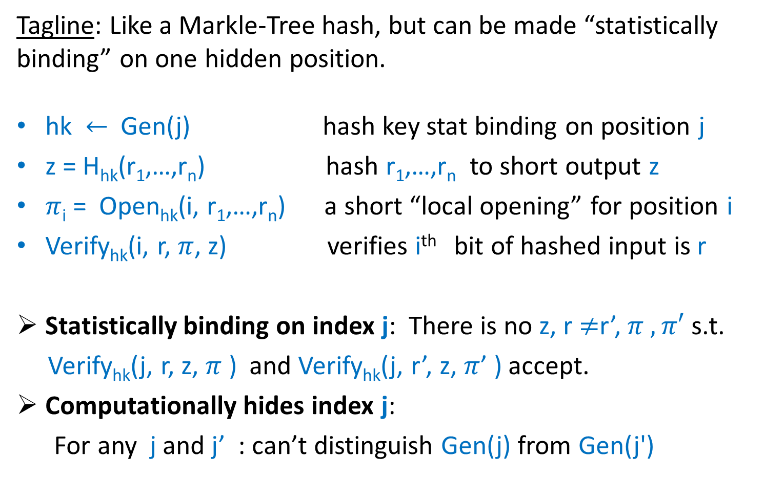
Def: Somewhere Stat Binding (SSB) Hash
Tagline: Like a Markle-Tree hash, but can be made “statistically binding” on one hidden position.
hk $←$ Gen(j) hash key stat binding on position j
z = H_{hk}(r₁,…,r_{n}) hash r₁,…,r_{n} to short output z
$π$_{i} = Open_{hk}(i, r₁,…,r_{n}) a short “local opening” for position i
Verify_{hk}(i, r, $π$, z) verifies i^{th} bit of hashed input is r
Statistically binding on index j: There is no z, r $≠$r’,$π , π′$ s.t.
Verify_{hk}(j, r, z, $π$ ) and Verify_{hk}(j, r’, z, $π$’ ) accept.
Computationally hides index j:
For any j and j’ : can’t distinguish Gen(j) from Gen(j')

Slide 18
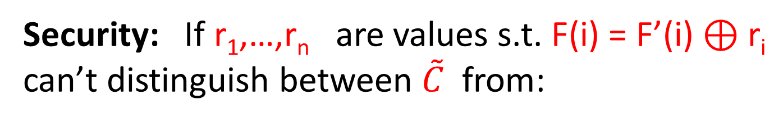
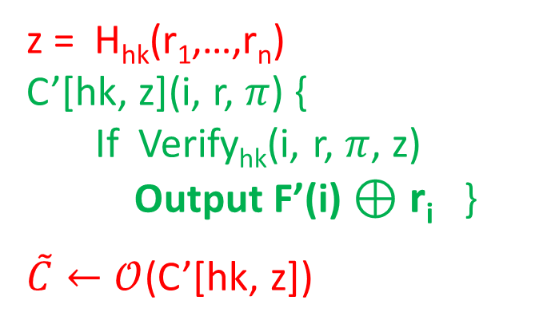
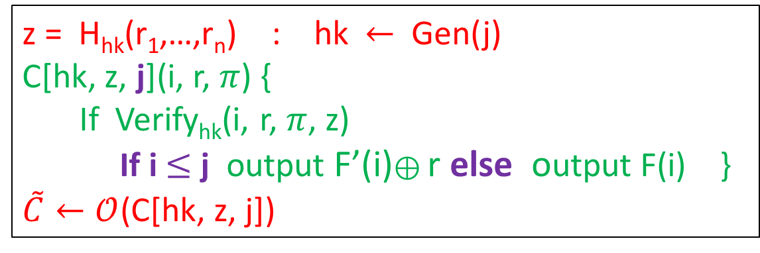
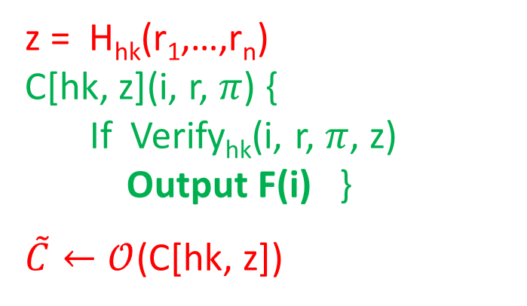
Security: If r₁,…,r_{n} are values s.t. F(i) = F’(i) $⊕$ r_{i}
can’t distinguish between $\tilde{C}$ from:
z = H_{hk}(r₁,…,r_{n})
C[hk, z](i, r, $π$) {
If Verify_{hk}(i, r, $π$, z)
Output F(i) }
$\tilde{C}←𝒪$(C[hk, z])
z = H_{hk}(r₁,…,r_{n})
C’[hk, z](i, r, $π$) {
If Verify_{hk}(i, r, $π$, z)
Output F’(i) $⊕$ r_{i} }
$\tilde{C}←𝒪$(C’[hk, z])
Hybrid j
z = H_{hk}(r₁,…,r_{n}) : hk $←$ Gen(j)
C[hk, z, j](i, r, $π$) {
If Verify_{hk}(i, r, $π$, z)
If i $≤$ j output F’(i)$⊕$r else output F(i) }
$\tilde{C}←𝒪$(C[hk, z, j])
j=0
j=n

Slide 19

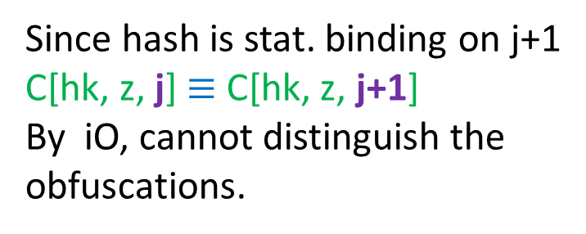


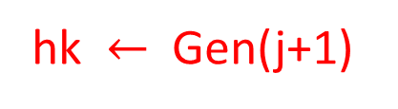
Hybrid j
$$≈$$
$$≈$$
$$≈$$
Hybrid j+1
Hybrid j + .5
hk $←$ Gen(j+1)
SSB hash key hk
computationally
hides binding index
Since hash is stat. binding on j+1
C[hk, z, j] $≡$ C[hk, z, j+1]
By iO, cannot distinguish the
obfuscations.
Hybrid j
z = H_{hk}(r₁,…,r_{n}) : hk $←$ Gen(j)
C[hk, z, j](i, r, $π$) {
If Verify_{hk}(i, r, $π$, z)
If i $≤$ j output F’(i)$⊕$r else output F(i) }
$\tilde{C}←𝒪$(C[hk, z, j])

Slide 20
Constructing SSB Hash
Relies on a combination of fully-homomorphic enc (FHE) and Merkle Trees.
r₀
r₁
r₂
r₃
r₄
r₅
r₆
r₇

Slide 21
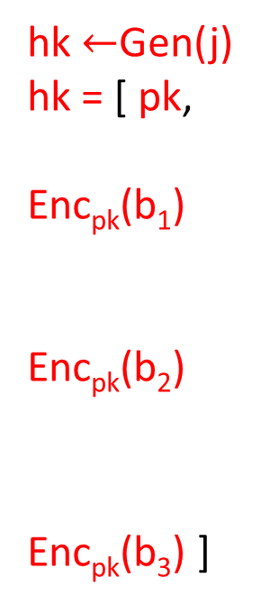
Constructing SSB Hash
  hash key hk encrypts a path to the binding index.
hk $←$Gen(j)
hk = [ pk,
Enc_{pk}(b₁)
Enc_{pk}(b₂)
Enc_{pk}(b₃) ]
b₁ = 0
b₂ = 1
b₃ = 1
r₀
r₁
r₂
r₃
r₄
r₅
r₆
r₇
j =b₁b₂b₃ in binary

Slide 22
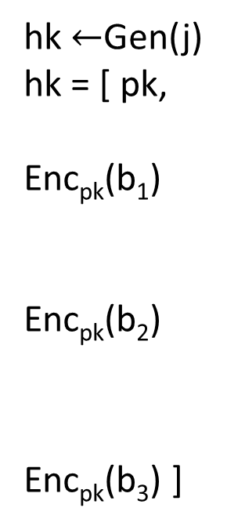
Constructing SSB Hash
Hashing associates ctext with each node, output root
Leafs are encryptions of data bits (randomness 0s)
Nodes at level t: homomorphically get an encryption
of the data of left or right child depending on bit b_{t}.
hk $←$Gen(j)
hk = [ pk,
Enc_{pk}(b₁)
Enc_{pk}(b₂)
Enc_{pk}(b₃) ]
[r₃]
[r₃]
[r₇]
[r₁]
[r₃]
[r₅]
[r₇]
r₀
r₁
r₂
r₃
r₄
r₅
r₆
r₇

Slide 23
Constructing SSB Hash
To open location i, give ciphertexts for all sibling on path from root to i.
To verify, recompute root.
hk $←$Gen(j)
hk = [ pk,
Enc_{pk}(b₁)
Enc_{pk}(b₂)
Enc_{pk}(b₃) ]
[r₃]
[r₃]
[r₇]
[r₁]
[r₃]
[r₅]
[r₇]
r₀
r₁
r₂
r₃
r₄
r₅
r₆
r₇

Slide 24
Constructing SSB Hash
Problem: adversary can choose invalid ctexts in the opening. No correctness in homomorphic evaluation.
hk $←$Gen(j)
hk = [ pk,
Enc_{pk}(b₁)
Enc_{pk}(b₂)
Enc_{pk}(b₃) ]
[r₃]
[r₃]
[r₇]
[r₁]
[r₃]
[r₅]
[r₇]
r₀
r₁
r₂
r₃
r₄
r₅
r₆
r₇

Slide 25
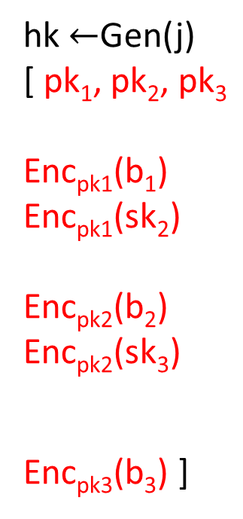
Constructing SSB Hash
Problem: adversary can choose invalid ctexts in the opening. No correctness in homomorphic evaluation.
Solution: Use the ideas of “bootstrapping”.
Homomorphic evaluation is only over ctexts in hk.
hk $←$Gen(j)
[ pk₁, pk₂, pk₃
Enc_{pk1}(b₁)
Enc_{pk1}(sk₂)
Enc_{pk2}(b₂)
Enc_{pk2}(sk₃)
Enc_{pk3}(b₃) ]
[r₃]
[r₃]
[r₇]
[r₁]
[r₃]
[r₅]
[r₇]
r₀
r₁
r₂
r₃
r₄
r₅
r₆
r₇

Slide 26
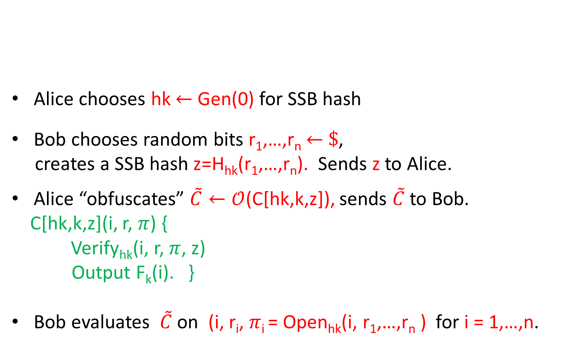
Review: Scheme for PRF Evaluation
Alice chooses hk $←$ Gen(0) for SSB hash
Bob chooses random bits r₁,…,r_{n} $←$ $\$$,
creates a SSB hash z=H_{hk}(r₁,…,r_{n}). Sends z to Alice.
Alice “obfuscates” $\tilde{C}←𝒪$(C[hk,k,z]), sends $\tilde{C}$ to Bob.
C[hk,k,z](i, r, $π$) {
Verify_{hk}(i, r, $π$, z)
Output F_{k}(i). }
Bob evaluates $\tilde{C}$ on (i, r_{i}, $π$_{i} = Open_{hk}(i, r₁,…,r_{n} ) for i = 1,…,n.
Alice has short key k for PRF F with 1-bit output.
Bob has no input, Bob should learn y= (F_{k}(1),…,F_{k}(n)).

Slide 27
Toward General SFE
So far: communication-efficient SFE for PRF evaluation.
Next: leverage these ideas to get a general SFE.
Step 1: A communication-efficient SFE for decryption
  Alice has secret decryption key sk.
  Bob has a large encrypted database Enc_{pk}(DB). Should learn DB.
Essentially same idea as our PRF evaluation scheme.
Step 2: From SFE for decryption to general SFE (black-box).

Slide 28
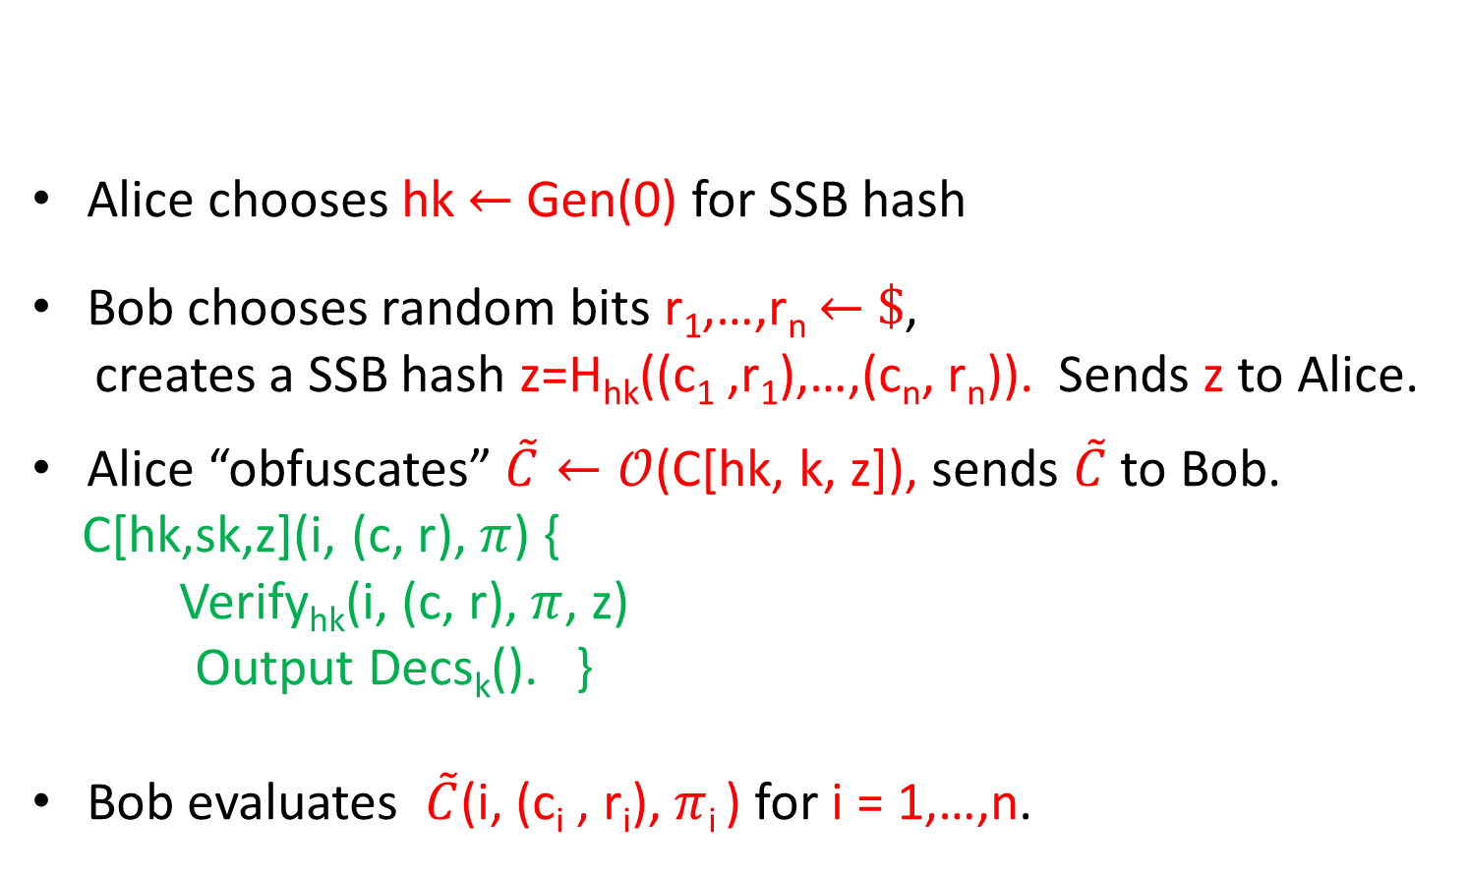
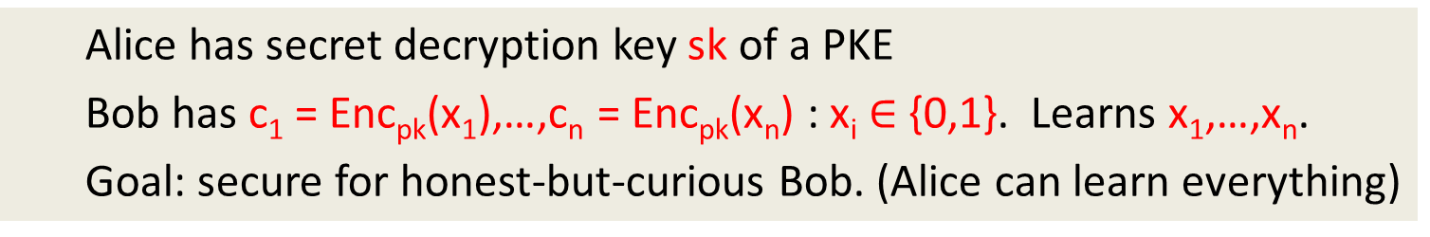
SFE for Decryption
  Alice has secret decryption key sk of a PKE
  Bob has c₁ = Enc_{pk}(x₁),…,c_{n} = Enc_{pk}(x_{n}) : x_{i} $∈$ {0,1}. Learns x₁,…,x_{n}.
  Goal: secure for honest-but-curious Bob. (Alice can learn everything)
Alice chooses hk $←$ Gen(0) for SSB hash
Bob chooses random bits r₁,…,r_{n} $←$ $\$$,
creates a SSB hash z=H_{hk}((c₁ ,r₁),…,(c_{n}, r_{n})). Sends z to Alice.
Alice “obfuscates” $\tilde{C}←𝒪$(C[hk, k, z]), sends $\tilde{C}$ to Bob.
C[hk,sk,z](i, (c, r), $π$) {
Verify_{hk}(i, (c, r), $π$, z)
Output Decs_{k}(). }
Bob evaluates $\tilde{C}$(i, (c_{i} , r_{i}), $π$_{i} ) for i = 1,…,n.
Security proof: same ideas as
In the PRF case.

Slide 29
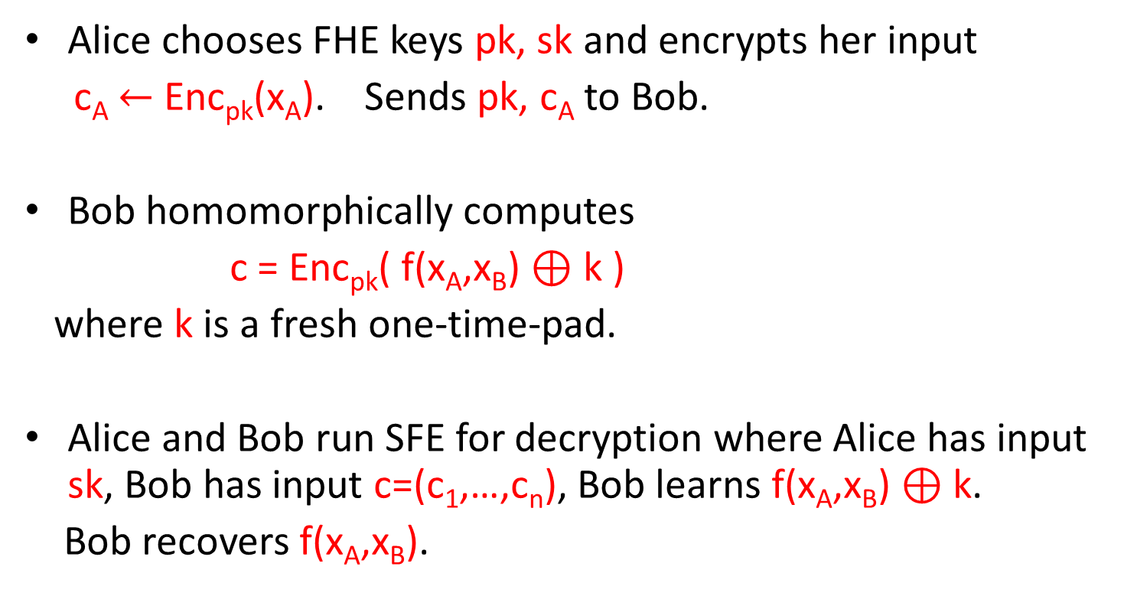
General Honest-but-Curious SFE
  Alice has input x_{A} , Bob has input x_{B} and Bob should learn f(x_{A}, x_{B})
Alice chooses FHE keys pk, sk and encrypts her input
c_{A} $←$ Enc_{pk}(x_{A}). Sends pk, c_{A} to Bob.
Bob homomorphically computes
c = Enc_{pk}( f(x_{A},x_{B}) $⊕$ k )
where k is a fresh one-time-pad.
Alice and Bob run SFE for decryption where Alice has input sk, Bob has input c=(c₁,…,c_{n}), Bob learns f(x_{A},x_{B}) $⊕$ k.
Bob recovers f(x_{A},x_{B}).
Communication:
O(|x_{A}|)

Slide 30
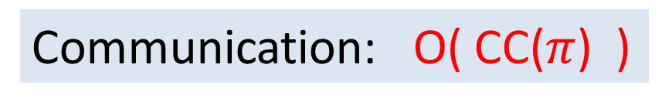
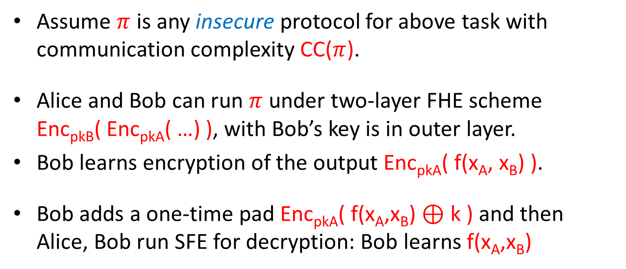
General Honest-but-Curious SFE II
  Alice has input x_{A} , Bob has input x_{B} and Bob should learn f(x_{A}, x_{B})
Assume $π$ is any insecure protocol for above task with communication complexity CC($π$).
  Alice and Bob can run $π$ under two-layer FHE scheme Enc_{pkB}( Enc_{pkA}( …) ), with Bob’s key is in outer layer.
  Bob learns encryption of the output Enc_{pkA}( f(x_{A}, x_{B}) ).
Bob adds a one-time pad Enc_{pkA}( f(x_{A},x_{B}) $⊕$ k ) and then Alice, Bob run SFE for decryption: Bob learns f(x_{A},x_{B})
Communication: O( CC($π$) )

Slide 31
Summary: Positive Results
In the honest-but-curious setting, communication complexity of SFE matches that of insecure protocols (security is free).
Same ideas give a communication efficient protocol in the malicious setting in the common random string (CRS) model.
  The simulator can choose CRS after knowing input/output of corrupted party.

Slide 32
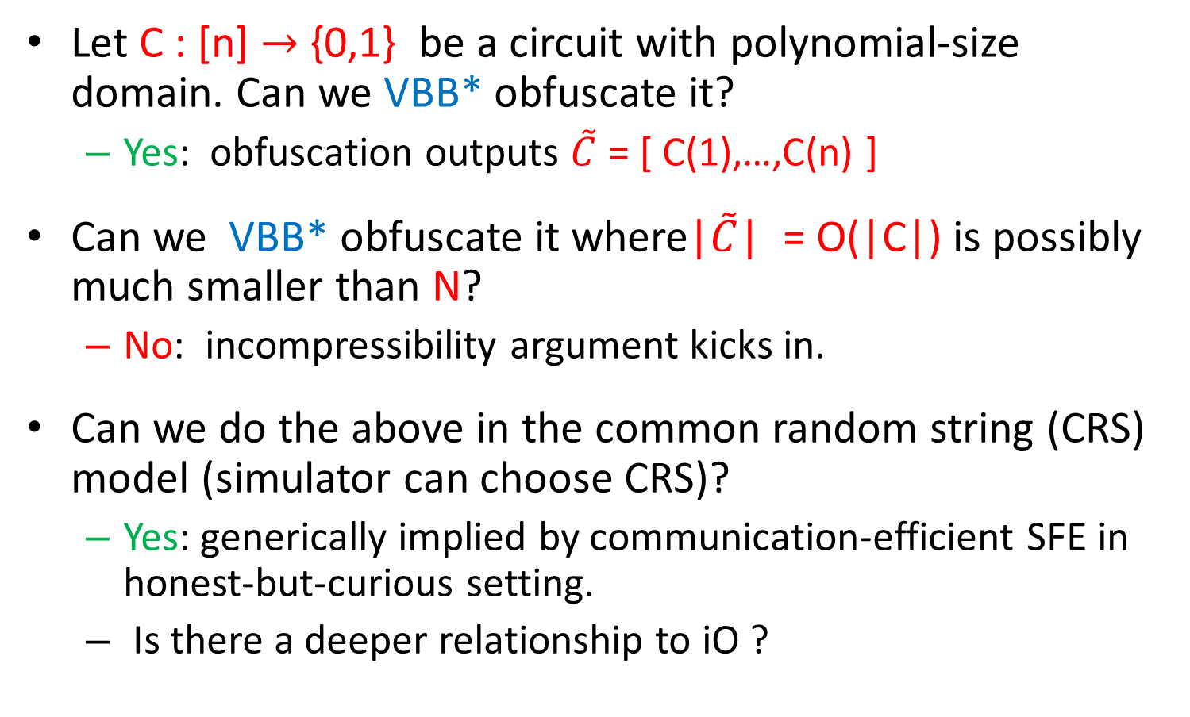
Communication-Efficient SFE vs. Obfuscation
Let C : [n] $→$ {0,1} be a circuit with polynomial-size domain. Can we VBB* obfuscate it?
  Yes: obfuscation outputs $\tilde{C}$ = [ C(1),…,C(n) ]
Can we VBB* obfuscate it where|$\tilde{C}$| = O(|C|) is possibly much smaller than N?
  No: incompressibility argument kicks in.
  Can we do the above in the common random string (CRS) model (simulator can choose CRS)?
  Yes: generically implied by communication-efficient SFE in honest-but-curious setting.
  Is there a deeper relationship to iO ?
VBB* : can simulate obfuscated circuit
given black-box access to C.

Slide 33
Conclusions
In general SFE, communication has to exceed output size in the malicious setting or even honest-but-deterministic setting, but not in the honest-but-curious setting.
  Does positive result require iO? Or can we do it under better assumptions?
  Could we get communication-efficient SFE in the malicious setting with some weaker security than simulation?
New tool: somewhere statistically binding (SSB) hash.
  Other applications?

