Slide 1
Two Round MPC via Multi-Key FHE
Daniel Wichs (Northeastern University)
Joint work with Pratyay Mukherjee

Slide 2


Multi-Party Computation
Arbitrary number of
corruptions.
f(x₁,…,x_{n})
Goal:
Correctness: Everyone computes f(x₁,…,x_{n})
Security: Nothing else revealed

Slide 3
Motivating Questions
Construct MPC with minimal round complexity.
Construct MPC directly using FHE techniques.

Slide 4
Round Complexity
Ideally: 2 is best we can hope for
Know: 4 from OT [BMR90,KOS03,AIK05,…], 3 from LWE [AJLTVW12], 2 with iO [GGHR14].
This talk: 2 from LWE.
* Results in CRS model, needed for malicious security.
Results require NIZKs for malicious security.

Slide 5
MPC from FHE
Parties run distributed key generation of FHE scheme: agree on a common public key pk, each party gets a secret-share of sk.
Each party i broadcasts c_{i} = Enc_{pk}(x_{i}). The parties run homomorphic evaluation to get c* = Enc_{pk}( f(x₁,…,x_{n}) ).
Parties run a distributed decryption to recover y = f(x₁,…,x_{n}).
For the FHE schemes of [BV11,BGV12] we can directly construct distributed key generation and decryption in 1 round each. Yields a 3 round MPC [AJLTVW12].

Slide 6
MPC from Multi-Key FHE
Each party i chooses pk_{i}, sk_{i} broadcasts c_{i} = Enc_{pki}(x_{i}). All parties run a multi-key FHE eval to get c* = Enc_{pk1,…,pkn}( f(x₁,…,x_{n}) ).
Parties run a distributed decryption to recover y = f(x₁,…,x_{n}).
Multi-key FHE defined by [Lopez Alt-Tromer-Vaikuntanathan 12], construction from NTRU. No “nice” distributed decryption.
Recent: multi-key FHE from LWE [Clear-McGoldrick 14].
This work: simplify multi-key FHE from LWE construction and show 1 round distributed decryption. Get 2 round MPC.

Slide 7
Gentry-Sahai-Waters FHE
Multi-Key FHE
(variant of Clear-McGoldrick)
2-round MPC

Slide 8
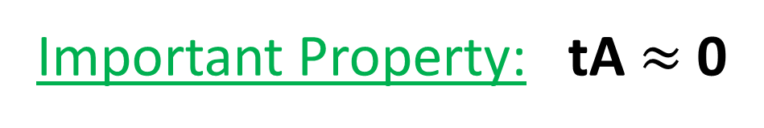
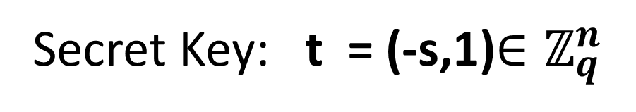
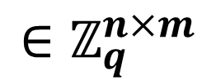
The GSW FHE: Key Generation
m
B
Public Key: A =
n
$$∈ℤ_{q}^{n×m}$$
b = sB+e
Secret Key: t = (-s,1)$∈ℤ_{q}^{n}$
Important Property: tA $≈$ 0

Slide 9
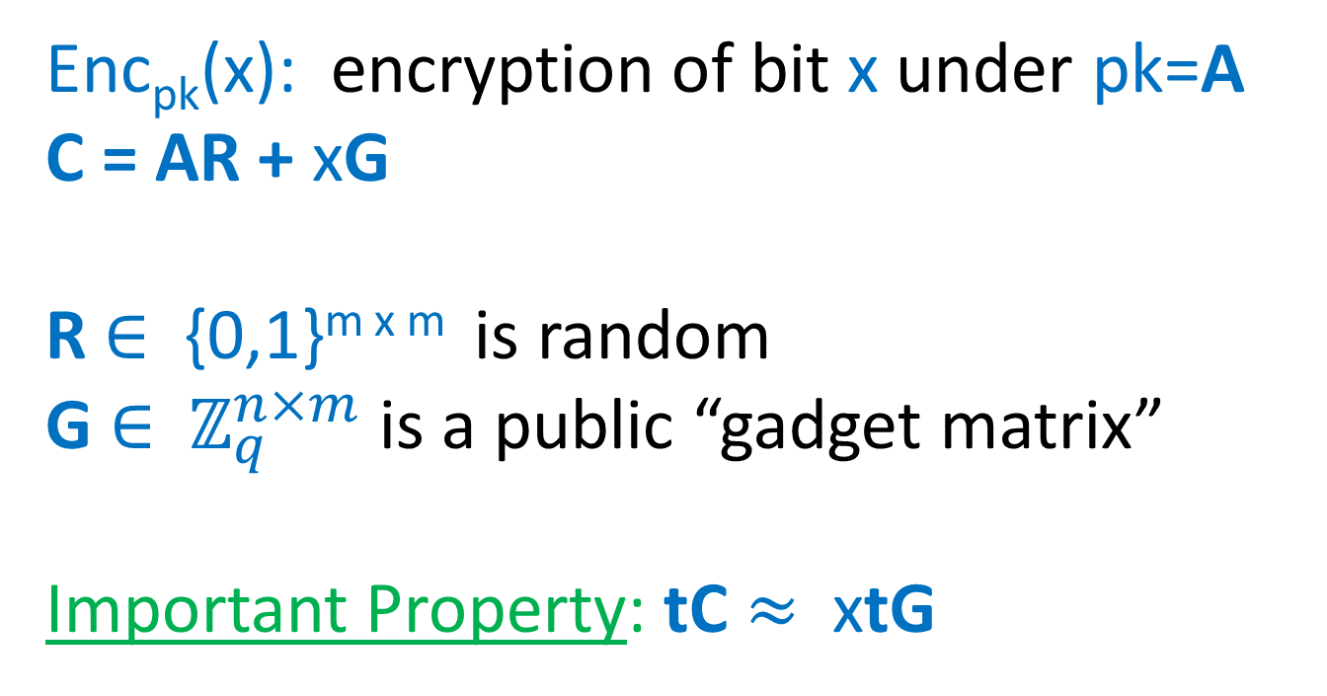
The GSW FHE: Encryption
Enc_{pk}(x): encryption of bit x under pk=A
C = AR + xG
R $∈$ {0,1}^{m x m} is random
G $∈$ $ℤ_{q}^{n×m}$ is a public “gadget matrix”
Important Property: tC $≈$ xtG

Slide 10
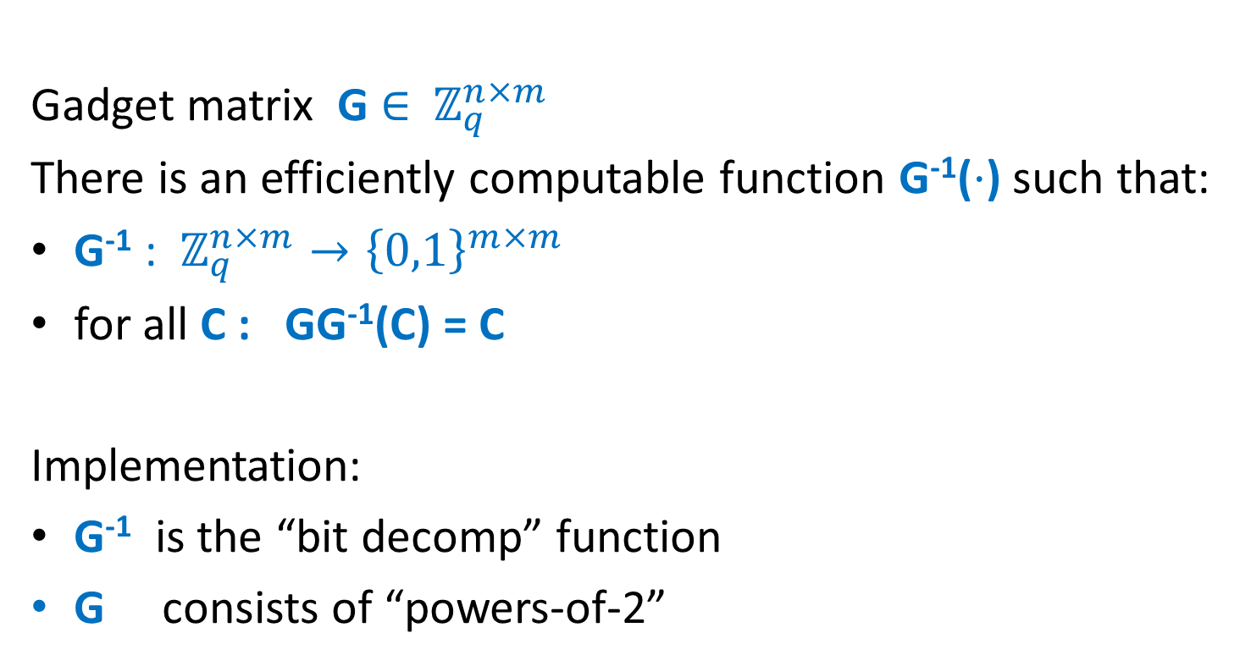
Gadget Matrix G
[Micciancio-Peikert ’12]
Gadget matrix G $∈$ $ℤ_{q}^{n×m}$
There is an efficiently computable function G⁻¹($⋅$) such that:
G⁻¹ : $ℤ_{q}^{n×m}→{\left\{0,1\right\}}^{m×m}$
for all C : GG⁻¹(C) = C
Implementation:
G⁻¹ is the “bit decomp” function
G consists of “powers-of-2”

Slide 11
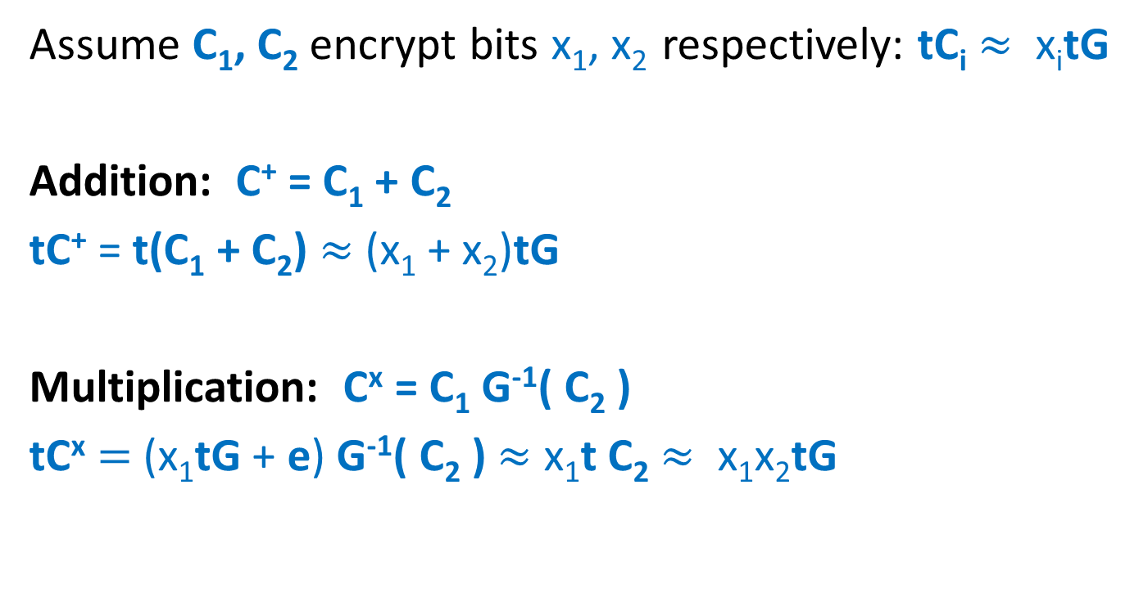
The GSW FHE: Evaluation
Assume C₁, C₂ encrypt bits x₁, x₂ respectively: tC_{i} $≈$ x_{i}tG
Addition: C⁺ = C₁ + C₂
tC⁺ = t(C₁ + C₂) $≈$ (x₁ + x₂)tG
Multiplication: C^{x} = C₁ G⁻¹( C₂ )
tC^{x} $=$ (x₁tG + e) G⁻¹( C₂ ) $≈$ x₁t C₂ $≈$ x₁x₂tG

Slide 12
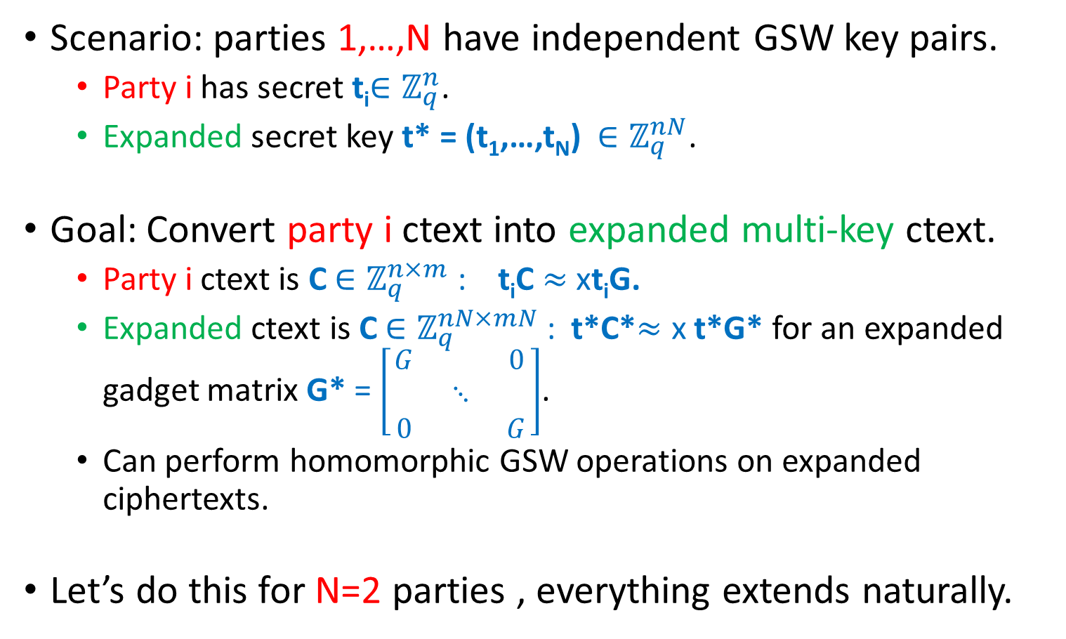
Multi-Key Version of GSW
Scenario: parties 1,…,N have independent GSW key pairs.
  Party i has secret t_{i}$∈ℤ_{q}^{n}$.
  Expanded secret key t* = (t₁,…,t_{N}) $∈ℤ_{q}^{nN}$.
Goal: Convert party i ctext into expanded multi-key ctext.
  Party i ctext is C $∈ℤ_{q}^{n×m}$ : t_{i}C $≈$ xt_{i}G.
  Expanded ctext is C $∈ℤ_{q}^{nN×mN}$ : t*C*$≈$ x t*G* for an expanded gadget matrix G* = $\left[\begin{matrix}G & & 0 \\ & ⋱ & \\ 0 & & G\end{matrix}\right]$.
  Can perform homomorphic GSW operations on expanded ciphertexts.
Let’s do this for N=2 parties , everything extends naturally.

Slide 13
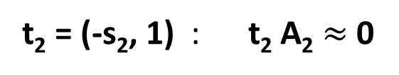
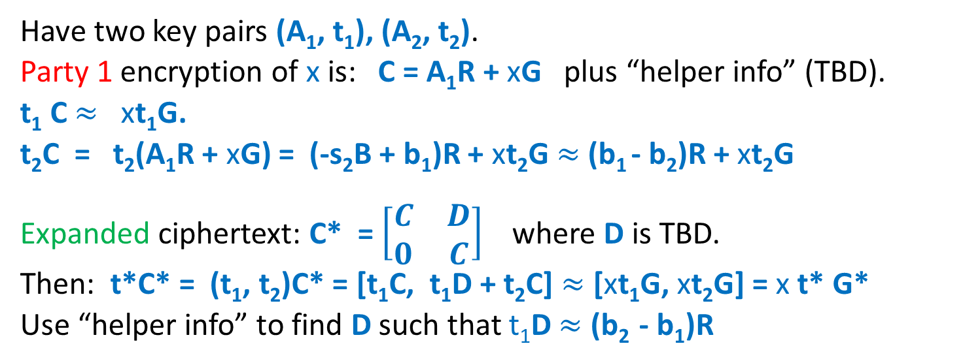
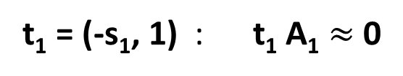
Ciphertext Expansion
B
B
A₁ =
A₂ =
b₁ = s₁B+e₁
b₂ = s₂B+e₂
t₁ = (-s₁, 1) : t₁ A₁ $≈$ 0
t₂ = (-s₂, 1) : t₂ A₂ $≈$ 0
Have two key pairs (A₁, t₁), (A₂, t₂).
Party 1 encryption of x is: C = A₁R + xG plus “helper info” (TBD).
t₁ C $≈$ xt₁G.
t₂C = t₂(A₁R + xG) = (-s₂B + b₁)R + xt₂G $≈$(b₁ - b₂)R + xt₂G
Expanded ciphertext: C* = $\left[\begin{matrix}C & D \\ 0 & C\end{matrix}\right]$ where D is TBD.
Then: t*C* = (t₁, t₂)C* = [t₁C, t₁D + t₂C] $≈$ [xt₁G, xt₂G] = x t* G*
Use “helper info” to find D such that t₁D $≈$ (b₂ - b₁)R

Slide 14
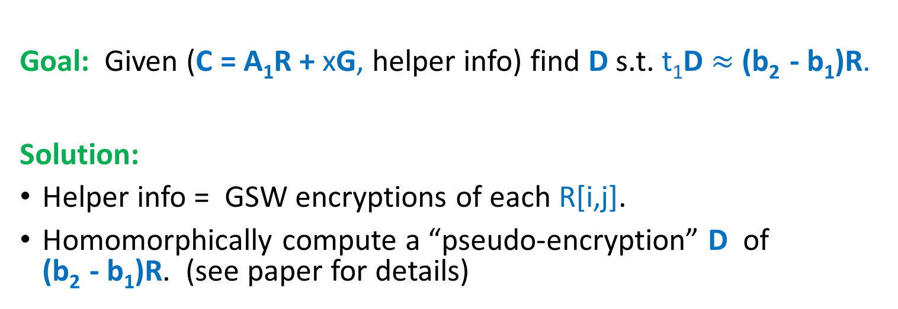
Ciphertext Expansion
B
B
A₁ =
A₂ =
b₁ = s₁B+e₁
b₂ = s₂B+e₂
t₁ = (-s₁, 1) : t₁ A₁ $≈$ 0
t₂ = (-s₂, 1) : t₂ A₂ $≈$ 0
Goal: Given (C = A₁R + xG, helper info) find D s.t. t₁D $≈$ (b₂ - b₁)R.
Solution:
Helper info = GSW encryptions of each R[i,j].
Homomorphically compute a “pseudo-encryption” D of (b₂ - b₁)R. (see paper for details)

Slide 15
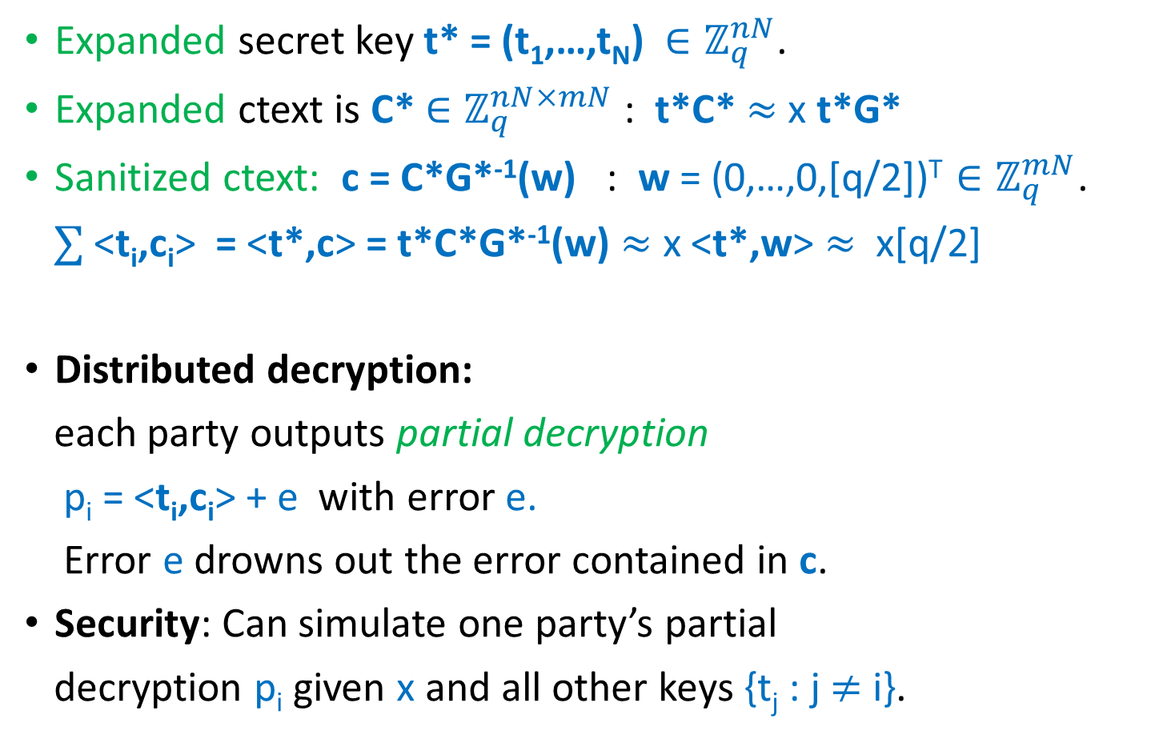
One-Round Distributed Decryption
  Expanded secret key t* = (t₁,…,t_{N}) $∈ℤ_{q}^{nN}$.
Expanded ctext is C* $∈ℤ_{q}^{nN×mN}$ : t*C* $≈$ x t*G*
Sanitized ctext: c = C*G*⁻¹(w) : w = (0,…,0,[q/2])^{T} $∈ℤ_{q}^{mN}$.
$∑$ <t_{i},c_{i}> = <t*,c> = t*C*G*⁻¹(w) $≈$ x <t*,w> $≈$ x[q/2]
Distributed decryption:
each party outputs partial decryption
p_{i} = <t_{i},c_{i}> + e with error e.
Error e drowns out the error contained in c.
Security: Can simulate one party’s partial
decryption p_{i} given x and all other keys {t_{j} : j $≠$ i}.
c₁
c =
…
nN
c_{N}

Slide 16
Putting it all together
Each party i chooses pk_{i}, sk_{i} broadcasts c_{i} = Enc_{pki}(x_{i}). All parties run a multi-key FHE eval to get c* = Enc_{pk1,…,pkn}( f(x₁,…,x_{n}) ).
Parties run a distributed decryption to recover y = f(x₁,…,x_{n}).
Secure for “all-but-one” corruption. Minor modifications are needed to prove security for arbitrary corruption.
Need NIZKs for malicious security (but no coin flipping).
Questions:
  Can we get rid of the CRS in honest-but-curious setting?
  Can we get 2 or even 3 rounds under different/weaker assumptions?

Slide 17
Thank you

