Slide 1
Learning Support Order for Manipulation in Clutter
Swagatika Panda, A.H. Abdul Hafez, C.V. Jawahar
Center for Visual Information Technology, IIIT-Hyderabad , India

Slide 2

What is clutter??

Slide 3
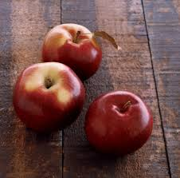
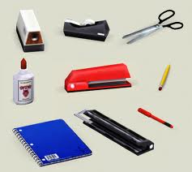
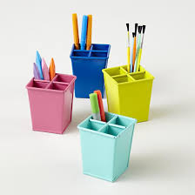
What is clutter??
Extremely cluttered
Spatial Isolation, single plane

Slide 4
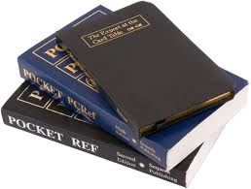
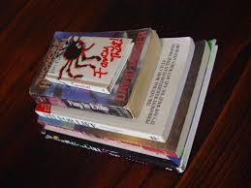
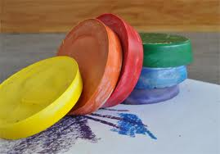
What is clutter??
Extremely cluttered
Spatial Isolation, single plane

Slide 5
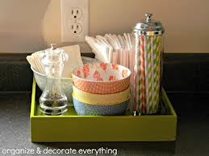
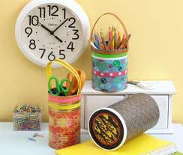
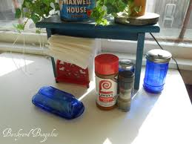
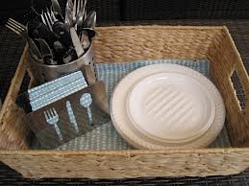
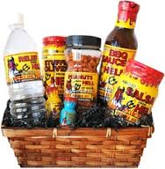
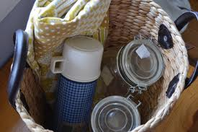

What is clutter??
Extremely cluttered
Spatial Isolation, single plane

Slide 6
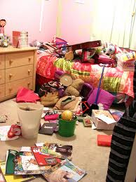
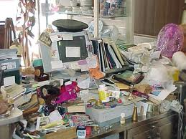
What is clutter??
Extremely cluttered
Spatial Isolation, single plane

Slide 7
What is clutter??
Extremely cluttered
Spatial Isolation, single plane
Grasping applications

Slide 8
What makes our job difficult ??

Slide 9
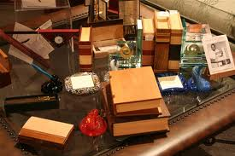
Different degrees of complexity
What makes our job difficult ??

Slide 10
Different degrees of complexity
Objects of complex shapes and varying sizes
What makes our job difficult ??

Slide 11

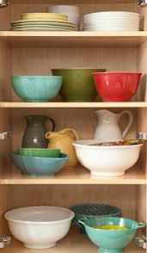
Different degrees of complexity
Objects of complex shapes and varying sizes
What makes our job difficult ??
Different types of interaction

Slide 12
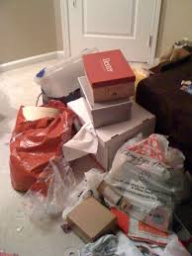
Different degrees of complexity
Objects of complex shapes and varying sizes
What makes our job difficult ??
Static objects in the background
Different types of interaction

Slide 13
How can the robot pick my stuff ??

Slide 14

How can the robot pick my stuff ??
Segment out the object(s)

Slide 15

How can the robot pick my stuff ??
Segment out the object(s)
Use efficient grasping technique

Slide 16
How can the robot pick my stuff ??
Segment out the object(s)
Use efficient grasping technique
Infer semantic interaction among objects

Slide 17

How can the robot pick my stuff ??
Segment out the object(s)
Use efficient grasping technique
Infer semantic interaction among objects
Remove the surrounding objects!

Slide 18
How can the robot pick my stuff ??
Segment out the object(s)
Use efficient grasping technique
Infer semantic interaction among objects
Remove the surrounding objects!
  Identify the supported objects …
  Remove them without causing damage to the environment.

Slide 19
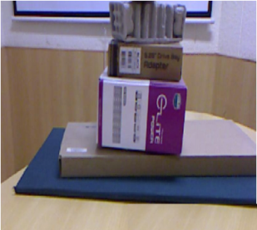


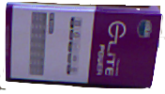
Our Goal …
Infer support relationship & derive a sequence in which the surrounding objects of our object of interest should be removed while causing minimal damage to the environment.
i.e.,
Learn the Support Order for the object of interest
1
2
3

Slide 20


Some of the recent work …
Support by multiple objects
Support in Hierarchy
Semantic interaction
Physical Contact
Clutter in real-world
Noisy background
^{Dogar and Srinivasa, RSS 11}
^{Dogar et al., RSS 12}
Rosman and Ramamoorthy, IJRR 11
^{Sjoo and Jensfelt, IROS 11}
^{Silberman et al., ECCV 12}

Slide 21
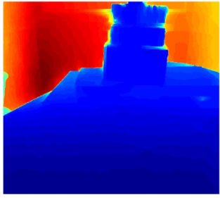
The framework …
RGB Image
Depthmap
Input: RGB Image and Depthmap captured using Kinect.

Slide 22
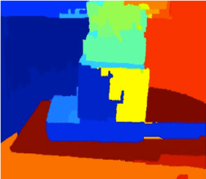
The framework …
RGB Image
Segmentation
SegmentedImage
Depthmap
Segmentation: Over-segmentation using Arbelaez et al. (PAMI’11)
Hierarchical segmentation using Hoiem et al. (IJCV’11)

Slide 23
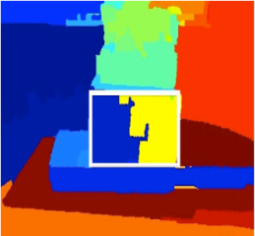
The framework …
RGB Image
Segmentation
SegmentedImage
Depthmap
Object Detection
Object of interest
Detected Region
Object Detection: SIFT feature matching.
RANSAC applied to discard outliers.
Matching segmented regions are merged.

Slide 24

The framework …
RGB Image
Support Matrix
Support Inference
Segmentation
SegmentedImage
Object Detection
Depthmap
Object Detection
Object of interest
Detected Region
Support Inference: Infers support relationships among the regions and stores in a support matrix.

Slide 25
The framework …
RGB Image
Support Matrix
Support Inference
1
Segmentation
Support order prediction
2
SegmentedImage
3
Depthmap
Object Detection
Output Object Sequence
Object of interest
Detected Region
Support Order Prediction: Support relationship captured in a tree.
Identification of scenarios to avoid damage.
Tree traversal to generate Support Order.

Slide 26
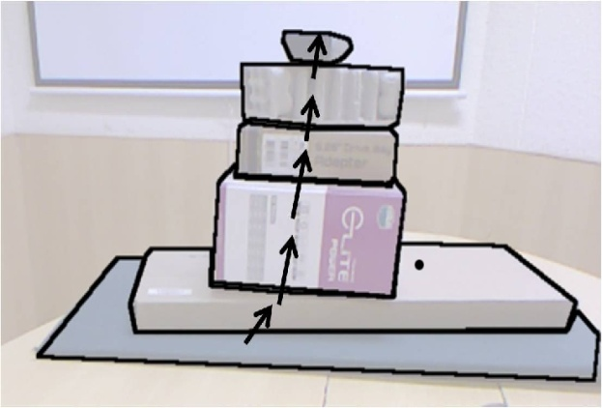
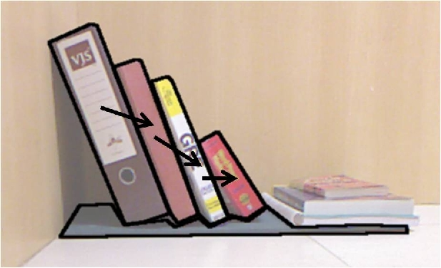
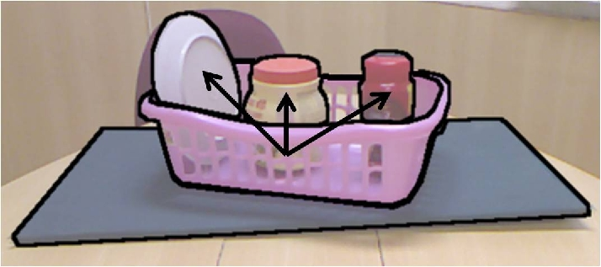
Types of support relationships …
Support from Below
Support from Side
Containment

Slide 27
Support Inference
MAP Inference [Silberman etal., ECCV’12]
Inference methods
Rule Based Inference
Infer supporting region and support type for each region.
Denote hidden supporting region as -1 and floor as 0.
Use geometric features f(i,j)
i : supported region, j: supporting region

Slide 28
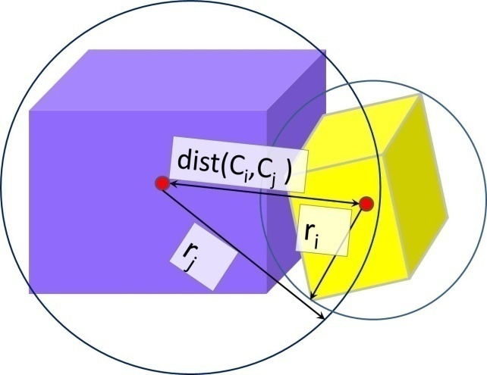
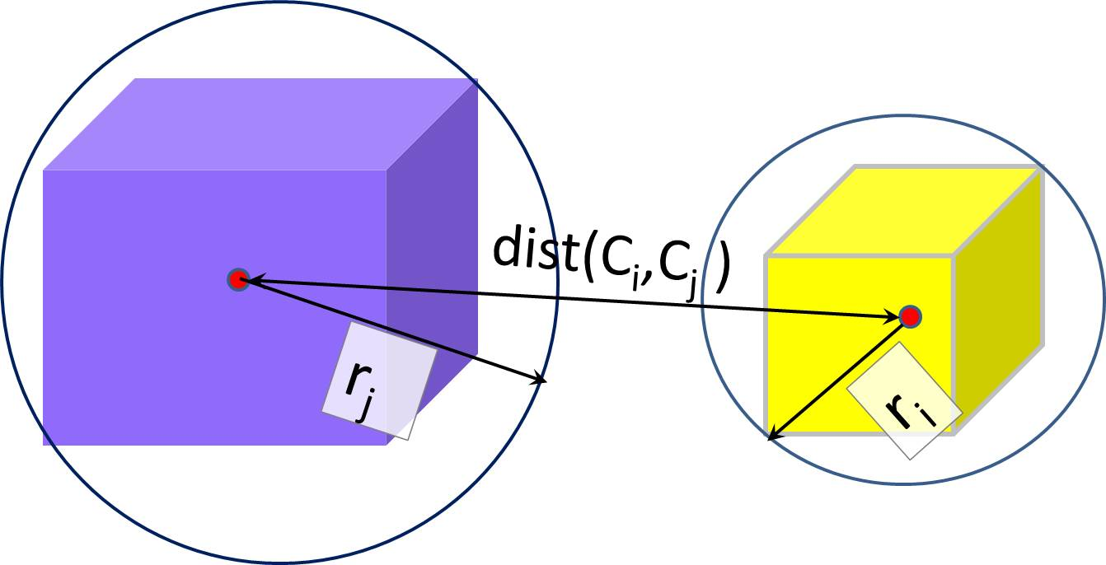
Features…
Close Proximity, f_{p} < 1
Proximity
At distance, f_{p} > 1

Slide 29
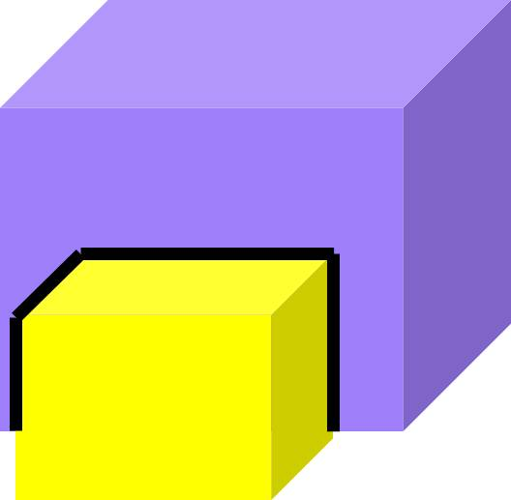
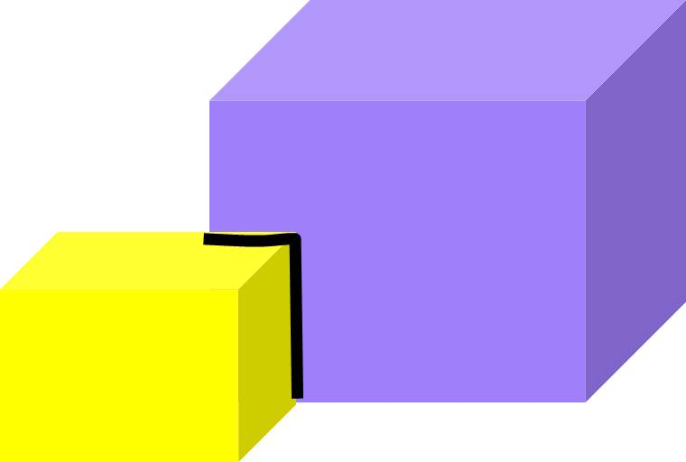
Features…
Significant overlap
Proximity
Boundary Ratio
Less overlap

Slide 30
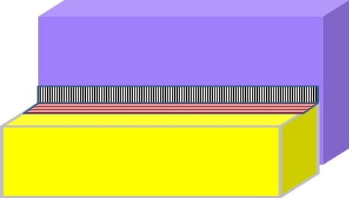
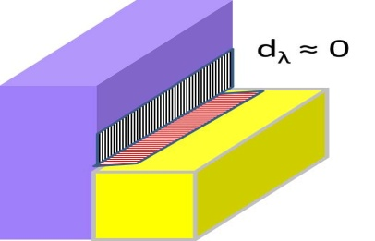
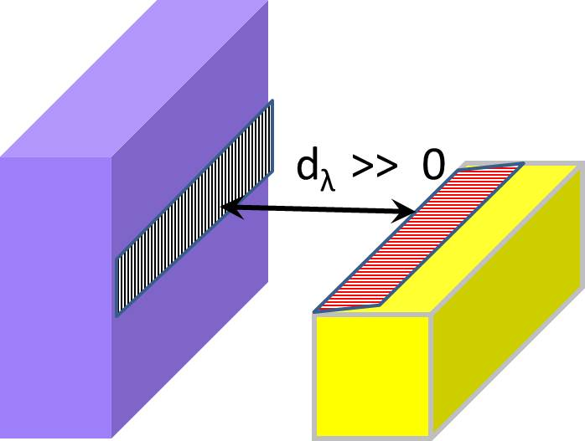
Features…
Visual Occlusion
Proximity
Boundary Ratio
Side view: actual contact
Depth Boundary
Side view: no contact
¹
¹ Mishra et al., “Segmenting simple objects using RGB-D”, ICRA’12

Slide 31

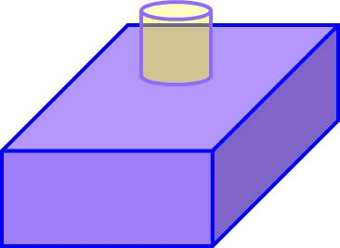
Features…
Containment
Proximity
Boundary Ratio
Depth Boundary
No containment
Containment

Slide 32
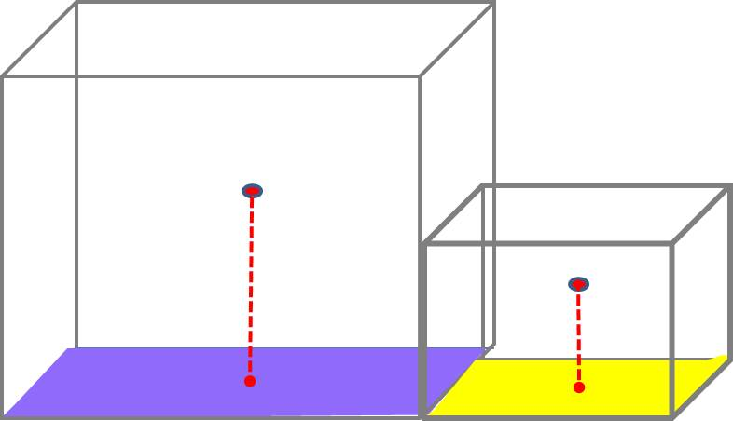
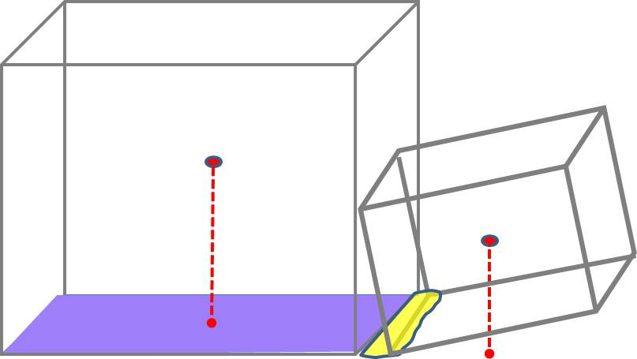
Features…
Stable object
Proximity
Boundary Ratio
Depth Boundary
Containment
Unstable object
Relative Stability

Slide 33
MAP support inference approach*
where,
S: supporting region
T: support type
M: structure class
^{Limitation:}
does not allow support by multiple objects
not designed for grasping applications
assumption that the supporting region is significantly larger than the supported regions.
* Silberman et al., “Indoor segmentation and support inference from RGBD images”, in ECCV, 2012

Slide 34
Rule based support inference approach
Structure class classification* to predict structure class:
Floor, Walls, Furniture, graspable objects
Identify graspable objects to avoid infeasible support relations.
For a region, find Support from below using Proximity fp and Boundary Ratio fbr.
Find containment by using 3D convex hull using containment feature fcnt
Find Support from side by finding regions in contact
(depth boundary, fd) that are not supported from below, but are stable (fstab).
* Silberman et al., “Indoor segmentation and support inference from RGBD images”, in ECCV, 2012

Slide 35
Beyond pairwise support relations …
4.1
3.1
2.1
2.2
1.1
1.3
1.2
O
Case1 : Support In Hierarchy

Slide 36
Beyond pairwise support relations …
2.1
2.2
2.3, 3.1
3.2
2.4
2.5
1.1
1.2
O
Case 2 : Simultaneous support in multiple hierarchy

Slide 37
Beyond pairwise support relations …
1.1
^{2.1}
1.2
1.3
O
^{2.2}
^{2.3}
O
^{1.1}
^{O}
Case 3 : Containment

Slide 38
Support Order Prediction…
O
O₉
O₃
O₅
O₆
O₈
O₁
O₄
O₇
O₈
O₂
O₁
O₄
O₇
O₂
O₅
O₆
O₉
O
O₃
Build Tree of Support
O
O₁
O₂
Root
Supporting Region
SupportedRegion

Slide 39
Support Order Prediction…
O
O₉
O₃
O₅
O₆
O₈
O₁
O₄
O₇
O₈
O₂
O₁
O₄
O₇
O₂
O₅
O₆
O₉
O
O₃
Build Tree of Support
Prune the redundant edges

Slide 40
Support Order Prediction…
O
O₉
O₃
O₅
O₆
O₈
O₁
O₄
O₇
O₈
O₂
O₁
O₄
O₇
O₂
O₅
O₆
O₉
O
O₃
Build Tree of Support
Prune the redundant edges
Skip the contained objects

Slide 41
Support Order Prediction…
O
O₉
O₃
O₅
O₆
O₈
O₁
O₄
O₇
O₈
O₂
O₁
O₄
O₇
O₂
O₅
O₆
O₉
O
O₃
Build Tree of Support
Prune the redundant edges
Skip the contained objects
Perform Reverse Level Order Tree Traversal

Slide 42
Support Order Prediction…
O
O₉
O₃
O₅
O₆
O₈
O₁
O₄
O₇
O₈
O₂
O₁
O₄
O₇
O₂
O₅
O₆
O₉
O
O₃
Build Tree of Support
Prune the redundant edges
Skip the contained objects
Perform Reverse Level Order Tree Traversal
Support Order: O3 → O9 → O2 → O8 → O7 → O4 → O1 → O

Slide 43
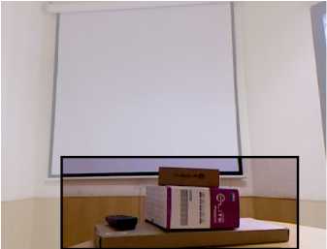
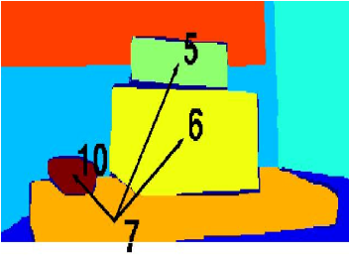
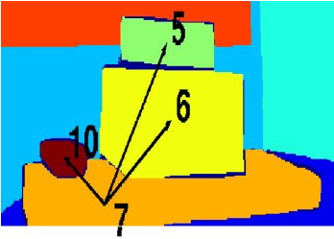
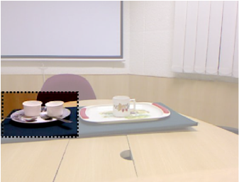
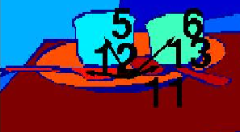
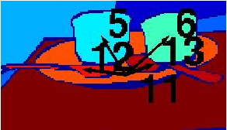
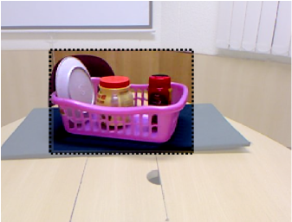
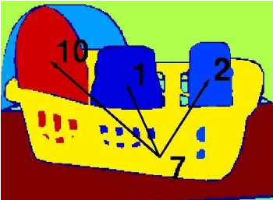
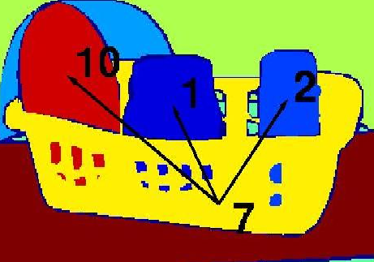
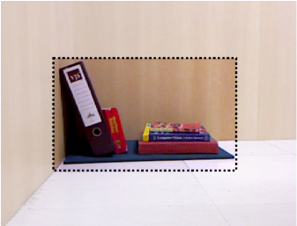
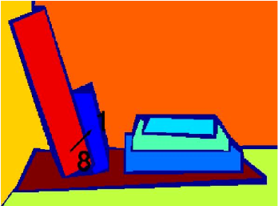
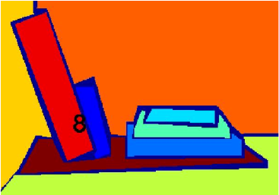
Results
R: 5 10 6 7
M: 5 10 6 7
Support from Below
R: 6 13 12 5 11
M: 6 13 12 5 11
Containment
R: 7
M: 7
Support from Side
R: 1 8
M: 8
Input Images
Rule based Inference
MAP Inference
Support order prediction

Slide 44
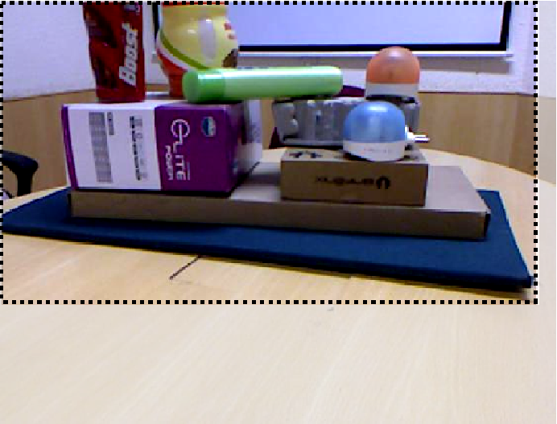
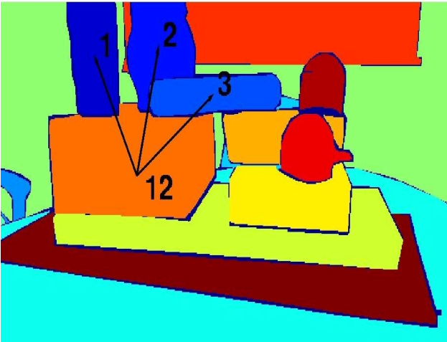
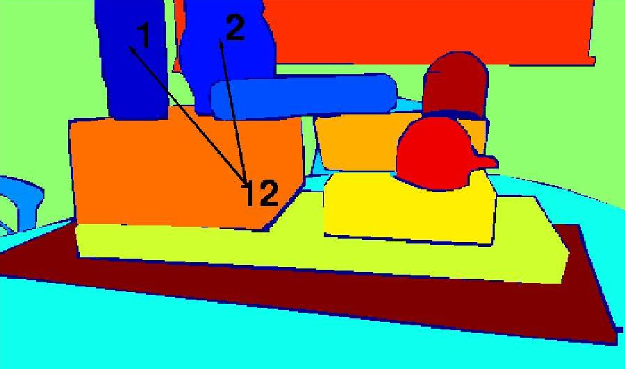


Demonstration of support by multiple objects
Input Images
Rule based Inference
MAP Inference

Slide 45
Dependency on Structure class prediction
False Positive
Chair classified as Graspable object
Missed support
Book classified as furniture
Input Image
Rule based Inference
MAP Inference

Slide 46
Accuracy of Support Inference
Region Source | Ground Truth |  | Segmentation
Inference Type | Type Agnostic | Type Aware | Type Agnostic | Type Aware
Rule based | 66.2 | 56.1 | 35.1 | 32.4
MAP Inference | 65.8 | 48.0 | 32.1 | 30.5

Slide 47
Limitations…
Limitations in segmentation
Failure in support inference at some settings
    baseline of supporting object invisible,
    supporting object is unstable,
    entire surface area of supporting object invisible

Slide 48
Future Work …
Improvement in Segmentation
Support Order Prediction using multiple views
Support Order Prediction in more complex settings
Extension to real-time grasping application
Exploring more types of support relationships

Slide 49

Thank You!

