Slide 1
Learning Semantic Interaction among Graspable Objects
Swagatika Panda, A.H. Abdul Hafez, C.V. Jawahar
Center for Visual Information Technology, IIIT-Hyderabad , India

Slide 2
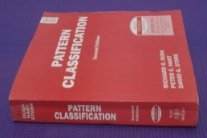


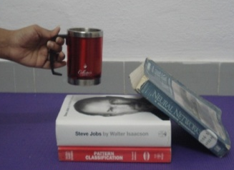
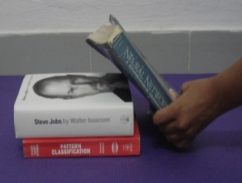
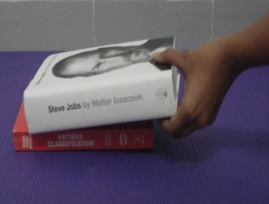
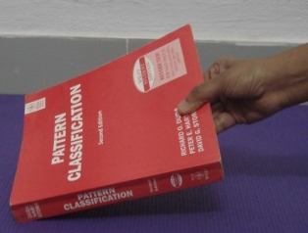
How do we pick objects …
Possibility of Damage
Objects are removed in an order
AIM
Automatically find the order (Support Order)using RGBD data.

Slide 3
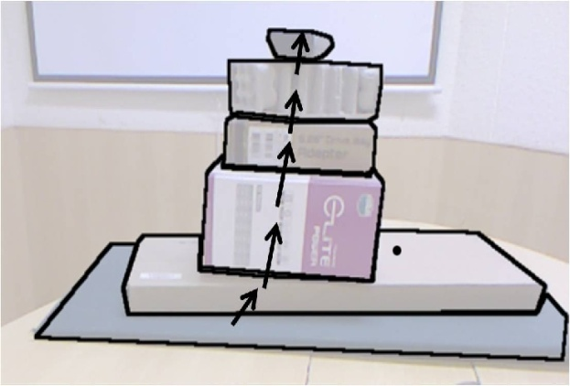
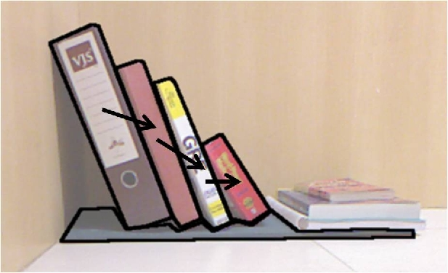
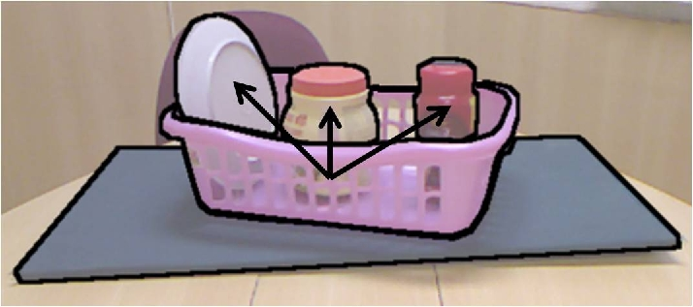
Types of support relationships …
Support from Below
Support from Side
Containment

Slide 4
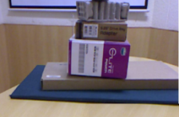
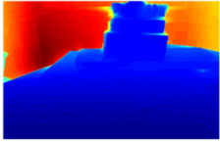
The framework …
RGB Image
Depthmap
Input: RGB Image and Depthmap captured using Kinect.

Slide 5
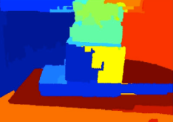
The framework …
RGB Image
Segmentation
Segmented Image
Depthmap
Segmentation: Over-segmentation using Arbelaez et al. (PAMI’11)
Hierarchical segmentation using Hoiem et al. (IJCV’11)

Slide 6
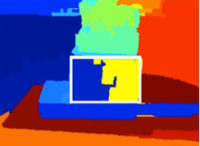
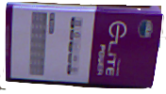
The framework …
RGB Image
Segmentation
Object Detection
Segmented Image
Detected Region
Depthmap
Object of interest
Object Detection: SIFT feature matching.
RANSAC applied to discard outliers.
Matching segmented regions are merged.

Slide 7

The framework …
RGB Image
Segmentation
Object Detection
Segmented Image
Detected Region
Depthmap
Object of interest
Support Matrix
Support Inference
Tree of Support
Support Inference: Infers support relationships among the regions and stores in a support matrix.

Slide 8


The framework …
RGB Image
Segmentation
Object Detection
Segmented Image
Detected Region
Depthmap
Object of interest
1
2
Support order prediction
Support Matrix
Support Inference
Tree of Support
3
Support Order
Support Order Prediction: Support relationship captured in a tree.
Identification of scenarios to avoid damage.
Tree traversal to generate Support Order.

Slide 9


Support Inference
Tree of Support
Structure class Classifier
Graspable objects {O_{i}}
(O_{i} – pa(O_{in}), O_{in})
Support Classifier
{O_{s}}
Object of interest O(O_{in})
O_{in}
Segmented Image
Out
In
Floor, Wall, Furniture
Q
Support Matrix
Structure class classifier: Logistic Regression
Stochastic Gradient Descent Algorithm
4 classes:
Floor, Wall, Furniture, Graspable Objects

Slide 10
Support Inference
Tree of Support
Structure class Classifier
Graspable objects {O_{i}}
(O_{i} – pa(O_{in}), O_{in})
Support Classifier
{O_{s}}
Object of interest O(O_{in})
O_{in}
Segmented Image
Out
In
Floor, Wall, Furniture
Q
Support Matrix
Support classifier: 3-layer feed-forward neural network classifier
Hierarchical support inference
Given regions (A, B), predict if B supports A.
Support types:
from below/ from side/ containment/none

Slide 11
Support Inference
Tree of Support
Structure class Classifier
Graspable objects {O_{i}}
(O_{i} – pa(O_{in}), O_{in})
Support Classifier
{O_{s}}
Object of interest O(O_{in})
O_{in}
Segmented Image
Out
In
Floor, Wall, Furniture
Q
Support Matrix
Hierarchical Support Inference:
Begin with object of interest O.
Compare each object with other objects except its parents and grand-parents.
Iterate until Q is empty.
#comparisons: O(nlogn)

Slide 12

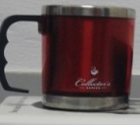



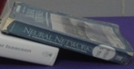












Illustration of Hierarchical Support Inference …
O_{in}
O_{out}
Support Matrix
Supported Region | Supporting Region | Support Type
 |  | Below
 |  | Below
 |  | Side

Slide 13
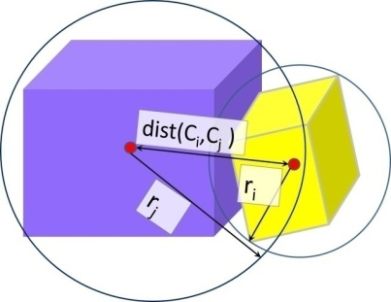
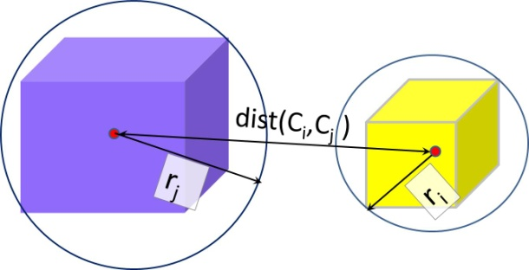


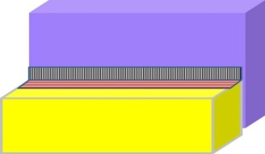
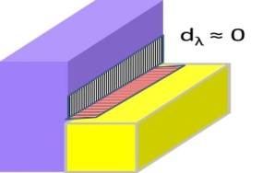
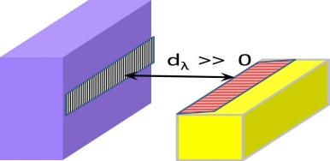

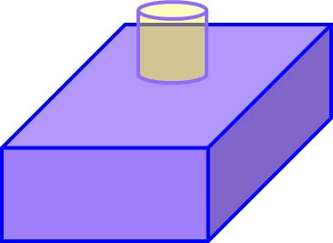
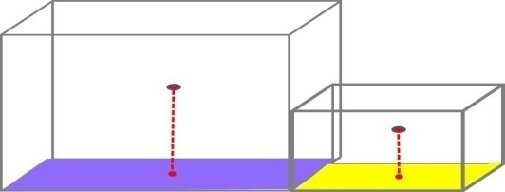
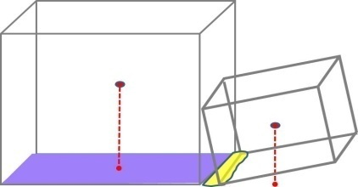
Features…
Significant overlap
Less overlap
Close Proximity, f_{p} < 1
At distance, f_{p} > 1
Proximity
Boundary Ratio
Visual Occlusion
Side view: actual contact
Side view: no contact
Containment
No containment
Depth Boundary
Containment
Stable object
Unstable object
Relative Stability

Slide 14
Beyond pairwise support relations …
4.1
3.1
2.1
2.2
1.1
1.3
1.2
O
Case1 : Support In Hierarchy

Slide 15
Beyond pairwise support relations …
2.1
2.2
2.3, 3.1
3.2
2.4
2.5
1.1
1.2
O
Case 2 : Simultaneous support in multiple hierarchy

Slide 16
Beyond pairwise support relations …
1.1
^{2.1}
1.2
1.3
O
^{2.2}
^{2.3}
O
^{1.1}
^{O}
Case 3 : Containment

Slide 17
Support Order Prediction…
O
O₉
O₃
O₅
O₆
O₈
O₁
O₄
O₇
O₈
O₂
O₁
O₄
O₇
O₂
O₅
O₆
O₉
O
O₃
Build Tree of Support
O
O₁
O₂
Root
Supporting Region
SupportedRegion

Slide 18
Support Order Prediction…
O
O₉
O₃
O₅
O₆
O₈
O₁
O₄
O₇
O₈
O₂
O₁
O₄
O₇
O₂
O₅
O₆
O₉
O
O₃
Build Tree of Support
Prune the redundant edges

Slide 19
Support Order Prediction…
O
O₉
O₃
O₅
O₆
O₈
O₁
O₄
O₇
O₈
O₂
O₁
O₄
O₇
O₂
O₅
O₆
O₉
O
O₃
Build Tree of Support
Prune the redundant edges
Skip the contained objects

Slide 20
Support Order Prediction…
O
O₉
O₃
O₅
O₆
O₈
O₁
O₄
O₇
O₈
O₂
O₁
O₄
O₇
O₂
O₅
O₆
O₉
O
O₃
Build Tree of Support
Prune the redundant edges
Skip the contained objects
Perform Reverse Level Order Tree Traversal

Slide 21
Support Order Prediction…
O
O₉
O₃
O₅
O₆
O₈
O₁
O₄
O₇
O₈
O₂
O₁
O₄
O₇
O₂
O₅
O₆
O₉
O
O₃
Build Tree of Support
Prune the redundant edges
Skip the contained objects
Perform Reverse Level Order Tree Traversal
Support Order: O3 → O9 → O2 → O8 → O7 → O4 → O1 → O

Slide 22
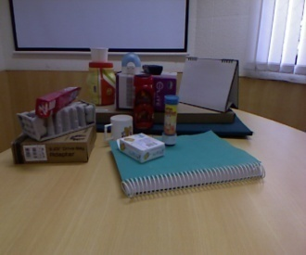
RGBD Dataset…
Collected 50 images in clutter using Kinect.
Data includes: RGB images, Depth maps, Point clouds
Data for individual objects at different orientation.
Annotation:
    Object Label
    Structure class Label
    Object instance Label
    Object Category Label

Slide 23
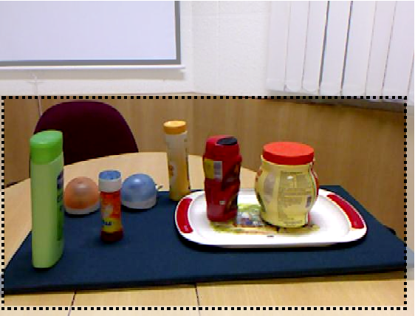
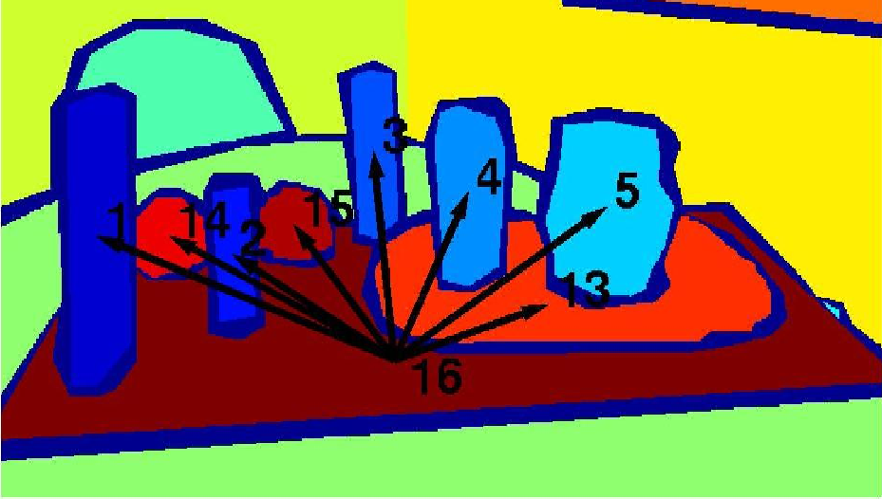
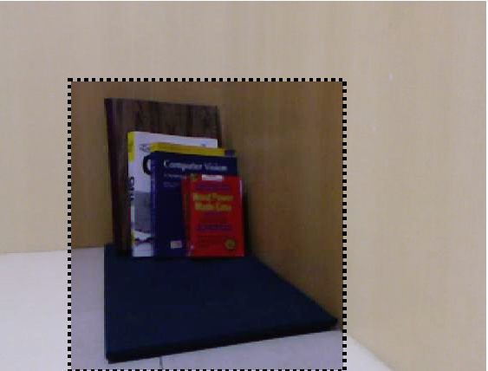
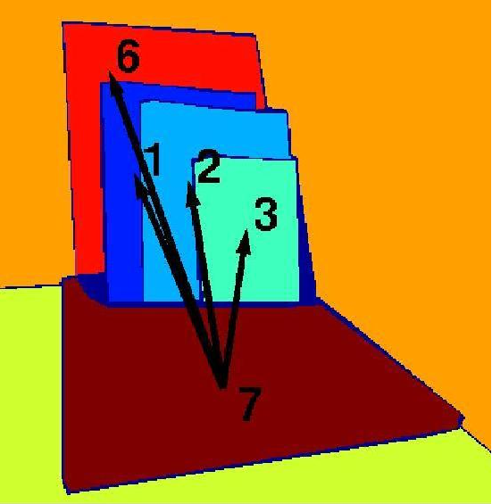
Results
Illustration of Support from Below
15 14 13 5 4 3 2 1 16
3 2 1 6 7

Slide 24
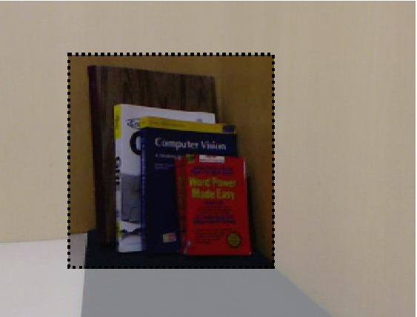

Results
Illustration of Support from Side
1
2
3 2 1
3
7
3 2 1 7
1
2
3

Slide 25
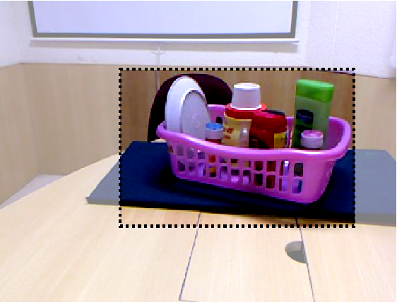
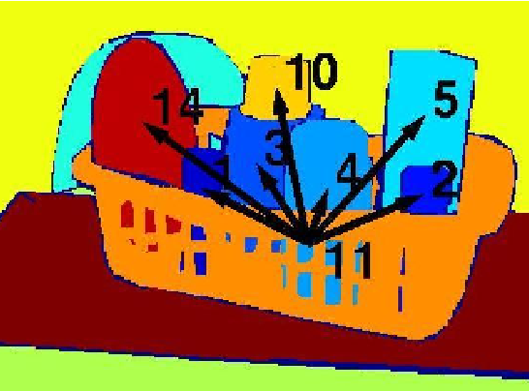
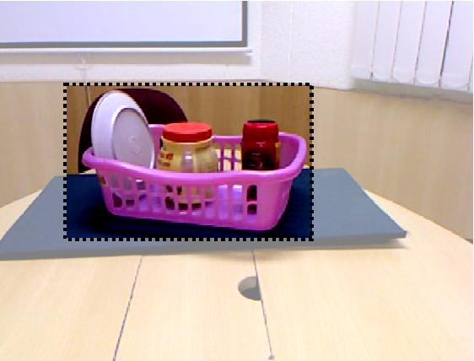
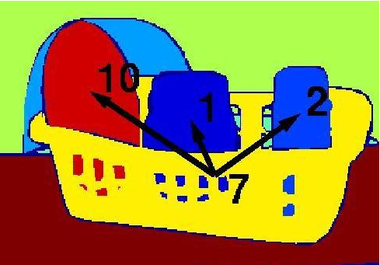
Results
Illustration of Containment
- 11
- 7

Slide 26
Accuracy of Support Inference
Inference | Structure class Inference |  | Support Class Inference
Type | Training | Testing | Training | Testing
Ground Truth Regions | 100 | 97.02 | 73.42 | 64.72
Segmented Regions | 97.79 | 83.88 | 53.00 | 49.17

Slide 27
Conclusion
Learned semantic interaction among objects in clutter by support inference and support order prediction
Created a RGBD dataset with objects in clutter involving contact and overlap.
Future work:
  Improvement in Segmentation
  Support Order Prediction using multiple views
  Support Order Prediction in more complex settings

Slide 28

Thank You!

