Slide 1
Effective Competition Organization to Obtain Effective Algorithmic Solutions from a Motivated, Possibly Colluding Community
Karl Lieberherr, Northeastern University,
College of Computer and Information Science, PRL
joint work with
Ahmed Abdelmeged (PhD Dissertation)
Ruiyang Xu

Slide 2

Solving Problems using the Crowd
They look at the
administrator who
only acts as referee.
We use the crowd for
fair peer evaluation!
They want to be
heard.
We want to
extract a
provably
reliable signal
(“best”,
collusion-
resistant
solution)
from the
complex
behavior of
the crowd.
Some are better
than others:
meritocracy.
Some want to
game the system
by colluding/lying.

Slide 3
Complex behavior of the crowd!
The correct solution is not known.
Correct solutions are refuted.
Incorrect solutions are defended.
Crowd members may change their mind about which solution is correct.
Players may lie about their strength and intentionally help a friend to become more meritorious (collusion).
How can we get a useful signal out of this complex behavior?
  a data mining problem.
  wrong approach: accumulate information about solutions.
  better approach: accumulate information about players.

Slide 4
Introduction
Theory
Methods
Applications/Results
Conclusion
In 2011, researchers from the Harvard Catalyst Project were investigating the potential of crowdsourcing genome-sequencing algorithms.

Slide 5
So, they collected a few million sequencing problems and developed an electronic judge that evaluates sequencing algorithms by how well they solve these problems.

Slide 6
And, they set up a two-week open online competition on TopCoder with a total prize pocket of $6000.

Slide 7
The results were astounding!

Slide 8
-- Nature Biotechnology, 31(2):pp. 108–111, 2013.
“... A two-week online contest ... produced over 600 submissions ... . Thirty submissions exceeded the benchmark performance of the US National Institutes of Health’s MegaBLAST. The best achieved both greater accuracy and speed (1,000 times greater).”

Slide 9
Introduction
Theory
Methods
Applications/Results
Conclusion
We want to lower the barrier to entry for organizing such competitions by having “meaningful” competitions where participants assist the administrator in evaluating their peers.
  Administrator: WHAT
  Players = Participants: HOW

Slide 10
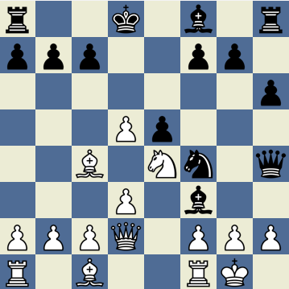
Organization is based on side-choosing games.
What is a side-choosing game (SCG)?
Black moves first and mates in 2 moves
A claim about a
combinatorial game G, e.g., Chess.
We ask 2 players x and !x:
x is a Proponent
!x is an Opponent
There is always a winner
and a loser. No ties.
Protocol for discourse is
determined by combinatorial
game.
x and !x must defend their side-choice
by winning the game.

Slide 11
What is a claim?
How is collaboration working?
A claim is a prediction about one’s performance interacting with an opponent in a given context.
Opponent tries to find an interaction which contradicts prediction. Claim is refuted but not necessarily false.

Slide 12
Organization is based on side-choosing games.
What is a side-choosing game (SCG)?
Black moves first and mates in 2 moves
It is about a claim C.
Structure: ChessBoard.
Logical Sentence:
For given ChessBoard-instance:
Exists move for Black
ForAll moves of White
Exists move for Black:
White King is mate
We ask 2 players x and !x:
x is a Proponent
!x is an Opponent
x and !x must defend their side-choice
by winning the game.

Slide 13
What is a side-choosing game?
There is always a winner
and a loser. No ties.
Protocol for discourse is
determined by logical
sentence.
Claim: Black mates in 2 moves
It is about a claim.
Structure: ChessBoard.
Logical Sentence:
For given ChessBoard-instance cb:
Exists move b1 for Black
ForAll moves w1(b1) of White
Exists move b2(b1,w1) for Black:
WhiteKingIsMate(b1,w1,b2)
We ask 2 players x and !x:
x is a Proponent
!x is a Proponent
We have one of them play
as devil’s advocate. Say x is
devil’s advocate. If x wins,
!x was not a serious Proponent.
Devil’s Advocate = Forced.

Slide 14
Side-Choosing Game (SCG) Cases
Sx (Side(x)) | S!x (Side(!x)) | P (Proponent) | W (Winner)
P | O | x | x
P | O | x | !x
P | P | x | x
P | P | x | !x
P | P | !x | x
P | P | !x | !x
…
How should we rank players? Player with the most wins? But there are cheap wins: when the other is forced.
Should we rank based on wins where other is not forced???

Slide 15
Another Issue: Distributing the Evaluation Work.
Administrator: Defines claim/game; checks that rules are followed; determines who wins and loses and keeps track of results.
Does Administrator have to solve the problems = develop winning strategies for claims?
No! We want the administrator to be a referee who is interested in problem solutions but who wants to get them from the players.
How can we make sure that the peer evaluation is fair?

Slide 16
Voting with Justification
You cannot just say: I am a Proponent.
You must justify your choice by game play.
As Proponent: you must win.
As Opponent: you must prevent the other from winning, i.e., you must win.

Slide 17
To play this SCG
Introduction
Theory
Methods
Applications/Results
Conclusion
Claim: Black mates in 2 moves
8
7
6
5
4
3
2
1
Proponents?
Opponents?
W L F
? ? ?
W: Winner
L: Loser
F: Forced
a b c d e f g h

Slide 18
Software Development: specifying a function
Pre and Post conditions for requirements
Exists gcd in Function(Nat,Nat -> Nat) ForAll x,y in Nat Exists d in Nat:
  d=gcd(x,y) Λ
  divides(d,x) Λ divides(d,y) Λ
  ! Exists s in Nat ((s>d) Λ divides(s,x) and divides(s,y)) Λ
  if x,y < C then Runtime(gcd,(x,y)) < RC
E.g., C = 10¹⁰, RC = 10 milliseconds.
We are hoping for Euclid’s or Schoenhage’s algorithm.

Slide 19
Gamification of Software Development for Computational Problems
Introduction
Theory
Methods
Applications/Results
Conclusion
Want reliable software to solve a computational problem? Design an SCG lab where the winning team will create the software you want.
A lab consists of Game/logical sentence interpreted in some structure.

Slide 20
Formal Science Claims: Saddle Point / Silver Ratio
claim
G(c) = ForAll x in [0,1] Exists y in [0,1]: x*y + (1-x)*(1-y^2) >= c
Strategy chosen depends on c.
  G(0.5)
  G(0.615)
  G(0.616)

Slide 21
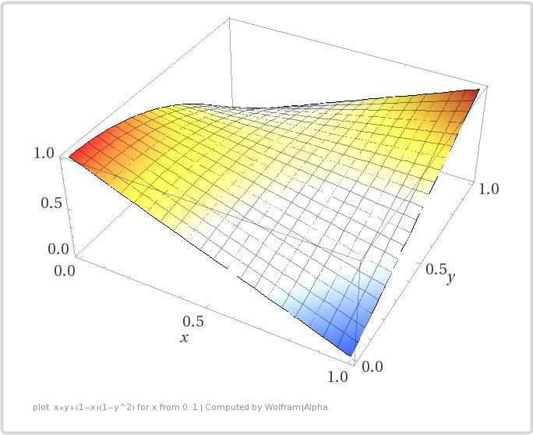

Slide 22
What is common to
Chess Puzzle claim
Software Development claim
Formal Science claim
  Two views
    Combinatorial Game G
      Claim: Start position is winning.
    Logical formula φ interpreted in structure A

Slide 23
Combinatorial Game
From Wikipedia: Combinatorial game theory (CGT) is a branch of applied mathematics and theoretical computer science that studies
  sequential games with
  perfect information, that is, two-player games which have a position. The players choose well-defined moves to achieve a defined winning condition.
We consider non-loopy games without draw: there is a winner and a loser.
  Equivalent definition: two-person game in extensive-form with perfect information.
The problem is purely strategic: how to best play the game against an ideal opponent.

Slide 24
Combinatorial Game Definition
There are two players. Sequential (turn-based). Perfect-Information, no chance or hidden information. (But players may hide their winning strategies.)
There is a finite set of possible positions of the game.
The rules of the game specify for both players and each position which moves to other positions are legal moves.
The game ends when a position is reached from which no moves are possible. A predicate on the final position determines who has won. There is an absolute winner: the first player to fulfill the winning condition. No ties or draws.
The game ends in a finite number of moves.

Slide 25
Logical Formula Claim⟨φ, A⟩
Claim⟨φ, A⟩
  φ is a well-formed formula.
  A is a structure, often consisting of several substructures. Think of A as a collection of data types that are needed to define the claim.
    φ refers to the functions defined in those data types.
What goes into φ, what goes into A? Into φ: what is better done by humans; into A: what is better done by machines.

Slide 26
Which view is better?
Combinatorial game view is simpler.
For evaluating games: combinatorial game view is sufficient.
For expressiveness: logical formula view is useful.
  There is a standard way of translating an interpreted logical formula into a combinatorial game, a so-called semantic game.

Slide 27
Outline for the Talk
Introduction
Theory
Methods
Applications/Results
Conclusion
Theory: Develop ranking theory for side-choosing games to find the most meritorious player.
  Novelties:
    Side-Choosing games.
    Meritocracy Management for Side-Choosing Games: Ranking functions for side-choosing games. Map game results to a ranking of players.
  Axiomatic approach:
    Formulate desirable axioms for ranking functions.
    Find representation theorem for ranking functions satisfying axioms.
Applications/Results:
  Lower barrier of entry for competition designers and participants
    Simplify work of administrator
    Make participation fun (collaborative, learning component)
  Organize communities for experience-based learning
  Software Development

Slide 28
Outline Theory
Combinatorial Games
Why Side-Choosing Games: Benefits
Side-Choosing Game = (CombinatorialGame, AgreementMap)
Side-ChoosingGameResult= Side-ChoiceResult x CombinatorialGameResults
Meritocracy management
  Tables with base and derived fields
  Important table: SCG-Table: (W,L,F)
  How to get to the SCG-Table?
  Axioms for Ranking and Representation Theorem: Surprise

Slide 29
Examples of Combinatorial Games
Truth of sentences in various logics
  First-order predicate logic
  Second-order predicate logic
  etc.
Positions in 2-person extensive-form games with perfect information. Choose a node (position) and ask: is it winning? Example: Mate in 2.
From Combinatorial Game Theory: chess, checkers, Nim (solved), etc.

Slide 30
Concepts
prerequisite
NEW
Semantic Game
“equivalent"
Winner,
Loser
Meritocracy: Evaluation/Axioms
Proponent, Opponent
collusion-
resistant
Combinatorial Game
NNEW
NPEL
CR
Claim
AgreementMap
Local Fault-Based
collusion
Side-Choosing Game
Fault
Representation Theorem
Forced
Design-time Decision
Side-Choosing Game Table
Run-Time Decision
Player Ranking (total preorder)

Slide 31
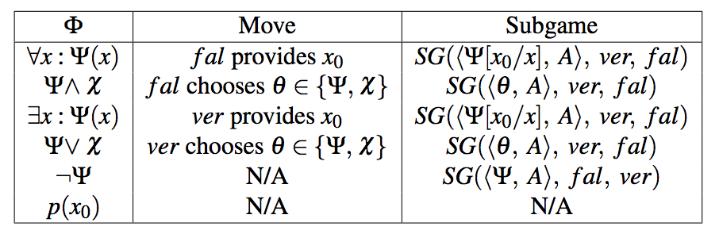
Standard Example: Semantic Game Rules
fal = Opponent
ver = Proponent

Slide 32
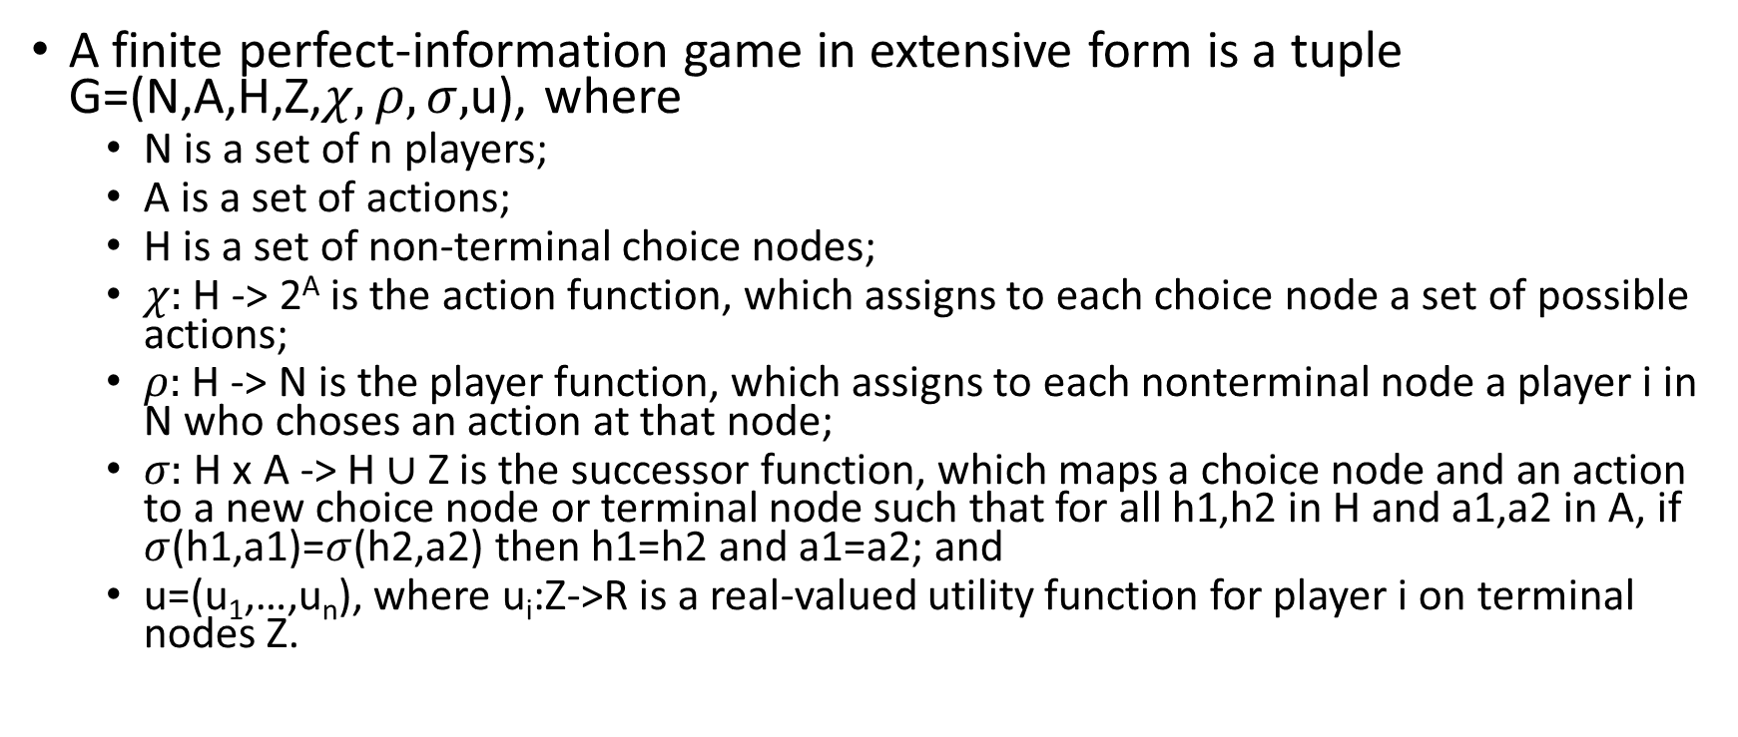
Alt. Comb. Game: Perfect-Information Game in Extensive Form (from Shoham & Leyton-Brown)
A finite perfect-information game in extensive form is a tuple G=(N,A,H,Z,$χ,ρ,σ,$u), where
  N is a set of n players;
  A is a set of actions;
  H is a set of non-terminal choice nodes;
  $χ:$ H -> 2^{A} is the action function, which assigns to each choice node a set of possible actions;
  $ρ:$ H -> N is the player function, which assigns to each nonterminal node a player i in N who choses an action at that node;
  $σ:$ H x A -> H $∪$ Z is the successor function, which maps a choice node and an action to a new choice node or terminal node such that for all h1,h2 in H and a1,a2 in A, if $σ$(h1,a1)=$σ$(h2,a2) then h1=h2 and a1=a2; and
  u=(u₁,…,u_{n}), where u_{i}:Z->R is a real-valued utility function for player i on terminal nodes Z.

Slide 33
Side-Choosing Games
Benefits
Based on Combinatorial Games
Side-Choosing Game = (Combinatorial Game, Agreement Map)
  side-choice followed by sequential game

Slide 34
Benefits of Side-Choosing Games
benefits: Objective, Low Overhead, Correct, Targeted Feedback, Well-Defined Interfaces.
Objective: The result depends on how well the participants solve the computational problems coming from the claim/game.
Low Overhead on Administrator: Prepare claim/game and check that the game rules are followed.
Correct: The winners demonstrate their opponent’s lack of skills for current claim/game.
Targeted Feedback: game plays give losers specific feedback.
Participants interact through well-defined interfaces. Choosing side and following game protocol.

Slide 35
Prominent Example of a Side-Choosing Game
The semantic game for some logic, e.g., predicate logic, is a combinatorial game. The start position is a sentence φ interpreted in some structure A.
Turn it into a side-choosing game by selecting an agreement map.

Slide 36




Toy Example: SCG Trace
Proponent
Opponent
,
)
SCG(∀x ∈ [0,1]: ∃ y ∈ [0,1]: x + y > 1.5,
Provides 1 for x
Weakening (too much!)
SCG(∃ y ∈ [0,1]: 1 + y > 1.5,
,
)
SCG = Side-Choosing Game
SCG = Scientific Community Game
SCG = Specker Challenge Game
SCG = SemantiC Game
all make are meaningful
Provides 1 for y
Strengthening
SCG( 1 + 1 > 1.5,
,
)
Wins

Slide 37
Abstraction Barriers/Important Steps
Widen: Semantic Games – Combinatorial Games: Generalize
  Key to side-choosing game definition
  Simplifies Meritocracy Theory for Side-Choosing Games
Minimum Recording: Side-Choosing Game Plays – SCG-Tables: Specialize without information loss
  based on relational table manipulations
Meritocracy: SCG-Tables – Player Ranking: Specialize
  based on axioms

Slide 38
What is a Side-Choosing Game Result?
Introduction
Theory
Methods
Applications/Results
Conclusion
Sx (Side(x)) | S!x (Side(!x))
P | O
O | P
P | P
O | O
Combinatorial Game G
  Not known whether there is a winning strategy
  outcome: Proponent/Winner
Side-Choice (P (Proponent) or O (Opponent))
abbreviated: Side-Choice Result x Combinatorial Game Result
P (Proponent) | Winner
x | x
x | !x
!x | x
!x | !x
One P against one O!

Slide 39
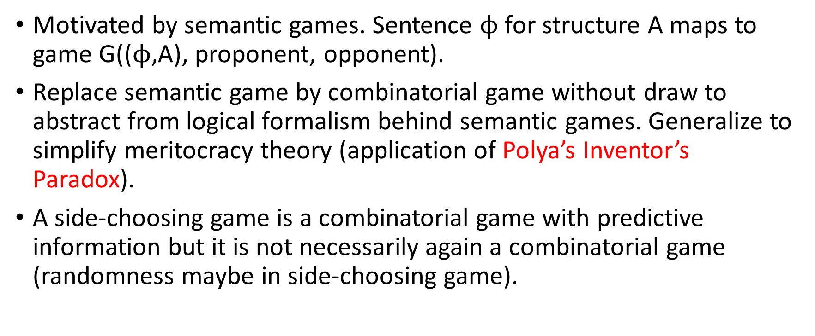
Side-Choosing Games, Overview
Motivated by semantic games. Sentence $ϕ$ for structure A maps to game G(($ϕ$,A), proponent, opponent).
Replace semantic game by combinatorial game without draw to abstract from logical formalism behind semantic games. Generalize to simplify meritocracy theory (application of Polya’s Inventor’s Paradox).
A side-choosing game is a combinatorial game with predictive information but it is not necessarily again a combinatorial game (randomness maybe in side-choosing game).

Slide 40
Terminology
Design-time decision for Proponent/Opponent. This is the design time for the winning strategy.
Run-time decision for Proponent/Opponent. This is the decision used when the defense game executes and might involve forcing at most one participant.
Side-choosing game consists of two parts
  simultaneous design-time decision
  run-time decision (imposed from outside) followed by sequential games defending run-time decision.

Slide 41
Agreement Map
The agreement function maps two players x,y with their design-time side choices dx=dy for combinatorial game G into a set of plays between the two players with run-time side choices rx, ry such that at most one player is forced.
We choose the following agreement function CAG (Competitive Agreement Game):
  Randomly choose z, one of the players x,y and force z.
    Play SCG(G, x, y, z, dx, dy, rx, ry)
    Play SCG(G, x, y, !z, dx, dy,!rx, !ry)
  Play SCG(G, x, y, z, dx, dy, rx, ry) is a game between x and y, where z is forced. If x is forced then rx=!dx and ry=dy. If y is forced then rx=dx and ry=!dy. The claim is: in the start position of G the player in the P role (d*=P) has a winning strategy.
  dx,dy,rx,ry have values in {P,O}. z has values in {x,y}. !z =x if z=y. !z = y if z=x. !P=O, !O=P.

Slide 42
Motivation for CAG
For some claims it is a disadvantage to have to move first because you give away a “secret” (e.g., the chess example Mate-in-2). Therefore, we choose the forced player randomly to balance the potential disadvantage.
We play two games to give each player a chance to test the other.

Slide 43
Alternative for CAG
CAG-1/2 only plays one game choosing the forced player randomly.
We choose the following agreement function CAG-1/2 (Competitive Agreement Game 1/2):
  Randomly choose one of the players x,y and force it.
    Play SCG(G, x, y, dx, dy, rx, ry)
    Play SCG(G, x, y, dx, dy, rx, ry) is a game between x and y. If rx=!dx and ry=dy then x is forced. If rx=dx and ry=!dy then y is forced.

Slide 44
What is a Side-Choosing Game (G,AM) for a Combinatorial Game G and an Agreement Map AM?
(G,AM) is played by x and y.
Game
  Choose a design-time side: P or O: dx, dy for G. P means: The start position of G is a winning position for player in P role. O means: The start position is not a winning position for player in P role.
  If dx!=dy: play game SCG(G, x, y, dx, dy, dx, dy)
  Else: Use agreement map AM to determine games to be played. Each game is of the form SCG(G, x, y, dx, dy, rx, ry) for run-time side-choices rx, ry determined by the agreement map AM.
  Each game result is recorded as a triple: W,L,F.

Slide 45
From Combinatorial to Side-Choosing Game
CG = Combinatorial Game, no notion of proponent, opponent.
SCG = Side-Choosing Game, notion of proponent/opponent at design-time and run-time.
  design-time proponent/opponent (choice by players)
    Proponent claims: start position of CG G is winning position for player who is run-time proponent.
  run-time proponent/opponent (influenced from outside, AM)
result (W,L,F). W,L,F have values in {x,y}.
A side-choosing game is a combinatorial game with predictive information but is not necessarily again a combinatorial game (randomness in AM).
A side-choosing game is a generalization of a semantic game. Semantic games also use the notion of proponent/opponent but are tied to a logical formalism which is irrelevant for studying meritocracy management in side-choosing games.

Slide 46
Result of a Side-Choosing Game Play
A game that produces an SCG-Row in an SCG-table. First move is simultaneous: choose a side: Proponent (P) or Opponent (O).
What is a row in an SCG-table?
  Presents one game result between two distinct participants x and y.
  Columns are: W,L,F (for Winner, Loser, Forced) (SCG-Table Rule 0).
  W,L contain either x or y. W≠L. There are no ties (SCG-Table Rule 1).
  F contains “none” or W or L (SCG-Table Rule 2).
    A participant is Forced if it has to take the opposite side than it has chosen. Synonym: Devil’s Advocate.

Slide 47
Result of several Side-Choosing Game Plays (continued)
What is an SCG-Table?
  Given a set of Players.
  A table of SCG rows satisfying rules 0-2 involving participants in Players.
  Multiple rows may involve the same two players (SCG-Table Rule 3).
To determine who wins the side war requires the execution of some protocol between the two participants. The SCG-Table definition does not specify the protocol: separation of concerns.

Slide 48
SCG-Tables
Introduction
Theory
Methods
Applications/Results
Conclusion
columns Concrete SCG-Table:
x: player
!x: other player
Sx: side of player x
S!x: side of player !x
P: Proponent
2/4
2/4
what we want
SideChoiceCases
core: Sx, S!x
SemanticGameCases
core: W,P
Abstract SCG-Table
core: W, L, F
derived: Fault, Control
core columns abstract SCG-Table:
W: Winner
L: Loser
F: Forced
3(5)/6
direct product
is-a
drop: Sx, S!x, P
derived columns SCG-Table:
Fault: Loser is not forced
Control: Loser in control
filter
Concrete SCG-Table
core: Sx, S!x, W, P
derived: F, L
number of columns (with derived)/number of rows
4(6)/12

Slide 49
Concepts
prerequisite
NEW
Semantic Game
“equivalent"
Winner,
Loser
Meritocracy: Evaluation/Axioms
Proponent, Opponent
collusion-
resistant
Combinatorial Game
NNEW
NPEL
CR
Claim
AgreementMap
Local Fault-Based
collusion
Side-Choosing Game
Fault
Forced
Representation Theorem
Design-time Decision
Side-Choosing Game Table
Run-Time Decision
Player Ranking (total preorder)

Slide 50
Problem we solve next: Meritocracy Finding
Given a tournament of side-choosing games among a set of Players, how can we find the most meritorious players?
Note: There is a lot of noise produced by the tournament:
  We don’t know whether claim is true.
  true claim might be refuted.
  false claim might be defended.
  players switch their sides between different games.
  players may lie about their strength and lose intentionally to help a friend become more meritorious (collusion among players).
  The more weak players or the more collusion, the more noise.
HOW CAN WE FIND ORDER IN THIS COMPLEXITY?

Slide 51
Informal Reasoning
Case Abbreviation | Winner/Loser | Forced/Unforced
WF | Win | Forced
WU | Win | Unforced
LF | Lose | Forced
LU | Lose | Unforced
Which of the four statistics is a reliable indicator
of strength or weakness?
WF: strength: no (because of possible collusion)
WU: strength: no (because of possible collusion)
LF: weakness: no (because of forcing)
LU (Fault): weakness: YES. Player is contradictory!
Loser is Proponent: should have won
Loser is Opponent: should have prevented the other
from winning.
Informal argument why counting Faults is interesting.

Slide 52
Fair Peer-Based Evaluation for n participants
Builds on Two-Participant Evaluation
Ranking systems for side-choosing games
Axiomatic treatment: collusion-resistant
  Introduce 3 axioms

Slide 53
Non-Negative Effect For Wins (Axiom 1: NNEW)
Introduction
Theory
Methods
Applications/Results
Conclusion
Px
Additional wins
cannot worsen Px’s
rank w.r.t. other participants.
Wins
Faults
undisputed: Wins don’t lower rank.

Slide 54
Non-Positive Effect For Losses (Axiom 2: NPEL)
Px
Implies:
Wins
Additional losses
cannot improve Px’s
rank w.r.t. other participants.
Faults
undisputed: Losses don’t increase rank.

Slide 55
Ranking Functions (Anonymity)
Output ranking is independent of participants’ identities.
Ranking function ignores participants’ identities.
Participants also ignore their opponents’ identities.

Slide 56
Collusion-Resistance
Slightly weaker notion than anonymity.
What you want in practice.
A participant Py can choose to lose on purpose against another participant Px, but that won’t make Px get ahead of any other participant Pz.

Slide 57
Collusion-Resistance (Axiom 3: CR)
Px
Games outside Px’s
control cannot worsen
Px’s rank w.r.t. other participants.
Wins
Faults
  Px is in control if (Px in W(inner)) or (not(Px in F(orced)))

Slide 58
Collusion-Resistant Axiom: Explanation
When additional rows are added to table T
  where you did not participate, your rank cannot come down
  where you won, your rank cannot come down.
  where you were forced, your rank cannot come down.

Slide 59
Preparing for the Discovery/Surprise:
Locally Fault Based (LFB)
Px
Py
Relative rank of Px
and Py depends
only on faults made
by either Px or Py.
Wins
Faults
Faults
Wins
“Locally” is used to exclude faults made by some third player z when ranking x versus y.

Slide 60
Discovery: Property of SCG-Tables
Introduction
Theory
Methods
Applications/Results
Conclusion
A useful design principle for ranking functions.
Under NNEW, NPEL : CR = LFB
LFB is quite unusual.
LFB lends itself to implementation.
Not only are faults important; they are fundamental.
NNEW Λ CR => LFB
NPEL Λ LFB => CR
NNEW Λ NPEL => (CR ⬄ LFB)

Slide 61
Proof
Venn Diagram for Game Kinds involving x,y
≥ monotonically non-decreasing
≤ monotonically non-increasing
WF(x), WF(y),LF(x),LF(y) shown in diagram
1ᴜ3-WF(x)=WU(x); 4ᴜ6-WF(y)=WU(y); 2ᴜ4:LU(x); 3ᴜ5:LU(y)
LFB: d_{W}U = 0, d_{LF}U = 0
All games
2, 3, 4, 5: LFB
x wins and y at fault
1 [!fl y] [w x] = [!c y] [w x]
2 [!w y] [fl x] = [!c y] [fl x]
3 [fl y] [w x] = [c y] [w x]
4 [w y] [fl x] = [c y] [fl x]
5 [!w x] [fl y] = [!c x] [fl y]
6 [!fl x] [w y] = [!c x] [w y]
7 [!c x] [!c y]
games that cannot
improve rank of
x wrt. y:
6 by NNEW
1,7 by CR
games that cannot
worsen rank of
x wrt. y:
6,7 by CR
1 by NNEW
Proves:
NNEW and CR => LFB
LF(y)
c(x)
c(y)
x wins:
W(x)
1
WF(x)
5
y at fault:
LU(y)
3
2
4
6
WF(y)
y wins:
W(y)
x at fault:
LU(x)
LF(x)
7
c(z) = z in control (full circle)
= (z wins) or (z not forced)
x at fault and y wins
NNEW: d_{W}U ≤ 0, NPEL: d_{L}U ≥ 0, CR: d_{W}U ≥ 0, d_{LF}U = 0, d_{LU}U ≥ 0

Slide 62
Ranking Axioms Imply
≥ monotonically non-decreasing
≤ monotonically non-increasing
Monotonicity Constraints
  NNEW: d_{WF}U ≤ 0 Λ d_{WU}U ≤ 0
  NPEL: d_{LF}U ≥ 0 Λ d_{LU}U ≥ 0
  CR: d_{WF}U ≥ 0 Λ d_{WU}U ≥ 0 Λ d_{LF}U = 0 Λ d_{LU}U ≥ 0
  LFB: d_{WF}U = 0 Λ d_{WU}U = 0 Λ d_{LF}U = 0
Above implies:
NNEW Λ CR => LFB
NPEL Λ LFB => CR
NNEW Λ NPEL => (CR ⬄ LFB)

Slide 63
Finding a concrete LFB function.
One example of an infinite family.

Slide 64
Fault-Counting Scoring Function
Provide a concrete example of a ranking function which is NNEW, NPEL and LFB and therefore CR.
  Players are ranked according to their score: the number of faults they make. The fewer the number of faults the higher the rank.
Satisfies the NNEW and NPEL
  Clearly, Fault Counting is LFB and therefore CR (by previous theorem).
Note: There is an infinite family of ranking functions that are LFB.

Slide 65
Side-Choosing Game Tournament Design
Full Round-Robin with adaptation: For every pair of players:
  If choosing different sides, play a single SG.
  If choosing same sides, play combinatorial game plays according to the chosen AM, i.e., CAG (two combinatorial games where they switch sides).

Slide 66
Neutrality with CAG
Each player plays n_{P}+ n_{O} - 1 combinatorial games in their chosen side, those are the only games in which it may make faults.
P = Proponent, O = Opponent
n_{O}
n_{P}
2 games; one player in chosen side
n_{O}
1 game; both players in chosen side
n_{P}

Slide 67
Summary Theory
Introduction
Theory
Methods
Applications/Results
Conclusion
Side-choosing games require a side-choice at the beginning and then resort to forcing if both choose same side. A side-choosing game finishes with one or more combinatorial games.
The axiomatic ranking theory producing the representation theorem: NNEW Λ NPEL => (CR ⬄ LFB), only depends of SCG-Tables satisfying rules 0-3 and not on the details of combinatorial games. The 4 rules provide an abstraction barrier from the details of protocols.
Simple Result: Full-Round Robin with Fault-Counting.

Slide 68
Solving Problems using the Crowd
USE SAFE SIDE-CHOOSING GAMES!
They look at the
administrator who
only acts as referee.
We use the crowd for
fair peer evaluation!
They want to be
heard.
We want to
extract a
provably
reliable signal
(“best”,
collusion-
resistant
solution)
from the
complex
behavior of
the crowd.
Some are better
than others:
meritocracy.
Some want to
game the system
by colluding/lying.

Slide 69
Application Concepts
Lab = (Side-Choosing Game, Participants)
Avatar
Competition System we built
Baby Avatar automatically generated from Side-Choosing Game
Participant
Human
Tools like Piazza are sufficient

Slide 70
Future Work
Problem decomposition labs.
Social Computing.
Evaluating Thoroughness.

Slide 71
Methods
Use piazza.com
  Use JSON for scientific discourse (objects sent back and forth during combinatorial game).
  Divide class into teams of 3.
For strategies in software
  We developed
    a generator for baby strategies
    administrator automated
Also used simulation (synthetic strategies) to help invent the theory.

Slide 72
Lower barrier of entry for competition designers
Introduction
Theory
Methods
Applications/Results
Conclusion
What can be done with SCGs?
  LFB ranking mechanisms, e.g., fault-counting.
  Shifting evaluation from administrator to players!
  Tournaments that fairly evaluate players!
    collusion-resistance is guaranteed.

Slide 73
Applications of SCG (1)
Introduction
Theory
Methods
Applications/Results
Conclusion
Teaching Software Development
  Students get Baby-Strategy to start (automatically generated from claim).
  Students add intelligence to their strategy to outperform the strategies of their peers.
  A strategy consists of a function for side choice and a function for each quantifier (we use simplified semantic games).
  Strategy with fewest losses wins. Strategies use web for fight!
  Weekly tournaments with slightly modified claim: encourage well-modularized software that is easy to change.

Slide 74
Applications of SCG (2)
Bring order to literature on solving computational problems.
  Authors are required to provide a strategy to defend the claim.
  Knowledge becomes active on the web.
  A newcomer might beat all current strategies. Easily verified by a tournament.
  Develop a Wikipedia for computational problems.

Slide 75
Applications of SCG (3)
Teaching Formal Sciences (e.g., Algorithms).
  Use a platform like Piazza to execute the protocol.
  Avoid claims where the semantic game gives away the solution.
  Divide class into groups of size 3. Balance skills in each group. Play tournaments within groups to prevent information overload for class.
  Students came up with solutions that were about 10 years behind the state-of-the-art.

Slide 76
Results
Introduction
Theory
Methods
Applications/Results
Conclusion
SCG usage for teaching using forum
  Innovation Success with Undergraduates using SCG on piazza.com: Qualitative Data Sources & Analysis
  Perfect for creating interaction between students (peer teaching)
Strategy competitions are useful for teaching (and good for competitive innovation).
  Some students stayed up to see their strategy succeed in the tournament.

Slide 77
Related Work
  Erlanger Konstruktivismus
    Paul Lorenzen, Dialogische Logik
    Konstruktive Wissenschaftstheorie, Suhrkamp, 1974.
Rating and Ranking Functions
Tournament Scheduling
Match-Level Neutrality

Slide 78
Rating and Ranking Functions (I)
Dominated by heuristic approaches
  Elo ratings.
  Who’s #1?
There are axiomatizations of rating functions in the field of Paired Comparison Analysis.
  CR not on radar

Slide 79
Rating and Ranking Functions (II)
Rubinstein[1980]:
  points system (winner gets a point) characterized as:
    Anonymity : ranks are independent of the names of participants.
    Positive responsiveness to the winning relation which means that changing the results of a participant p from a loss to a win, guarantees that p’s rank would improve.
    IIM: relative ranking of two participants is independent of matches in which neither is involved.
  “beating functions” are restricted to complete, asymmetric relations.

Slide 80
Tournament Scheduling
Neutrality is off radar.
  Maximizing winning chances for certain players.
  Delayed confrontation.

Slide 81
Match-Level Neutrality
Dominated by heuristic approaches
  Compensation points.
  Pie rule.

Slide 82
Conclusions
Introduction
Theory
Methods
Applications/Results
Conclusion
Semantic games (and their generalization: side-choosing games) of interpreted logic sentences provide a useful foundation to organize computational problem solving and formal science communities for research and experience-based learning.
We found a solution to the problem of lowering the barrier of entry for competition organizers by shifting evaluation tasks from the administrator to the players.
We show the fundamental nature of locally fault-based evaluation in the presence of collusion-resistance.
Simple result: 3 axioms, representation theorem, adapted full round-robin tournament with fault-counting gives fair, collusion-resistant evaluation of SCGs.

Slide 83

CCIS
45 faculty + 9 researchers
  7 new faculty in 2012
  6 new faculty in 2013
634 undergrads, 606 MS, 97 PhDs
$7.6 million in grant funding in 2012
PhD Programs in:
  Computer Science
  Information Assurance
  Health Informatics
  Network Science

Slide 84
Research at CCIS
Formal Methods
  10 papers in FMSD, FMCAD, TOPLAS, and CAV since ’08
  NSF CAREER for building dependable concurrent software
Robotics and Computer Vision
  NSF CAREER for building robots that handle uncertainty
  New hire for 2013: Rob Platt
Network Science
  Founders of the field: Laszlo Barabasi and Alex Vespignani
  20+ papers in Nature, Science, and PNAS since ‘08
Security
  19+ papers at NDSS, CSS, S&P, and Usenix Security since ‘08
  Funding from DARPA, Symantec, and Verisign
Programming Languages
  19 papers in POPL, OOPSLA, and ICFP since ‘08
  Active in the ECMA Javascript standards body
DB, IR, and ML
  Papers in SIGIR, CIKM, KDD, SIGMOD, VLDB, ICDM
  New research center for digital humanities

Slide 85

Questions?
Karl Lieberherr
lieber@ccs.neu.edu

Slide 86
Thank You!

Slide 87
For Hansruedi
Proper tournament evaluation for side-choosing games.
Games with winners and losers, no draws.
Evaluation must satisfy 3 axioms.
Collusion-resistant axiom: Games outside a player’s control cannot lower that player’s rank with respect to other players.

Slide 88
Collusion-Resistance (Axiom 3: CR)
  Px is not in control if not (Px in W(inner)) and (Px in F(orced))
  Px is not in control if Px does not participate or (Px in L(oser) and (Px in F(orced))
Px
Games outside Px’s
control cannot worsen
Px’s rank w.r.t. other participants.
Wins
Faults
  Px is in control if (Px in W(inner)) or (not(Px in F(orced)))
  Fault: Loser is not forced.

Slide 89
Side-Choosing Game
Combinatorial game G
Proponent: start position is a winning position.
Opponent: start position is not a winning position.
Choose side.
Need for forcing.
Faults.

Slide 90
end Hansruedi

Slide 91
Combinatorial Games

Slide 92
Examples of Combinatorial Games
Truth of sentences in various logics
  First-order predicate logic
  Second-order predicate logic
  etc.
Positions in 2-person extensive-form games with perfect information. Choose a node (position) and ask: is it winning? Example: Mate in 2.
From Combinatorial Game Theory: chess, checkers, Nim (solved), etc.

Slide 93
Standard Example: SCG Rules
fal = Opponent
ver = Proponent

Slide 94
Alt. Comb. Game: Perfect-Information Game in Extensive Form (from Shoham & Leyton-Brown)
A finite perfect-information game in extensive form is a tuple G=(N,A,H,Z,$χ,ρ,σ,$u), where
  N is a set of n players;
  A is a set of actions;
  H is a set of non-terminal choice nodes;
  $χ:$ H -> 2^{A} is the action function, which assigns to each choice node a set of possible actions;
  $ρ:$ H -> N is the player function, which assigns to each nonterminal node a player i in N who choses an action at that node;
  $σ:$ H x A -> H $∪$ Z is the successor function, which maps a choice node and an action to a new choice node or terminal node such that for all h1,h2 in H and a1,a2 in A, if $σ$(h1,a1)=$σ$(h2,a2) then h1=h2 and a1=a2; and
  u=(u₁,…,u_{n}), where u_{i}:Z->R is a real-valued utility function for player i on terminal nodes Z.

Slide 95
Side-Choosing Games
Benefits
Based on Combinatorial Games
Side-Choosing Game = (Combinatorial Game, Agreement Map)
  side-choice followed by sequential game

Slide 96
Benefits of Side-Choosing Games
benefits: Objective, Low Overhead, Correct, Targeted Feedback, Well-Defined Interfaces.
Objective: The result depends on how well the participants solve the computational problems coming from the claim/game.
Low Overhead on Administrator: Prepare claim/game and check that the game rules are followed.
Correct: The winners demonstrate their opponent’s lack of skills for current claim/game.
Targeted Feedback: game plays give losers specific feedback.
Participants interact through well-defined interfaces. Choosing side and following game protocol.

Slide 97
Prominent Example of a Side-Choosing Game
The semantic game for some logic, e.g., predicate logic, is a combinatorial game. The start position is a sentence φ interpreted in some structure A.
Turn it into a side-choosing game by selecting an agreement map.

Slide 98
Toy Example: SCG Trace
Proponent
Opponent
,
,
)
SCG(∀x ∈ [0,1]: ∃ y ∈ [0,1]: x + y > 1.5
Provides 1 for x
Weakening (too much!)
,
,
)
SCG(∃ y ∈ [0,1]: 1 + y > 1.5
SCG = Side-Choosing Game
SCG = Scientific Community Game
SCG = Specker Challenge Game
SCG = SemantiC Game
all make are meaningful
Provides 1 for y
Strengthening
,
,
)
Wins
SCG( 1 + 1 > 1.5

Slide 99
Toy Example: SCG Trace
Proponent
Opponent
,
)
SCG(∀x ∈ [0,1]: ∃ y ∈ [0,1]: x + y > 1.5,
Provides 1 for x
Weakening (too much!)
SCG(∃ y ∈ [0,1]: 1 + y > 1.5,
,
)
SCG = Side-Choosing Game
SCG = Scientific Community Game
SCG = Specker Challenge Game
SCG = SemantiC Game
all make are meaningful
Provides 1 for y
Strengthening
SCG( 1 + 1 > 1.5,
,
)
Wins

Slide 100
Abstraction Barriers/Important Steps
Widen: Semantic Games – Combinatorial Games: Generalize
  Simplifies Meritocracy Theory for Side-Choosing Games
Minimum Recording: Side-Choosing Game Plays – SCG-Tables: Specialize without information loss
  based on relational table manipulations
Meritocracy: SCG-Tables – Player Ranking: Specialize
  based on axioms

Slide 101
What is a Side-Choosing Game Result?
Introduction
Theory
Methods
Applications/Results
Conclusion
Sx (Side(x)) | S!x (Side(!x))
P | O
O | P
P | P
O | O
Combinatorial Game G
  Not known whether there is a winning strategy
  outcome: Proponent/Winner
Side-Choice (P (Proponent) or O (Opponent))
abbreviated: Side-Choice Result x Combinatorial Game Result
P (Proponent) | Winner
x | x
x | !x
!x | x
!x | !x
One P against one O!

Slide 102
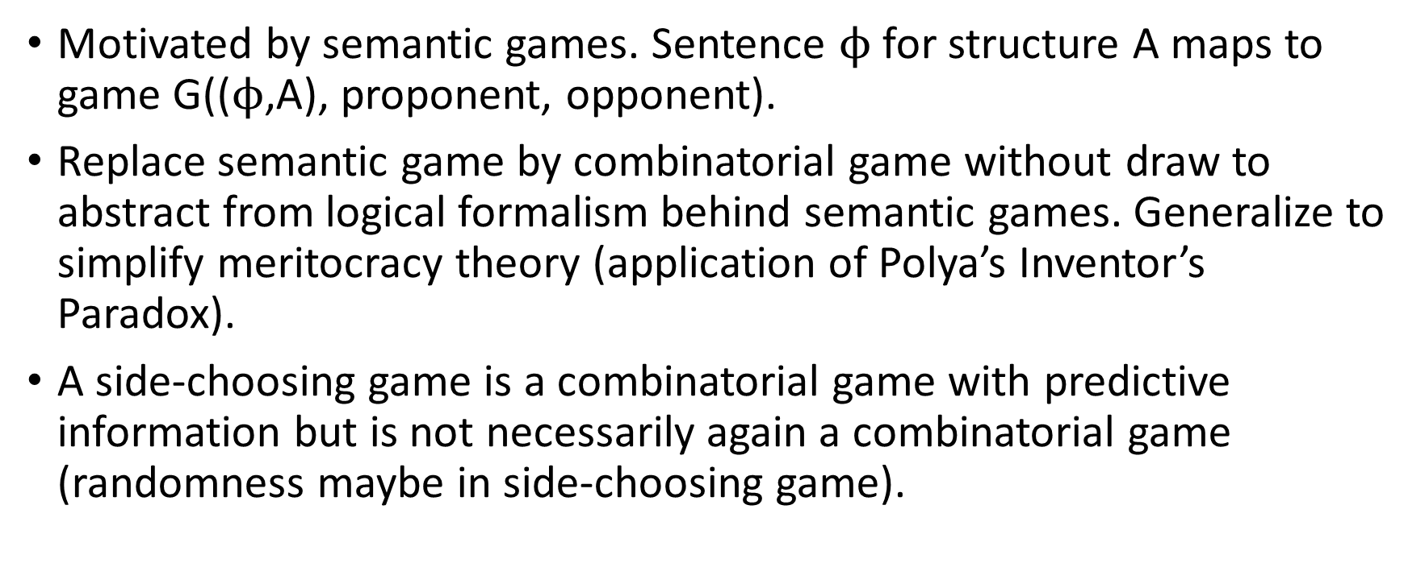
Side-Choosing Games, Overview
Motivated by semantic games. Sentence $ϕ$ for structure A maps to game G(($ϕ$,A), proponent, opponent).
Replace semantic game by combinatorial game without draw to abstract from logical formalism behind semantic games. Generalize to simplify meritocracy theory (application of Polya’s Inventor’s Paradox).
A side-choosing game is a combinatorial game with predictive information but is not necessarily again a combinatorial game (randomness maybe in side-choosing game).

Slide 103
Agreement Map
The agreement function maps two players x,y with their design-time side choices dx=dy for combinatorial game G into a set of plays between the two players with run-time side choices rx, ry such that at most one player is forced.
We choose the following agreement function CAG (Competitive Agreement Game):
  Randomly choose z, one of the players x,y and force z.
    Play SCG(G, x, y, z, dx, dy, rx, ry)
    Play SCG(G, x, y, !z, dx, dy,!rx, !ry)
  Play SCG(G, x, y, z, dx, dy, rx, ry) is a game between x and y, where z is forced. If x is forced then rx=!dx and ry=dy. If y is forced then rx=dx and ry=!dy. The claim is: in the start position of G the player in the P role (d*=P) has a winning strategy.
  dx,dy,rx,ry have values in {P,O}. z has values in {x,y}. !z =x if z=y. !z = y if z=x. !P=O, !O=P.

Slide 104
Motivation for CAG
For some claims it is a disadvantage to have to move first because you give away a “secret” (e.g., the chess example Mate-in-2). Therefore, we choose the forced player randomly to balance the potential disadvantage.
We play two games to give each player a chance to test the other.

Slide 105
Alternative for CAG
CAG-1/2 only plays one game choosing the forced player randomly.
We choose the following agreement function CAG-1/2 (Competitive Agreement Game 1/2):
  Randomly choose z, one of the players x,y and force z.
    Play SCG(G, x, y, z, dx, dy, rx, ry)
    Play SCG(G, x, y, z, rx, ry) is a game between x and y, where z is forced. If x is forced then rx=!dx and ry=dy. If y is forced then rx=dx and ry=!dy.

Slide 106
What is a Side-Choosing Game (G,AM) for a Combinatorial Game G and an Agreement Map AM?
(G,AM) is played by x and y.
Game
  Choose a design-time side: P or O: dx, dy for G. P means: The start position of G is a winning position for player in P role. O means: The start position is not a winning position for player in P role.
  If dx!=dy: play game SCG(G, x, y, dx, dy, dx, dy)
  Else: Use agreement map AM to determine games to be played. Each game is of the form SCG(G, x, y, dx, dy, rx, ry) for run-time side-choices rx, ry determined by the agreement map AM.
  Each game result is recorded as a triple: W,L,F.

Slide 107
From Combinatorial to Side-Choosing Game
CG = Combinatorial Game, no notion of proponent, opponent.
SCG = Side-Choosing Game, notion of proponent/opponent at design-time and run-time.
  design-time proponent/opponent (choice by players)
    Proponent claims: start position of CG G is winning position for player who is run-time proponent.
  run-time proponent/opponent (influenced from outside, AM)
Same Information
  CG(G, x, y, dx, dy, rx, ry)
  CG(G, x, y, z, rx, ry), z is forced player.
result (W,L,F). W,L,F have values in {x,y}.
A side-choosing game is a combinatorial game with predictive information but is not necessarily again a combinatorial game (randomness in AM).
A side-choosing game is a generalization of a semantic game. Semantic games also use the notion of proponent/opponent but are tied to a logical formalism which is irrelevant for studying meritocracy management in side-choosing games.

Slide 108
Side-Choosing Game between two players x and y for a combinatorial game g
Given: Combinatorial Game g and an Agreement Map AM, e.g., CAG.
Game
  Both players x and y choose simultaneously a design-time side: P or O: dx, dy for g. P means: The starting position of g is a winning position for player P. O means: the starting position of g is not a winning position for player P.
  If dx!=dy: play game CG(g, x, y, dx, dy, dx, dy)
  Else: Use agreement map AM to determine games to be played. Each game is of the form CG(g, x, y, dx, dy, rx, ry) for run-time side-choices rx, ry determined by the agreement map AM.
  Each game result is recorded as a triple: W,L,F.

Slide 109
Result of a Side-Choosing Game Play
A game that produces an SCG-Row in an SCG-table. First move is simultaneous: choose a side: Proponent (P) or Opponent (O).
What is a row in an SCG-table?
  Presents one game result between two distinct participants p and q.
  Columns are: W,L,F (for Winner, Loser, Forced) (SCG-Table Rule 0).
  W,L contain either p or q. W≠L. There are no ties (SCG-Table Rule 1).
  F contains “none” or W or L (SCG-Table Rule 2).
    A participant is Forced if it has to take the opposite side than it has chosen. Synonym: Devil’s Advocate.

Slide 110
Result of several Side-Choosing Game Plays (continued)
What is an SCG-Table?
  Given a set of Players.
  A table of SCG rows satisfying rules 0-2 involving participants in Players.
  Multiple rows may involve the same two players (SCG-Table Rule 3).
To determine who wins the side war requires the execution of some protocol between the two participants. The SCG-Table definition does not specify the protocol: separation of concerns.

Slide 111
SCG-Tables
Introduction
Theory
Methods
Applications/Results
Conclusion
columns Concrete SCG-Table:
x: player
!x: other player
Sx: side of player x
S!x: side of player !x
P: Proponent
2/4
2/4
what we want
SideChoiceCases
core: Sx, S!x
SemanticGameCases
core: W,P
Abstract SCG-Table
core: W, L, F
derived: Fault, Control
core columns abstract SCG-Table:
W: Winner
L: Loser
F: Forced
3(5)/6
direct product
is-a
drop: Sx, S!x, P
derived columns SCG-Table:
Fault: Loser is not forced
Control: Loser in control
filter
Concrete SCG-Table
core: Sx, S!x, W, P
derived: F, L
number of columns (with derived)/number of rows
4(6)/12

Slide 112

Core sets, Dan Feldman
Given data D and Algorithm A with A(D) intractable, can we efficiently reduce D to C so that A(C) fast and A(C) $\sim$ A(D)?

Slide 113
Illustrate that collusion-resistance is essential
best player not on top if wins against non-forced are counted.
A,B,C,D players. D perfect, B,C colluding, A beats D?
  all non-forced losses?
  A-B 1:0 collusion: x game plays
  A-C 1:0 collusion
  A-D 0:1
  B-C 0:1
  B-D 0:1
  A x+1 wins, B 0 wins, C 1 win, D 1 win: A overall winner
  A 1 fault, B x+2 faults, C 2 faults, D 0 faults: D overall winner
  engage D again: C-D 0:1

Slide 114
Claim: In full round-robin tournament
can count wins and still have perfect on top?
Would contradict the representation theorem!
when is the perfect on top?
connection to collusion-resistance?
perfect has 0 faults.
in full-round robin tournament for n players:
  perfect wins all n-1 games, 0 faults
  others can artificially play more games and win more than n-1 but no longer full-round-robin tournament.

Slide 115
Table extension
axioms are about table extensions
full round-robin has a fixed number of games

