Slide 1
Software Development with Semantic Games
Karl Lieberherr, CCIS,
Northeastern University, Boston
joint work with Ahmed Abdelmeged

Slide 2
Technology View
How to maintain a technology portfolio for a product?
  can the clever processes involved in the product be improved?
  produce more out of less?
  how can an employee convince management that her solution is better?
Our answer: Build a set of Labs related to the portfolio and use competitions to find the best solutions.

Slide 3
Competitions
Intro
drive research and innovation
motivate egoistic participants
  gain recognition
  win prize
reveals meta-knowledge about participants’ knowledge of domain
diffuse knowledge about the domain

Slide 4
Competition Examples
Intro
Historical
  Tartaglia and Fior 1535: solving cubic equations
Modern
  SAT competitions
  Netflix prize competition

Slide 5
Platforms Facilitating Competitions
Intro
TopCoder
  developing software
Kaggle
  data mining
FoldIt
  protein foldings
EteRNA
  protein synthesis
Project Euler, Jutge
  for education

Slide 6
Typical Pattern
Intro
performance is measured against benchmarks
ad-hoc solutions
central administrator
  participants do not directly communicate

Slide 7
SCG Alternative
Intro
Organize a scientific community around a family of open problems
  constructivist logic approach based on semantic games
    broadly applicable, non ad-hoc
  decisions must be justified through interaction
  collaboration and competition
  designed for imperfect scholars: have opportunity to learn through targeted feedback.

Slide 8
Approach in a nutshell
Use a sequence of competitions to find the best players.
We are interested in the code of the best players
  defends claims
  use for decision making

Slide 9
Approach in a nutshell
How can we reliably find the best players?
  E.g., which tournament mechanism should be used? Round-robin, Swiss, Knock-out?
  Player evaluation must be fair.

Slide 10
Truth and Clever Constructions
We are not just interested in WHETHER a claim is true but WHY it is true.
We are NOT asking for a PROOF why a claim is true but for a constructive demonstration that the claim is true.
Having a proof is ideal but is not required for supporting a claim. It is enough knowing the CLEVER CONSTRUCTIONS without having a proof why they work.

Slide 11
Problem we address:
Deciding Claims with Unreliable Users
Intro
Claim⟨φ, A⟩
  φ is a logical formula
  A is a “rich” structure
Is φ true for structure A?
Several users, participants
  some say yes
  some say no
WHO IS RIGHT?
Issues:
Can do better than voting.
How to deal with denial of truth attacks.
How can a yes voter (verifier) convince a no voter (falsifier) that she might be wrong?
How can we find a verifier who consistently convinces falsifiers that they might be wrong?

Slide 12
Example: Lab Definition
φ(c ∈ C)= ∀ x ∈ X ∃ y ∈ Y : p(x,y,c)
  O(laf): φ(c₀) true: verifier
  K(arl): φ(c₀) false: falsifier

Slide 13
Concrete 1
Stable Marriages Lab
φ(c ∈ C)= ∀ x ∈ X ∃ y ∈ Y : p(x,y,c)
X = Instances, e.g., preferences.
Y = Solutions, e.g., marriages.
C = Quality, e.g., 1 if all stable, 0 otherwise.
p(x,y,c)=quality(x,y)=c
φ(1) is true

Slide 14
Concrete 2
Saddle Point Lab
φ(c ∈ C)= ∀ x ∈ X ∃ y ∈ Y : p(x,y,c)
X = [0,1]
Y = [0,1]
C = [0,1]
p(x,y,c) = x*y + (1-x)*(1-y²) >= c
φ(0.5) is true
φ(0.7) is false

Slide 15
Concrete 3
Protein Folding / Minimization Lab
φ(c ∈ C)= ∃ x ∈ X ∀ y ∈ X : p(x,y,c)
X = Solutions, e.g., protein foldings
C = Quality, e.g., energy of folded protein
φ(c ∈ C) = ∃ x in X ∀ y in X: c = quality(x) <= quality(y) (minimum energy protein folding)
φ(0.4) is true
φ(0.5) is true

Slide 16
Example
φ(c ∈ C)= ∀ x ∈ X ∃ y ∈ Y : p(x,y,c)
  O(laf): φ(c₀) true: verifier
  K(arl): φ(c₀) false: falsifier
  Experiment
    K:x₀ O:y₀ p(x₀,y₀,c₀) true
      objective evidence for O to be stronger than K.
        K must have made at least one mistake, while O might have been perfect.
          if φ(c₀) true, K took the wrong position.
          if φ(c₀) false, K chose the wrong x₀

Slide 17
Example (continued 1)
φ(c ∈ C)= ∀ x ∈ X ∃ y ∈ Y : p(x,y,c)
  O(laf): φ(c₀) true: verifier
  K(arl): φ(c₀) true: verifier
  Experiment 1
    O(laf): φ(c₀) true: verifier
    K(arl): φ(c₀) false: forced falsifier
      K:x₁ O:y₁ p(x₁,y₁,c₀) true
        no evidence that Olaf is stronger

Slide 18
Example (continued 2)
φ(c ∈ C)= ∀ x ∈ X ∃ y ∈ Y : p(x,y,c)
  O(laf): φ(c₀) true: verifier
  K(arl): φ(c₀) true: verifier
  Experiment 2
    K(arl): φ(c₀) true: verifier
    O(laf): φ(c₀) false: forced falsifier
      O:x₂ K:y₂ p(x₂,y₂,c₀) false
        objective evidence that Olaf is stronger. Karl must have made at least one mistake, while Olaf might have been perfect.

Slide 19
Generalizing SGs
First ask users for their favorite position.
If both choose the same position, force one to play the devil’s advocate.
Winner | Forced | Payoff (u, !u) | Truth evidence
u | None | (1, 0) | Pos(u)
u | u | (1, 0) | None
u | !u | (0, 0) | Pos(u)

Slide 20
Automate Experiments
Ask Olaf and Karl to write avatars that play on their behalf.
Can do lots of experiments.

Slide 21
Take-Home Messages
Intro
How to find the meritocratic people (high user strength) who know the “truth” and who can defend it.
Generating Admissible Evidence
  How to generate admissible evidence for strength: Semantic Games.

Slide 22
Key Topic
Intro
Generalized Semantic Games of interpreted logic statements, a.k.a. claims, provide a useful foundation for defending claims with unreliable users.

Slide 23
Applications
Intro
Formal science Wikipedia.
Solving computational problems.
Solving hardware and software verification problems.
Education in formal science.
Wikipedia has a subjective process for disputing claims,
Can make formal science claims about computational problems and h/w and s/w
Students get feedback on the position they take on formal science claims. With minimal instructor involvement.

Slide 24
Labs = Claim Families
Motivating Labs
Families of related claims expressed as interpreted logic statements.
Allow parameterization.
Design popular labs where many people will contribute.
Potential reward for designing popular labs: Turing Award.
Lab(parameter1, parameter2, …)

Slide 25
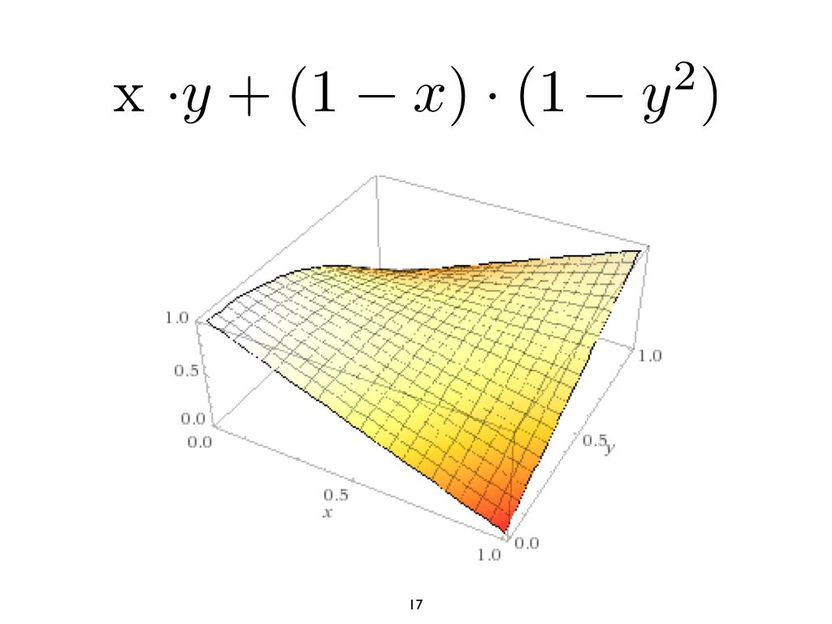
φ(c ∈ [0,1])= ∀ x ∈ [0,1] ∃ y ∈ [0,1] : x*y + (1-x)*(1-y²) >= c
Motivating Labs

Slide 26
Goal of a Lab
Make a contribution to society
  Development
    If the lab is useful, employees will use it to build better components for products
  Research
    If the lab is useful
      many contributors will join
      you might win an award
  Teaching
    If the lab is useful, the students will have fun challenging each other and learning together

Slide 27
Software Development with SCG
Process: Improve software and requirements
Agile Software Development role
Providing generic functionality
  competition software
    check all rules defined by claim family
  baby avatars
    defined by claim family; makes random choices

Slide 28
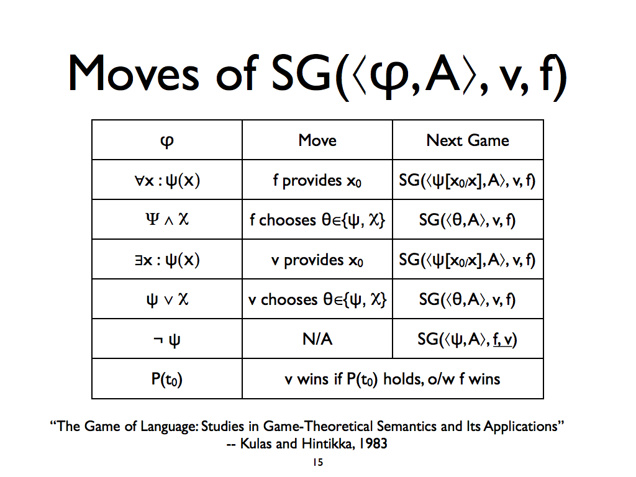

Slide 29
Generic Investigation Cycles
Pose a Question
Pose another
Question
Find a Solution
Design
Experiments
Evaluate Results
Popper
Evaluate Results
Run
Experiments

Slide 30
Investigation Cycles
For questions whose solution can be automated.
Cycles
  Debug, Improve question: red right cycles
  Debug, Improve solution: left gray cycle

Slide 31
Important Events during Investigation Cycles
First owner/user who proposes popular question.
First user who finds a solution that is not successfully challenged by experiment.

Slide 32
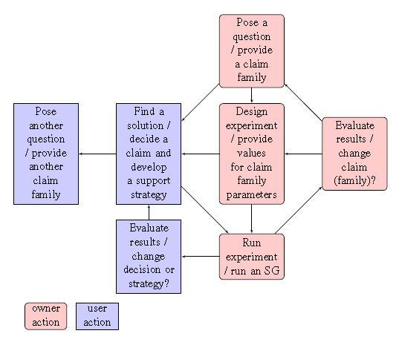

Slide 33
SCG: Software Development
Investigation Cycles
Pose a question: Claim Family: Owner
Software Manager
Requirements
Evaluate Results: Histories+Estimates (Claim,Users):Owner
Find Issues with Requirements
Pose a Different Question as Owner:
User
Generalize/Reduce
Design Experiments:
Tournament + SG-Instance
:Owner + System
Find a solution:
Avatar: User
Developer
Evaluate Results: Histories+Estimates (Claim,Users): User
Find Issues with Software= Avatar
Popper
Run Experiments: Run Competition: System
algorithm on next slide

Slide 34
Run Experiments
TM: tournament mechanism
Investigation Cycles
PSM: Position Selection Mechanism
Player{Position preferredPosition;}
SCG(Set<Player> players, Claim claim, TM tm, PSM psm){
  //set preferred positions for players for claim;
  Set<ArgumentResult> argumentResults= empty;
while(true){
    UserEval ue = tm.algoUE(players, argumentResults);
    argumentResults.append(tm.algoSCD.runRound(players, ue, psm));
if(tm.algoSCD.isfinished()){return ue;}
}
}
runRounds runs one or more SGs

Slide 35
A Fair TM
A full round robin tournament of CAGs, eliminates the potential unfairness arising from playing a different number of games against any other opponent or being forced more often.

Slide 36
Example Lab: Polynomial-time Decision Problems
Motivating Labs
Parameters: Decision Problem, monotonic function
LandauAlgorithmic(D:DecisionProblem, f(n)) = Exists algorithm A for D ForAll inputs i of size at most n: runningTime(A,i) in soft O(f(n)).
  CobhamLandau(D:DecisionProblem,n^c)=D is in P (solvable in polynomial time)
  CobhamLandau(Primes,n^7.5) where n is the number of digits (AKS Algorithm).

Slide 37
What if you cannot do it?
It seems impossible.
Motivating Labs
If you could do it, you could also do many other things that seem impossible.
CookLab(D: DecisionProblem) = D is NP-complete = D in NP and ForAll D1: NP, problem D1 is polynomial-time reducible to D.
Cook showed: CookLab(Satisfiability) is true.
CookLab also known as CookLevinLab

Slide 38
Game behind CookLab
Motivating Labs
Expose any errors that could have been made. Claim is CookLab(D1).
  D1 is not in NP. Demonstrate that the algorithm either gives the wrong output or is too slow:
    Give n0,c,i0: runtime(A,i0)>c*size(i0)^k for all n>n0. k is the polynomial exponent.
  Explore the transformation algorithm and give an input where the algorithm breaks for one of two reasons:
    gives incorrect output
    is too slow

Slide 39
Second Contributor to
Cook Lab (21 claims): Karp
Motivating Labs
CookLab(0-1 integer programming)
CookLab(Clique)
CookLab(3-SAT)
CookLab(ChromaticNumber)
CookLab(MaxCut)
….

Slide 40
CookKarp Lab
Motivating Labs
CookKarpLab(D: DecisionProblem) = D in NP and Exists D1 in CookLab (i.e., D1 is NP-complete) s.t. D is polynomial-time reducible to D1.

Slide 41
StrassenLab
Motivating Labs
Matrix Multiplication Algorithms
StrassenLab(c in [2,3))=Exists M in MatrixMultiplicationAlgorithms: RunTime(M) in O(n^c) .
StrassenLab(2.80)
Lab proposed by Zurich Faculty (1969)

Slide 42
Detailed StrassenLab 1
Motivating Labs
Matrix Multiplication Algorithms
StrassenLab(c in [2,3), d in Nat)=Exists M in MatrixMultiplicationAlgorithms: ForAll inputs i of size n: RunTime(M,i) < d * (n^c) .
StrassenLab(2.80)
Lab proposed by Zurich Faculty (1969)

Slide 43
Detailed StrassenLab 2
Motivating Labs
Matrix Multiplication Algorithms
StrassenLab(c in [2,3))=Exists M in MatrixMultiplicationAlgorithms: Exists d in Nat: Exists n0 in Nat: ForAll inputs i of size n>n0: RunTime(M,i) < d * (n^c) .
StrassenLab(2.80)
Lab proposed by Zurich Faculty (1969)

Slide 44
Detailed StrassenLab 3
Motivating Labs
Matrix Multiplication Algorithms
StrassenLab(c in [2,3), d in Nat, n0 in Nat)=Exists M in MatrixMultiplicationAlgorithms: ForAll inputs i of size n>n0: RunTime(M,i) < d * (n^c) .
StrassenLab(2.80)
Lab proposed by Zurich Faculty (1969)

Slide 45
Contributors (besides Strassen)
Motivating Labs
Pan
Bini
Schoenhage
Romani
Coppersmith-Winograd (2.37)
Stothers
Williams

Slide 46
Outline
Introduction/Motivating Examples
Related Work
Our Approach
Evaluation
Conclusions

Slide 47
Current Approaches to Deciding Formal Science Claims
Related
Proofs.
  Too challenging for many.
    errors in proofs
Model checkers.
  Don’t handle “rich” structures.
Semantic Games.

Slide 48
Decision Making Using Semantic Games (SGs)
Related
A semantic game for a given claim⟨φ(p0), A⟩ is a game played by a verifier and a falsifier, denoted SG(⟨φ(p0), A⟩, verifier, falsifier), such that:
  A |= φ(p0) <=> the verifier has a winning strategy.

Slide 49
Toy Example
Related
S(c ∈ [0,2]) = ∀x ∈ [0,1]: ∃ y ∈ [0,1]: x + y > c
S(c) is true for c ∈ [0,1) and false for c ∈ [1,2]
Best strategy:
  for the falsifier: x=0
  for the verifier: y=1

Slide 50




Toy Example: SG Trace
Related
,
,
)
SG(∀x ∈ [0,1]: ∃ y ∈ [0,1]: x + y > 1.5
Provides 1 for x
Weakening (too much!)
,
,
)
SG(∃ y ∈ [0,1]: 1 + y > 1.5
Provides 1 for y
Strengthening
SG( 1 + 1 > 1.5
,
,
)
Wins

Slide 51
Related

Slide 52
Strategies
Related
A strategy is a set of functions, one for each potential move.

Slide 53
Related

Slide 54
Example
Related
For
  A potential falsifier strategy is: provideX(c){ 0.5 }.
  A potential verifier strategy is: provideY(x, c){ x }.

Slide 55
Example: SG Trace
Related
SG(
,
,
)
Provides 0.5 for x
Weakening (too much!)
SG(
,
,
)
Provides 0.5 for y
Strengthening
SG(
,
,
)
Wins

Slide 56
SG Properties
(Relevant to our approach)
Related
SG winners drive their opponents into contradiction.
Faulty verifier (falsifier) actions can produce a false (true) claim from a true (false) one.
Faulty actions will be exposed by a perfect opponent leading to a loss.
Winning against a perfect verifier (falsifier) implies that the claim is false (true).
Losing an SG implies that either you did a faulty action or you were on the wrong position.

Slide 57



C/S Systems
Related
Challenges
Define user contributions.
Evaluate users and their contributions
Combine user contributions.
Encourage and retain users.
Encouragement
User
contributions
Filter
Owners
∑
Combined user contributions
“Crowdsourcing systems on the world-wide web” --Anhai Doan, Raghu Ramakrishnan and Alon Y. Halevy, 2011
57

Slide 58
Generic Investigation Cycles
Related
Pose a Question
Pose another
Question
Find a Solution
Design
Experiment
Evaluate Result
Popper
Evaluate Result
Run
Experiment

Slide 59
Outline
Introduction/Motivating Examples
Related Work
Our Approach
Evaluation
Conclusions

Slide 60
Overview to our approach
We use SGs to collect evidences of truth of claims and skill/strength of users.
Egoistic users produce social welfare.

Slide 61
SG Advantages
SGs provides a foundation to:
  Combine user contributions : winner’s position and moves are assumed to be correct.
  Evaluate users: winner is assumed to be more skilled.
SGs can help retaining users as they can be fun to play and watch.
SGs have a collaborative nature. Winners provide information to losers. SGs help “educate” the players.

Slide 62
Avatar
Avatar
View lab as a language L of all claims that can be formulated in the lab.
L_{true} (L_{false}) is the set of true (false) claims in L.
There is a set of Skolem functions S_{true} used to defend claims in L_{true} and another set of Skolem functions S_{false} for L_{false}.
The burden of demonstrating the correctness of the Skolem functions is divided among two users.

Slide 63
Avatar
Avatar
S_{true} and S_{false} are certificates that can be used to defend the true and false claims.
A perfect avatar for a claim family is a pair (S_{true}, S_{false}), where the position chosen by the avatar is the winner position of SG(c, S_{true} , S_{false}).
An avatar (S_{true} , S_{false}) applied to a claim c is used to
  take a position on c
  defend the position taken

Slide 64
Example Avatar for
Saddle Point Lab
Avatar
Defending SaddlePoint(c)
  if SaddlePoint(c)
    use S_{true}: when given an x, construct y
    else use S_{false}: construct x
From now on: we assume that labs are well understood: we can write avatars.
Issue: In practice the avatars may be buggy.

Slide 65
Generic Investigation Cycles
Pose a Question
Pose another
Question
Find a Solution
Design
Experiments
Evaluate Results
Popper
Evaluate Results
Run
Experiments

Slide 67
Investigation Cycles
For questions whose solution can be automated.
Cycles
  Debug, Improve question: red right cycles
  Debug, Improve solution: left gray cycle

Slide 68
Proposed Approach
Owners provide a claim c, the unreliable users provide strategies (a.k.a. avatars) for playing SG(c,-,-).
We get the avatars to play numerous SGs. Then we combine their outcome to:
  Estimate the truth likelihood of c.
  Estimate the strength of avatars.
Users update their avatars and then we iterate.

Slide 69
First Shot: Using SGs
Given a claim c, run numerous SG(c, v, f) where v, f are chosen at random from the crowd.
  The more often the verifiers win, the more likely c is true.
  Users with more wins have better strategies.
Suppose c is true (false), and the falsifier (verifier) wins. This reduces the estimated truth likelihood of c.
Suppose c is true (false), and the falsifier (verifier) loses. This reduces the estimated skill level of the falsifier (verifier).

Slide 70
Generalizing SGs
First ask users for their favorite position.
If both choose the same position, force one to play the devil’s advocate.
Winner | Forced | Payoff (u, !u) | Truth evidence
u | None | (1, 0) | Pos(u)
u | u | (1, 0) | None
u | !u | (0, 0) | Pos(u)

Slide 71
PSM
Winner | Forced | Payoff (u, !u) | Truth evidence
u | None | (1, 0) | Pos(u)
u | u | (1, 0) | None
u | !u | (0, 0) | Pos(u)

Slide 72
Generalized Semantic Games
Forced players.
The algorithms to handle the unreliable users.
  PSM
  TM
    User evaluation.
    Claim evaluation.
Claim family relations.

Slide 73
Estimating Claim Truth Likelihood
Truth Likelihood = Ev / (Ev + Ef), where Ev(Ef) is the number of times the non-forced verifier (falsifier) wins. [unweighted]
Each win is weighted.

Slide 74
The Tournament Mechanism (TM)
SGs are binary interaction mechanisms that need to be scaled to the crowd.
CIM decides which SGs to play.
Several tournament options.
Should be simple and intuitive for users.
Need a fair TM with minimal effect on estimated user skill levels.

Slide 75
Software Development with SCG
Process: Improve software and requirements
Agile Software Development role
Providing generic functionality
  competition software
    check all rules defined by claim family
  baby avatars
    defined by claim family

Slide 76
Sources of Unfairness
Users u1 and u2, taking the same position on claim c, are not given the same chance if:
  u1 and u2 play a different number of SGs against any other opponents.
  Either u1 or u2 is forced more often.
  There are other players that are willing to lose against either u1 or u2 on purpose.

Slide 77
The Contradiction Agreement Game (CAG)
If two users choose different positions (contradiction) on a given claim. They play a regular SG.
If two users choose the same position (agreement) on a given claim. They play two SGs where they switch playing devil’s advocate.
CAGs eliminate the forcing advantage.

Slide 78
A Fair TM
A full round robin tournament of CAGs, eliminates the potential unfairness arising from playing a different number of games against any other opponent or being forced more often.

Slide 79
Outline
Introduction/Motivating Examples
Related Work
Our Approach
Evaluation
Conclusions

Slide 80
Use of SCG in courses
Software Development
  Baby avatar generated - important
  Software has to be reliable!
Algorithms
  Piazza
    Worked best on optimization problems

Slide 81
Synthetic Users (1)
A synthetic user with skill level p, denoted sup, makes the perfectly correct action with probability p and makes the perfectly incorrect action with probability (1-p).

Slide 82
Example Synthetic User
Perfectly Correct Actions
ProvideX(c){ 0.552 }
ProvideY(c, x){ min(x, x/(2-2*x)) }
Perfectly Incorrect Actions
ProvideX(c){ 0 }
ProvideY(c, x){ x>0.5?0:1 }

Slide 83
Synthetic Users (2)
A synthetic user sup chooses its position on a claim c to be the winner position of SG(c, sup, sup).
su1 will always choose the correct position.
Otherwise, the probability of choosing the correct position depends on the claim.

Slide 84
Evaluation with Synthetic Users
Context: Formal Science Wikipedia
Configurations of system:
  Set of players: skill distributions (uniform, bimodal, etc.)
  Claim families
    teaching: have perfect solution
    research: perfect solution not known
  Tournament mechanism (round-robin, Swiss, etc.)
    claim estimation and player estimation
  Position Selection Mechanism (CAG, RF, etc.)
  Weighting function

Slide 85
Conclusions
Our contributions
  Combine standard techniques: Semantic Games and Tournaments with new components (PSM, Weighting, etc.) to decide claims with unreliable users.
  Formal Science Wikipedia
    make knowledge active, disputable

Slide 86
Thank You!

Slide 87
Semantic Game (SG)
An SG is a structured formal argument between two players taking opposing positions. There is a single winner.
What does winning mean?
  supporting evidence for winner’s position
    weighted by strength of winner and loser
  winner is stronger (has better grasp of the underlying structure)

Slide 88
Connection to semantic games
Avatar
if true, YES-prover has winning strategy, Skolem function
if false, NO-prover has winning strategy, Skolem function
The prover executes the Skolem functions and checks who wins.

Slide 89
Avatar
Avatar
View lab as a language L of all claims that can be formulated in the lab.
L_{true} (L_{false}) is the set of true (false) claims in L.
There is a set of Skolem functions S_{true} used to defend claims in L_{true} and another set of Skolem functions S_{false} for L_{false}.
The burden of demonstrating the correctness of the Skolem functions is divided among two users.

Slide 90
Avatar
Avatar
S_{true} and S_{false} are certificates that can be used to defend the true and false claims.
A perfect avatar for a claim family is a pair (S_{true}, S_{false}), where the position chosen by the avatar is the winner position of SG(c, S_{true} , S_{false}).
An avatar (S_{true} , S_{false}) applied to a claim c is used to
  take a position on c
  defend the position taken

Slide 91
Example Avatar for
Saddle Point Lab
Avatar
Defending SaddlePoint(c)
  if SaddlePoint(c)
    use S_{true}: when given an x, construct y
    else use S_{false}: construct x
From now on: we assume that labs are well understood: we can write avatars.
Issue: In practice the avatars may be buggy.

Slide 92
True claim
player1/player2 | correct TP | correct S_{true} | incorrect S_{false}
correct TP | same correct pos.
correct S_{true} |  |  | correct defense
incorrect S_{false} |  | correct defense
Both players have problems with refuting false claims.
True claims will be defended properly.
False claims could be refuted incorrectly.

Slide 93
False claim
player1/player2 | correct TP | correct S_{true} | incorrect S_{false}
correct TP | same correct pos.
correct S_{true} |  |  | incorrect refutation?
incorrect S_{false} |  | incorrect refutation?
Both players have problems with refuting false claims.
True claims will be defended properly.
False claims could be refuted incorrectly.

Slide 94
Evidence-Based Evaluation
Vote
  Verifier, Falsifier
    wins: amplifies vote
    loses: weakens vote

Slide 97
Generic Investigation Cycles
Pose a Question:Owner
Evaluate Results:Owner
Pose a Different
Question as Owner
Design
Experiments
Find a Solution
Popper
Evaluate Results
Run
Experiments

Slide 98
Generic Investigation Cycles
Pose a Question
Pose another
Question
Find a Solution
Design
Experiments
Evaluate Results
Popper
Evaluate Results
Run
Experiments

Slide 99
Investigation Cycles
For questions whose solution can be automated.
Cycles
  Debug, Improve question: red right cycles
  Debug, Improve solution: left gray cycle

Slide 100
Important Events during Investigation Cycles
First owner/user who proposes popular question.
First user who finds a solution that is not successfully challenged by experiment.

Slide 101
Investigation Cycles
SCG specific
Pose a question: Claim Family: Owner
Evaluate Results: Histories+Estimates (Claim,Users):Owner
Pose a Different Question as Owner:
User
Design Experiments:
Tournament + SG-Instance
:Owner + System
Find a solution:
Avatar: User
Evaluate Results: Histories+Estimates (Claim,Users): User
Popper
Run Experiments: Run Competition: System

Slide 102
Investigation Cycles
SCG: Chess specific
Pose a question: Claim Family: Owner
Can white force a win for game config. c?
Evaluate Results: Histories+Estimates (Claim,Users):Owner
Find issues with config. c
Pose a Different Question as Owner:
User
Choose a different config. c’
(Reduce)
Design Experiments:
Tournament + SG-Instance
:Owner + System
Find a solution:
Avatar: User
Chess player writes program (winning strategy)
Evaluate Results: Histories+Estimates (Claim,Users): User
Find issues with winning strategy
Popper
Run Experiments: Run Competition: System

Slide 103
SCG: Software Development
Investigation Cycles
Pose a question: Claim Family: Owner
Software Manager
Requirements
Evaluate Results: Histories+Estimates (Claim,Users):Owner
Find Issues with Requirements
Pose a Different Question as Owner:
User
Generalize/Reduce
Design Experiments:
Tournament + SG-Instance
:Owner + System
Find a solution:
Avatar: User
Developer
Evaluate Results: Histories+Estimates (Claim,Users): User
Find Issues with Software= Avatar
Popper
Run Experiments: Run Competition: System
algorithm on next slide

Slide 104
Run Experiments
TM: tournament mechanism
Investigation Cycles
PSM: Position Selection Mechanism
Player{Position preferredPosition;}
SCG(Set<Player> players, Claim claim, TM tm, PSM psm, WeightingFunction weightingFunction){
  //set preferred positions for players for claim;
  Set<ArgumentResult> argumentResults= empty;
while(true){
    UserEval ue = tm.algoUE(players, argumentResults);
    ClaimEval ce = tm.algoCE(players, argumentResults, ue, weightingFunction);
argumentResults.append(tm.algoSCD.runRound(players, ue, psm));
if(tm.algoSCD.isfinished()){return [ue,ce];}
}
}
runRounds runs one or more SGs

Slide 105
Extended SGs (overview)
Extended SGs
Position Selection Mechanism (PSM)
  select positions based on user preferences
Tournament Mechanism (TM)
  to scale SGs to an arbitrary number of players
  three algorithms
    user estimator (algoUE): to estimate player strength
      soundness
    claim estimator (algoCE): to assess claim truth based on the outcome of several SGs.
      resilient to attacks on truth either by weak or malicious players.
    scheduler (SCD)

Slide 106
Position Selection Mechanism (PSM)
Extended SGs
PSM
  assigns positions to players taking into account
    preferred positions of players
    claim
  determines
    scores
    evidence
  must satisfy
    fairness
    progress

Slide 107
PSM
Extended SGs
In case the loser was forced, the evidence that the winner is stronger might be distorted and is ignored.
In case the winner was forced, the evidence that the winner’s position is correct might be distorted and is ignored.

Slide 108
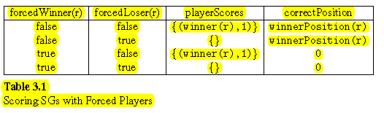
PSM
Extended SGs
forced players

Slide 109
PSM
Extended SGs
forcedWinner(SGResult r)= preferredPosition(winner(r)) !=winnerPosition(r)
forcedLoser(SGResult r)= preferredPosition(loser(r)) ==winnerPosition(r)

Slide 110
Tournament Mechanism
Extended SGs
binary game -> multiple games -> ranking of users
also want: most likely correct position on underlying claim based on preferred position of users
Scheduler (SCD)
  fair evaluation of users
  minimization of number of binary games
User Estimator (UE)
  sound
Claim Estimator: most likely correct position
  resilient to attacks on truth
    by weak or malicious users

Slide 111
Attacks on Truth
Extended SGs
Formal Decision Making under Denial of Truth Attacks (DoT)
  CE is flooded with distorted evidence of the correctness of the incorrect position.
  Discriminate between evidence.
Targeted Attacks
  selectively failing to defend the correct position in a critical game.

Slide 112
Denial of Truth Attack
Extended SGs
Generate a large number of distorted evidences.
  evidences
    supporting the incorrect position
    about who is stronger
Make system unavailable to do its intended job: Find the truth.
In analogy to: Denial of Service Attack.

Slide 113
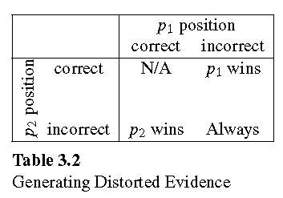
Claim Estimation
Distorted Evidence
Extended SGs

Slide 114
Meritocracy
Extended SGs
User evaluation gives rise to meritocratic claim evaluation.

Slide 115
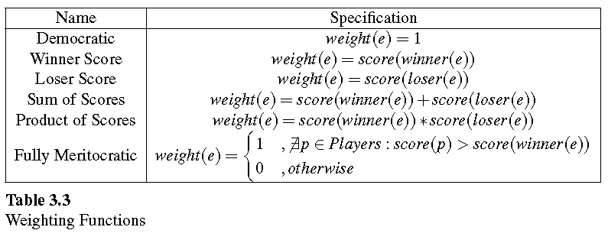
WeightingFunctions
Extended SGs

Slide 116
Claim Evaluation
Extended SGs
Input: Claim, Players with Preferred Positions (Verifier or Falsifier), Arguments between pairs of Players following ArgumentProtocol(Claim), ArgumentResults, PositionSelectionMechanism with Scoring Table, TournamentMechanism.
Output:
  Most likely correct position for Claim.
  User evaluation (strength for each Player).

Slide 117
Scheduler
Extended SGs
Two important conflicting requirements
  fair evaluation
  minimum number of required binary games

Slide 118
cycle
truth unknown; strength of both + outcome of game
claim eval users
strength of users would depend on claim eval
how is claim eval related to user eval.

Slide 119
Rationale for User Skill Estimation
Claim truth is not always known. The best we can do is to rely on our estimate of claim truth which depends on user evaluation. There are two ways to view the strength of users:
1. Strength is related to taking the correct position.
2. Strength is related to winning SGs.
The second perspective requires a larger skill set than the first. Because, it is a property of SGs that it is impossible to defend the incorrect position against a perfect player. Therefore, we take the second perspective and define the strength as the ratio of wins.
Claim evaluation depends on user evaluation.

Slide 120
Is User Skill Estimation Dependent on Correct Position?
Incorrect positions are impossible to defend against a perfect player and are harder to support in general. Therefore, the correctness of the position taken by the user is reflected in the fraction of games the user wins.
The truth or falsity of claims is often unknown and it is derived from the results of the semantic games and the strength of players participating in them.
Yes!

Slide 121
Furthermore, it is not enough to take the correct position to be a strong player. It is also critical for users to be able to support the position they take. Otherwise, they are not strong players.

Slide 122
What is the practical significance of our system? Let’s assume, a real project is about solving a computational problem. Our system is based on an investigation cycle. Lab owners try to attract talented users to the lab defining the computational problem. The investigation cycle has a loop to improve the quality of the solution of the computational problem as well as a cycle to improve the quality of the lab definition. Both kinds of improvements are promoted by the semantic games.

Slide 123
Position = VERIFIER | FALSIFIER;
ArgumentResult {
  Player verifier;
  Player falsifier;
  Player winner;
  Player loser;
}
Player{
  Position preferredPosition;
}

Slide 124
Evidence e for claim c and game g(c)
weight(e): different algorithms
winner(e)= winner(g)
loser(e)= loser(g)
forced(e) (0 or 1 forced players)
verifier(e)=
falsifier(e)
admissible(e)
no evidence for strength: just counting

Slide 125
Software Developers
Voting with evidence
Claim c, set of developers U, set TP of two party certificates providing evidence whether c is true (verifier) or false (falsifier).
  SG(u1,u2,p)=u: developer u1 was

Slide 126
Cook Lab
Parameter: Decision Problem D
NP : Decision problems with polynomially checkable certificate.
CookLab(D: DecisionProblem) = D in NP and ForAll D1: NP, problem D1 is polynomial-time reducible to D.
Cook showed: CookLab(Satisfiability) is true.

Slide 127
Game behind CookLab
Expose any errors that could have been made. Claim is CookLab(D1).
  D1 is not in NP. Demonstrate that the algorithm either gives the wrong output or is too slow:
    Give n0,c,i0: runtime(A,i0)>c*size(i0)^k for all n>n0. k is the polynomial exponent.
  Explore the transformation algorithm and give an input where the algorithm breaks for one of two reasons:
    gives incorrect output
    is too slow

Slide 128
Second Contributor to
Cook Lab (21 claims): Karp
CookLab(0-1 integer programming)
CookLab(Clique)
CookLab(3-SAT)
CookLab(ChromaticNumber)
CookLab(MaxCut)
….

Slide 129
CookKarp Lab
CookKarpLab(D: DecisionProblem) = D in NP and Exists D1 in CookLab (i.e., D1 is NP-complete) s.t. D is polynomial-time reducible to D1.

Slide 130
StrassenLab
Matrix Multiplication Algorithms
StrassenLab(c in [2,3))=Exists M in MatrixMultiplicationAlgorithms: RunTime(M) in O(n^c) .
StrassenLab(2.80)

Slide 131
Contributors (besides Strassen)
Victor Pan
Bini
Schoenhage
Romani
Coppersmith-Winograd (2.37)
Stothers
Williams

Slide 132
Russell-Sundaram-Canetti Lab
Symmetric Alternation
S 2P : parameter: Language L
interactive proof system x in L, YES-prover, NO-prover.
special case of what we do?
claims are of the form x in L.
To substantiate their claims, provers give strings y and z as certificates.
irrefutable certificates
see “Oblivious Symmetric Alternation” for good intro to Symmetric Alternation.

Slide 133
Simple Example: Claim Family
language L of true claims: S(c)=ForAll x in [0,1] Exists y in [0,1]: x*y + (1-x)*(1-y^2)>= c, c in [0,1].
Irrefutable certificate for
  YES-prover certificate: Skolem function f that computes y=f(x).
  NO-prover certificate: x-coordinate of saddle point
L is in S₂^{P} ?

Slide 134
Simple Example: Claim Family
language L of true claims: S(c)=ForAll x in [0,1] Exists y in [0,1]: x*y + (1-x)*(1-y^2)>= c, c in [0,1].
Irrefutable certificate for
  YES-prover certificate: Skolem function f that computes y=f(x).
  NO-prover certificate: x-coordinate of saddle point

Slide 135
Connection to semantic games
if true, YES-prover has winning strategy, Skolem function (= certificates)
if false, NO-prover has winning strategy, Skolem function
The polynomial prover executes the Skolem functions and checks who wins.

Slide 136
Avatar
inspired by Ravi
View lab as a language L of all claims that can be formulated in the lab.
L_{true} (L_{false}) is the set of true (false) claims in L.
There is a set of Skolem functions S_{true} used to defend claims in L_{true} and another set of Skolem functions S_{false} for L_{false}.
The burden of demonstrating the correctness of the Skolem functions is divided among two users.

Slide 137
Avatar
S_{true} and S_{false} are certificates that can be used to defend the true and false claims.

Slide 138
Example Avatar for
Saddle Point Lab
Defending SaddlePoint(c)
  if SaddlePoint(c)
    use S_{true}: when given an x, construct y
    else use S_{false}: construct x

Slide 140
[4:41:22 PM] Ahmed Abdelmeged: http://en.wikipedia.org/wiki/Glicko_rating_system
[4:27:57 PM] Ahmed Abdelmeged: http://research.microsoft.com/pubs/67956/NIPS2006_0688.pdf

Slide 141
Lieberherr-Specker Lab
Parameter: Generalized Satisfiability Problem
Given set of relations R
R-formulas, predicate F on R-formulas.
LSClaim(R,F,c) = ForAll R-formulas s satisfying F(s) Exists assignment J in Assignments(s): fsat(s,J)>=c.
LSOptClaim(R,F) = Exists c in [0,1]: LSClaim(R,F,c) and ForAll e > 0: LSCLaim(R,F,c+e)

Slide 142
Lieberherr-Specker Lab: Example
Generalized Satisfiability Problem
Given set of relations R = or-relations with optionally negated literals
R-formulas are CNFs, predicate F on R-formulas = any pair of clauses is satisfiable.
LSClaim(R,F,0.615) = ForAll R-formulas s satisfying F(s) Exists assignment J in Assignments(s): fsat(s,J)>=c.
LSOptClaim(R,F) = Exists c in [0,1]: LSClaim(R,F,c) and ForAll e > 0: !LSCLaim(R,F,c+e)
  c= (sqrt(5)-1)/2= 0.618…

Slide 143
Johnson Lab: Example
Satisfiability Problem, CNFs
Predicate F(k,s)) on CNFs = all clauses are of at least length k.
JClaim(k,c) = ForAll CNFs s satisfying F(k,s) Exists assignment J in Assignments(s): fsat(s,J)>=c.
JOptClaim(k) = Exists c in [0,1]: JClaim(k,c) and ForAll e > 0: !JCLaim(k,c+e)
  c= 1-(1/2^k))

Slide 144
Scoring with Forced Players
forced |  | payoff |  | correct position
w | !w | w | !w
not-forced | not-forced | 1 | 0 | w
not-forced | forced | 0 | 0 | w
forced | not-forced | 1 | 0 | N/A
forced | forced | 0 | 0 | N/A

Slide 145
Scoring Table
forced |  | payoff |  | Explanation
w | !w | w | !w | !w = loser
not-forced | not-forced | 1 | 0 | !w is self-contradictory (1)
not-forced | forced | 0 | 0 | !w is handicapped (2)
forced | not-forced | 1 | 0 | !w is self-contradictory (3)
forced | forced | 0 | 0 | exclude, not needed (4)
winner who gets a point is better than the loser. A self-contradictory
player is weaker than the winner.

Slide 146
CUP algorithm.
claim c.
ask for positions: verifiers and falsifiers.
Determine the two best of each.
Play 10 games between the two best verifiers and choose the one with the highest winning ratio.
Same for falsifiers.
The top verifier plays against the top falsifier.

Slide 147
Claim Kinds: Avatars
Winning strategy is revealed by semantic game. Those claims cannot be played multiple times.
  Claims of the form: Exists d in D: p(d).

Slide 148
SCG
We postulate games that produce two classes of evidence:
  the winner is stronger than the loser
  the winner’s position is the correct position
Admissibility contexts

Slide 149
SCG
based on two-person games
adds a
  Position Selection Mechanism (PSM)
    Minimize number of forced players
    Table: Forced Scoring
  Tournament Mechanism (TM)
    Scheduler (SCD)
    User Evaluator (UE)
    Claim Evaluator (CE)
      Meritocratic: Degree of Meritocrcy

Slide 150
Degree of Meritocracy
uniform: all evidences carry the same weight.
extremely meritocratic: evidences involving the winner of the tournament carry weight 1 and all others carry the weight 0.

Slide 151
Full Round-Robin with n players and CAGs
at most n(n-1) games (exact if all are CAGs).
Those games produce basic evidences.
Combine evidences to best player and correct position. (Might have multiple good players for different aspects.)
What is best strategy for combining evidences?
Multiple evaluations of same round robin.

Slide 152
Information retrieval problem
combine evidences
frame of discernment
mass function: sum of strengths
Dempster’s rule
clustering of two-party certificates

Slide 153
Constraint satisfaction
Given a set of two-party certificates:
  evidences for strength
  evidences for position
w(s1,s2)=a*s1 + b*s2
Find a subset of two party certificates that give the best result.
Find an assignment to position and strength that satisfies the most two-party certificates.
Most probable world.

Slide 154
Constraint satisfaction
Given a set of two-party certificates:
  evidences for strength
  evidences for position
Find a subset of two party certificates that give the best result.
Find an assignment to position and strength that satisfies the most two-party certificates.
Most probable world.

Slide 155
Evidence Classes
Better to wait with engaging an evidence until we know the good players.

Slide 156
PreferredPosition (of player) | correct | incorrect
Player: non-malicious | win | win
Player: malicious | win if opponent takes incorrect position | win if opponent takes correct position

Slide 157
Incorrect Evidences
Assumption: falsifier is the incorrect position.
When falsifiers play against each other, one of them will generate an incorrect evidence.
falsifiers cannot generate a correct evidence.
Therefore, if malicious players could be present, we ignore evidences from games of the form falsifier/falsifier and verifier/verifier.
Games between falsifiers only generate predetermined evidences.

Slide 158
Cup algorithm still works
Games between verifiers only still produce

Slide 159
Resilient Tournament Evaluation
Take only evidences from games where both players take opposite positions and the loser has high merit.
The Meritocracy Cup algorithm is a resilient tournament evaluation.
  The best Falsifier and the best Verifier should have high strength. There are border cases, like if there is only one falsifier.

Slide 160
Claim Evaluation Environment (CE)
Spectrum: degree of meritocracy
  low meritocracy: Democratic CE
    all evidences carry the same weight
  high meritocracy: Fully meritocratic CE
    all evidences involving the winner have weight 1, all other evidences have weight 0.

Slide 161
As Data Clustering Problem?
http://dataclustering.cse.msu.edu/papers/TPAMI-0239-0504.R1.pdf
evidences as data
some evidences: for true, for false

Slide 162
Denial of Truth Attack
Generate a large number of distorted evidences.
  evidences supporting the incorrect position
  evidences about who is stronger
Make system unavailable to do its intended job: Find the truth.
In analogy to: Denial of Service Attack.

Slide 164
winning ratio = score / number of SGs

Slide 165
JPA: Java persistence API
Bean shell: turn text into a class object

Slide 166
Asymptotic Bounds
Parameter: Decision Problem
LandauAlgorithmic(D:DecisionProblem, f(n)) = Exists algorithm A for D ForAll inputs of size n: A.runningTime(n) in O(f(n)).
  CobhamLandau(D:DecisionProblem,n^c)=D is in P (solvable in polynomial time)

Slide 167
What if you cannot do it?
It seems impossible.
If you could do it, you could also do lots of other impossible things.
CookLab(D: DecisionProblem) = D in NP and ForAll D1: NP, problem D1 is polynomial-time reducible to D.

Slide 168
Run Experiments
Player{Position preferredPosition;}
SCG(Set<Player> players, Claim claim, TM tm, PSM psm, WeightingFunction weightingFunction){
  //set preferred positions for players for claim;
  Set<ArgumentResult> argumentResults= empty;
while(true){
    UserEval ue = tm.algoUE(players, argumentResults);
    ClaimEval ce = tm.algoCE(players, argumentResults, ue, weightingFunction);
argumentResults.append(tm.algoSCD.runRound(players, ue, psm));
if(tm.algoSCD.isfinished()){return [ue,ce];}
}
}
runRounds runs one or more SGs

Slide 169
Evaluation with Synthetic Avatars
Context: Formal Science Wikipedia
Configurations of system:
  Set of players: skill distributions (uniform, bimodal, etc.)
  Claim families
    teaching: have perfect solution
    research: perfect solution not known
  Tournament mechanism (round-robin, Swiss, etc.)
    claim estimation and player estimation
  Position Selection Mechanism (CAG, RF, etc.)
  Weighting function

Slide 170
Formal Science Wikipedia
Purpose: bring formal science knowledge into an active, objectively refutable form on the web.
Formal science

Slide 171
Interactive Proofs / SCG
IP: enable the establishment of a claim via a statistical argument without providing any additional information as to why it is true. Works for any claim in PSPACE.
SCG: enable the establishment of a claim via a statistical argument (combining evidence) without providing a proof as to why it is true. Works for any logic with semantic games. SCG is more general, but cannot provide the same bounds as IP.

Slide 172
Interactive Proofs / SCG
IP: Prover and Verifier.
SCG: Verifier (Exists) and Falsifier (ForAll).
note the switch: Verifier to Falsifier.

Slide 173
Interactive Proofs
interactive proof system for L is an interactive protocol (P, V)
common input: x
Prover
Verifier
. . .
# rounds = poly(|x|)
accept/reject

Slide 174
SCG
SCG for L is an interactive protocol (V, F)
common input: x
Verifier
Falsifier
. . .
# rounds = poly(|x|)
accept/reject

Slide 175
Interactive Proofs
interactive proof system for L is an interactive protocol (P, V)
  completeness: x ∈ L ⇒
  Pr[V accepts in (P, V)(x)] ≥ 2/3
  soundness: x ∉ L ⇒ ForAll P*
  Pr[V accepts in (P*, V)(x)] ≤ 1/3
  efficiency: V is p.p.t. machine
repetition: can reduce error to any ε
p.p.t. = probabilistic polynomial-time

Slide 176
SCG
SCG for claim family for L is an interactive protocol (V, F)
  completeness: x ∈ L ⇒
    if V is perfect: ForAll F*: F* accept
  soundness: x ∉ L ⇒
    if F is perfect: ForAll P*: F reject

Slide 177
Decision Making Using Unreliable Users
TM = Tournament Mechanism
PSM = Position Selection Mechanism
SCG(Set<User> users, Claim claim, TM tm, PSM psm, W8ingFunction w8ingFunction){
Map<User,position> preferredPositions = …;
Set<ArgumentResult> argumentResults= empty;
while(true){
UE = algoUE(users, argumentResults);
CE = algoCE(users,UE, preferredPositions,
argumentResults, w8ingFunction);
argumentResults.append(tm.runRound(
preferredPositions, UE, psm)); // semantic games
if(tm.isfinished()) {return [UE,CE];}
}
}

Slide 178
Landau
f(n) in O(g(n)): Exists d in PosReal: Exists n0 in Nat: ForAll n > n0: f(n) < d * g(n)

Slide 179
Divide and Conquer Lab ?

