Slide 1

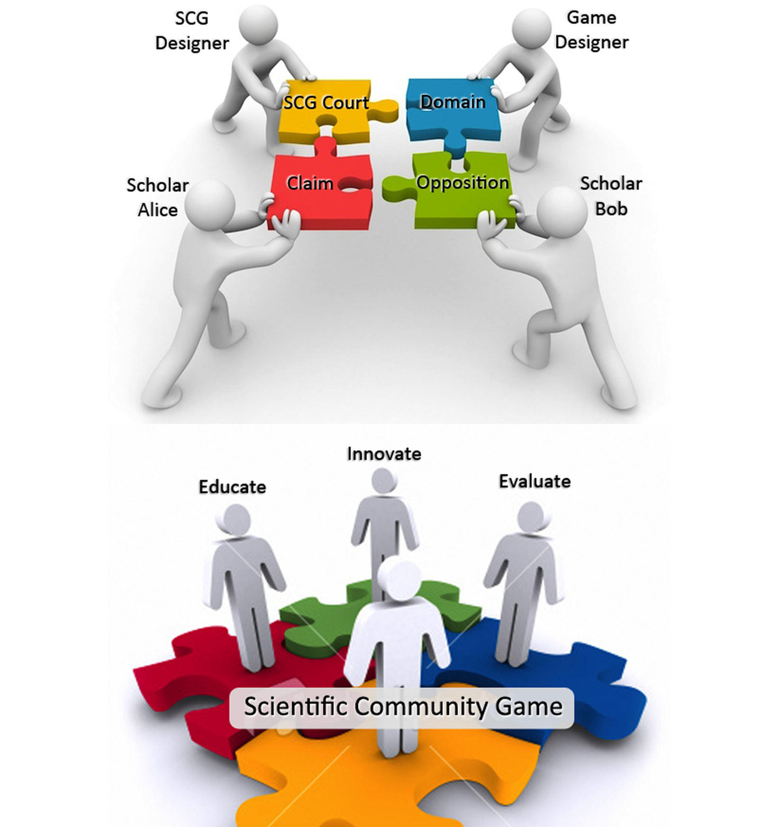
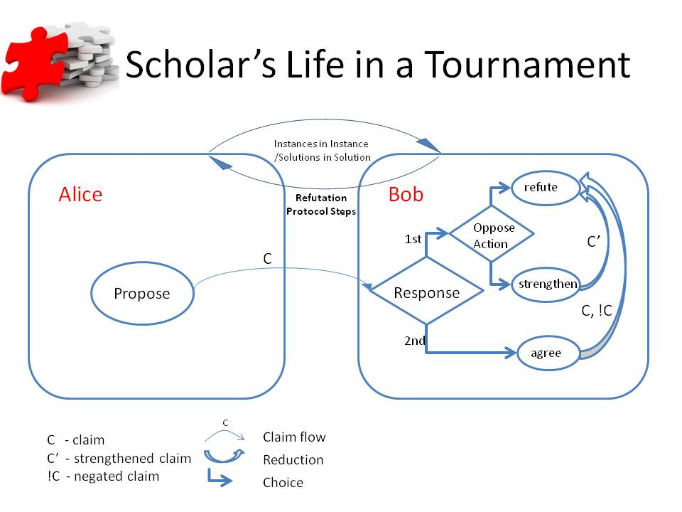
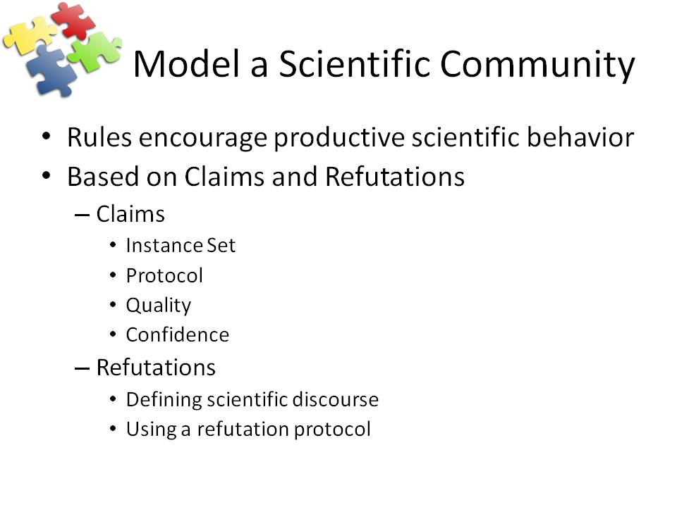
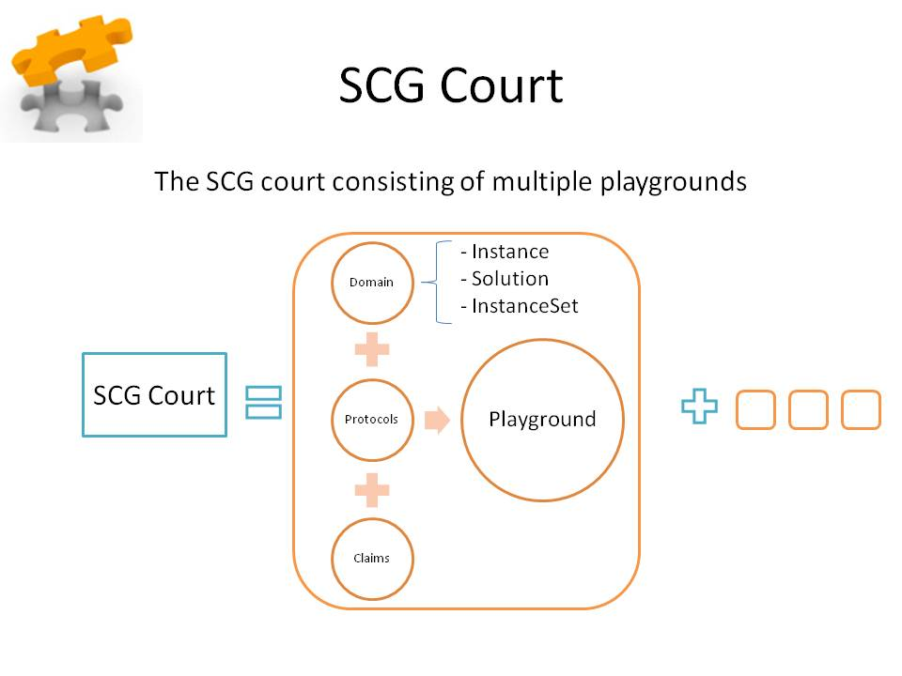
The Scientific Community Game
Education and Innovation Through Survival in a Virtual World of Claims
Karl Lieberherr, Ahmed Abdelmeged, Yue Liu
Northeastern University
College of Computer and Information Science
ABSTRACT ID# 2083
INTRODUCTION
APPLICATIONS
The Scientific Community Game (SCG) is in the spirit of Karl Popper who is one of the prominent philosophers of science of the 20th century. The SCG involves proposing and opposing claims related to a constructive domain (e.g., STEM domains in computer science, mathematics, engineering, etc.). Central to opposing claims is refuting claims based on a refutation protocol. When playing the game, scholars make constructive claims about the domain and oppose others’ claims. The scholars who are the most successful in defending and opposing claims win the game and gain a high reputation in the community. The main benefits of the game are: (1) the scholars give each other constructive feedback about their claims. Scholars who lose points gain knowledge to improve their game in the future. (2) When scholars try to maximize their reputation points and win the game, they create a common good: knowledge. The claims that have not been successfully opposed are candidates for truth which benefit the social welfare. (3) The competition and collaboration are well structured and effective. The scholars will have a consistent interface for all problems and a community for comparing various solution approaches fairly. (4) The game is fun and adjusts to the skill levels of scholars. The SCG can be played productively for (1) developing reliable software for computational problems, (2) evaluating potential employees, (3) developing new knowledge in the given domain, (4) evaluating algorithmic innovations fairly and (5) teaching software development / problem solving techniques in a fun game environment.
- Software Development for
Computational Problems
Algorithm Design
Mathematical Problem Solving
Experiential Learning
Examples of
Instance / Solution:
Raw Materials / Product
Algorithm / Input
Number / Graph
Network / Flow
Expression / Assignment
Number / Number
Graph / Path
Numbers / Decision Tree
Terrain / Trajectory
Return On Investment for playground designers: a small investment in defining a domain, etc. produces an interactive environment to assimilate and create domain knowledge.
Return on Investment for scholars and avatar designers: The SCG rules need to be learned only once because they are the same across playgrounds. A small investment in learning the SCG rules and a domain etc. leads to numerous learning and teaching and innovation opportunities. The more a scholar teaches, the higher the scholar’s reputation.
FUTURE WORK
REFERENCE
CONTACT
Web Application for Crowd Sourcing and Education. On-line
definition of playgrounds to be used by managers and teachers.
Providing a library of predefined domains, protocols, claims and
playgrounds. In SCG Court allow tournaments where humans
play role of scholar (currently only avatar (software) play role of
scholar). A perfect scientific community is one where the scholars
agree: how far from the perfect state is a given scientific community?
Related Work: Generalizing and Improving TopCoder
The Specker Challenge Game for Education and Innovation in Constructive Domains, with Ahmed Abdelmeged and Bryan Chadwick, Keynote talk and paper at Bionetics 2010 Cambridge, December 2010, Springer Verlag.
Karl Lieberherr
College of Computer and Information Science
Email: lieber@ccs.neu.edu
Phone: 617-373-2077
Website: http://www.ccs.neu.edu/home/lieber

