Slide 1
Access Query Builder:
Building Queries with the Principle of Least Information
Karl Lieberherr

Slide 2
References
Richard Rasala
Law of Demeter
Berkeley CS 186 slides (for example only)
http://www.northeastern.edu/rasala/cs1100-tutorials/access-query/index.htm
http://www.ccs.neu.edu/home/lieber/LoD.html
http://en.wikipedia.org/wiki/Law_of_Demeter

Slide 3
New Rule we follow
Leads to queries that are easier to develop and debug!

Slide 4
Principle of Least Information for
Query Writing
A query does a join of the minimum number of tables to provide the required fields and their correct values. A query also does a projection of the minimum number of fields needed. In addition, a query does exactly one of four things
  calculated field: There are two kinds: introduce a calculated field
    without aggregation.
    using aggregation, i.e., with a Totals-query that does non-trivial aggregation (sum, average, etc.).
  elimination of duplicates: eliminate duplicate rows.
  row selection: select a subset of the rows using a condition.
Leads to queries that are easier to develop and debug!

Slide 5
Principle of Least Information for Queries
1. Calculated Field
1. Without Aggregation
2. Elimination of Duplicates
3. Selection
2. With Aggregation
(Totals Query)

Slide 6
Why minimum information?
Don’t want to overload and confuse our brains.

Slide 7
What is minimized?
Minimum number of tables to achieve correct results.
Minimum number of fields are selected (projection) to achieve correct result.
Each query implements one task involving a minimum but correct join, and a minimum projection and one of introducing a calculated field, possibly with aggregation, elimination of duplicates and row selection. We minimize the operations performed by a query to one of the above.

Slide 8
Pure join
If you need a pure join of tables, do a row selection without a condition.

Slide 9
Example
We use the sailors database from a lecture at Berkeley.

Slide 10
Example Database
Sailors
Boats
sid | sname | rating | age
1 | Fred | 7 | 22
2 | Jim | 2 | 39
3 | Nancy | 8 | 27
bid | bname | color
101 | Nina | red
102 | Pinta | blue
103 | Santa Maria | red
Reserves
sid | bid | day
1 | 102 | 9/12
2 | 102 | 9/13

Slide 11
Find sailors who reserved two or more boats
Next slide shows a confusing way of writing a query!

Slide 12
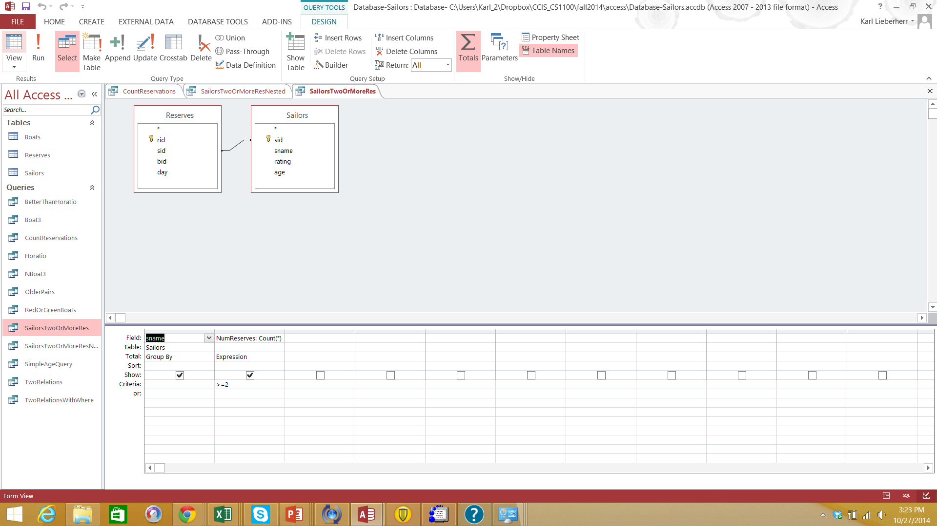

Slide 13
Same Using Nested Query:
Find sailors who reserved two or more boats
Subquery CountReservations not shown. It counts the number of reservations per sailor.
We assume the names are unique; otherwise we need to add the disambiguation pattern.

Slide 14
