Slide 1
Access Test Solutions Fall 2014
Questions 7 and 8
Karl Lieberherr

Slide 2
Query 7
How many courses has each instructor taught during 2011? List LastName and number of courses.
  Which patterns come to mind?
    AggregateForOther
    Disambiguation

Slide 3
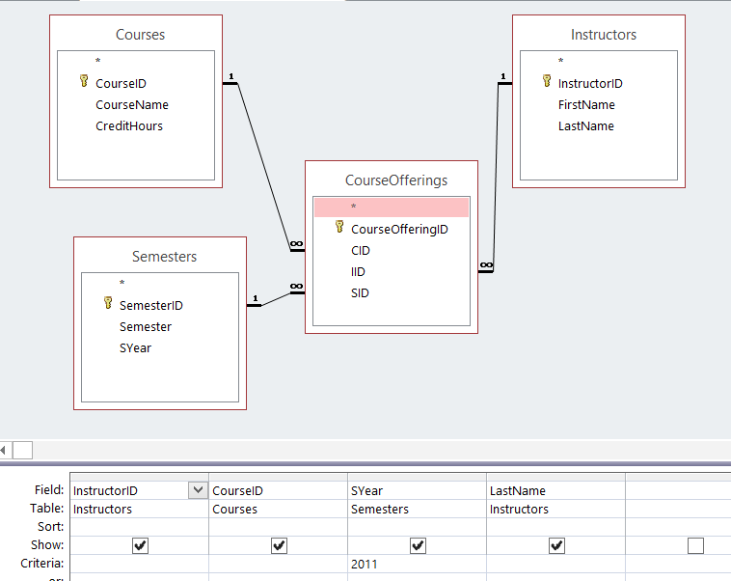
Query7a: Courses taught by Instructor in 2011

Slide 4
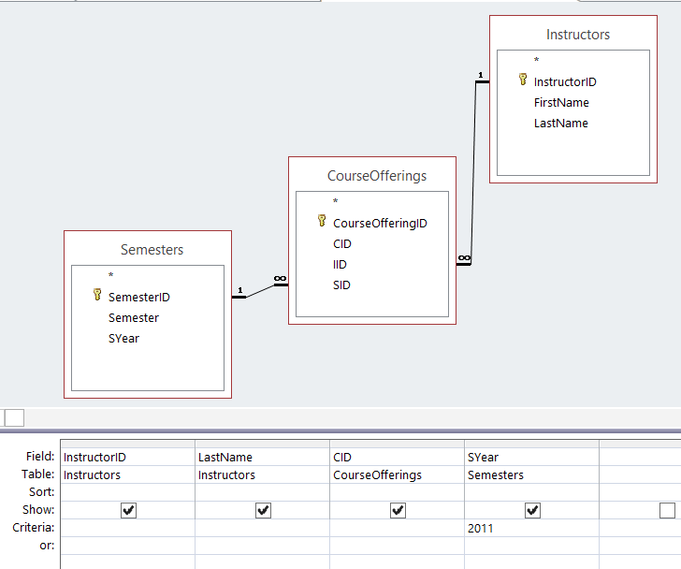
Alternative for Query7a
Alternative is correct
because CID has one
CourseID associated
with it.

Slide 5
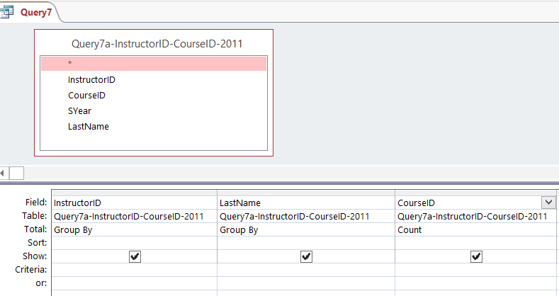
Query7: Count Courses

Slide 6
Query 8
How many distinct courses has each instructor taught during 2011? List LastName and number of distinct courses.
Differences to Query 7 highlighted in red.
Patterns: same as for 7 and add: Required Elimination of Duplicates.
Important: If there is a small change in the problem formulation there should be a small change in the solution.

Slide 7
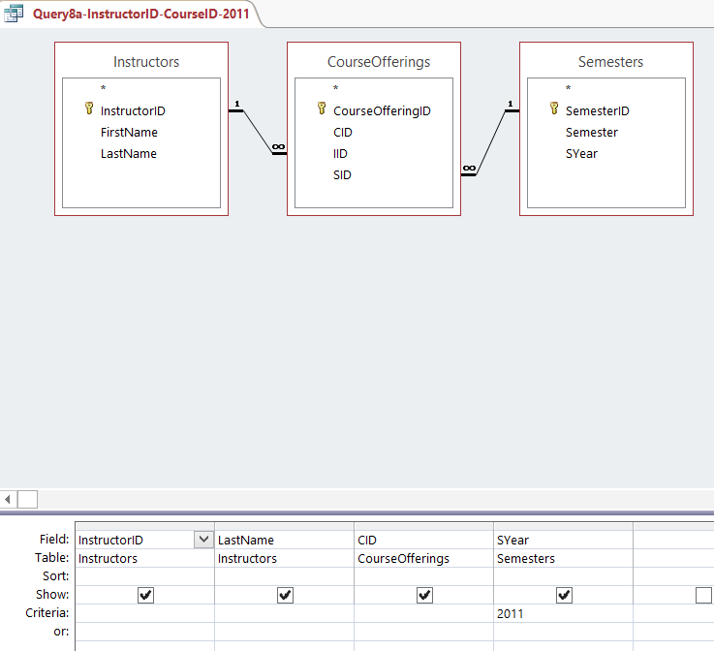
Query8a = Query7a

Slide 8

Output
16 rows
eliminate duplicates

Slide 9
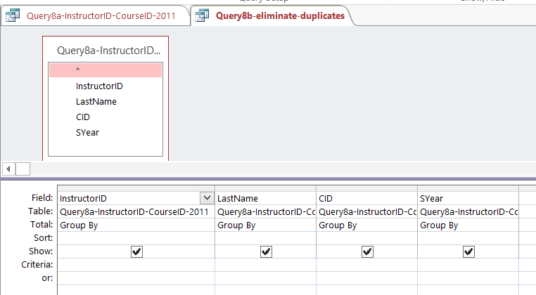
Eliminate duplicates

Slide 10
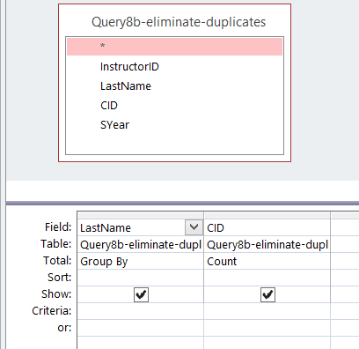
Query8: identical to Query7, except using 8b.

Slide 11
Difference between Question 7 and 8
In the problem formulation, the only difference is the word distinct.
If following the Principle of Least Information, the only difference in the solution is the ADDITION of an elimination of duplicates. Otherwise, the solution is identical.
The solution following the Principle of Least Information is more modular.

Slide 12
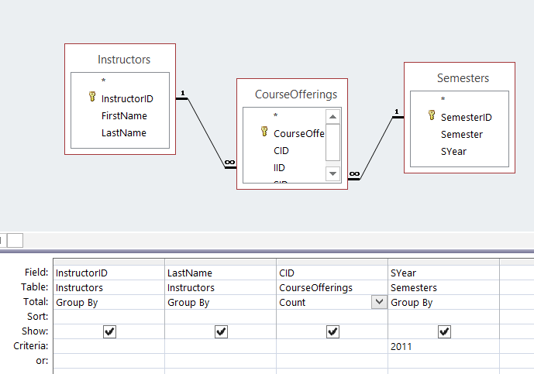
Query 7alt: Violates Principle of Least Info.

Slide 13
Query 7alt: Not modular
To change for Query 8, have to replace the count by a group by and add a second query to do the count.
This is different from just inserting an elimination of duplicates (pure group by).

