Slide 1
Access Patterns
Karl Lieberherr

Slide 2
Patterns
It is useful to think in terms of problem solving patterns when writing queries.
We follow the Principle of Least Information which divides queries into four pattern kinds:
  calculated field
  elimination of duplicates (distinct rows for selected fields)
  aggregation-Totals (non-trivial aggregation with calculated field)
  selection
We cover two patterns of the aggregation-Totals: AggregateForOther and CountForSelf. Also two composite patterns: ArgMax and AboveAverage Patterns. Disambiguation Pattern.

Slide 3
Pattern: AggregateForOther
Instantiations and Examples
  SumForOther
    Examples:
      OrderTotals: For each OrderID, sum all extended prices.
      CourseLoad: For each Student, sum the credit hours.
      MenuItemUnitsSold: For each menu item, sum the units sold.
  AverageForOther
    Example:
      AverageGPA: For each StudentID, compute the average grade across all courses taken.
  CountForOther
    Example:
      CountCoursesStudent: For each StudentID, count the number of courses taken.
      CountCoursesInstructor: For each InstructorID, count the number of courses taught.

Slide 4
Pattern: CountForSelf
Examples
  CountWins: Count the wins a team made.
  CountLosses: Count the number of losses a team had.

Slide 5
We review some of the common patterns we have used.
IMPORTANT NOTE: SQL is given for informational purposes only to summarize the effects of clicking in the Query Builder. We have not covered SQL but used the Query Builder instead.

Slide 6
Table
ID A B C
1 a1 b1 5
2 a1 b1 8
3 a1 b2 7
4 a1 b2 2
5 a1 b2 1
6 a2 b1 7
7 a2 b1 8
8 a3 b2 0

Slide 7
Pattern SumForOther: What we want: summing for distinguished column of another column
A SumOfC
a1 23
a2 15
a3 0

Slide 8
Pattern SumForOther: SQL query
SELECT Table1.A, Sum(Table1.C) AS SumOfC
FROM Table1
GROUP BY Table1.A;

Slide 9
Pattern SumForOther: Query Builder Manipulation
Create Query
Choose Table1
Select column A
Select column C
Totals (GroupBy default)
Sum for column C

Slide 10
Table
ID A B C
1 a1 b1 5
2 a1 b1 8
3 a1 b2 7
4 a1 b2 2
5 a1 b2 1
6 a2 b1 7
7 a2 b1 8
8 a3 b2 0

Slide 11
Pattern CountForSelf: What we want: Counting for distinguished column
B CountOfB
b1 4
b2 4

Slide 12
Pattern CountForSelf: SQL
SELECT Table1.B, Count(Table1.B) AS CountOfB
FROM Table1
GROUP BY Table1.B;

Slide 13
Pattern CountForSelf: Query Builder Manipulation
Create Query
Select Table1
Select column B
Select column B
Totals (GroupBy)
For second column B choose count

Slide 14
Table2 (GameResults)
ID winner loser forced
1 1 2 1
2 2 1 2
3 1 3 3
4 3 2 2
5 4 1 4
6 1 4 4
7 1 5 0
1 Baltimore Orioles
2 New York Yankees
3 Toronto Blue Jays
4 Tampa Bay Rays
5 Boston Red Sox
Forced: Team was handicapped
(played without their strongest player)

Slide 15
Pattern CountForSelf: What we want: count wins for each team
winner CountOfwinner
1 4
2 1
3 1
4 1

Slide 16
Pattern CountForSelf: SQL
SELECT Table2.winner, Count(Table2.winner) AS CountOfwinner
FROM Table2
GROUP BY Table2.winner;

Slide 17
CountForSelf: Query Builder Manipulation
Create Query
Choose Table2
Select winner column twice
Totals (GroupBy)
For second winner column: Count

Slide 18
ArgMax and AboveAverage Pattern
Composite pattern involving several other patterns.

Slide 19
ArgMax Pattern
Example Queries
  Which are the most expensive menu items?
  Which are the most expensive orders?
  Which course has been taken by the most number of students?
  List the students who have taken the smallest number of credits.

Slide 20
Implementation of ArgMax Pattern
Use an AggegrationForOther query to create the list of numbers lon of which the maximum is computed (subquery 1).
Compute the maximum M (subquery 2).
Select the numbers in lon which are =M (use subquery 1 and 2). Use selection query or relationship with join.

Slide 21
AboveAveragePattern
Examples
  Which orders are above average?

Slide 22
Implementation of AboveAverage Pattern
Use an AggegrationForOther query to create the list of numbers lon of which the average is computed (subquery 1).
Compute the average A (subquery 2).
Select the numbers in lon which are >A (use subquery 1 and 2). Use selection query.

Slide 23
Disambiguation Pattern
Example Query:
  How many courses is each instructor available to teach? List the last name of the instructor who can teach and the number of courses.
  Note: We list the last name and not the primary key (InstructorID). Therefore there is a need for the disambiguation pattern because there may be multiple instructors with the same last name.
Name not unique. Use ID to disambiguate but don’t show it. Let’s call this the Disambiguation Pattern.

Slide 24
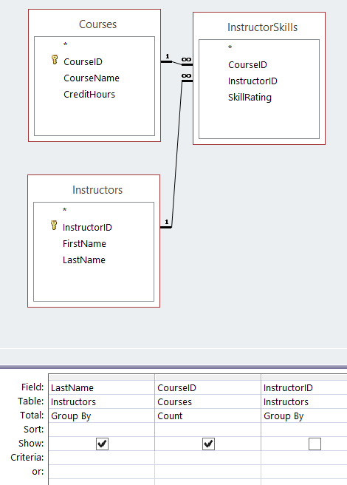
Disambiguation
Pattern

Slide 25
Required Elimination of Duplicates Pattern
Example Query:
  How many courses use textbooks published by “Wiley”?
  Note: when we list CourseIDs and TextbookIDs there may be courses that use two textbooks by Wiley. We cannot count the CourseIDs directly and need first an isolated Elimination of Duplicates.

Slide 26
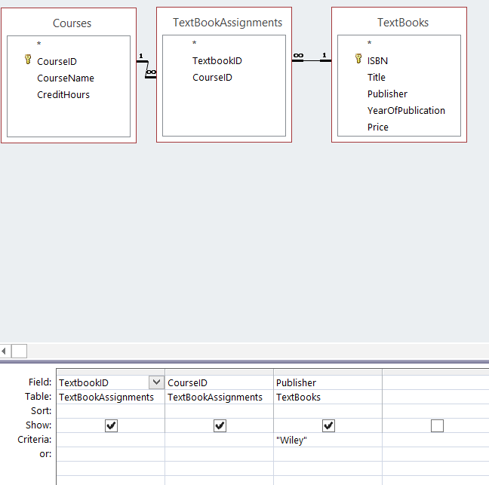
First Subquery

Slide 27
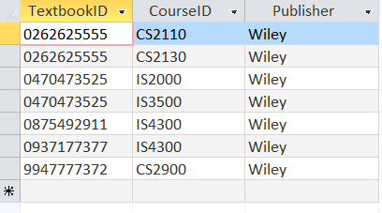
output

Slide 28
Summary
We covered
  two single table aggregation patterns: AggregateForOther and CountForSelf.
  two composite patterns: ArgMax and AboveAverage.
  There are many more patterns we covered in class.

Slide 29
Table2 (DebateResults)
ID winner loser forced
1 1 2 1
2 2 1 2
3 1 3 3
4 3 2 2
5 4 1 4
6 1 4 4
7 1 5 0

Slide 30
What we want: count faults
Faulter CountOfFaulter
1 2
2 1
5 1

Slide 31
Add calculated field for Faulters: subquery
What do we want for the subquery?

Slide 32
Create Faulter column from Loser column
Faulter forced
2 1
1 2
1 4
5 0

Slide 33
SQL
SELECT Table2.loser AS Faulter, Table2.forced
FROM Table2
WHERE (((Table2.loser)<>[forced]));

Slide 34
Query Builder Manipulation
Create Query
select loser column; rename to Faulter; condition <>[forced]
select forced column (for checking result)
name subquery: Faults

Slide 35
Reminder: What we want
Faulter CountOfFaulter
1 2
2 1
5 1

Slide 36
SQL
SELECT Faults.Faulter, Count(Faults.Faulter) AS CountOfFaulter
FROM Faults
GROUP BY Faults.Faulter;

Slide 37
Query Builder Manipulation
Create Query
Choose subquery Faults
Select Faulter column twice
Totals (GroupBy)
select Count for second

