Slide 1
Debates / Socratic Method for Computational Problems
Karl Lieberherr
Based on Ahmed Abdelmeged’s Dissertation

Slide 2
Contents
Defining interpreted logical formulas
Defining semantic games for interpreted logical formulas
Examples, including deriving a simple algorithm involving numbers.
Evaluation of semantic games
  Debate graph
  Merit graph

Slide 3
What you learn
A standard logical notation to define computational problems precisely.
How to argue about claims and computational problems and convincingly demonstrate that your solution is right.
Maintain balance: make sure that your solution is not underrated and the solution of others is not overrated.

Slide 4
What is a debate?
Based on semantic games in logic.
The game is defined by the structure of a logical formula which defines a computational problem.
Therefore we define first the standard way to structure logical formulas.

Slide 5
Propositional Logic
We refer to your favorite programming language where you have Boolean variables and Boolean operators: and, or, not.
Example: (A or B) and (!A or !B).
Propositional logic is not powerful enough to express interesting computational problems.
  Need predicate logic: introduce predicates and quantifiers

Slide 6
Predicate Logic
Predicates
  G(x,y,z)
  A predicate describes a property of objects, or a relationship among objects represented by the variables.

Slide 7
Quantification
Concepts
  Universal quantifier
  Existential quantifier

Slide 8
Forming propositions from predicates
A predicate with variables can be turned into a proposition by applying one of the following two operations to each variable:
  Assign a value to the variable
  Quantify the variable using a quantifier (Universal or Existential)

Slide 9
Universal Quantifier
ForAll x: P(x)
Universal quantifier and connective and.
  ForAll x: P(x)
  P(c1) and P(c2) and P(c3) and (Pc4) (if the domain of x only contains 4 elements)

Slide 10
Existential Quantifier
Exists x: P(x)
Existential quantifier and connective or.
  Exists x: P(x)
  P(c1) or P(c2) or P(c3) or (Pc4) (if the domain of x only contains 4 elements)

Slide 11
Order of Quantifiers
The positions of the same type of consecutive quantifiers can be switched.
The positions of different types of quantifiers can not be switched.

Slide 12
Well-Formed Formulas (wffs)
Syntax Rules
Important for game definition.
We consider logical formulas which are interpreted in some structure defined by a signature.
The signature specifies the constant symbols, relation symbols and function symbols.
We think of a structure as a set of classes with methods (defining the functions and relations).

Slide 13
Terms
Any variable is a term.
Any constant symbol from the signature is a term.
An expression of the form f(t1, … ,tn), where f is an n-ary function symbol, and t1, … ,tn are terms, is again a term.

Slide 14
Atomic Formulas
If t1 and t2 are terms then t1=t2 is an atomic formula.
If R is an n-ary relation symbol, and t1, … ,tn are terms, then R(t1, … ,tn) is an atomic formula..

Slide 15
Formulas
(well-formed formulas)
The set of formulas is defined to be the smallest set containing the set of atomic formulas such that
  ! φ is a formula when φ is a formula
  (φ and ψ) and (φ or ψ) are formulas when φ and ψ are formulas
  (Exists x φ) is a formula when x is a variable and φ is a formula
  (ForAll x φ) is a formula when x is a variable and φ is a formula

Slide 16
Semantic Games (SGs) for interpreted formulas
A semantic game for a given claim⟨φ, A⟩ is a game played by a verifier and a falsifier, denoted SG(⟨φ, A⟩, verifier, falsifier), such that:
  A |= φ <=> the verifier has a winning strategy for φ.

Slide 17
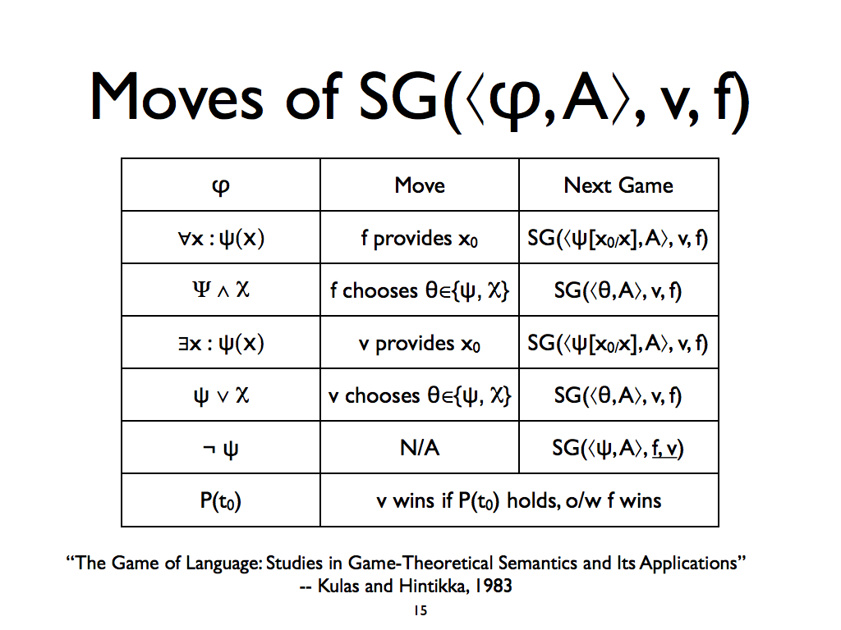

Slide 18
Rule-based Algorithm
The input to this algorithm is a logical sentence and two players, one playing the verifier role and the other the falsifier role. The players assign values to variables and choose from subexpressions for “and” and “or”
The output is one of the players: the winner.

Slide 19
Algorithmic Languages
Most of the time we use imperative languages for expressing algorithms.
Imperative
Functional
Rule-based
Special-purpose (not Turing complete): decision-trees, finite state machines, etc.

Slide 20
Example of rule-based execution
Uses pattern matching
Claim = ForAll n in N Exists q in Q: MinCounterfeitBall(n,q).
Which rule is matched? ForAll chooses n₀. \psi =Exists q in Q: MinCounterfeitBall(n₀,q).
Which rule is matched? Exists chooses q₀.
MinCounterfeitBall(n,q) = CounterfeitBall(n,q) and (ForAll q’<q: !CounterfeitBall(n,q’)).
Which rule is matched? and. \psi=CounterfeitBall(n,q).

Slide 21
Example of rule-based execution (2)
Claim CounterfeitBall(n,q) =
Exists a ternary decision tree T
  ForAll m in [1..n]
    P(T,m,q)
Which rule is matched: Exists chooses T₀. \psi=ForAll m in [1..n] P(T₀,m,q).
Which rule is matched: ForAll chooses m₀. \psi=P(T₀,m₀,q).
Which rule is matched: The last one. Determines the winner.

Slide 22
Strategies
A strategy is a set of functions, one for each potential move.

Slide 23
Truth and Clever Algorithms
We are not just interested in WHETHER a claim is true but WHY it is true.
We are NOT asking for a PROOF why a claim is true but for a constructive demonstration that the claim is true.
Having a proof is ideal but is not required for supporting a claim. It is enough knowing the CLEVER algorithms without having a proof why they work.

Slide 24
Examples
Toy Example
Silver Ratio Example
  Illustrate incremental development of winning strategy

Slide 25
Toy Example
S(c ∈ [0,2]) = ∀x ∈ [0,1]: ∃ y ∈ [0,1]: x + y > c
S(c) is true for c ∈ [0,1) and false for c ∈ [1,2]
Best strategy:
  for the falsifier: x=0
  for the verifier: y=1

Slide 26




Toy Example: SG Trace
,
,
)
SG(∀x ∈ [0,1]: ∃ y ∈ [0,1]: x + y > 1.5
Provides 1 for x
Weakening (too much!)
,
,
)
SG(∃ y ∈ [0,1]: 1 + y > 1.5
Provides 1 for y
Strengthening
SG( 1 + 1 > 1.5
,
,
)
Wins

Slide 27
Example: Lab Definition
φ(c ∈ C)= ∀ x ∈ X ∃ y ∈ Y : p(x,y,c)
  B(ingran): φ(c₀) true: verifier
  K(arl): φ(c₀) false: falsifier

Slide 28
Silver Ratio Lab
φ(c ∈ C)= ∀ x ∈ X ∃ y ∈ Y : p(x,y,c)
X = [0,1]
Y = [0,1]
C = [0,1]
p(x,y,c) = x*y + (1-x)*(1-y²) >= c
φ(0.5) is true
φ(0.7) is false

Slide 29
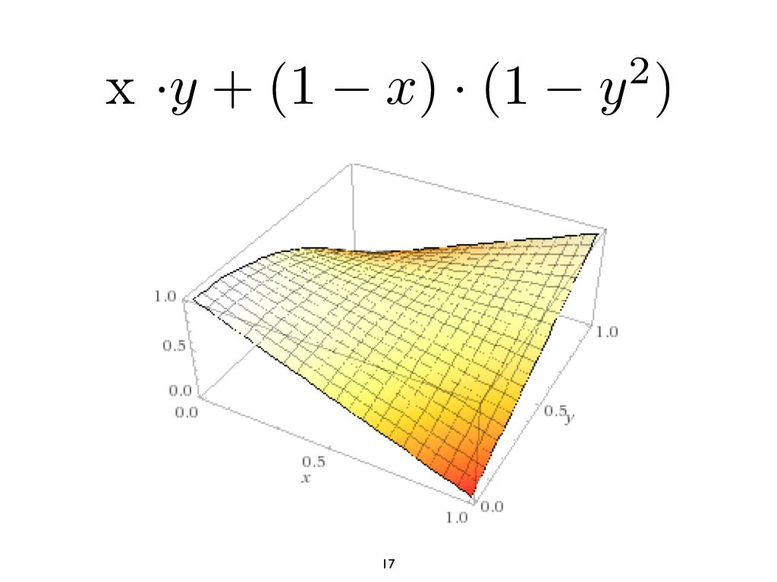

Slide 30
Example
φ(c ∈ C)= ∀ x ∈ X ∃ y ∈ Y : p(x,y,c)
  B(ingran): φ(c₀) true: verifier
  K(arl): φ(c₀) false: falsifier
  Experiment
    K:x₀ B:y₀ p(x₀,y₀,c₀) true
      objective evidence for B to be stronger than K.
        K must have made at least one mistake, while B might have been perfect.
          if φ(c₀) true, K took the wrong side.
          if φ(c₀) false, K chose the wrong x₀

Slide 31
Example (continued 1)
φ(c ∈ C)= ∀ x ∈ X ∃ y ∈ Y : p(x,y,c)
  B(ingran): φ(c₀) true: verifier
  K(arl): φ(c₀) true: verifier
  Experiment 1
    B(ingran): φ(c₀) true: verifier
    K(arl): φ(c₀) false: forced falsifier
      K:x₁ O:y₁ p(x₁,y₁,c₀) true
        no evidence that Bingran is stronger

Slide 32
Example (continued 2)
φ(c ∈ C)= ∀ x ∈ X ∃ y ∈ Y : p(x,y,c)
  Z(hengxing): φ(c₀) true: verifier
  K(arl): φ(c₀) true: verifier
  Experiment 2
    K(arl): φ(c₀) true: verifier
    Z(hengxing): φ(c₀) false: forced falsifier
      Z:x₂ K:y₂ p(x₂,y₂,c₀) false
        objective evidence that Zhengxing is stronger. Karl must have made at least one mistake, while Zhengxing might have been perfect.

Slide 33
Silver Ratio
claim
G(c) = ForAll x in [0,1] Exists y in [0,1]: x*y + (1-x)*(1-y^2) >= c
A specification of an algorithm:
Write a program which takes an x as input and
produces a y as output so that the above condition holds.

Slide 34
Winning Strategy developed incrementally
Strategy chosen depends on c.
  G(0.5)
  G(0.615)
  G(0.616)

Slide 35
Silver Ratio
G(1/2)
winning strategy for verifier:
f(x,y) = x*y + (1-x)*(1-y^2)
if x>1-x : y=1. f(x,y)=x > 1/2
1-x>x : y=0. f(x,y)=1-x > 1/2
1-x=x : y=1. f(x,y)=1/2
formal debate:
falsifier x=0.75
verifier y=1
0.75>0.5 verifier wins

Slide 36
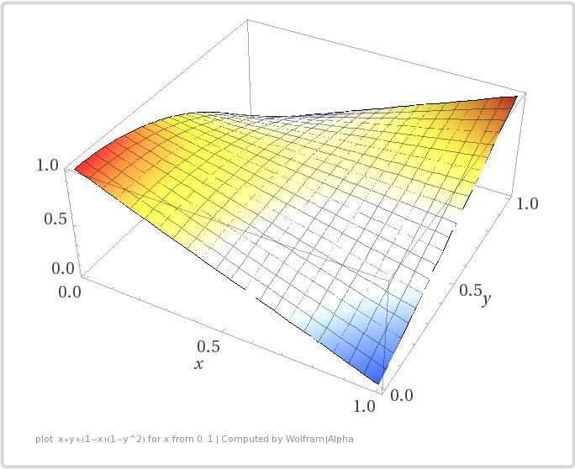

Slide 37
Silver Ratio
G(0.615)
winning strategy for verifier:
Choose y=x.
Result: x^3-x+1
minimize x^3-x+1
local minimum at x=1/sqrt(3) =
min{x^3-x+1}~~0.6151 at x~~0.57735
formal debate:
falsifier x=0.58
verifier y=0.58
x^3-x+1 where x = 0.58
Result: 0.615112 > 0.615

Slide 38
Silver Ratio
G(0.616)
formal debate 1:
falsifier x=0.3
verifier y=0.3
Result 0.727
verifier wins
formal debate 2:
x=0.57735
y=0.57735
Result 0.6151 < g(0.616)
verifier loses!!!!!!!!!!!!!!!

Slide 39
Silver Ratio
Question:
Is G(0.616) really true?
What is the winning strategy?
The winning strategy is an algorithm which maps an x to a y
such that f(x,y)>=0.616 holds for all x in [0,1].
Homework:
Find such an algorithm.

Slide 40
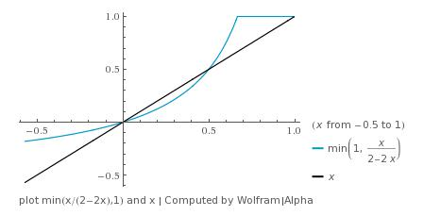
Silver Ratio

Slide 41
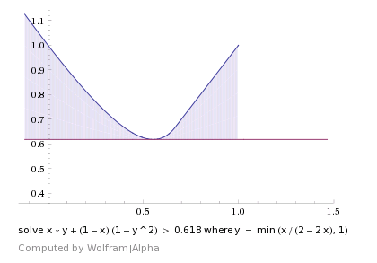
Silver Ratio

Slide 42
Example: Silver Ratio
For
  A potential falsifier strategy is: provideX(c){ 0.5 }.
  A potential verifier strategy is: provideY(x, c){ x }.
SP=G

Slide 43
Example: SG Trace
SG(
,
,
)
Provides 0.5 for x
Weakening (too much!)
SG(
,
,
)
Provides 0.5 for y
Strengthening
SG(
,
,
)
Wins

Slide 44
SG Properties
(Relevant to our approach)
SG winners drive their opponents into contradiction.
Faulty verifier (falsifier) actions can produce a false (true) claim from a true (false) one.
Faulty actions will be exposed by a perfect opponent leading to a loss.
Winning against a perfect verifier (falsifier) implies that the claim is false (true).
Losing an SG implies that either you did a faulty action or you were on the wrong side.

Slide 45
Avatar
Avatar
View lab as a language L of all claims that can be formulated in the lab.
L_{true} (L_{false}) is the set of true (false) claims in L.
There is a set of required functions S_{true} used to defend claims in L_{true} and another set of required functions S_{false} for L_{false}.
The burden of demonstrating the correctness of the required functions is divided among two participants.

Slide 46
Avatar
Avatar
S_{true} and S_{false} are certificates that can be used to defend the true and false claims.
A perfect avatar for a claim family is a pair (S_{true}, S_{false}), where the side chosen by the avatar is the winner side of SG(c, S_{true} , S_{false}).
An avatar (S_{true} , S_{false}) applied to a claim c is used to
  take a side on c
  defend the side taken

Slide 47
Example Avatar for
Silver Ratio Lab
Avatar
Defending SilverRatio(c)
  if SilverRatio(c)
    use S_{true}: when given an x, construct y
    else use S_{false}: construct x
Issue: In practice the avatars may be buggy.
Issue: humans might have to help the avatar.

Slide 48
Generalizing SGs
First ask participants for their favorite side (u is a participant).
If both choose the same side, force one to play the devil’s advocate.
Winner | Forced | Payoff (u, !u)
u | None | (1, 0)
u | u | (1, 0)
u | !u | (0, 0)

Slide 49
Temporary Summary
Use formal debates about claims to improve your algorithmic solutions and learn from others.
Works for other STEM areas.

Slide 50
Evaluation
We focus only on losses in non-forced side.
We represent debate results as a graph, called the debate graph, but we focus only on a subgraph, called the merit graph, for the purpose of evaluation.

Slide 51
Merit Graph different sides
V Verifier
F Falsifier
fixed claim c
debate
Mike:F
Susie:V
Mike-Susie: 0-1
Susie offers learning opportunity to Mike
Susie teaches Mike
tie impossible
or
source
not forced
Mike:F
Susie:V
Mike-Susie: 1-0
Merit graph only shows debates where winner has merit.
target wins
teaches source

Slide 52
same sides
red does not count because
loser is forced.
Both Mike and Susie want to be verifiers.
One student becomes devil’s advocate.
possibilities:
  Mike:forced loses against Susie:non-forced
  Mike:forced wins against Susie:non-forced
  Mike:non-forced loses against Susie:forced
  Mike:non-forced wins against Susie:forced
source
not forced
Mike:V
Susie:V
target wins

Slide 53
Merit Graph same sides
fixed claim c
Mike:V
Susie:V
Mike-Susie: 0-1
or
Mike:V
Susie:V
or
Mike-Susie: 1-0
source
not forced
Mike:V
Susie:V
Mike-Susie: 1-0
Mike-Susie: 0-1
or
Mike:V
Susie:V
target wins

Slide 54
Regular Debate Graph same sides
source is forced
fixed claim c
target wins
Mike:V
Susie:V
Mike-Susie: 0-1
Mike-Susie: 1-0
Red edges are in regular debate graph but not in merit graph.
Merit graph only shows debates where winner has merit.
source
not forced
target wins

Slide 55
Why Merit Graph
Allows us to quickly find meritorious students by looking at debate outcomes.
  Find students with minimal number of outgoing edges.
Students assign each other merit without involving teaching staff (which must define the claim to be debated. Claim is about current learning module).

Slide 56
Properties of Merit Graph
Perfect student has outdegree 0.
If there is a debate between two students taking opposite sides, there will be an edge in the merit graph.

Slide 57
Merit Graph for Claim c
F falsifier
V verifier
Edge: source loses in non-forced
position to target.
x: counts outgoing edges.
2
Kunal:F
Cong:V
0
1
Gaurav:F
perfect
Possible scenario:
Gaurav and Kunal have misunderstood claim c and they think it is false.
Cong wins a debate with both of them applying the winning strategy she found
for c. Kunal and Gaurav have two debates, one of which Gaurav wins while Kunal
is in non-forced position, which indicates
that Gaurav has a somewhat better understanding. But still, he took the wrong
side.

Slide 58
Counting wins does not find meritorious students
2/1
2/0
Brandon:F
Kunal:F
Cong:V
0/3
1/4
Gaurav:F
blue: counting wins
x: counts outgoing edges
2/0
Mike:F
1/0
Zach:F
Denial of Truth Attack
Gaurav is not the perfect student
Other students helped him to distort the truth

Slide 59
Conclusions
Technology to engage students in giving feedback to each other and learning from each other and grading each other fairly.
Grading mistakes are impossible.
Suitable for online debates in large online classes.

Slide 60
Extra slides

Slide 61
Bound variables
An appearance of a variable in a well-formed-formula (wff) is said to be bound if either a specific value is assigned to it or it is quantified.
If an appearance of a variable is not bound, it is free.
Scope of a quantifier is given by parentheses or brackets.

