Slide 1
CS 4300 Computer Graphics
Prof. Harriet Fell
CS4300
Lectures 13,14 – October 3, 4, 10 2012

Slide 2
Today’s Topics
Curves
Fitting Curves to Data Points
Splines
Hermite Cubics
Bezier Cubics

Slide 3
Curves
A curve is the continuous image of an interval in n-space.
Implicit f(x, y) = 0
x² + y² – R² = 0
B
Parametric (x(t), y(t)) = P(t)
P(t) = tA + (1-t)B
A
Generative proc → (x, y)

Slide 4
Curve Fitting
We want a curve that passes through control points.
interpolating curve
Or a curve that passes near control points.
approximating curve
How do we create a good curve?
What makes a good curve?

Slide 5
Axis Independence
If we rotate the set of control points, we should get the rotated curve.

Slide 6
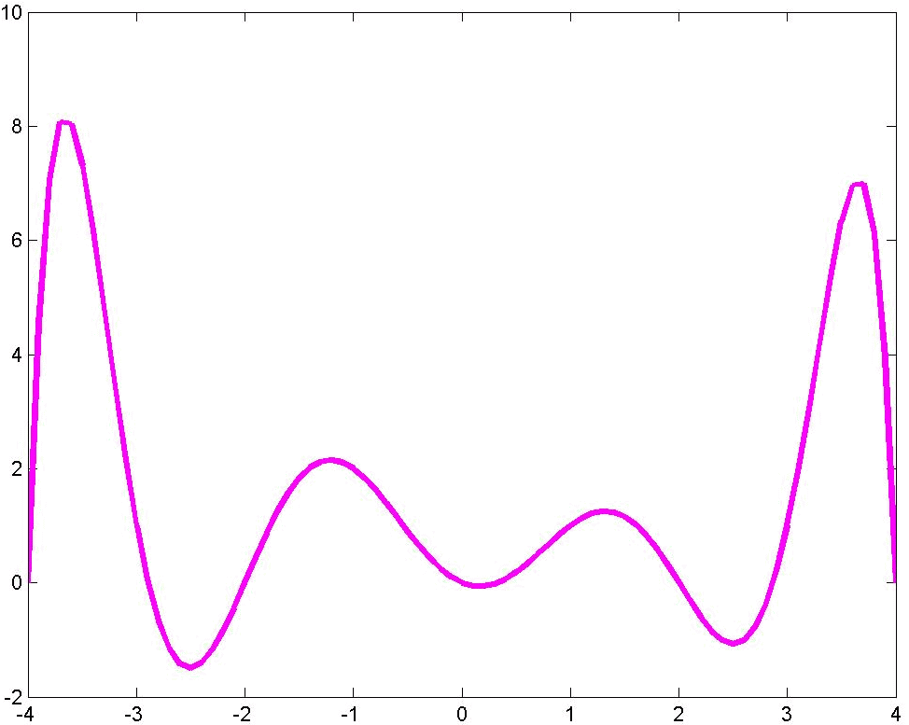
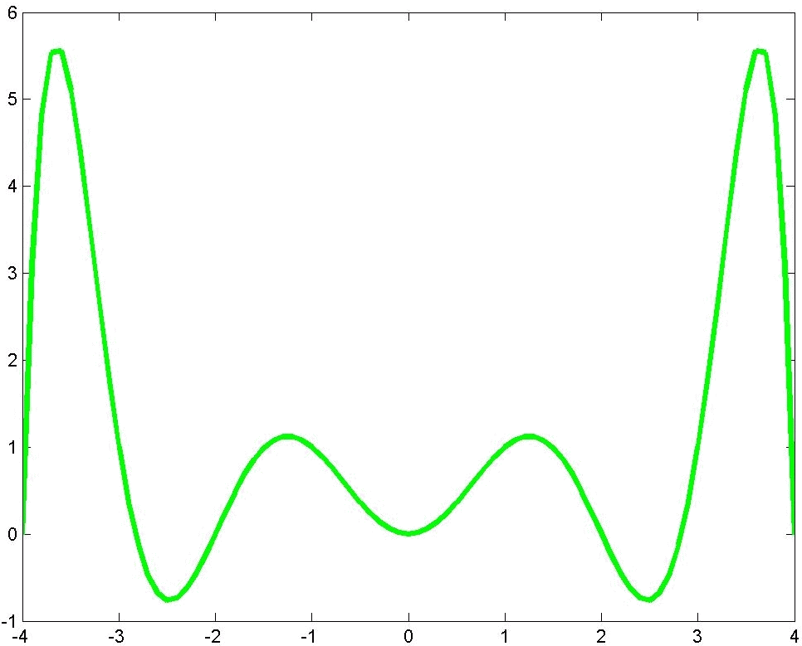
Local Control

Slide 7
Variation Diminishing
Never crosses a straight line more than the polygon crosses it.

Slide 8
Continuity
C⁰ continuity
C¹ continuity
C² continuity
G² continuity
Not C² continuity

Slide 9
How do we Fit Curves?
The Lagrange interpolating polynomial is the polynomial
of degree n-1 that passes through the n points,
(x₁, y₁), (x₂, y₂), …, (x_{n}, y_{n}),
and is given by
Lagrange Interpolating Polynomial from mathworld

Slide 10
Example 1

Slide 11
Polynomial Fit
P(x) = -.5x(x-2)(x-3)(x-4)

Slide 12
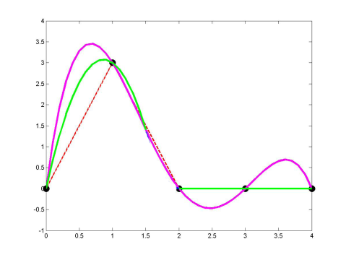
Piecewise Fit
P_{a}(x) = 4.1249 x (x - 1.7273)
0 ≤ x ≤ 1.5
P_{b}(x) = 5.4 x (x - 1.7273)
1.5 ≤ x ≤ 1.7273
P_{c}(x) = 0
1.7273 ≤ x ≤ 4
October 2, 2012
12

Slide 13
Spline Curves

Slide 14
Splines and Spline Ducks
Marine Drafting Weights
http://www.frets.com/FRETSPages/Luthier/TipsTricks/DraftingWeights/draftweights.html

Slide 15
Drawing Spline Today (esc)
Draw some curves in PowerPoint.
Look at Perlin’s B-Spline Applet.

Slide 17
Hermite Cubics
P(t) = at³ + bt² +ct +d
P(0) = p
P(1) = q
P'(0) = Dp
P'(1) = Dq
Dq
Dp
q
p

Slide 18
Hermite Coefficients
P(t) = at³ + bt² +ct +d
P(0) = p
P(1) = q
P'(0) = Dp
P'(1) = Dq
For each coordinate, we have 4 linear equations in 4 unknowns

Slide 19
Boundary Constraint Matrix

Slide 20
Hermite Matrix
M_{H}
G_{H}

Slide 21
Hermite Blending Functions

Slide 22
Splines of Hermite Cubics
a C¹ spline of Hermite curves
a G¹ but not C¹ spline of Hermite curves
The vectors shown are 1/3 the length of the tangent vectors.

Slide 23
Computing the Tangent Vectors Catmull-Rom Spline
p₃
p₅
p₂
p₄
P(0) = p₃
P(1) = p₄
P'(0) = ½(p₄ - p₂ )
P'(1) = ½(p₅ - p₃ )
p₁

Slide 24
Cardinal Spline
The Catmull-Rom spline
P(0) = p₃
P(1) = p₄
P'(0) = ½(p₄ - p₂ )
P'(1) = ½(p₅ - p₃ )
is a special case of the Cardinal spline
P(0) = p₃
P(1) = p₄
P'(0) = (1 - t)(p₄ - p₂ )
P'(1) = (1 - t)(p₅ - p₃ )
0 ≤ t ≤ 1 is the tension.

Slide 25
Drawing Hermite Cubics
How many points should we draw?
Will the points be evenly distributed if we use a constant increment on t ?
We actually draw Bezier cubics.

Slide 26
General Bezier Curves

Slide 27
Low Order Bezier Curves
n = 0 b_{0,0} (t) = 1
B(t) = p₀ b_{0,0} (t) = p₀ 0 ≤ t ≤ 1
p₀
p₀
n = 1 b_{0,1} (t) = 1 - t b_{1,1} (t) = t
B(t) = (1 - t) p₀ + t p₁ 0 ≤ t ≤ 1
p₁
n = 2 b_{0,2} (t) = (1 - t)² b_{1,2} (t) = 2t (1 - t) b_{2,2} (t) = t²
B(t) = (1 - t) ² p₀ + 2t (1 - t)p₁ + t² p₂ 0 ≤ t ≤ 1
p₀
p₂
p₁

Slide 28
Bezier Curves
r
q
Bezier Arch
s
p
n = 3 b_{0,3} (t) = (1 - t)³ b_{1,3} (t) = 3t (1 - t)²
b_{2,3} (t) = 3t²(1 - t) b_{2,3} (t) = t³
B(t) = (1 - t) ³ p + 3t (1 - t)²q + 3t²(1 - t)r + t³s 0 ≤ t ≤ 1

Slide 29
Bezier Matrix
B(t) = (1 - t) ³ p + 3t (1 - t)²q + 3t²(1 - t)r + t³s 0 ≤ t ≤ 1
B(t) = a t ³ + bt² + ct + d 0 ≤ t ≤ 1
M_{B}
G_{B}

Slide 30
Geometry Vector

Slide 31
Properties of Bezier Curves

Slide 32
Geometry of Bezier Arches
r
q
B(t)
s
p
Pick a t between 0 and 1 and go t of the way along each edge.
Join the endpoints and do it again.

Slide 33
Geometry of Bezier Arches
r
qr
q
qrs
pqr
rs
pqrs = B(1/2)
pq
s
p
We only use t = 1/2.

Slide 34
drawArch(P, Q, R, S){
if (ArchSize(P, Q, R, S) <= .5 ) Dot(P);
else{
PQ = (P + Q)/2;
QR = (Q + R)/2;
RS = (R + S)/2;
PQR = (PQ + QR)/2;
QRS = (QR + RS)/2;
PQRS = (PQR + QRS)/2
drawArch(P, PQ, PQR, PQRS);
drawArch(PQRS, QRS, RS, S);
}
}

Slide 35
Putting it All Together
Bezier Arches
Catmull-Rom Splines

