Slide 1
CS 4300 Computer Graphics
Prof. Harriet Fell
Fall 2011
Lecture 27 – November 9, 2011

Slide 2
Topics
Ray intersections with
plane
triangle
quadrics
Recursive Ray Tracing

Slide 3
More Ray-Tracing
Ray/Plane Intersection
Ray/Polygon Intersection
Ray/Triangle Intersection

Slide 4
Equation of a Plane
Given a point P₀ on the plane and a normal to the plane N.
N = (A, B, C)
(x, y, z) is on the plane if and only if
(x-a, y-b, z-c)·N = 0.
(x, y, z)
P₀ = (a, b, c)
Ax + By + Cz –(Aa + Bb + Cc) = 0
D

Slide 5
Ray/Plane Intersection
Ax + By + Cz = D
P₀ = (x₀, y₀, z₀)
Ray Equation
x = x₀ + t(x₁ - x₀)
y = y₀ + t(y₁ - y₀)
z = z₀ + t(z₁ - z₀)
P₁ = (x₁, y₁, z₁)
A(x₀ + t(x₁ - x₀)) + B(y₀ + t(y₁ - y₀)) + C(z₀ + t(z₁ - z₀)) = D
Solve for t. Find x, y, z.

Slide 6
Planes in Your Scenes
Planes are specified by
A, B, C, D or by N and P
Color and other coefficients are as for spheres
To search for the nearest object, go through all the spheres and planes and find the smallest t.
A plane will not be visible if the normal vector (A, B, C) points away from the light.
or we see the back of the plane

Slide 7
Ray/Triangle Intersection
Using the Ray/Plane intersection:
Given the three vertices of the triangle,
Find N, the normal to the plane containing the triangle.
Use N and one of the triangle vertices to describe the plane, i.e. Find A, B, C, and D.
If the Ray intersects the Plane, find the intersection point and its β and γ.
If 0 ≤ β and 0 ≤ γ and β + γ ≤ 1, the Ray hits the Triangle.

Slide 8
Ray/Triangle Intersection
Using barycentric coordinates directly: (Shirley pp. 206-208)
Solve
e + td = a + β(b-a) + γ(c-a)
for t, γ, and β.
The x, y, and z components
give you 3 linear equations
in 3 unknowns.
If 0 ≤ t ≤ 1, the Ray hits the Plane.
If 0 ≤ β and 0 ≤ γ and β + γ ≤ 1,
the Ray hits the Triangle.
(x_{d}, y_{d}, z_{d})
(x_{d}, y_{d}, z_{d})
c
a
b
(x_{e}, y_{e}, z_{e})

Slide 9
Images with Planes and Polygons

Slide 10
Images with Planes and Polygons

Slide 11
Ray Box Intersection
(xh, yh, zh)
(xl, yl, zl)
t1 = (xl - x0) / xd
(x0, y0, z0) + t (xd, yd, zd)
(xd, yd, zd) a unit vector
(x0, y0, z0)

Slide 12
Ray Box Intersection http://courses.csusm.edu/cs697exz/ray_box.htm or see Watt pages 21-22
Box: minimum extent Bl = (xl, yl, zl) maximum extent Bh = (xh, yh, zh)
Ray: R0 = (x0, y0, z0) , Rd= (xd, yd, zd) ray is R0 + tRd
Algorithm:
Set tnear = -INFINITY , tfar = +INFINITY
For the pair of X planes
if zd = 0, the ray is parallel to the planes so:
if x0 < x1 or x0 > xh return FALSE (origin not between planes)
else the ray is not parallel to the planes, so calculate intersection distances of planes
t1 = (xl - x0) / xd (time at which ray intersects minimum X plane)
t2 = (xh - x0) / xd (time at which ray intersects maximum X plane)
if t1 > t2 , swap t1 and t2
if t1 > tnear , set tnear = t1
if t2 < tfar, set tfar= t2
if tnear > tfar, box is missed so return FALSE
if tfar < 0 , box is behind ray so return FALSE
Repeat step 2 for Y, then Z
All tests were survived, so return TRUE

Slide 13
Quadric Surfaces
ellipsoid
elliptic cylinder

Slide 14
Quadric Surfaces
1-sheet hyperboloid
2-sheet hyperboloid

Slide 15
Quadric Surfaces
cones

Slide 16
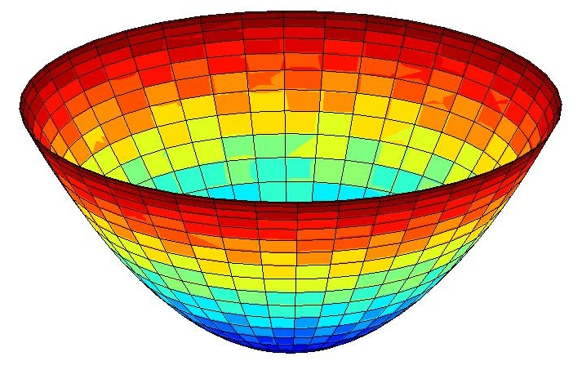
hyperbolic parabaloid
elliptic parabaloid

Slide 17
Quadric Surfaces
parabolic cylinder
hyperbolic cylinder

Slide 18
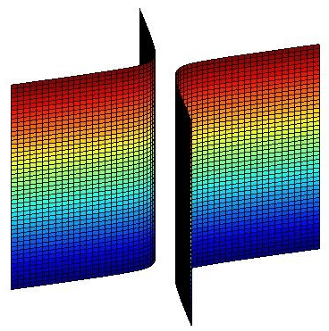
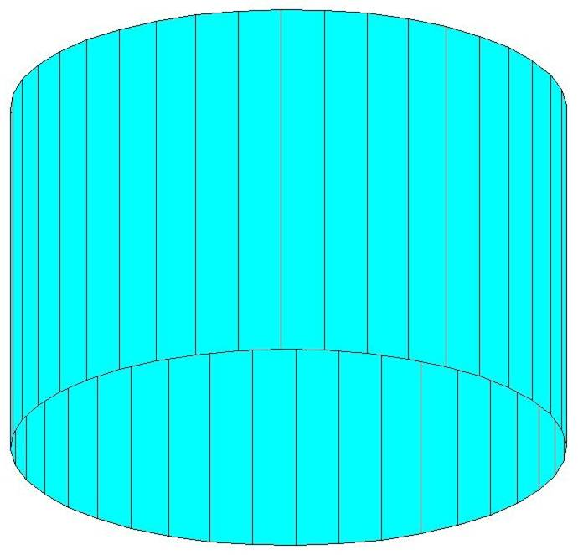
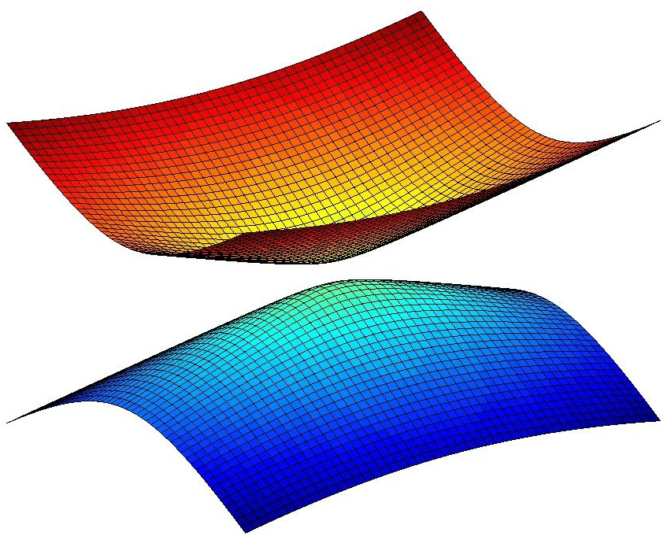
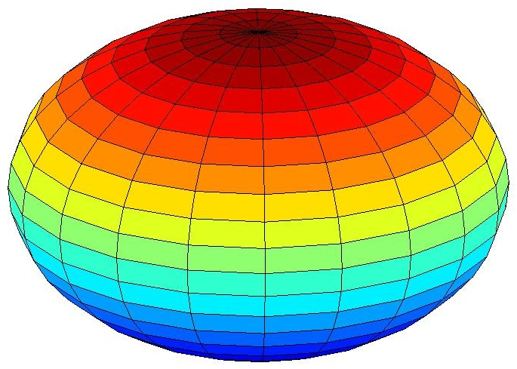
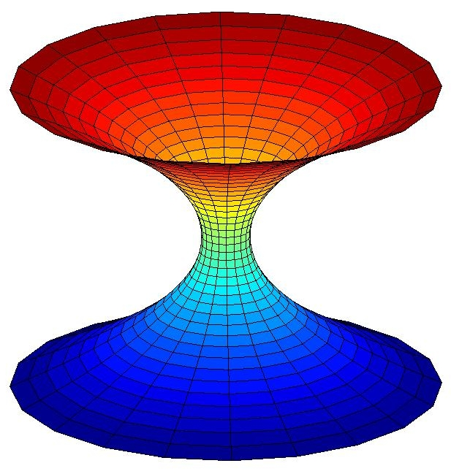
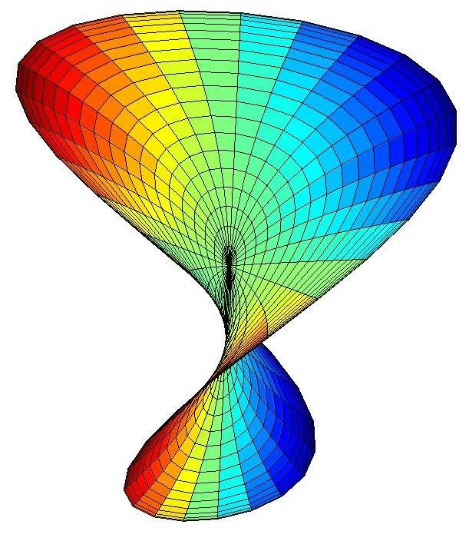
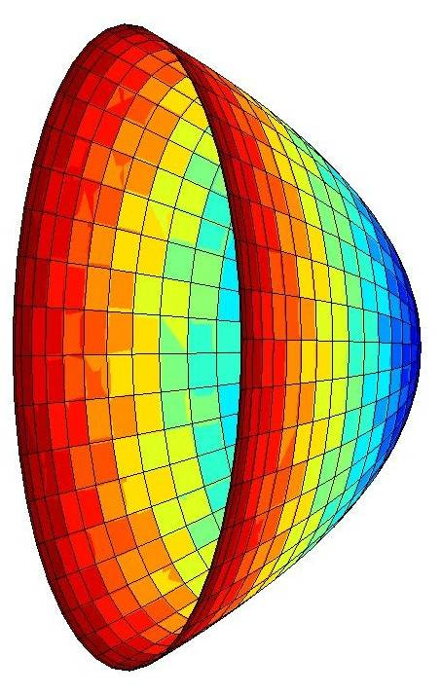
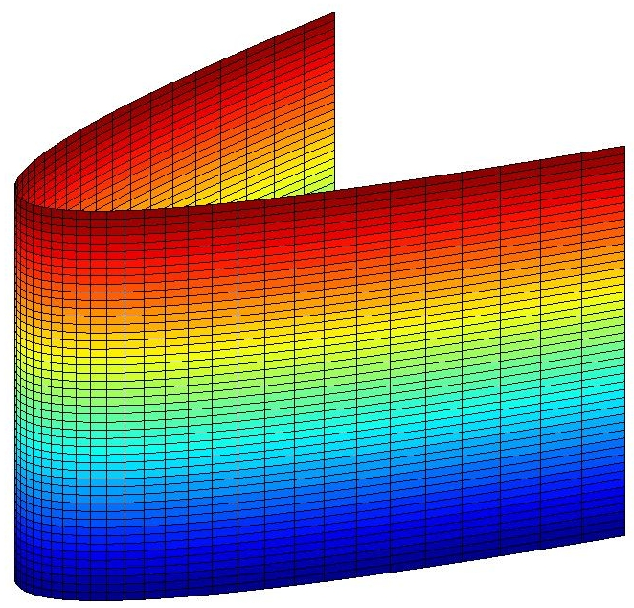
General Quadrics in General Position

Slide 19
General Quadric Equation
Ray Equations

Slide 20
Ray Quadric Intersection Quadratic Coefficients
A = a*xd*xd + b*yd*yd + c*zd*zd
+ 2[d*xd*yd + e*yd*zd + f*xd*zd
B = 2*[a*x0*xd + b*y0*yd + c*z0*zd
+ d*(x0*yd + xd*y0 ) + e*(y0*zd + yd*z0 ) + f*(x0*zd + xd*z0 )
+ g*xd + h*yd + j*zd]
C = a*x0*x0 + b*y0*y0 + c*z0*z0
+ 2*[d*x0*y0 + e*y0*z0 + f*x0*z0 + g*x0 + h*y0 + j*z0] + k

Slide 21
Quadric Normals
Normalize N and change its sign if necessary.

Slide 22
MyCylinders

Slide 23
Student Images

Slide 24
Student Images

Slide 25
Recursive Ray Tracing
Adventures of the 7 Rays - Watt
Specular Highlight on Outside of Shere

Slide 26
Recursive Ray Tracing
Adventures of the 7 Rays - Watt
Specular Highlight on Inside of Sphere

Slide 27
Recursive Ray Tracing
Adventures of the 7 Rays - Watt
Reflection and Refraction of Checkerboard

Slide 28
Recursive Ray Tracing
Adventures of the 7 Rays - Watt
Refraction Hitting Background

Slide 29
Recursive Ray Tracing
Adventures of the 7 Rays - Watt
Local Diffuse Plus Reflection from Checkerboard

Slide 30
Recursive Ray Tracing
Adventures of the 7 Rays - Watt
Local Diffuse in Complete Shadow

Slide 31
Recursive Ray Tracing
Adventures of the 7 Rays - Watt
Local Diffuse in Shadow from Transparent Sphere

Slide 32
Recursive Ray-Tracing
How do we know which rays to follow?
How do we compute those rays?
How do we organize code so we can follow all those different rays?

Slide 33
select center of projection(cp) and window on view plane;
for (each scan line in the image ) {
for (each pixel in scan line ) {
determine ray from the cp through the pixel;
pixel = RT_trace(ray, 1);}}
// intersect ray with objects; compute shade at closest intersection
// depth is current depth in ray tree
RT_color RT_trace (RT_ray ray; int depth){
determine closest intersection of ray with an object;
if (object hit) {
compute normal at intersection;
return RT_shade (closest object hit, ray, intersection, normal,
depth);}
else
return BACKGROUND_VALUE;
}

Slide 34
// Compute shade at point on object,
// tracing rays for shadows, reflection, refraction.
RT_color RT_shade (
RT_object object, // Object intersected
RT_ray ray, // Incident ray
RT_point point, // Point of intersection to shade
RT_normal normal, // Normal at point
int depth ) // Depth in ray tree
{
RT_color color; // Color of ray
RT_ray rRay, tRay, sRay;// Reflected, refracted, and shadow ray color = ambient term ;
for ( each light ) {
sRay = ray from point to light ;
if ( dot product of normal and direction to light is positive ){
compute how much light is blocked by opaque and
transparent surfaces, and use to scale diffuse and specular
terms before adding them to color;}}

Slide 35
if ( depth < maxDepth ) { // return if depth is too deep
if ( object is reflective ) {
rRay = ray in reflection direction from point;
rColor = RT_trace(rRay, depth + 1);
scale rColor by specular coefficient and add to color;
}
if ( object is transparent ) {
tRay = ray in refraction direction from point;
if ( total internal reflection does not occur ) {
tColor = RT_trace(tRay, depth + 1);
scale tColor by transmission coefficient
and add to color;
}
}
}
return color; // Return the color of the ray
}

Slide 36
Reflections, no Highlight

Slide 37
Second Order Reflection

Slide 38
Refelction with Highlight

Slide 39
Nine Red Balls

Slide 40
Refraction
N
I
θ_{I}
θ_{T}
T
-N

Slide 41
Indices of Refraction
Material | η at λ=589.3 nm
vacuum | 1 (exactly)
helium | 1.000036
air at STP | 1.0002926
water ice | 1.31
liquid water (20°C) | 1.333
ethanol | 1.36
glycerine | 1.4729
rock salt | 1.516
glass (typical) | 1.5 to 1.9
cubic zirconia | 2.15 to 2.18
diamond | 2.419
http://en.wikipedia.org/wiki/List_of_indices_of_refraction

Slide 42
One Glass Sphere

Slide 43
Five Glass Balls

Slide 44
A Familiar Scene

Slide 45
Bubble

Slide 46
Milky Sphere

Slide 47
Lens - Carl Andrews 1999

