Slide 2
Survey of End-to-End Mobile Network
Measurement Testbeds
Utkarsh Goel (MSU), Mike P. Wittie (MSU),
KC Claffy (CAIDA), and Andrew Le (Mintybit)
Nov 12, 2014

Slide 3
Introduction
Application responsiveness and user experience tied to end-to-end network performance
  E.g. live video, social gaming, interactive communications, and augmented reality
Available network mobile network testbeds and measurement tools are limited in functionality and/or deployment scope
We surveyed currently active efforts to capture a snapshot of existing work and identify directions for future work

Slide 4
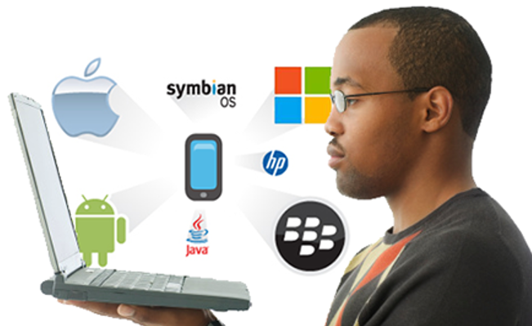

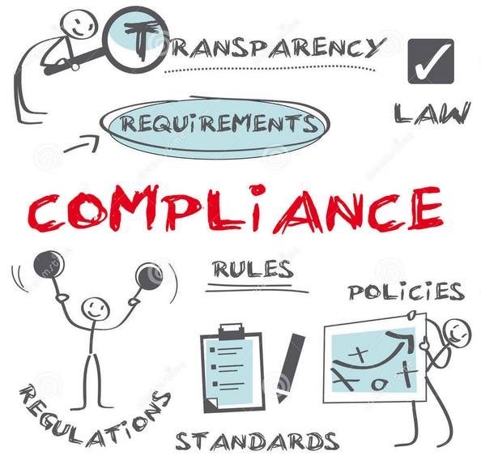
Goals of E2E mobile measurement
Developers
  Want to evaluate their application traffic from mobile devices to their servers
  Academic testbeds and paid services have limited geographic diversity
  Measurement tools have limited functionality
Researchers
  Want flexibility to test various hypothesis
  High barrier to experimentation (expertise in other groups, old code, IRB approvals)
  Develop their own tools (5 in 2014, 7 in 2013, 5 in 2012-2009)
Regulators
  Want to understand the availability, reliability, and performance of mobile networks over time
  Few tools have needed longevity and geographic diversity
  Develop their own tool (FCC Speed Test), but with somewhat limited functionality
Notes:
We heard from Google about studies of YouTube traffic
RTT imporatant to download time (especially high variation in 2G networks)
Our view is that we will provide ability to collect data – but it’s up to individual researchers to makes sure they follow ethical and legal guidelines
Developers
Libratto (application performance (database load, request delay), but not traffic performance)
Google Analytics (application traffic, not size, compression, or other metrics)

Slide 5
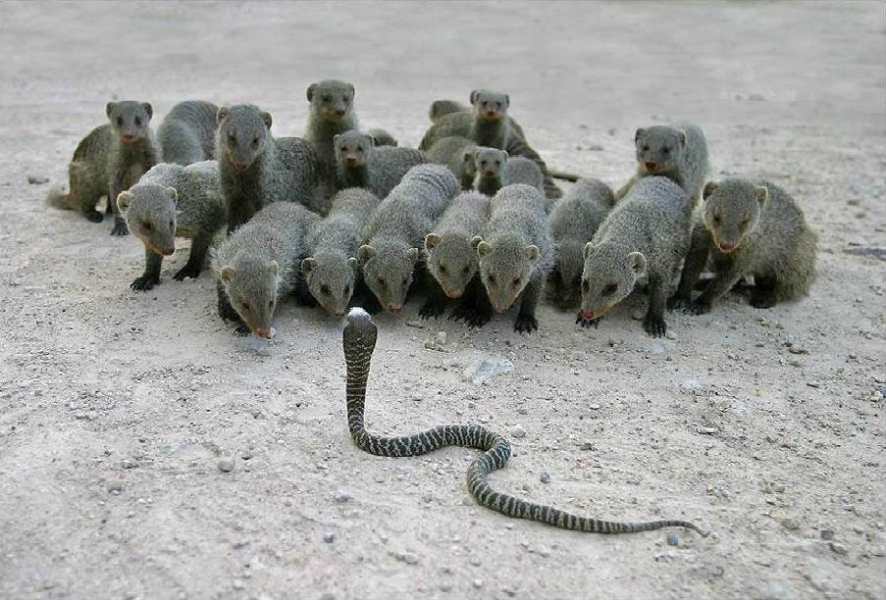
Shared Challenges
Incentives for adoption
  Bundling of measurement code (ALICE)
  Free devices (PhoneLab)
  Press coverage (FCC SpeedTest)
  Reciprocity (MITATE, Seattle)
  Volunteerism/curiosity
Resource protection
  Tit-for-tat (MITATE)
  Hard limits (Seattle)
User-privacy
  “Ethical Privacy Guidelines for Mobile Connectivity Measurements” by Ben Zevenbergen et al. (supported by M-Lab)

Slide 6
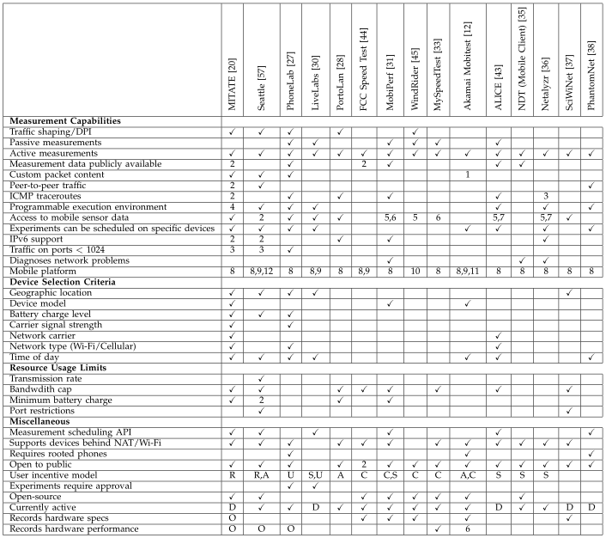
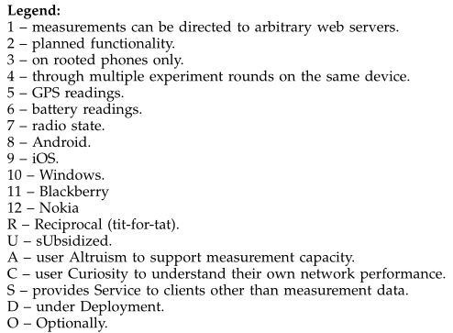
Measurement capabilities
Details in our paper!
Device selection criteria
Resource usage limits
Miscallaneous features

Slide 7
Measurement Tool Categories
Application Testbeds
Experiments with arbitrary traffic
  MITATE
  Seattle
  PhoneLab
  PortoLan
  LiveLabs
Measurement Tools
Collect network performance metrics
  FCC Speed Test
  MySpeedTest
  MobiPerf
  ALICE
  Akamai Mobitest
  WindRider
Open-access
Public datasets
Curated
Libraries
Private-ish
Traffic shaping
Infrastructure Testbeds
Exps. with network configuration
  SciWiNet
  PhantomNet
Diagnosis Tools
Discover network configuration
  NDT
  Netalyzr
Sprint, T-Mobile
Browser-based
Dual interfaces
Mobile app

Slide 8
Conclusions
Limited support for detection of traffic discrimination at a large scale
  Seattle, PhoneLab, PortoLan?, WindRider (deprecated)
Difficulty in supporting long-term studies
  Popularity of tools declines over time (FCC Speedtest, PhoneLab)
Hard to support wide-area evaluation
  Single city deployments (PhoneLab, PortoLan)
  Small number of mobile nodes (Seattle > 500)
Differences experiment configuration and execution
  Open-access (MITATE, Seattle)
  Curated (PhoneLab, PortoLan)
Notes:
MITATE is light-weight and so we’d like to deploy it on sensors and wearable devices, or resource constrained FPGAs

Slide 9
Conclusions
Need a more concerted effort among developers, researchers, and regulators
  Developers do not know what tools are available
  Researchers work on different projects limited in scale
  Regulators need large scale, diverse data
Grater adoption of (perhaps fewer) tools
Funding should support new ideas and encourage their integration with existing testbeds

Slide 10
Acknowledgements
Thanks to
Justin Cappos
Geoffrey Challen
David Choffness
Nick Feamster
Walter Johnston
Valerio Luconi
Jim Martin
John Rula
Mario Sanchez
Hongyi Yao
for help in describing their work in our survey

Slide 11
Questions?
mwittie@cs.montana.edu

