Slide 1
Making Cellular Networks Scalable and Flexible
Li Erran Li
Bell Labs, Alcatel-Lucent
Joint work with collaborators at university of Michigan,
Princeton, and Stanford
Notes:
Slide 2:
Lets put on the hat of cellular operators. What problems are we
facing? We have three big challenges. First, mobile data has been
growing exponentially over the past 5 or 6 years. It shows no sign of
abating. Second, we have to manage huge number of devices. Besides
smartphones and tablets, we started to witness a growing number of
machine-type communication devices or Internet of Things. Third,
cellular networks are supporting a diverse set of applications for
subscriber devices and machine type devices.
The sheer scale of these problems makes it hard for us to understand
the performance bottlenecks and fix them at scale.
Slide 3:
We need to rethink our design space. The current way of designing
cellular networks is hard to scale. At the access, it uses a small
number of macro base stations with a small number of antennas; at the
core, it uses a small number of packet gateways to provide service and
Internet exit points. We would like a paradigm shift. I would like to
promote the principle of design-in-the-large. What does it mean? It
means the need to leverage the strength in numbers. We would like to
design functionalities in the large number of base station antennas
and access switches. To do that, we have to design intelligent
algorithms and scalable systems to coordinate them. Some times,
The law of large numbers make prediction easier at a larger scale. In this talk,
you will see an interesting example where pushing a system larger can
substantially improve performance, with a simpler system design.
In particular, my talk will address three problems. Good science
often comes from real data. First, I will start with my work in
network monitoring and analytics. This is a journey started 7 years.
At the time when Blackberry rules the mobile world, a year before the
start of smartphone revolution, operators do not have much idea on
what is going on in their data network. How their resources are used?
Do data users have a good experience? To answer these questions, we
built a product. Our product taps the interfaces of 3G (later LTE)
equipment and obtains a copy of real packet data. I worked on many
interesting monitoring and analytics problems. I begin to see many
performance bottlenecks that require long term solutions. In this
talk, I will address two of them. The first is access bandwidth
bottleneck. The second is the inflexible control of the core networks.
Slide 5: Let me give you an overview of the monitoring problems I
worked on. As an operator, we want to monitor in real time many
cumulative distributions, distributions of cell load over time,
distributions of high signaling subscribers over time, distribution of
communication patterns over time. If there are significant changes, it
indicates anomalous events, e.g. flash crowd, worm outbreaks, etc.
To handle the challenge of scalable distribution monitoring, we use approximation data
Structures as a key tool, e.g. O(1) stochastic estimation of quantiles, O(1) FM
sketches to count distinct hosts. We leverage statistical inference to
obtain accurate distribution data, e.g. estimation of multiple
quantiles continuously, estimation of communication pattern changes.
Slide 6: Lets visualize the network problem problems our monitoring
tool found. Here is a picture of the cells in a region. Each dot
represents a cell. There are color-coded to indicate how well they are
performing.
Slide 7: If we zoom in on some of the cells, we see their performance
metrics in terms of signaling load, average TCP loss, etc. This one
has a very high average TCP loss rate, 5.5%.
Slide 8: What caused these problems? We have paid engineers who
monitor the operator networks. When such problem happens. They will
manually look at the base station performance data and give an
educated guess. We saw an opportunity to optimize the process. We took
in the two data sources. We use machine learning tools and domain
knowledge to identify root causes.
Slide 9: Let me show you some of the root causes we found. The X axis
is the fraction of total power used by voice traffic. They Y axis is
the log of average TCP loss rate. Each circle represents a cell. As
you can see, the more power used by voice, the less available for
data. This increases TCP loss rate.
Slide 10: Here is another root cause. The X axis is the fraction of
3.5G to 3G handoffs. Y axis is the log of average TCP loss rate. As
you can see, the more such handoffs, the higher the loss rate. This is
because 3G is less efficient than 3.5G. TCP connections experience
such handoffs will have a throughput slump and incur a higher delay.
This causes TCP to drop packets.
Slide 11: Let me show you two other main root causes. The two color
bars represent the fraction of root causes due to load and coverage.
We can see a breakdown per cell. Some cells are dominated by load,
some by coverage, some has a mixture of both. Some has other root
causes.
Slide 12:
Operators can have short term fixes to these problems. If it is due to
system interaction, they can try to avoid inter-technology handoff if
possible, try to do better admission control for cells with high voice
traffic. If it is due to load, we need better load balancing across
technologies and carrier frequencies. If it is due to coverage, we can
intelligently allocate transmission powers among cells or move
boundary users to a lower carrier frequency.
Slide 13:
Many of the monitoring and analytics problems I worked on are deployed
in our product. The product was developed in my group at Bell Labs and
first released in 2008. It has been deployed in many national cellular
operators.
I am currently working on a real time on-demand analytics system
leveraging recent advances in big data streaming systems such as Spark
from Berkeley.
Slide 14: Now I would like to propose long term fixes to the access
bandwidth bottlenecks.
Thanks very much for the introduction. It is great to visit MSR today. I think we all agree that cellular networks have become an essential part of our digital life. We use our smartphones and tablets everyday. It is very important that we make the cellular networks scalable and flexible.
Today I would like to present my work on how to make cellular networks more scalable and flexible.
Cellular networks have been increasingly important to everyone. The question is, are they performing well? If not, what can we do about it? I will first start with some measurement work to identify performance bottlenecks. I will then proceed to design.
I would like to show some of my work that tries to understand the performance bottlenecks of current cellular networks. I will then proceed to design.
Status of current Internet through monitoring and measurement (tech transfer): 8-10min
Argos (deep dive): add log(M) calibration, and layered architecture, pre-distortion stuff?, 25-30min
CellSDN: 8-10min
Vision: ??

Slide 2
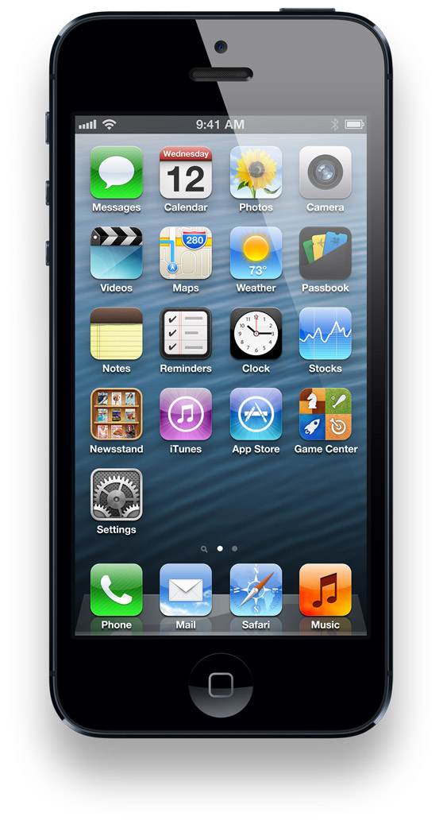
LTE Cellular Network Architecture
Base Station (BS)
Serving Gateway
Packet Data
Network Gateway
Serving Gateway
Internet
User Equipment (UE)
access
core
Notes:
This figure shows the architecture of today’s cellular core networks. User equipment connect to base stations via radio channels.
Base stations connect to the Internet via the cellular core network. There are two main components in the cellular core network, serving gateway and packet data network gateway.

Slide 3
PART I: Radio Access Networks

Slide 4
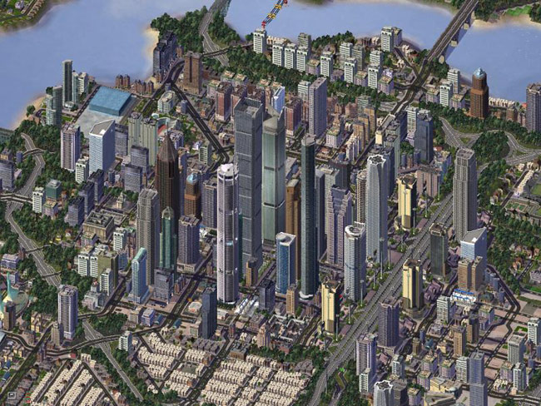

Dense and Chaotic Deployments
Dense: high SNR per user leads to higher capacity
  Small cells, femto cells, repeaters, etc

Slide 5
Problems
Current LTE distributed control plane is ill-suited
  Hard to manage inter-cell interference
  Hard to optimize for variable load of cells
Dense deployment is costly
  Need to share cost among operators
  Maintain direct control of radio resources
    Lacking in current 3gpp RAN sharing standards
5

Slide 6
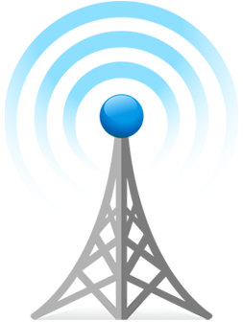
SoftRAN: Big Base Station Abstraction
Big Base Station
Radio Element 1
time
controller
frequency
Radio Element 2
Radio Element 3
time
time
time
frequency
radio element
frequency
frequency
6

Slide 7
Radio Resource Allocation
Flows
3D Resource Grid
time
radio element
frequency
7

Slide 8
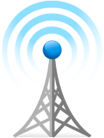
SoftRAN: SDN Approach to RAN
Coordination :
X2 Interface
Control Algo
Control Algo
PHY & MAC
PHY & MAC
Control Algo
PHY & MAC
BS1
BS3
Control Algo
Control Algo
BS5
PHY & MAC
PHY & MAC
BS2
BS4

Slide 9
SoftRAN: SDN Approach to RAN
Control Algo
Operator Inputs
Network OS
RadioVisor
PHY & MAC
PHY & MAC
PHY & MAC
RE3
RE1
RE5
PHY & MAC
PHY & MAC
Radio Element (RE)
RE2
RE4

Slide 10
SoftRAN Architecture Summary
CONTROLLER
RAN Information Base
Periodic Updates
Controller
API
Bytes
Rate
Queue
Size
Network
Operator
Inputs
RADIO ELEMENTS
Interference
Map
Flow
Records
QoS
Constraints
3D Resource Grid
Radio
Element API
Time
Radio Resource
Management
Algorithm
Radio Element
POWER
FLOW
Frequency
10

Slide 11
RadioVisor Design
Slice manager
  Slice configuration, creation, modification, deletion and multi-slice operations
Traffic to slice mapping at RadioVisor and radio elements
3D resource grid allocation and isolation
  Considers traffic demand, interference graph and policy
RadioVisor
3D Resource Grid
Allocation & Isolation
Slice
Manager
Traffic to Slice
Mapping

Slide 12
Summary
Dense deployment calls for central control of radio resources
Deployment costs motivate RAN Sharing
We present the design of RadioVisor
  Enables direct control of per slice radio resources
  Configures per slice PHY and MAC, and interference management algorithm
  Supports flexible slice definitions and operations

Slide 13
PART II: Cellular Core Networks

Slide 14
LTE Cellular Network Architecture
Base Station (BS)
Serving Gateway
Packet Data
Network Gateway
Serving Gateway
Internet
User Equipment (UE)
access
core
Notes:
This figure shows the architecture of today’s cellular core networks. User equipment connect to base stations via radio channels.
Base stations connect to the Internet via the cellular core network. There are two main components in the cellular core network, serving gateway and packet data network gateway.

Slide 15
Cellular core networks are not flexible
Most functionalities are implemented at
Packet Data Network Gateway
  Content filtering, application identification,
  stateful firewall, lawful intercept, …
This is not flexible
Packet Data
Network Gateway
Combine functionality from different vendors
Easy to add new functionality
Only expand capacity for bottlenecked functionality
Notes:
Most functionalities are implemented at the packet gateway today, including application identification, content filtering, monitoring and billing, and so on.
It is not flexible because carriers cannot combine functionality from different vendors.
It is also not easy to add new functionality because vendors have to integrate the functionality with other functionalities that might have already exist for more than 10 years.
It is also no possible to only expand capacity for bottlenecked functionality. Carriers have to buy a new equipment in order to expand the capacity.

Slide 16


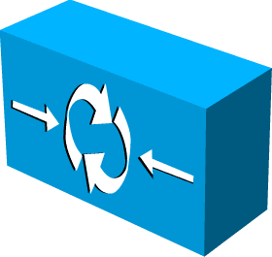
SoftCell Overview
Simple hardware
+ SoftCell software
Controller
Internet
Notes:
To be free from such control bottlenecks, we designed a new cellular network architecture called SoftCell. SoftCell applies the principle of software defined networking. Instead of using specialized data plane equipment, we will just use SDN switches. The SoftCell controller coordinates the data plane functions.
To enable direct control and flexibility, we propose a new architecture. It uses the principle of software defined networking. We will make use of commodity hardware which will be controlled by a controller. We make no changes to user equipment and the Internet.
It makes no change no user equipment, the radio access technology, or the Internet.
It only replaces the core network with commodity switches and middleboxes, controlled by a logically centralized controller.
Data Plane:
Switch: connectivity, traffic steering
Middlebox: various network services
~mix-match, combine functionality from different vendors
~easy to add new functionality
~up-/down-scale
~cheap
Control Plane:
Logically centralized controller, centralized control, rather than distributed protocol (hard to reason, debug, trouble shooting)
~Easy to manage
~Easy to change

Slide 17

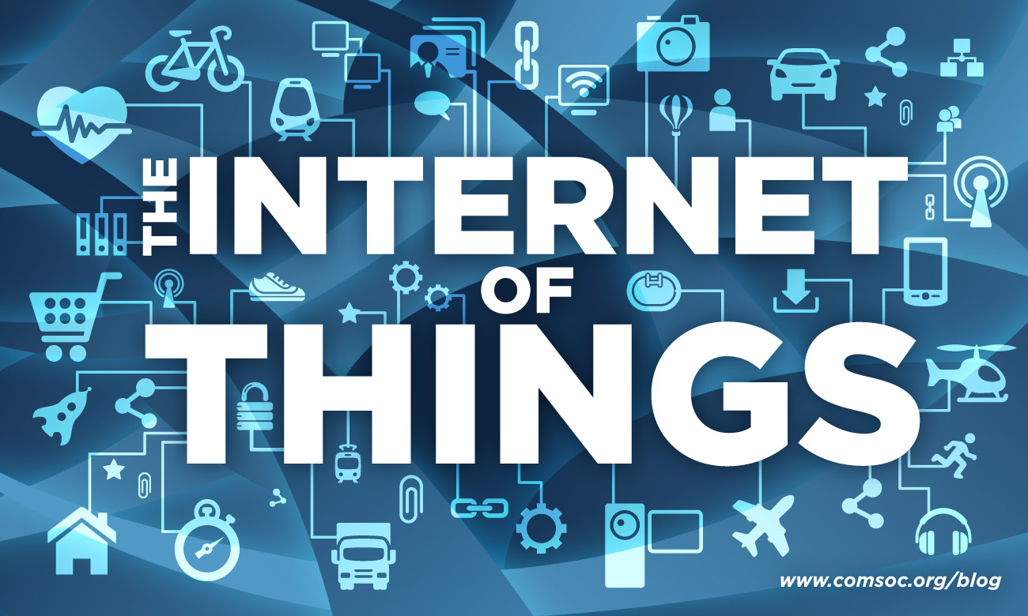
SoftCell Design Goal
Fine-grained service policy for diverse app needs
  Video transcoder, content filtering, firewall
  M2M services: fleet tracking, low latency medical device updates
with diverse needs!
Notes:
Due to the diverse needs from subscriber mobile apps and M2M apps, we need to support fine-grained policies such as video transcoder, content filtering, fleet tracking.
We wan three things. First, we want unified control of data plane. Second, we would like to flexibly control routing and Internet exit points. Third,
Given the different needs of subscribers and the many user scenarios of machine type communication (also known as Internet of Things), we would like to design the network for high performance and scalable support of fine-grained policies.

Slide 18
SoftCell Design
Scalable system design
  Classifying flows at access edge
  Offloading controller tasks to switch local agent
Intelligent algorithms
  Enforcing policy consistency under mobility
  Multi-dimension aggregation to reduce switch rule entries
Controller
LA
LA
Gateway Edge
LA
~1 million Users
~10 million flows
~up to 2 Tbps
LA
Access Edge
~1K Users
~10K flows
~1 – 10 Gbps
Notes:
We will apply the principle of design-in-the-large to address the challenges. We leverage the strength of the numerous access switches. In our system design, we move the packet classification function to the access edge. We offload controller tasks to switch local agent. For example, we can cache service policies. We do not need the controller involvement for flows which matches cached policies.
We use intelligent algorithms to enforce policy consistency under mobility and reduce the number of rules we put in switches.
We would like to move the service functions out of P-GW. To support fine-grained polices, we will need intelligent algorithms to minimizes the number of service routing entries in switch tables.

Slide 19
Summary
SoftCell uses commodity switches and middelboxes to build flexible and cost-effective cellular core networks
SoftCell achieves scalability with
Asymmetric Edge Design
Data Plane
Multi-dimensional Aggregation
Control Plane
Hierarchical Controller Design
Exploit multi-stage tables in modern switches
  Reduce m×n rules to m+n rules
Notes:
In conclusion, CellSDN uses commodity switches and middleboxes to build flexible and cost-effective cellular core networks.
It supports fine-grained service policies and traffic management policies.
It achieves scalability with asymmetric edge design, multi-dimensional aggregation and hierarchical controller.

Slide 20
PART III: Cellular WAN

Slide 21
LTE Cellular Network Architecture
Base Station (BS)
Serving Gateway
Packet Data
Network Gateway
Serving Gateway
Internet
User Equipment (UE)
access
core
Notes:
This figure shows the architecture of today’s cellular core networks. User equipment connect to base stations via radio channels.
Base stations connect to the Internet via the cellular core network. There are two main components in the cellular core network, serving gateway and packet data network gateway.

Slide 22

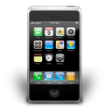
Current Mobile WANs
Organized into rigid and very large regions
Minimal interactions among regions
Leads to poor user experience and poor resource utilization
Two Regions

Slide 23
SoftMoW Solution
Hierarchically builds up a network-wide control plane
  Lies in the family of recursive SDN designs (e.g. XBAR, ONS’13)
In each level, abstracts both control and data planes and exposes a set of “dynamically-defined” logical components to the control plane of the level above.
  Virtual Base stations (VBS), Gigantic Switches (GS), and Virtual Middleboxes (VMB)
Latency Matrix
Union of Coverage
Sum of capacities
GS
VBS
VMB
Core Net
RadioAccess Network
Policy

Slide 24
Conclusion and Future Work
CellSDN seeks to address fundamental limitations of current cellular architecture
  Control plane abstractions: 3D resource grid, big base station, virtual data plane
  Intelligent algorithms in the control plane to achieve global objects: interference management, routing
Future work on CellSDN
  Security
  Scalable real-time monitoring and analytics

Slide 25
Questions?

