Slide 1
Increasing Scalability in Algorithms for Centralized and Decentralized POMDPs
Christopher Amato
Carnegie Mellon University
Feb 5th, 2010

Slide 2

Introduction
Sequential decision-making
Reasoning under uncertainty
Decision-theoretic approach
Single and cooperative multiagent
Notes:
Soccer: sequential (one decision affects the next), uncertainty (some inaccuracy in passing/shooting, unknown info), objective (maximize difference in score)

Slide 3
Outline
Introduction
Background
  Partially observable Markov decision processes (POMDPs)
  Decentralized POMDPs
My contributions to solving these models
  Optimal dynamic programming for DEC-POMDPs
  Increasing scalability for POMDPs and DEC-POMDPs
Future work
  Algorithms and applications

Slide 4
Dealing with uncertainty
Agent situated in a world, receiving information and choosing actions
What happens when we don’t know the exact state of the world?
Uncertain or imperfect information
This occurs due to
  Noisy sensors (some states look the same or can be incorrect)
  Unobservable states (may only receive an indirect signal)

Slide 5
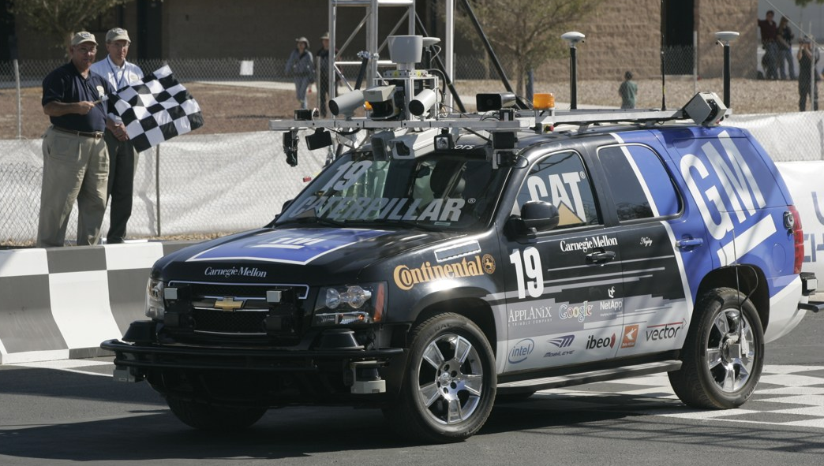
Example single agent problems
Robot navigation (autonomous vehicles)
Inventory management (e.g. decide what to order based on uncertain supply and demand)
Green computing (e.g. moving jobs or powering off systems given uncertain usage)
Medical informatics (e.g. diagnosis and treatment or hospital efficiency)

Slide 6

Single agent: partially observable
Partially observable Markov decision process (POMDP)
Extension of fully observable MDP
Agent interacts with partially observable environment
  Sequential decision-making under uncertainty
  At each stage, the agent takes a stochastic action and receives:
    An observation based on the state of the system
    An immediate reward
a
Environment
o,r

Slide 7
POMDP definition
A POMDP can be defined with the following tuple: M = <S, A, P, R, Ω, O>
  S, a finite set of states with designated initial state distribution b₀
  A, a finite set of actions
  P, the state transition model: P(s'| s, a)
  R, the reward model: R(s, a)
  Ω, a finite set of observations
  O, the observation model: O(o| s', a)
In blue, are the differences from fully observable MDPs

Slide 8
POMDP solutions
A policy is a mapping Ω*  A
  Map whole observation histories to actions because the state is unknown
  Can also map from distributions of states (belief states) to actions for a stationary policy
Goal is to maximize expected cumulative reward over a finite or infinite horizon
  Note: in infinite-horizon, cannot remember the full observation history (it’s infinite!)
Use a discount factor, γ, to maintain a finite sum over the infinite horizon

Slide 9

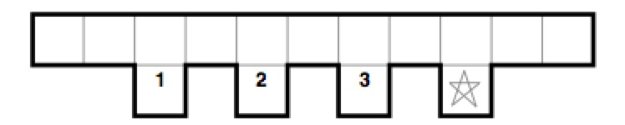

Example POMDP: Hallway
States: grid cells with orientation
Actions: turn , , , move forward, stay
Transitions: noisy
Observations: red lines
Rewards: negative for all states except starred square
Minimize number of steps to the starred square for a given start state distribution
Notes:
The observations cause the exact state to be unknown. Adjust a probability distribution over states (belief state).

Slide 10
Decentralized domains
Cooperative multiagent problems
Each agent’s choice affects all others, but must be made using only local information
Properties
  Often a decentralized solution is required
  Natural way to represent problems with multiple decision makers making choices independently of the others
  Does not require communication on each step (may be impossible or too costly)
  But now agents must also reason about the previous and future choices of the others (more difficult)

Slide 11
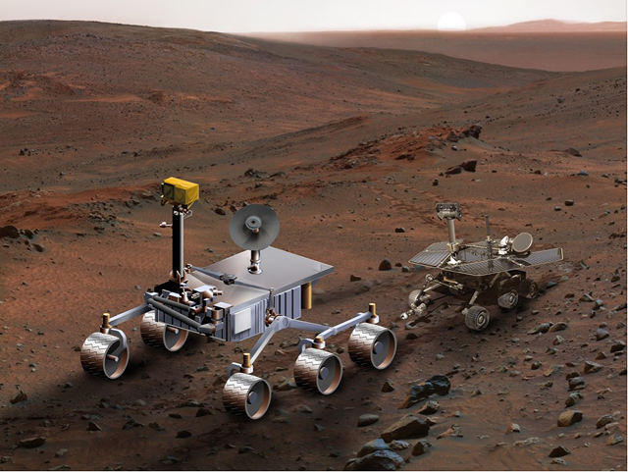
Example cooperative multiagent problems
Multi-robot navigation
Green computing (decentralized, powering off affects others)
Sensor networks (e.g. target tracking from multiple viewpoints)
E-commerce (e.g. decentralized web agents, stock markets)

Slide 12
Multiple cooperating agents
Decentralized partially observable Markov decision process (DEC-POMDP)
Multiagent sequential decision-making under uncertainty
  At each stage, each agent takes an action and receives:
    A local observation
    A joint immediate reward
a₁
r
o₁
a₂
Environment
o₂

Slide 13
DEC-POMDP definition
A DEC-POMDP can be defined with the tuple: M = <I, S, {A_{i}}, P, R, {Ω_{i}}, O>
  I, a finite set of agents
  S, a finite set of states with designated initial state distribution b₀
  A_{i}, each agent’s finite set of actions
  P, the state transition model: P(s’| s, ā)
  R, the reward model: R(s, ā)
  Ω_{i}, each agent’s finite set of observations
  O, the observation model: O(ō| s’, ā)
Similar to POMDPs, but now functions depend on all agents

Slide 14
DEC-POMDP solutions
A local policy for each agent is a mapping from its observation sequences to actions, Ω*  A
  Note that an agents do not generally have enough information to calculate an estimate of the state
  Also, planning can be centralized but execution is distributed
A joint policy is a local policy for each agent
Goal is to maximize expected cumulative reward over a finite or infinite horizon
  Again, for infinite-horizon cannot remember the full observation history
In infinite case, a discount factor, γ, is used

Slide 15
Example: 2-Agent Grid World
States: grid cell pairs
Actions: move , , , , stay
Transitions: noisy
Observations: red lines
Rewards: negative unless sharing the same square
Notes:
Note the differences from POMDPs – no shared information (belief state), so need to deal with own uncertainty as well as consider what the other agents may or may not do

Slide 16
Challenges in solving DEC-POMDPs
Like POMDPs, partial observability makes the problem difficult to solve
Unlike POMDPs: No centralized belief state
  Each agent depends on the others
  This requires a belief over the possible policies of the other agents
  Can’t transform DEC-POMDPs into a continuous state MDP (how POMDPs are typically solved)
Therefore, DEC-POMDPs cannot be solved by POMDP algorithms

Slide 17
General complexity results
NEXP
PSPACE
P
NEXP
subclasses and finite horizon complexity results

Slide 18
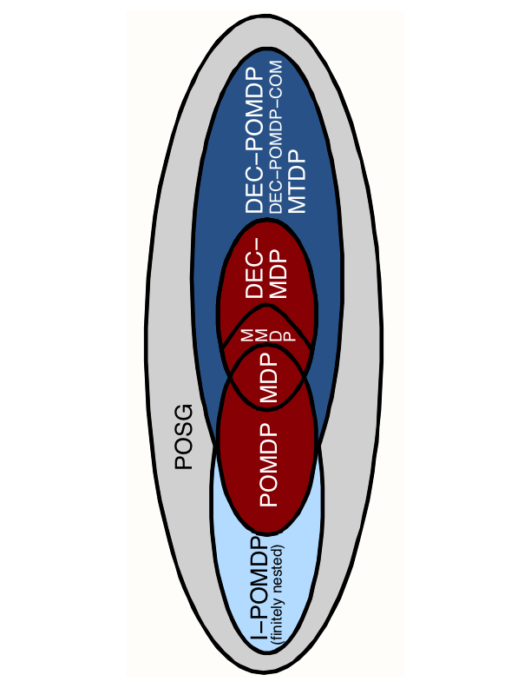
Relationship with other models
Ovals represent complexity, while colors represent number of agents and cooperative or competitive models

Slide 19
Overview of contributions
Optimal dynamic programming for DEC-POMDPs
  ε-optimal solution using finite-state controllers for infinite-horizon
  Improving dynamic programming for DEC-POMDPs with reachability analysis
Scaling up in single and multiagent environments by methods such as:
  Memory bounded solutions
  Sampling
  Taking advantage of domain structure

Slide 20
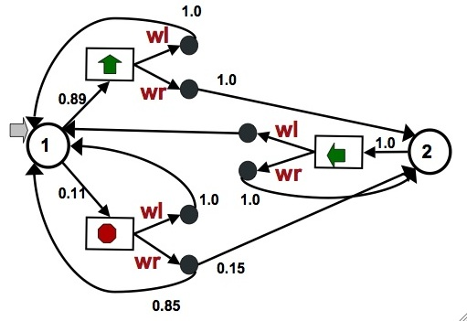
Infinite-horizon polices as stochastic controllers
  Designated initial node
  Nodes define actions
  Transitions based on
    observations seen
  Inherently infinite-
    horizon
  Periodic policies
  With fixed memory,
    randomness can offset
    memory limitations
Actions: move in direction or stop
Observations: wall left, wall right
For DEC-POMDPs use one controller for each agent

Slide 21
Evaluating controllers
Stochastic controller defined by parameters
  Action selection: Q  ΔA
  Transitions: Q × O  ΔQ
For a node, , and the above parameters, value at state s is given by Bellman equation (POMDP):

Slide 22
Optimal dynamic programming for DEC-POMDPs
JAIR 09
Infinite-horizon dynamic programming (DP): Policy Iteration
  Build up finite-state controllers as policies for each agent (called “backups”) over a number of steps
  At each step, remove or prune controller nodes that have lower value using linear programming
  Redirect and merge remaining nodes to produce a stochastic controller
  Continue backups and pruning until provably within ε of optimality (can be done in finite steps)
  First ε-optimal algorithm for infinite-horizon

Slide 23
Optimal DP for DEC-POMDPs: Policy Iteration
Start with a given controller
Exhaustive backup: generate all next step policies by considering any first action and then choosing some node of the controller for each observation
Evaluate: determine value of starting at each node at each state and for each policy for the other agents
Prune: remove those that always have lower value (merge as needed)
Continue with backups and pruning until error is below ε
o₂
a₁
a₂
= Initial controller
for agent 1
o₁
o₁
o₂
a₁
o₁
o₂
o₂
a₁
a₁
a₁
a₂
o₁,o₂
o₁
o₁,o₂
o₁
a₁
o₂
o₂
o₁
s₁
s₂
(backup for action 1)

Slide 24
Optimal DP for DEC-POMDPs: Policy Iteration
Start with a given controller
Exhaustive backup: generate all next step policies by considering any first action and then choosing some node of the controller for each observation
Evaluate: determine value of starting at each node at each state and for each policy for the other agents
Prune: remove those that always have lower value (merge as needed)
Continue with backups and pruning until error is below ε
o₂
a₁
a₂
= Initial controller
for agent 1
o₁
o₁
o₂
a₁
o₁
o₂
o₂
a₁
a₁
a₂
o₁,o₂
o₁
o₁
o₂
s₁
s₂
(backup for action 1)

Slide 25
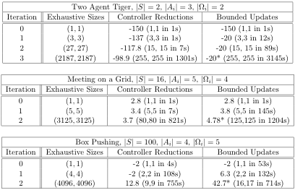
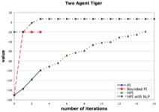
Improvements and experiments JAIR 09
Can improve value of controller after each pruning step
Can use heuristics and sampling of the state space (point-based method) to produce approximate results
Optimal DP can prune a large number of nodes
Approximate approaches can improve scalability
Optimal methods: value, controller size and time
Optimal and approximate methods

Slide 26
Incremental policy generation ICAPS 09
Optimal dynamic programming for DEC-POMDPs requires a large amount of time and space
In POMDPs, methods have been developed to make optimal DP more efficient
These cannot be extended to DEC-POMDPs (due to the lack of a shared viewpoint by the agents)
We developed a new DP method to make the optimal approaches for both finite and infinite-horizon more efficient

Slide 27
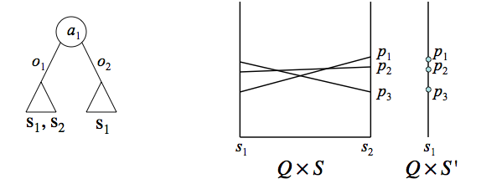
Incremental policy generation (cont.)
Can avoid exhaustively generating policies (backups)
Cannot know what policies the others may take, but after an action is taken and observation seen, can limit the number of states considered (see a wall, other agent, etc.)
This allows policies for an agent to be built up incrementally
That is, iterate through possible first actions and observations, adding only subtrees (or subcontrollers) that are not dominated

Slide 28
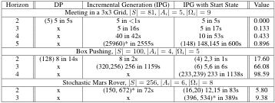
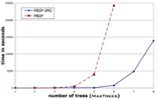
Benefits of IPG and results ICAPS 09
Solve larger problems optimally
Can make use of start state information as well
Can be used in other dynamic programming algorithms
  Optimal: Finite-, infinite- and indefinite horizon as well as policy compression
  Approximate: PBDP, MBDP, IMBDP, MBDP-OC and PBIP
Increases scalability in optimal DP (finite or infinite-horizon)
x signifies inability to solve problem with 2GB memory
… and approximate DP
Notes:
The important thing to note is that original DP runs out of researches after a small horizon while IPG and IPG with start state can scale to larger horizons (and thus produce higher quality solution in infinite-horizon as well)

Slide 29
Approximate methods
Optimal approaches may be intractable, causing approximate methods to be desirable
Questions
  How can high-quality memory-bounded solutions be generated for POMDPs and DEC-POMDPs?
  How can sampling be used in the context of DEC-POMDPs to produce solutions efficiently?
  Can I use goals and other domain structure to improve scalability?

Slide 30
Memory-bounded solutions
Can use fixed-size finite-state controllers as policies for POMDPs and DEC-POMDPs
How do we set the parameters of these controllers to maximize their value?
  Deterministic controllers - discrete methods such as branch and bound and best-first search
  Stochastic controllers - continuous optimization
o₁
q?
q
a?
o₂
q?
(deterministically) choosing an action and transitioning to the next node

Slide 31
Nonlinear Programming approach IJCAI 07, UAI 07, JAAMAS 09
Use a nonlinear program (NLP) to represent an optimal fixed-size controller for POMDPs or set of controllers for DEC-POMDPs
Consider node value as well as action and transition parameters as variables
Thus, find action selection and node transition parameters that maximize the value using a known start state
Constraints maintain valid values and probabilities

Slide 32
NLP formulation (POMDP case)
Variables: x(q’,a,q,o) = P(q’,a|q,o), y(q,s)= V(q,s)
Objective: Maximize
Value Constraints: s S, q Q
Probability constraints: q Q, a A, o Ω
Also, all probabilities must sum to 1 and be greater than 0

Slide 33
Mealy controllers recent submission
Controllers currently used are Moore controllers
Mealy controllers are more powerful than Moore controllers (can represent higher quality solutions with the same number of nodes)
Provides extra structure that algorithms can use
Can be used in place of Moore controllers in all controller-based algorithms for POMDPs and DEC-POMDPs
o₁
o₁
,a₂
a₂
o₁
o₁
Moore=
o₂
,a₂
o₂
Mealy=
,a₁
Q A
a₁
Q×O A
o₂
o₂
,a₁

Slide 34
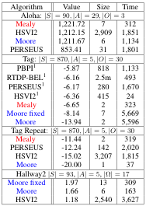
NLP results: POMDP case JAAMAS 09 and unpublished
Optimizing a Moore controller can provide a high-quality solution
Optimizing a Mealy controller improves solution quality without increasing controller size
Both approaches perform better in truly infinite-horizon problems (those that never terminate)
DEC-POMDP results are similar, but discussed later
Future specialized solvers may further increase quality
34

Slide 35
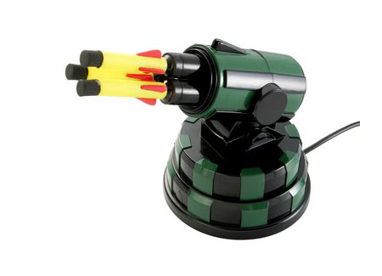
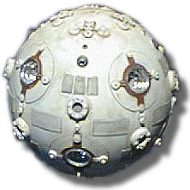
Achieving goals in DEC-POMDPs AAMAS 09
Unclear how many steps are needed until termination
Many natural problems terminate after a goal is reached
  Meeting or catching a target
  Cooperatively completing a task
Notes:
Speaking of problems that terminate…

Slide 36
Indefinite-horizon DEC-POMDPs
Described for POMDPs Patek 01 and Hansen 07
Our assumptions
  Each agent possesses a set of terminal actions
  Negative rewards for non-terminal actions
Problem stops when a terminal action is taken by each agent
Can capture uncertainty about reaching goal
Many problems can be modeled this way
We showed how to find an optimal solution to this problem using dynamic programming

Slide 37
Goal-directed DEC-POMDPs
Relax assumptions, but still have goal
Problem terminates when
  The set of agents reach a global goal state
  A single agent or set of agents reach local goal states
  Any combination of actions and observations is taken or seen by the set of agents
More problems fall into this class (can terminate without agent knowledge)
Solve by sampling trajectories
  Produce only action and observation sequences that lead to goal
  This reduces the number of policies to consider
  We proved a bound on the number of samples required to approach optimality
b₀
a₁
o₃
a₁
o₃
a₁
g
o₁

Slide 38
Getting more from fewer samples
Optimize a finite-state controller
  Use trajectories to create a controller
  Ensures a valid DEC-POMDP policy
  Allows solution to be more compact
  Choose actions and adjust resulting transitions (permitting possibilities that were not sampled)
  Optimize in the context of the other agents
Trajectories create an initial controller which is then optimized to produce a high-valued policy
o₁
g
o₁
g
a₁
a₁
o₁
o₃
1
o₃
2
a₁
g
o₁
g
0
o₄
o₂
o₁
a₁
3
a₁
4
a₃
g
a₄
o₂₋₄
o₃
5
a₁
o₁
g

Slide 39
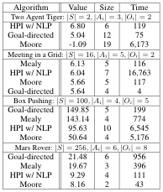
Experimental results AAMAS 09 and unpublished
We built controllers from a small number of the highest-valued trajectories
Our sample-based approach (goal-directed) provides a very high-quality solution very quickly in each problem
Heuristic policy iteration and optimizing a Mealy controller also perform very well
Notes:
Goal-directed and Mealy do well even on the very large Mars Rover problem. A huge DEC-POMDP.

Slide 40
Conclusion
Optimal dynamic programming for DEC-POMDPs
  Policy iteration: ε-optimal solution with finite-state controllers (infinite-horizon)
  Incremental policy generation: a more scalable DP
  When problem terminates can use DP for optimal solution
Scaling up in single and multiagent environments
  Heuristic PI: better scalability by sampling state space
  Optimizing finite-state controllers
    Can represent an optimal fixed-size solution
    Approximate approaches perform well
    Mealy controllers: more efficient and provide structure
  Goal-based problems
    Take advantage of structure present
    Sample-based approach that approaches optimality

Slide 41
Conclusion
Lessons learned
  Studying optimal approaches improves both optimal and approximate methods
  Showed memory-bounded techniques, sampling and utilizing domain structure can all be used to provide scalable algorithms from POMDPs and DEC-POMDPs

Slide 42
Other contributions
High-level Reinforcement Learning in Strategy (Video) Games AAMAS 10
  Allowed the game AI to switch between high-level strategies in a leading strategy game (Civilization IV)
  Improved play after a small number of trials (50+)
Solving Identical Payoff Bayesian Games with Heuristic Search AAMAS 10
  Developed new solver for Bayesian Games with identical payoffs
  Uses the BG structure to more efficiently find solutions

Slide 43
Future work
Tackling the major roadblocks to decision-making in large uncertain domains
  How can decision theory be used in scenarios that involve a very large number of agents?
  Can we develop efficient learning algorithms for partially observable systems?
  How can we mix cooperative and competitive multiagent models? (e.g. soccer with opponent)
  How can we extend and further scale up single and multiagent methods so they are able to solve realistic systems?
Applications: Robotics, medical informatics, green computing, sensor networks, e-commerce

Slide 44
Thank you!
C. Amato, D. S. Bernstein and S. Zilberstein. Optimizing Memory-Bounded Controllers for Decentralized POMDPs. UAI-07
C. Amato, D. S. Bernstein and S. Zilberstein. Solving POMDPs Using Quadratically Constrained Linear Programs. IJCAI-07
C. Amato, D. S. Bernstein and S. Zilberstein. Optimizing Fixed-Size Stochastic Controllers for POMDPs and Decentralized POMDPs. JAAMAS 2009
D. S. Bernstein, C. Amato, E. A. Hansen and S. Zilberstein. Policy Iteration for Decentralized Control of Markov Decision Processes. JAIR 2009
C. Amato, J. S. Dibangoye and S. Zilberstein. Incremental Policy Generation for Finite-Horizon DEC-POMDPs. ICAPS-09
C. Amato and S. Zilberstein. Achieving Goals in Decentralized POMDPs. AAMAS-09
C. Amato and G. Shani. High-level Reinforcement Learning in Strategy Games. AAMAS-10
F. Oliehoek, M. Spaan, J. Dibangoye and C. Amato. Solving Identical Payoff Bayesian Games with Heuristic Search. AAMAS-10

